Slide 1
Motor Vehicle Rental / Ride Share Excise Tax
Interim Joint Committee on Appropriations and Revenue
November 2, 2023

Slide 2
KEY HB 8 (2022) PROVISIONS CODIFIED IN KRS 138.472
Effective January 1, 2023:
Person means the holder of any of the following certificates:
(1) Limousine;
(2) Peer-to-peer car sharing;
(3) Taxicab;
(4) Transportation network; and
(5) U-Drive-It.
An excise tax is imposed upon every person for the privilege of providing a motor vehicle for sharing or for rent, with or without a driver, within the Commonwealth.
The tax is imposed at the rate of six percent (6%) of the gross receipts derived from the:
(1) Rental of a shared vehicle by a peer-to peer car sharing company;
(2) Rental of a vehicle by a motor vehicle renting company;
(3) Sales of TNC services;
(4) Sales of taxicab services; and
(5) Sales of limousine services.
The tax imposed . . . shall be administered and collected by the department. Revenues generated from the tax shall be deposited into the general fund.

Slide 3
RETROACTIVE CHANGES MADE IN HB 360 (2023)
Defined Human Services Transportation Delivery (HSTD) as:
The provision of transportation services to any person that is an eligible recipient in one (1) of the following state programs:
Nonemergency medical transportation under KRS Chapter 205;
Mental health, intellectual disabilities, or comprehensive care under KRS Chapter 202A, 202B, 210, or 645;
Work programs for public assistance recipients under KRS Chapter 205;
Adult services under KRS Chapter 205, 209, 216, or 273;
Vocational rehabilitation under KRS Chapter 151B or 157; or
Blind industries or rehabilitation under KRS Chapter 151B or 163;
Excluded receipts derived from HSTD from “gross receipts”.

Slide 4
REGISTRATION
Rental / Ride Share taxpayers register electronically through DOR’s online portal.
Motor Vehicle Rental / Ride Share Excise Tax Application (TARS) opened for registrants beginning December 15, 2022.
Registration application consists of general business information regarding business name, address, location, corporate officers, transportation certificate numbers, and tax account numbers.
Currently
130 approved registrants
100% electronic filers

Slide 5
TAX FILING
Motor Vehicle Rental / Ride Share Tax Return opened for electronic filing February 1, 2023.
Tax return and payment are due monthly on the 20th following the reporting month. The first filing deadline was February 21, 2023. (February 20th was Presidents’ Day.)
Tax Returns must be filed and paid electronically.
Applicable penalties and interest calculate for late filings and payments.

Slide 6
RENTAL / RIDE SHARE TAX RECEIPTS
MONTH | MILLIONS
February | $1.65
March | $2.32
April | $2.98
May | $3.49
June | $3.72
July | $3.63
August | $3.73
September | $3.59
TOTAL | $25.11

Slide 7
FREQUENTLY ASKED QUESTIONS
Motor Vehicle Rental Ride Share Excise Tax - TAXANSWERS (ky.gov)
Are taxicab services for human service transportation delivery (HSTD) subject to the Rental / Ride Share Excise Tax?
No. If you provide HSTD services, please contact the Department of Revenue regarding registration requirements.
What types of businesses are subject to the 6% excise tax?
The Motor Vehicle Rental / Ride Share Excise Tax is imposed upon the gross receipts of:
1. Peer-to-peer car sharing companies
2. Motor vehicle renting companies
3. Transportation network companies (TNCs)
4. Taxicab service providers
5. Limousine service providers
KRS 281.010 provides further definitions related to these groups. Each of these groups must be licensed through the Kentucky Transportation Cabinet, under the provisions of KRS 281.630. These providers may collect the tax from their customers as a separate charge.

Slide 8
FREQUENTLY ASKED QUESTIONS
Motor Vehicle Rental Ride Share Excise Tax - TAXANSWERS (ky.gov)
Are the following separately stated charges passed on to the customer included in gross receipts subject to the excise tax?
Vehicle license cost recovery fees – Yes, these charges are expenses of the provider passed on to the customer as taxable charges for using the services.
Airport concession recovery fees – Yes, these charges are expenses of the provider passed on to the customer as taxable charges for using the services.
Airport consolidated facility charges – Yes, these charges are expenses of the provider passed on to the customer as taxable charges for using the services.
Local, municipal license fee imposed under KRS 68.200 – No , this charge is a fee that providers must collect from their customers and remit to the imposing local taxing jurisdiction.
U-Drive-It Tax imposed under KRS 138.463 – No, this is a tax imposed on holders of U-Drive-It permits and calculated on the gross rental or lease charges paid by the customer.
Tolls and parking fees – Yes, these charges are expenses of the provider passed on to the customer as taxable charges for using the services.
Gratuities – No, voluntary gratuities are not included. Yes, mandatory gratuities are charges for services necessary to complete the transaction.
Gross receipts subject to the tax means the total consideration received for the rental of a vehicle or any charges made to provide the taxable services to a customer. These charges include daily or hourly rental fees, time or mileage charges, fees for using the services, fuel charges, pickup and delivery fees, late fees, and any charges for any services necessary to complete the transaction.

Slide 9
FREQUENTLY ASKED QUESTIONS
Motor Vehicle Rental Ride Share Excise Tax - TAXANSWERS (ky.gov)
Are the following types of transactions considered providing a motor vehicle for sharing or rent within the Commonwealth?
Rentals or services that originate in Kentucky and terminate outside Kentucky – Yes.
Rentals or services that originate outside Kentucky and terminate outside Kentucky, but come through Kentucky – No.
Rentals or services that originate outside Kentucky and terminate in Kentucky – No.
Rentals or services that originate in Kentucky and terminate in Kentucky – Yes.
When is the tax due?
The Motor Vehicle Rental / Ride Share Excise Tax is due monthly on the 20th day of the month following the end of the month in which the rentals / ride shares occurred.
How does a person file and pay the tax due?
The Motor Vehicle Rental / Ride Share Excise Tax is filed and paid electronically with the Department of Revenue. More guidance is available at this at this link.
How does a person register with the Department of Revenue?
Registration information for the Motor Vehicle Rental / Ride Share Excise Tax is available at this at this link.

Slide 10
FREQUENTLY ASKED QUESTIONS
Motor Vehicle Rental Ride Share Excise Tax - TAXANSWERS (ky.gov)
Is the 6% excise tax required to be listed on car rental contracts?
Yes, if the 6% Motor Vehicle Rental / Ride Share Excise Tax is charged to the end consumer, then the 6% excise tax must be separately stated on the corresponding rental contract and receipt.
Are motor vehicle dealers in the loaner / rental program provided under KRS 138.4605 subject to Motor Vehicle Rental / Ride Share Excise Tax?
No, a motor vehicle dealer in the loaner / rental program is not subject to the Motor Vehicle Rental / Ride Share Excise Tax.
Is the Motor Vehicle Rental / Ride Share Excise Tax filed and paid along with my U-Drive-It tax?
No, the Motor Vehicle Rental / Ride Share Excise Tax is filed and paid separately to the Department of Revenue and the U-Drive-It Tax is filed and paid to the Transportation Cabinet Division of Motor Carriers.
What types of exemptions are available to exclude receipts from the Motor Vehicle Rental / Ride Share Excise Tax (i.e., state / municipal rental customers, federal customers, 501(C)(3) nonprofits, state schools, etc.)?
The Motor Vehicle Rental / Ride Share Excise Tax is imposed upon the persons providing the rentals or ride sharing services regardless of the tax status of the customers; therefore, there are no exemptions from tax due on the rental or ride share receipts.

Slide 11
FREQUENTLY ASKED QUESTIONS
Motor Vehicle Rental Ride Share Excise Tax - TAXANSWERS (ky.gov)
How are rentals under a one-year agreement with the rental agreement contract for each unit rewritten every thirty days treated under the Motor Vehicle Rental / Ride Share Excise Tax? Would this arrangement qualify as a rental or a lease?
A rental customer under a one-year agreement with a rental contract rewritten every 30 days is a rental subject to the Motor Vehicle Rental / Ride Share Excise Tax. A rental is a contract for the use of a motor vehicle for less than 365 days. A lease would be a contract of 365 days or more. See KRS 138.462
Are all motor carrier certifications subject to the new Rental / Ride Share Excise Tax?
No, the following Kentucky Transportation Cabinet motor carrier certifications are NOT subject to the new Rental / Ride Share Excise Tax:
Disabled person vehicle certificate
Household goods certificate
Charter bus certificate
Bus certificate
Property certificate
Driveaway certificate
Automobile utility trailer certificate

Slide 12
DOR EXCISE TAX WEBSITE
Motor Vehicle Rental / Ride Share Excise Tax - Department of Revenue (ky.gov)

Slide 13
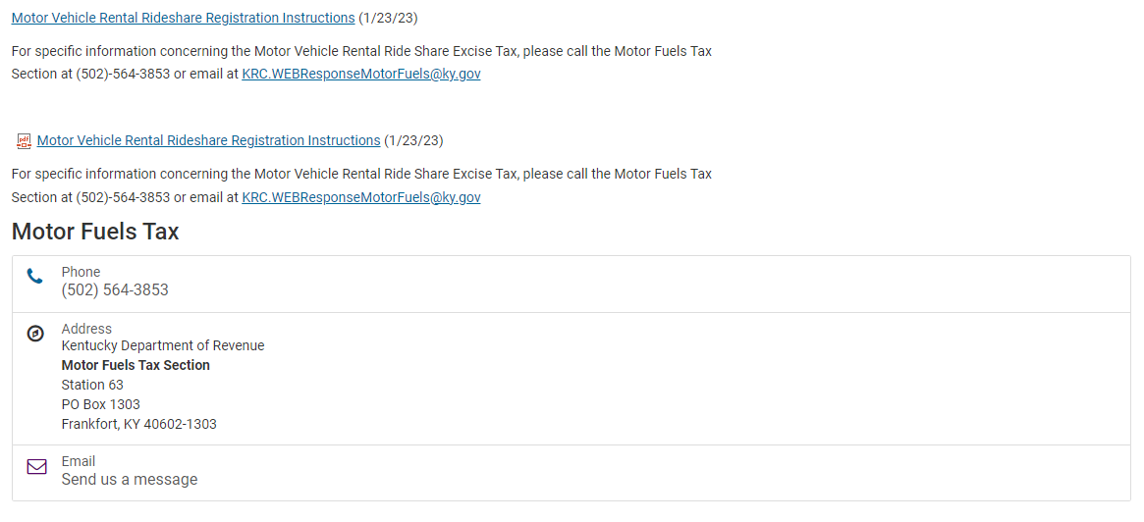
DOR EXCISE TAX WEBSITE
Motor Vehicle Rental / Ride Share Excise Tax - Department of Revenue (ky.gov)

Slide 14
CONTACT INFORMATION
Department of Revenue:
Motor Vehicle Rental / Ride Share Excise Tax - Department of Revenue (ky.gov)
Tax Answers:
Motor Vehicle Rental Ride Share Excise Tax - TAXANSWERS (ky.gov)
Motor Fuels Tax Compliance Section Email:
KRC.WEBResponseMotorFuels@ky.gov
Motor Fuels Tax Compliance Section Phone Number:
502-564-3853
Office of Sales & Excise Taxes
Executive Director: Richard Dobson Richard.Dobson@ky.gov 502-564-5523
Division of Miscellaneous Taxes
Director: Kim Hensley KimberlyF.Hensley@ky.gov 502-782-1644
Assistant Director: Toni Fields Latonia.Fields@ky.gov 502-564-2087

