Slide 1

COME SOAR WITH US.
Interim Joint Committee on Appropriations and Revenue
November 2, 2023

Slide 2
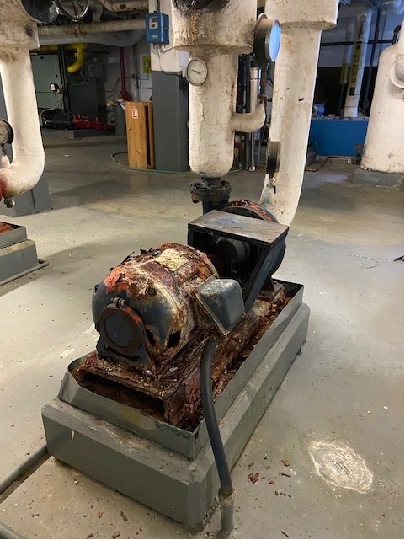
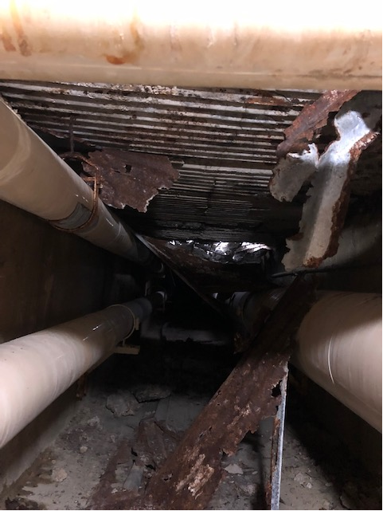
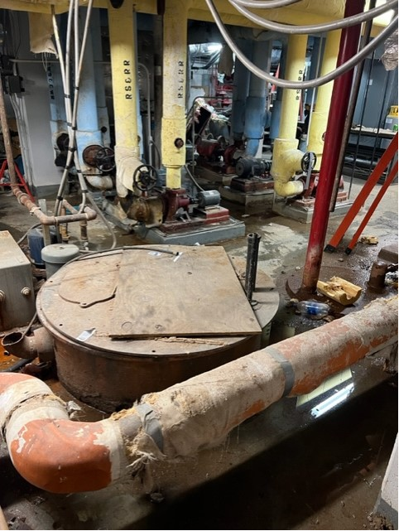
Capital Projects Request
Share of CPE Requested $700 million Asset Preservation Pool
  Morehead State University share - $35,264,000
  Suggested Language:
  Funding for individual asset preservation, renovation, and maintenance projects at Kentucky’s public postsecondary institutions in Education, General, and state-owned, and operated residential housing facilities, fixed asset pedestrian and student parking areas, and for the razing of university-owned buildings.

Slide 3
Capital Projects Request
Bond Funds
Priority # 1
Construct Multi-Disciplinary Classroom Building - $90 million
New 120,000 square foot building to serve current program needs and accommodate future growth.
  Replacing one building built in 1954 and another built in 1961
  Accessibility challenges
  Technology challenges
  Mechanical/Electrical/Plumbing system challenges

Slide 4
Capital Projects Request
Bond Funds
Priority # 2
Construct Science and Engineering Building Phase Two - $19.6 million
New 120,000 square feet building for biology, chemistry, physics, earth sciences, space systems engineering, engineering, engineering technology and computer science and other programs at Morehead State University. Will be state-of-the-art facility efficiently designed to replace other outdated facilities on campus.

Slide 5
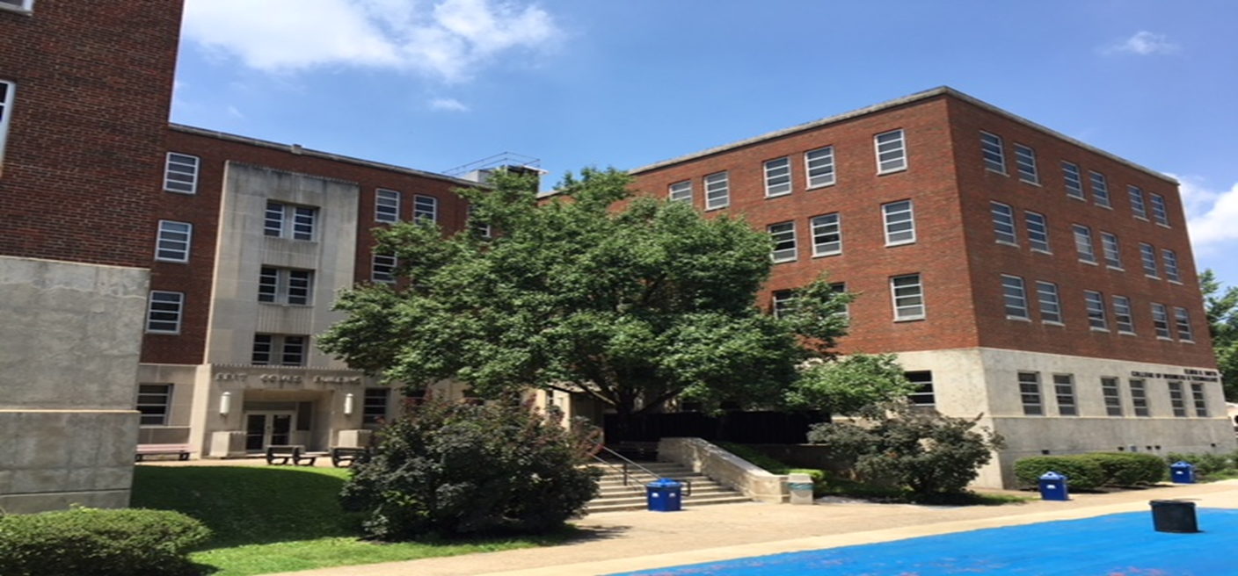
Capital Projects Request
Bond Funds
Priority # 3
Renovate Combs Classroom Building - $40.867 million
The Bert T. Combs Building houses business and other academic classrooms, offices and programs. This project will provide improved instructional facilities and extend the useful life of the facility. The existing structure is in need of major renovation as no substantial renovation has been done since the facility was built.
Upgrades Needed:
______________________________________________________________________________________________________________________________________________________________________________________________________________________________________________________________________________________________________________________________________________________________________________________
Interiors
Classrooms
Technology
HVAC System
Piping/Plumbing
Electrical System
Elevator Replacement
Roof Replacement
Security
Interior Signage

Slide 6
Capital Projects Request
Agency Bond Funds
Priority # 1
Construct New Residence Hall # 1 - $49.8 million
Construct new 345 bed residence hall. The new hall will include common areas for student learning interaction and recreation. This new facility will replace obsolete and deteriorating older residence hall.
Priority # 2
Construct New Residence Hall # 2 - $40.35 million
Construct new 250 bed residence hall. The new hall will include common areas for student learning interaction and recreation. This new facility will replace obsolete and deteriorating older residence hall.

Slide 7
Operating Request
State General Funds
Craft Academy for Excellence in Science and Mathematics
Request: $4,985,100 in each fiscal year for the Craft Academy for Excellence in Science and Mathematics

Slide 8
Operating Request
State General Funds
Space Science Center
Request: $1,000,000 in fiscal year 2024-2025 and $500,000 in fiscal year 2025-2026 for the operations of the Morehead State University Space Science Center.

Slide 9
Questions

