Slide 1
UNIVERSITY OF KENTUCKY 2024-26 Capital projects request
Angie Martin, VICE PRESIDENT FOR FINANCIAL PLANNING AND CHIEF BUDGET OFFICER Mary Vosevich, Vice President for Facilities Management and Chief Facilities Officer
INTERIM JOINT COMMITTEE ON APPROPRIATIONS AND REVENUE | NOV 2, 2023

Slide 2
university of Kentucky 2024-26 CAPITAL PROJECT priorities
1
Construct/Improve Medical/Administrative Facility 3
2
Asset Preservation 2024-26
3
Construct Agricultural Research Facility 1
4
Construct Research Facility
2

Slide 3
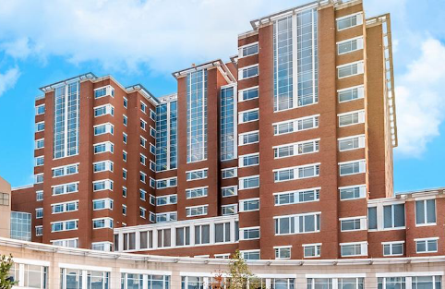
2024-26 capital project priorities
1
Construct/Improve Medical/Administrative Facility 3
PRIORITY
Scope: Agency Bonds $800 million Restricted Funds $1.2 billion Total $2.0 billion
Expansion of Albert B. Chandler Hospital to provide 700 +/- beds as well as needed clinical support spaces
With construction of a new bed tower, space will be available for comprehensive services for pediatric behavioral health initiatives
Reauthorization requested - design team selections are currently underway
Completion scheduled for 2029
3

Slide 4
2024-26 capital project priorities
2
Asset Preservation 2024-26
PRIORITY
Scope: State Bonds $168.7 million
Share of CPE requested $700 million Asset Preservation Pool
Building Systems improvements ― mechanical, electrical, plumbing, building envelope, life safety
Utility Infrastructure Systems improvements ― steam, chilled water, electrical
Major renovations to multiple buildings being considered
4

Slide 5
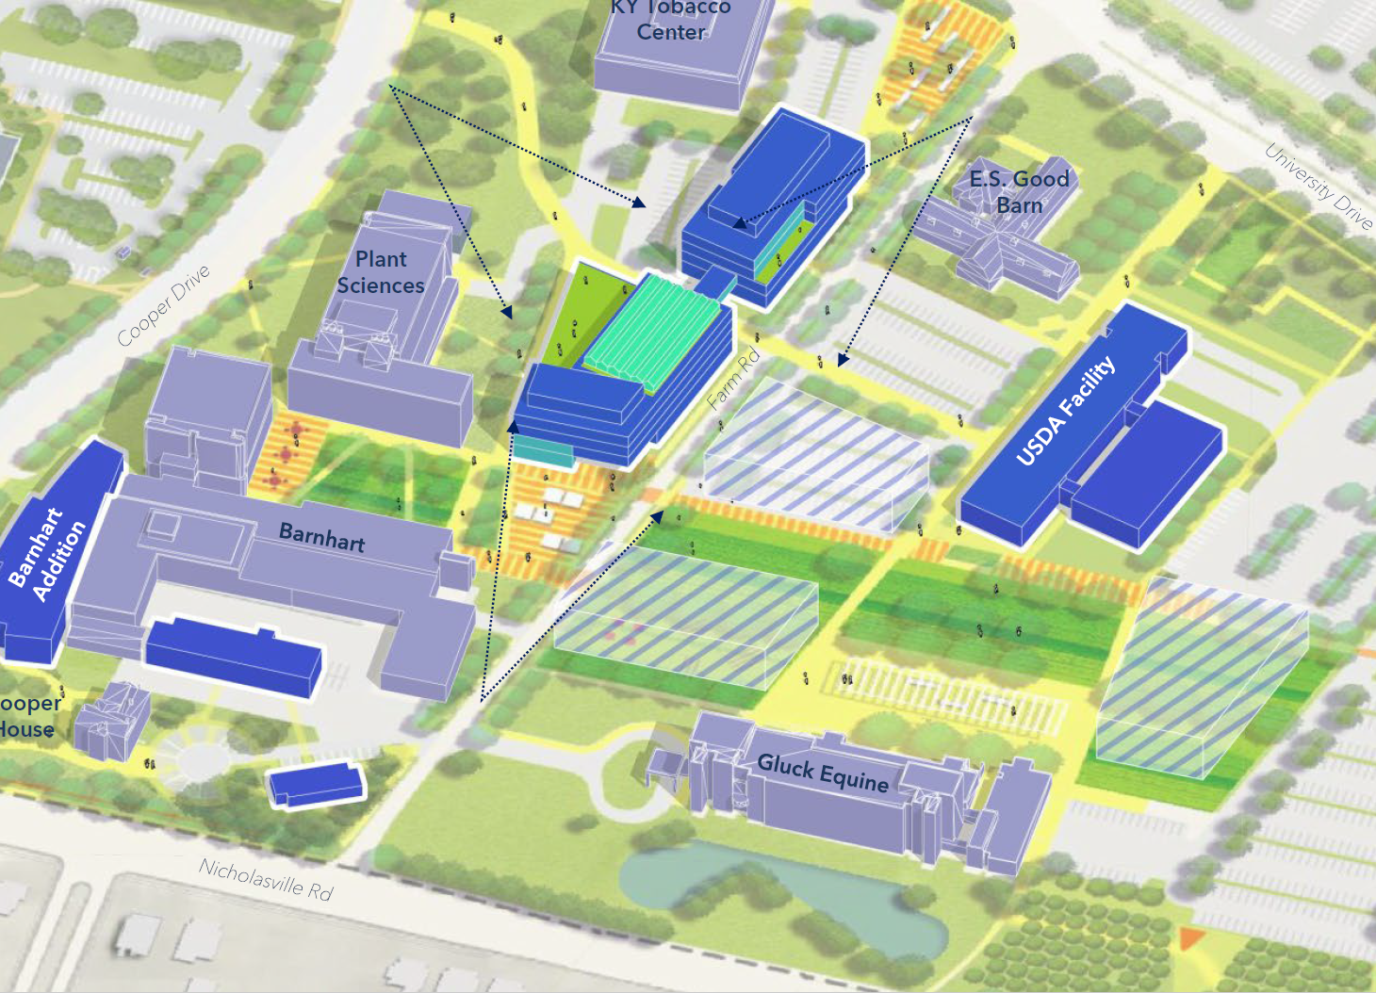
2024-26 capital project priorities
3
Construct Agricultural Research Facility 1
PRIORITY
Scope: State Bonds $200 million Restricted Funds 50 million Total $250 million
New facility to replace aging lab research and classroom facilities for the Martin-Gatton College of Agriculture, Food and Environment
Reauthorization requested - design team selections are currently underway
Completion scheduled for 2026
5

Slide 6
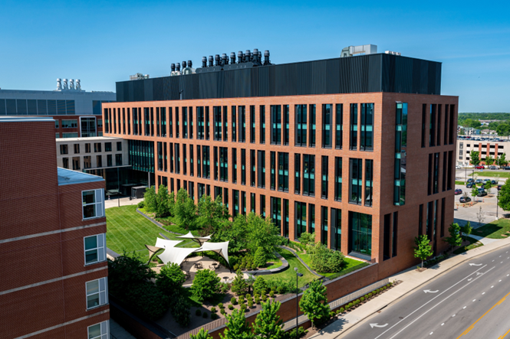
2024-26 capital project priorities
4
Research Facility
PRIORITY
Scope: State Bonds $350 million Agency Bonds 100 million Total $450 million
300,000 +/- square feet building to expand research capabilities that advance the priorities and needs of the Commonwealth
Completion scheduled for 2026
6

Slide 7
Questions?

