Slide 1
University of Louisville Capital Plan and Priorities 2024-26 Appropriations and Revenue Committee November 2, 2023

Slide 2
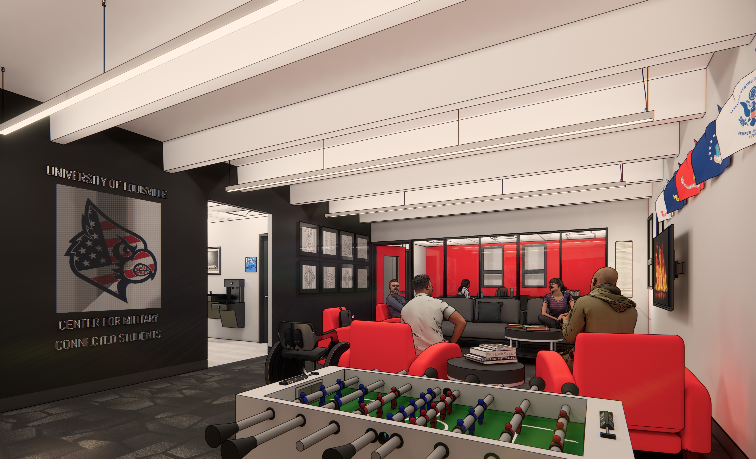
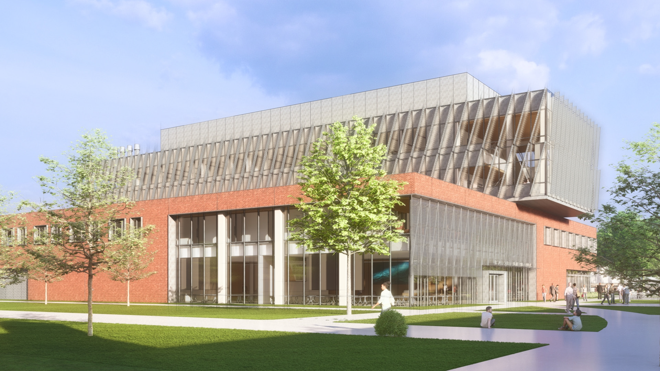
Appreciation of Current Capital-Related Support
Asset Preservation
Center for Military-Connected Students
Engineering Building

Slide 3
HEALTH SCIENCES SIMULATION CENTER
& COLLABORATION HUB
THE NEED: Kentucky faces a critical need for skilled health care workers, particularly nurses.
More than 6,000 open nursing positions in Kentucky. More than 200,000 nationally
Produced more bachelor’s degree-prepared nurses than any other school in Kentucky (2022)
Hub will enable UofL to grow its nursing program by more than 50 percent
Will provide space for additional health profession degrees: Biomedical Science, Biotechnology, Genetic Counseling
Letters of support from Louisville Mayor, UofL Health, Norton Healthcare, JCTC
Projected budget: $280 million
State contribution: $260 million
UofL bonds: $20 million

Slide 4
STEM ACADEMIC CENTER
THE NEED: Kentucky needs more STEM graduates to meet workforce demand.
U.S. shortage of 3.5 million STEM workers by 2025 (National Association of Manufacturing/Deloitte)
Continues enrollment and retention growth in STEM:
State-of-the-art academic center enables Kentucky to compete with other states, which are building similar facilities
Pre-medicine/dentistry | Biochemistry
Nursing | Computer Science
Engineering | Neuroscience
Projected budget: $142 million
State contribution: $142 million

Slide 5
Thank you

