Slide 1
Secondary Career & Technical Education (CTE) Wayne D. Lewis, Jr., PhD Commissioner of Education David Horseman Associate Commissioner Kentucky Department of Education Office of Career & Technical Education & Student Transition

Slide 2
Steps Taken to Improve CTE & Progress Made
2

Slide 3
CTE Merger
Executive Order (EO) 2012-737
Transitioned the 53 State-Operated Area Technology Centers (ATCs) from the KY Education and Workforce Development Cabinet to the KY Department of Education
Created a unified system of secondary CTE that allowed for common practices, curriculum, and technical assistance for all K-12 CTE programs
EO also established the State’s CTE Advisory Committee

Slide 4
Kentucky CTE Reports

Slide 5
SREB Report: From Two Systems to One World-Class System of Technical Centers
The report offers four (4) over-arching recommendations:
Commission an in-depth study that will identify funding priorities and formulate recommendations to create an improved and more equitable funding system for all technical centers;
Based on a set of best practices priorities, establish an accountability system that not only measures outcomes, but also measures whether all of the components are in place that will maximize opportunities for all students;
Forge a unified system of world-class technical centers; and
Establish stronger, more formal ties between the state’s secondary and postsecondary education institutions and private sector business and industry partners by creating a robust system of state and regional advisory committees.

Slide 6
Thomas P. Miller & Associates Report: “First Things First”, A Funding Analysis of Kentucky’s CTE System
The report concludes with seven recommendations:
Base funding for CTE on state goals and business and industry needs;
Convene a committee to explore ways of funding CTCs and ATCs equally;
Provide adequate funding for CTE programs to accomplish state priorities;
Create a proactive, intentional process of funding large equipment purchases and maintaining and/or upgrading current equipment;
Allow locally-operated centers and schools to set a budget for the entire school year;
Consider an additional per-pupil funding formula weight tied to state-prioritized occupational and program areas based on state and regional industry needs; and
Explore CTE performance funding.

Slide 7
New Skills for Youth (NSFY) Initiative
Began in January 2016 through the generous support of JP Morgan Chase & Company with a five-year, $75 million program aimed at connecting students to in-demand careers.
NSFY is a collaboration of the Council of Chief State School Officers (CCSSO), JP Morgan Chase and Advance CTE that supports states as they work to align career-focused education with high-skill, high-demand occupations.

Slide 8
NSFY Grant Opportunity
Grant has consisted of two phases for states:
Phase One - $100,000
Six-month plan design, development, and early implementation phase
Kentucky was 1 of 25 states to receive Phase One funds (May-November, 2016)
Phase Two - $2,000,000
Three-year implementation phase – Ends December 2019
Kentucky was 1 of 10 states to receive Phase Two funds

Slide 9
Kentucky’s Grant Vision
A regionalized governance and delivery of CTE through accelerated career academies that:
are employer-led through regional workforce areas and ensures cross-institutional involvement;
encompass career pathways that have seamless transitions from secondary to postsecondary education and are aligned to the state and region’s most in-demand careers;
involve shared resources and funding among all partners; and
provide valuable industry certifications and credentials that are recognized by business and industry.

Slide 10
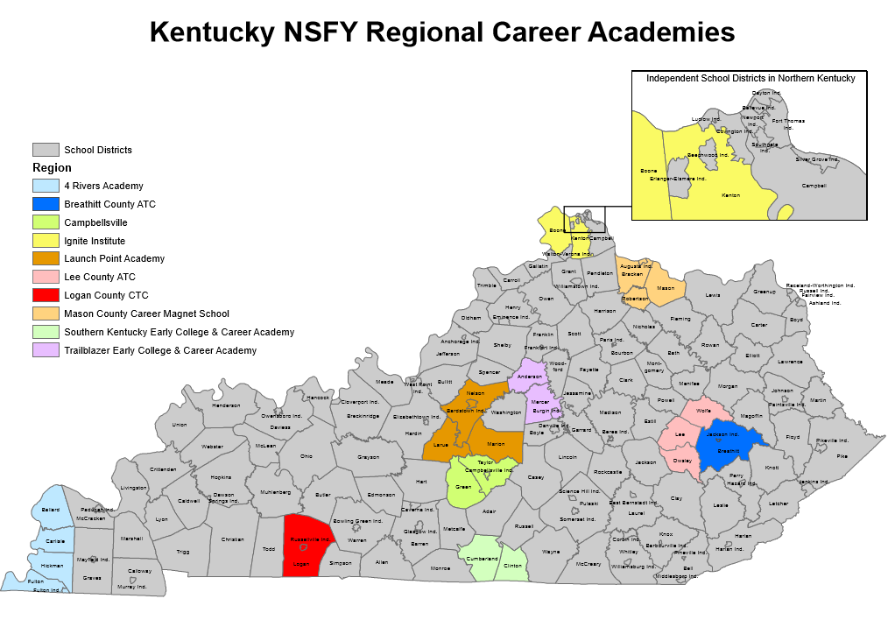

Slide 11
Employer Engagement Strategies
KWIB / Local WIB Approval of Industry Certification List for K-12 Accountability
Tech Ready Apprentices for Careers in KY (TRACK) Youth Apprenticeship Program (2013)
Youth Employment Solutions (YES) Agreement with ADECCO (2014)
Partnership for Advancing Youth Apprenticeship (PAYA) National Network Member (invitation only, 2019)
NSFY Regional Work-Based Learning Trainings with Employers (2019)

Slide 12
Other Continuous Improvement Efforts
Alignment of K-12 Career Pathways to Labor Market Information - KYstats Partnership
New Teacher Induction for Occupation-Based Certified CTE Teacher
Changes to EPSB Regulations for Occupation-Based Certified CTE Teachers
ATC and District Partnerships (personnel)
Professional Development
Project-Based Learning
Instructional Leadership
Academic and CTE Integration

Slide 13
Executive Order (EO) 2018-883: KDE Reorganization
KDE Office of Career & Technical Education became the KDE Office of Career & Technical Education & Student Transition
Office now responsible for all High School Graduation Requirements, Acceleration (Dual Credit, Advanced Placement, etc.) and Guidance/Advising

Slide 14
Future Goals, Needs & Plans
14

Slide 15
CTE Task Force
Established by LRC in June 2019
Tasked with creating recommendations for future structure, governance and funding models for the state’s CTE system.
Co-Chairs:
Senator Mike Wilson
Representative Bobby McCool

Slide 16
Issues / Concerns for Consideration
Different funding mechanisms and personnel systems for state centers / local centers
Lack of Adequate Funding for ALL High-Demand CTE Programs
Discrepancies in statute/regulation for locally-operated CTE center funding formula

Slide 17
LAVEC Statute vs. Regulation Formula
KRS 157.069
(Number of Students/Time in Pathway)/FTE Hours (6)
100 Students/2 Hours = 50/6 = 8.3 FTE
100 Students/1 Hour = 100/6 = 16.7 FTE
705 KAR 2:140
(Number of Students*Time in Pathway)/FTE Hours (6)
100 * 2 = 200/6 = 33.3 FTE
100 * 1 = 100/6 = 16.7 FTE
KDE currently distributes funding based on the regulatory formula.

Slide 18
LAVEC Funding 2004-2018
Year | LAVEC Funds | CTC Changes
2004 | $9,985,400.00
2005 | $8,986,890.00
2006 | $10,000,987.25
2007 | $11,045,395.00 | Bath, Jessamine, Johnson and Oldham Added Oldham took over ATC
2008 | $11,857,700.00
2009 | $11,757,600.00
2010 | $11,757,600.00 | Oldham Dropped
2011 | $11,971,200.00 | Scott and Muhlenberg Added Muhlenberg took over ATC
2012 | $12,393,550.00 | Grant and Kenton Added Kenton took over ATC
2013 | $11,843,500.00
2014 | $11,843,500.00
2015 | $11,843,500.00
2016 | $11,843,500.00
2017 | $11,843,500.00
2018 | $11,843,500.00

Slide 19
Unfunded LAVEC Schools / Open Requests
Hardin County
Hopkins County
Laurel County
Oldham County
Owensboro Independent
Spencer County
*Taylor County
*Ignite Institute

Slide 20
Unfunded High-Demand or Top Support Pathways within LAVEC-Funded Centers
2016 – 2017: ~40
2017 – 2018: ~80
2018 – 2019: ~60

Slide 21
Current Uses of ATC Funding (State-Operated Centers)

