Slide 1

Council on Postsecondary Education
Budget Review Subcommittee on Education
Dr. Aaron Thompson, President
November 10, 2020

Slide 2
Overview
Council Priorities and Results
Current Year General Fund
CARES Act Funding
Budgetary Impact of COVID-19
Priorities for 2021-22

Slide 3




Four Priorities Driving CPE’s Work
Build broad understanding that higher education is the key to personal opportunity and economic growth.
Make higher education affordable for all Kentuckians.
Ensure students earn degrees or certificates regardless of race, income, age or geography.
Meet Kentucky’s current and future workforce needs through high-quality, innovative programs.
Notes:
In Kentucky, adults are not as large a segment of the student population, but they are still numerous. In the most recent reporting year available, adults 25 and older made up:
34% of total enrollment (all levels, public and private) – 12% of these were URM students
51% of undergraduate certificates awarded – 12.5% were awarded to URM adults
33% of associate and bachelor’s degrees awarded (public and private) – 14% were awarded to URM adults

Slide 4
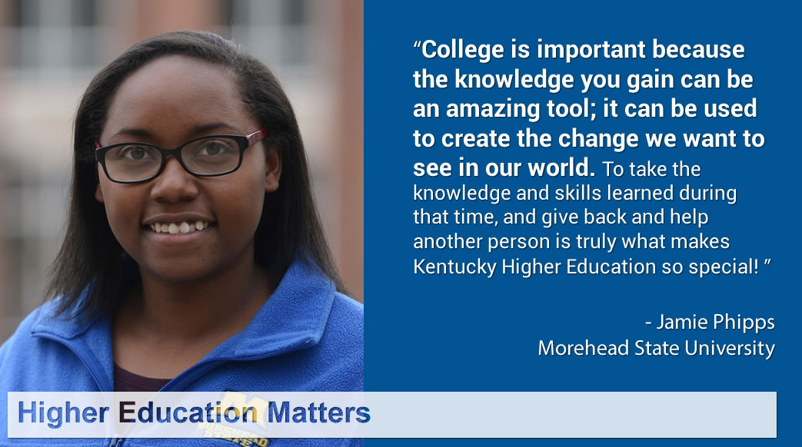

Higher Ed Matters social media campaign
Listening tours
Editorials & interviews in state media
State & national speaking engagements
CPE Policy Insight (blog)
Notes:
If we are not providing equitable opportunities for adults and thinking about ways to level the playing field, we’re failing a large part of our student population.
While our higher education system remains focused on traditional undergraduate residential students, they are becoming a smaller and smaller portion of who we serve.
According to a 2018 NCES study, nationally (read bullets). And this was before COVID-19. Homelessness and food insecurity are even bigger issues today.

Slide 5

Lowest tuition increase in 20 years
Work Ready Kentucky Scholarship promotion
FAFSA completion campaign
Used CPE funds to offset campus COVID costs
Exploring new revenue streams & operational efficiencies
Notes:
If we are not providing equitable opportunities for adults and thinking about ways to level the playing field, we’re failing a large part of our student population.
While our higher education system remains focused on traditional undergraduate residential students, they are becoming a smaller and smaller portion of who we serve.
According to a 2018 NCES study, nationally (read bullets). And this was before COVID-19. Homelessness and food insecurity are even bigger issues today.

Slide 6

60% by 2030
Closing achievement gaps
Focus on diversity, equity and inclusion
Innovations in teaching and learning
Improve P-20 pipeline
Diversify teaching corps
Address adult learners needs
Notes:
If we are not providing equitable opportunities for adults and thinking about ways to level the playing field, we’re failing a large part of our student population.
While our higher education system remains focused on traditional undergraduate residential students, they are becoming a smaller and smaller portion of who we serve.
According to a 2018 NCES study, nationally (read bullets). And this was before COVID-19. Homelessness and food insecurity are even bigger issues today.

Slide 7
Progress Toward 60x30 Goal
3.47%
2.79%
4.26%
1.7% annual growth rate needed
Source: Kentucky Postsecondary Education Data System.
Notes:
In Kentucky, adults are not as large a segment of the student population, but they are still numerous. In the most recent reporting year available, adults 25 and older made up:
34% of total enrollment (all levels, public and private) – 12% of these were URM students
51% of undergraduate certificates awarded – 12.5% were awarded to URM adults
33% of associate and bachelor’s degrees awarded (public and private) – 14% were awarded to URM adults

Slide 8
Student Enrollment – Public Institutions
-3.0%
+11.7%
Notes:
In Kentucky, adults are not as large a segment of the student population, but they are still numerous. In the most recent reporting year available, adults 25 and older made up:
34% of total enrollment (all levels, public and private) – 12% of these were URM students
51% of undergraduate certificates awarded – 12.5% were awarded to URM adults
33% of associate and bachelor’s degrees awarded (public and private) – 14% were awarded to URM adults

Slide 9
Credentials Awarded – Public Institutions
+17.5%
+34.1%
Notes:
In Kentucky, adults are not as large a segment of the student population, but they are still numerous. In the most recent reporting year available, adults 25 and older made up:
34% of total enrollment (all levels, public and private) – 12% of these were URM students
51% of undergraduate certificates awarded – 12.5% were awarded to URM adults
33% of associate and bachelor’s degrees awarded (public and private) – 14% were awarded to URM adults

Slide 10
6-Year Graduation Rates – Public Universities
Total Graduation Rate
URM Graduation Rate
+5.2 ppt
+6.8 ppt
Notes:
In Kentucky, adults are not as large a segment of the student population, but they are still numerous. In the most recent reporting year available, adults 25 and older made up:
34% of total enrollment (all levels, public and private) – 12% of these were URM students
51% of undergraduate certificates awarded – 12.5% were awarded to URM adults
33% of associate and bachelor’s degrees awarded (public and private) – 14% were awarded to URM adults

Slide 11
3-Year Graduation Rates – KCTCS Institutions
+7.4 ppt
+7.8 ppt
Notes:
In Kentucky, adults are not as large a segment of the student population, but they are still numerous. In the most recent reporting year available, adults 25 and older made up:
34% of total enrollment (all levels, public and private) – 12% of these were URM students
51% of undergraduate certificates awarded – 12.5% were awarded to URM adults
33% of associate and bachelor’s degrees awarded (public and private) – 14% were awarded to URM adults

Slide 12
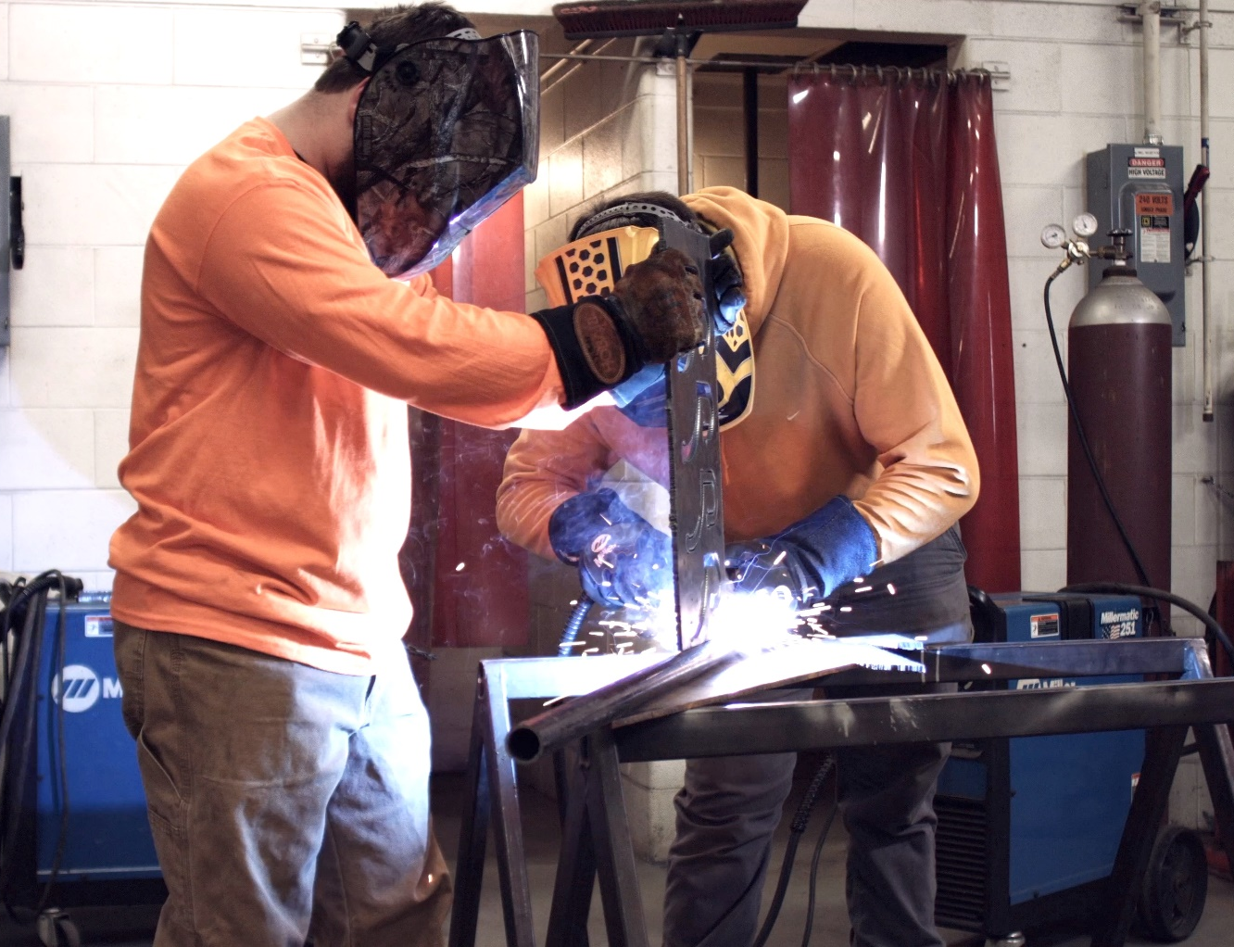
Education to Work Agenda
QA Commons initiative
Employer partnerships
Programs for displaced workers & adult learners
Program approval policy that considers market demand and job outcomes
Notes:
If we are not providing equitable opportunities for adults and thinking about ways to level the playing field, we’re failing a large part of our student population.
While our higher education system remains focused on traditional undergraduate residential students, they are becoming a smaller and smaller portion of who we serve.
According to a 2018 NCES study, nationally (read bullets). And this was before COVID-19. Homelessness and food insecurity are even bigger issues today.

Slide 13

Looking Ahead
Strengthen intersection between education and work and P-12 and postsecondary.
Empower and support our most vulnerable populations.
Help Kentucky campuses weather the current crisis and emerge more nimble and innovative.
Continue to change the value equation in higher education.
Notes:
If we are not providing equitable opportunities for adults and thinking about ways to level the playing field, we’re failing a large part of our student population.
While our higher education system remains focused on traditional undergraduate residential students, they are becoming a smaller and smaller portion of who we serve.
According to a 2018 NCES study, nationally (read bullets). And this was before COVID-19. Homelessness and food insecurity are even bigger issues today.

Slide 14
Current Year General Fund

Slide 15
CARES Act Funding
Federal Grants to Support:

Slide 16
Budgetary Impact of COVID-19

Slide 17
Budgetary Impact of COVID-19 (Cont’d)
Actions Taken:
Personnel
- Staff Furloughs and Layoffs
- Salary Reductions
- Eliminated Faculty and Staff Positions
- Reduced Retirement Contributions
- Cut Student Employment
- Hiring Freezes
- Outsourced Services
- Reduced Overtime
Operating
- Postponed Repair and Maintenance
- Renegotiated Contracts
- Eliminated Travel
- Cut Utilities Cost

Slide 18
Priorities for 2021-22
Campus Operating Funds
Performance Funding
Address “Fiscal Cliff” in 2021-22 budget
  Unless action is taken by the General Assembly, stop-loss and hold-harmless provisions sunset, impacting three universities and six community colleges
  Additional funding to advance attainment agenda
  Pension Relief
  Keep KERS contribution rate the same in 2021-22 or provide additional funding to offset rate increase

Slide 19
Priorities for 2021-22 (Cont’d)
Campus Operating Funds (Cont’d)
KSU Land Grant Match
  Federal matching requirement
  Responsibility of the state
  $1.2 M more needed in current year and in 2021-22
Capital Investment
Asset Preservation Funding
To help address $7.0 billion renovation & renewal need
  CPE recommends no campus matching requirement

Slide 20
Summary
Results/CARES Act Funding
Postsecondary system is on track to meet 60X30 goal
CARES Act funding only covers about 25% of COVID-19 costs and foregone revenue
Campuses have taken bold action to meet the challenge
Priorities for 2021-22
Address the fiscal cliff (maintain stop loss)
Provide additional funding for campus operations
Meet federal match for KSU Land Grant program
Fund Asset Preservation without a match requirement

Slide 21
Questions?

