Slide 1
ROCKCASTLE
COUNTY SCHOOLS
Carrie Ballinger, Superintendent

Slide 2
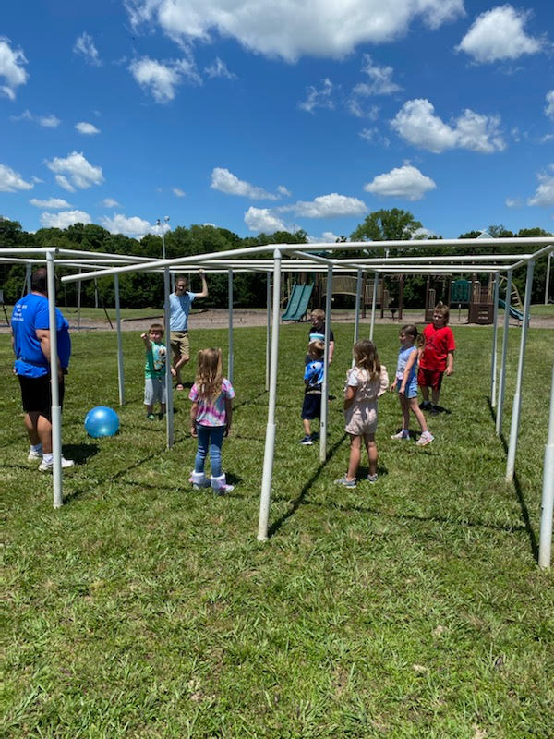
Camp Rock at a Glance
Targeted Instruction at all 5 Schools in the District
600 Plus Students Targeted
Intentional Camp Environment
Core Standards Based Instruction Provided in the Morning Focused on Mathematics and Reading
Enrichment Provided in the Afternoon
Special Offerings in Music, Art, Fitness, Technology, STEM Courses, and Social Emotional Learning
Small Group Targeted Instruction Provided by over 120 Staff Members
Individual and Small Group Counseling Provided Daily

Slide 3
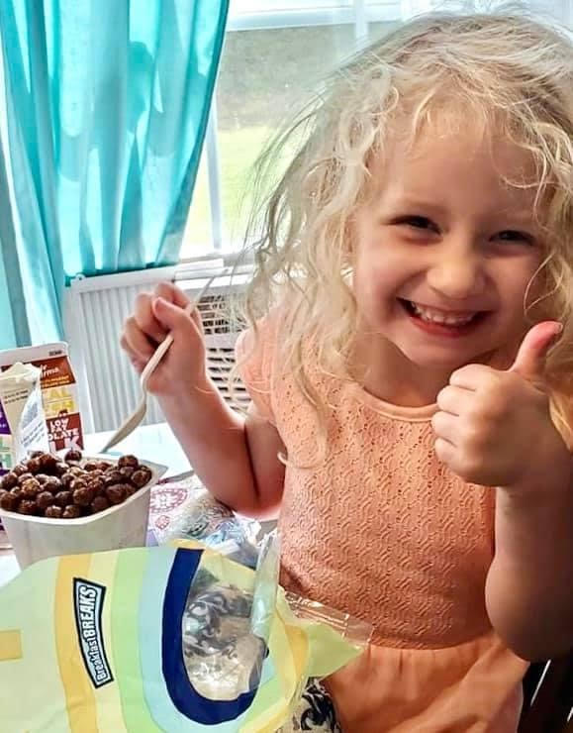
Elementary
Re-Ignite
Targeted Instruction at 3 Elementary Schools
Focus on the Love of Learning
AM Instruction Utilizing Literary Camp and i-Ready Math Core
Partnership with Christian Appalachian Project for Onsite Camp Andrew Jackson
Partnership with Christian Appalachian Project for STEM Activities Through Camp in a Box
Daily Counseling Offered Both Individually and in Group Sessions
Enrichment in Art, Music, Fitness and Social Emotional Learning

Slide 4
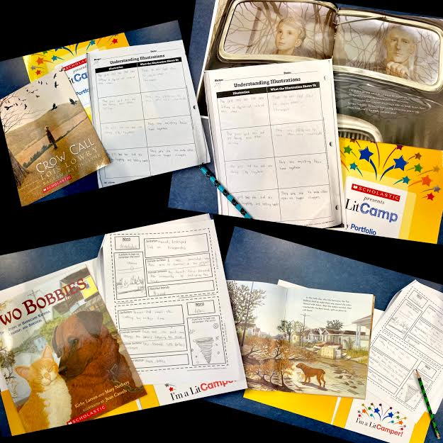
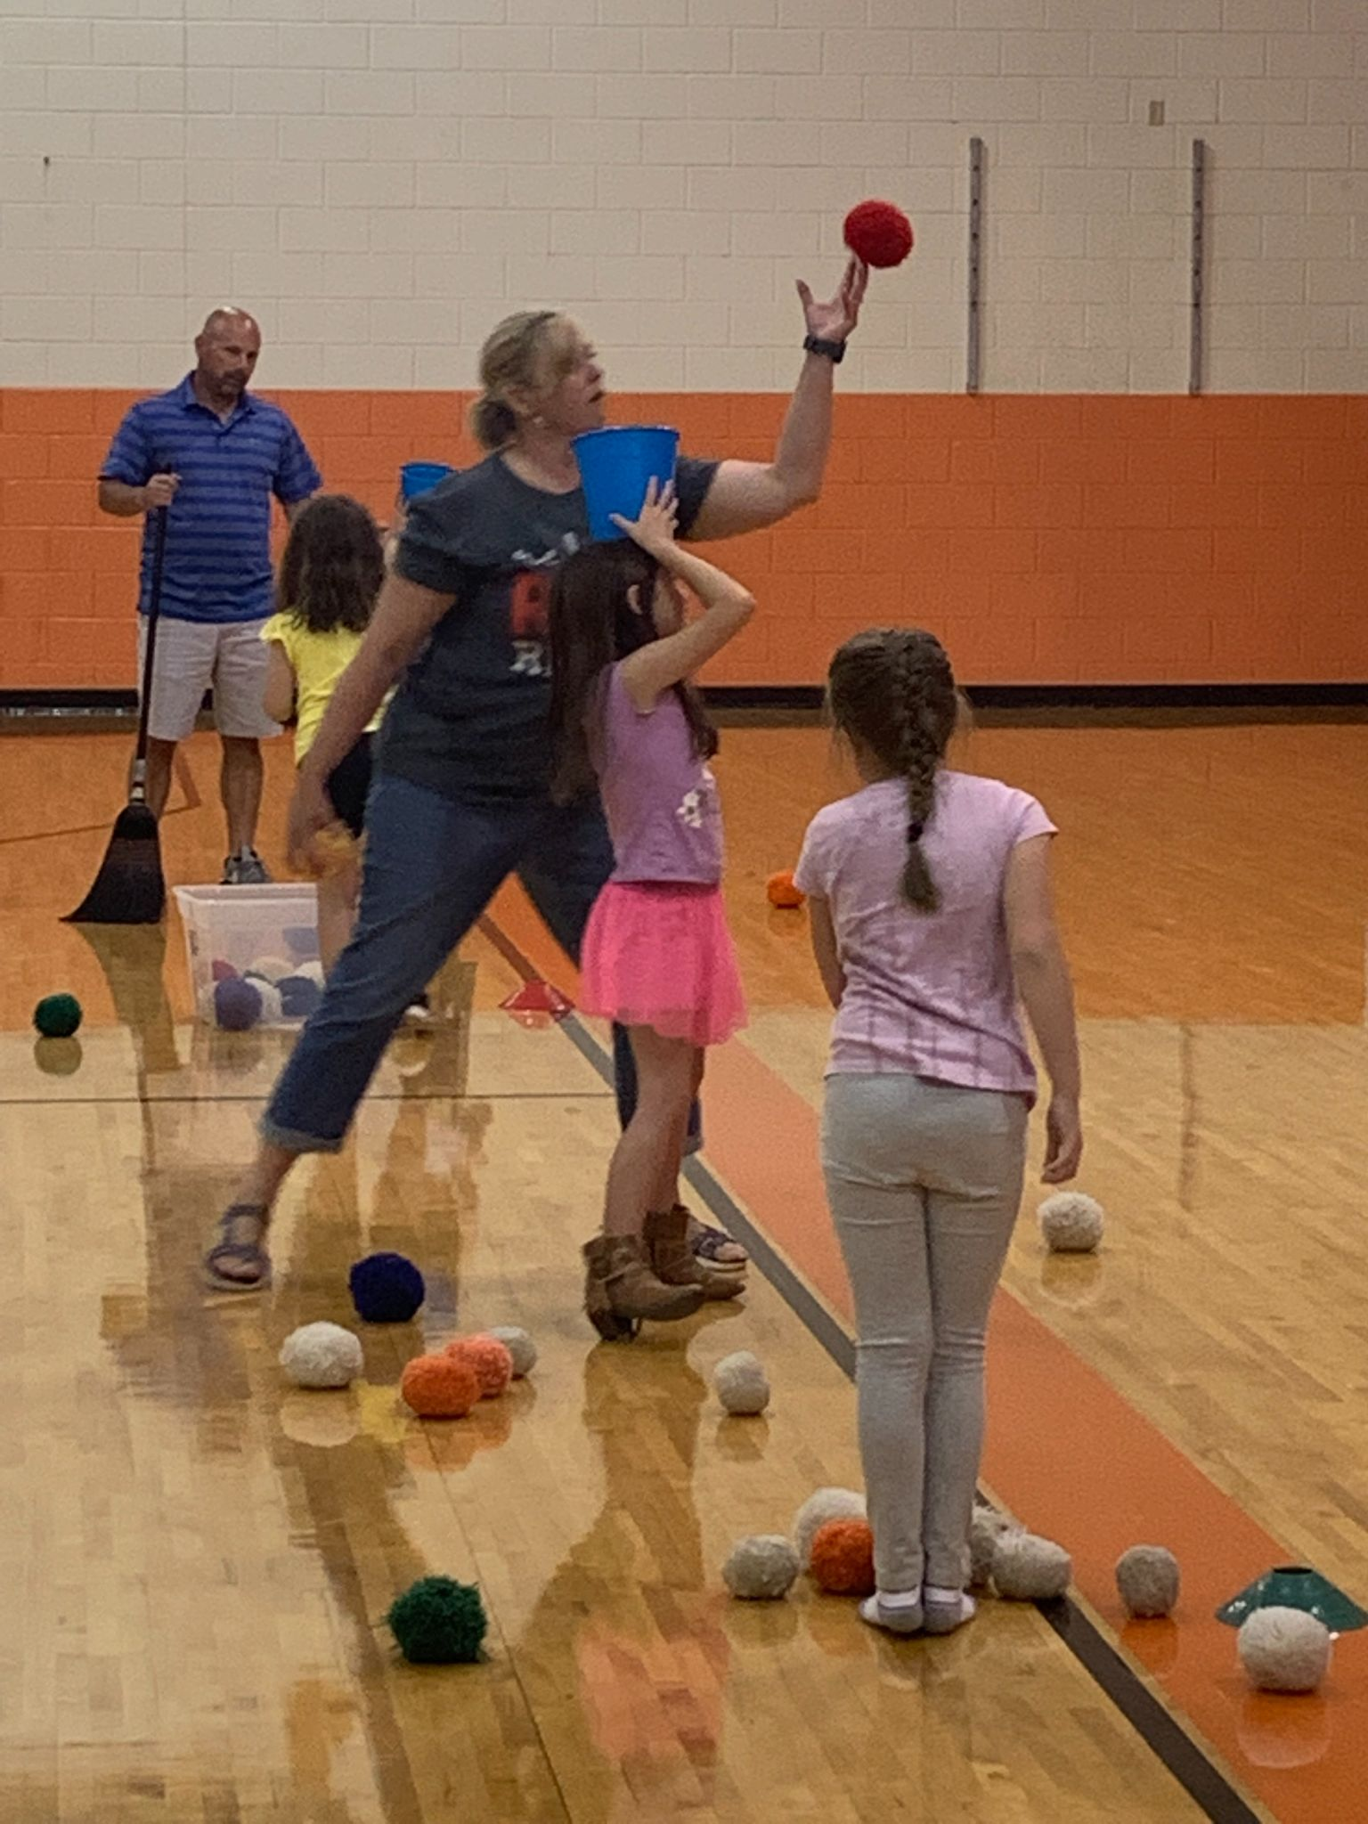
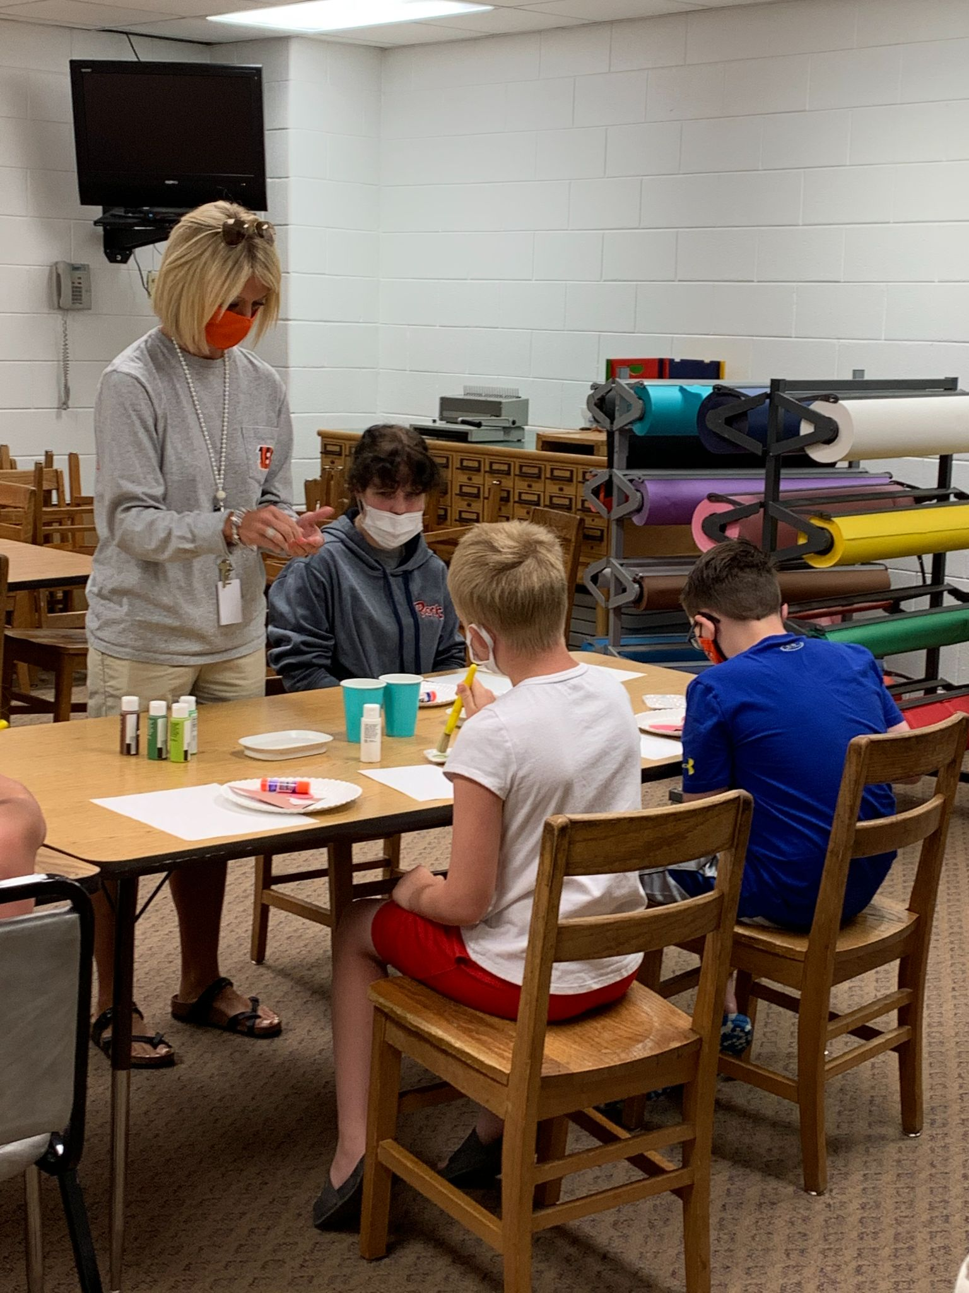
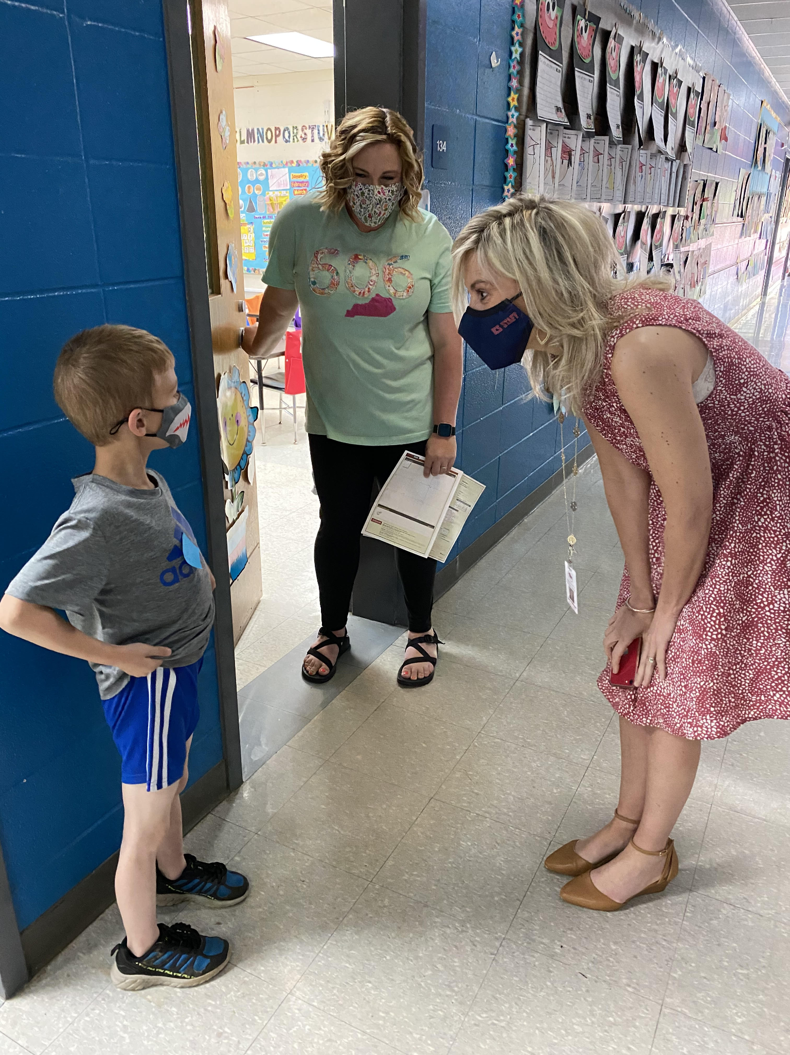
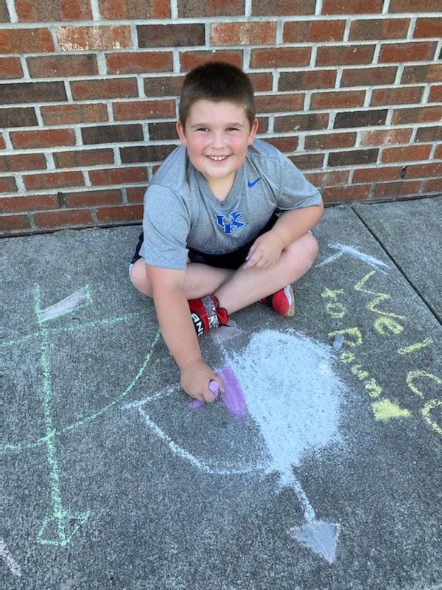
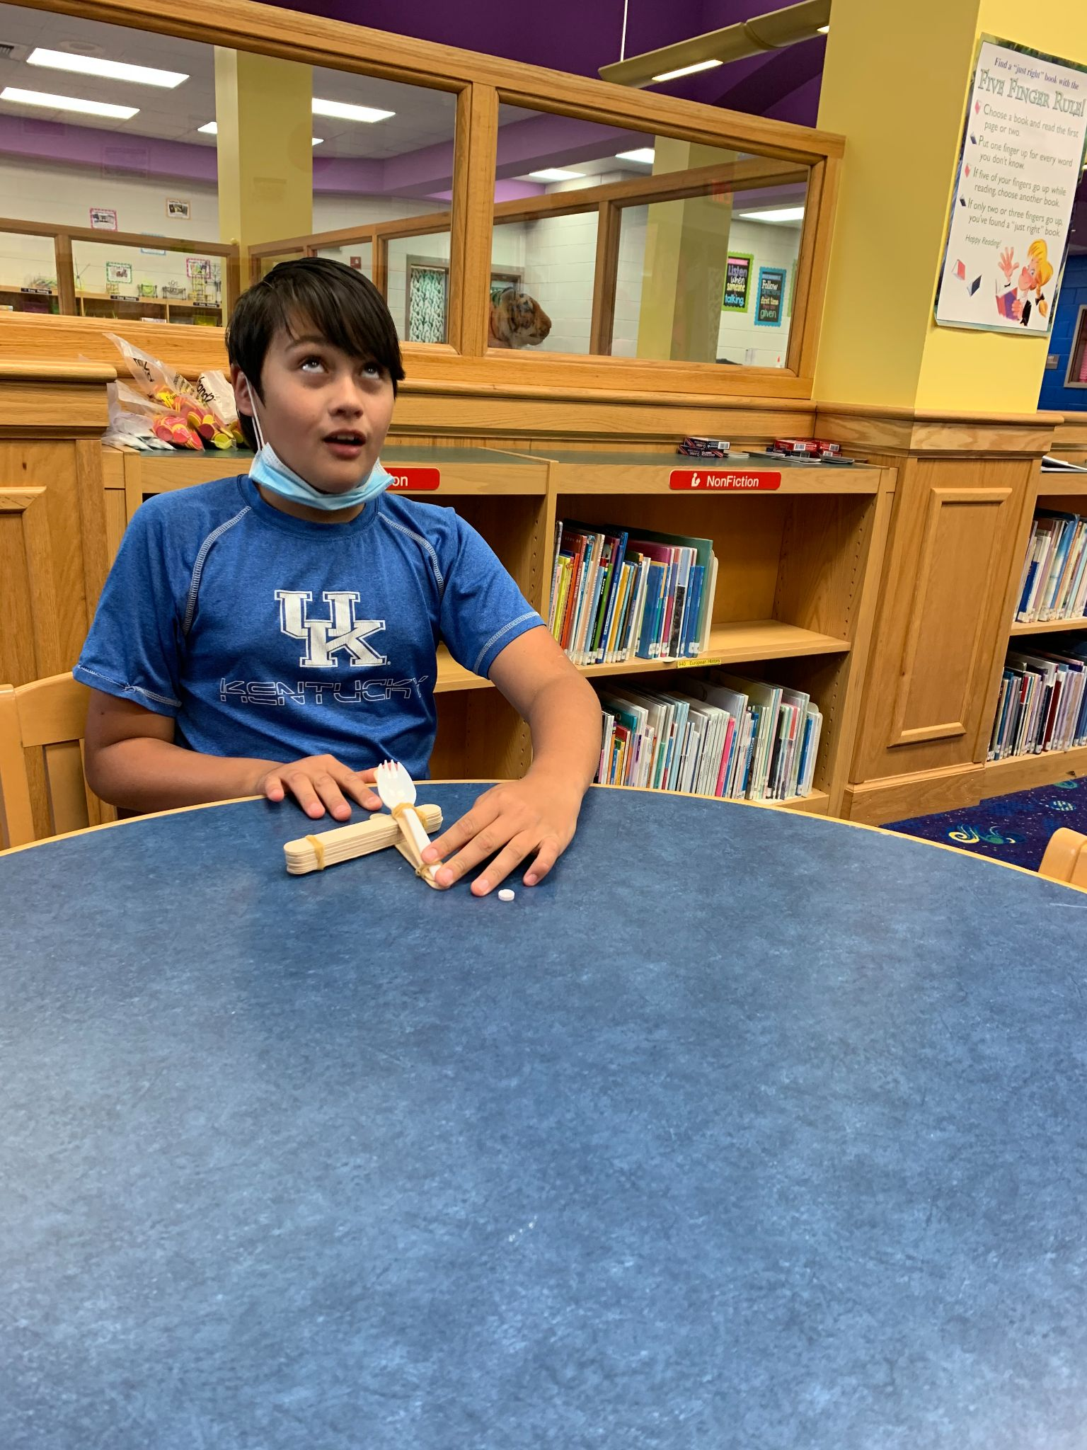
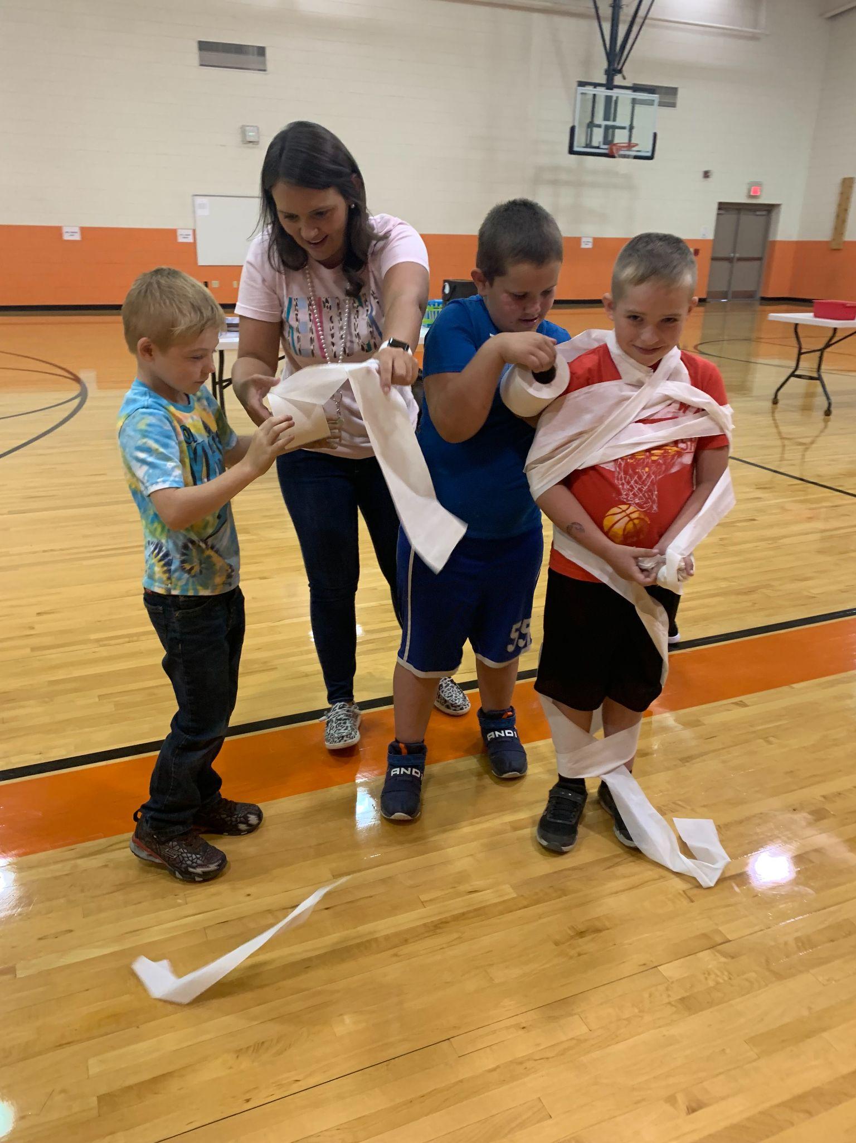
Camp Rock

Slide 5
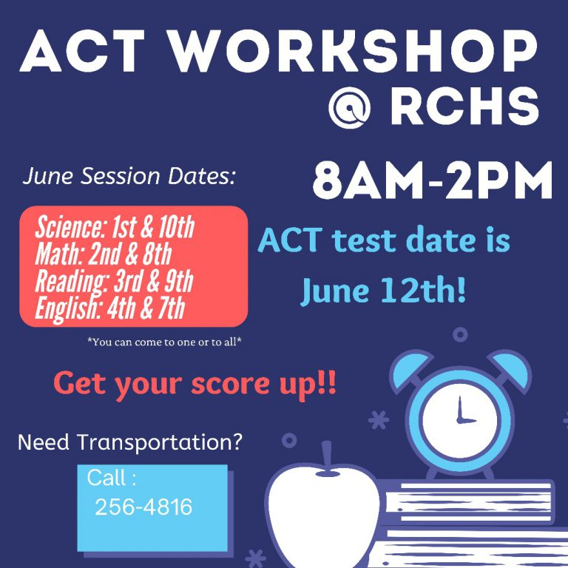
RCMS/RCHS Re-Ignite
Focus on Rebranding In-Person Learning
Credit Recovery: 175 Students Participated
Earned Diplomas: 18 Seniors
Credits Recovered: 244 Credits
ACT Boot Camp
Career Planning Sessions Offered
Gear Up Summer Camp: STEM Focus...60 Students Reached
Transportation Provided: 11,242 Miles Traveled @ cost of $50,000
Mental Health Support Provided Through District and School Counselors With Individual and Group Sessions for Students
Free Breakfast/Lunch Each Day

Slide 6
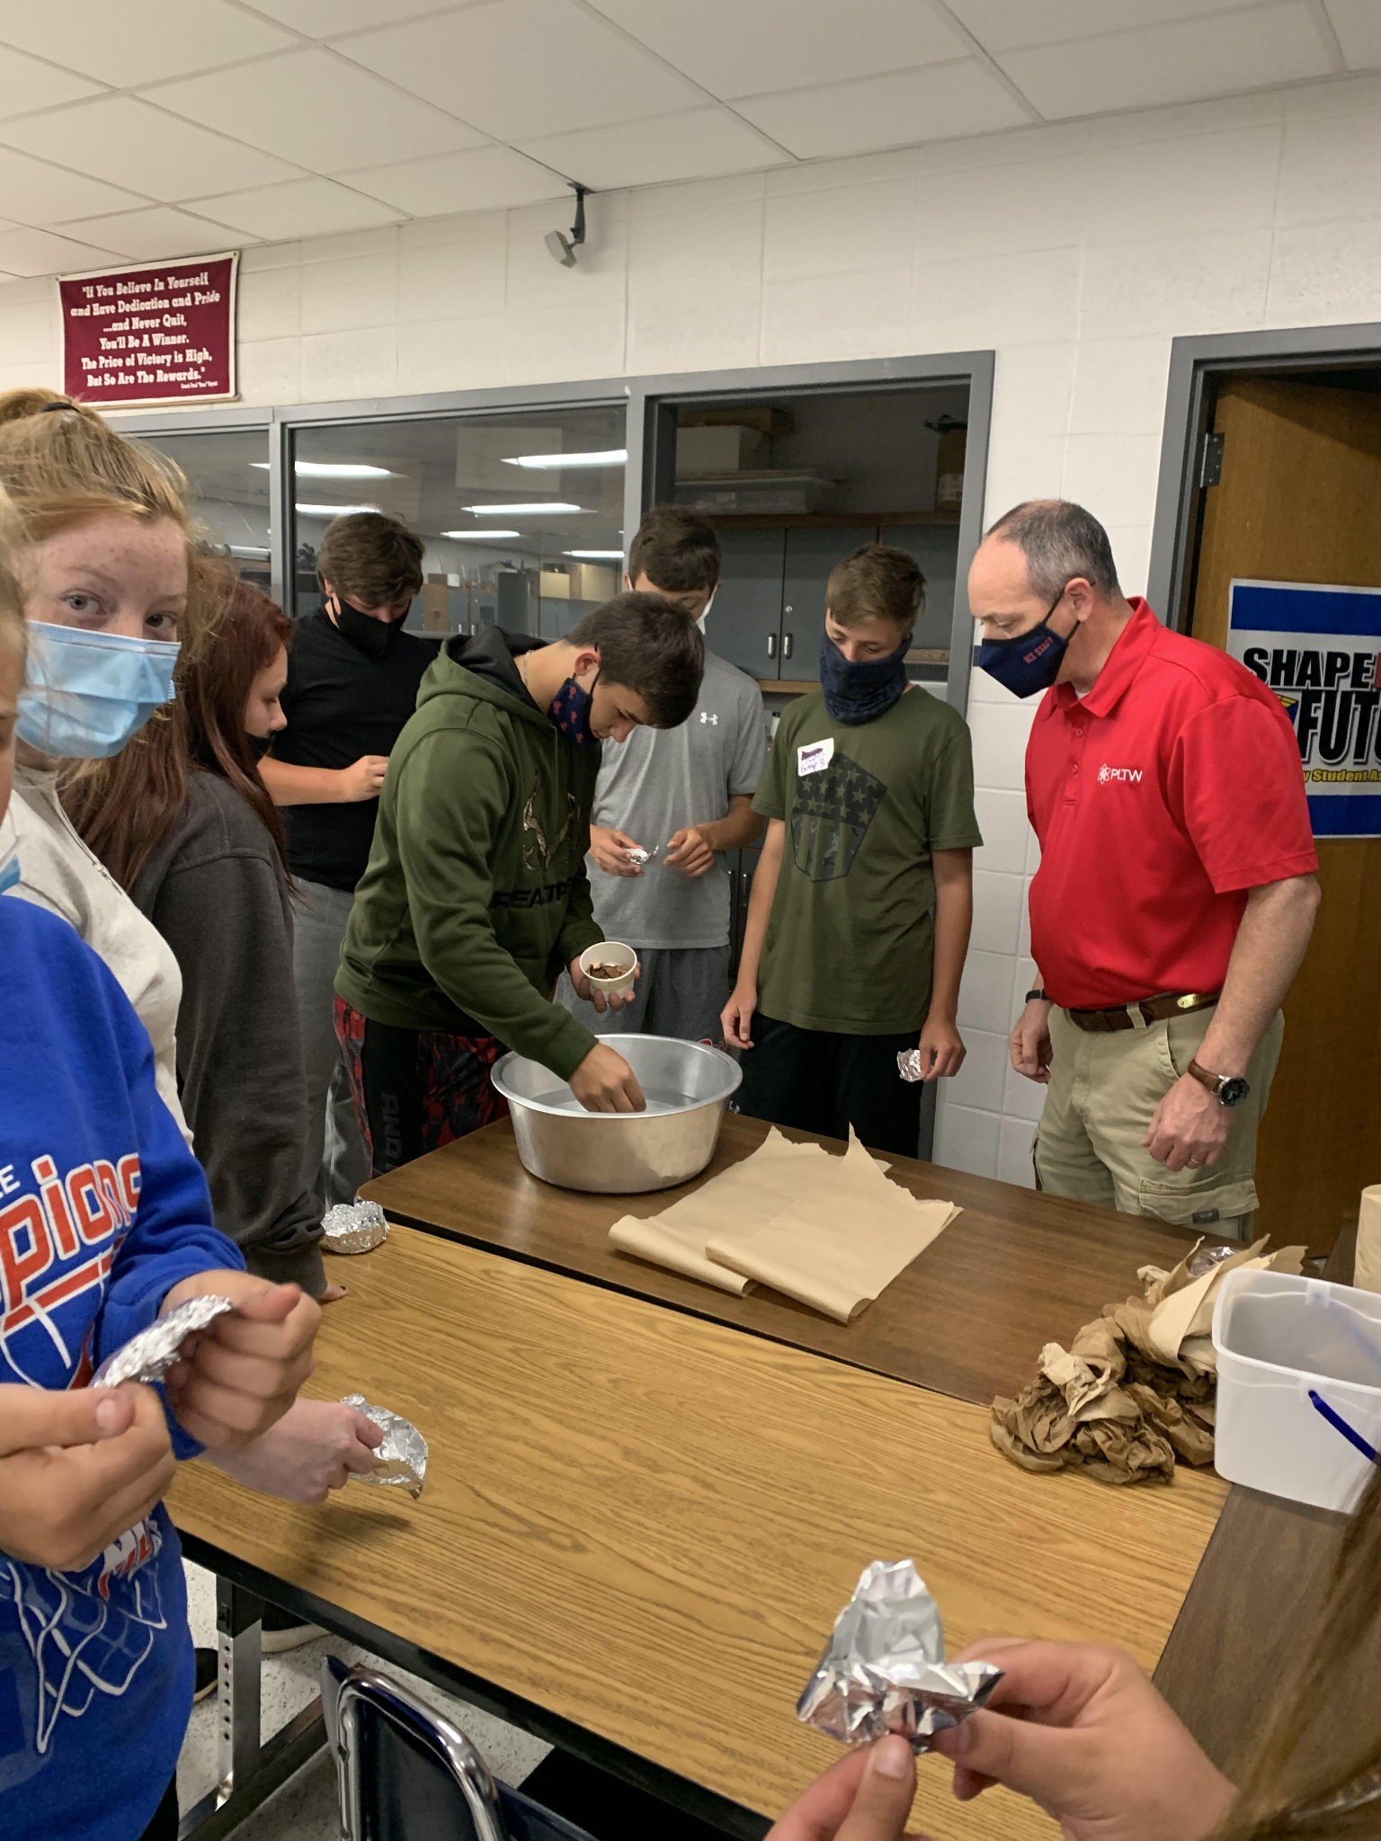
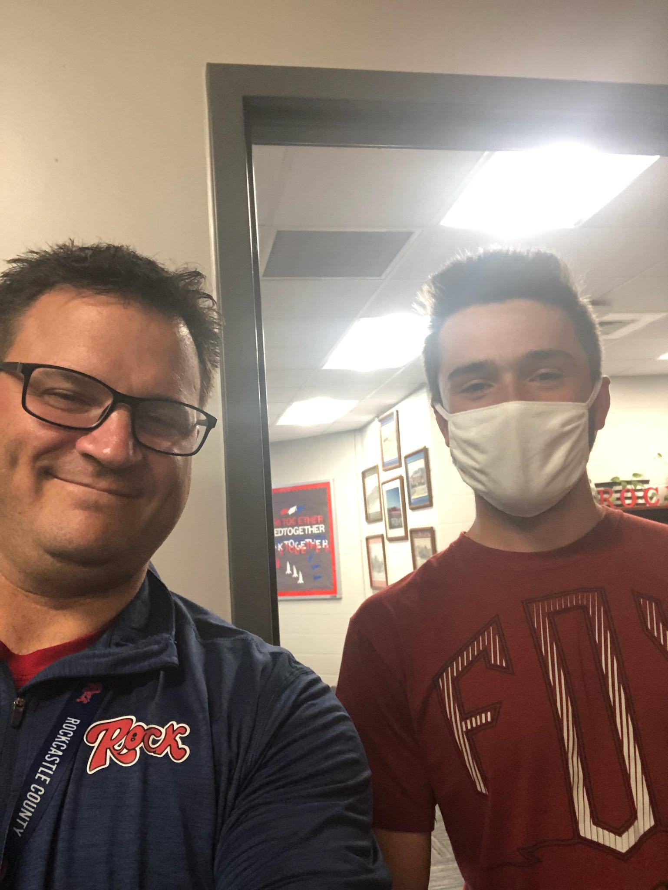
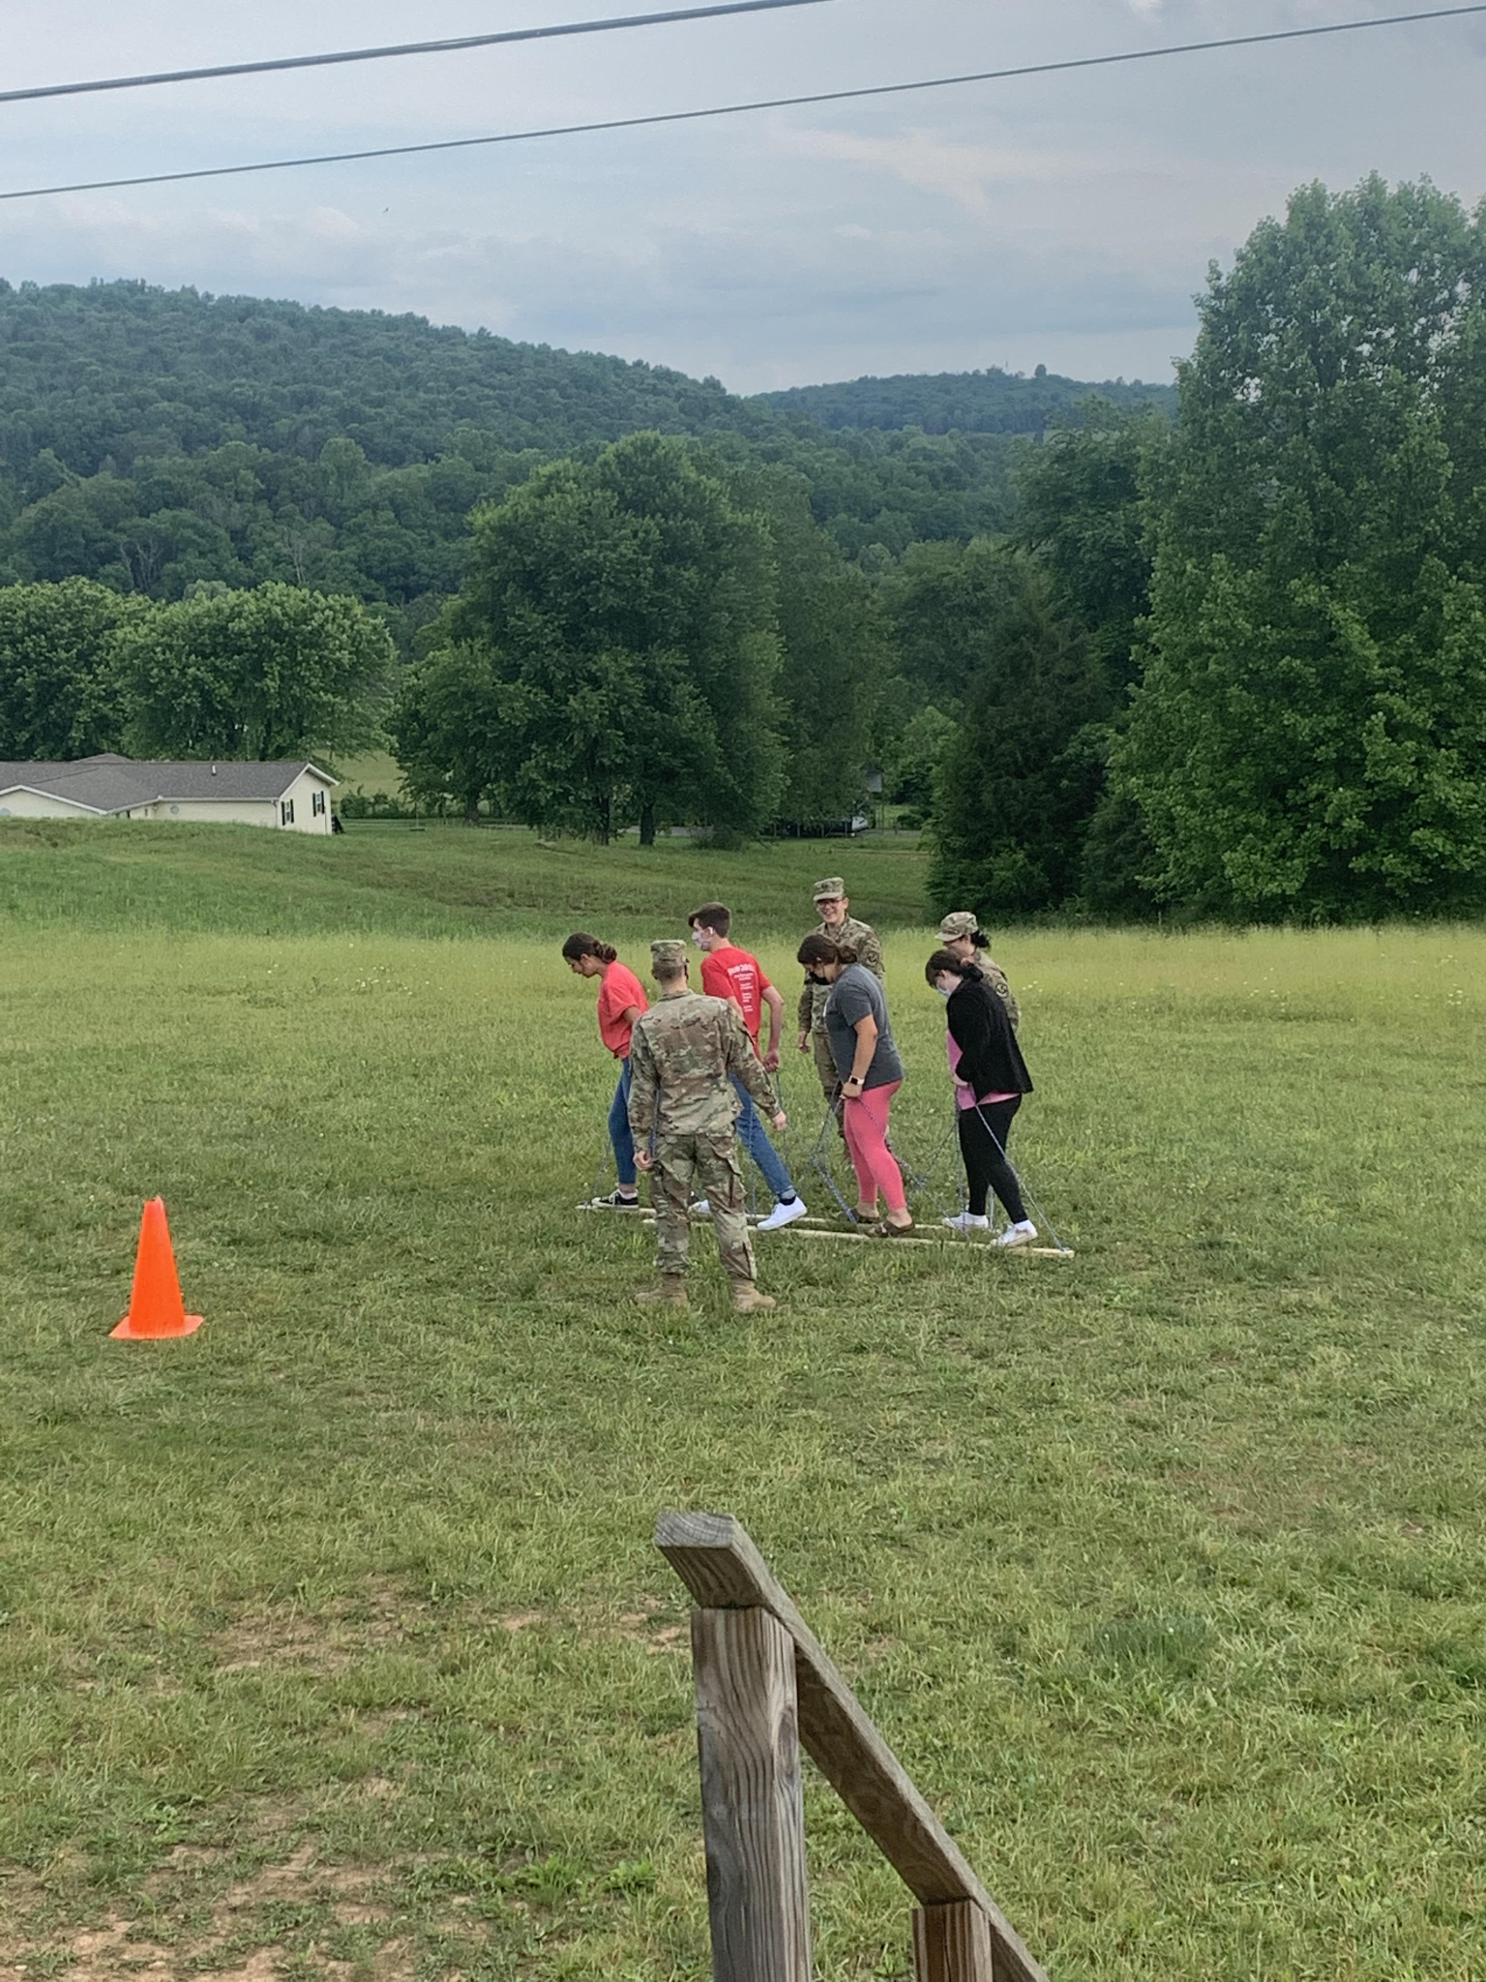
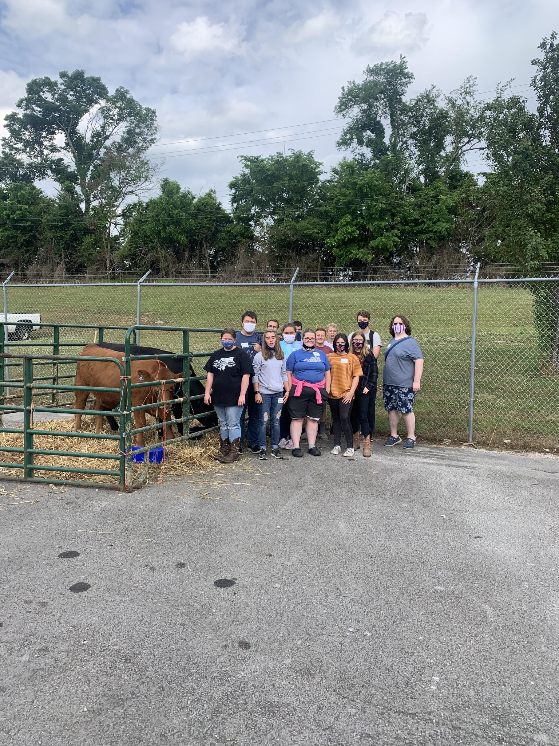
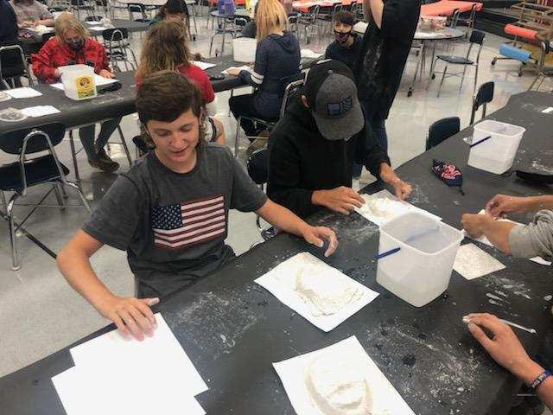
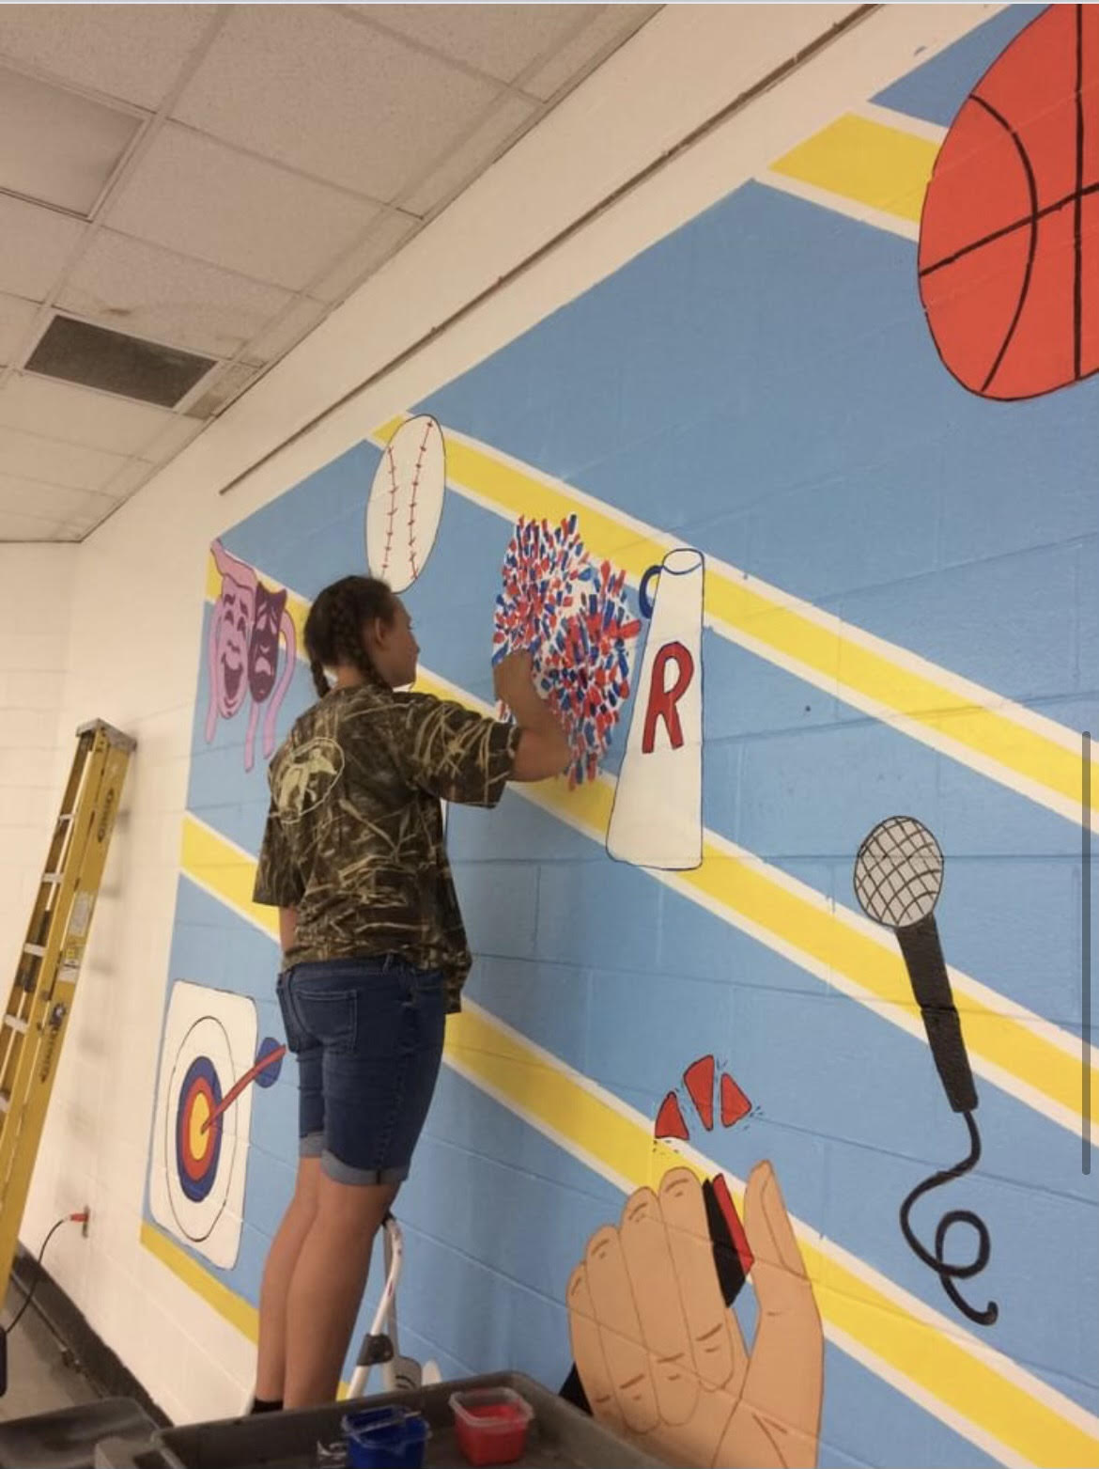
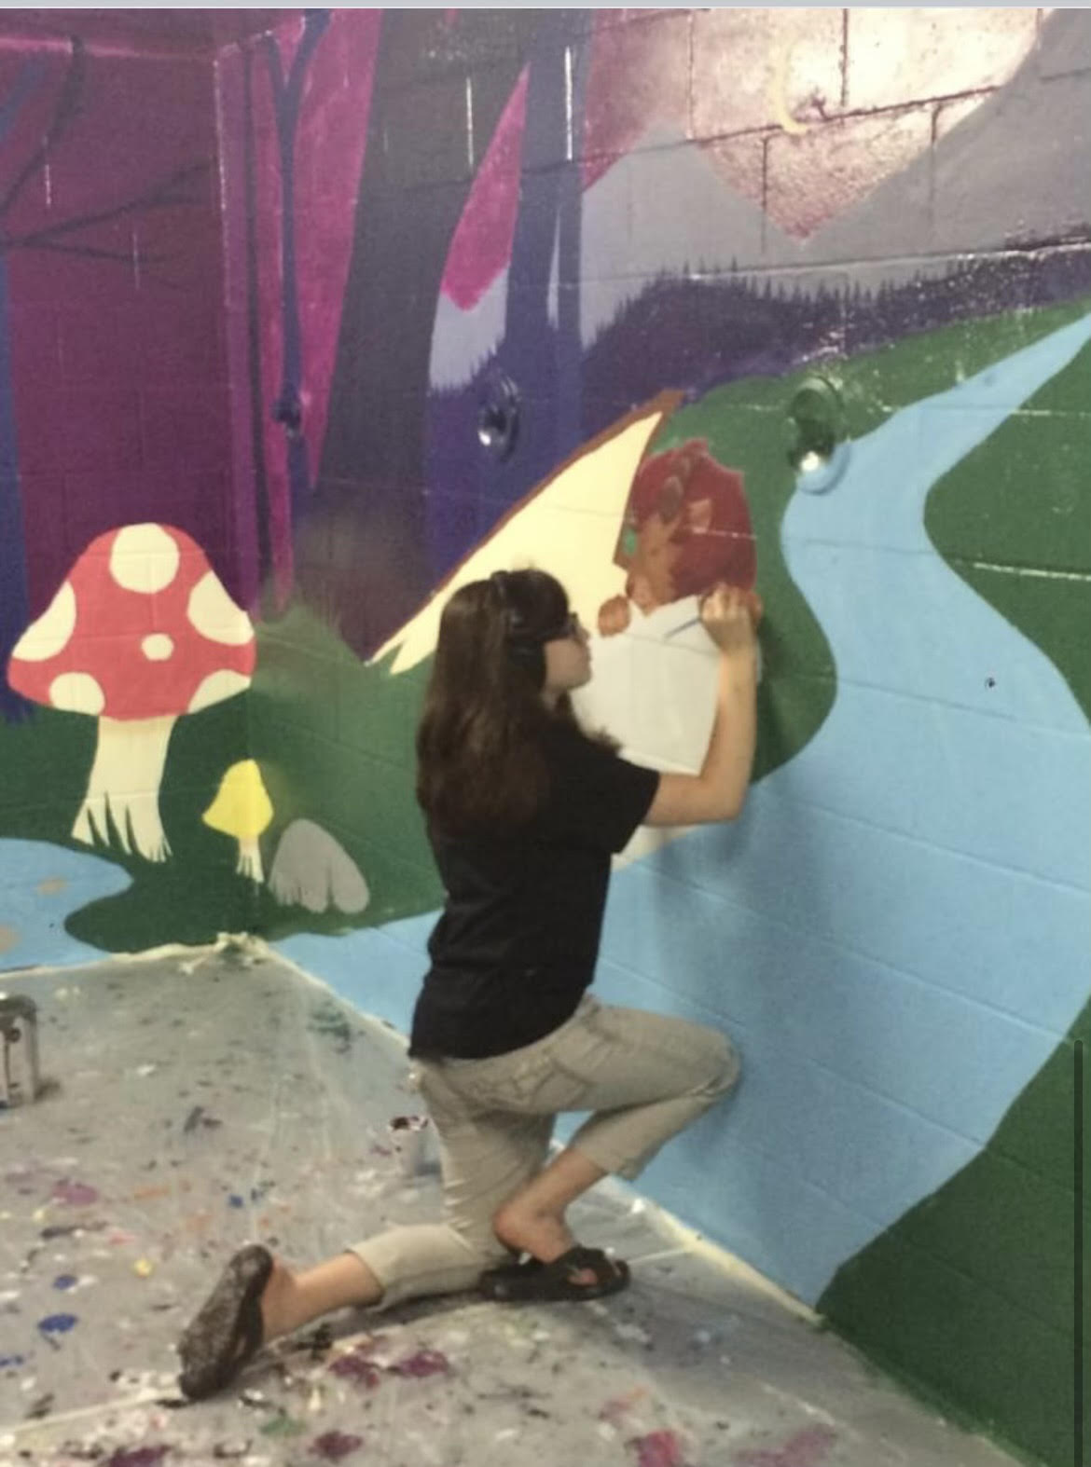
Camp Rock

Slide 7
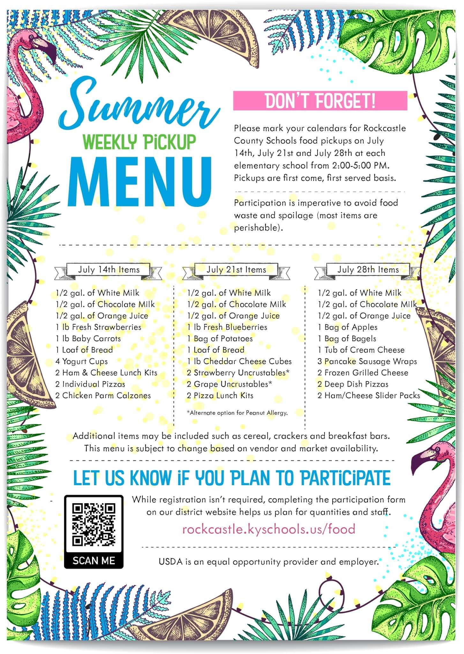
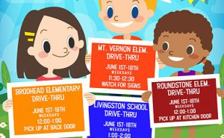
Community Partnerships
Community Feeding Sites: 11,087 Meals Served
Rockcastle Regional Ability Walk
Rockcastle County Longest Day of Play
Christian Appalachian Project: Camp AJ Camp in a Box/OnSite Camp
City and County Government support

Slide 8
Rocket Vision
Transitioning from Summer to Fall:
Implementation of Trauma Plan
PBIS District Implementation
Horizontal and Vertical Curriculum Alignment P-5
PLC Focus on Data-Driven Tier 1 Instruction With Support From New Academic Interventionists at all 3 Elementary Schools
Districtwide Mental Health Focus (3 new positions)
Comprehensive P-5 Literacy Program Implementation
Advanced KY at RCMS and RCHS
APP Harvest Partnership
JAG Implementation at RCHS

