Slide 1

Kentucky Lottery Corporation
Presentation to the Budget Review Subcommittee on Education
Mary R. Harville
President and CEO
August 4, 2021
Presentation Title

Slide 2

Background
Created by constitutional amendment and legislative act passed in 1988, KRS Chapter 154A.
The corporation shall conduct and administer lottery games which will result in maximization of revenues for the Commonwealth of Kentucky while at the same time provide entertainment to its citizens.
Sales began in April 1989, and in 1999 the General Assembly amended KRS 154A to direct lottery proceeds to college scholarship and grants.
Presentation Title

Slide 3
Mission and vision
Mission: Fueling imagination and funding education for all Kentuckians.
Vision: Enrich the lives of all Kentuckians through our Principles, Products, Proceeds, People, and Partners.
Presentation Title

Slide 4
FY2021 Results
Record sales of $1.586 billion, an increase of $382.9 million or 31.8% from FY2020.
Record prizes awarded to players of $1.07 billion, an increase of $266.2 million or 33.2% from FY2020.
Record payments to retailers of $90.6 million, an increase of $19.6 million or 27.5% from FY2020.
Record cash dividend transfers of $354.8 million, an increase of $76.3 million or 27.4% more than FY2020.
Presentation Title

Slide 5
Where the Money Goes
INCEPTION-TO-DATE SALES AS OF JUNE 30, 2021
$23,346,657,000

Slide 6
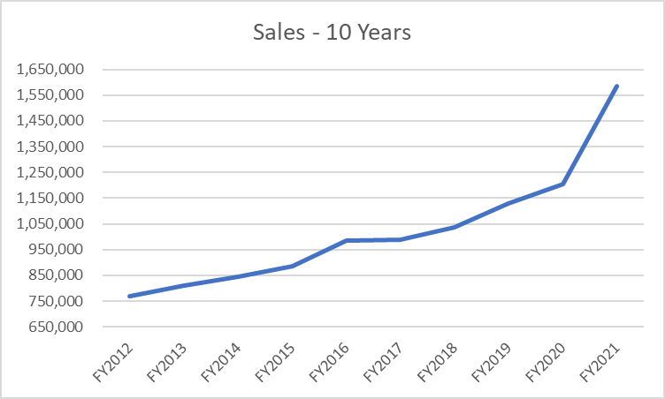
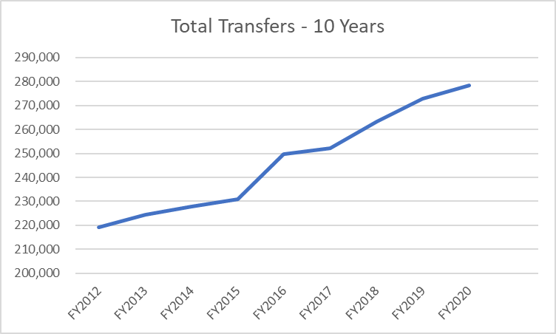
Sales & Total Transfers

Slide 7
Sales & Total Transfers
(in millions)

Slide 8
Lottery Results
100% of KEES money awarded is funded by the Lottery.
More than 98% of all KHEAA funding comes from the Lottery.
More than $4.0 billion provided in scholarships and grants since 1999.
    1 in 5 Kentucky citizens have received grants and scholarships from Lottery proceeds.
    820,000 Kentucky college student recipients of Lottery’s educational assistance.
    2.43 million grants and scholarships awarded.
Presentation Title

Slide 9
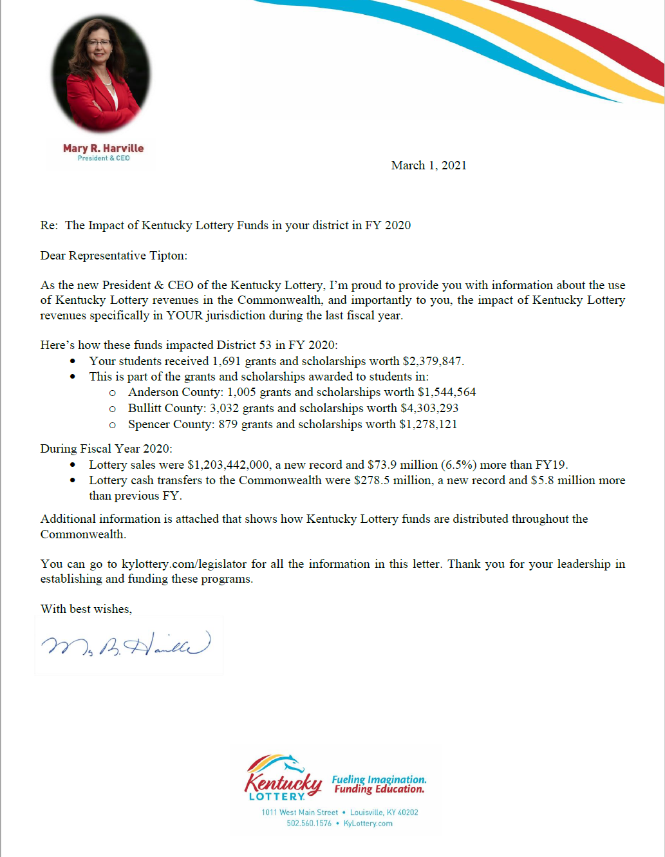
Kylottery.com/legislator

Slide 10
Questions?
Presentation Title

