Slide 1
Interim Joint Committee on Appropriations & Revenue Budget Review Subcommittee on Education October 6, 2021
Aaron Thompson, CPE President
David McFaddin, EKU President

Slide 2
Overview
Postsecondary Education Update
Proposed Regulatory Relief Measures

Slide 3
Postsecondary Education Update
Lowest tuition and fee increases in over 20 years
Making great progress closing achievement gaps
STEM+H degrees and credentials are growing at unprecedented rates
Number of short-term certificates awarded on the rise (grew by 9.5% in 2020)
High school students taking dual credit courses increased by 10.0% in 2020 (75% increase over past six years)

Slide 4
Postsecondary Education Update Lowest Tuition Increases in Decades
In the early 2000s, CPE devolved responsibility for tuition setting to campus governing boards
Increases in tuition and fees averaged over 10% per year between 2003 and 2010
The Council has adopted tuition ceilings every year since 2010, with an average rate of growth of 3.4%
Average increase the past two years is below 1.0%

Slide 5
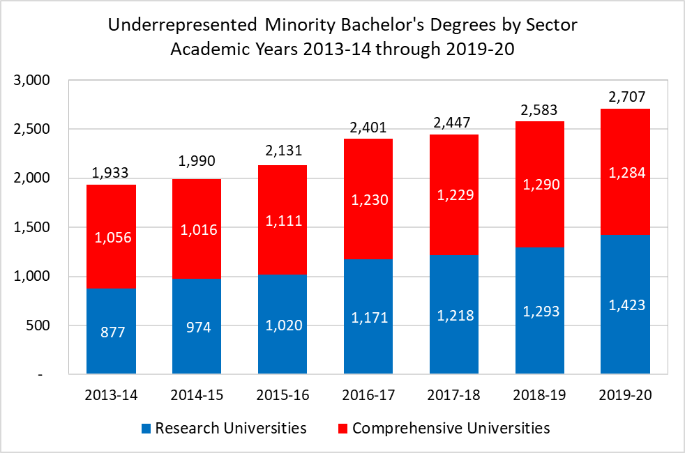
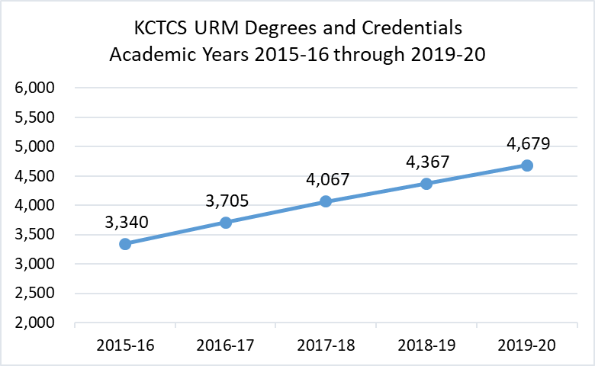
Postsecondary Education Update Growth in URM Degrees and Credentials
Between 2016 and 2020, KCTCS degrees and credentials awarded to URM students increased by 1,339, or by 40%
This represents an average annual growth rate of 8.8% in URM degrees and credentials
Between 2014 and 2020, bachelor’s degrees awarded to URM students grew by 774 degrees, or by 40%
The research sector accounted for 71% of that increase, with URM degrees growing by 62% at the research universities and by 22% at comprehensive universities

Slide 6
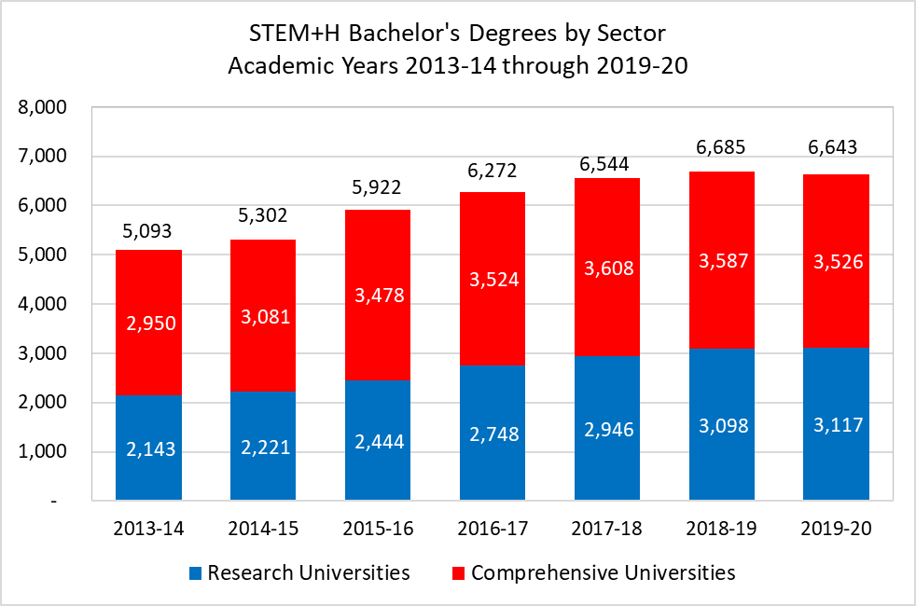
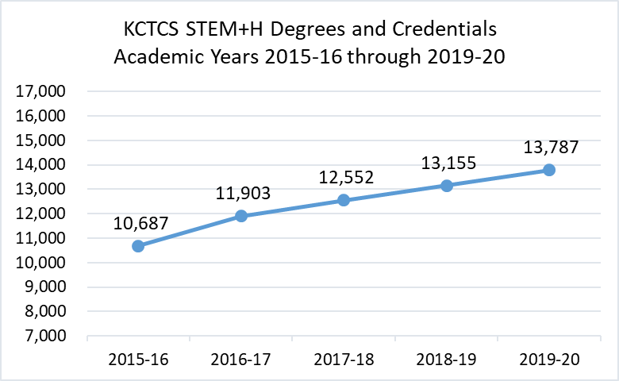
Postsecondary Education Update Growth in STEM+H Degrees and Credentials
Between 2016 and 2020, STEM+H degrees and credentials at KCTCS increased by 3,100 awards, or by 29%
This represents an average annual growth rate of 6.6% in STEM+H degrees and credentials
Between 2014 and 2020, STEM+H bachelor’s degrees grew by 1,550 degrees, or by 30%
The research sector accounted for 63% of that increase, with STEM+H degrees growing by 45% at the research universities and by 20% at comprehensive universities

Slide 7
Proposed Regulatory Relief Measures
Vendor Forms: Modify KRS 45A.695 to eliminate the requirement for vendors to complete and sign Personal Service Contract (PSC) invoices.
Student IDs: Modify KRS 61.931(6)(d). It triggers security incident procedures unnecessarily, since student ID numbers protect against misuse of personal information.
Open Records: Match KRS 61.880 language, the appeal timeline for open records requests, with KRS 61.846, the 60-day appeal timeline for open meetings.

Slide 8
Proposed Regulatory Relief Measures (Cont’d)
Disposal of Property: Make existing budget language permanent, regarding real property sale proceeds returned proportionately to the funding source.
Printing: Exempt the institutions from KRS 57.091, which requires Governor’s approval of all state printing contracts.
Modify Tuition Waivers: Make tuition waivers “last dollar” scholarships by requiring students to apply for federal and state aid.
Notes:
.

Slide 9
Proposed Regulatory Relief Measures (Cont’d)
Lease Reporting: Increase threshold on capital lease reporting to Capital Projects and Bond Oversight Committee from $100,000 to $200,000 (consistent with the $200,000 threshold for inclusion in biennial budgets).
Lease Terms: Allow more flexibility on lease terms, including extending the number of optional renewal terms. Allow the universities and KCTCS to waive the state’s thirty-day cancellation requirement.
Notes:
.

Slide 10
Proposed Regulatory Relief Measures (Cont’d)
Capital Projects: Increase the Capital Projects and Bond Oversight Committee capital project reporting threshold for public institutions from $1.0 million to $2.5 million.
COVID-19 Immunity: Provide public institutions immunity from claims related to taking reasonably necessary actions to comply with federal, state, or local guidance to diminish the impact of COVID-19.
Notes:
.

Slide 11
Questions?

