Slide 1
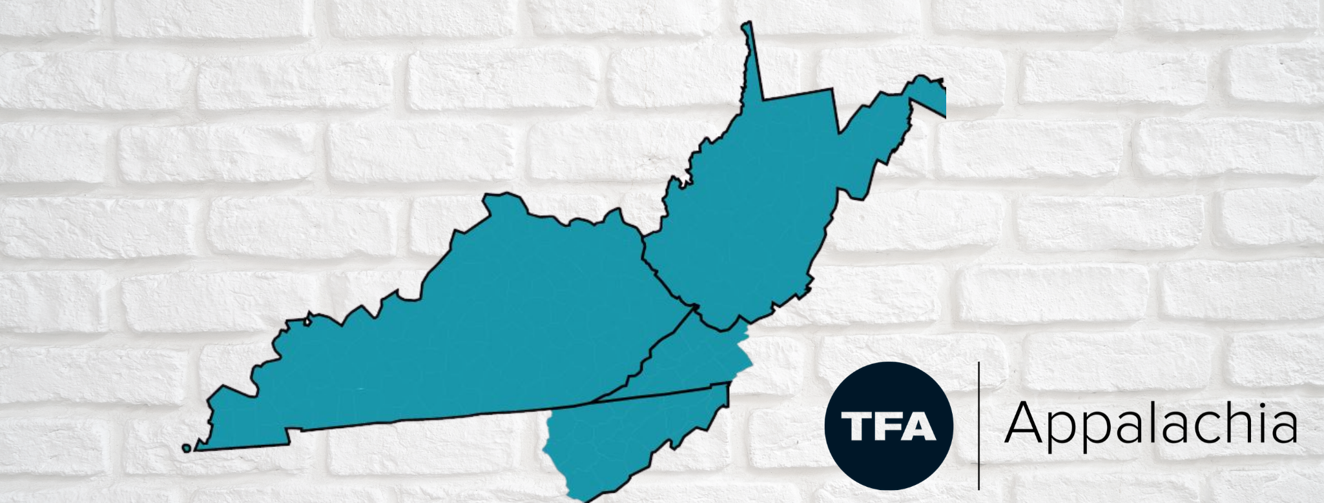
Senate Education Committee, 10.06.21

Slide 2
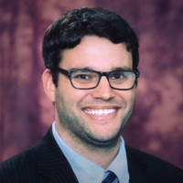
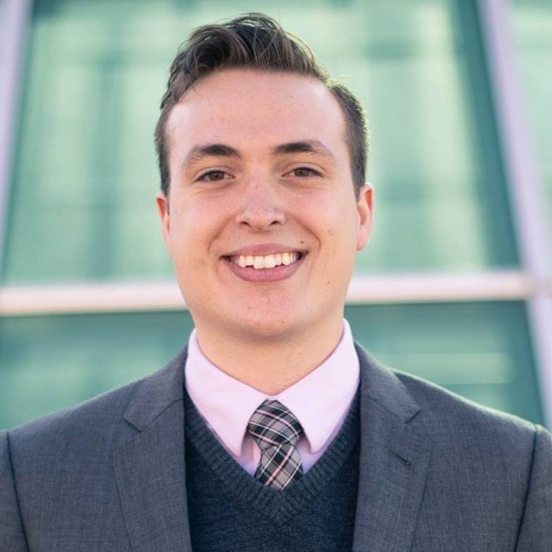
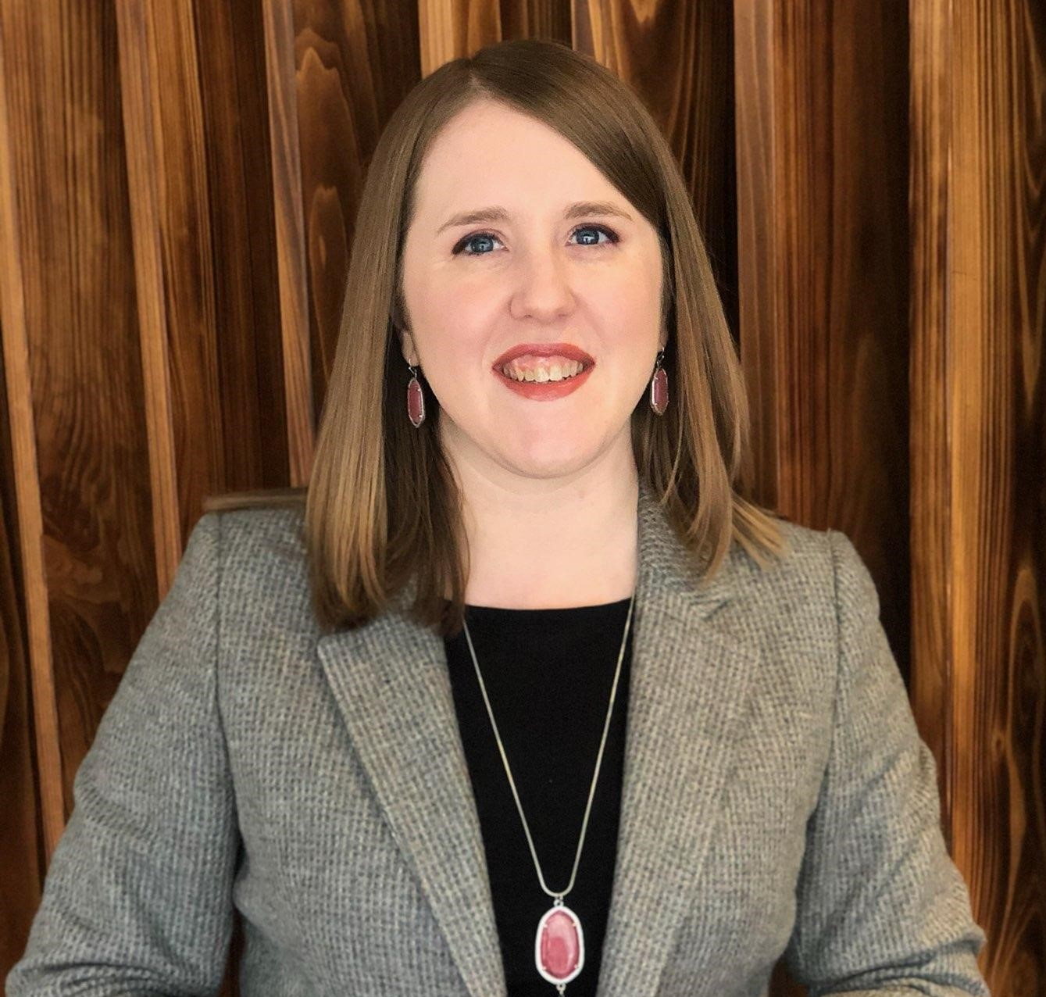
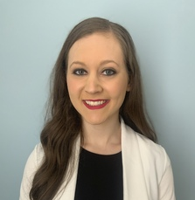
PRESENTERS
Jason Wheeler
MD, Appalachian Education Initiatives
TFA Appalachia
Gavin Pielow
Law & Justice Teacher
Knott County Central High School
Stephanie Devine
Executive Director
TFA Appalachia
Brittany Curry
Mathematics Teacher
Letcher County Central High School
Ashley Morrow
College Success Coach
Knox Central High School

Slide 3
OUR IMPACT: 2011-2021
To date, TFAA has recruited and supported more than 175 of our nation’s brightest leaders to teach, lead and live in Eastern Kentucky.
In counties with TFAA placement, College and Career Readiness (CCR) rates have grown at double the rate of counties without a TFAA placement.
TFAA teachers have established 8 Advanced Placement (AP) programs, as well as global service corps, student internship programs, coding clubs, aerospace courses and more. Compared to their TFA peers across the nation, our teachers rank at the top when measuring for satisfaction and learning.
100% of principals with TFA teachers in their building report they would recommend hiring a TFAA teacher to a fellow school leader.

Slide 4
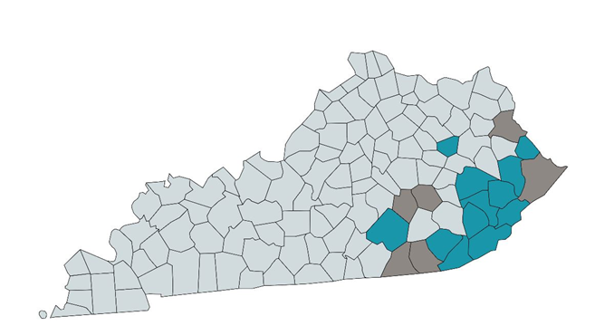
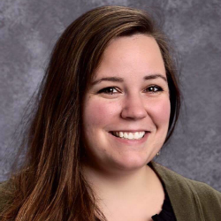
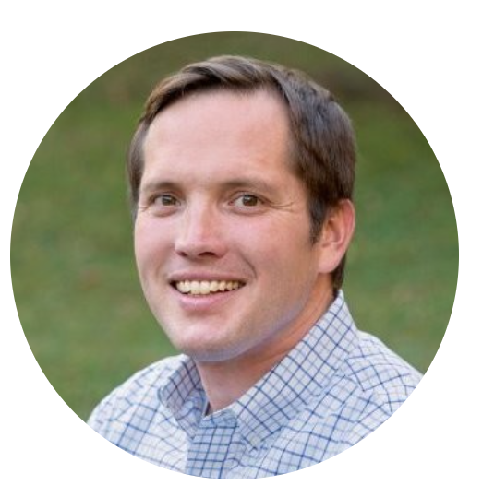
OUR IMPACT: 2011 - 2021
Teach For America teachers and alumni continue to make significant contributions across the state in all sectors, ranging from education to entrepreneurship.
High School
Middle School
Elementary School
90 - 150
30 - 90
25 - 50
Average number of students impacted by a single TFAA teacher each year
As research demonstrates time and again, teacher quality is the #1 predictor of student achievement in a classroom.
Notes:
https://www.google.com/url?q=https://legislature.ky.gov/Committees/Pages/Committee-Details.aspx?CommitteeRSN%3D73%26CommitteeType%3DSenate%2BStanding%2BCommittee&sa=D&source=editors&ust=1633016797844000&usg=AOvVaw0JVkUCt2ep3pHt-HngMQG-

Slide 5
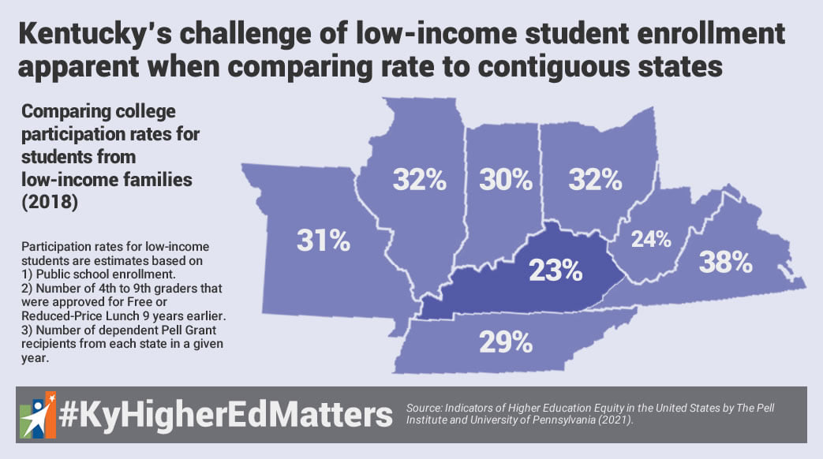
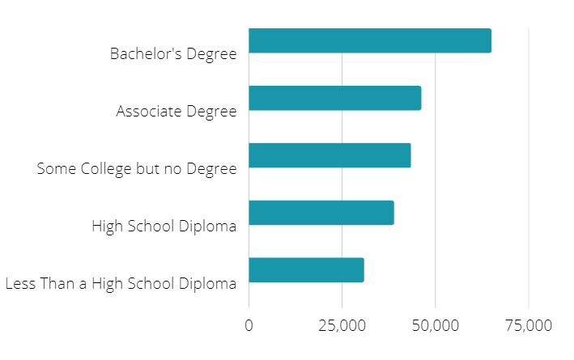
OUR FUTURE: 2021 AND BEYOND
While dramatic progress has been made across the mountains of Eastern Kentucky, much is still needed to ensure our students are equipped to learn, lead and thrive. In particular, we know that a significant increase in Appalachian students ready for, enrolled in, and completing postsecondary programs - ranging from certificate to 4 year degree bearing - is vital for an educated workforce and regional economic mobility.
Salary Earnings by Amount of Schooling Completed

Slide 6
OUR FUTURE: 2021 AND BEYOND
TFAA’S 10-YEAR GOAL: By 2030, twice as many students in Central Appalachian communities will achieve postsecondary readiness and success, putting them on the path to economic mobility and a future filled with possibility.
What is TFAA’s role?
Grow, recruit and retain a workforce of high quality teachers-both supporting exceptional leaders to come back home, as well as attracting top talent from across the globe to live and lead in Eastern Kentucky
Dramatically increase our value to communities through free coaching and PD to non-TFAA teachers, as well as free hybrid summer programming to maximize student growth across the region
Sustain and expand our new College Success Coach program, catalyzing generational increases in postsecondary readiness and success while creating ecosystems of support in local schools
TFAA requests an increase of our biennial legislative appropriation from $1,000,000 ($500,000 per year) to $2,000,000 ($1,000,000 per year) to dramatically increase our impact in rural Eastern Kentucky, advancing K-12 student outcomes and increasing postsecondary readiness and success.

Slide 7
TFAA’s Role: Grow and retain a workforce of high quality teachers by both bringing exceptional leaders back home and attracting top talent to the region from across the globe.
PROVIDING WORLD CLASS TEACHER LEADERS
Made Possible by 2019-2020 Appropriation | Potential Impact of Increased Allocation
Increased our incoming teaching cohort size by 25% compared to the prior year, enabling us to meet persistent (HS STEM) and emerging (elementary, middle school, and social studies) placement needs in the region. Recruited a diverse teacher cohort, including 50% Pell grant recipients and 32% first generation college students In partnership with the KY ARC, launched the Mountain Teacher Fellowship, retaining 11 TFAA teachers for an additional 2 years. | Grow our teacher workforce and placement geography, as well as pursue a pathway to certifying teachers in special education Dramatically increase our local recruitment efforts, working with local campuses to get great Eastern Kentucky talent back home Sustain and grow our Mountain Teacher Fellowship, aiming for 50% retention of our teachers past their initial commitment

Slide 8
HEARING FROM THE FIELD
Gavin Pielow
Law & Justice teacher
Knott County Central High School
Notes:
Gavin-please be ready to spend 30-45 seconds sharing who are you, why TFA, and what your experience has been like in Knott COunty. If time, share what you think could be true if TFA expanded its corps size to reach needs

Slide 9
HEARING FROM THE FIELD
Brittany Curry
Mathematics teacher
Letcher County Central
High School
2021 Mountain Teacher Fellow
Notes:
Brittany-please be ready to share 45 seconds of why TFAA, why the MTF and how its impacting your retention-I love your story of how you’re building your own generational wealth/support system given all your mom did for you-and a tiny bit about what you think would be possible if we grew the Fellowship

Slide 10
“Teach For America Appalachia has been an incredible partner over the years and a key player in helping Eastern Kentucky schools fill the teacher shortage gap. Their commitment to providing high quality support for teachers and recruiting talented members is at the heart of their success. They [TFA teachers] have been able to positively impact our students, families, and communities by building life-changing relationships. Our communities are better because of their work.”
-Harlan Independent School District Superintendent C.D. Morton
HEARING FROM THE FIELD
Jason Wheeler
Managing Director, Appalachian Education Initiatives
TFA Appalachia

Slide 11
TFAA’s Role: Expand our new College Success Coach program, catalyzing generational increases in postsecondary readiness and success while creating ecosystems of support in local schools.
CATALYZING POSTSECONDARY SUCCESS
Made Possible by 2019-2020 Appropriation | Potential Impact of Increased Allocation
In partnership with PFE and SESC, we launched an entirely new body of work - our College Success Coach program - which serves high school seniors and first year postsecondary students in 17 EKY high schools. Each coach serves a cohort of 25 seniors to and through their first year of postsecondary, with a focus on first generation students, students with incarcerated parents, and students with minority status. To date, CSCs have served/are serving 850 students, supporting them to earn $719,351 in scholarships and achieve 62% postsecondary enrollment in just 6 months. | Opportunity to double the size of our program to two coaches per high school, thus impacting twice as many students per year Launch and integrate a Peer Forward mentoring model into EKY high schools, adding 3 layers of pre-postsecondary support for students in grades 9-11 as they matriculate into a CSC cohort Create and present white papers positioning EKY as a national proof point of rapid improvement in postsecondary readiness and attainment Notably, siblings of first generation college students are 40% more likely to complete a postsecondary degree; the CSC program has the potential to create generational impact as it sustains and grows.

Slide 12
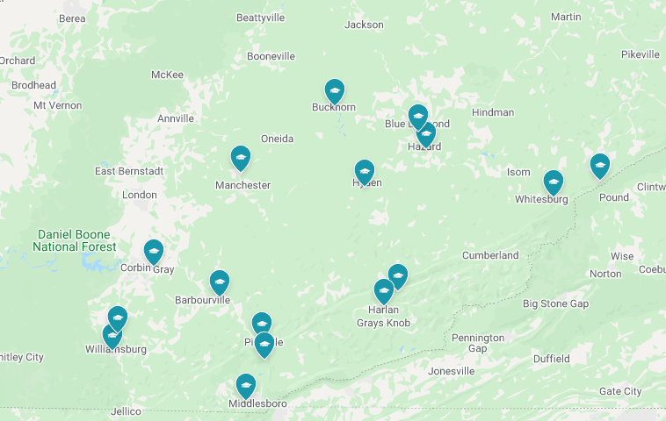
HEARING FROM THE FIELD
Ashley Morrow
College Success Coach
Knox Central High School
WHERE COLLEGE SUCCESS COACHES WORK

Slide 13
Grow our teaching force by 25% adding both homegrown talent and diverse perspectives to school systems across EKY.
Increase our contributions to communities by supporting non-TFAA teachers and districts through free, world class professional development and coaching
Launch a College Success Coach program that reaches 850 academically-ready and at-risk students as they work to enroll and persist in postsecondary programs, ranging from certificate to four-year degree-bearing.
EXECUTIVE SUMMARY: IMPACT IN 2020
Thanks to the Legislature’s generous allocation of $500,000 in 2020, TFAA was able to:

Slide 14
By deepening our partnership with the KDE and the Legislature through an
annual allocation of $1,000,000, TFAA stands ready to:
Commit to an ongoing increase in our teaching workforce, including geographic expansion of placement, higher percentage of homegrown candidates, and added pathways to certify candidates in special education given significant demand
Radically increase year-over-year retention of our top teaching talent through the Mountain Teacher Fellowship, both decreasing vacancies and enriching the quality of our regional teaching force
Provide customized professional development and coaching to non-TFAA teachers at absolutely no cost to districts
Scale our free to student and district summer programming, providing rigorous on-site and virtual programming to students, both remedial and enrichment focused
Sustain and grow our proven College Success Coach model
Draw national attention to Eastern Kentucky as a proof point of rapid improvement in postsecondary readiness and success
EXECUTIVE SUMMARY: POTENTIAL IMPACT IN 2021 AND BEYOND

