Slide 1


KSU Monthly Update
Budget Review Subcommittee on Education
October 19, 2022
Capitol Annex, Room 154

Slide 2
KSU’s Representatives
Dr. Ronald A. Johnson, Interim President
Dr. Daarel E. Burnette, Interim Chief of Staff/COO
Dr. Bridgett Golman, Interim VP of Student Engagement and Campus Life
Dr. Gerald Shields, Interim Chief Financial Office/CFO

Slide 3

Today’s Remarks
Update: KSU 3-Phase Plan
Enrollment Trends and Retention
Status of New Student Residence Hall
Outstanding Student Balances

Slide 4
Update: KSU 3-Phase Plan

Slide 5
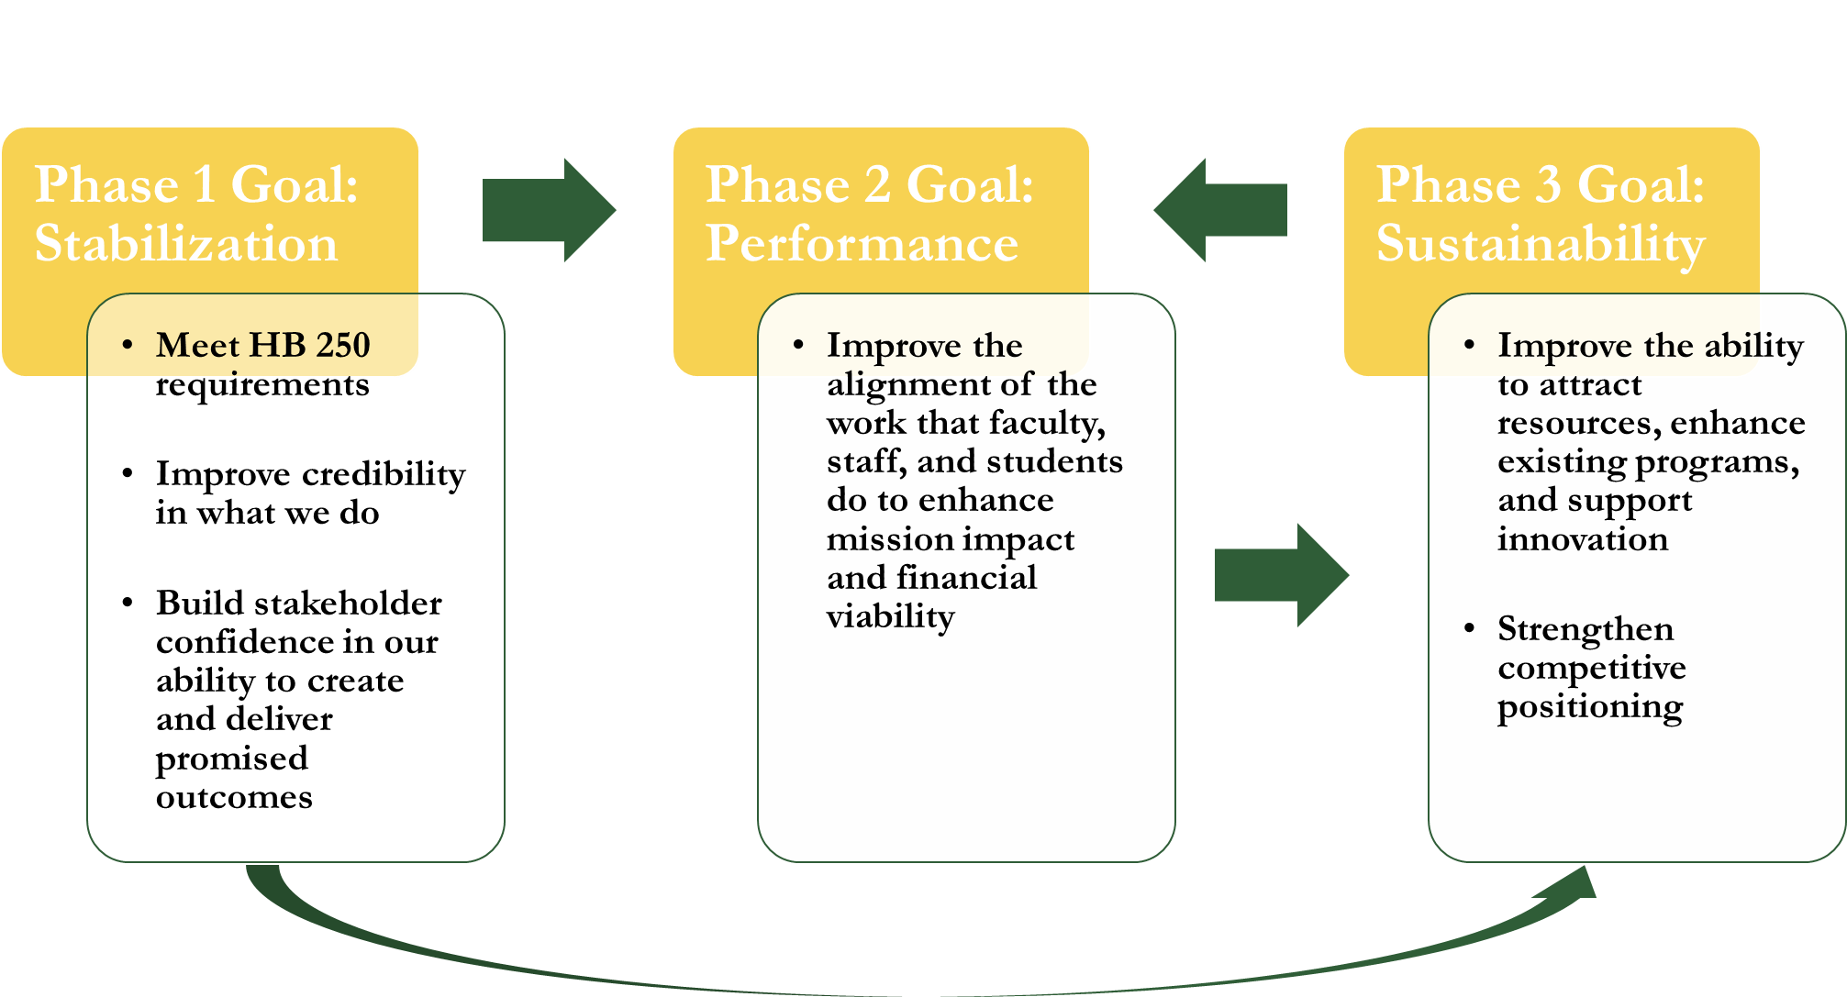
KSU’s 3-Phase Plan

Slide 6
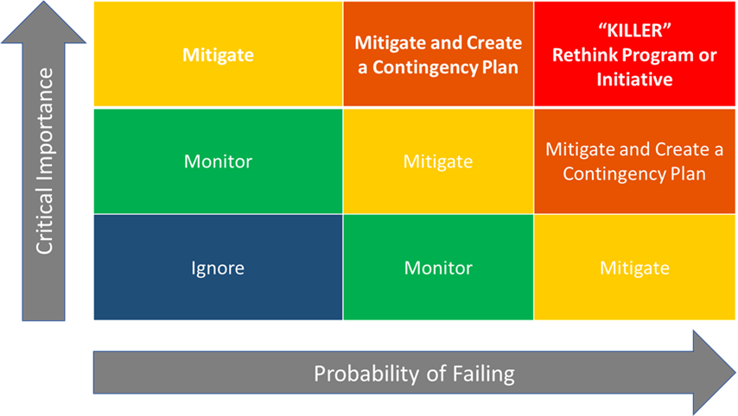
Phase 1: It’s a Matter of De-risking
Phase 1 of our plan involves strategies focused on finding and moderating the effects of existential or “killer” risks to KSU’s ability to succeed in achieving stabilization, performance, and sustainability.
These key risks can undermine the successful delivery of intended outcomes overtime even when the business model is in full alignment today.
De-risking strategic operations is an essential step in deciding the future scope and scale of the KSU’s programs.

Slide 7
Emergency Declaration for Campus Facilities

Slide 19

Focus: Student Engagement and Success
KENTUCKY STATE UNIVERSITY
DIVISION OF STUDENT ENGAGEMENT AND CAMPUS LIFE
VICE PRESIDENT FOR
STUDENT AFFAIRS
Dr. Bridge
tt Golman
EXECUTIVE ADMINISTRATIVE ASSISTANT Vacant
^{FOR} AVP FOR
STUDENT DEA
AVP
N OF
STUDENTS
ENROLLMENT
SERVICES
SUCCESS
ADMISSIONS &
RECRUITMENT
UNIVERSITY
COLLEGE/ ADVISING
STUDENT
CONDUCT
FINANCIAL
AID
COUNSELING
RESIDENCE
LIFE
ORIENTATION
CAREER
SERVICES
STUDENT
OMBUDSMAN
TESTING
CENTER
RETENTION
CAMPUS LIFE &
GREEK AFFAIRS
HOUSING
UPWARD
BOUND
DISABILITY
SERVICES
SCHOLARSHIPS
STUDENT SUPPORT
SERVICES
HEALTH
CENTER

Slide 20
Enrollment Trends and Retention

Slide 21
Undergraduate Students Are the Principal Target Recipients
FY 2023 Credential Seeking Student Headcount Enrollment Budget versus Census
Undergraduate Students | FY 2023 Budgeted Enrollment Headcount | FY 2023 Enrollment Headcount Census – 9/14/2022 | Difference
Full-Time | 1,139 | 1293 | 154
Part-Time | 192 | 58 | 134
Total | 1,331 | 1351 | 20
Graduate Students | FY 2023 Budgeted Enrollment Headcount | FY 2023 Enrollment Headcount Census – 9/14/2022 | Difference
Full-Time | 44 | 57 | 13
Part-Time | 77 | 60 | 17
Total | 121 | 117 | 4

Slide 22
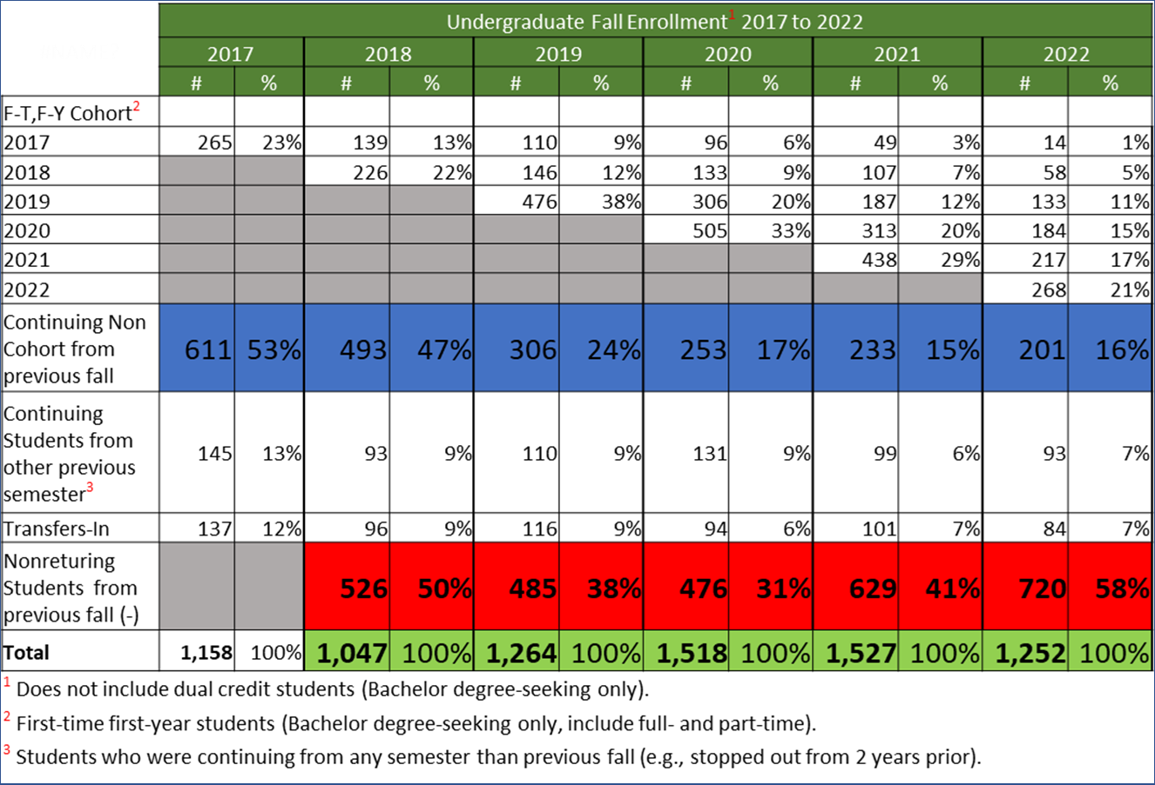
KSU Undergraduate Enrollment Trends 2017-22

Slide 23
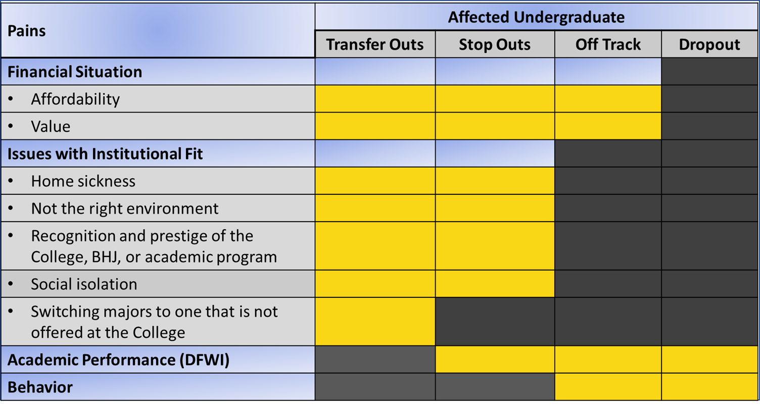
Non-Returning Students: Key Factors

Slide 24
KSU Fall to Fall Progression vs Retention 2017-22

Slide 25
KSU Fall to Fall Progression, Retention, and Completion 2017 and 2018

Slide 26
New Residence Hall (January 2023)
6. KSU - Video Walkthrough - Exterior + Common.mp4 (sharepoint.com)

Slide 27
New Residence Hall Update
Students Occupancy (408 Beds): Late January 2023
  Network switches, fiber, wireless access points – January 2023
  Security Cameras – January 2023
  Washers & Dryers – Placed order and expected delivery - December 2022
  Furniture - Installation begins after Holiday break/January 2023
Dining Hall – Awaiting negotiations with vendor (need 8 months)
Explore Parking Lot Options in Spring 2023

Slide 28
Outstanding Student Balances

Slide 29
Outstanding Balances: Undergraduates
($1,857,015)
Student Type | Head Count | Percent | Debt Balance
Continuing | 381 | 60% | $1,189,123
First Time Freshman | 196 | 31% | $478,799
Readmit | 23 | 4% | $82,687
Non-degree Seeking | 3 | .04% | $7,150
Transfer | 35 | 5% | $99,255
Grand Total | 638 | 100% | $1,857,015
Ranges | Head Count | Percent | Debt Balance
.01 - $3,500 * | 431 | 68% | $622,079
$3,501 - $5,000 | 85 | 13% | $357,647
$5,001 - $7,500 | 89 | 14% | $551,218
$7,501 - $10,000 | 20 | 3% | $172,245
$10,001 & Above | 13 | 2% | $153,824
Grand Total | 638 | 100% | $1,857,015

Slide 30
Actions Taken
Financial Aid & Bursar Notifications via WIRED (student portal)
Call Campaign – Family Scholar House Assistance (Sep 10-12, 2022)
  434 Calls (103 Answered, 207 Voice Messages)
  71% Success Rate
Personal Emails from Bursarmail and Finaidmail
Announcements via Thorobred Central email Blast (online Portal)

Slide 31
Questions

