Slide 1
Inflationary Impact on School Construction Projects
Chay Ritter, Kentucky Department of Education

Slide 2
Agenda
School District Facility Planning
Funding
Financing
Need/Unmet Need
Kentucky Facilities Inventory Classification System
HB 678 (2022 Regular Session)
Construction
Questions

Slide 3
School District Facility Planning
Each school district has a district facility plan (DFP).
To create a DFP, the district convenes a local planning committee (LPC).
The LPC is an advisory committee with 10-20 members that includes parents, teachers, building administrators, facilities directors, central office staff, local board members, local planning officials and the school superintendent (non-voting member).
The committee develops a plan based on the district’s buildings, financial capability, demographics and other relevant information to address a district’s construction needs based on criteria in the Kentucky Schools Planning Manual.

Slide 4
District Facility Plan
A minimum of three public meetings.
A district is required to develop a new District Facility Plan (DFP) every four years. A waiver can be requested to extend a DFP up to four additional years.

Slide 5
DFP Priorities
Priority 1: Educational projects to begin within the next biennium
Priority 2: Educational projects not scheduled to start within the next biennium
Priority 3: Non-Educational Additions or Expansions (may include kitchens, cafeterias, administrative areas, etc.)
Priority 4: Management Support Areas which may include central offices or bus garages
Priority 5: Discretionary Construction which may include extracurricular facilities (athletic facilities and excess space added to other facilities)

Slide 6
Funding for School Facilities
Local taxes restricted for facilities
  “Nickels”
  Each district is required to have one nickel which restricts local tax revenue for facilities construction or renovations, but some will have additional nickels.
State equalization
School Facilities Construction Commission (SFCC) Offers of Assistance
SFCC Special Offers of Assistance

Slide 7
Financing
Districts typically issue bonds to pay for projects or pay cash
Bonding capacity = borrowing power
  This is impacted by interest rates, credit rating(s) and existing debt service
A district may have a gap in funding which may result in a phased project done over a longer time period or a reduction in project scope (i.e. removing items from the project)

Slide 8
Need/Unmet Need
Biennially, KDE calculates the Need/Unmet Need for each school district.
Need is identified by using priority projects 1-4 on the DFP as of June 30 of the odd fiscal year.
Unmet Need is then determined by subtracting any projects which have been initiated and local available revenue from the “Need.”
SFCC uses the Need/Unmet Need Report to determine each district’s “Offers of Assistance.”

Slide 9
Kentucky Facilities Inventory Classification System (KFICS)
KFICS consists of four components used in providing a Kentucky School Score. Asset Planner is the software tool that districts use to provide:
  Audits (age and condition)
  Space Planner (floor plans and inventory of rooms) Survey
  CPTED (Crime Prevention Through Environmental Design) Survey
  Site Survey
All school buildings receiving a Kentucky School Score are included in the Ranked Report which is provided to the legislature.

Slide 10
HB 678 (2022 Regular Session)
Until June 30, 2024, a local school board may adopt a resolution which allows them to conduct new construction of renovations under provisions of HB 678.
If operating under HB 678, a district may commence funding, financing, design, construction, renovation or modification of district facility projects without prior approval from KDE.
A district may spend restricted funds on extracurricular facilities.
There are 139 districts currently operating under HB 678.
Speeds up several processes which can benefit districts.

Slide 11
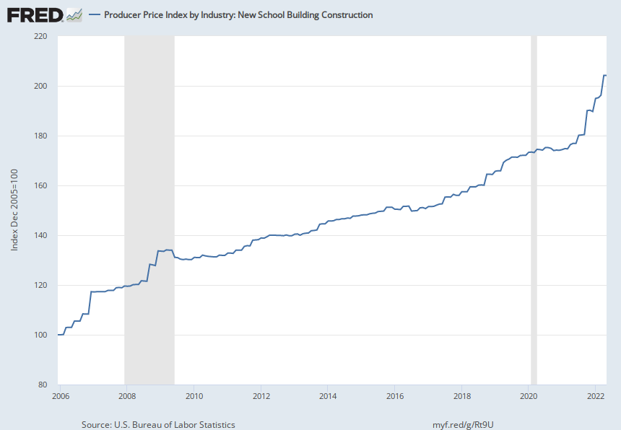
Producer Price Index by Industry, New School Building Construction (1)

Slide 12
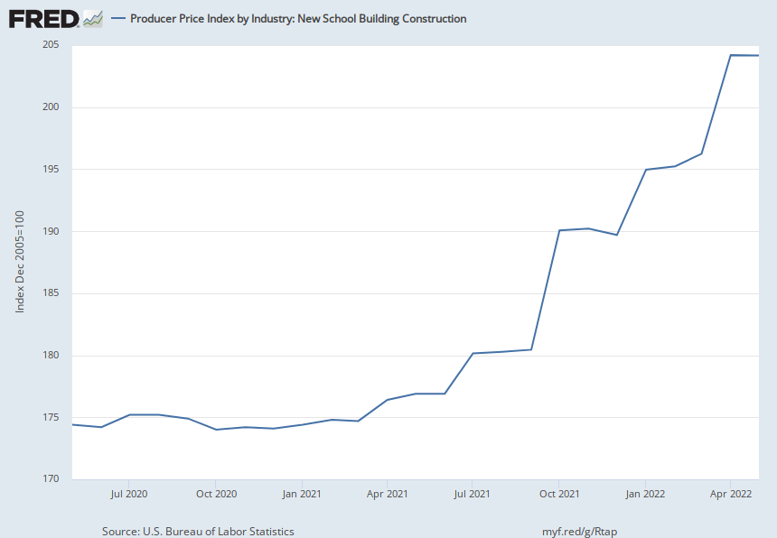
Producer Price Index by Industry, New School Building Construction (2)

Slide 13
Menifee County
Board Office (New Construction)
Initial estimates in August 2021 were $2.0-$2.5 million. Revised estimates in May 2022 were $3.5 million.
Basement/storage construction was removed from project to save money.

Slide 14
Rowan County
Rodburn Elementary Renovation and Addition
Initial estimates in November of 2021 were $5.5 million. Revised estimates in March 2022 were $6.2 million. As of late August 2022, the estimates were revised once again to reflect a cost of $8.1 million
Districts expects future revisions to estimates to increase the costs as well

Slide 15
Christian County Schools
Consolidated High School Project
Initial estimate of $107 million in November 2021, $117 million in February 2022, and $137 million in May 2022.
District expects that the entire project may now exceed $137 million and reduction in scope of work is possible.

Slide 16
Woodford County
New high school
Initial estimates in July 2019 were $36 million. Three years later, bids came in at $73 million.

Slide 17
Issues
Construction costs may exceed bonding potential.
Districts may reduce the scope of the project, do the project in phases over a longer time or shelve the project all together.
Districts are putting in significant “local effort” but unable to reach facility-related goals.
It is important to note that “your mileage may vary.” Not all projects are experiencing the same increases as every project is different. Location, materials, availability of labor and many other factors may impact the project cost.

