Slide 1
IJC Budget Review Subcommittee on Education
June 7th, 2023

Slide 2
Presenters
Jamie Link, Secretary
Sam Flynn, Chief of Staff and General Counsel
Shelby Lewis, Executive Director, Office of Legislative Services
Anthony Hudgins, Deputy Executive Director, Office of Unemployment Insurance

Slide 3
Highlights
Lowest Unemployment Rate Ever
3.7% for month of April 2023
Lowest rate ever recorded in Kentucky
Lowest number of people on unemployment since 1977
54,000 more jobs than in February of 2020
Over 30 projects announced this year, committing nearly $3.8B to new investment and creating over 3,000 new Kentucky jobs

Slide 4
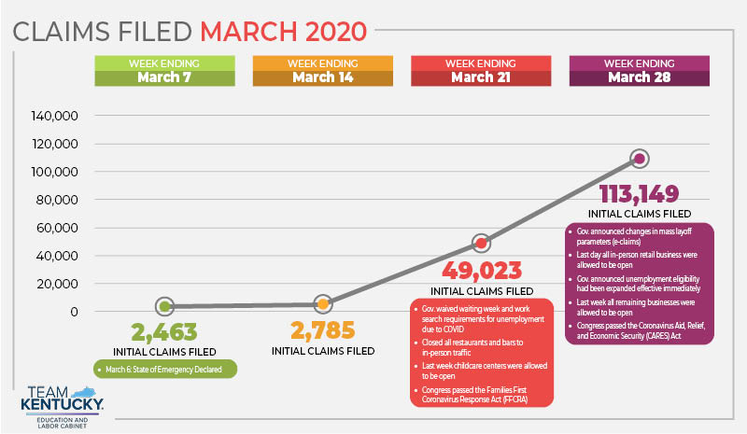

Slide 5
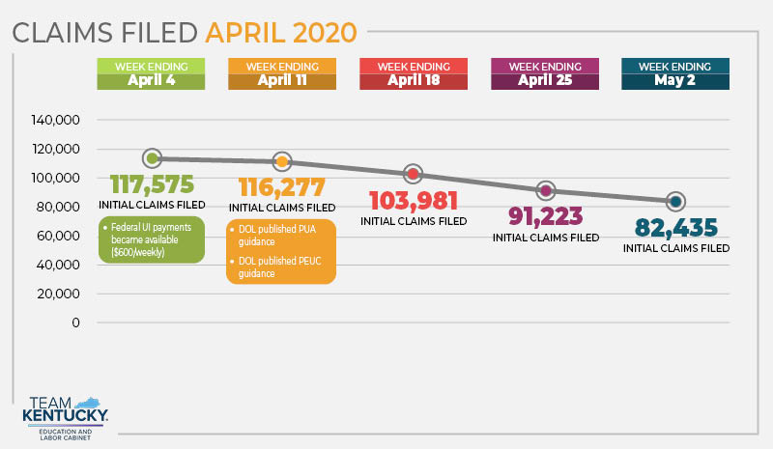

Slide 7
Unemployment Insurance Program Pre-2020
In 2017, all Unemployment Insurance Offices were closed (reopened in April 2022) and unemployment insurance staff were reduced by 95 and hiring was frozen
In 2017, Career Centers downsized from 51 offices to 22 offices
Zero (0) Unemployment Insurance staff in local offices
Less than 25 staff to adjudicate claims
26 weeks of benefits
HB 4: 12 weeks (current); HB 146: 16 weeks beginning July 1st, 2023

Slide 8
Changes to Unemployment Insurance – HB 4, 2022 RS
12 Weeks of Benefits (now 16 weeks due to HB 146, 2023 RS)
Five Work Search Activities per Week is Required
Suitable Work Provision
Work Share Program (more details on following slide)
Work Search Audit
Employers Tax Rate Changes (addressed in HB 146, 2023 RS)
Staff Training Required

Slide 9
Work Share Program
Employer Advantages
​Reduce or eliminate layoffs
Keep valuable, skilled employees during downturns
Recover quickly as business returns to normal
Save time and expense of hiring, training new workers when business recovers
Lessen impact on employer reserve account during slowdowns
Provide flexibility during challenging economy
Employee Advantages
​Keep same job and benefits
Receive partial unemployment benefits on reduced work hours
Avoid financial hardship of layoff or lost job
Reduce stress caused by instability of layoff
Avoid expense, time searching for new job
Receive weekly work share benefit

Slide 10
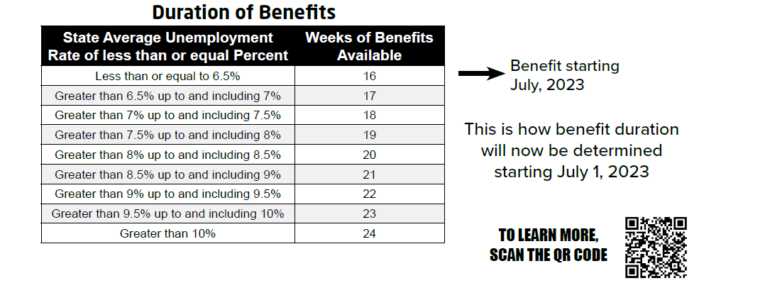
Changes to Unemployment Insurance – HB 146, 2023 RS
Starting July 1st, 2023
16 Weeks of Benefits (benefits not to exceed 24 weeks)

Slide 11
Look Back Period
The look back period is calculated twice a year
The January through June available benefit weeks are determined by Kentucky’s average unemployed rate from the prior July through September months, 3-6 months prior to January
The July through December’s available benefit weeks are determined by Kentucky’s average unemployment rate from the prior January through March months, 3-6 months prior to July
Example: if a construction worker is laid off during the winter months, their available weeks of benefits would be based on the unemployment rate for the prior summer

Slide 12
Changes to Unemployment Insurance – HB 146, 2023 RS
Training Opportunities for Five (5) Additional Benefit Weeks
Information will be available on claimant’s confirmation page and in the summary of their accounts
Suitable Work
Reports to the Governor, the Legislative Research Commission, and to the Interim Joint Committee on Economic Development and Workforce Investment
Reversing Program Changes - Employer Contribution Rate related to HB 4
Kentucky employer’s have remained on the lowest contribution rate schedule since 2019

Slide 13
Update on UI Trust Fund
Infusion of American Rescue Plan Act (ARPA) Funds kept rates low
HB 144, 2022 RS allocated $242M into the UI Trust Fund
Kentucky employers have remained on the lowest contribution rate schedule since 2019 (currently Schedule A)
2024 Employer Contribution Rates are expected to remain on the lowest rate schedule
Current UI Trust Fund balance is $834M (June 5th, 2023)

Slide 14
Personnel Needs
Supplemental funding is critical for UI Programs
HB 89, 2023 RS, section 6 requested the funding for these positions
ELC has requested 60 additional UI staff
40 Career Development Office Staff
20 Unemployment Insurance Staff
All staff will be crossed trained to provide, at a minimum, the basic functions of each other’s programs

Slide 15
Status on UI Workload
Pandemic backlog reached zero (0) on March 1, 2023
2.8 million claims processed
February 2020 – September 30th, 2021

Slide 16
Update on UI System
1st RFP: March 2020 – July 2021
Vendor withdrew their bid during negotiations.
2nd RFP: September 2021 – September 2022
Vendor became unresponsive during negotiations. Vendor is now involved in litigation.
3rd RFP: January 2023 - Present
Bid protest was resolved and denied.
Finance and Administration Cabinet is currently evaluating proposals.

Slide 17
Overview of Service Capacity Upgrade Fund (“SCUF”)
$30.7M has been collected through SCUF since 2018
$30M has been moved to the Capital Project for the new UI System
SCUF assessment restarted during 2023
Employer 1st Quarter Reports were due May 1st, 2023
SCUF collections are approximately $10-$12M per year.

Slide 18
Thank You!

