Slide 1
National Board Certification and Speech Pathologist/Audiologist Salary Supplement
Kentucky Department of Education

Slide 2
National Board Salary Supplement (KRS 157.395)
May be a public school teacher, a secondary teacher employed in the Kentucky Tech school or career and technical program operated by the Kentucky Department of Education
If certificate obtained from National Board for Profession Teaching Standards between July 14, 2000 and July 1, 2020, teacher would receive $2,000 supplement for the life of the certificate.
If certificate obtained after July 1, 2020, teacher would receive supplement for the life of the certificate based on the amount appropriated

Slide 3
702 KAR 3:060
Must teach or mentor other teachers in the field of certification the majority of the time
Partial salary supplement is available under certain conditions
Can switch districts and qualify for same supplement
Districts may pay more than the supplement dependent upon local board policy
District pays qualified applicant, KDE reimburses the district

Slide 5
School Districts with Highest Percentage of NBC Teachers
Anchorage Independent Schools: 20%
Oldham County Schools: 14%
Calloway County Schools: 14%
Spencer County Schools: 14%
Woodford County Schools: 11%
Statewide average: 4%
*Based on 2021-2022 data

Slide 6
Historical NBC Salary Supplement
Fiscal Year | Appropriation | Cost | Difference
2024 | $4,655,500 | TBD
2023 | $4,600,000 | $3,794,239 | $805,761
2022 | $2,750,000 | $4,130,356 | ($1,380,356)
2021 | $2,750,000 | $4,382,874 | ($1,632,874)
2020 | $2,750,000 | $4,552,462 | ($1,802,462)
2019 | $2,750,000 | $4,497,206 | ($1,747,206)
2018 | $2,750,000 | $4,436,583 | ($1,686,583)
2017 | $2,750,000 | $4,226,925 | ($1,476,925)
2016 | $2,750,000 | $4,446,862 | ($1,696,862)
2015 | $2,750,000 | $4,574,899 | ($1,824,899)
2014 | $2,750,000 | $4,406,696 | ($1,656,696)
2013 | $2,750,000 | $4,153,898 | ($1,403,898)
2012 | $2,750,000 | $3,899,658 | ($1,149,658)
2011 | $2,750,000 | $3,495,033 | ($745,033)
2010 | $2,750,000 | $2,987,580 | ($237,580)
2009 | $2,750,000 | $2,754,993 | ($4,993)
2008 | $2,750,000 | $2,454,000 | $296,000
2007 | $2,504,000 | $2,031,000 | $473,000
2006 | $2,104,000 | $1,858,000 | $246,000
2005 | $1,858,000 | $1,374,977 | $483,023
2004 | $1,458,000 | $1,029,080 | $428,920
2003 | $600,000 | $510,000 | $90,000
2002 | $600,000 | $256,692 | $343,308

Slide 7
National Board Certification in Kentucky
National Board Certification was designed to develop, retain and recognize accomplished teachers and to generate ongoing improvement in schools nationwide. It is the most respected professional certification available in K-12 education.
Created by teachers, for teachers, the National Board Standards represent a consensus among educators about what accomplished teachers should know and be able to do. Board certification is available in 25 certificate areas spanning 16 disciplines from Pre-K through 12th grade.
Notes:
The certification process requires that teachers demonstrate standards-based evidence of the positive effect they have on student learning in alignment with the Five Core Propositions. They must exhibit a deep understanding of their students, content knowledge, use of data and assessments and teaching practice. They must also show that they participate in learning communities and provide evidence of ongoing reflection and continuous learning.

Slide 8
National Board Certification
400 hours of time and effort and can take up to three years of commitment.
$2,000 to go through the process.
Detailed portfolio that includes examples of student work and an outline of what they have done outside of the classroom to improve student achievement. They also must include video recordings that show how they teach and interact with students.
A reflective piece on student assessment and learning, and as well as take a rigorous exam to demonstrate they have mastered the content of their chosen certification area.
Generally, only about half of those who seek certification in the first year receive it.

Slide 9
National Board Certification and Equity
We know through research that NBCTs reach students that need them the most. Studies have also found that the positive impact of having a Board-certified teacher is even greater for minority and low-income students.
We are highlighting, through the NB Equity Standards Bundle, how schools can build a culture of professional learning and growth through NB certification.
We are strengthening teaching continuum statewide, focus on high needs students

Slide 10
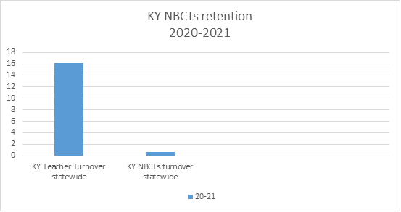
NBCTs’ Retention Data for 2020-2021
Notes:
In 2020-2021, NBCTs made up 7.1% of all teachers in Kentucky. We also know that the Kentucky teacher turnover count was 16.2 % statewide. According to all the NBCT filters cited above, Scott calculated that the KY NBCTs ‘ turnover was 0.7% which sustains the narrative that NBCTs remain in the classroom in greater numbers than non-NBCTs. Based on this data, we can conclude that the turnover rate comparisons provide compelling reasons to show that National Board Certification is an effective teacher retention tool in Kentucky.
As part of the retention study, CERRA surveyed members of the SC National Board Network to gain anecdotal evidence related to the impact of National Board certification (NBC) on teacher instruction and retention. Members, all of whom are NBCTs in the state, were asked if they believed that the NBC process affected their planning, instruction, and/or assessment practices. All survey respondents credited the process with enabling them to reflect on their practice and better assess the different needs of their students. Such reflection and differentiated instruction often have a positive impact on student learning and growth and can lead to an improvement in the teacher’s overall effectiveness. Teachers also reported that the supplement positively impacted their decision to stay in the classroom.

Slide 11
KY NBCTs National Ranking
State Rankings by Total Number of National Board Certified Teachers: KY 8th with 4,283 NBCTS
State Rankings by Total Number of New National Board Certified Teachers: KY 9th with 104 new NBCTs
State Rankings by Total Number of National Board Certified Teachers who Maintained Certification: KY 7th with 329 MOCs
State Rankings* by Percentage of National Board Certified Teachers: KY 6th with 9.7%
Notes:
*Calculations based on total number of NBCTs as a percent of 2021-2022 teacher workforce in each state. Data Source: U.S. Department of Education, National Center for Education Statistics, Common Core of Data (CCD), "State Nonfiscal Public Elementary/Secondary Education Survey", 2021-22 v.1a.and NBCT self-reported data Rankings based on actual percentages, not rounded totals. Updated January 23, 2023

Slide 12
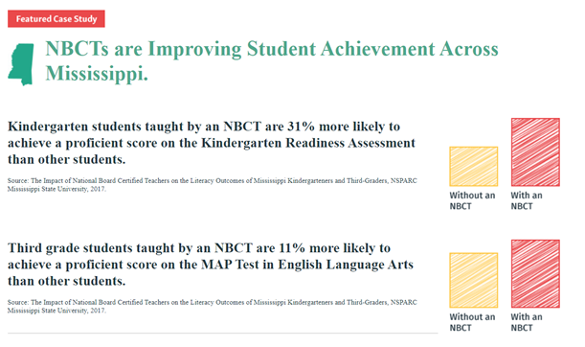
NBCTs Impact on Student Success

Slide 13
Speech Language Pathologist or Audiologists Salary Supplement (KRS 157.397)
Local Board of Education Employee
Must hold a certificate of clinical competence issued by the American Speech-Language Hearing Association; or
Board certification from the American Board of Audiology; and
A valid KY credential approved and issued by the Education Professional Standards Board under KRS Chapter 161; or
A license approved and issued by the KY Board of Speech-Language Pathology and Audiology under KRS Chapter 334A

Slide 14
Speech Language Pathologist or Audiologists Salary Supplement
The salary supplement is to be the same amount as the salary supplement to a public school teacher that obtained the National Board for Professional Teaching Standards certificate
The supplement ceases if the speech language pathologist or audiologist is employed in a position where the speech language pathology or audiology services are “incidental” to his or her duties

Slide 15
Speech Language Pathologist or Audiologists Salary Supplement
KRS 157.397 was effective July 15, 2010 but funded with $2.3 million in HB 1 (2022 RS)
Preliminary submissions from districts indicate approximately 1,000 applicants for this salary supplement

Slide 16
Contacts at KDE
Elly Gilbert, Assistant Director, Division of Educator Recruitment and Development
Jocelyne A. Waddle, Education Administration Program Consultant II, Division of Educator Recruitment and Development
Chay Ritter, Division Director, Division of District Support Services

