Slide 1
—Someone Famous

Slide 2
THE PROBLEM
5,580
Opportunity Youth in NKY
WIOA Funding Targets Youth
18+

Slide 3
THE OPPORTUNITY
Creating equitable access to
workforce development programs for
at-risk, in-school youth ( ages 16 and 17)
supporting their paths to enter the workforce
or enroll in secondary education.

Slide 4
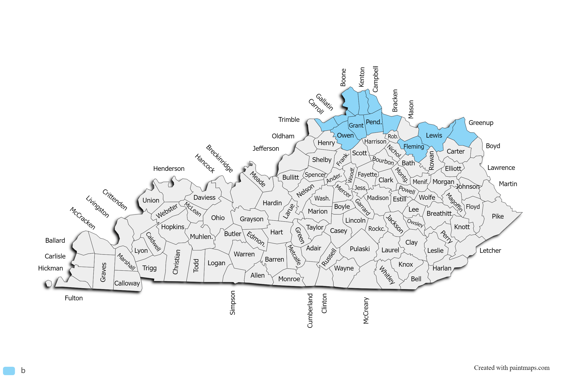
SERVICE AREA

Slide 5
POPULATION
10,148
Grades 11-12
22,643
High School
Students
16,046
Grades 10-12

Slide 6
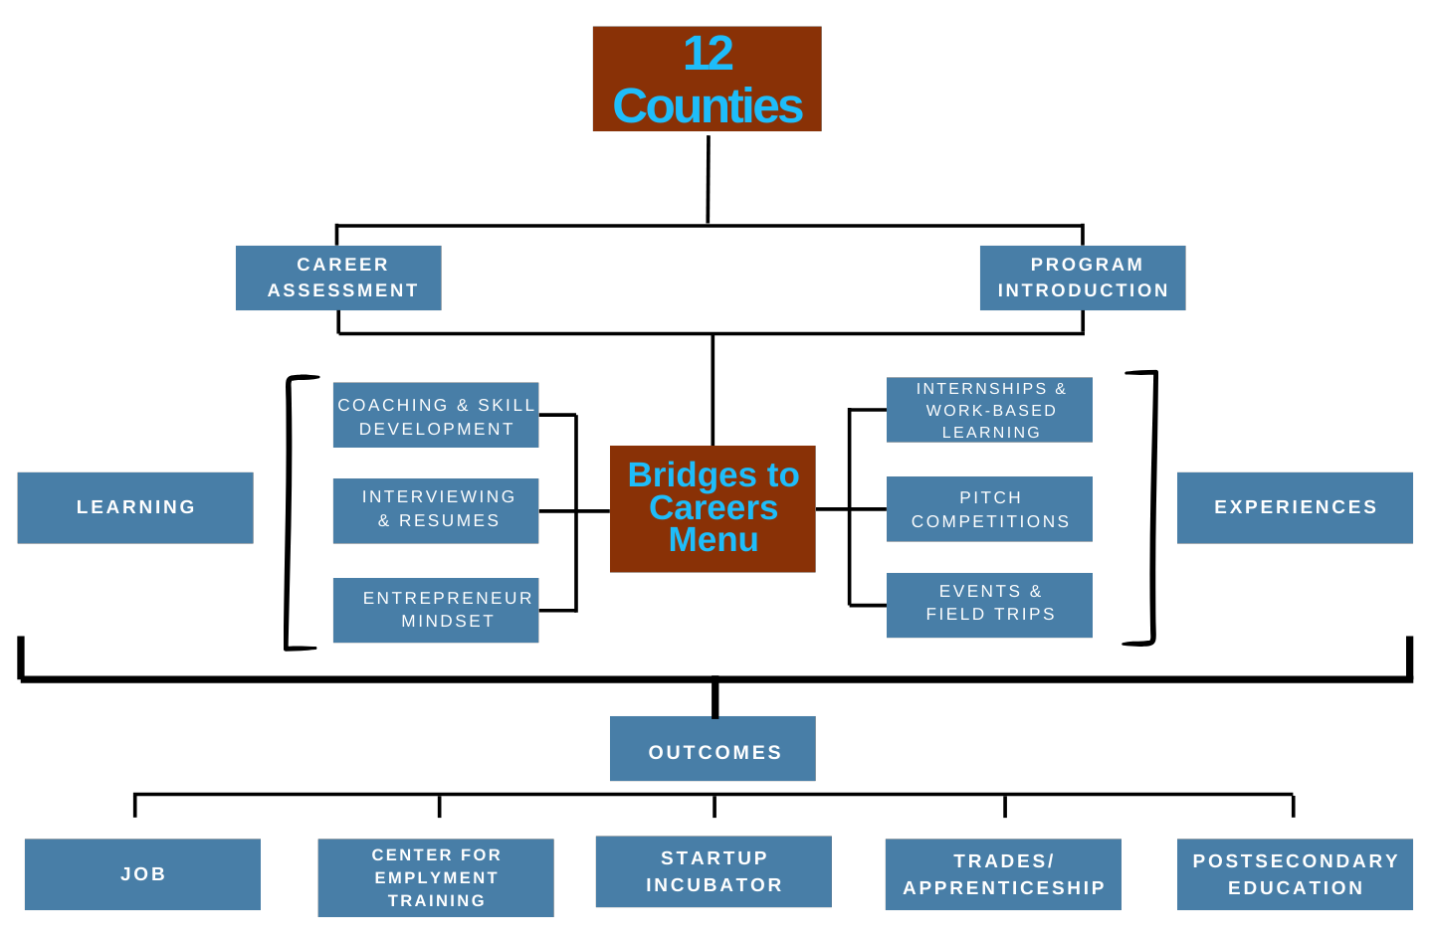
THE MODEL

Slide 7
PARTNERS
NKY Workforce Lead
High School Lead
Employment Services Lead
Entrepreneur Development Lead

Slide 8
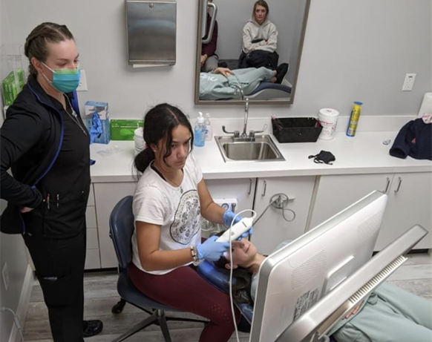
SERVICES
Career Assessments
Current | 22,000
Projected | 22,000

Slide 9
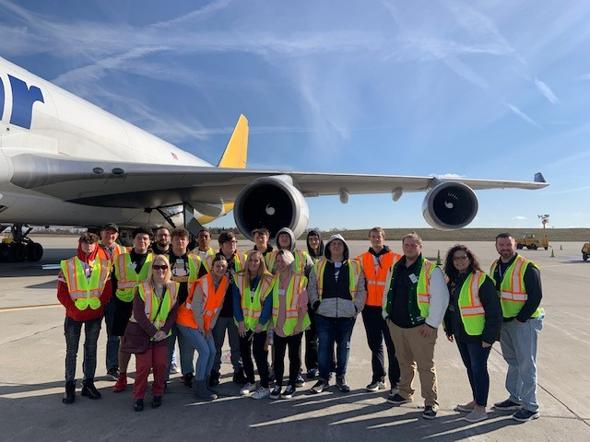
SERVICES
Coaching
Current | 2,700
Projected | 6,000

Slide 10
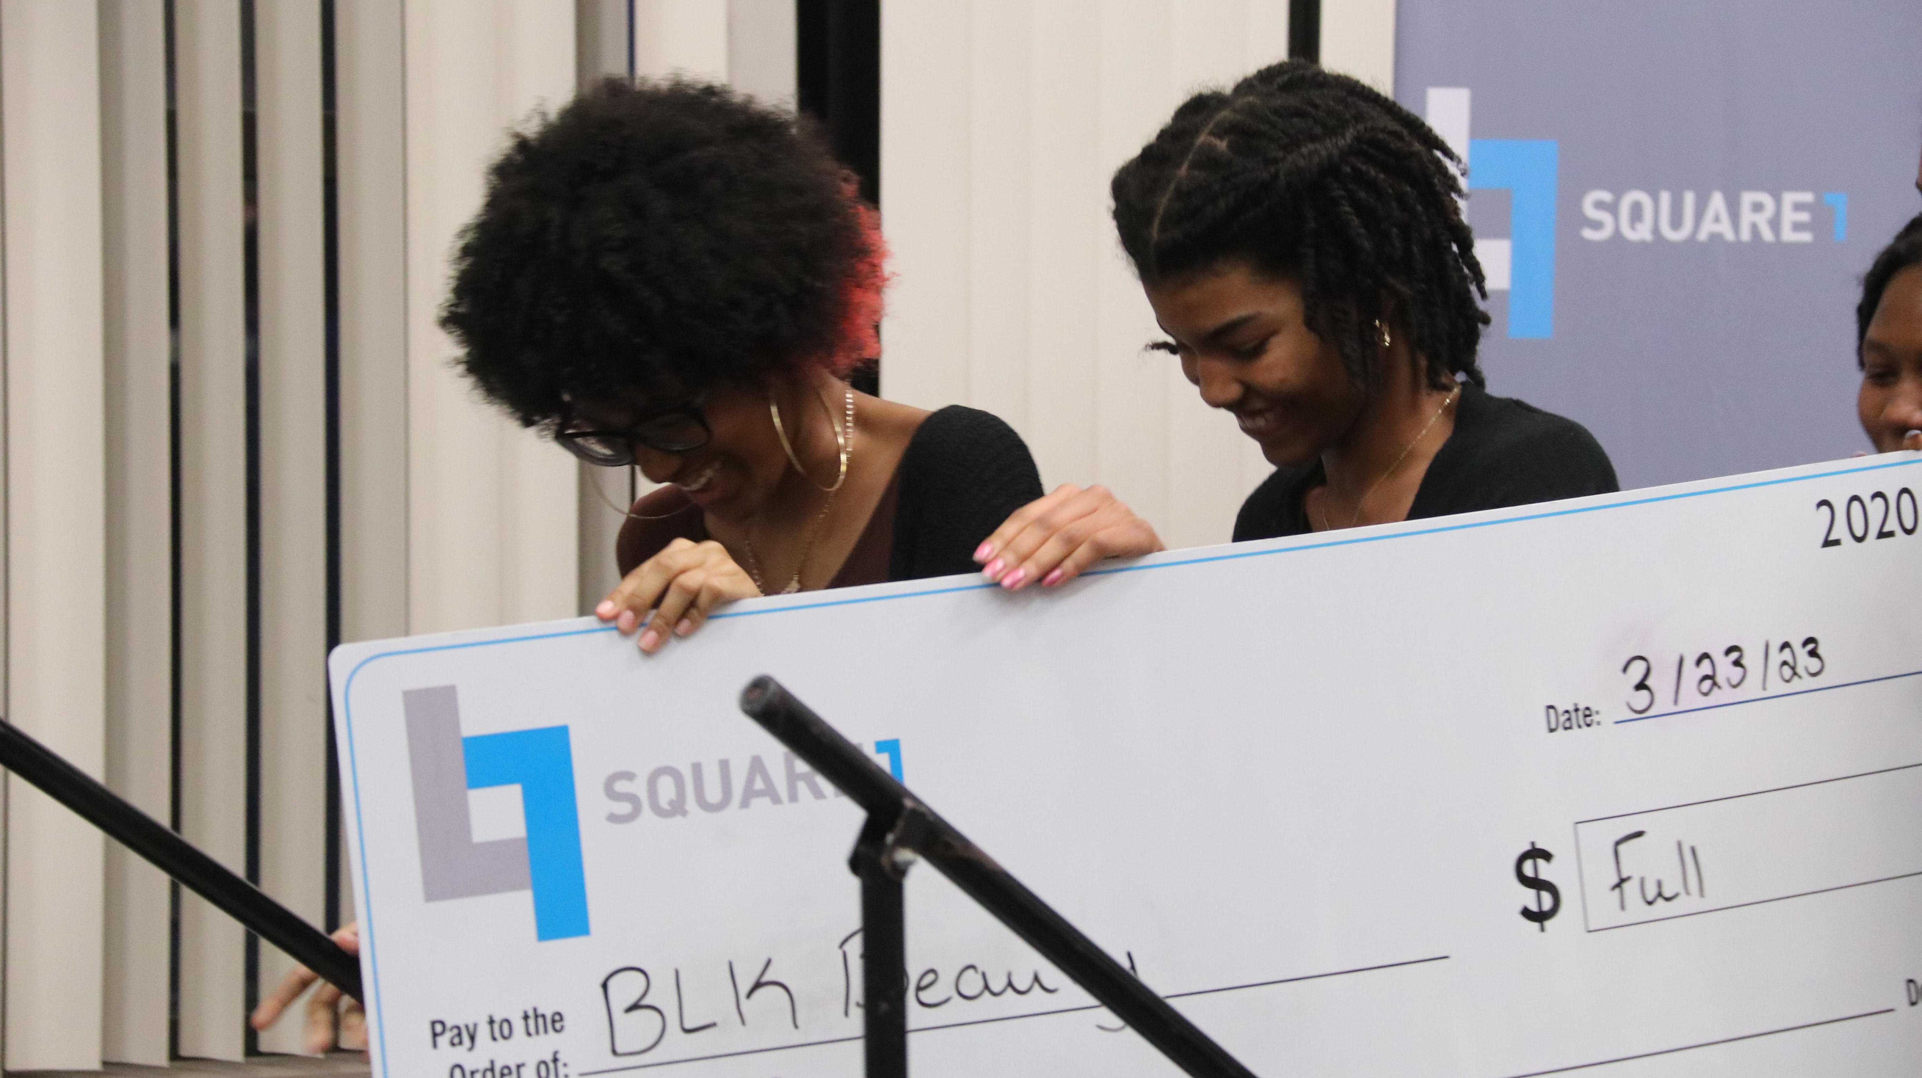
SERVICES
Innovation & Entrepreneurship
Current | 850
Projected | 1,500

Slide 11
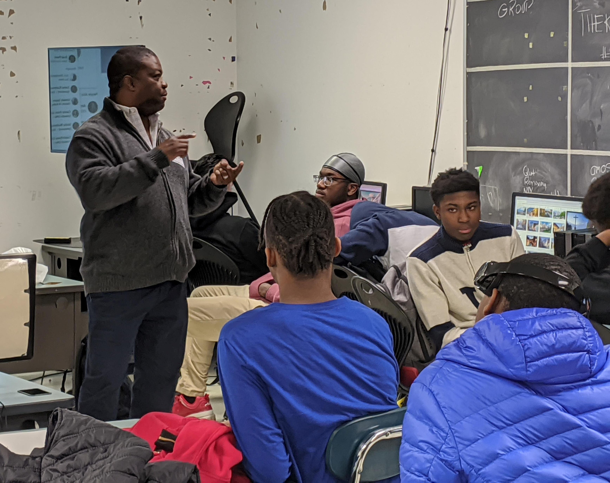
SERVICES
Startup Incubator
Current | 20
Projected | 50

Slide 12
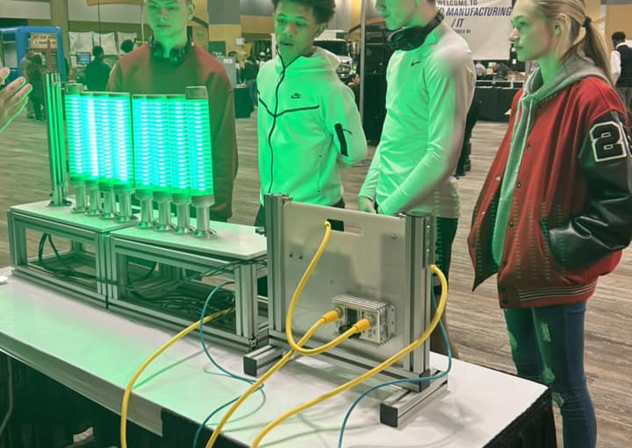
SERVICES
Work-based Learning
Current | 1,860
Projected | 4,000

Slide 13
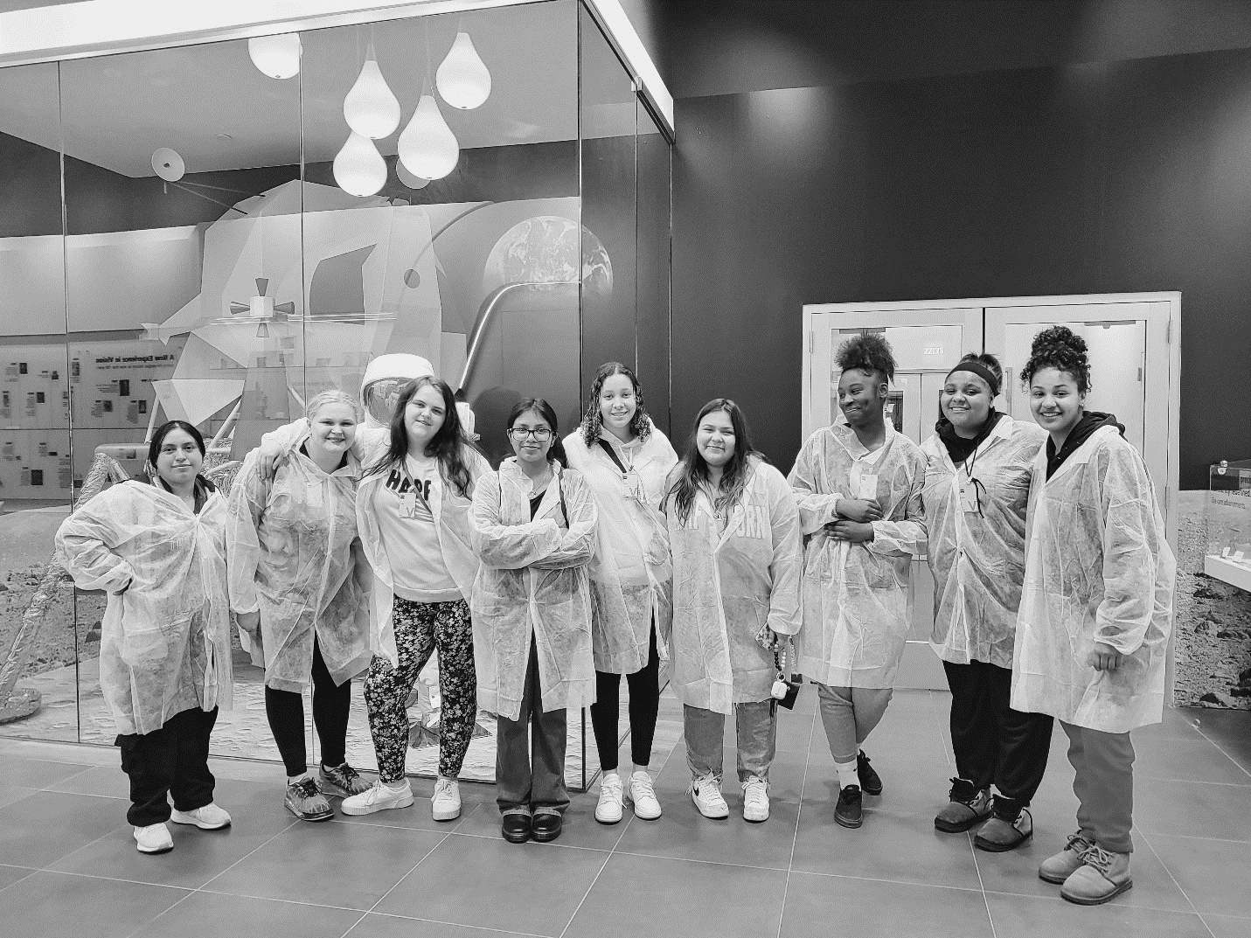
SERVICES
Internships & Skills Training
Current | 242
Projected | 500

Slide 14
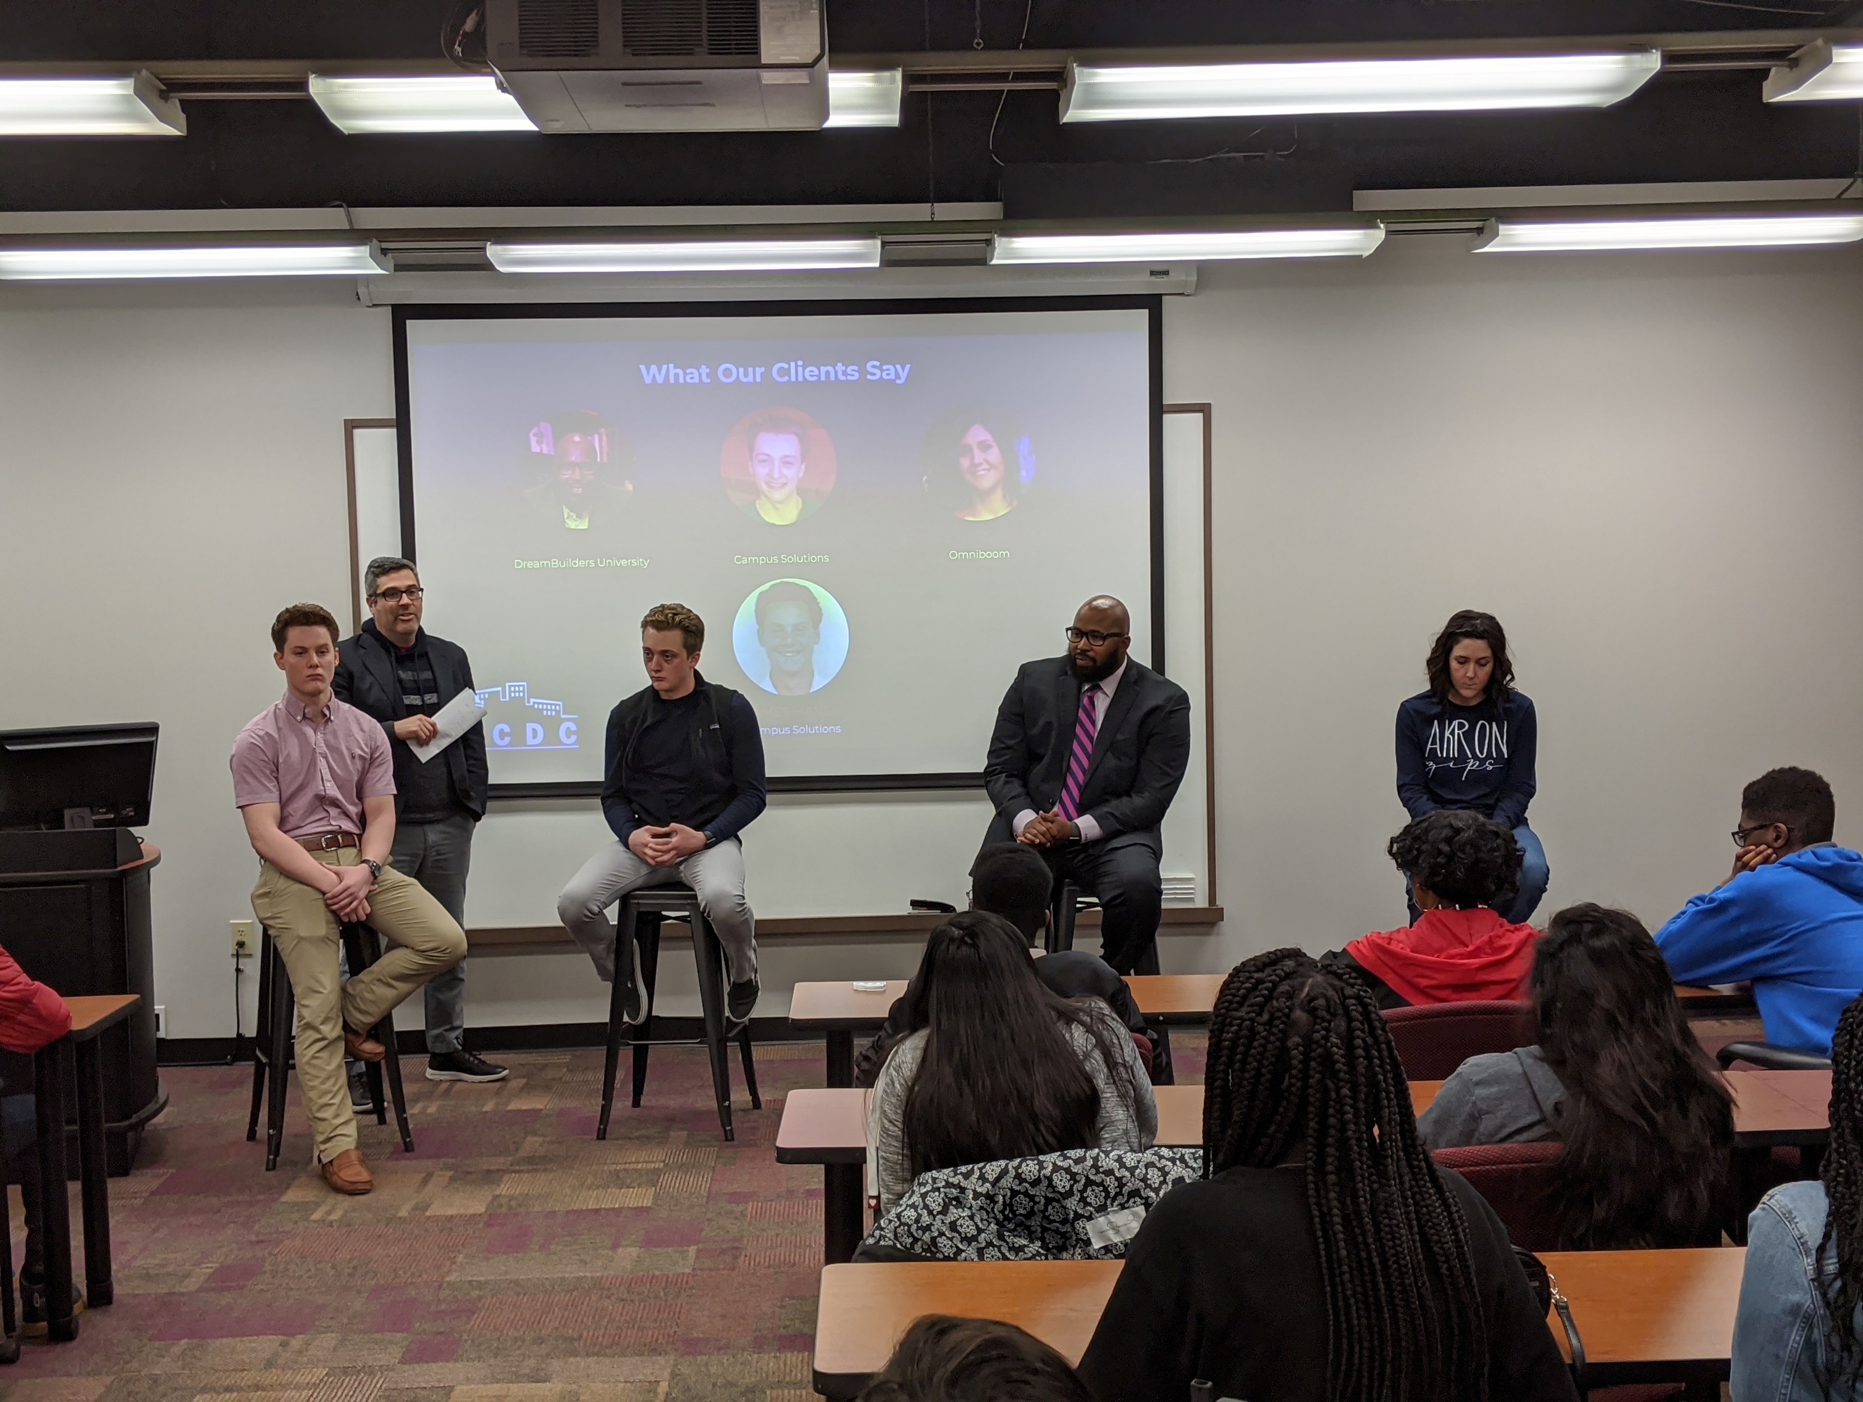
SERVICES
Resume Development and Interview Prep
Current | 286
Projected | 600

Slide 15
SERVICES
Experiences, Events, and Networking
Current | 800
Projected | 1,500

Slide 16
BUSINESS PARTNERS

Slide 17
THE REQUEST
Bridges to Careers requests an investment of $1,250,000 to provide expanded and enhanced personal, workforce, career, and entrepreneur development services to more than 20,000 high school-aged youth throughout the
12-county NKY region.
Contact: Keith Schneider, President @ Square1 / keith@ideastartgrow.com / 859.750.2013

