Slide 1
Kentucky Postsecondary Education Update
Aaron Thompson, CPE President
Lee Nimocks, Senior Vice President and Chief of Staff
Kentucky Council on Postsecondary Education

Slide 2
Requested presentation topics:
Kentucky’s postsecondary education goals
Postsecondary education’s strengths and challenges
Assessment of Kentucky’s Students Right to Know website
College affordability, and strategies to reduce borrowing and student debt.
Strategies to engage and skill up more adult learners.

Slide 3
Kentucky’s Strategic Agenda for Postsecondary Education (required by statute) establishes priorities for the system and provides a framework for setting performance goals (state and campus level) in each of the five areas of focus.

Slide 4
Guiding Goal
60%
Increase the percent of working age Kentuckians with a postsecondary credential 60% by 2030.
55% with a degree or credential as of 2021

Slide 5
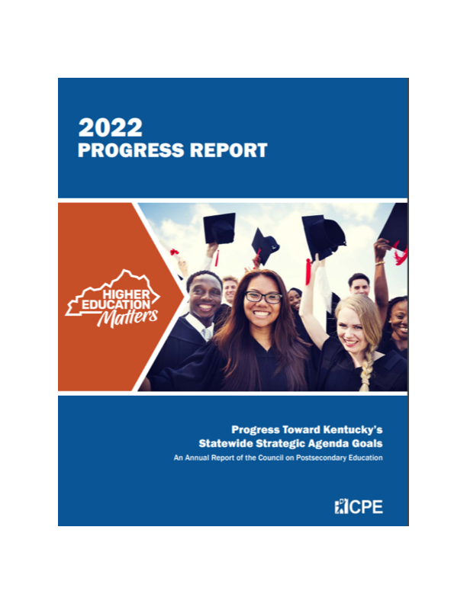
Assessment of progress
Key Strengths
There’s been Increased degree and certificate production in key workforce areas. For example, the number of health-related credentials at public campuses has increased 13.25% over the past 5 years. STEM degrees are up 7.5%
Graduate degrees awarded at public universities are up almost 25% since 2017-18.
Enrollment of URM students at public universities continues to rise - up 11.6% in 5 years.
Graduation rates at public universities are up for all students (from 54.5% in 2017-18 to 59.2% in 21-22). They are also up for URM (42.7% to 48.4%) and low-income students (41.9 to 46.1%).
Dual credit continues to increase: Over 30% of high school seniors graduated with dual credit from KCTCS in 2021, up from 23% in 2017.

Slide 6
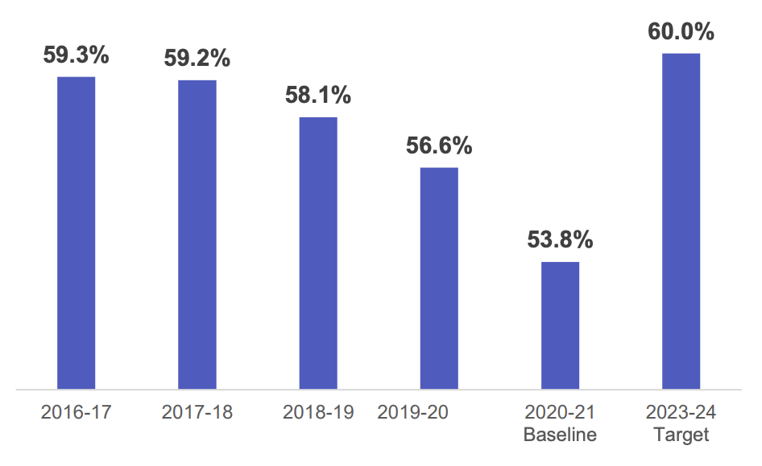
Assessment of progress
Key Challenges
In-State College Going Rate
Continued decline in the in-state college-going rate of recent high school graduates (from 59% in 2017 to 54% in 2021).
Undergraduate enrollment (not including high school students) at the universities and KCTCS has steadily declined over the past five years (7.3 and 21.9 percent, respectively).
Key demographic groups have seen significant enrollment declines (low-income and adult learners).

Slide 7
Trends and Issues Faced by Higher Education Nationally
Enrollment Challenges – Nationally, higher education enrollment peaked in 2011. A significant drop off in traditional college age students is expected over the next several years.
Increasing Focus Graduate Employability and Better Alignment with State Economic Development Goals – program/workforce demand alignment, work-based learning opportunities, stronger career guidance/advising, and closer linkages with economic and workforce agendas.
Public Questioning about the value of Postsecondary Education – Public trust in the ROI of postsecondary education has declined in recent years.
Rising Financial Pressures – State appropriations have not fully recovered since the great recession in many states. Declining enrollment and diminishing revenue sources have added to this pressure.
Changing Student Needs and Demographics – Institutions need to address the needs of non-traditional students, part-time learners, students from a range of socio-economic backgrounds and students with greater advising and counseling needs.
Advances in Technology – Online and hybrid learning options now account for over half of enrollment nationally. While technology offers opportunities for more accessible and personalized learning, it requires investments in infrastructure and training for educators.

Slide 8
Kentucky’s Student Right to Know Website

Slide 9
Student Right to Know Website
KYStats/CPE project designed to create greater transparency about college cost and return on investment at KY’s public colleges/universities and high school CTE programs.
Students, families, high school counselors and others can compare the overall cost of attendance, tuition, financial aid and graduation rates for each institution, among other factors.
Users can also review Kentucky-specific workforce and salary data for graduates in particular fields of study.
Students can review all majors at the institutions, learn about the top occupations for each degree and compare typical salary outcomes for early-, mid- and late-career workers.
The website also shows the percentage of students who have received loans for a particular program, the average loan amount and the rates of default.

Slide 10
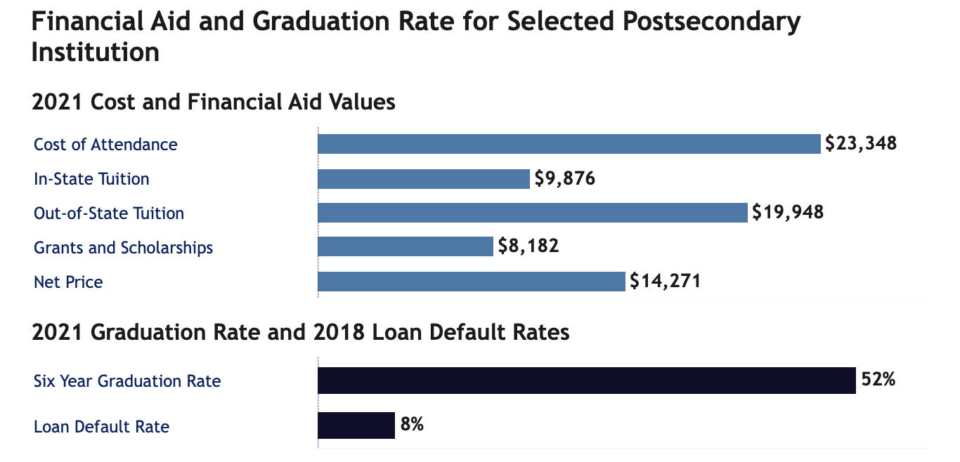
Student Right to Know – College Cost and Affordability
Provides cost data for each institutions (tuition and total cost of attendance)
Data on average grant and scholarship amounts
Information on average loan amounts and the institution’s default rates.
Data on average loan amounts and percent of students receiving loans by major.

Slide 11
Student Right to Know – Occupational Information
Provides top occupations for each major with average annual openings
Includes typical salaries for each of the occupations at different times in a career.
All the data is Kentucky specific – from our higher education and workforce data.

Slide 12
Student Right to Know – Opportunities for Greater Impact
Site use is not as high as expected or desired (currently averaging about 400 views a month).
CPE and KY Stats are working to increase the visibility and use of site by:
Students and Families
High School Counselors
College and Career Advisors
Adult Education Staff
Librarians and others
CPE & KYStats are integrating Student Right to Know into a larger student college going portal.
Need: dedicated budget to improve usability, update look/feel, and market broadly to Kentucky students and families.

Slide 13
College Affordability and Strategies to Reduce Student Debt

Slide 14
The shift in higher ed funding
Over the last two decades, decreased state support has shifted more of the burden of funding higher education to tuition and fees.
Sources: Budget of the Commonwealth, CPE Comprehensive Database, Audited Financial Statements.

Slide 15
Fewer low-income students are going to college
Low-income status is determined by usage of Pell Grants, which are federally funded grant awards based on demonstrated financial need.
Students must fill out the FAFSA to obtain any type of financial aid.
40%
decrease
Source: CPE Data, Research and Advanced Analytics Unit.

Slide 16
Campus commitment to financial aid
Campus-funded aid per student is larger than both federal and state sources combined and has grown by $2,833 per student or 186% since 2010.
Sources: Sources: IPEDS; Commonfund Institute, Higher Education Price Index, 2021 Update; CPE Data, Research and Advanced Analytics Unit.

Slide 17
CPE’s commitment to keeping tuition increases low
CPE has kept tuition increases under 2.7% for the last five years.
Source: CPE Finance Unit.

Slide 18
FAFSA completion in Kentucky on the decline
Kentucky’s high school graduating class of 2021 left $54M of Pell grant money unclaimed.
Sources: “Kentucky Goes to College.” Kentucky Higher Education Assistance Authority. 2023. National College Attainment Network.

Slide 19
Unmet financial need after all assistance is applied to total cost
Over the past decade the percent of students who have unmet financial need in KY has decreased 11 percentage points from 79.4% to 68.3%.
This is due to strong efforts to moderate tuition increases, as well as significant state and campus investments in financial aid.
However, 30% of students still have significant financial need – over $10K, and the percent with over $15K in unmet need has risen from 6.1% to 14.5%.
Source: Investigating the Financial Tipping Point: The Effect of Unmet Financial Need on Retention. CPE.

Slide 20
Student debt for Kentucky KCTCS completers is declining
Average Debt for Completers at KCTCS
2017-18 to 2021-22
Among all students completing programs at KCTCS, average student debt declined over the past 5 years by $2,543 or 33.7%.
Among only students with debt, average debt declined by $1,294 or 8.4%.
Efforts to moderate tuition, increases in financial aid, better financial counseling, and declining low-income enrollment are contributing to lower debt levels at two- and four-year institutions.
Source: KY Postsecondary Data System, CPE Office of Data and Advanced Analytics
Notes:
Need to get percent of students holding debt at KCTCS and the public universities

Slide 21
Debt levels for undergraduate completers at Kentucky public universities also is declining
Average Debt for Undergraduate Degree Completers at KY Public Universities
2017-18 to 2021-22
Among all students graduating with undergraduate degrees at Kentucky’s public universities, average student debt declined over the past 5 years by $2,593 or 11.7%.
Among only students with debt, average debt declined by $1,484 or 4.3%.
”Debt” is primarily comprised of subsidized and unsubsidized loans from the federal government, Parent Plus loans, and private loans.
Source: KY Postsecondary Data System, CPE Office of Data and Advanced Analytics

Slide 22
Strategies to Improve College Affordability
Continue efforts to keep college costs low:
Moderate increases in tuition and other college-related costs
Grow state funding supporting campuses and students
Continue strong investments in state and institutional financial aid
Recognize and support student basic needs (food security, childcare, housing)
Improve financial literacy:
More trainings and better advising for students, families and K12 staff
Simplify information about college costs and financial aid and make it more accessible
Increase FAFSA completion
Encourage Early Postsecondary Opportunities:
Dual Credit, AP, Early College Programs, Summer Bridge Programs
Strengthen links between college and career:
Improve understanding of higher education’s positive impact on employability and income
Increase experiential learning opportunities.

Slide 23
Strategies to engage and skill up more adult learners

Slide 24
Who are Kentucky’s Current Adult Learners?
The majority of are younger adults. Sixty percent are between the ages of 25 and 34
The majority (60%) are female.
Underrepresented minority students make up 18% percent of the adult learner population in Kentucky
Adult students are more likely to attend part-time (62%)
Of those adults who have financial aid records, 45% are from low-income backgrounds and half (49.5%) have dependent children.
Adults represent 20% of the overall undergraduate student population in Kentucky versus 32% a decade ago
Source: KPEDS. This data represents unduplicated enrollment counts at KY public and AIKU institutions. Low-income and having children were determined with 2019-20 financial aid file data and does not include AIKCU students.

Slide 25
Potential Adult Learner Market in KY
Notes:
There’s a big adult market for postsecondary education in Kentucky.
1.3 million adults in KY with a high school diploma or some college but no degree
Nearly 200,000 have an associate degree only – we know from market research that many be ready/interested in pursuing a bachelor’s degree.
Even if 5% of this total population were to enroll, that would mean 75,000 more students pursuing a postsecondary degree or credential –
And if they graduate, 75,000 more families, and the generations that follow, will have shifted their economic and educational trajectories in a much more positive direction.
There are approximately 230,000 Kentucky adults between the ages of 25 and 39 who:
Are not currently enrolled in postsecondary education
Do not have a degree
They are currently in the workforce
They are making less than $35,000 annually, substantially less than the median income in Kentucky.

Slide 26
Adult enrollment has sharply declined over the decade
Enrollment of adults has declined 46% overall:
48% at KCTCS
43% at public universities
Source: CPE Data, Research and Advanced Analytics Unit.

Slide 27
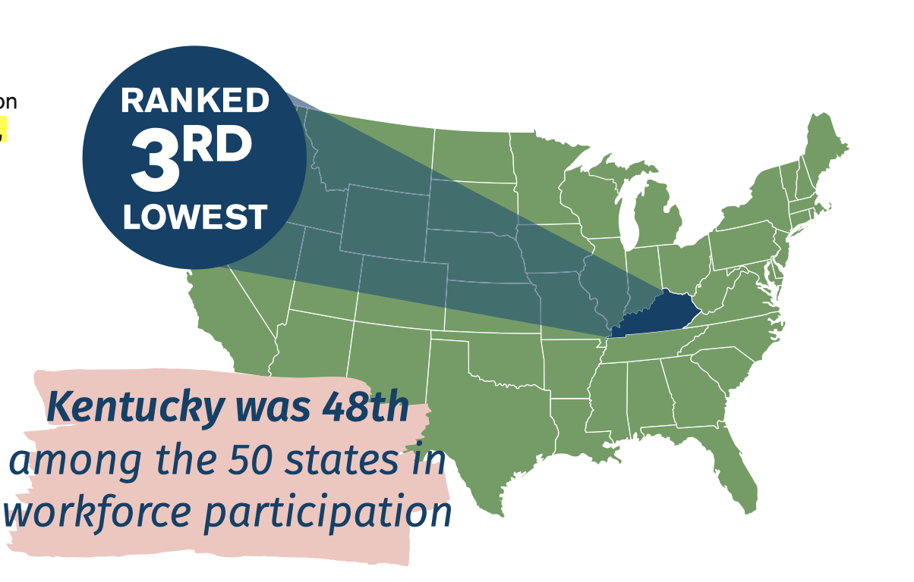
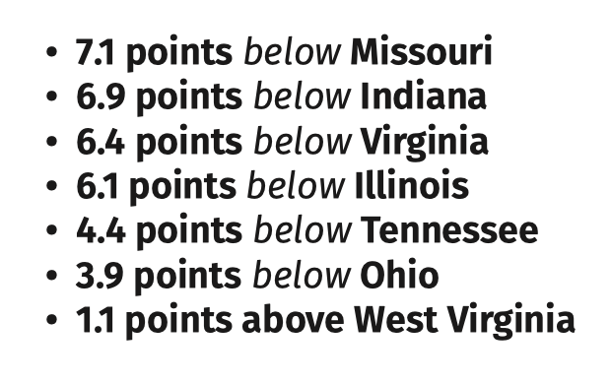
Workforce Participation in Kentucky
Workforce Participation Rate: The share of the adult population age 16 or older that is either employed or unemployed and looking for work. Active-duty military and institutionalized individuals are excluded.

Slide 28
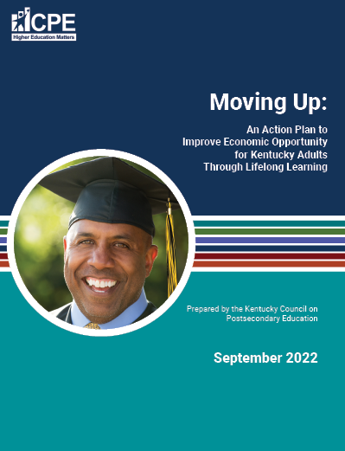
Responding to the Challenge
Released Kentucky’s Adult Learner Action Plan last fall. Strategies fall in three areas:
Accessibility – How can we ensure adult residents have the support and resources they need to enroll and succeed?
Institutional Innovation – This area addresses both campus organizational structures and academic programs. How can we ensure adults students are able to easily navigate administrative and advising systems, and thrive in the classroom?
Partnerships – How can we ensure deeper connections to business and community to strengthen career pathways for adult learners?

Slide 29
Key Strategies
Ensure greater flexibility in program scheduling (multiple term starts and courses available during the evenings, weekends, online, and self-paced).
Work with state to increase access to reliable broadband.
Provide advising, tutoring, financial aid counseling outside of standard business hours.
Connect adult students to childcare options in the community/on campus.
Recognize prior learning and experience and apply to degree progress, with an initial focus on military experience.
Ensure there is strong alignment between academic programs and employer needs.
Relaunch Project Graduate, and other programs to reengage adult learners who already have college credit.
Target recruitment strategies and financial aid to help adults skill-up and improve their employment options.

