Slide 1
Budget Review Subcommittee on Education Asset Preservation Update and CPE Functions and Fund Sources
Council on Postsecondary Education
November 2, 2023

Slide 2
Overview
Asset Preservation Update
CPE Functions and Funding Sources
CPE Agency Budget

Slide 3
Asset Preservation Update VFA Study Projected Need
In 2005, the Council contracted with Vanderweil Facilities Advisors (VFA) to conduct a comprehensive review of Kentucky public postsecondary facilities
Evaluators examined over 700 E&G facilities and concluded in early 2007 that the facilities inventory was in poor condition compared to industry standards
Most buildings at the time were over 30 years old and their condition and utility was consistent with their age
HVAC systems, plumbing, and electrical wiring in many buildings had far exceeded their useful life expectancies
Many buildings no longer adequately supported the academic programming for which they were intended

Slide 4
Asset Preservation Update VFA Study Projected Need (Cont’d)
Overall, evaluators concluded that a total investment of $6.1 billion was needed to bring campus E&G facilities up to industry standards
During the six years following the study, a combination of factors, resulted in more than a $1.0 billion increase in asset preservation need, including:
a growing inventory of aging facilities, infrastructure, and systems
increasing construction costs, and
minimal state investment in asset preservation
In a 2013 update to the original study, researchers found that the collective cost of bringing postsecondary facilities up to industry standards would grow to $7.3 billion by 2021

Slide 5
Asset Preservation Update Program Funding
In the enacted state budget (22 RS, HB 1), the General Assembly authorized $683.5 million in General Fund supported bond funds for a Postsecondary Education Asset Preservation Pool
The stated purpose of the pool is to provide funding for individual asset preservation, renovation, and maintenance projects at Kentucky public postsecondary institutions
The state budget also appropriated $16.5 million for a stand-alone asset preservation project at KCTCS
In total, the General Assembly authorized $700.0 million for asset preservation, the amount CPE requested in its budget submission

Slide 6
Asset Preservation Update Allocation of Funds
The $683.5 million Asset Preservation Pool was allocated based on each institution’s share of system total Category I and II square feet

Slide 7
Asset Preservation Update Matching Requirements
The enacted budget (HB 1) specifies the following matching requirements for accessing Asset Preservation Pool funds:
Each project for research institutions shall be matched at 30 percent from funds provided by each research institution (30¢ per state $1.00)
Each project for comprehensive institutions and KCTCS shall be matched at 15 percent from funds provided by each comprehensive institution and the KCTCS (15¢ per state $1.00)
Eligible sources of matching funds include cash, agency bonds, private funds, grants, or other institutional funds
General Fund appropriations cannot be used as a match

Slide 8
Asset Preservation Update Uses of Funds
Pool funds will be used for individual asset preservation, renovation, and maintenance projects at institutions in E&G and state-owned and operated residential housing facilities
Projects that preserve, renovate, or renew E&G facilities are eligible to receive funds from the Asset Preservation Pool
Projects that preserve, renovate, or renew state-owned and operated residential housing facilities are eligible
Routine maintenance and repair projects and ongoing M&O costs are not eligible to receive funds from the pool

Slide 9
Asset Preservation Update Expenditure Certification
Asset Preservation Pool funds are distributed to institutions using an expenditure and reimbursement approach
Institutions will expend their own funds on eligible projects before seeking reimbursement from the state
As expenditures are made, institutions submit reimbursement requests to the Council and OSBD
The requests will identify project expenditures made during the period, state funds requested, and campus matching funds
CPE staff will review the requests and verify that project expenditures are eligible for reimbursement. Projects are reviewed by CPE prior to initiation

Slide 10
Asset Preservation Update Projects and Estimated Totals by Phase (9/30/2023)
Figures include state Bond Funds and required campus matching funds.

Slide 11
CPE Functions and Funding Sources

Slide 12
CPE Functions and Funding Sources
Strategic Initiatives and Leadership
Academic Excellence and Student Success
Finance and Administration
P-20 Policies and Programs
Legal, Human Resources and Compliance, Licensure
External Affairs and Communications

Slide 13
CPE Functions and Funding Sources Strategic Initiatives and Leadership
Current Functions and Staffing Staff
CPE President’s Office 3
Planning and Accountability, Strategic Agenda Development 3
Research, Data, and Advanced Analytics 4
Technology Support 3
Board Relations, Government Affairs 2
Funding Source: General Fund
Healthcare Workforce Initiative 2.5
Funding Source: Federal Funds (Expire 9/30/26)

Slide 14
CPE Functions and Funding Sources Strategic Initiatives and Leadership (Cont’d)
Additional Investment Needed Staff
Postsecondary Board Member Education and Orientation 1
Higher Education Performance and Accountability 2
Additional staff in Research, Data, and Advanced Analytics to collect and analyze information.
Adult-Focused Programs and Services 1.5
Workforce Development Initiatives 5
Provide state-level coordination in several workforce areas, including behavioral health, K-12 teaching, advanced manufacturing, and information technology. These replacement funds will build on success of the current Healthcare Workforce Initiative.
Funding Source: General Fund

Slide 15
CPE Functions and Funding Sources Academic Excellence and Student Success
Current Functions and Staffing Staff
Academic Policy Development 4
Program Review and Approval 1
Transfer Policy and Coordination 1.5
Funding Source: General Fund
Kentucky Student Success Collaborative (KYSSC) 3
Funding Source: Private Grant (Expires 6/30/24)
Kentucky Virtual Library 3
Funding Sources: Some General Fund, Library Fees

Slide 16
CPE Functions and Funding Sources Academic Excellence and Student Success (Cont’d)
Additional Investment Needed Staff
Transfer Policy and Coordination 1
Will allow focus on new strategies to streamline and improve transfer
Student Progression and Support Services (KYSSC replacement) 3
Lead collaborative efforts to improve retention, completion. Currently developing strategies to address students’ basic needs, behavioral health and completion of foundational course in a student’s first year
Academic Program Oversight and Coordination 2
Will allow more focus on competency-based and work-based learning, AI, and other innovations and accelerate efforts to fully incorporate essential skills throughout the college experience
Funding Source: General Fund

Slide 17
CPE Functions and Funding Sources Finance and Administration
Current Functions and Staffing Staff
Finance and Budget 3
Biennial Budget Development
Tuition and Fee Setting
Performance Funding Administration
Trust Fund Administration
Administrative Services 7
Grants, Contracts, and Purchasing
Agency Budget Administration
Logistics, Office Management
Funding Source: General Fund

Slide 18
CPE Functions and Funding Sources Finance and Administration (Cont’d)
Additional Investment Needed Staff
Financial Planning and Analysis 2
Campus Financial Health Assessment
Risk Assessment and Intervention
Financial Aid and Affordability 1
College Costs and Affordability Analyses
Financial Aid Policy and Program Evaluation
Funding Program Management ¹
Funding Source: General Fund
1
An additional employee will be required to help administer the Fund for Higher Education and Economic Development, if the requested funds ($20 million in each year of the upcoming biennium) are authorized.

Slide 19
CPE Functions and Funding Sources P-20 Policies and Programs
Current Functions and Staffing Staff
Commonwealth Education Continuum 4
Kentucky Advising Academy and Dual Credit Oversight 4.5
Professional Development (for school counselors and family resource center staff, regarding postsecondary advising)
Summer Bridge Programs
Funding Source: Federal Funds (ARPA – Expires 6/30/24) Some General Fund
GEAR UP Kentucky 22 FT
12 INT
Funding Source: Federal Funds (expires 9/30/26)

Slide 20
CPE Functions and Funding Sources P-20 Policies and Programs (Cont’d)
Additional Investment Needed Staff
Kentucky Advising Academy and Dual Credit Oversight 4
Replacement funds to continue work in:
Expanding early college opportunities
Improving educational pathways
Funding Source: General Fund

Slide 21
CPE Functions and Funding Sources Legal, Human Resources, Compliance, Licensure
Current Functions and Staffing Staff
Legal, Human Resources and Compliance 4.5
DEI/Equity and Inclusion Policy and Program Assessment 3
KSU Oversight ¹ 2
Funding Source: General Fund
Licensure of Non-Public Institutions 3
Funding Source: Licensure Fees
¹
CPE received a special appropriation of $1.5 million for use in the 2022-2024 biennium for KSU oversight. CPE will require a similar appropriation for 2024-2026 to continue this work.

Slide 22
CPE Functions and Funding Sources External Affairs and Communications
Current Functions and Staffing Staff
Strategic Communications 4
Business and Industry Partnership Development
Funding Source: General Fund

Slide 23
CPE Agency Budget

Slide 24
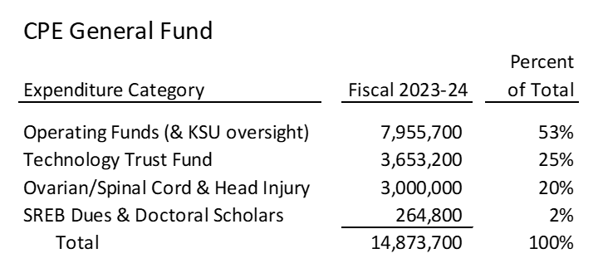
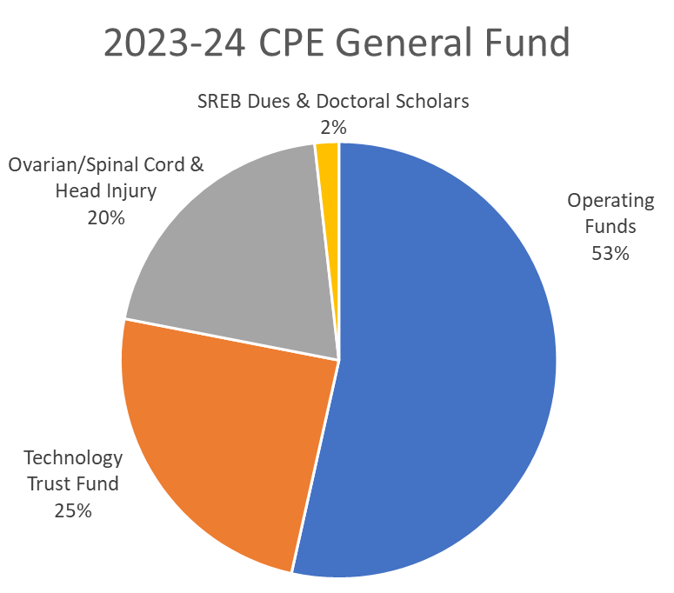
CPE Agency Budget 2023-24 General Fund

Slide 25
CPE Agency Budget 2024-2026 Additional Budget Requests

Slide 26
CPE Agency Budget Higher Education Coordination & Management
Component | 2024-25 | 2025-26
Higher Education Coordination & Management | $3,000,000 | $3,000,000
Request Features
Funding will allow expansion of CPE’s role in connecting higher education and workforce and economic development, P-20 transitions, monitoring postsecondary institution finances, and evaluating academic programs
Will support 25 positions at CPE in 2024-25 and 2025-26, 12 of whom are currently funded with federal or private grant funds
Needed to effectively respond to growth in CPE’s statutory duties and responsibilities and expanded due diligence and oversight role

Slide 27
CPE Agency Budget Incentive Grants
Component | 2024-25 | 2025-26
Incentive Grants to Strengthen Workforce Participation & Economic Growth | $20,000,000 | $20,000,000
Request Features
Will support the Fund for Higher Education & Economic Development (FHEED).
Will provide incentive grants to campuses to increase educational attainment, strengthen workforce alignment, foster collaboration, improve efficiencies and build a more streamlined P-20 pipeline.
CPE will form an advisory committee to provide guidance in the use and distribution of funds. Up to 20% of the funds would be used for statewide programming, professional development, and coordination.

Slide 28
CPE Agency Budget Incentive Grants (Cont’d)
Examples of fund use may include:
Strengthen behavioral health and other high demand pipelines (healthcare, education, technology, and manufacturing)
Project Graduate relaunch to encourage adults to come back to finish degrees
Strengthen P-20 pipeline through summer bridge programs and other college readiness initiatives
Strengthen transfer and other credit-for-prior learning strategies and programs
Improve institutional financial transparency
Respond to challenges and opportunities posed by technology and AI

Slide 29
CPE Agency Budget Incentive Grants (Cont’d)
More examples of fund use:
Expand competency-based programs to improve access for adults and place-bound students
Incorporate KY Graduate Profile elements (civic education, financial literacy, critical thinking) in General Education programs
Improve quality, accessibility of dual credit and other early college programming
Support local and regional entrepreneurism and small business development
Develop multi-campus collaborations to expand access and create efficiencies in delivering high-cost programs

Slide 30
CPE Agency Budget KSU Oversight
Component |  | 2024-25 | 2025-26
KSU Oversight |  | $750,000 | $750,000
Request Features
Continuation funding for financial and programmatic oversight of Kentucky State University
Will support staffing and professional services needed to ensure that progress is made towards goals set forth in KSU’s Management Improvement Plan

Slide 31
CPE Agency Budget SREB Dues and Doctoral Scholars
Component | 2024-25 | 2025-26
SREB Dues & Doctoral Scholars Program | $60,000 | $110,000
Request Features
Current budget for SREB Doctoral Scholars in $50,000 per year, which funds one URM scholar at UK and one URM scholar at UofL.
UK and UofL match the funding, bringing the total to four URM scholars.
Requested funding will allow another class of scholars in FY25 and FY26
The program is intended to create a community of scholars on each campus who have shared experiences over their three years in the program
$10,000 per year will cover SREB dues cost increase

Slide 32
Questions?

