Slide 1
School Safety Update for Budget Review Subcommittee on Education
By
The Kentucky Center for School Safety
Jon Akers, Executive Director

Slide 2
Presentation format as requested
Two main areas of interest:
Safe Schools Funding and School Resource Officers
1. Per SB91- Safe Schools Allocation, history of how this allocation is being used and how it’s being distributed
2. Per HB6- School Resource Officers- Historical numbers, assignments, roles and responsibilities

Slide 3
School Safety Legislation 1998-2024 that impacted KCSS (a quick review)
House Bill 330-1998: Established KCSS and Accountability system for schools.
Senate Bill 8- 2013: Enhanced EOP and Access Control
Senate Bill 1- 2019 “School Safety and Resiliency Act”: comprehensive
Senate Bill 8-2020: Further defined SSRA
Senate Bill 2- 2024: Guardian, Mapping, Trauma, Suicide, STOP tipline
Senate Bill 91- 2024: Increased KCSS Operations budget and added private schools.
House Bill 6- SRO $16.5 mil FY25 and $18 mil FY26 and School-based Mental Health support

Slide 4
Historical Allocations Safe School Funds

Slide 5
Statutory Authority to Establish School Safety Budget Senate Bill 91 (passed by the 2024 General Assembly)
5) Center for School Safety: Included in the above General Fund appropriation is $15,000,000 in each fiscal year for the Center for School Safety. Notwithstanding KRS 158.446, the Center for School Safety shall allot these moneys for the purposes described in KRS 158.440, 158.441, 158.4415, 158.4416, 158.442, 158.445, and 158.446 at both public and private school buildings, campuses, grounds, recreational areas, or athletic fields, except that no more than $2,000,000[$1,500,000] in each fiscal year may be retained for operating and administrative purposes. The Center for School Safety shall research and evaluate commercial software solutions available to improve school safety. Notwithstanding KRS 45.229, any portion of General Fund not expended for this purpose shall lapse to the Budget Reserve Trust Fund Account (KRS 48.705). Mandated reports shall be submitted pursuant to Part III, 24. of this Act.

Slide 6
As Approved by KCSS Board of Directors Allocation Calculations FY25 & FY26

Slide 7
Allocation Calculations FY25 & FY26 recap
KCSS Partners (EKU, MSU, KSBA) proposed budgets as presented: $2,000,000
KDE personnel allocation: $221,000
Statewide Safe Schools allocation formula ($20,000* + $15.71 x ADA) as presented: $12,779,000
*171 school districts, KSB, KSD, and Model Laboratory

Slide 8
Thank you!!
We’ve been able to expand our services to both public and private schools.
Double our Safe School Assessment Program
Double our Threat Assessment Team Trainings
Provide Principal Mentors for New Principals
In addition to our standard menu of trainings (district, regional and state), annual conference, and in- person technical assistance.

Slide 9
Kentucky Center for School Safety Partnership
Eastern Kentucky University/KCSS- administers, directs and oversees all aspects of the services that are provided to schools in our state relating to current practices in school safety.
Kentucky School Boards Association- as directed by KCSS, provides training and technical assistance to school districts. In person services.
Murray State University- as directed by KCSS, houses our vast Resource Center as well as our website kycss.org

Slide 10
FY25 & FY26 Operating Budgets for EKU, KSBA and MSU

Slide 11
How school districts are using Safe School Funds

Slide 12
Statutory Authority to Allocate Funds for Mental Health Services House Bill 6 (passed by the 2024 General Assembly)
(11) School-Based Mental Health Services Providers: Included in the above General Fund appropriation is $7,412,500 in each fiscal year to fund school-based mental health services provider full-time equivalent positions on a reimbursement basis. The Kentucky Center for School Safety, in consultation with the Office of the State School Security Marshal, shall develop criteria to determine which districts shall receive funding to meet the requirements of KRS 158.4416(3)(a). The criteria shall include:
(a) A local district’s use of Medicaid funding to supplement General Fund;
(b) An equitable and balanced statewide distribution; and
(c) Any other criteria to support a trauma-informed approach in schools.
Notwithstanding KRS 45.229, any portion of General Fund not expended for this purpose shall lapse to the Budget Reserve Trust Fund Account (KRS 48.705). Mandated reports shall be submitted pursuant to Part III, 24. of this Act.

Slide 13
Allocation of State Funds for School-based Mental Health Care Providers for FY25 & FY26
$7,412,500 divided by 172 school districts= $43,095.93
School Counselors, School Psychologists or School Social Workers
Local decision…KCSS role is to determine the allocation not specifically which position should be funded.
Superintendents and Boards of Education can determine how best to use these funds.
Position needs to be an employee of the school district

Slide 14
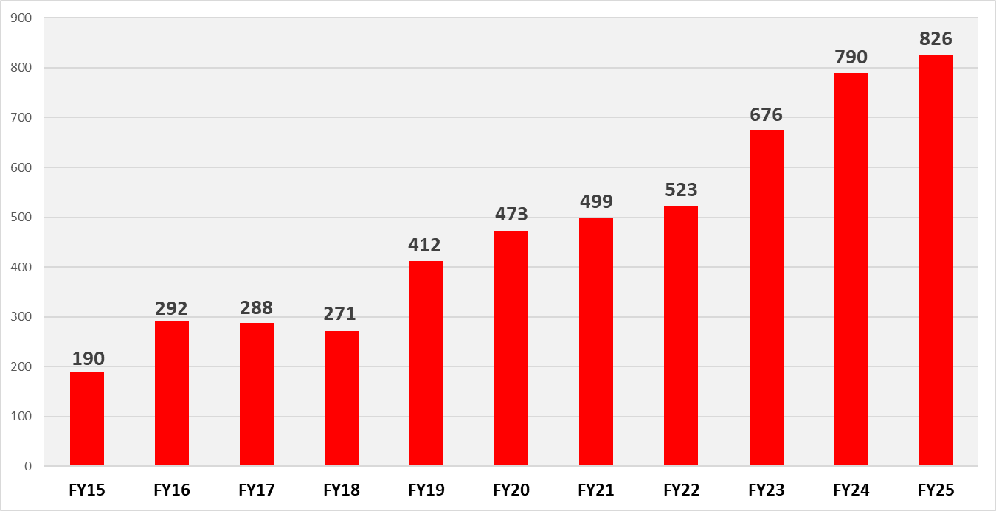
School Resource Officers in Kentucky by Fiscal Year

Slide 15
SROs Assigned to Schools in FY25

Slide 16
The Role of the SRO
Foster a positive culture in the school
Build long-term, meaningful relationships with students and staff
Be a positive role model for all
Build trust among students and staff
Act as a law enforcement officer for law-related offenses
Serve as an informal counselor
Act as an educator about subject matter relevant to LE
Collaborate with administration about school safety models
Among other duties to ensure a safe learning environment conducive to high levels of learning for all students

Slide 17
School Safety Issues Typically Handled by SROs
It should be noted that “safety issues” in schools, which are handled by SROs, should be viewed through two separate lenses.
On one hand, the SRO will serve as the lead LE liaison in the building for all things resulting in a LE response (i.e. assaults, thefts, destruction of property, general disorders, active threat mitigation, etc.).
On the other, the SRO will serve as the subject matter expert in collaboration with school administration over all things school safety related (i.e. crisis incident response, drill planning, development of the school safety plan, etc.)

Slide 18
Questions, comments and discussion

