Slide 1
Putting Young Kentuckians to Work
Michael Gritton
KentuckianaWorks
Myra Wilson
Cumberlands Workforce Development Board

Slide 2
Kentucky has 10 Workforce Boards
Common acronyms for workforce boards:
WIB – Workforce Investment Board
WDB – Workforce Development Board
LWA – Local Workforce Area
7 of the 10 WIBs are managed by Area Development Districts (ADDs)

Slide 3
WIOA Formula Funding
WIBs are overseen by:
Board of Directors made up of employers and community organizations
Local Elected Officials (LEOs)
US Department of Labor
Kentucky
By formula to each state based on measures of unemployment
10 local WIBs
By formula to each local area based on measures of unemployment

Slide 4
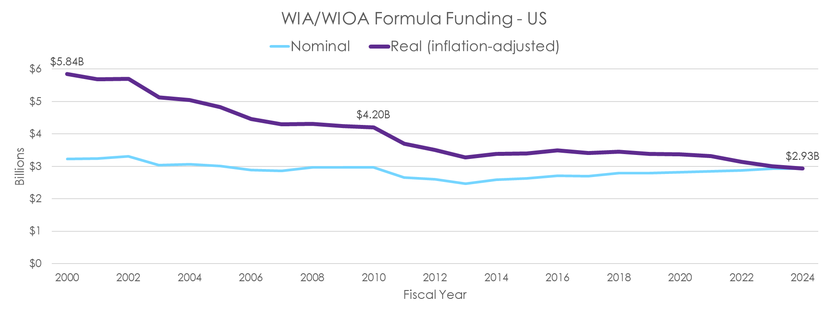
Federal investment in workforce development has been shrinking
50% real decline over the last 2 decades
Source: US Department of Labor
Note: ARRA not included

Slide 5
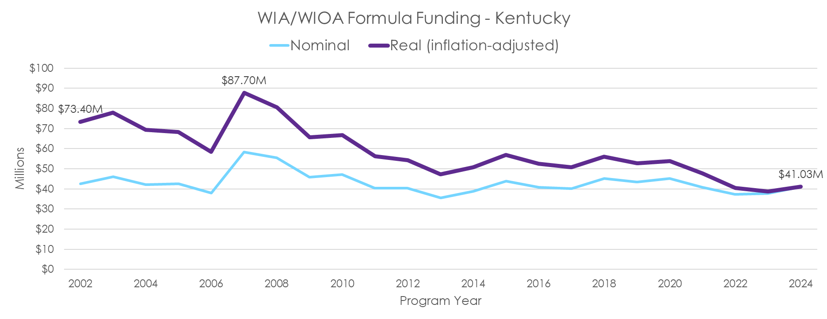
As a result, federal investment in workforce development in Kentucky has been shrinking
44% real decline over the last 2 decades
Source: US Department of Labor
Note: ARRA not included

Slide 6
High school seniors need help finding quality work
Today, no person or organization is responsible for helping high school seniors who are not enrolling in postsecondary find that first good job.
High schools don’t do it – they’re measured on graduation, not job placement after graduation.
Workforce Boards don’t do it – our only “Youth” funding stream is really focused on disconnected youth -- young adults who are not working and not in school.

Slide 7
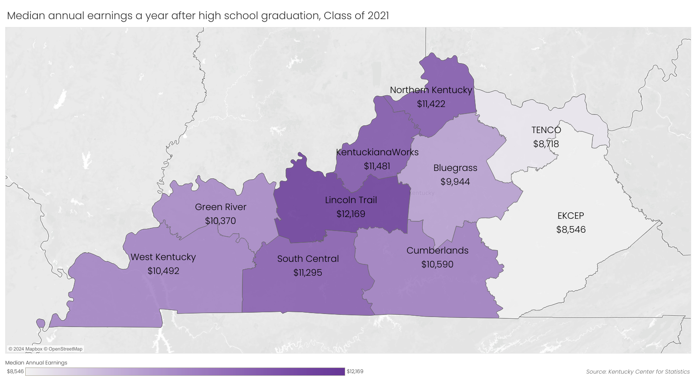
High school seniors need help finding quality work
For the high school class of 2021
74% of graduates worked in Kentucky the federal fiscal year following graduation
Median ANNUAL earnings were only $10,500
Less than a full-time, year-round minimum wage job
Source: Kentucky Center for Statistics,
High School Feedback Report Card 2024-07

Slide 8
Workforce pipeline impacted by youth disconnection
Across the Commonwealth, 1-in-7 young people ages 16 to 24 were not working or enrolled in school in 2022 – nearly 75,000 young adults!
Kentucky’s youth disconnection rate is among the top 10 highest across states
Adverse outcomes from the pandemic and natural disasters may increase disconnection rate
Chronic absenteeism, lower college enrollment, poor mental health
Source: US Census Bureau, 2022 American Community Survey Public Use Microdata Sample

Slide 9
Youth Disconnection Rate in KY
In some rural parts of the state, 1-in-4 youth and young adults are disconnected from work and school.

Slide 10
The economic costs of youth disconnection
INDIVIDUAL
Lost income
Poorer health outcomes
More involvement with the criminal justice system
TAXPAYER
Lower tax revenue
Higher government expenditures
Police, corrections
Public assistance programs
NATION
Lower economic output
Higher poverty
Higher crime
Source: Belfield & Levin, The Economics of Investing in Opportunity Youth, (2012)

Slide 11
The economic costs of youth disconnection
$14K
TAXPAYER BURDEN
per youth for every year they experience disconnection in their young adult years
$235K
TAXPAYER BURDEN
per youth over the course of their lifetime after experiencing persistent youth disconnection
Source: Belfield & Levin, The Economics of Investing in Opportunity Youth, (2012)

Slide 12
KentuckianaWorks
Our Vision
A fully prepared and engaged workforce that is aligned with the needs of employers.
Our Mission
Engaging employers, educators, and job seekers with resources to build a stronger community through the dignity of work that satisfies needs, creates value, and inspires hope.

Slide 13
KentuckianaWorks is the workforce development board for the Louisville region
Operate a regional network of career services that includes planning and workshops to help job seekers with their career goals, resume, interview skills, and job search
Provide career training programs and connections to education
Connect employers with skilled, qualified workers
Convene employer groups by sector to build relationships
Use labor market intelligence to understand the local economy

Slide 14
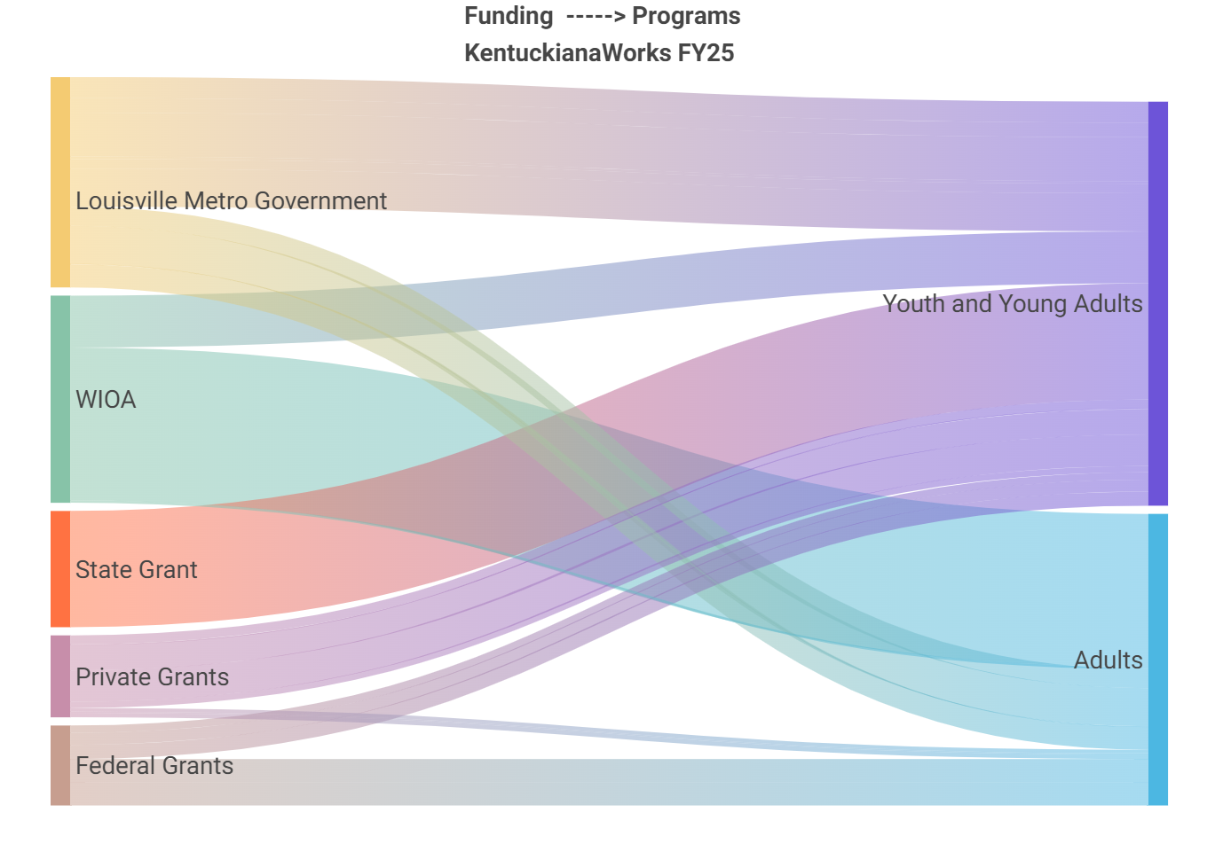
30%
58%
30%
17%
12%
42%
11%

Slide 15
The Spot: Young Adult Opportunity Center
July 1, 2023 – June 30, 2024
Served 1,006 young adults across 7 counties
581 new enrollments
187 job placements
37 completed internships
159 occupational skills credentials
Provides free career resources for young adults ages 16-24 across the Louisville region
Partnership between KentuckianaWorks and Goodwill Industries of Kentucky

Slide 16
Meet Alvey
Alyssa (Alvey) Madero
Enrolled at The Spot: Young Adult Opportunity Center in Bullitt County
Completed multiple training courses
Completed her GED!
Proud mom of 3 kids and recently got married
Currently works full time for UPS in the Brokerage Department and plans to begin pursuing her college degree soon

Slide 17
Cumberlands Workforce Development Board - WIOA Youth
Spring 2020 - Summer 2022
$2.1 million on paid work experience hours
579 youth
195 different worksite employers
Combined total of 206,871 working hours

Slide 18
Thank You!
Michael Gritton
Executive Director, KentuckianaWorks
502.208.2349
michael.gritton@
kentuckianaworks.org
Myra Wilson
Director, Cumberlands Workforce Development Board
270.866.7425
myra@lcadd.org

