Slide 2
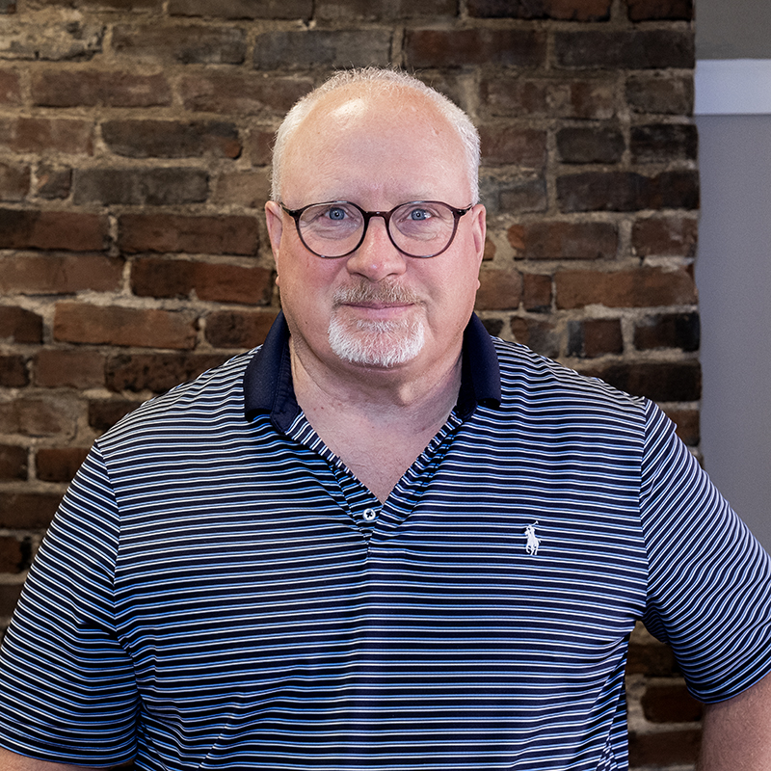
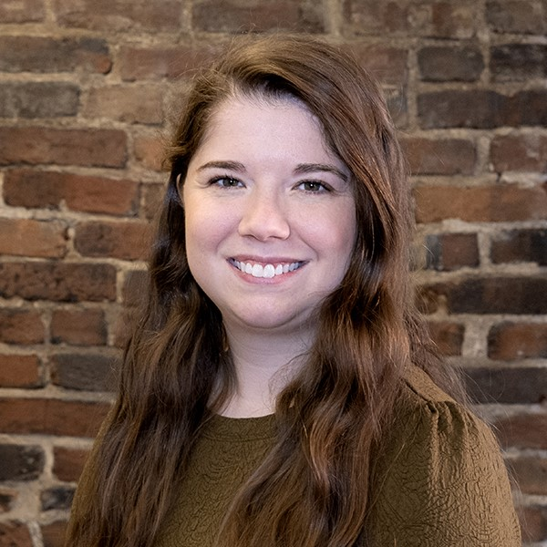
Rowan Claypool Max Morley Bonnie Baragary
Founder/CEO Recruitment Coordinator Teacher Support Coordinator
AmeriCorps Program Manager Former Teach Kentucky Teacher

Slide 3
Teach Kentucky History
Founded in 2002
Mission – recruit young, talented degree-holders to move to Kentucky and begin a career in education
2 teachers in first Cohort
Hallmarks of Growth
2002 – partnership with the University of Louisville
2017 – Admission into Serve Kentucky/AmeriCorps
2018 – partnership with Asbury
Other significant foundation and institutional partnerships secured across the year

Slide 4
Teach Kentucky - Today
Four full-time staff
CEO
Recruitment Coordinator
Teacher Support Coordinator
Development Coordinator
Support staff (accounting, HR, etc.) external to the organization
2024 Cohort By the Numbers
407 Applications
153 Invitations to Recruitment Weekend
59 Invitations to Proceed
Total of 42 teachers in our 2024 Cohort
Notes:
Notes:
407 applications – Kentucky is drawing national interest. Young college graduates are applying to move here specifically.
75 invitations to RW – we are selective with our invitations

Slide 5
Teacher Support and Retention
Summer Institute
Navigating the System
Application -> Hiring Process -> Onboarding
Professional Support and Development
Full-time Teacher Support Coordinator
Retired Teacher Advocates (RTA)
Teach Kentucky Network
Fostering a Sense of Belonging
Notes:
Notes:
407 applications – Kentucky is drawing national interest. Young college graduates are applying to move here specifically.
75 invitations to RW – we are selective with our invitations

Slide 6
Teacher Growth and Leadership
Kate Grindon (2003)
Principal, Noe Middle School
Tyler Shearon (2007)
Executive Administrator, Operations Services, JCPS
Raja Kaur (2011)
Director of Professional Development and Learning, JCPS
Deloreon Burton (2011)
Educational Recovery Liaison, Kentucky Dept. of Education
Notes:
Notes:
407 applications – Kentucky is drawing national interest. Young college graduates are applying to move here specifically.
75 invitations to RW – we are selective with our invitations

Slide 7
Teach Kentucky Benefits
Summer Institute
$2,500 Institute / Relocation Grant
$14,000 education award through AmeriCorps
Up to $4,000 in relocation benefits through JCPS
Full teacher certification
Earn a Master of Arts in Teaching
Ongoing Professional Development
Community integration, including Serve Kentucky projects
Begin careers immediately
valuable classroom experience
full salary, benefits, retirement plan
Partnership with ClassAct Credit Union
Banking partner for out-of-state members
$5,000 line of credit
$3,000 loan
$25,000 pre-approval toward a vehicle
Financial Literacy Support
Notes:
Note – all of this is done without any financial support from the Commonwealth.
Every year, we work to identify patterns, issues, and pain points at every step of our process, and then make plans to get better.

Slide 8
Current Funding Streams
Foundation Grants
James Graham Brown, Gheens, CE&S, Cralle
JCPS Partnership
$3,000 / teacher in year one
$2,000 / teacher in year two
$1,000 / teacher in year three
Spalding University Partnership
Revenue share of tuition paid by Teach Kentucky members
Asbury College Partnership
Revenue share of tuition paid by Teach Kentucky members
Notes:
JCPS pay tied to retention

Slide 9
Teach Kentucky’s Impact on KY
500+ total teachers in Kentucky classrooms
337 teachers in high-need content
STEM, Special Education, ESL, etc.
65%
224 current teachers
40-45 new teachers each year
90% retention year-over-year
For every 4 TKY members, we gain one “bonus” Kentuckian
spouse, friend, etc.
Over $3 million in new federal dollars through AmeriCorps education awards
2237 “years” of teaching by Teach Kentucky members
450+ Master’s Degrees earned in Kentucky colleges
Notes:
Note – all of this is done without any financial support from the Commonwealth.
$14,000 in education awards / teacher - > new federal dollars coming into the state. For our 2024 Cohort, that means

Slide 10
Investment in Our Impact
Teach Kentucky is requesting an annual allocation of $1,000,000 in the 2026-2028 budget.
Through this investment, Teach Kentucky stands ready to:
Increase recruitment to 150% of average level
From 40-45/year to 60-65/year
Meaningfully increase year-over-year retention through year five
Enhance our Summer Institute professional development toward standard-setting cohorts of first-year teachers
Elevate Kentucky as a destination for young, talented future educators
Sunset philanthropic sustaining dollars, allowing that money to be reallocated into other parts of the community

Slide 11
Rowan Claypool Max Morley Bonnie Baragary
rowan@teachkentucky.com max@teachkentucky.com bonnie@teachkentucky.com

