Slide 1
State Supplemental Funding for Career & Technical Education (CTE) Kentucky Department of Education Office of Career & Technical Education

Slide 2
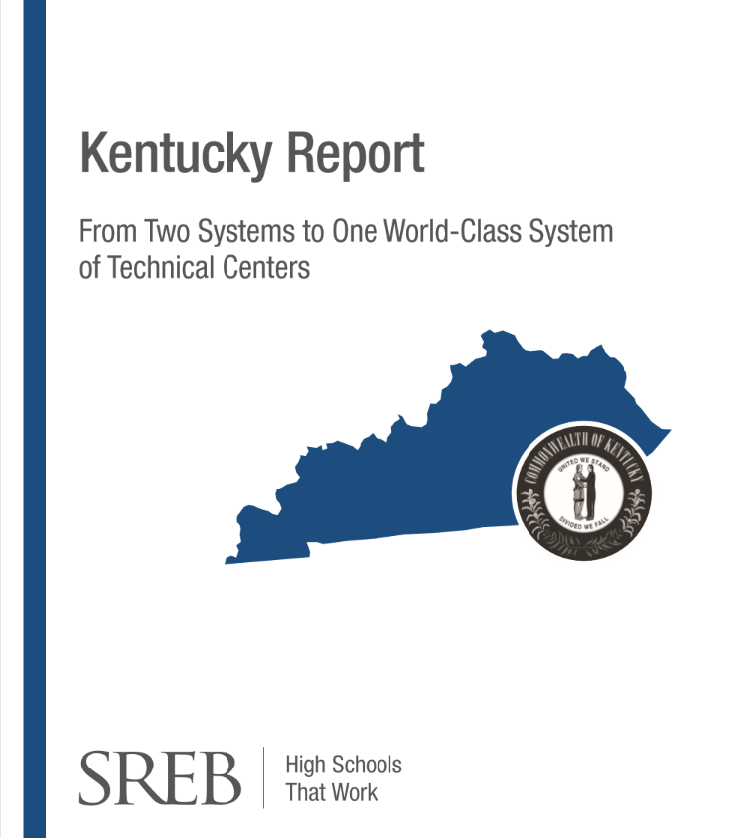
Kentucky CTE Reports

Slide 3
Funding Report Recommendations
Base funding for CTE on state goals and business and industry needs;
Convene a committee to explore ways of funding CTCs and ATCs equally;
Provide adequate funding for CTE programs to accomplish state priorities;
Create a proactive, intentional process of funding large equipment purchases and maintaining and/or upgrading current equipment;
Allow locally-operated centers and schools to set a budget for the entire school year;
Consider an additional per-pupil funding formula weight tied to state-prioritized occupational and program areas based on state and regional industry needs; and
Explore CTE performance funding.

Slide 4
 | State Operated ATCs | Former State ATCs (transitioned to local control) | Local CTE Programs | KDE Central Office | KCTCS
Former SEEK | $3,521,260 (20% to districts that own building) $14,879,518 (Personnel & Operating) | $2,495,685 (Green, Nelson, Knox, Madison) |  | $831,894 (25% Innovation Funds) | $1,153,543 (for serving secondary students where no ATC/CTC exists) | $22,881,900 TOTAL SEEK
General Fund | $23,107,400 (Personnel) $1,978,176 (Operating) $3,029,224 (Utilities, Etc.) $25,000 (Industry Certifications) |  | $70,063,400 (Grants) $50,000 (Industry Certifications) | $5,166,900 (Central Office Personnel) $533,900 (JROTC Pilot Program Personnel) $140,000 (Central Office / ATC Support) $90,000 (JROTC Support) |  | $104,184,000 TOTAL GENERAL FUND
TOTALS | $46,540,578 | $2,495,685 | $70,113,400 | $6,762,694 | $1,153,543 | $127,065,900
FY25 Biennium State Budget for CTE

Slide 5
2024 House Bill 499
Equitable funding for all CTE students
Incentivizes indicators of high-quality CTE that are important to workforce development
Elimination of the mid-year adjustment
Middle school career exploration
Innovation and support fund
Leverages federal funding
Simplifies types of CTE and terminology

Slide 6
2024 House Bill 499

Slide 7
Allocation Variables
FTE changes
Programming changes
Incentives
Updated pathway weights
Converted local center 25% allocation removed from funding
Addition of converted centers FTEs to FTE and incentive totals

Slide 8
 | FY 22 | FY23 | FY24 | FY25
Small District A | $62,360 | $151,816 | $168,029 | $143,706
Small District B | $0 | $164,988 | $141,756 | $162,994
Medium District A | $203,232 | $374,772 | $401,813 | $400,937
Medium District B | $0 | $500,014 | $545,012 | $521,507
Large District A | $768,079 | $1,252,504 | $1,213,230 | $1,159,578
Large District B | $0 | $2,033,609 | $2,099,356 | $2,184,626

Slide 9
 | Number of ATCs Funded | ATC Program Operational Funding | Number of Local Districts Funded | Local District Funding
FY22 | 51 | $1,437,893 | 33 | $12,043,500
FY25 | 50 | $1,978,176 | 160 | $70,063,400
FY25 Total Student Values
Total Weighted FTEs (Local Districts) | 30,072.18
60% Local District Weighted FTE Value | $1,397.90
40% Local District Incentive Value | $504.62
Total Weighted FTEs (ATCs) | 6,434.88
ATC Weighted FTE Value | 307.41

Slide 10
Michael Ford Superintendent Russell County Schools

Slide 11
Considerations
Funding equity
Inclusion of state-operated centers into the funding formula
Consider increasing supplemental funding to mitigate the inclusion of additional ATC FTEs as well as incentives to local districts

