Slide 1
House Bill 4 Testimony| July 15, 2025

Slide 2
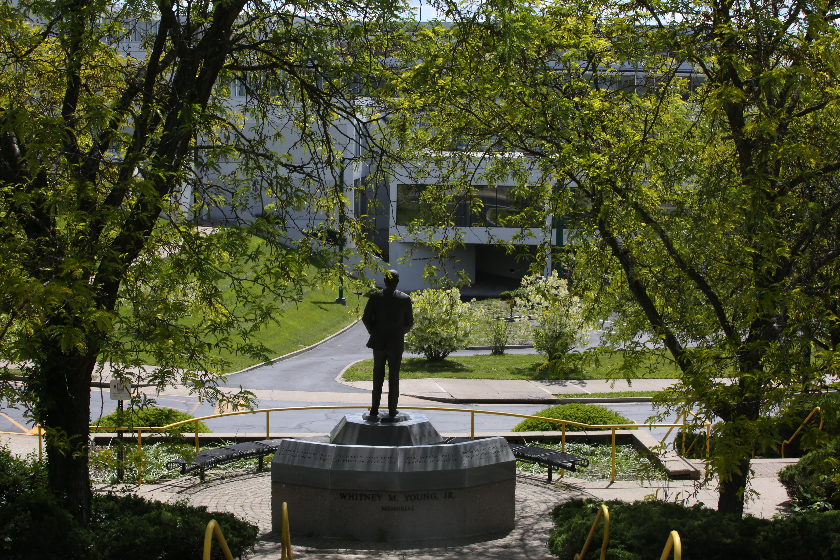

Slide 3
Measures Taken
Guidance: Senior administrators received guidance on how to comply with House Bill 4.
DEI Office & Program Dissolution: DEI offices and positions at KSU were dissolved prior to the passage of House Bill 4.
Training Cessation: All DEI training sessions for faculty, staff, and students have been permanently discontinued. Mandatory civil rights trainings do not include DEI training, and trainers instruct employees not to promote DEI initiatives at KSU.
Position Audit: KSU’s HR personnel reviewed all job descriptions for DEI-adjacent language. All job descriptions that included such language were revised, and affected employees were notified to cease any DEI-related initiatives.
Program Audit: KSU Academic & Student Affairs personnel have begun an internal audit of KSU programs to identify and address any activities that might be construed as promoting “discriminatory concepts” or “indoctrination.”
Scholarships Audit: KSU Advancement staff conducted an internal audit of donor agreements to identify any agreements that require staff to consider the religion, race, sex, color, or national origin of applicants or candidates.

Slide 4
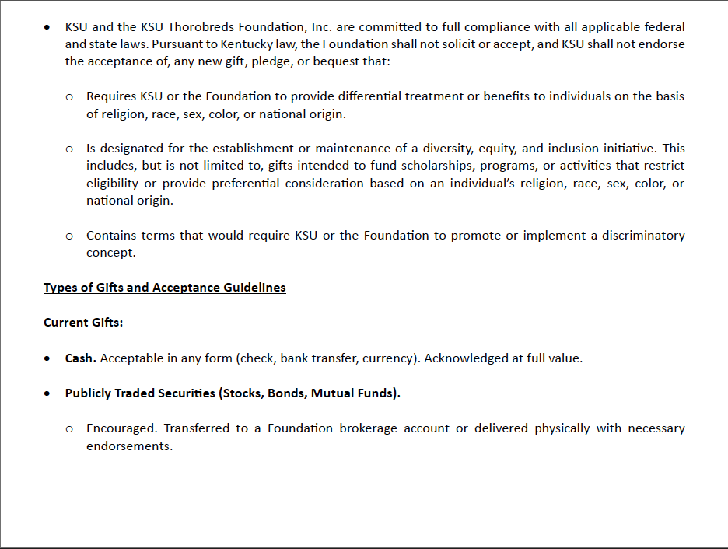
Measures Taken
Policy Review and Revision: All KSU policies have undergone a comprehensive review and revision to remove any criteria or language that would provide preferential treatment based on religion, race, sex, color, or national origin.
Viewpoint Neutrality Policy: The KSU Board of Regents approved the institution’s viewpoint neutrality policy on June 27, 2025.

Slide 5
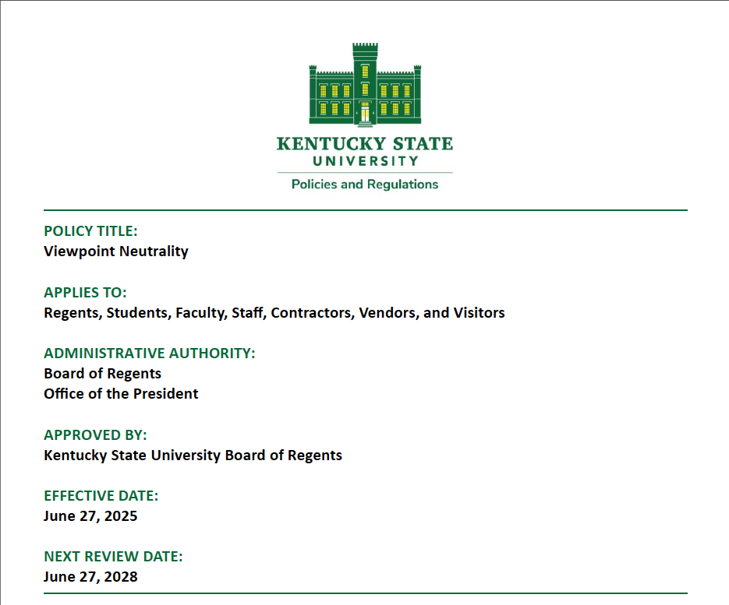
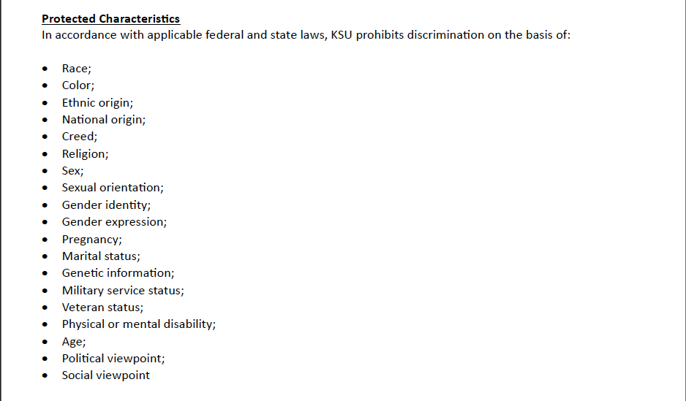
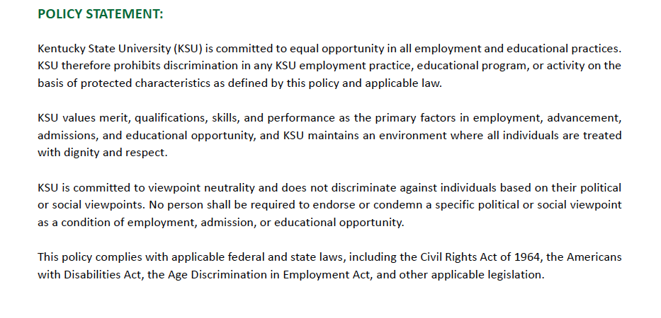
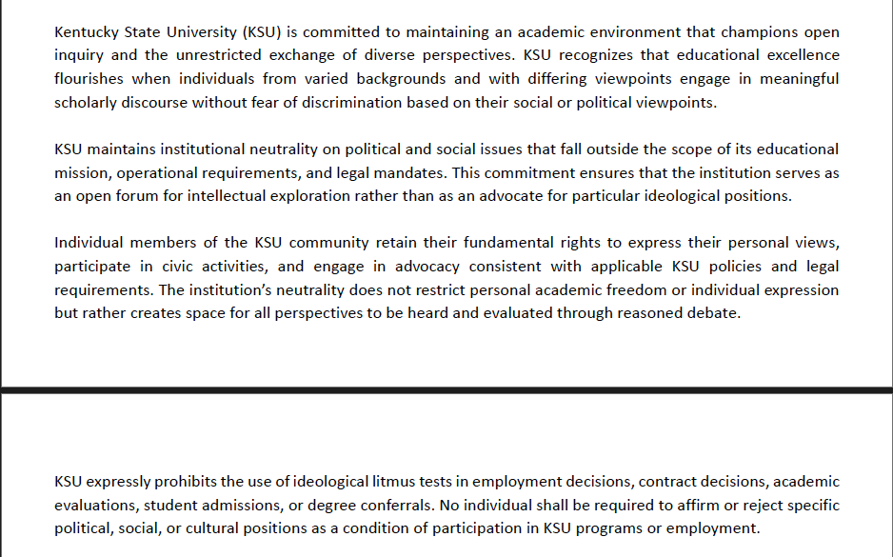
Measures Taken

Slide 6
Ongoing/Planned Measures
Donor Agreements: KSU Advancement staff will meet with private donors to encourage them to amend the language of their donor agreements.
Personnel Training: KSU has planned ongoing training for all departments on KSU’s revised policies and the nuances of House Bill 4 to ensure consistent and compliant practices.
Website Changes: As part of ongoing website updates, designated staff will review content for DEI language. Pages containing such content will be evaluated for compliance with House Bill 4. Content that does not meet statutory requirements will be archived if required for record retention or otherwise updated to align with House Bill 4 and current institutional policies.
Ongoing Audits: KSU personnel will continue to audit programs and job descriptions to ensure ongoing compliance with House Bill 4 and institutional policies.
August 30, 2025, Report: KSU staff are cognizant of the August 30 deadline for the certification report and will ensure the report is submitted timely.
Intellectual Freedom Surveys: KSU will administer CPE’s intellectual freedom and viewpoint diversity surveys by no later than November 1, 2025.

Slide 7
Compliance Status
Current Status (as of July 7, 2025):
KSU has achieved substantial compliance with the core requirements of House Bill 4.
Areas of Ongoing Work:
Full Operational Integration: Ensuring that the spirit of the viewpoint neutrality policy and non-discriminatory treatment is fully integrated into all daily operations and departmental practices.
Ongoing Monitoring: Establishment of robust internal monitoring and audit processes to ensure sustained compliance and to address any unforeseen interpretations or challenges that may arise.
Anticipated Date for Full Compliance:
Full operational integration and complete refinement of all programs are anticipated to be completed by August 30, 2025.

Slide 8
Faculty/Personnel Terminations or Reassignments
Terminations:
No faculty or personnel have been terminated directly as a result of KSU’s compliance with House Bill 4.
Restructuring/Renaming:
DEI offices and positions were eliminated prior to the passage of House Bill 4.
All job descriptions that included DEI-adjacent language or initiatives were revised to remove such content, and affected employees were notified to cease any DEI-related initiatives.

Slide 9
Program or Department Closures
Closures:
No academic programs or departments have been closed as a direct result of House Bill 4. KSU remains dedicated to providing its comprehensive academic offerings.
Reassignments/Role Adjustments:
Programs are undergoing ongoing review and, if necessary, adaptation to ensure they align with House Bill 4’s emphasis on viewpoint neutrality and non-discriminatory treatment.
No KSU degree programs require any student to enroll in or complete an academic course dedicated to the promotion or justification of a discriminatory concept.

Slide 10
Savings Achieved Through Compliance
No Savings Have Been Achieved:
KSU eliminated its DEI offices and DEI-focused positions years prior to the passage of House Bill 4, so the institution did not need to eliminate dedicated DEI budgets this year or last year.
KSU has not hired external DEI trainers or consultants in years, so a reduction in these expenditures has not been realized since the passage of House Bill 4.
Potential Future Savings:
KSU will carefully review conference agendas to see if they contain any DEI training—even if DEI training is not the primary purpose of a conference.
KSU will not pay for employees to attend such conferences unless an exemption under House Bill 4 applies.

Slide 11
No Continuation of DEI-Related Measures
DEI-Related Measures are not Continuing Under Different Names or Programs:
KSU eliminated its DEI programs years ago, and the institution will not allow DEI-related measures to continue under new names.
KSU remains steadfast in its commitment to fostering a welcoming and supporting environment for all students, faculty, and staff.
Intellectual Diversity & Free Expression: Emphasis on intellectual diversity and the robust exchange of ideas is being reinforced through academic programming, campus dialogue initiatives, and faculty development.
Talent Recruitment: Recruitment efforts continue to focus on attracting a broad range of talented individuals. These efforts prioritize merit, qualifications, and unique perspectives, while strictly adhering to House Bill 4’s prohibition on preferential treatment based on protected characteristics.
Compliance with Spirit and Letter of the Law: All continuing and newly developed initiatives are being rigorously reviewed to ensure they align with both the letter and the spirit of House Bill 4.

Slide 12
Conclusion & Next Steps
Proactive Compliance: KSU has taken proactive and comprehensive steps to achieve compliance with House Bill 4 by the mandated deadlines.
Commitment to Core Values: KSU remains committed to fostering a campus environment that champions academic freedom, intellectual diversity, equal opportunity, and a sense of belonging for every individual.
Ongoing Adaptation: KSU will continue to monitor the legislative landscape and adapt our policies and practices as necessary to ensure sustained compliance while upholding our mission of providing an excellent educational experience for all.

