Slide 1
Council on Postsecondary Education
Agency Budget and Priorities for FY 2027-2028
Travis Powell | Executive VP and General Counsel
Dr. Amanda Ellis | Senior VP of Student Access and Success
Leslie Brown | Assistant VP of Operations

Slide 2
The Council on Postsecondary Education
State coordinating agency for postsecondary education under KRS 164.020
Leads long-term planning, sets academic standards, and reviews/approves academic programs
Focused on affordability across public colleges and universities
Aligns higher education with workforce and economic needs to increase attainment and promote prosperity
Provides data-driven policy recommendations to the Kentucky General Assembly
Shapes a high-quality, efficient, and accessible postsecondary system
Supports economic growth and meets the evolving needs of students and the Commonwealth

Slide 3
CPE Agency Budget for FY 2025-2026
Expenditure Category | Guiding Legislation | Fiscal Year 2025-26 | Percent of Total
General Fund - Operating | Core Functions KRS 164 | $ 8,252,900 | 25%
General Fund - Technology Trust | KRS 164.7911, KRS 164.7921 and KRS 164.800 | 3,667,600 | 11%
General Fund - Healthcare Workforce Investment | KRS 164.0401 - 164.0407 | 3,000,000 | 9%
Restricted Fund - Private Grants | Enhance Core Functions of KRS 164 | 4,186,300 | 12%
Restricted Fund - Licensure | KRS 164.945 - 164.947 and KRS 164.540 | 600,000 | 2%
Federal | Enhance Core Functions of KRS 164 | 1,507,900 | 4%
Fiduciary - Tobacco Settlement - Cancer Research | Executive Branch Budget Bill | 6,250,000 | 19%
Fiduciary - Restricted Fund - Cancer Research Matching | KRS 164.043 | 3,000,000 | 9%
Fiduciary - General Fund - Ovarian and Spinal Cord & Head Injury | Executive Branch Budget Bill and KRS 211.500 to 211.504 | 3,000,000 | 9%
 | TOTAL FY2025-26 | $33,464,700

Slide 4
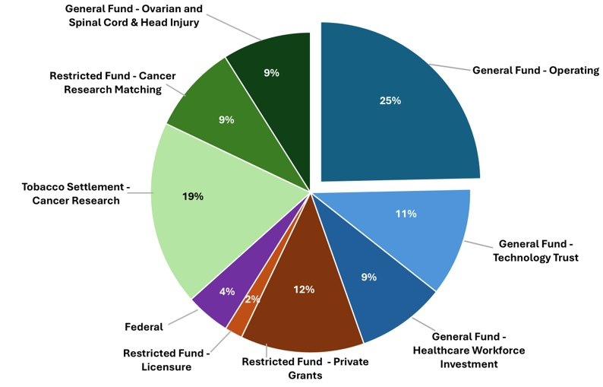
CPE Agency Budget for FY 2025-2026

Slide 5
Financial Responsibility in Education and Workforce Impact (SB 91)
As required by Section 76 of Senate Bill 91 (2024), CPE submitted a report detailing all programs it administered in FY 2023 and 2024, the statutes authorizing them, and related expenditures. The report confirms that all CPE-led initiatives are statutorily grounded and strategically aligned to Kentucky’s education and workforce goals. These investments directly support workforce development by improving student outcomes, increasing credential attainment, and aligning with employer needs.
This progress is a testament to the power of a statewide higher education coordinating board to drive change and improvement through policy, analysis, and deep collaboration with campuses, state education and workforce agencies, and other key stakeholders.
cpe.ky.gov/data/publications

Slide 6

Additional Agency Budget Requests
Futuriti – Request: $250K/year
Futuriti.org is a statewide digital platform developed by CPE in collaboration with KDE and KYSTATS. This tool provides more than 700 Kentucky-specific career profiles, cost and outcomes data for all postsecondary institutions, and support for both high school and adult learners, including those emphasized in SB 191.
This investment would support:
  Continued development of a cost-of-living calculator, an employer benefit database, and an apprenticeship hub
  1 full-time staff member for site maintenance/development

Slide 7
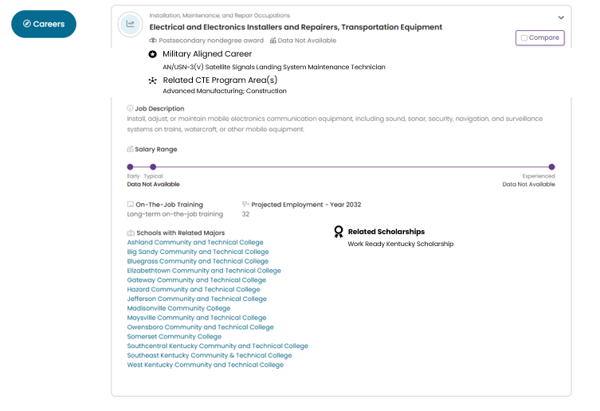
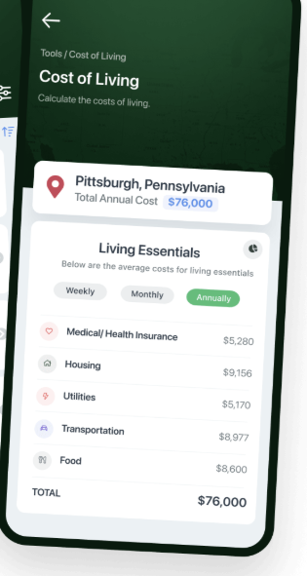
Futuriti Expansion Projects

Slide 8
Additional Agency Budget Requests, continued.
Summer Bridge Programs – Request: $750K/year
Summer bridge programs are a proven strategy to support the transition from high school to college, especially for students from low-income and underrepresented backgrounds. Evaluations of prior CPE-sponsored programs show increased college persistence and enrollment, with measurable gains in tuition revenue and workforce readiness.
This investment would support:
  2 full-time staff members
  Evaluation
  Direct campus grants

Slide 9
Additional Agency Budget Requests, continued.
Workforce and Economic Development Expansion – Request: $1M/year
To build on the success of CPE’s workforce unit, CPE desires to expand efforts to meet workforce demands and unlock economic mobility for Kentuckians.
This investment will support:
Building on the success of education and industry partnerships in the healthcare field by expanding efforts to other high-need sectors
Faculty Development Center and Graduate Profile Fellows Program
1 full-time staff member, operating costs, and competitive grants to postsecondary institutions to enhance innovative, workforce-aligned curricula

Slide 10
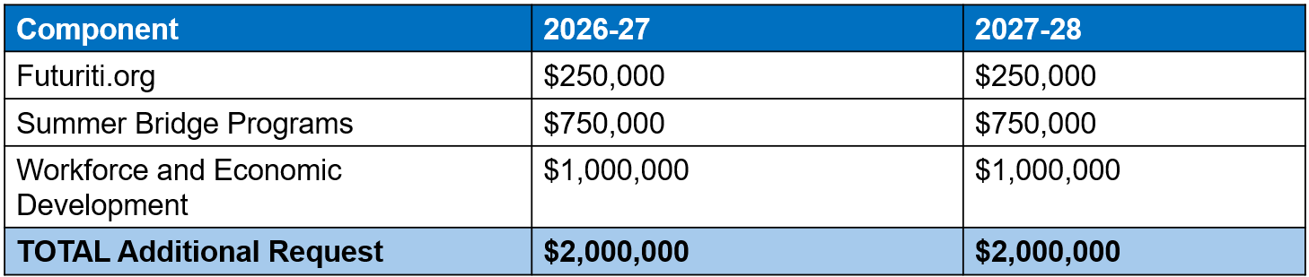
Additional Agency Request Summary
Together, these initiatives represent a comprehensive and coordinated investment in Kentucky’s workforce future. The total additional request directly supports the Council’s statutory responsibility to strengthen postsecondary education’s role in driving economic prosperity for all Kentuckians.

Slide 11


Questions?

