Slide 1


Slide 2
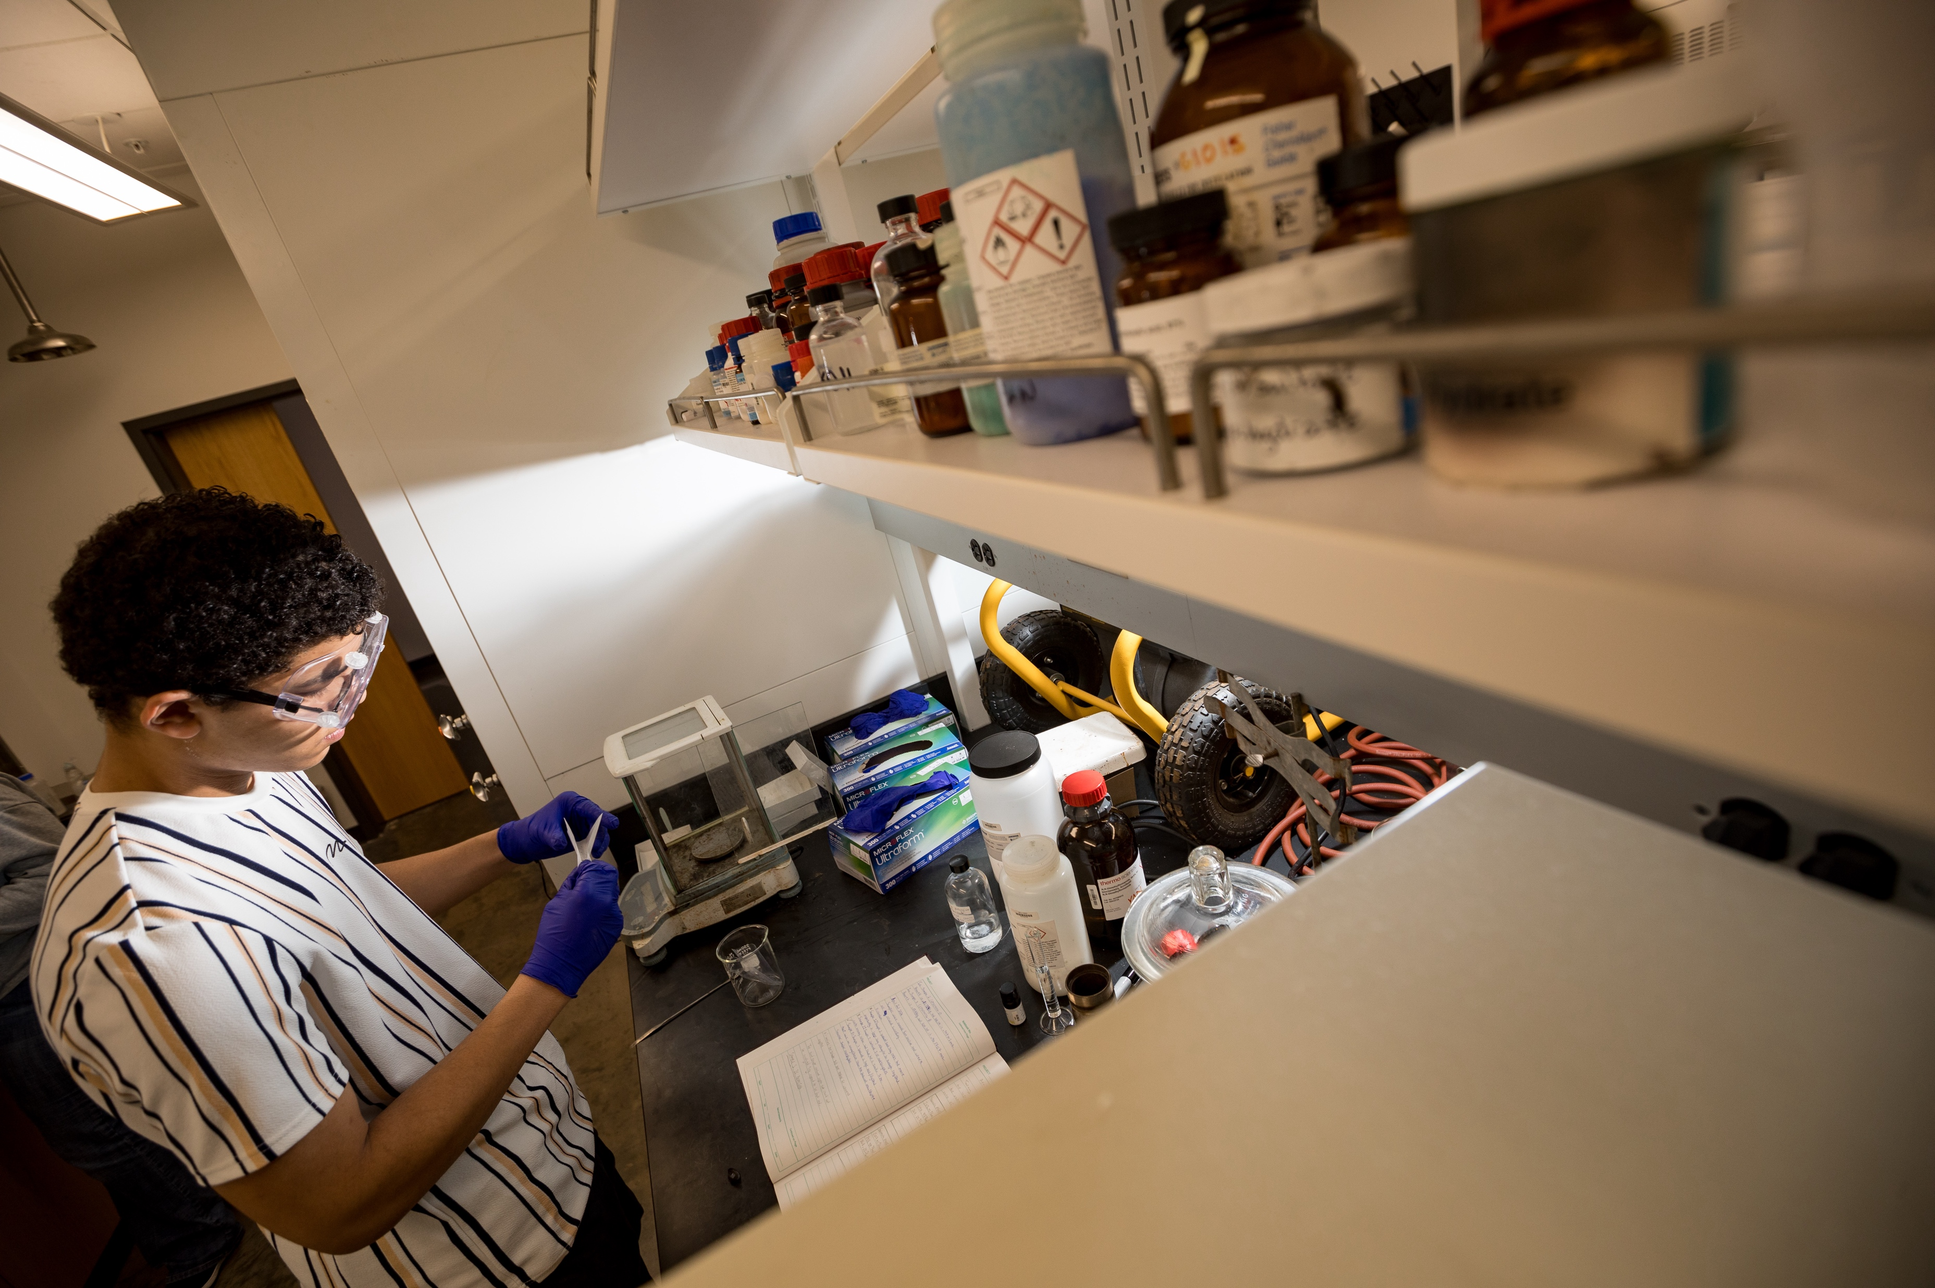
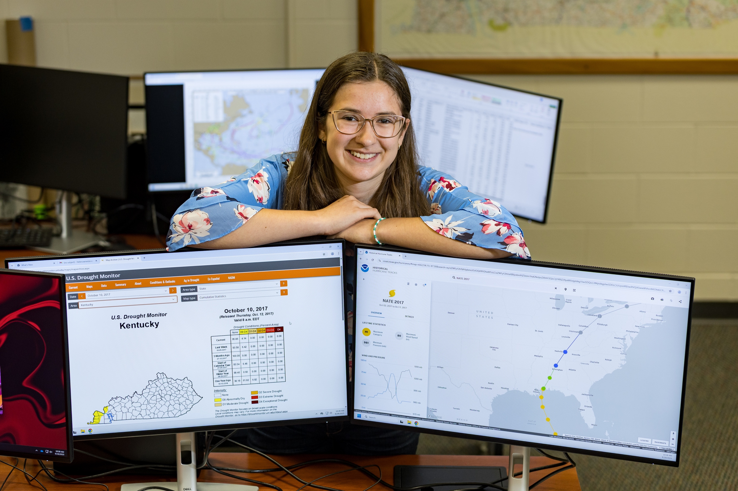
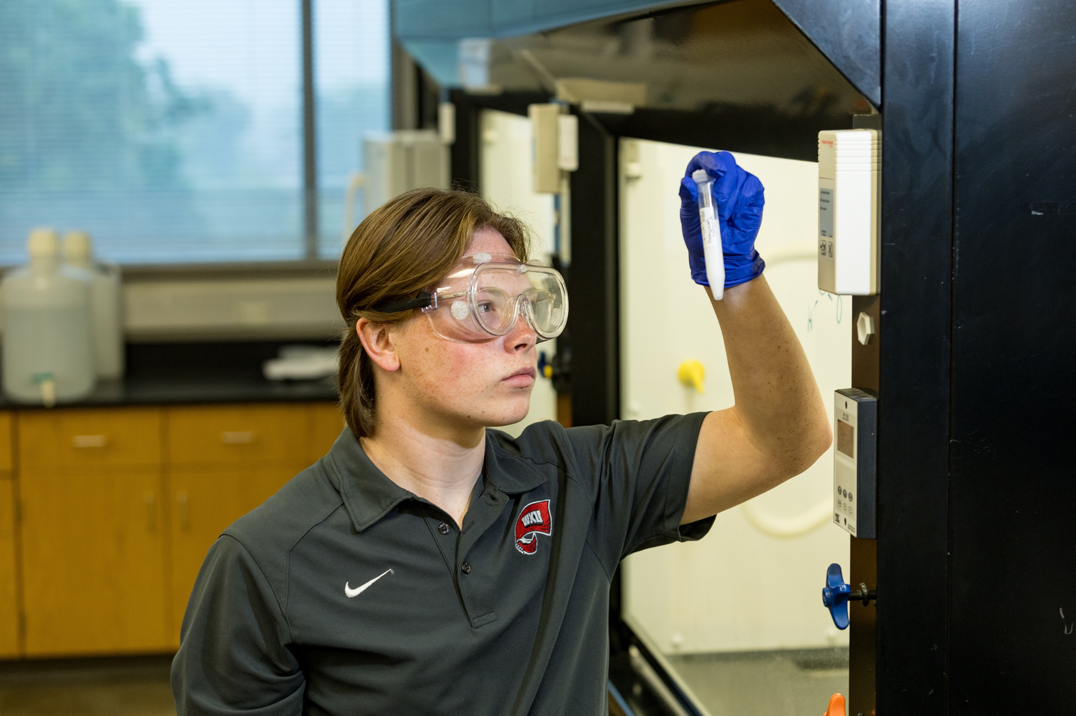
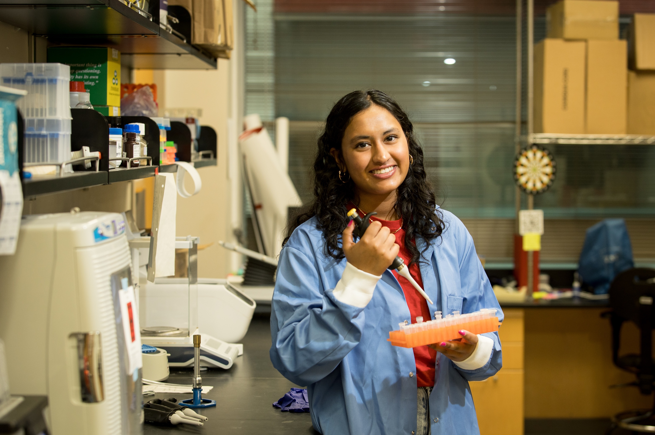
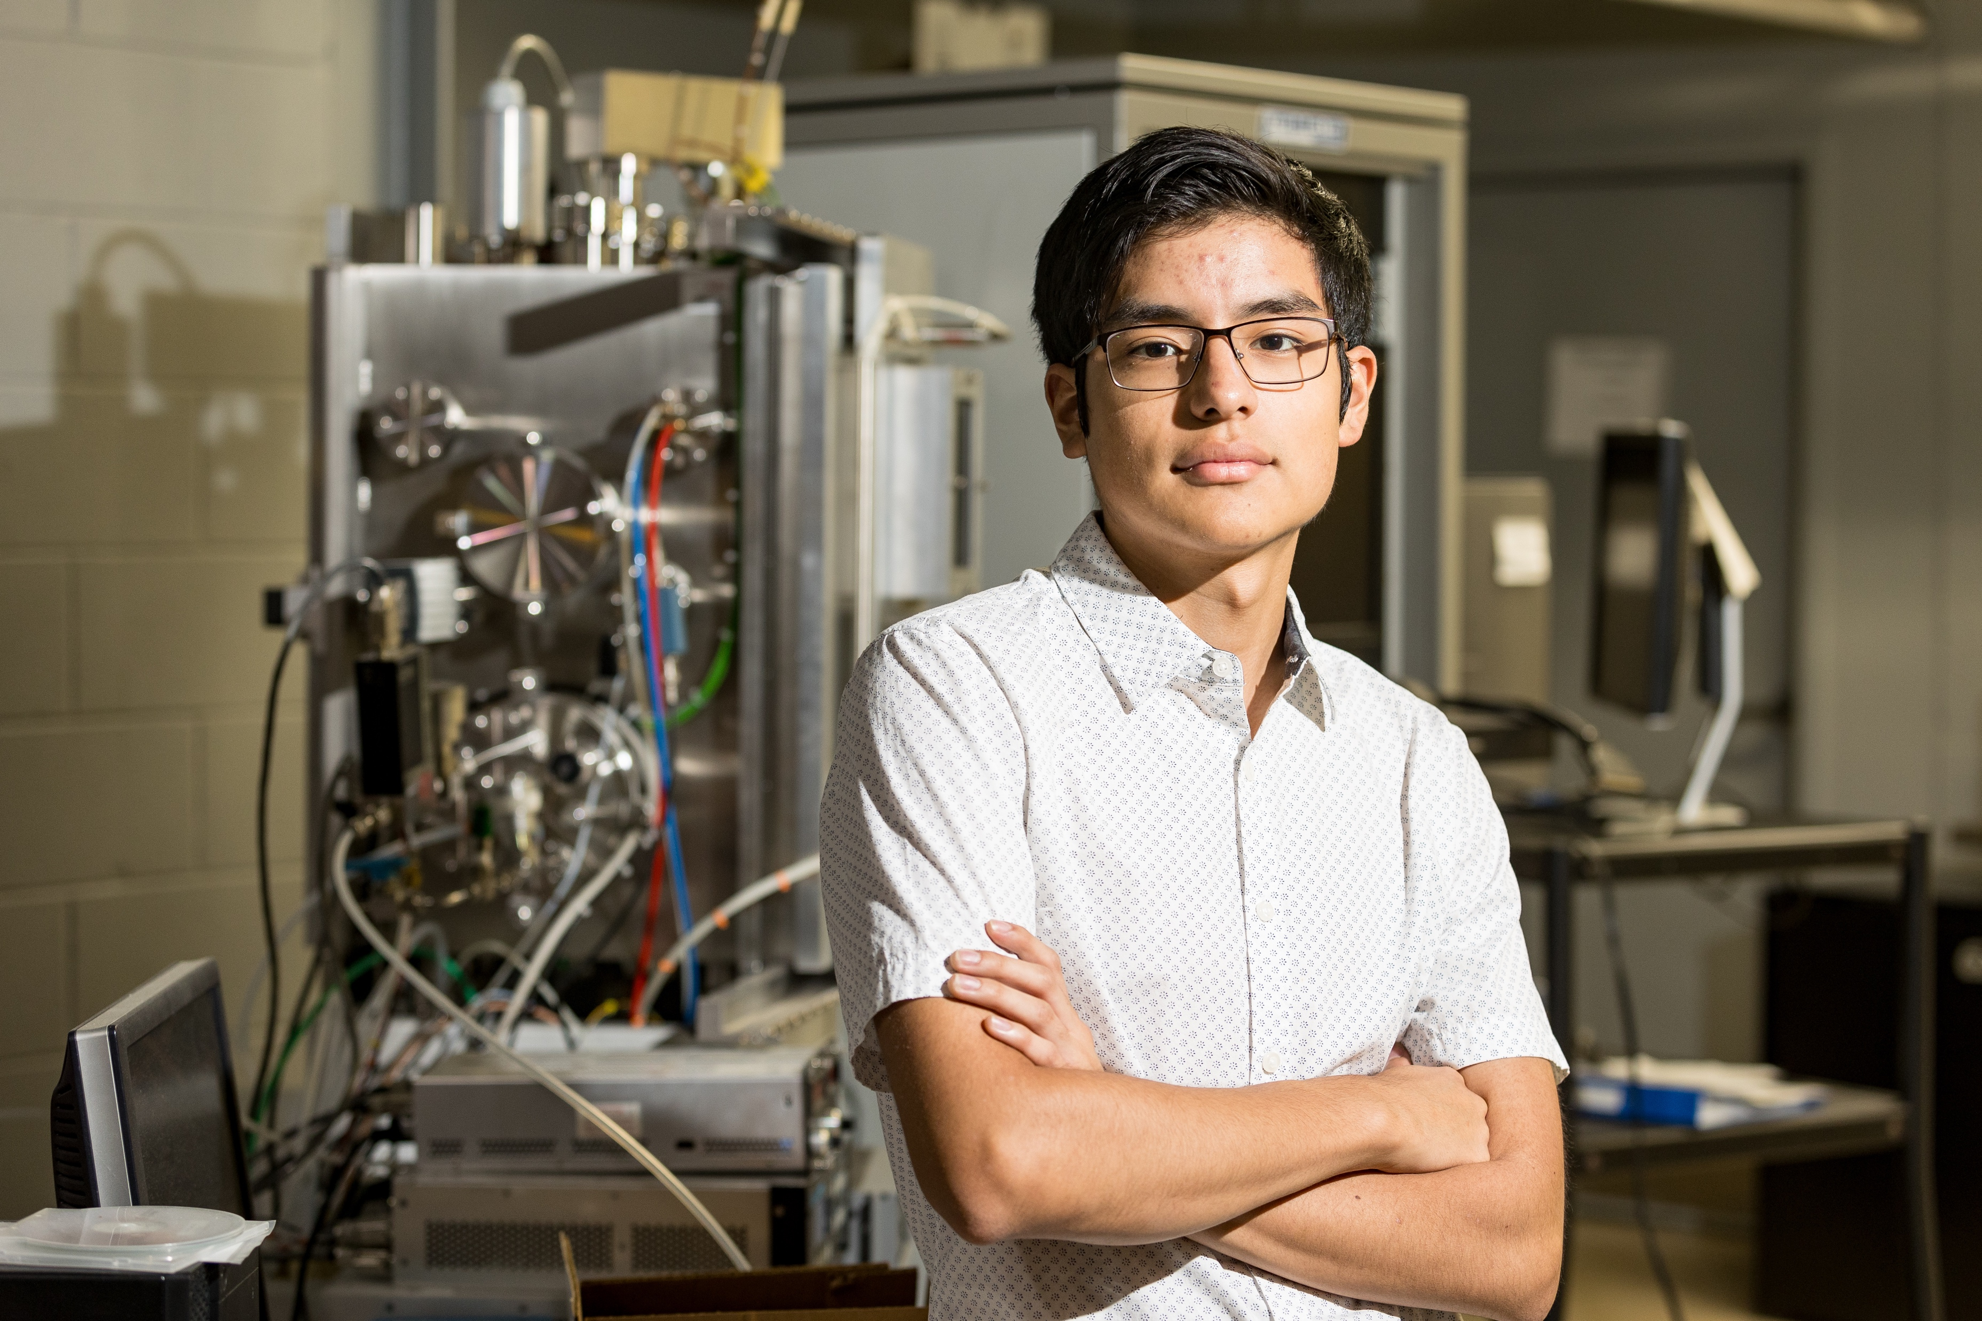
The Gatton Academy’s Mission
The Carol Martin Gatton Academy of Mathematics and Science in Kentucky is a residential program on the campus of Western Kentucky University for bright, highly motivated Kentucky high school students who have demonstrated interests in pursuing advanced careers in science, technology, engineering, and mathematics. Students enhance their creativity, curiosity, reasoning ability, and self-discipline through the companionship of peers, university courses, faculty-led research, and study abroad, preparing them for leadership roles in the Commonwealth of Kentucky.

Slide 3
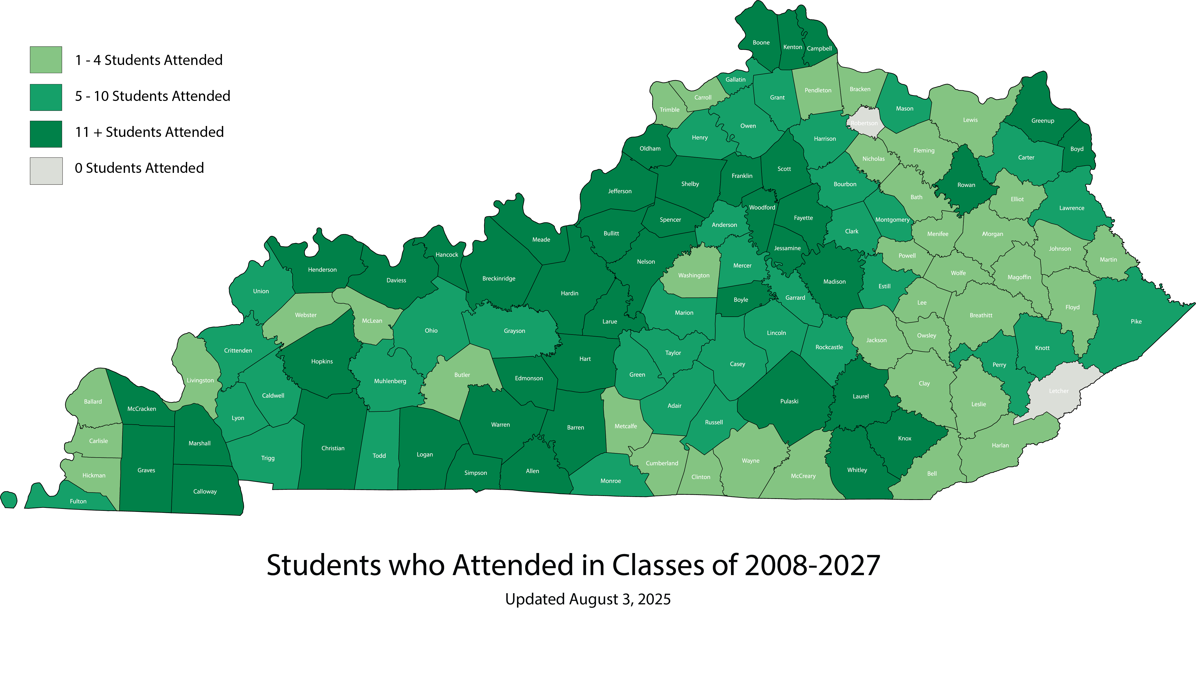
Established as Kentucky’s
Statewide Academy

Slide 4
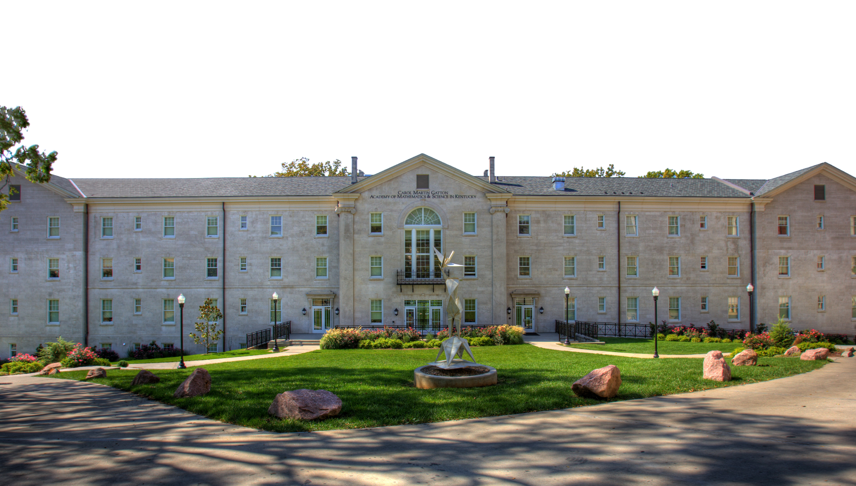
History
August 2007: Opened our doors with 120 students
2016-2017: Expanded to serve 200 students
May 2025: Graduated our 18th class
Over 1200 Gatton alumni

Slide 5


Exceptional Program
Included on Jay Mathew’s List of Public Elites since 2009
Ranked #1 2012, 2013, and 2014 by Newsweek/Daily Beast (after 2014 ineligible for ranking)
Intel School of Distinction Finalist 2012
NCSSS Innovative Partnership Award 2021
American’s Languages: Guide to Exemplary Programs & Practices in U.S. Language Education 2021
Recent Grants:
- General Motors (4 times in 5 years: 2021; 2023; 2024; 2025)
- Jesse Ball DuPont Fund 2023-2026
- Council for Post Secondary Education 2024

Slide 6
Exceptional Students
Admissions requirements:
  - Minimum ACT Math of 22
  - Completion of Algebra 1, Geometry, and Algebra 2 (or College Algebra)
  - Essays
  - Educator recommendation
  - Interview
Start in Trigonometry (or higher) and complete math through
at least Calculus 2
Ready to live away from home in a college environment

Slide 7
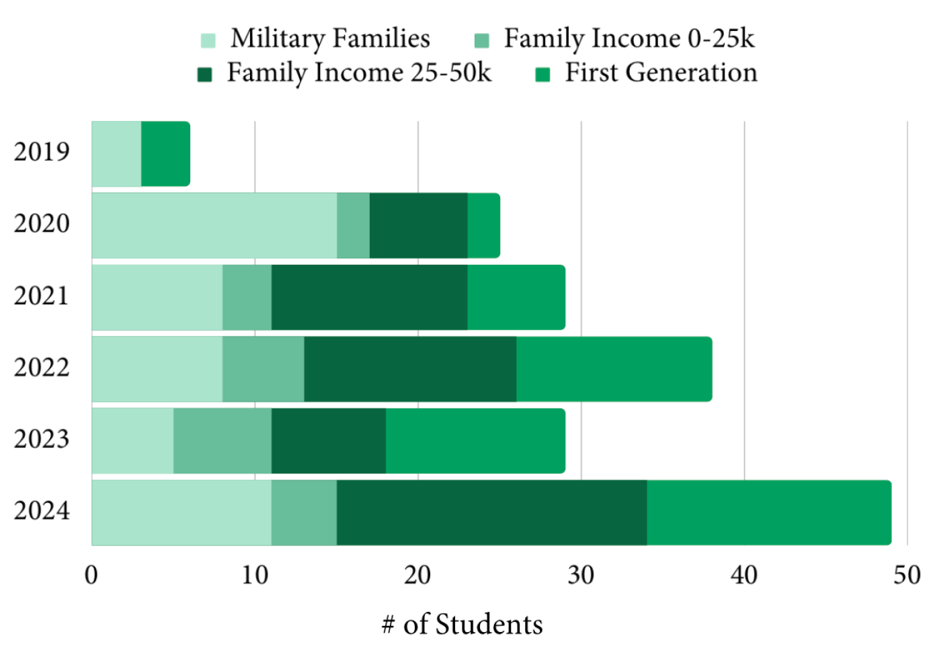
Exceptional Students – Demographics

Slide 8
Exceptional Students – ACT
Class | Sophomore Admission | Senior Exit | 2 Year Growth
2017 | 30.8 | 32.8 | 2.0
2018 | 30.4 | 32.9 | 2.5
2019 | 30.3 | 32.7 | 2.4
2020 | 31.4 | 33.7 | 2.3
2021 | 31.6 | 33.2 | 1.6
2022 | 30.6 | 31.2 | 0.6
2023 | 28.7 | 31.8 | 3.1
2024 | 29.1 | 32.0 | 2.9
2025 | 27.8 | 31.1 | 3.3
2026 | 28.5 | N/A | N/A
2027 | 28.8 | N/A | N/A
pandemic

Slide 9
Exceptional Students – National Merit
*Top 1% of students who take the PSAT nationally; approximately 2% of Kentucky students qualify annually.*

Slide 10
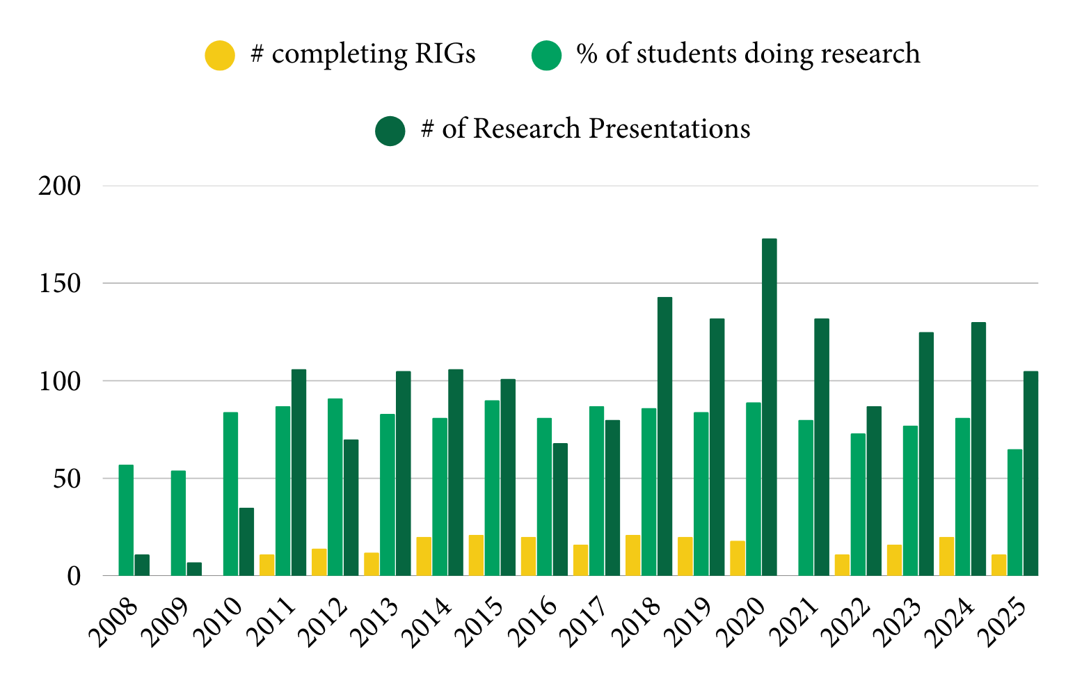
Exceptional Students – Research

Slide 11
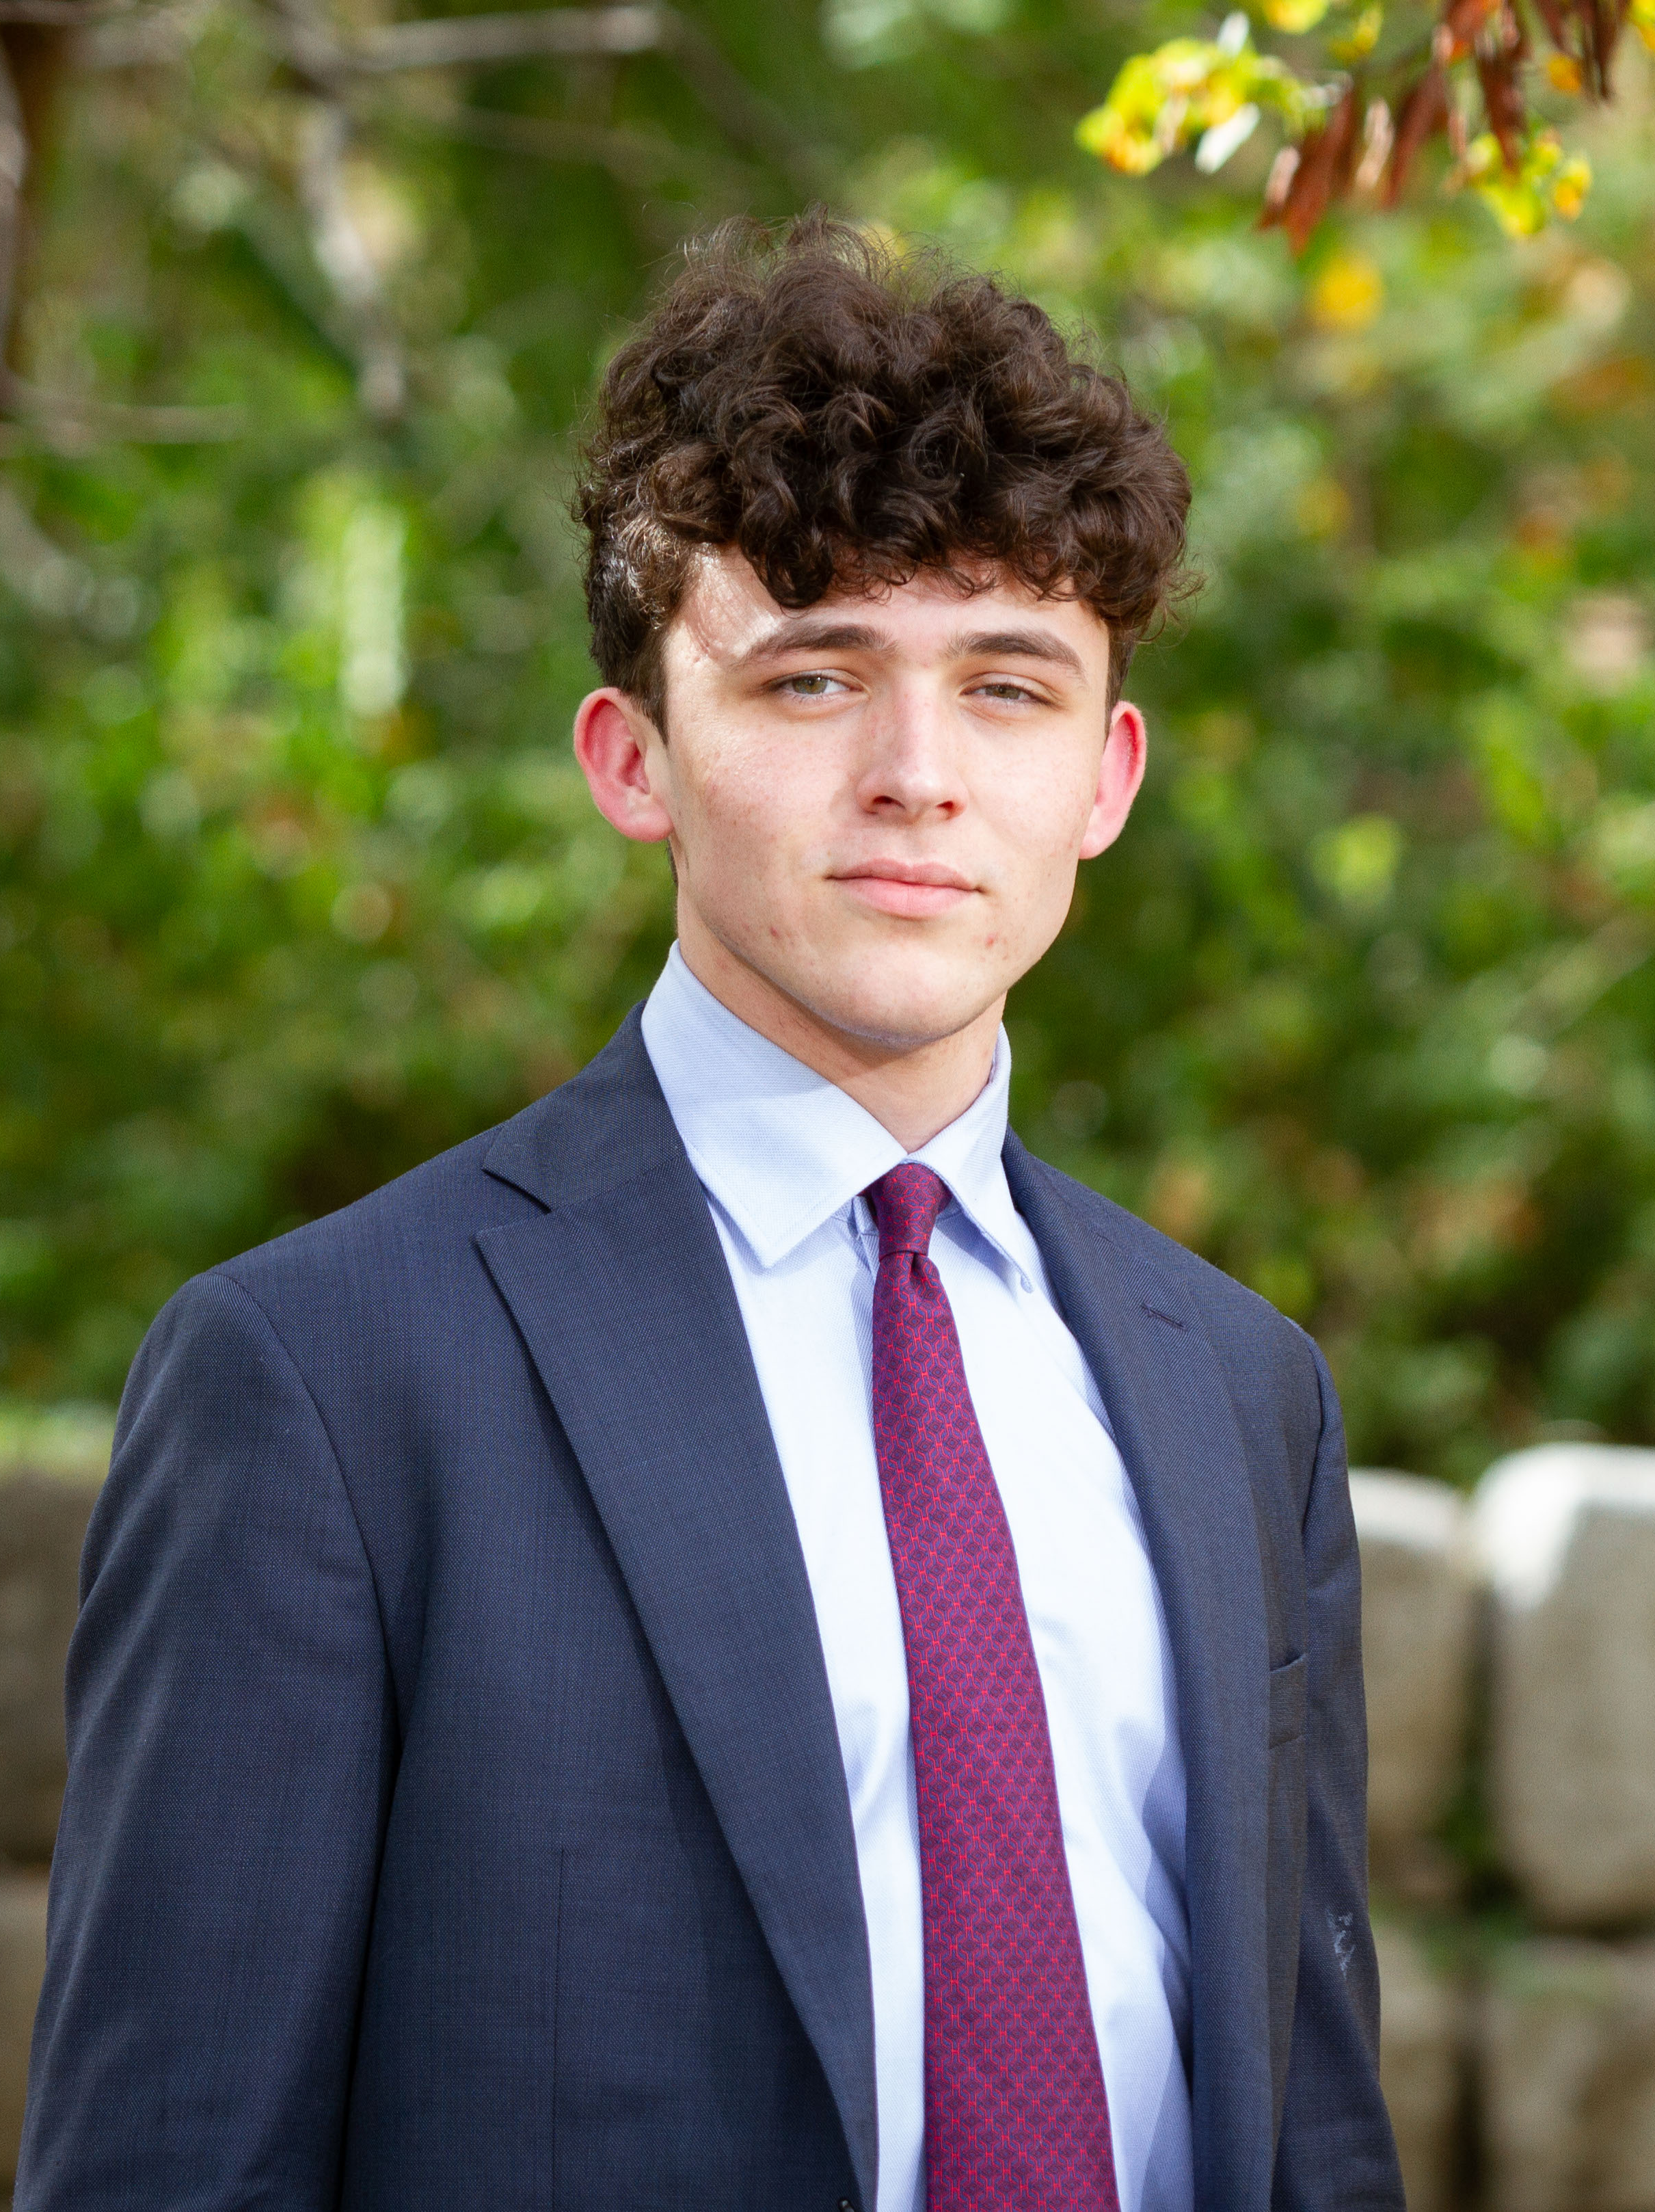
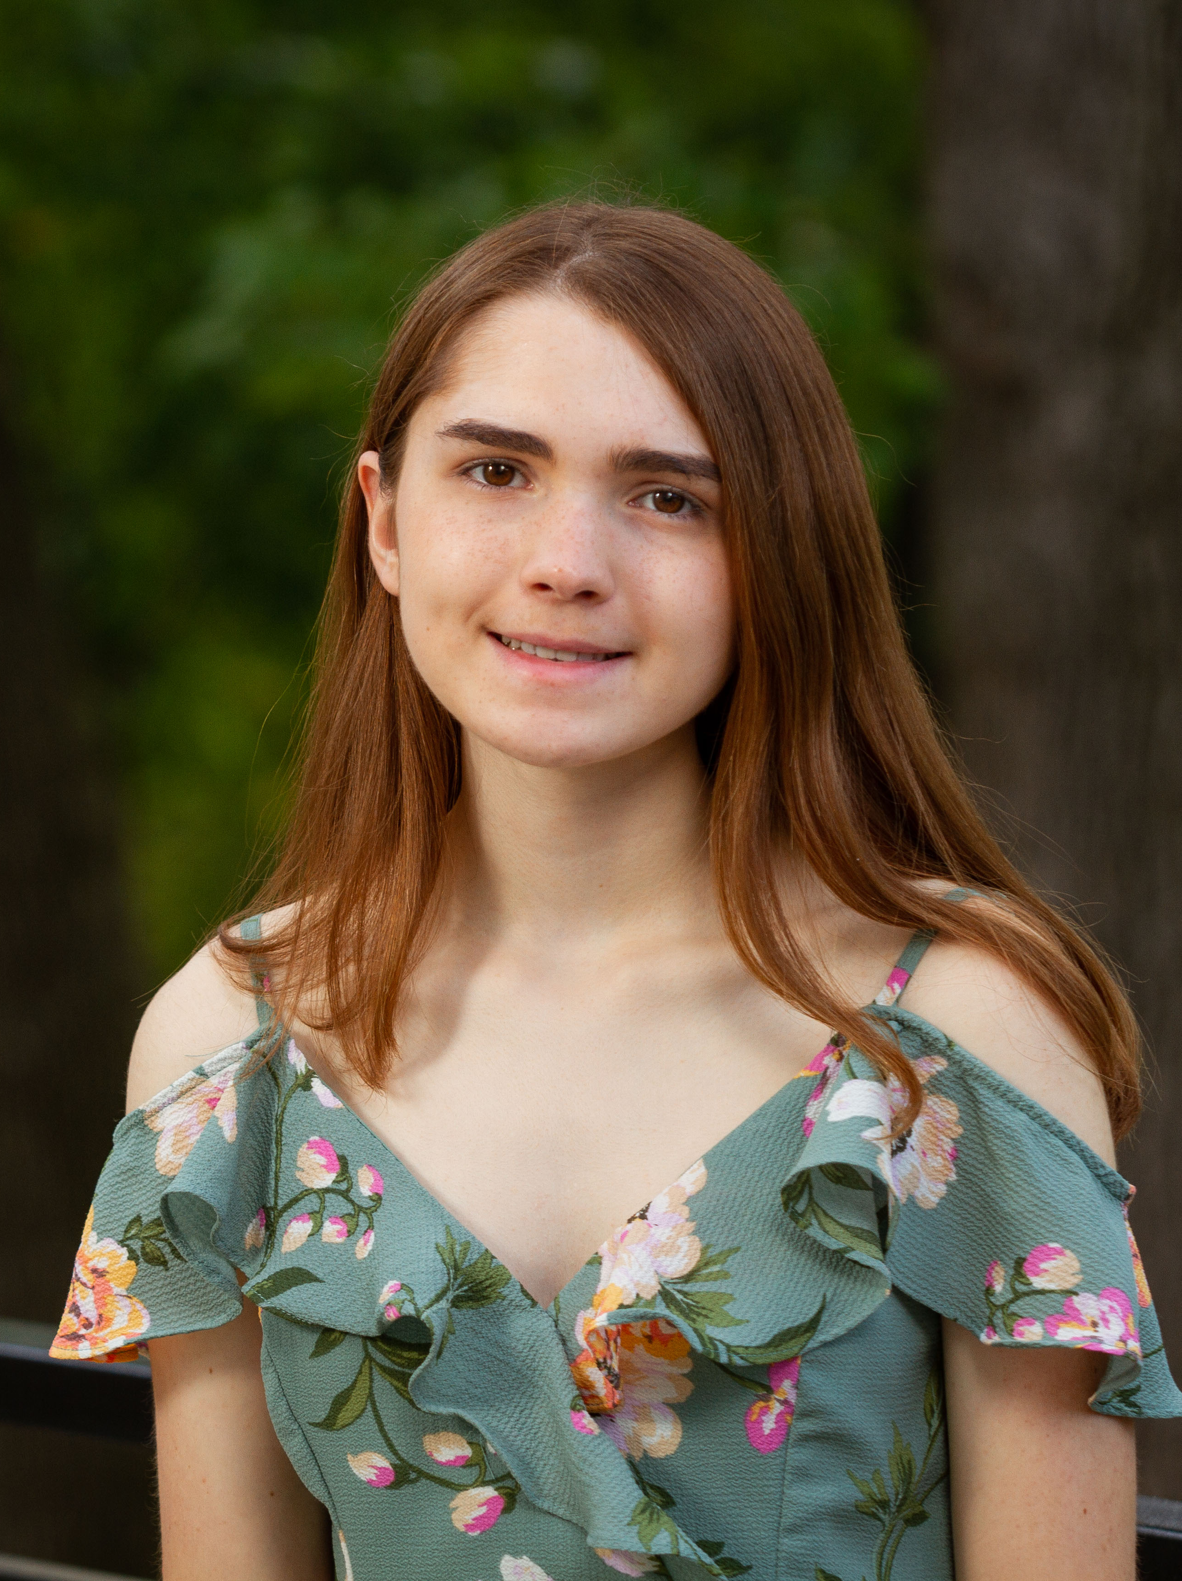
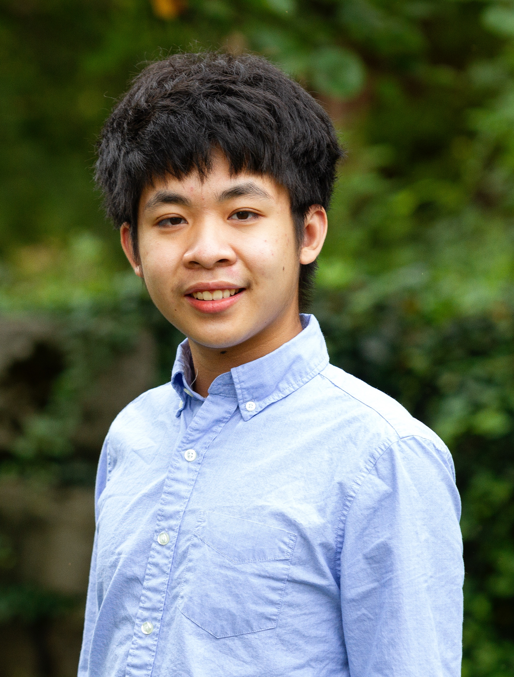







Exceptional Students – Awards

Slide 12
Exceptional Opportunities
Ivy League
Overall
Gatton’s: 7.68%
General: 5.32%
University of Chicago
Gatton’s: 8.59%
General: 4.48%
MIT
Gatton’s: 13.9%
General: 4.5%
Gatton’s 5-year rate: 19.54%
The General Assembly’s investment has created an elite educational experience accessible by students statewide. Gatton students’ experiences and outcomes rival those of students attending the nation’s most prestigious high schools.

Slide 13
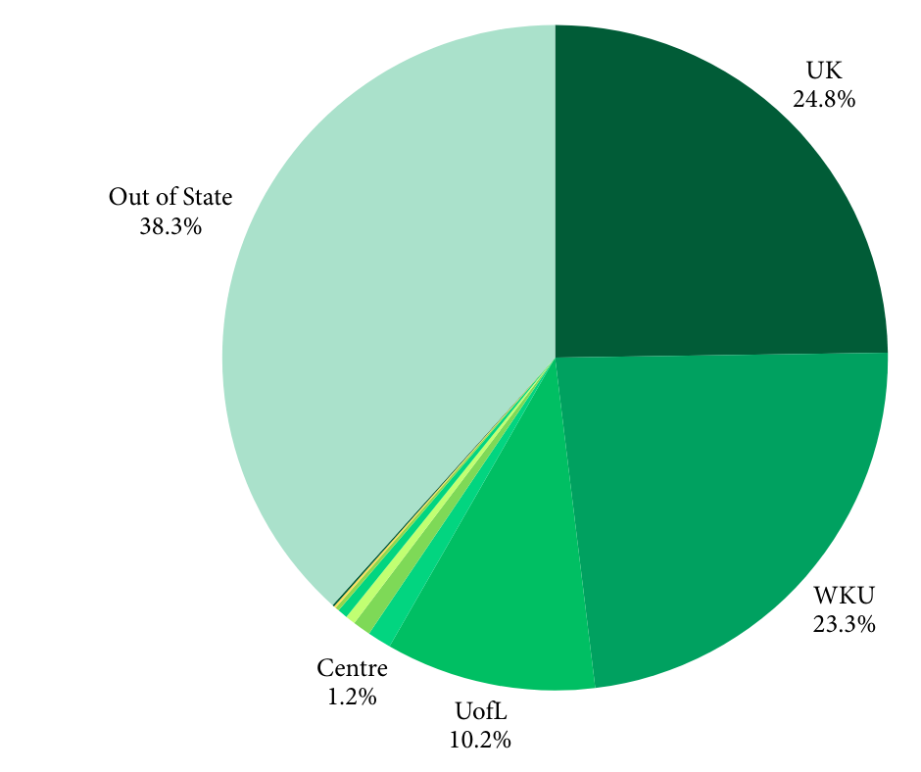
Exceptional Opportunities

Slide 14
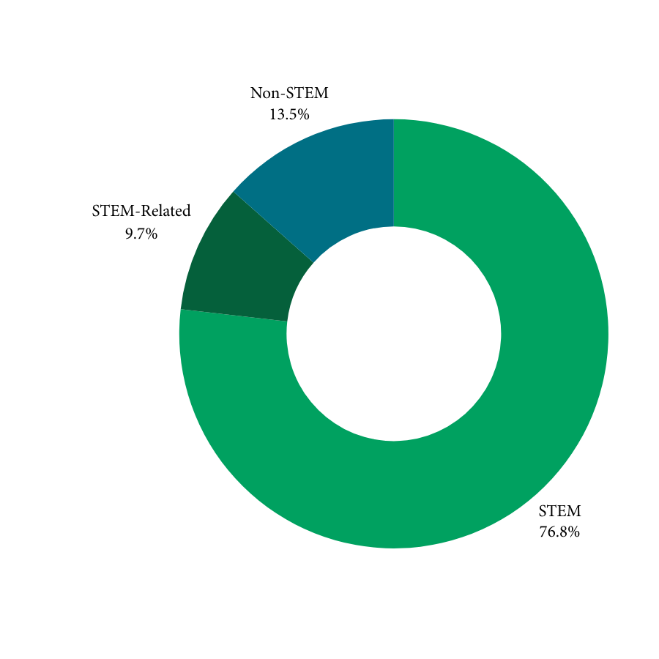
Exceptional Alumni
87% of Gatton alumni major in STEM and STEM-Related fields compared to only 22.6% of US college students.
Approximately 48% of students who enter college as STEM majors change majors or leave college.
National Science Board, 2012
Chen & Soldner, 2013

Slide 15
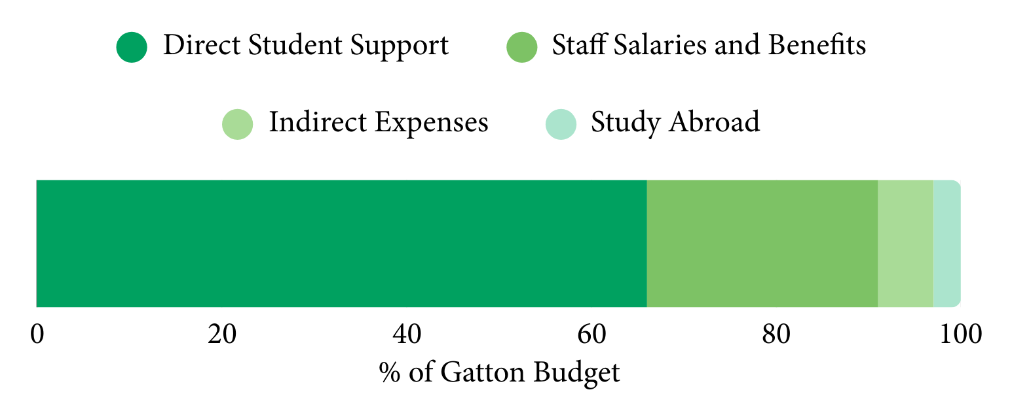
Sound Investment
$30,715 per student for 180 students

Slide 16
Sound Investment
2007-08:
Gatton Academy opens
2015-16:
Increase for expansion
2017-19:
Cuts to funding
2020-21:
Funding restored
2024-26:
9% increase

Slide 17
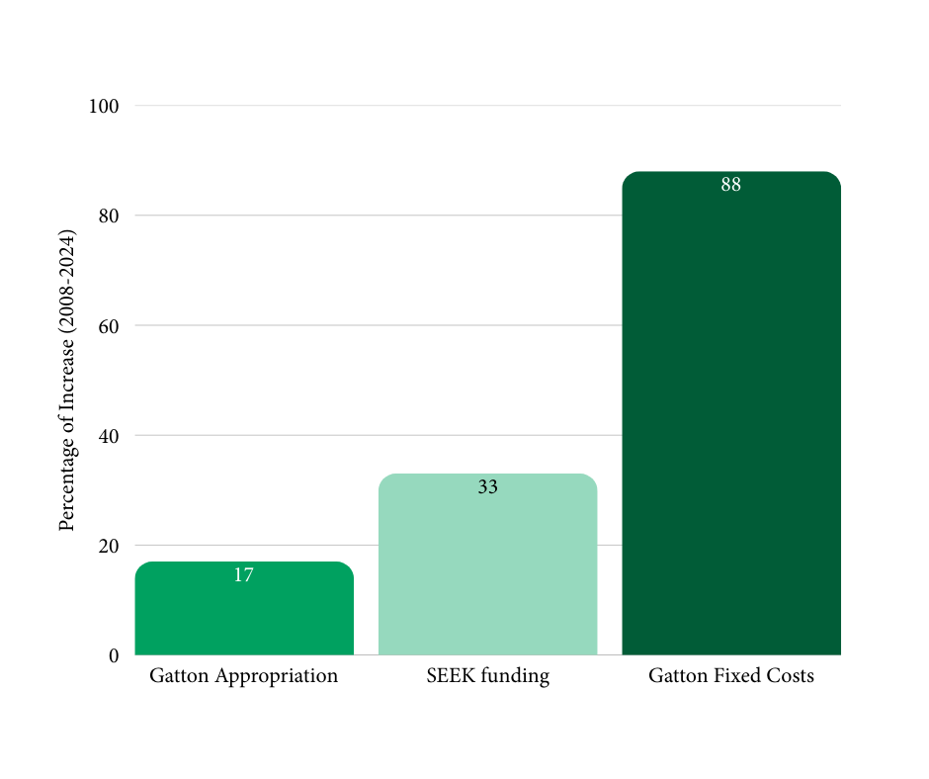
Sound Investment
Rising Costs of Attendance vs. Appropriation, 2008-2024

Slide 18
Sound Investment
The Gatton Academy’s unique structure makes us well-positioned compared to many other states’ academies.
Students’ SEEK funds and test scores remaining with their districts allows us to be partners rather than competitors.
This structure was purposeful in Gatton’s founding. Our partnerships are mutually beneficial and maximize opportunities for students. Academies in other states without these benefits cannot recruit in schools.

Slide 19
The Gatton Academy’s Vision
The Gatton Academy is a global leader in education, preparing Kentucky students for tomorrow’s STEM careers and infinite possibilities.

Slide 20



The Gatton Academy’s Vision

Slide 21
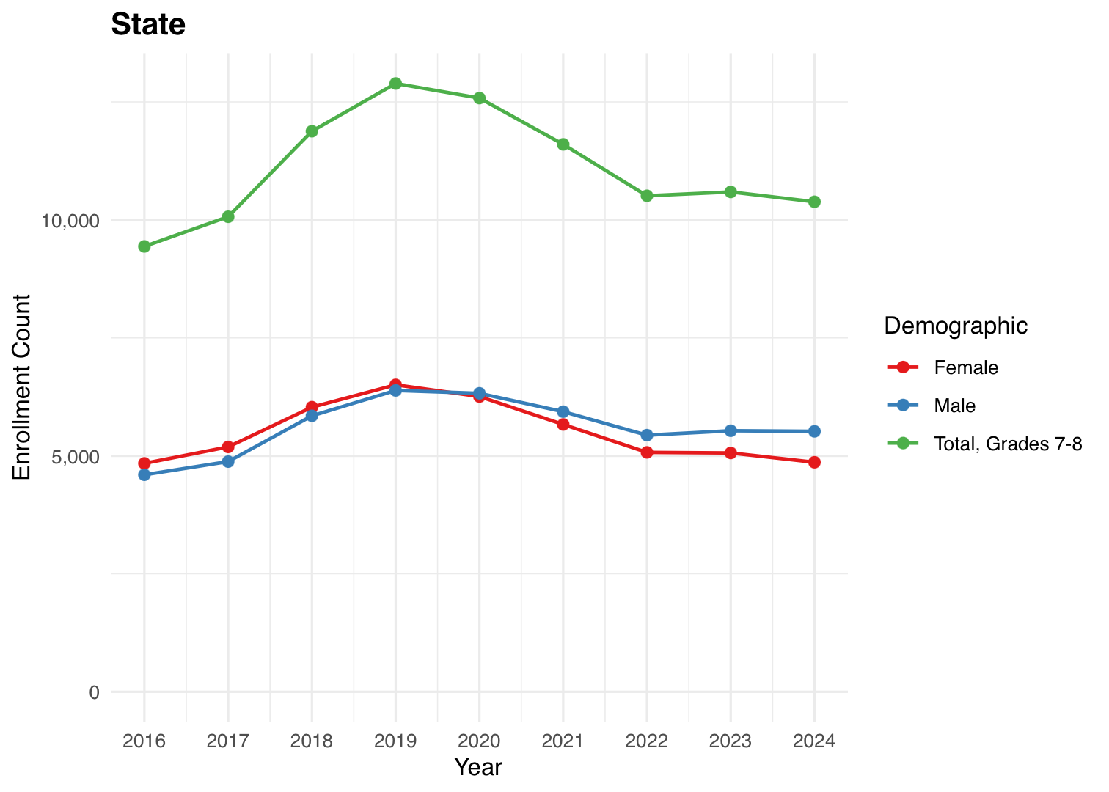
The Gatton Academy’s Vision
Algebra 1 Enrollments in Kentucky, 2016-2024
Access to advanced coursework has declined, particularly access to Algebra 1 in 8th grade and Algebra 2.
The Gatton Academy and The Center for Gifted Studies are well-positioned to partner with the General Assembly to address this problem.
Data Source: KYSTATS (2025); Figure by Tyler Clark

Slide 22
Kentucky’s Statewide Leader in
Advanced Education

Slide 23

Lynette Breedlove, Ph.D.
Director, The Gatton Academy of Mathematics and Science
lynette.breedlove@wku.edu

