Slide 1
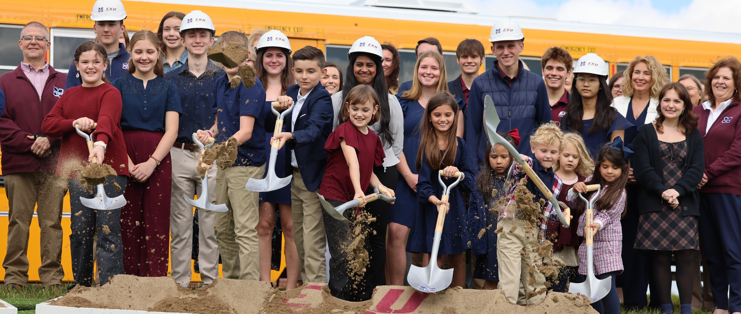

A Vision Years in the Making…
Now Becoming Reality

Slide 2
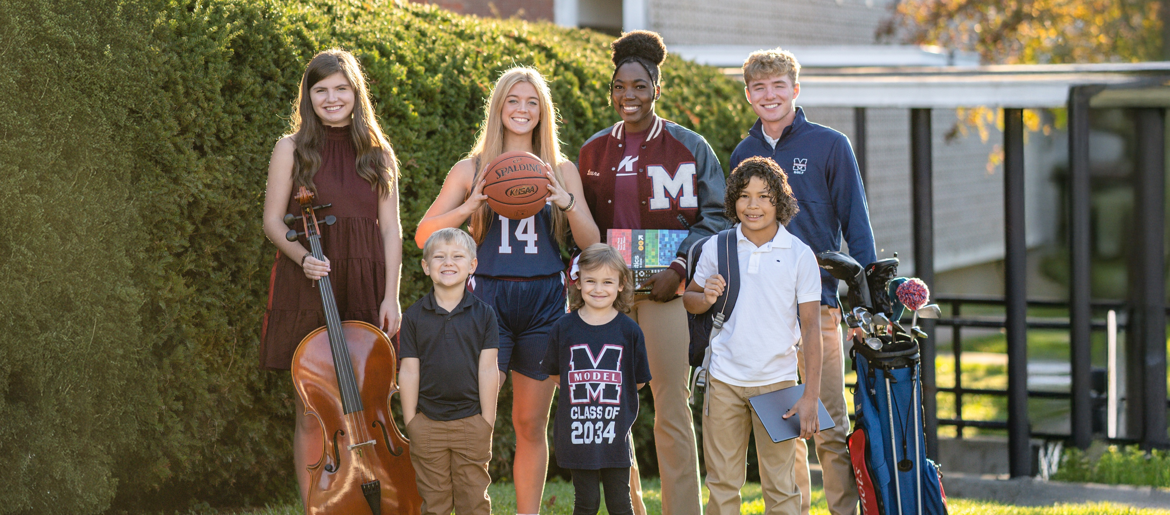

But a building doesn’t make a school…
People do.

Slide 3
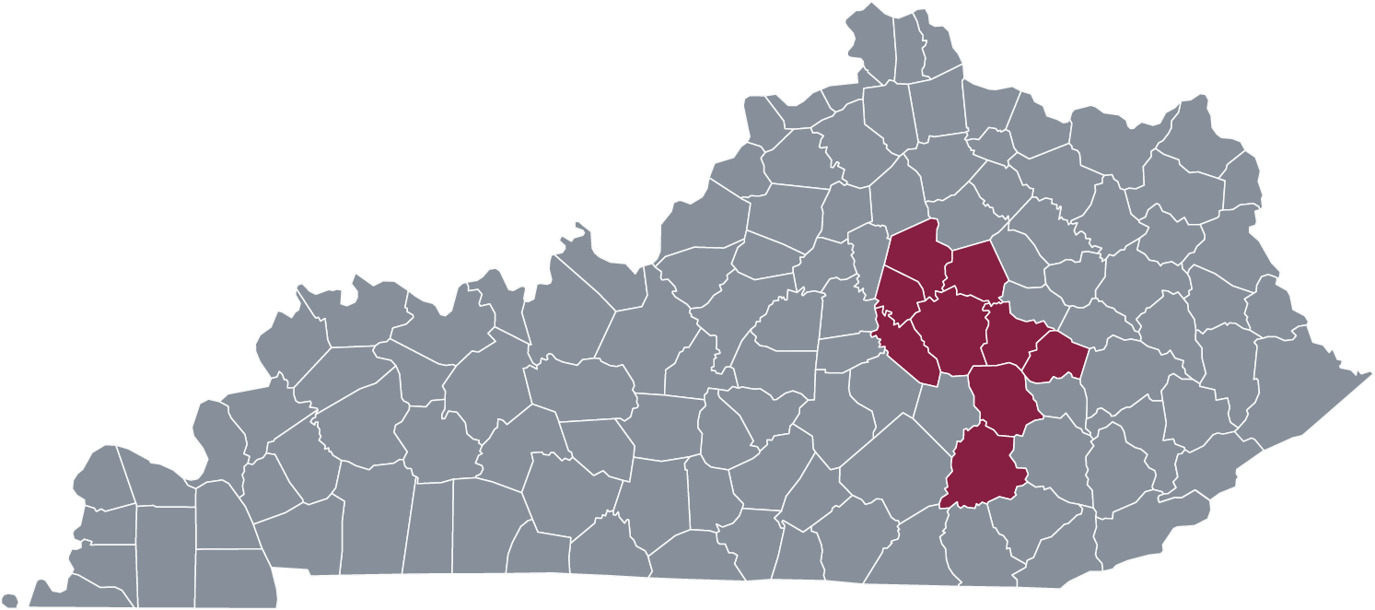
Proud to be the
Commonwealth’s
Lab School
PK-12 public school with open admission by application date
758 students
From 9 districts
10% of students have a disability
Same assessments and standards as every Kentucky public school
Living laboratory for teacher training, research, and applied learning experiences
Mission established in statute (KRS 164.380)
Applied clinical experiences that support “learning by doing” for Kentucky’s future teachers, nurses, mental health professionals, child development specialists, occupational therapists
  12,500+ hours of undergrad learning in 2024-25
Center for Educator Excellence – professional development for in-service teachers
Over 15 faculty/staff serve in a leadership capacity training professional educators across the nation

Slide 4


A Tradition of Academic Excellence
Model Elementary earned highest possible state academic rating in 2024
Consistently ranked in the top 10 highest-performing high schools in Kentucky
Graduation requirements based on competencies
  All seniors complete research projects
College/Career Readiness: state average 81.0% vs. Model 96.4% ≈15% higher
AP Platinum School of Excellence: ranked in the top 7% of schools nationwide & recognized every year since the award began

Slide 5
Key Fiscal Metrics
Year | Total Model Enrollment | Annual State Support for Model Lab Per Pupil
2020-21 | 659 | $7,544
2021-22 | 732 | $6,875
2022-23 | 760 | $6,332
2023-24 | 737 | $6,203
2024-25 | 720 | $6,350
2025-26 | 758 | $6,032
EKU receives $4.571M in annual state support for Model
  This number has not been adjusted since its initial allocation in 2020
As enrollment grows, Model’s state funding remains flat, resulting in a decrease in per-pupil support
Model does not receive any SEEK funding nor does it receive federal funding (e.g., IDEA-B, Title I, School Lunch Program, etc.)
  KDE ruled Model ineligible for federal funding, though 10% of Model Lab students are identified as special needs (similar to state average)
Model is not able to levy any local taxes

Slide 6
Model Maximizes Efficiency
Per-Pupil Spending
2023-24
Every dollar the state invests in Model stretches farther
than the average.
Per-Pupil Spending*
$13,471 vs. $19,020 statewide
≈34% lower
$20k
$19,020
$13,471
$10k
KENTUCKY AVERAGE
MODEL
*according to latest audited financial data (2023-24)

Slide 7

Advancing the Priorities of the Commonwealth
Preserving our undergraduate focus while broadening our contributions to meet Kentucky’s emerging needs
Expanding our impact beyond education to support the university in recruiting and preparing the next generation of future health professionals through a residential academy

Slide 8
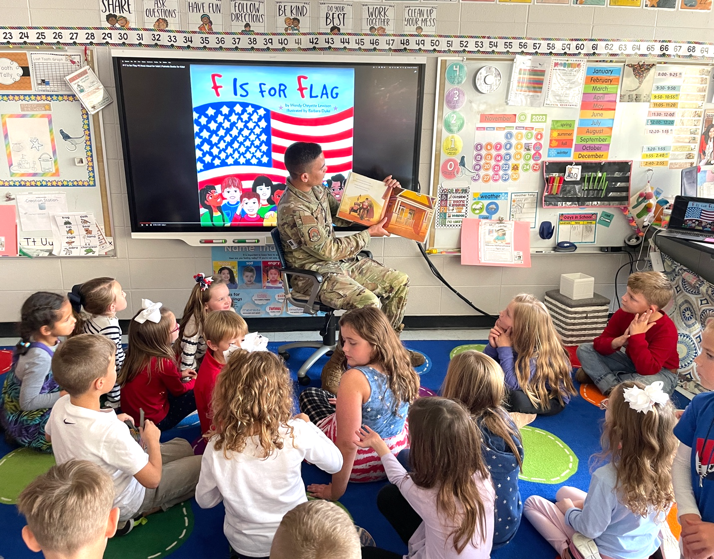
Sustaining Achievement as
Enrollment Increases
Continuing our tradition of success
  Serving PK-12 students
  Collaboratively preparing pre-service professionals
  Equipping in-service teachers with tools and training
Strengthening our role within the university by serving as a learning lab for undergraduates and supporting the need for more healthcare professionals through an innovative residential academy
The consideration for the committee and General Assembly is to establish a per-pupil funding model that accounts for:
  Enrollment growth
  Base increases equivalent to guaranteed base funding to other districts

