Slide 1

Morehead State University
Craft Academy
Presentation to IJC Budget Review Subcommittee September, 2025

Slide 2

Craft Academy for Excellence in Science and Mathematics
Vision: To empower academically exceptional Kentucky students by providing a residential, dual-credit college experience to prepare them for STEM careers and future leadership, fostering innovation, creativity, and entrepreneurial skills to benefit the Commonwealth.
Mission: Aspires to empower KY high achieving youth to imagine, invent, and impact STEM careers in a focused effort to improve the quality of lives in EKY and KY.
Commitment: To educating the whole student, rigorous STEM curriculum, experiential learning, leadership development and a global outlook.

Slide 3
Craft Academy Quick Facts
Established in 2016 – 10th entering class
Residential living on campus and learning (2 HS +2 College)
Currently serves 200 students supported by a State Mandated Program
Strong STEM+H (X)
Average GPA in HS – 3.8
High matriculation to graduate and professional schools
Strong emphasis on workforce for our state and economy
Internships, service learning, undergraduate research, edu abroad
Named #6 on Top 30 HS STEM programs in the U.S.

Slide 4
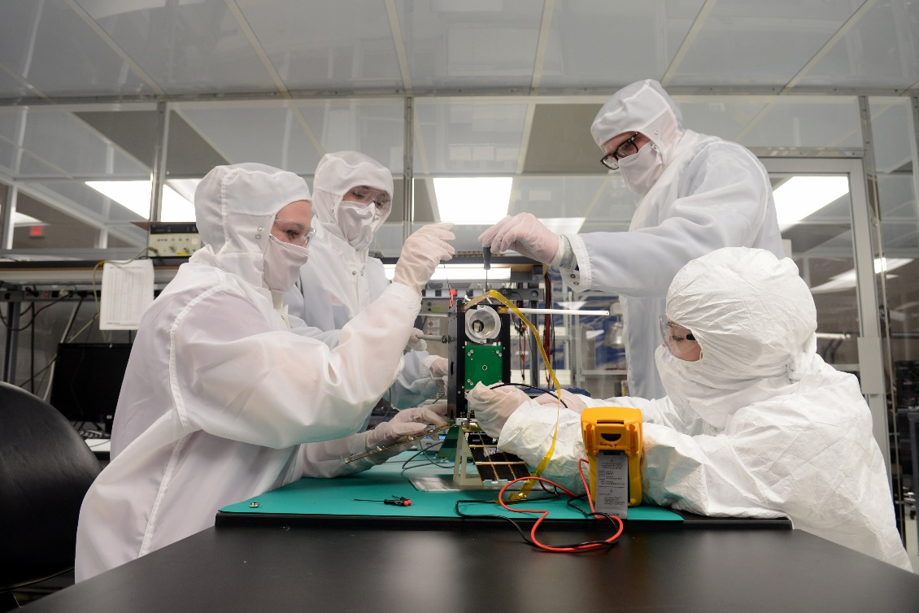
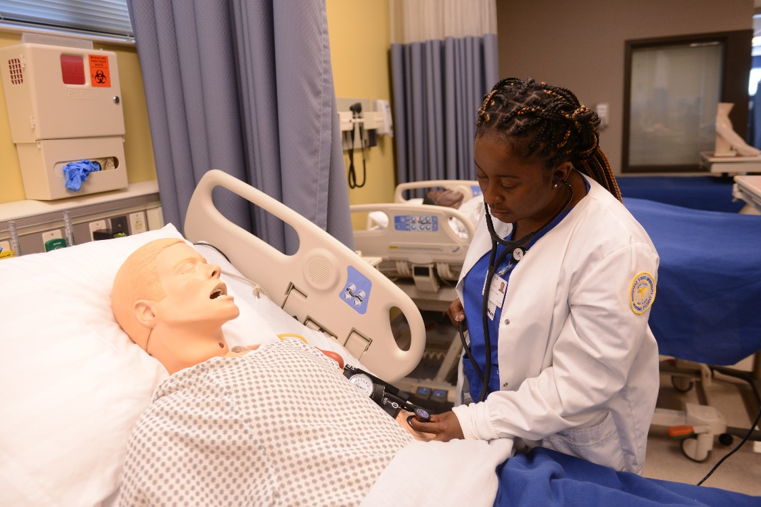
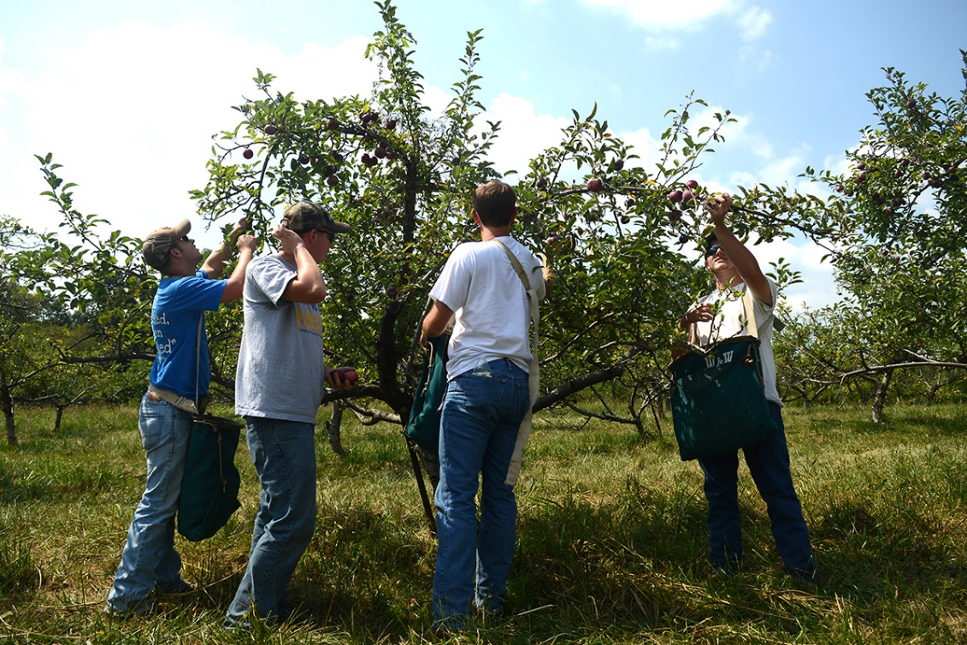
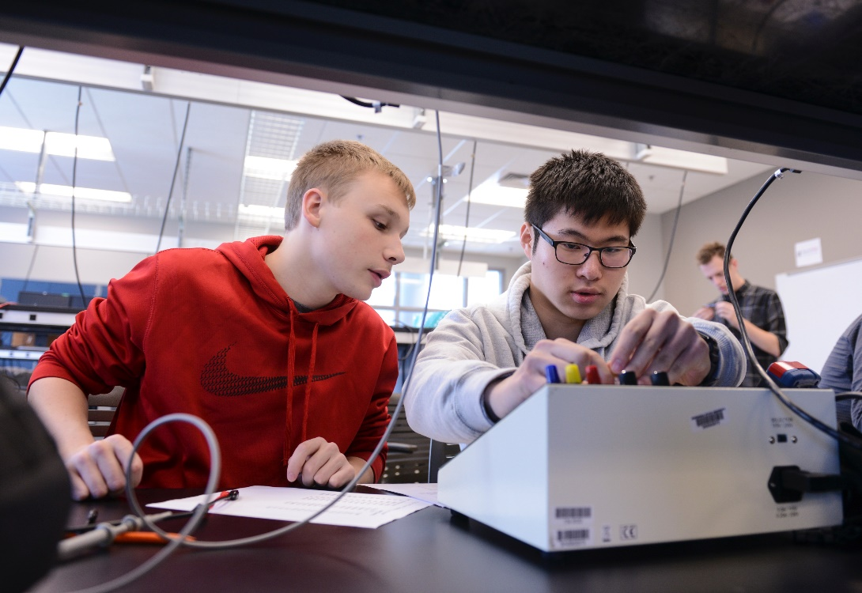
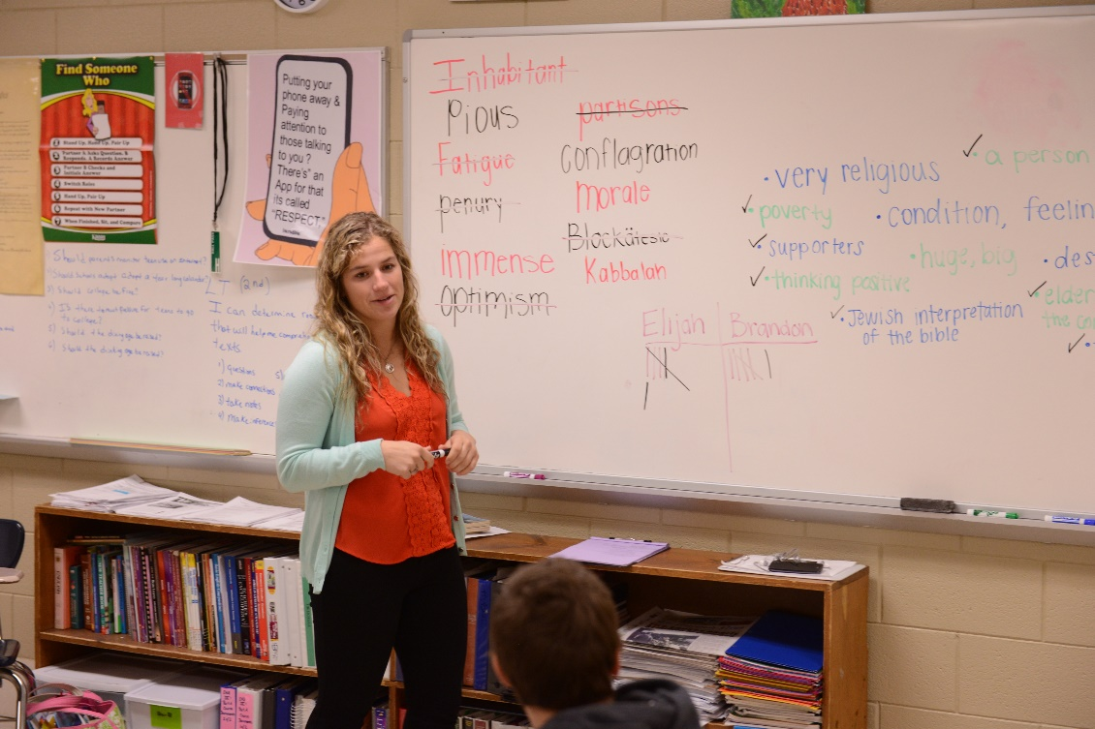
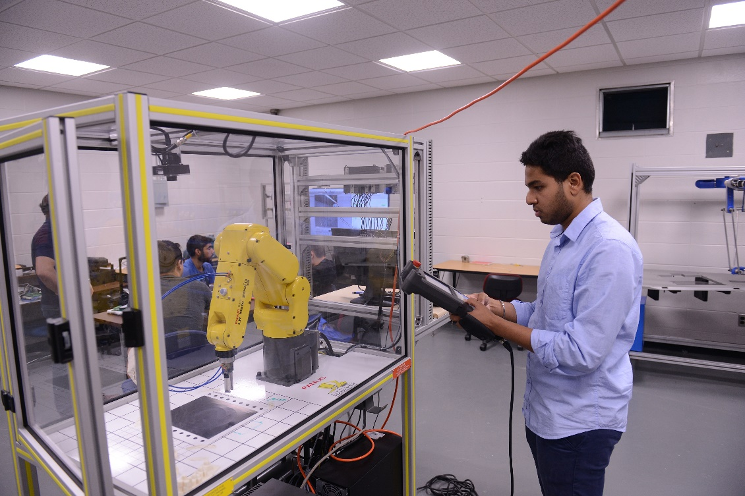
Strong Academic STEM Programs
Serving the Economy and Region
Space Science / Astrophysics
Biomedical Sciences
Biology / Chemistry / Geo/ Physics
Computer Science
Veterinary Sciences
Engineering

Slide 5

Economic Development

Slide 6
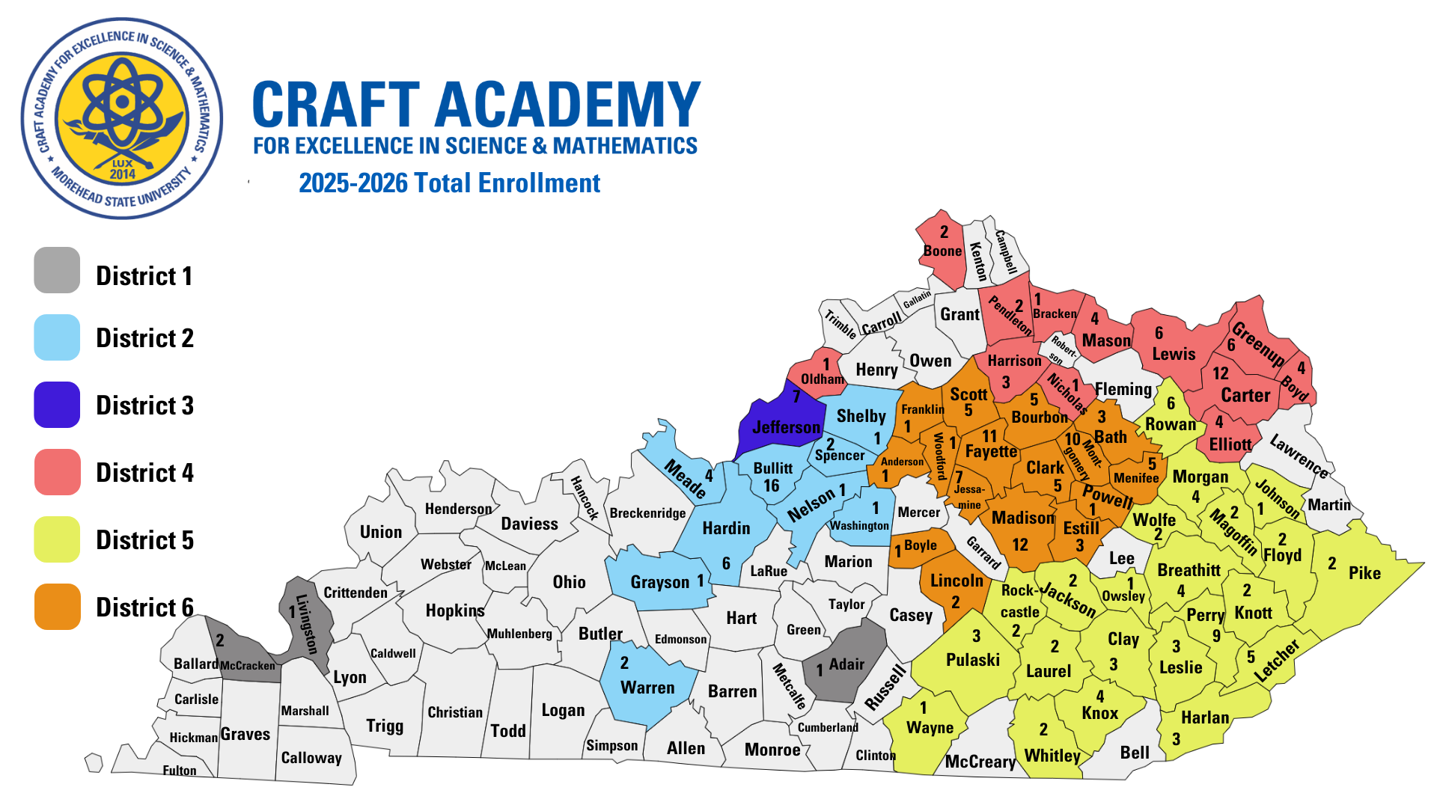

Slide 7
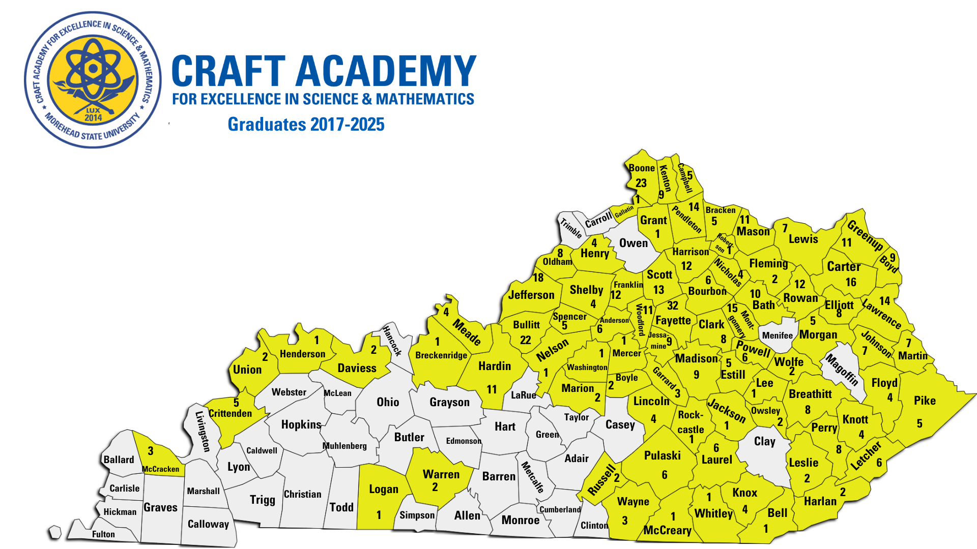

Slide 8
Craft Academy State Biennial Budget

Slide 9
Craft Academy External Support
Dr. Joe Craft and Ambassador Kelly Craft
Provide funds for special events and other student support
Funds competitive events, scholarships for Jr. Sr. Yr. of College
Other support

Slide 10
Possible Future Growth Opportunities
Currently funded at 200 students per year
MSU has instructional, housing, and student support capacity to go to 250 students
Estimated annual additional cost: $1.25 – 1.35 million

