Slide 1
Teacher Compensation in Kentucky Public K-12 Schools: An Estimate*
John Garen, Ph.D.
Emeritus Professor of Economics, University of Kentucky and Scholar, Bluegrass Institute
Paul Coomes, Ph.D.
Emeritus Professor of Economics, University of Louisville
October 15, 2025
*Based largely on the authors’ Bluegrass Institute Policy Brief “Estimated Growth in Annual Public Teachers’ Compensation in Kentucky,” March 20, 2025, www.bluegrassinstitute.org/content/files/2025/10/Growth-in-teachers--compensation-study-3.pdf.

Slide 2
The average annual teacher salary in FY24 was $58,788 (and rose to $61,107 in FY25).
Adjusted for inflation, average teacher salaries fell by 7.1 percent between 2006 (the earliest year for which consistent data are available) and 2024.
Salary data from Kentucky Department of Education. Adjustment for inflation using US implicit price deflator for personal consumption expenditures.

Slide 3
The state further subsidizes teacher salaries with the “on behalf” payments for pensions, health insurance, life insurance, technology support, and debt service on construction projects. On behalf payments related to compensation amounted to $1.93 billion in fiscal year 2024.
We estimate that average fringe benefits per teacher were $35,406 in FY24.
One can see that after inflation, these payments rose 61 percent over the period studied.

Slide 4
Combining salaries and benefits, we see that total average compensation was $94,194. Because of large increases in fringe benefits, especially contributions to the Kentucky Teachers’ Retirement System (TRS), average inflation-adjusted compensation per teacher rose 10.5 percent over the period.

Slide 5
Jefferson now $118,000, up 21%.
Fayette now over $112,000, up 31%.

Slide 6
Some Related K-12 Measures
The 10.5 percent increase in average teacher compensation was much less than the 40.5 percent increase in inflation-adjusted per pupil funding received by Kentucky’s K-12 schools.

Slide 7
The number of public-school students has fallen on net over the last 30 years, while the number of teachers and staff have grown.
The pupil to teacher ratio fell from 15.5 in 1994 to 13.1 in 2023.
The pupil to non-teacher staff ratio fell from 13.2 in 1994 to 10.1 in 2023.

Slide 8
Kentucky ranked 45th among states in the share of total staff who were teachers.

Slide 9
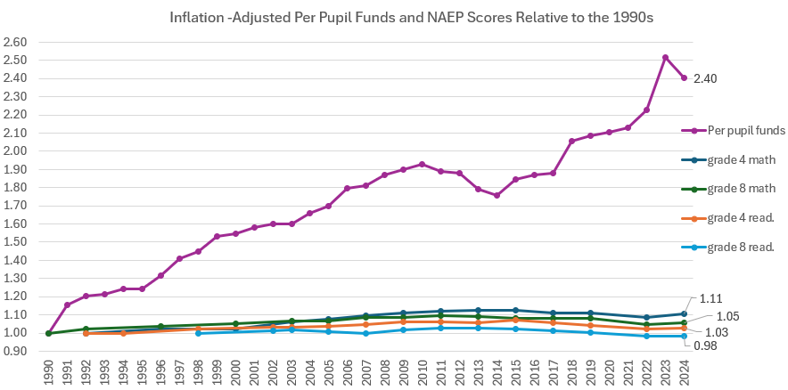
Improvement in educational performance has been small, especially compared to funding increases.
Inflation-adjusted per pupil funding rose from $8,293 in 1990 to $19,934 in 2024; 2.4 times higher.
Compared to their initial 1990s scores, NAEP grade 4 math is 1.11 times higher, grade 8 math is 1.05 times higher, grade 4 reading 1.03 times as high, and grade 8 reading is 0.98 times as high.

Slide 10
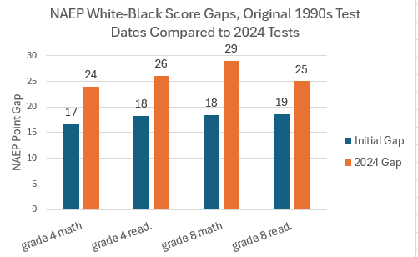
The gaps between White and Black student NAEP scores were higher in 2024 that at the NAEP test inception in the 1990s.

Slide 11
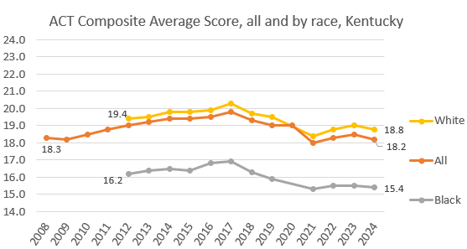
ACT scores showed a small increase to 2017, then a decline. The White-Black score gap has not lessened.

