Slide 1






Building Kentucky’s Digital Workforce Pipeline
A Strategic Workforce Investment for Kentucky’s Future
weleadcs.org

Slide 2



THE CHALLENGE
92% of jobs require technology skills
47% require 'definitely digital' skills (Java, Python, etc.)
50% of tech jobs now require AI skills
+98% increase in one year
3,400 open computing jobs/month in KY – average $80,000/ year
Jobs open 120+ days - leading indicator of skills gap in KY tech workforce

Slide 3


THE OPPORTUNITY
START WHERE THE GAP BEGINS
DATA SCIENCE
CYBERSECURITY
AI LITERACY
No data science pathways in KY high schools → We Lead CS launching in 2026-2027
Enrollment: only 336 students statewide → We Lead CS added 57 more in one year
Launching Kentucky’s first high school AI literacy course spring 2026
EMPLOYER ADVISORY BOARD ENSURES INDUSTRY ALIGNMENT

Slide 4


RETURN ON INVESTMENT (ROI)
WORKERS: INCREASED WAGES
01
Workers with 1 digital skill earn 23% more; 3+ skills earn
45% more
BUSINESSES: HIGHER PROFITS AND GROWTH
02
Companies with advanced digital skills → 168% higher revenue
44% more likely to see consistent growth
KENTUCKY: ECONOMIC GROWTH
03
Digital skills = higher wages, productivity, and tax revenue

Slide 5
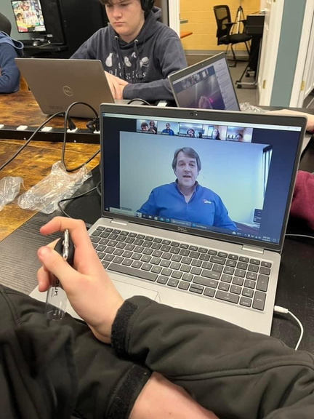
GROWTH & IMPACT
Growth: 68 students → 225 students → projected 750 by 2028
5 schools → 26 schools → statewide virtual reach
JumpStart pre-internships and 60 paid virtual internships by 2026

Slide 6

THE ASK
Increase appropriation from $3M → $5M (2026–2028)
Expands AI, Data Science, Cybersecurity, Programming, Networking pathways across Kentucky
Supports 250 new students/year
Total enrollment +750 in 2027-2028
Strengthens employer partnerships
Virtual work based learning
Paid work experience for students

Slide 7

PREPARING STUDENTS. POWERING EMPLOYERS.
Building Kentucky’s digital workforce pipeline
01
Proven results, scalable statewide
02
Smart return on investment for Kentucky’s future
03

Slide 8

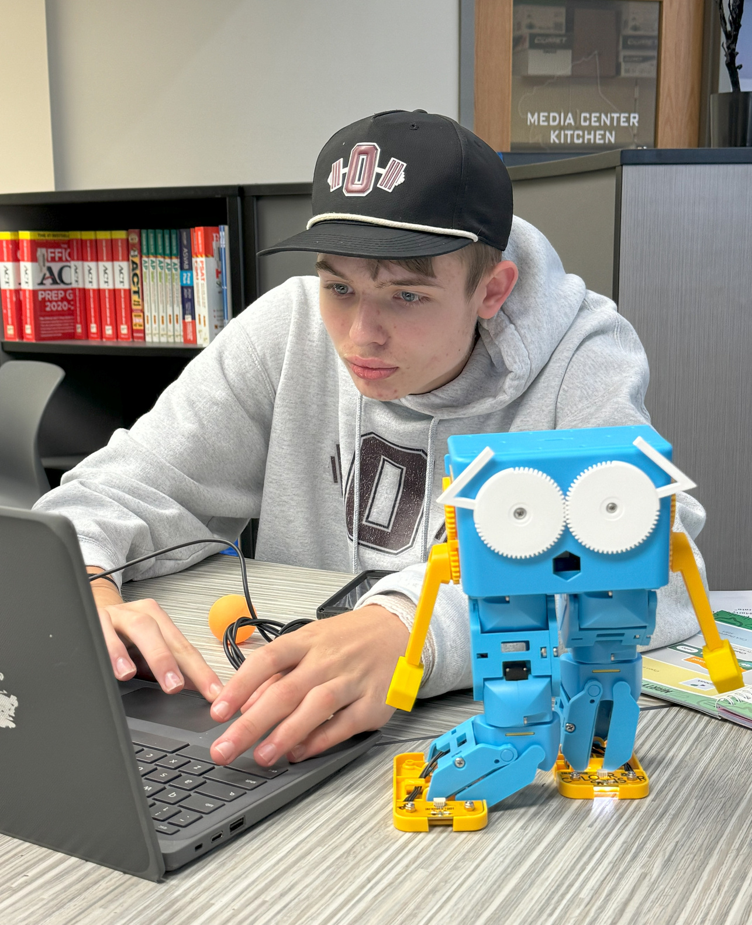



CONTACT US
502-475-1245
asells@weleadcs.org
www.weleadcs.org

