Slide 1
District Data Profiles School Year 2016-17
Presentation to Education Assessment and Accountability Review Subcommittee
by the
Office of Education Accountability
June 19, 2018
Notes:
Good Afternoon. Today, we’re presenting the Kentucky District Data Profiles for school year 2017.
This publication won a notable document award in 2012 from the National Conference of State Legislatures.
This is the 11th year of the report. The first year of the report was the 2007 school year.
Caution should be used when comparing certain measures over the years: Graduation Rate, Student Achievement (CATS, KPREP) and Fund Balance Percent have changed over the years.

Slide 2
Purpose of District Profiles
Easy access to commonly used education data
Quick reference
Can be used for comparative purposes
Notes:
The purpose of the profiles reports is to provide easy access to commonly used education data.
It is intended as a quick reliable reference for seeing how each district compares to the state as a whole and to other districts with similar characteristics.

Slide 3
Primary Data Sources
School Report Card
Infinite Campus (IC)
MUNIS
Notes:
The profiles are a compilation of data from the Kentucky Department of Education and the Kentucky Center for Statistics.
Much of it is housed in KDE School Report Card that is available online. The Report Cards provide information about each
district, including test performance, teacher qualifications, student safety, parent involvement and much more.
The data were recorded by districts in two main systems:
The student information system, usually referred to by its vendor, Infinite Campus, or “IC”,
and Munis, the accounting, Payroll and financial system used by all of the districts..

Slide 4
Data Profiles Organization
Data Dictionary
173 District Profiles
State Profile
Rankings on Selected Measures
Notes:
Here’s an overview of what is in the data profiles.
The data dictionary provides data definitions and sources.
That’s followed by 173 district profiles, in alphabetical order.
After those is one profile for Kentucky as a whole.
At the end of the report are several ranking tables. Those are useful for comparing districts and to see where certain districts rank.

Slide 5
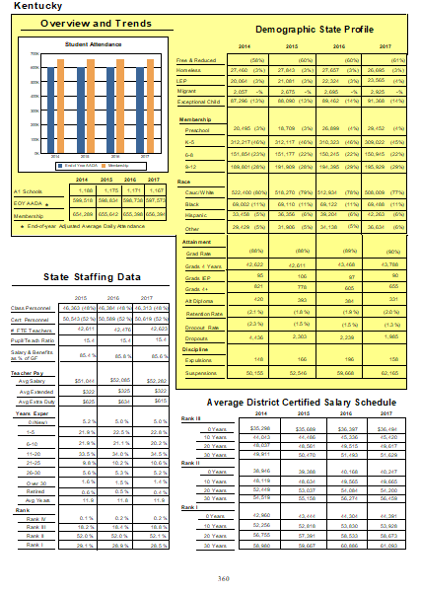
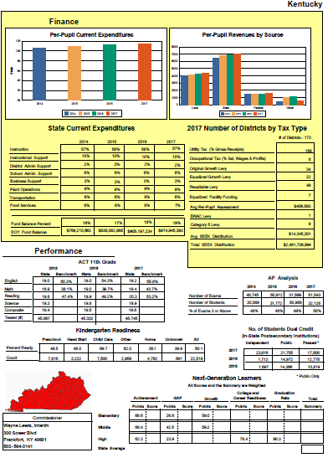
Layout of Each Profile
Notes:
Here’s a birds-eye view of the profile
Each profile has 2 pages.
Page 1 has an overview, staffing information, student characteristics, graduation and other attainment data, and discipline data.
Page 2 has financial and student performance data.

Slide 6
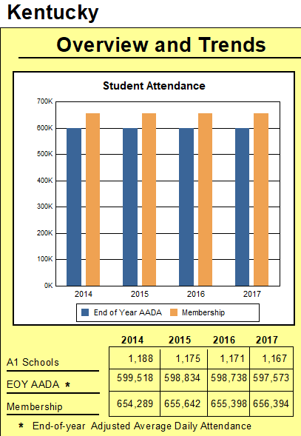
Overview and Trends
Number of Students
EOY AADA
Membership
A1 schools
Notes:
The Overview section of each profile shows the number of students, in terms of membership and adjusted average daily attendance, as well as the number of A1 schools in the district.
A1 Schools as reported in the Data Dictionary are: The number of schools under administrative control of a principal and eligible to establish a school-based decision-making council. An A1 school is not a program operated by or as a part of another school.

Slide 7
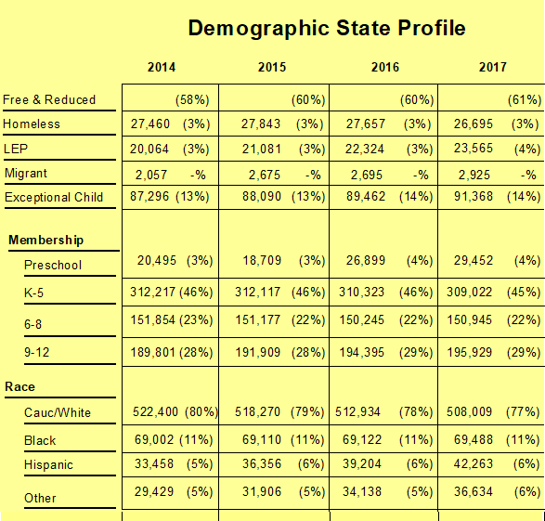
Demographic Profile
Free/Reduced-Price Lunch
Limited English Proficiency
Exceptional (“special ed.”)
Membership by Grade Level
Race/Ethnicity
Notes:
Page 1 of the profiles also provides Demographics and membership by grade level for the current year and three prior years.
For example, free and reduced-price lunch eligibility for 2017—is 61% for the state as a whole. That’s a up 3% points from 2014.

Slide 8
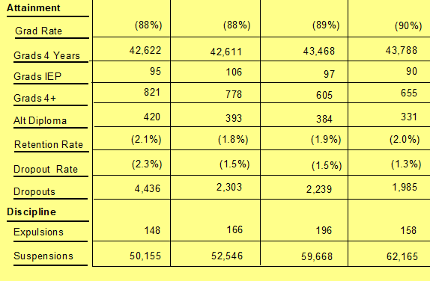
Attainment and Discipline
Notes:
Also On page 1 is information about graduation, retention, and dropout rates, along with dropout and disciplinary counts.

Slide 9
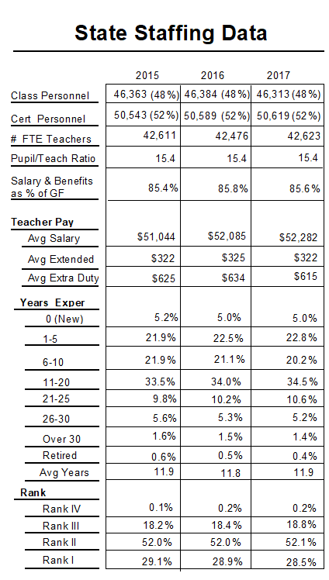
Staffing Data
Classified Personnel
Certified Personnel
Teachers (FTE)
Pupil/Teacher Ratio
Salary & Benefits as % of General Fund Expenditures
Teacher Pay
Teacher Experience
Teacher Rank
Notes:
The Staffing section, includes the number of classified and certified personnel, teacher experience, rank, and salaries.
Please note the Number FTE Teachers includes only classroom teachers.
FTE stands for Full Time Equivalent.

Slide 10
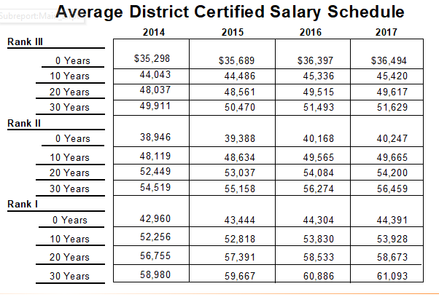
Staffing – Data State Level
Salary Schedule by Rank and Experience
Notes:
There’s also a state and district salary schedule by rank and years of experience. The state profile shows averages of all the district schedules.

Slide 11
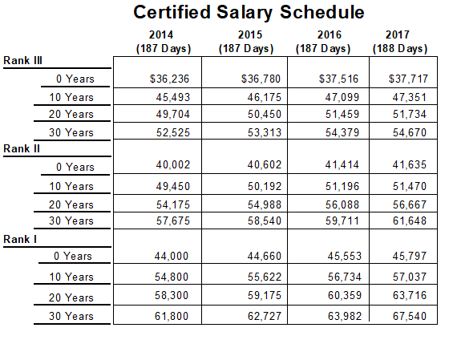
Staffing –Data District Level
Salary Schedule by Rank and Experience
Notes:
While the district schedule shows Contract Teaching Days, which are the number of base days a board of education has adopted to pay certified staff each year.
The number of contract days for districts range from 185 days to 188 days. 185 days is the minimum days a district can have.
The majority of districts are at the 185 day level.

Slide 12
Student Performance
AP – Advanced Placement
ACT-11th Grade
Kindergarten Readiness
Dual Credit
Next-Generation Learners
Notes:
Student Performance includes ……. Look at slide.

Slide 13
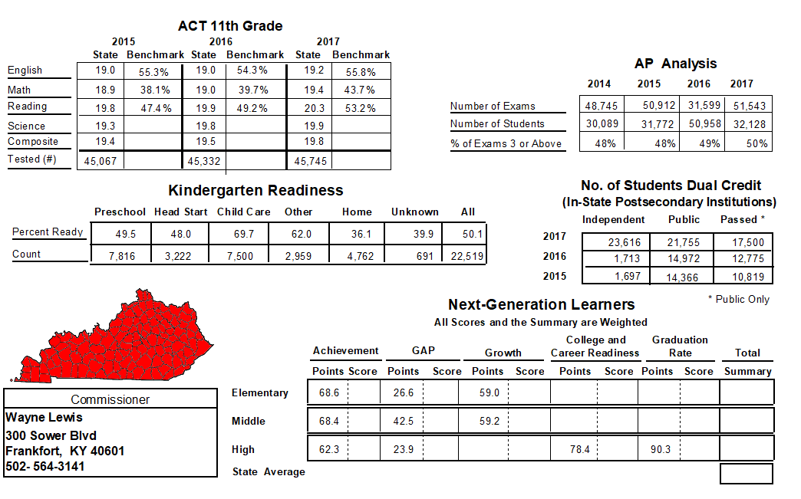
Student Performance
Notes:
This is the actual State’s Performance information.
This is the third year Dual Credit is captured. Dual Credit allows students to earn high school and college credit for the same course simultaneously.
Next Generation Learners is the component of the current accountability model that includes: Achievement, Gap, Growth, College/Career Readiness and
graduation rates, . Scores for the five components are no longer shown because 2017 was the last year for the previous accountability system and KDE chose not to report them.

Slide 14
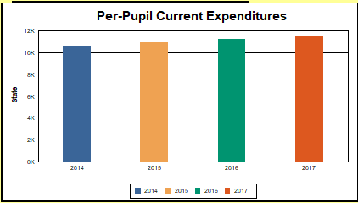
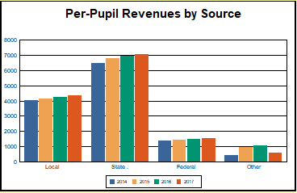
Finance
Notes:
Finance is also reported on page two of the report.
It reports a rich array of information, starting with per-pupil current expenditures and revenues...

Slide 15
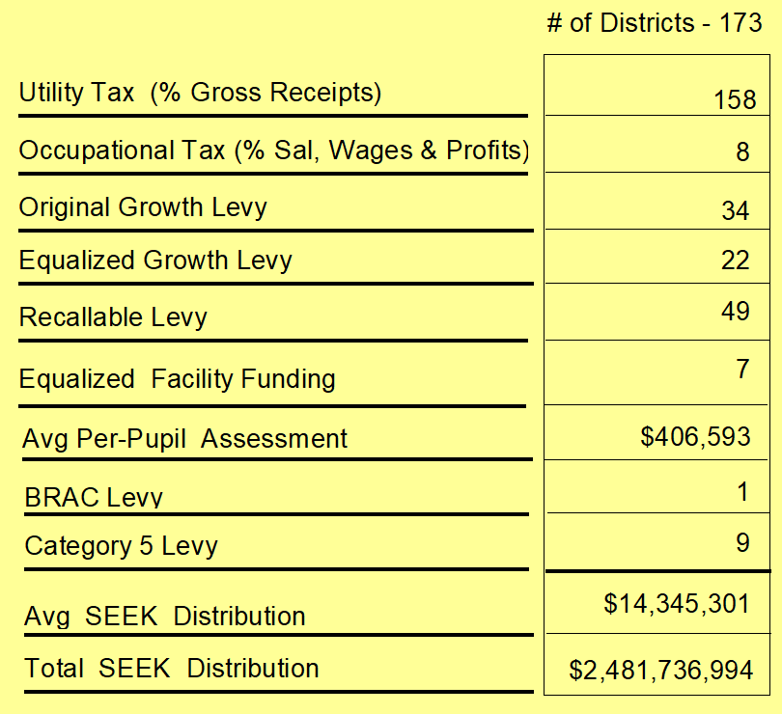
Finance
State profile shows counts of districts with each type of tax
Notes:
... It also reports tax rates and the SEEK distribution.
The Average Per-pupil Assessment for the State is $406,593 . This number by
itself doesn’t show the range in district per- pupil property Assessements.
The district per-pupil assessments range from a high of $1.3 million to a low
of just above 100,000. Page 365 of the report shows the wide range of assessment by District.
As you can see here, the state profile reports the number of districts with various types of taxes ... <go to next slide>

Slide 16
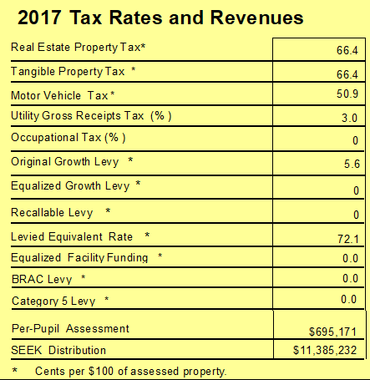
Finance
Each district profile shows dollar amounts or rates
Notes:
... while the district profiles report dollar amounts or rates, as you can see in this example.

Slide 17
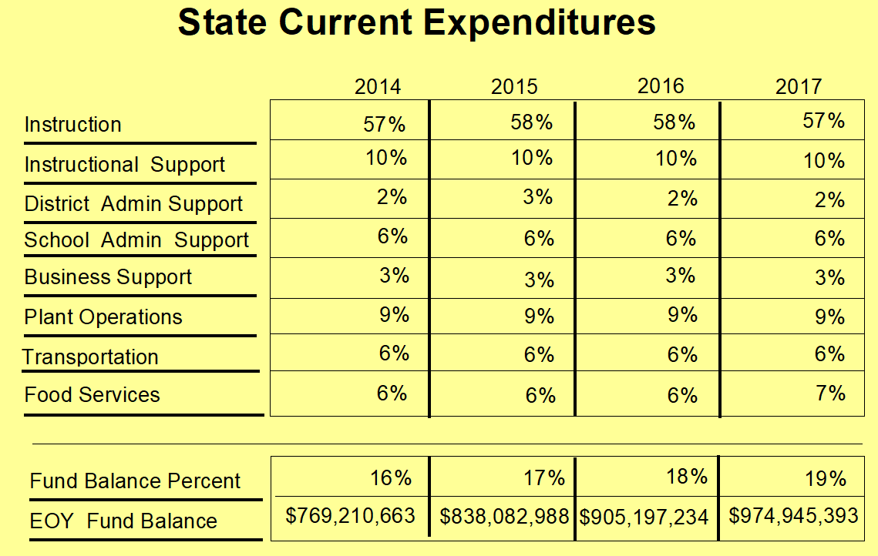
Finance
Notes:
...The Finance section also reports the end-of-year fund balance as well as expenditures by function, as a percentage of all current expenditures. Current expenditures is an accounting term of art.
This slide shows the state as a whole. For example, in 2017, 57% of current expenditures was spent on Instruction.

Slide 18
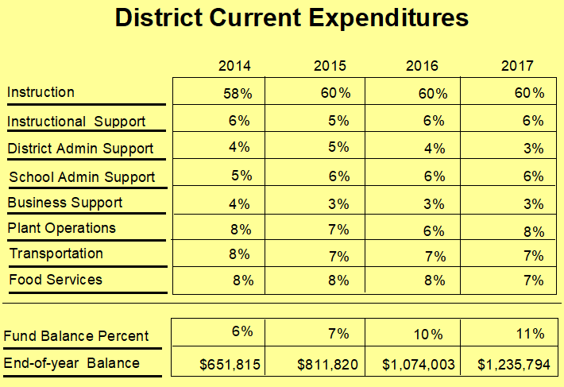
Finance
Notes:
...This is an actual district’s current expenditures
Fund Balance Percent calculation changed beginning in school year 2011-2012.
I will now hand it over to Bart who will discuss the interactive online component of the District Data Profiles that allows users to explore the data graphically.

Slide 19
Interactive District Data Profiles
Feedback from EAARS:
mobility-most members bring their phones with them
Desire to interact with the data
Ability to make quick comparisons

