Slide 1
Homeschooling In Kentucky
Presentation to the
Education Assessment and Accountability Review Subcommittee by the
Office of Education Accountability
September 18, 2018

Slide 2
Presentation Outline
Background and Major Conclusions
Home School Enrollment
Available Outcomes
Laws--Kentucky and Nation
Challenges Enforcing Kentucky Laws

Slide 3
Background
Home schools are private unaccredited schools operated by a parent or guardian
Kentucky Constitution protects right to educate a child consistent with the conscience of parent/guardian
Reasons for homeschooling
Social, academic, religious, flexibility, safety
Home schools in Kentucky include
Home instruction, online, tutors, enrollment part- or full-time in nonaccredited school, home school cooperatives

Slide 4
Data Used In The Report
OEA survey of school district Directors of Pupil Personnel (DPPs)
Staff review of home school laws in other states
Kentucky Department of Education
Kentucky Council on Postsecondary Education
Interviews
Officials from school districts, Cabinet for Health and Family Services (CHFS), and Administrative Office of the Courts
Homeschool parents and groups

Slide 5
Major Conclusions
Home school enrollments rising
KY slightly exceeds the nation
Outcome and demographic data for majority of homeschooled children not available
Home school graduates enrolling in Kentucky colleges outperform public school graduates but enroll in lower percentages

Slide 6
Major Conclusions
KY requirements for home schools higher than some states, lower than others
Home school groups believe that KY law provides accountability
Many DPPs report insufficient accountability for home schools
They report some families using home school laws to avoid legal consequences of public school truancy
DPPs’ authority to monitor or enforce requirements limited
Accountability rests ultimately with CHFS or local courts, under laws that pertain to child neglect

Slide 7
Major Conclusions
Challenges to enforcing home school laws include
Divided responsibilities for monitoring/enforcing
Uncertain minimum criteria required for home school attendance and scholarship reports
Time limitations on DPPs, CHFS, and courts
Statute permits greater roles for
KBE in clarification of requirements in home school attendance and scholarship reports; and
KDE in review of these reports

Slide 8
Presentation Outline
Background and Major Conclusions
Home School Enrollment
Available Outcomes
Laws--Kentucky and Nation
Challenges Enforcing Kentucky Laws

Slide 9
Home School Enrollment
Over 26,500 Kentucky school-aged children in 2017
3.6 percent of school-aged children in Kentucky versus 3.3 percent in nation
Nationally, percentage has more than tripled since the 1970s
Historical data for KY not available

Slide 10
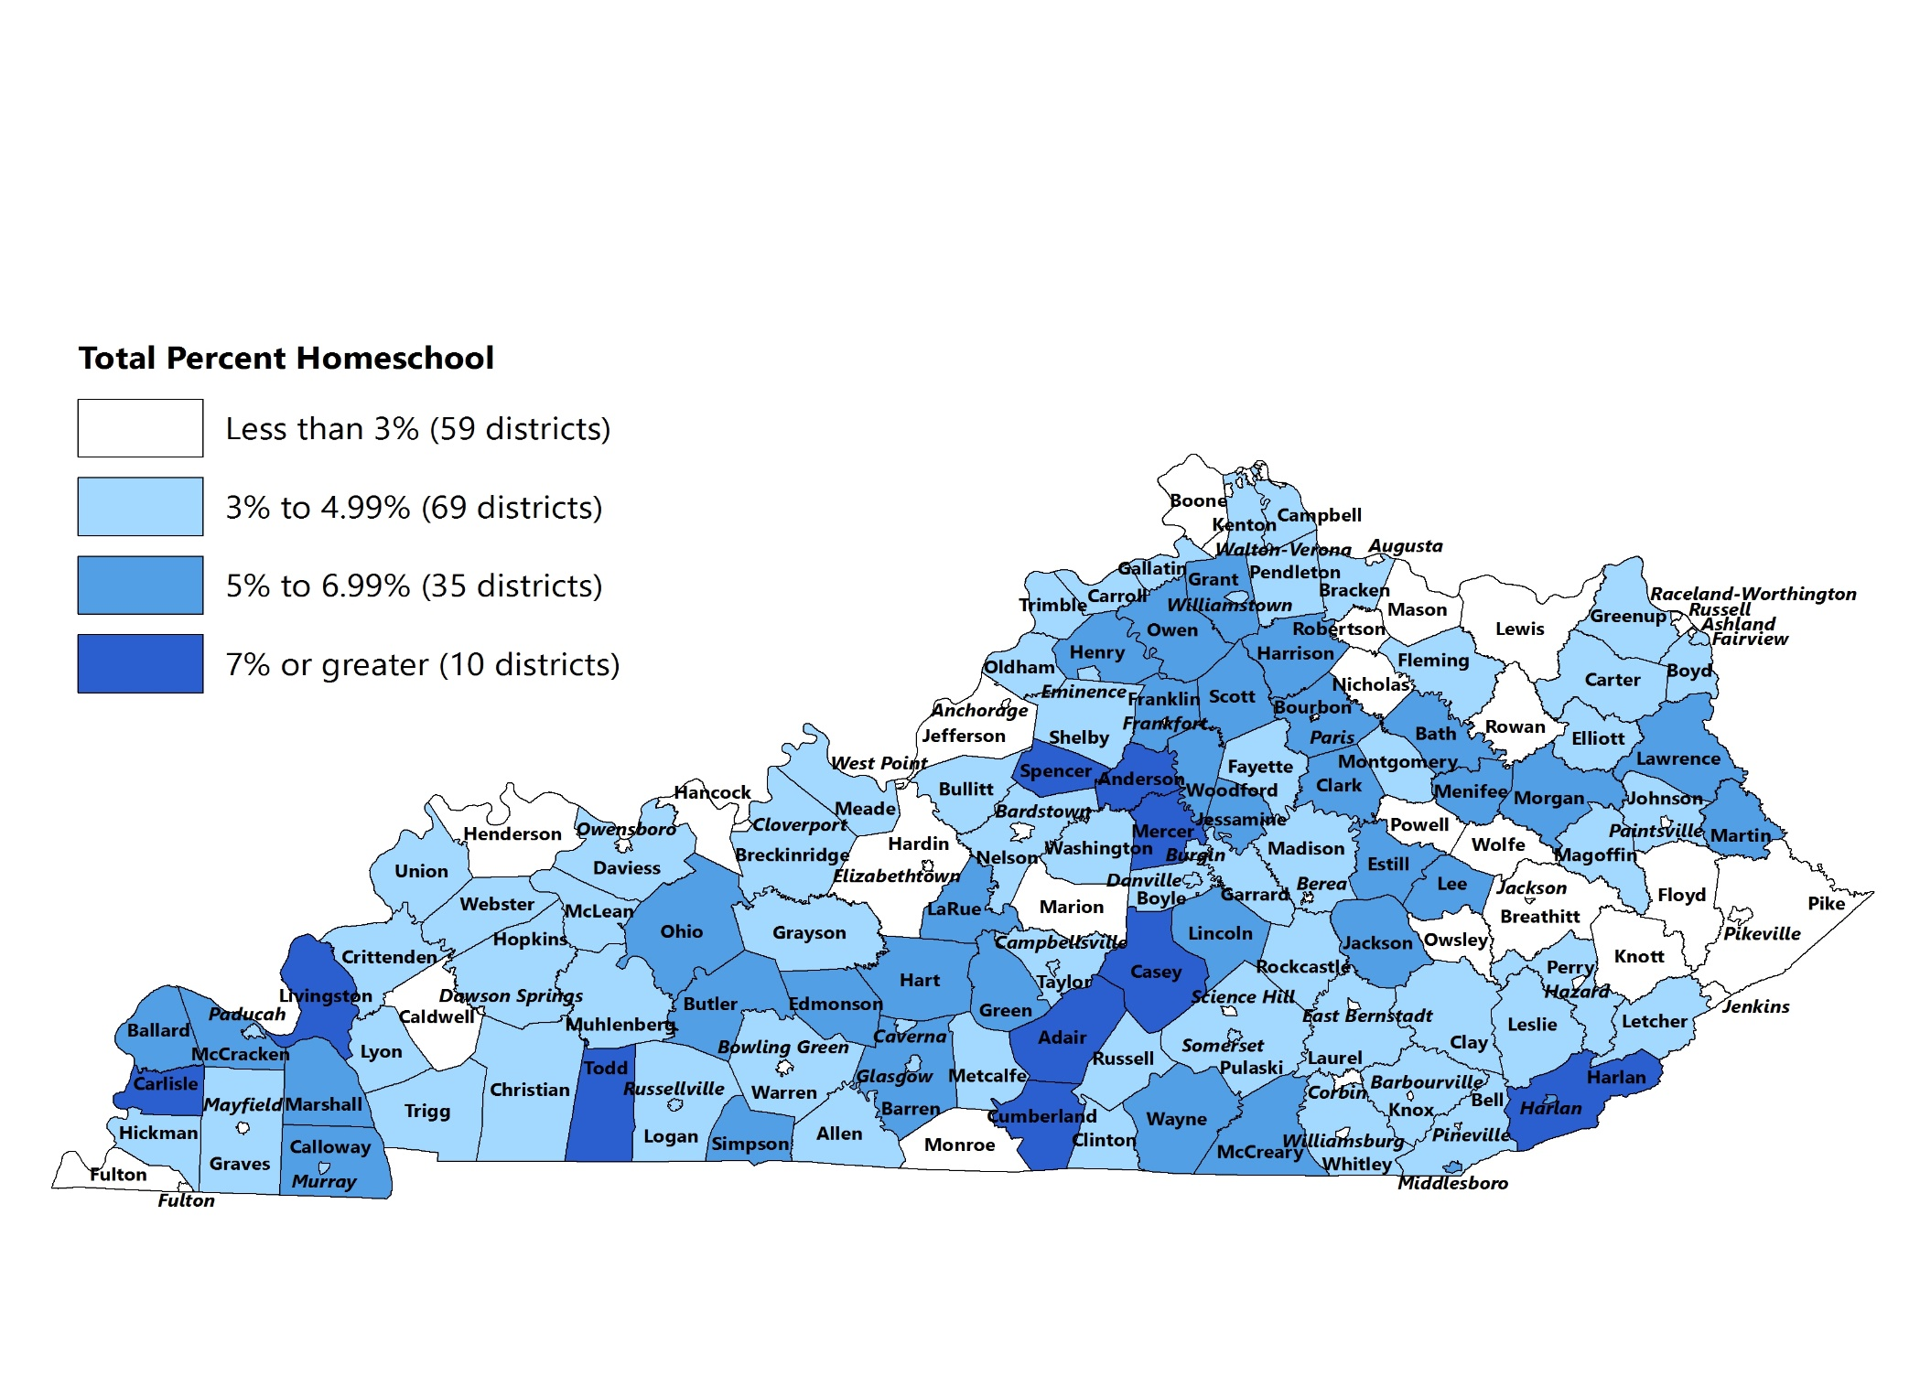
Percentage Of Students Homeschooled By School District, 2017

Slide 11
Students Transferring From Kentucky Public Schools To Home Schools 2012 Through 2017
Increase may be associated with anticipated changes in the legal
dropout age from 16 to 18, beginning in 2016.

Slide 12
DPPs Cite Abuse Of Home School Law To Avoid Public School Truancy Charges
Habitually truant students or their parents can face legal consequences
46 percent of DPPs often observe families they believe are transferring to home school to avoid legal consequences of truancy
Applies primarily but not exclusively to high school students

Slide 13
Percentage Of Students Chronically Absent Transfer To Homeschool Versus All Others, 2017

Slide 14
Presentation Outline
Background and Major Conclusions
Home School Enrollment
Available Outcomes
Laws--Kentucky and Nation
Challenges Enforcing Kentucky Laws

Slide 15
Limited Outcome Data Available
Data for all home school students not available in Kentucky or nation
Academic achievement reported in this study and in other published studies based on small samples of students; results are not likely representative of all students
Outcomes for the majority of homeschooled children in Kentucky are simply unknown

Slide 16
Dual Credit GPAs Kentucky Public School, Home School And Other High School Students, 2017
GPA | Public School (n= 23,000) | Home School (n=400) | Other (n=2,032)
GPA 3.5 and above | 57% | 73% | 60%
GPA 3.0 to 3.49 | 27 | 17 | 25
GPA 2.0 to 2.99 | 10 | 7 | 9
GPA below 2.0 | 6 | 3 | 6

Slide 17
Average ACT Composite 2016 Kentucky High School Graduates Enrolled In Kentucky Colleges, 2017
Public School (n=16,894) | Home School (n=236) | Other (n=2,324)
22.5 | 23.9 | 24.3

Slide 18
First Year College GPAs Of 2016 Kentucky Public School, Home School And Other Graduates, 2017
GPA Range | Public School (n=17,206) | Home School (n=283) |  | Other (n=2,637)
 | Percent of Students
GPA 3.5 or Above | 41% |  | 61% |  | 49%
GPA 3.0 to 3.49 | 26 |  | 21 |  | 26
GPA 2.0 to 2.9 | 15 |  | 10 |  | 13
GPA Below 2.0 | 18 |  | 8 |  | 12
Note: These data are only for students enrolled in Kentucky public postsecondary
institutions. Less than 20 percent of homeschooled 2016 graduates enrolled in
any Kentucky postsecondary institutions in 2017.

Slide 19
Presentation Outline
Background and Major Conclusions
Home School Enrollment
Available Outcomes
Laws--Kentucky and Nation
Challenges Enforcing Kentucky Laws

Slide 20
Kentucky Home School Requirements Under Compulsory Attendance Laws
Subject to direct monitoring by DPPs
Report enrollment to school district annually
Keep attendance and scholarship reports
Not subject to any direct monitoring
Teach required subjects:
reading, math, history, civics, writing, spelling, and grammar
Ensure attendance for duration as long as public school term

Slide 21
KY Home School Laws Difficult To Compare With Other States
Kentucky offers only one set of legal options that allow families to home school, but many states offer two or more
Some states that appear to have higher requirements than KY also offer a legal option to homeschool that has lower requirements
Alternative options are often based on religious or conscientious objections

Slide 22
Home School Laws In Surrounding States
Lower Requirements
Indiana, Missouri, and Illinois do not require annual notification
Higher Requirements
West Virginia and Ohio require
High school diploma or other qualification; or
Routine reporting of outcomes or curriculum
Diplomas
West Virginia, Tennessee, Ohio, and Missouri laws clarify equal legal status of home school diplomas for specific purposes
Note: Tennessee and Virginia have higher requirements in some but not all home school options

Slide 23
DPP Concerns About Kentucky Home School Laws
Almost half disagree that they have the practical ability to enforce compulsory attendance laws for home schools
Less than one third report high likeliness that a homeschool that is not educating will face a consequence, unless physical neglect or abuse is evident
Many believe Kentucky should require more of home schools
No minimum requirements for attendance and scholarship reports

Slide 24
Home School Advocates Interviewed For This Study Against Increasing Requirements
Believe that accountability exists under current law
Higher requirements such as some in surrounding states would place undue burden on families educating children without state support
Some forms of accountability in other states compel parents to make educational choices they may not feel are best for the child

Slide 25
Presentation Outline
Background and Major Conclusions
Home School Enrollment
Available Outcomes
Laws--Kentucky and Nation
Challenges Enforcing Kentucky Laws

Slide 26
Kentucky Laws That Require Children To Be Educated
Fundamental right to educational instruction
Compulsory public school attendance
Lack of adequate education a form of child neglect

Slide 27
Law | Entity | Authorized Actions
Compulsory Attendance | DPP | Monitor enrollment Request and review attendance and scholarship reports at any time
Educational Neglect | Any individual | Required to report neglect to authorities, when known or reasonably believed
 | CHFS/ DCBS* | Investigate claims of educational neglect Make case plan requiring improvements Refer to court
 | Local* Courts | Order a court appearance Require evidence of education Require family to enroll child in public or other accredited school
*Neither CHFS nor local courts are required to take specific action on reports of neglect.

Slide 28
Law | Entity | Authorized Actions
Compulsory Attendance | DPP
Educational Neglect | Any individual
 | CHFS/ DCBS
 | Local Courts
Responsibility divided among entities and individuals

Slide 29
Law | Entity | Authorized Actions
 |  | Monitor enrollment Request and review attendance and scholarship reports at any time
 |  | Required to report neglect to authorities, when known or reasonably believed
 |  | Investigate claims of educational neglect * Make case plan requiring improvements Refer to court
 |  | Order a court appearance* Require evidence of education Require family to enroll child in public or other accredited school
Criteria
not
clear

Slide 30
Best Practice Document
Developed in 1997 by Christian Home Educators of Kentucky (CHEK), the Kentucky Home Education Association (KHEA), DPPs from four Kentucky districts, and the KDE liaison for nonpublic schools
Attempts to clarify roles
Describes and sometimes interprets law
Many DPPs are unaware of or confused about the document, especially whether it represents law or informal guidance

Slide 31
Time Limitations On DPPs, CHFS, And Local Courts
DPPs, CHFS, and courts report limitations in time and personnel available to address their many duties under the law
DPPs feel primary responsibility to address duties related to public school attendance
CHFS or local courts may prioritize reports of physical abuse or neglect over educational neglect alone

Slide 32
Variation In DPPs’ Reports Of Accountability
Some DPPs (approximately one third) report high likeliness that home school parents or guardians not educating will ultimately face consequences in local courts
Factors explaining variation among districts:
Willingness of local courts or CHFS to take action on educational neglect, in the absence of other forms of neglect or abuse
Home school response to contact with government officials

Slide 33
Potential For Greater Clarity And Guidance Under Existing Laws
All of the findings contained in OEA’s report concern the potential for greater clarity and guidance under existing laws that apply to home schools, especially KRS 159.040. That statute authorizes, but does not require, roles not currently played by the Kentucky Board of Education and Kentucky Department of Education.

Slide 34
KRS 159.040 Attendance At Private And Parochial Schools
Attendance at private and parochial schools shall be kept by the authorities of such schools in a register provided by the Kentucky Board of Education, and such school authorities shall make attendance and scholarship reports in the same manner as is required by law or by regulation of the Kentucky Board of Education of public school officials. Such schools shall at all times be open to inspection by directors of pupil personnel and officials of the Department of Education.

Slide 35
Finding 3.1
KRS 159.040 authorizes the Kentucky Board of Education to play a role in establishing criteria required for attendance and scholarship reports that apply to all schools. KBE has not proposed regulations for the keeping of scholarship reports.

Slide 36
Finding 3.2
KRS 159.040 requires home schools to keep attendance in a register provided by KBE. KBE does not provide home schools with an attendance register.

Slide 37
Finding 3.3
KRS 159.040 allows KDE to play a role in inspecting attendance and scholarship reports. KDE does not currently play such a role.
Notes:
KDE may but does not currently play a role inspecting attendance and scholarship reports.

Slide 38
Finding 3.4
The best practice document developed in 1997 and updated since then attempts to provide clarity to homeschooling families and DPPs. The best practice document was developed by a task force that included members of statewide home school organizations, DPPs and a KDE representative. Many DPPs are either not aware of this document or are confused about whether it represents law or suggested practices.

Slide 39
Finding 3.5
By law, CHFS and local courts have the sole authority to determine whether a child is being educationally neglected. Currently, guidance and tools to make determinations of educational neglect are limited. Thus, determinations of educational neglect are made based on the discretion of DCBS workers or judges.

Slide 40
Conclusion
Enrollments are increasing but vary among districts
Outcome data for majority of homeschool children not available
Kentucky requires more of home schools than some states and less than others
Many DPPs have concerns about insufficient accountability for home schools that may not be educating
Current law allows room for greater clarification of home school requirements

