Slide 1
Textbooks And Instructional Materials
Presentation To The
Education Assessment And Accountability Review Subcommittee
Kentucky Legislative Research Commission
Office Of Education Accountability
October 16th, 2018

Slide 2
Major Themes From The Report
Collaborative process of print materials selection and purchasing, and centralized technology planning.
Shift in expenditures from print to technology.
Access to technology has increased, but some issues remain.

Slide 3
Data Used For The Report
Annual Financial Reports
School years 2008 through 2017
OEA Instructional Materials Survey
Sent out to all 173 Kentucky school district superintendents
92.5 percent participation rate
Technology Readiness Survey

Slide 4
KETS Master Plan
Guides purchasing, developing, and use of technology.
Emphasizes instructional devices as central to incorporating technology into the learning environment.
Encourages low device to student ratios in districts.
Supported by Kentucky Technology Readiness Survey.
Available online with easily accessible information.

Slide 5
Selection and Adoption Process
KRS 156.405
Establishes the State Textbook Commission
Statutorily required to meet once per quarter
Provide state-sponsored listing of quality vetted instructional materials

Slide 6
Selection, Adoption, and Purchasing Process
School Level
Determine which instructional materials shall be used per KRS 160.345(2)
Request quantities of instructional materials needed
District Level
Local boards determine the allocation of instructional resource funding per school
District textbook coordinators and other district staff provide support during selection and vetting

Slide 7
Selection and Adoption Process
 | Percent Of Districts Indicating “Occasionally” Or “Often”
Member Of Education Community | Print |  | Digital
Central Office Staff
District curriculum leader | 93.2% |  | 87.1%
District textbook coordinator | 84.5 |  | 81.1
Director of special education | 82.4 |  | 81.1
Superintendent | 51.7 |  | 60.1
District chief information officer | 49.7 |  | 58.1
School-Based Staff
Principals | 98.6% |  | 95.3%
Teachers, other than through SBDM | 98.6 |  | 92.6
School-based decision making (SBDM) council, if applicable | 84.4 |  | 82.3
Students | 39.2 |  | 37.7
Parents, other than through SBDM | 33.1 |  | 36.1
Members of the community | 19.0 |  | 15.6

Slide 8
Advantages and Disadvantages Associated With Using Digital Instructional Materials
Level | Advantages | Disadvantages
Student | Increased access to technology Increased levels of student engagement Personalized learning | Student distraction Device breakage
Teacher | Frequent content updates More professional development Data-based decision making Enhanced communication | Outdated hardware Teacher “buy-in”
District/School | Lower printing costs Decreased need for large-scale print purchases Content organization | Costs for hardware purchases Hardware maintenance Network reliability

Slide 9
Instructional Materials Expenditures

Slide 10
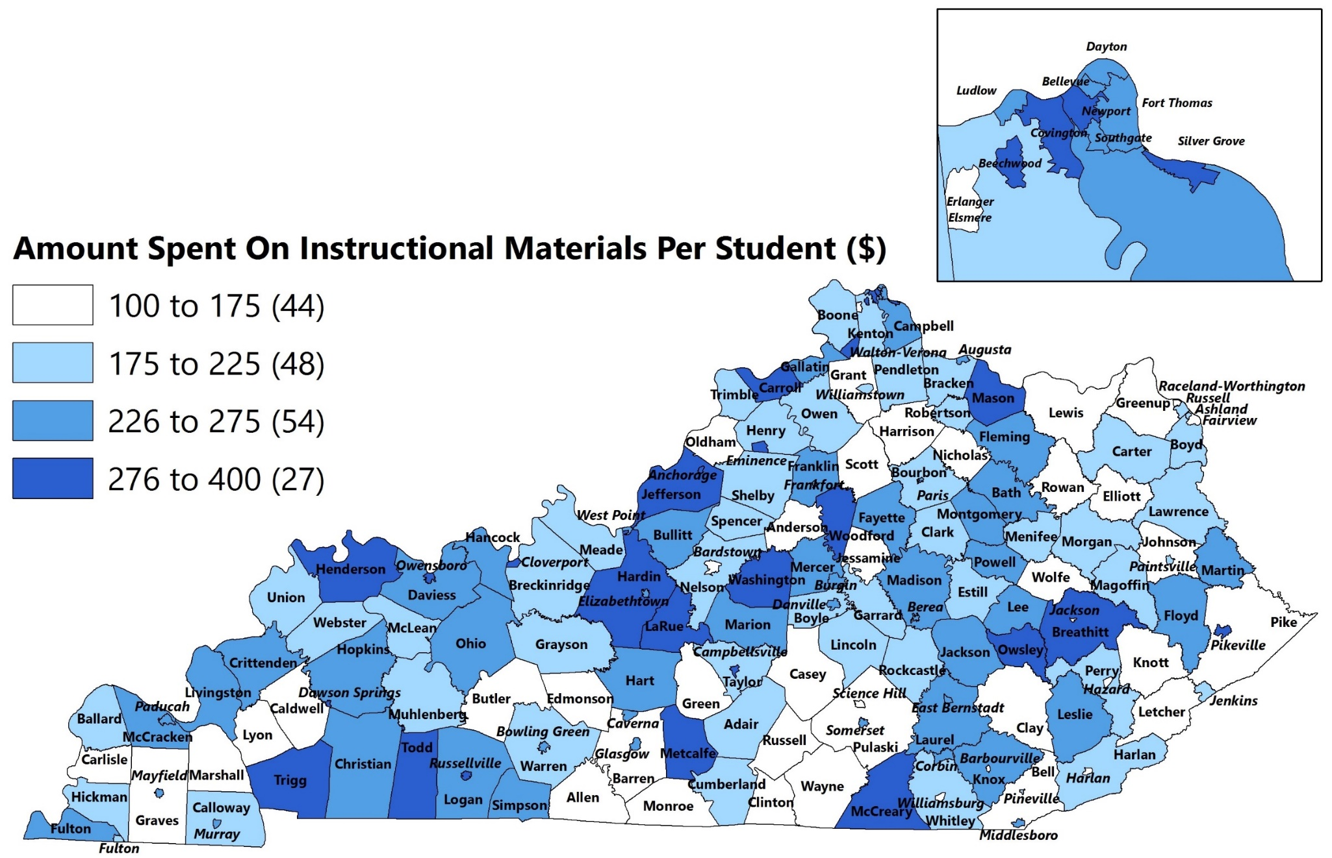
Per Student Instructional Materials Expenditures
2008 Through 2017
*Avg. $242 Per Student For State

Slide 11
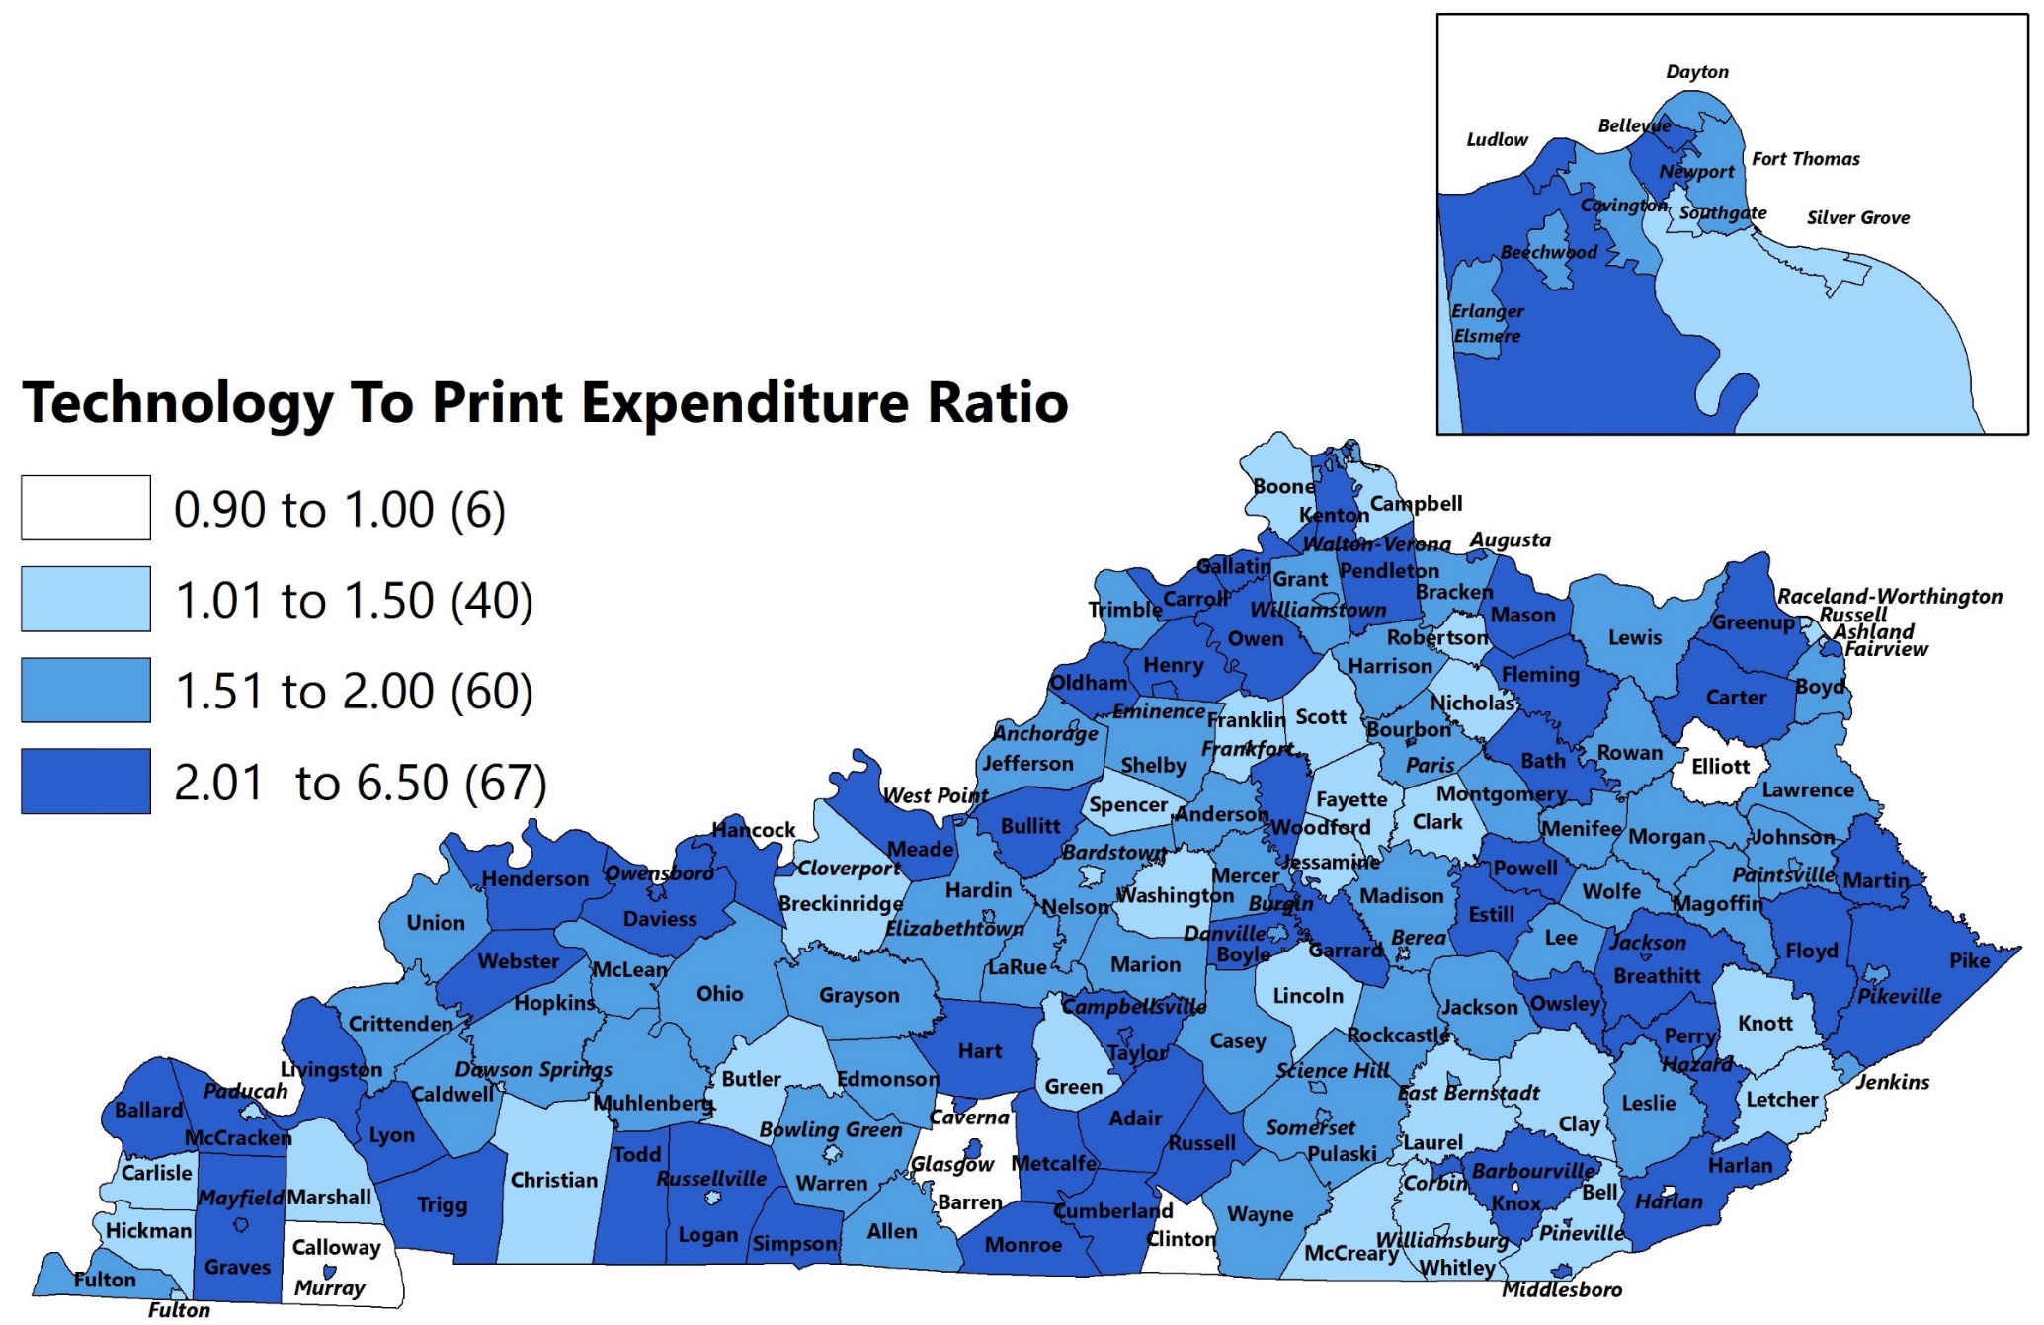
Technology To Print Expenditure Ratio
2008 Through 2017
*2 To 1 Technology To Print Ratio For State

Slide 12
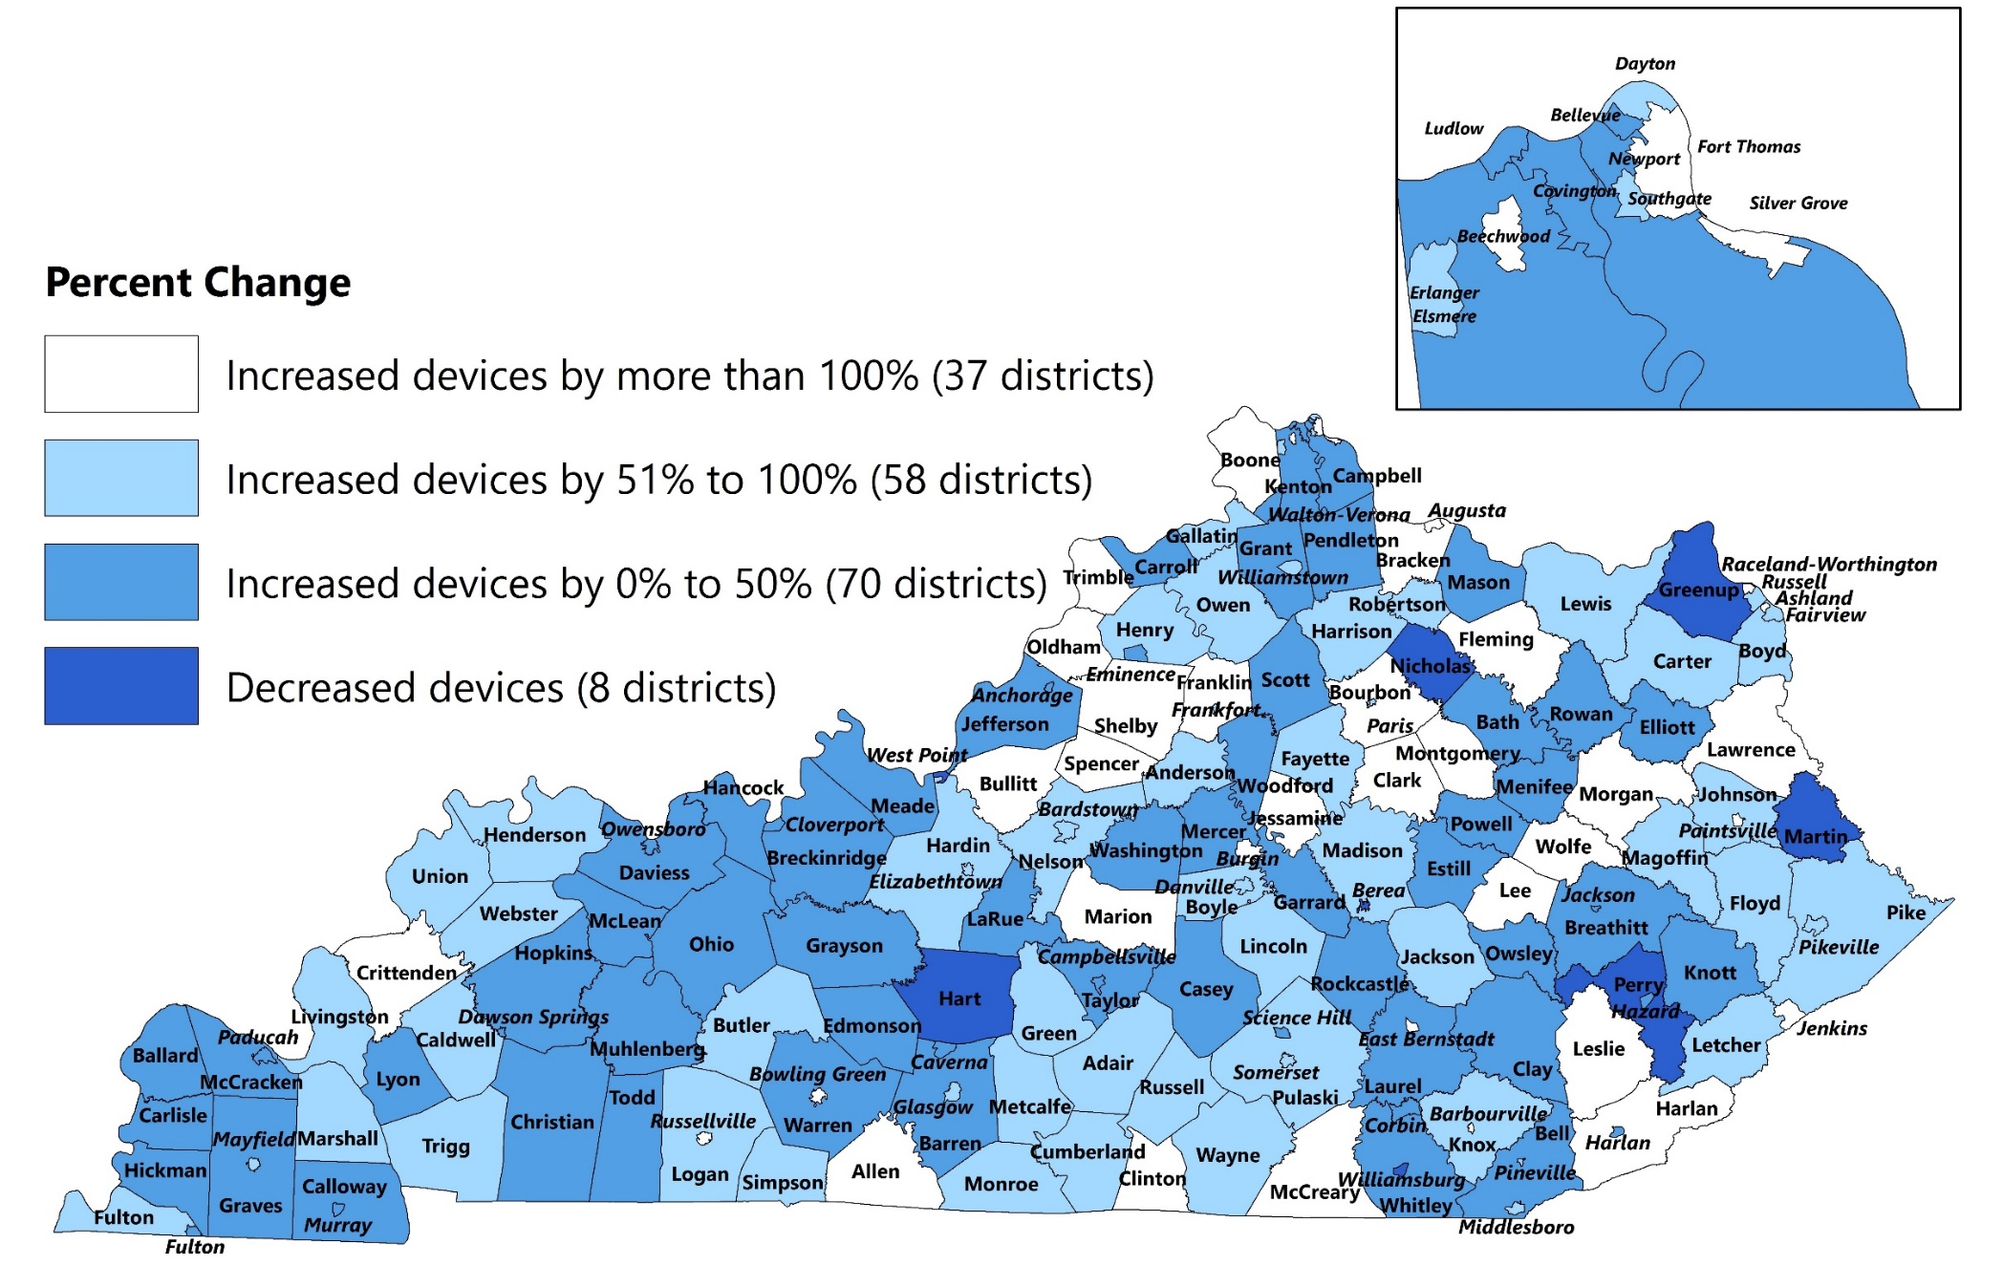
Change In Number Of Student Devices
2014 To 2017
Source: Staff analysis of data from the Kentucky Technology Readiness Survey.

Slide 13
Instructional Device Operating Systems
 | 2014 |  |  | 2017
Operating Systems | Number | Percent |  | Number | Percent
Windows 7 | 237,000 | 55.7% |  | 201,378 | 31.6%
Chrome OS (Chromebook) | 8,737 | 3.6 |  | 182,032 | 28.6
Windows 10 | 0 | 0.0 |  | 90,202 | 14.2
iOS 8.x or later (Apple devices) | 0 | 0.0 |  | 62,984 | 9.9
iOS 7.x or earlier (Apple devices) | 76,105 | 31.0 |  | 32,060 | 5.0
Mac OS X 10.9,10.10, or later | 45,345 | 10.7 |  | 40,351 | 6.3
Other | 58,347 | 13.4 |  | 27,734 | 4.4
Source: Staff analysis of data from the Kentucky Technology Readiness Survey.

Slide 14
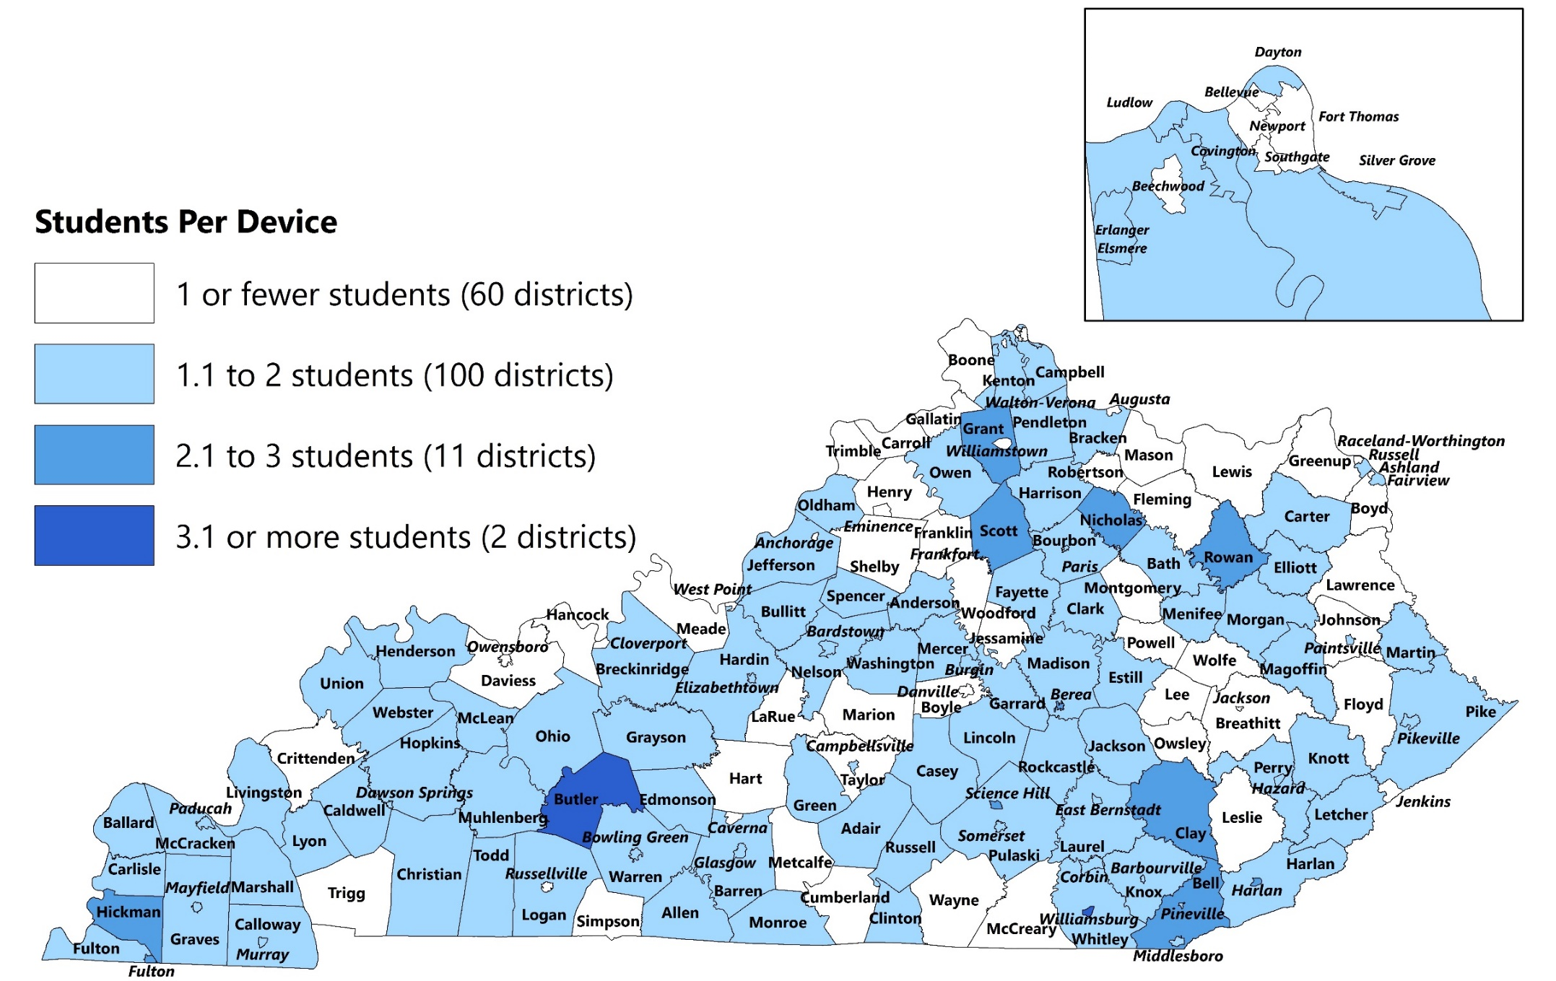
Students Per Device By District
2017
Source: Staff analysis of data from the Kentucky Technology Readiness Survey.

Slide 15
Students Per Instructional Device
Source: Staff analysis of data from the Kentucky Technology Readiness Survey.

Slide 16
Levels Of Access

Slide 17
Levels Of Access
Benefits of technology tools and online programs depends on:
Network connections and wireless capabilities of school districts
Students’ home internet access

Slide 18
School Network Connection And Wireless Capacity
Wireless ability to support BYOD or 1:1 implementation, described as dense wireless ready for every student to connect one or two devices and have a good user experience.
Source: Staff analysis of data from the Kentucky Technology Readiness Survey.

Slide 19
Student Home Internet Access
4 out of 5 students had a reliable network connection.
In 2014, estimated 75.3 percent
Ranged from 30 percent to 100 percent by district.
Supports OEA survey results.

Slide 20
Finding 2.1
KRS 156.405 establishes the State Textbook Commission to provide a recommended list of current and high quality instructional materials to local school districts. KRS 156.405(9) states that the commission is to convene at least once per quarter in meetings that are open to the public subject to KRS 424.110 and KRS 424.210. The commission has not met since June 2015 and has not maintained minutes or a list of members during this time.

Slide 21
Finding 4.1
The 2018-2024 KETS Master Plan includes conflicting measures of student attendance. Appendix E states that technology needs standards involve three criteria, including component ratios (quantities) based on average daily attendance. Appendix H details the 2018-2024 Budget Summary using per student average daily membership (ADM) as the unit variable.

Slide 22
Finding 4.2
The KETS Master Plan and the Kentucky Technology Readiness Survey are available online, allowing citizens and policymakers to access information and to understand the technology strategy for Kentucky education, the state of Kentucky’s technology education across districts, and the progress that has been made.

Slide 23
Finding 4.3
Between 2014 and 2017, Kentucky school districts increased technology devices, reduced device-to-student ratios, and updated operating systems. As discussed in the literature review, the data only shows that districts acquired the technology tools to carry out educational goals; however, the actual effects on student learning and outcomes are unknown.

Slide 24
Conclusion
Collaborative process of print materials selection and purchasing, and centralized technology planning.
Shift from print to technology and digital.
Access to technology has increased, but some issues remain.

Slide 25
End

