Slide 1
2019 Fall School Accountability Results
Wayne D. Lewis, Jr., PhD
Kentucky Commissioner of Education
Education Assessment and Accountability Review Subcommittee
Thursday, October 17, 2019

Slide 2
Standard Setting Panel Participants
Members of the Accountability | Performance Standard Setting Committee
Hal Heiner, chair, Kentucky Board of Education Gary Houchens, member, Kentucky Board of Education Danny Adkins, superintendent, Floyd County schools Paul Mullins, superintendent, Logan County schools Marty Pollio, superintendent/Dena Dosett, chief executive director, Jefferson County schools Diane Hatchett, superintendent, Berea Independent schools Scott Hawkins, superintendent, Woodford County schools Aaron Collins, superintendent, Fulton County schools Teresa Nicholas, district assessment coordinator, Pulaski County schools Amanda Reed, district assessment coordinator, LaRue County schools Stephen Flatt, director of special education, Marshall County schools Jerri Rowland, principal, Monroe County Area Technology Center | Susan Brashear, principal, Whitley Central Intermediate School Amy Lingo, dean, College of Education, University of Louisville Amy Razor, executive director, Northern Kentucky Cooperative for Educational Services Rhonda Caldwell, executive director, Kentucky Association of School Administrators Rhonda Caldwell/Owens Saylor, Kentucky Association of School Administrators Melissa Aguilar, executive director, Kentucky Workforce Innovation Board Rhonda Harmon, executive director, KASC Annissa Franklin, chief administrative officer, Urban League of Lexington Sarah Davasher-Wisdom, chief operating officer, Greater Louisville Inc. Penny Christian, parent, member of Kentucky PTA Margo Bruce, teacher, Webster County High School Amanda Underwood, teacher, Mason County Middle School

Slide 3
The Ratings
These diverse accountability indicators factor into a school’s overall five-star rating include:
Reading and mathematics proficiency
Proficiency in social studies, science and writing
Students’ academic growth/progress over one academic year
Transition readiness (college and career readiness)
Graduation rate
Schools that receive higher ratings do not receive additional state or federal funding.

Slide 4
2018-2019 School Ratings
School Level | Total Number of Schools | 1-Star | 2-Star | 3-Star | 4-Star | 5-Star
Elementary | 725 | 46 | 132 | 364 | 146 | 37
Middle | 319 | 23 | 65 | 159 | 60 | 12
High | 228 | 20 | 54 | 120 | 27 | 7
Total | 1272 | 89 | 251 | 643 | 233 | 56
A three star rating shows that a school’s overall performance is on pace with the majority of other schools in the state.

Slide 6
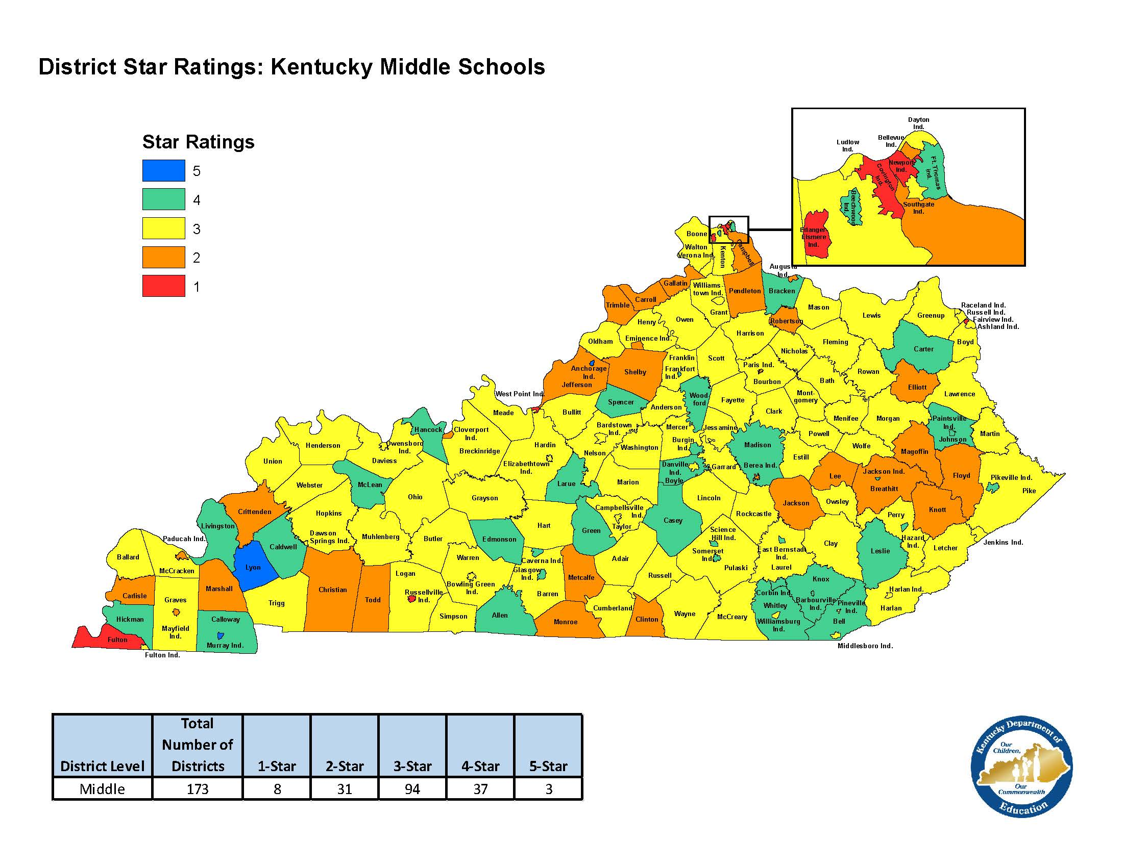

Slide 7
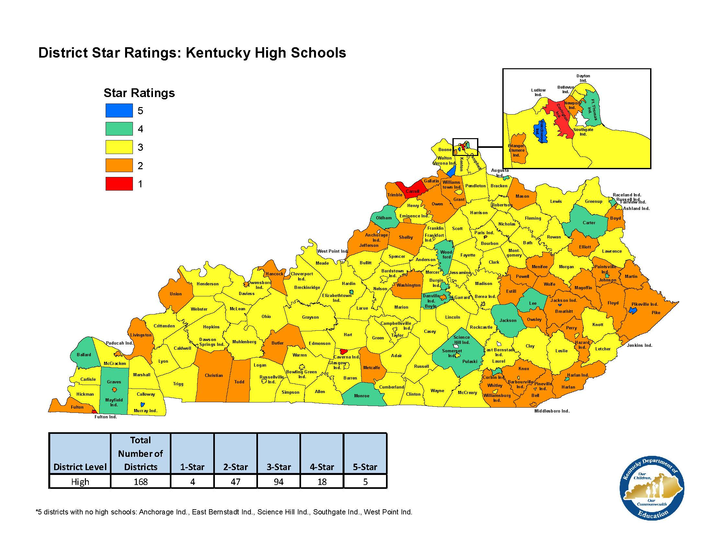

Slide 8
Student Growth
Growth is based on a comparison of student scores from one year to the next in reading and mathematics. This indicator also includes the progress of English learners on an English language proficiency exam that includes speaking, listening, reading and writing in English at the elementary and middle school levels. The English Language Proficiency growth results for English learners are included in the reading calculation.
School Level | Total Number of Schools | Very Low | Low | Medium | High | Very High
Elementary | 716 | 79 | 189 | 164 | 212 | 72
Middle | 319 | 38 | 89 | 125 | 41 | 26

Slide 9
Commissioner’s List
Austin Tracy Elementary School (Barren County)
Blaine Elementary School-MS Level (Lawrence County)
Botts Elementary School (Menifee County)
Brooks Elementary School (Bullitt County)
Cochran Elementary (Jefferson County)
Fallsburg Elementary School-ES Level (Lawrence County)
Frakes School Center-ES Level (Bell County)
Frankfort High School (Frankfort Independent)
G.R. Hampton Elementary School (Knox County)
Garth Elementary School (Scott County)
Green County Middle School
Hacker Elementary School (Clay County)
Kentucky School For The Blind-ES Level
Leatherwood Elementary School-MS Level (Perry County)
Monroe County High School
Munfordville Elementary School-ES Level (Hart County)
Robinson Elementary School-ES Level (Perry County)
Squires Elementary School (Fayette County)
Viper Elementary School-ES Level (Perry County)
Westridge Elementary (Franklin County)
Schools with at least a 10-point gain in proficiency from 2017-2018 to 2018-2019 and received a Very High label for the growth indicator (elementary/middle schools) or the transition indicator (high schools) in 2018-19.

Slide 10
2018-19 Assessment Results

Slide 11
Performance Level Descriptors
NOVICE A novice student has a minimal understanding of the Kentucky Academic Standards at grade level. The student communicates ideas ineffectively or inaccurately, providing little detail and little or no support. Attempts at problem-solving or critical thinking are minimal or inappropriate.
APPRENTICE An apprentice student has a basic understanding of the Kentucky Academic Standards at grade level. The student demonstrates some problem-solving and critical thinking skills, but they are not consistently applied. The student communicates ideas in a basic manner, but explanations, solutions or justifications may be unclear or ineffective.
PROFICIENT A proficient student has a broad understanding of the Kentucky Academic Standards at grade level. The student usually communicates ideas accurately using clear and appropriate examples, supporting or justifying those ideas with relevant details and evidence. Problem-solving and critical thinking skills are used effectively.
DISTINGUISHED A distinguished student has a comprehensive understanding of the Kentucky Academic Standards at grade level. The student consistently communicates ideas in a sophisticated and complex manner, using thorough supporting detail and explicit examples. The student reasons and solves problems by using appropriate strategies in an insightful way.

Slide 12
Novice Performance - Elementary
Novice levels across student groups provide a stark illustration of Kentucky’s achievement gaps.
Elementary Students
Elementary Students

Slide 13
Novice Performance – Middle Schools
Novice levels across student groups provide a stark illustration of Kentucky’s achievement gaps.
Middle Schools
Middle Schools

Slide 14
Science, social studies, writing
Elementary Performance Levels by Year
Novice Apprentice Proficient Distinguished Prof./Dist.

Slide 15
Science, social studies, writing
Middle School Performance Levels by Year
Novice Apprentice Proficient Distinguished Prof./Dist.

Slide 16
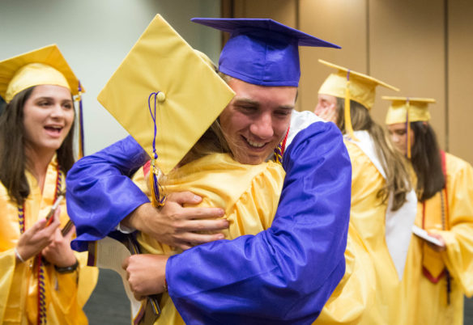
2018-19 Transition Readiness

Slide 17
Transition Readiness
The Transition Readiness indicator gives students flexibility on how they demonstrate either academic or career readiness. This indicator also includes the attainment of English language proficiency for English learners on an exam that includes speaking, listening, reading and writing in English. The indicators include earning a high school diploma AND meeting expectations for either academic or career readiness.
School Level | Total Number of Schools | Very Low | Low | Medium | High | Very High
High | 228 | 30 | 62 | 71 | 40 | 25

Slide 18
Novice Performance – High Schools
Novice levels across student groups provide a stark illustration of Kentucky’s achievement gaps.
High Schools
High Schools
Performance Level Percentages are for the ACT and Alternate K-PREP assessment.

Slide 19
Graduation Indicator
School Level | Total Number of Schools | Very Low | Low | Medium | High | Very High
High | 228 | 22 | 42 | 32 | 61 | 71
The Graduation indicator includes a 5-year and 4-year adjusted cohort graduation rate. Both the 4-year and 5-year adjusted cohort formula uses the number of students who graduate in four and five years divided by the number of students who form the adjusted cohort for the graduating class. The 5-year rate recognizes the persistence of students and educators in completing the requirements for a Kentucky high school diploma. Kentucky’s Graduation indicator averages the 4- and 5-year rates.

Slide 20
Federal Classifications

Slide 21
CSI Schools
50 schools designated for comprehensive support & improvement
Schools identified as CSI have additional responsibilities for school improvement, but this designation also makes them eligible for additional funding and resources to support their turnaround efforts.
34 of 50 schools are in Jefferson County.

Slide 22
CSI Schools
Atkinson Academy (Jefferson County)
Breckinridge-Franklin Elementary (Jefferson County)
Byck Elementary (Jefferson County)
Cane Run Elementary (Jefferson County)
Coleridge-Taylor Montessori Elementary (Jefferson County)
Conway Middle (Jefferson County)
Cordia High School (Knott County)
Cordia Middle School (Knott County)
Doss High (Jefferson County)
Duff-Allen Central Elementary (Floyd County)
Emmalena Elementary School (Knott County)
Engelhard Elementary (Jefferson County)
Fairview Elementary School (Fairview Independent)
Fairview High School (Fairview Independent)
Frayser Elementary (Jefferson County)
Frederick Law Olmsted Academy North (Jefferson County)
Fulton County Elementary (Fulton County)
Fulton County Middle School (Fulton County)
Greenwood Elementary (Jefferson County)
Holmes Middle School (Covington Independent)
Iroquois High (Jefferson County)
Jacob Elementary (Jefferson County)
Kennedy Montessori Elementary (Jefferson County)
King Elementary (Jefferson County)
Knight Middle (Jefferson County)
Maupin Elementary (Jefferson County)
McFerran Preparatory Academy (Jefferson County)
Mill Creek Elementary (Jefferson County)
Minors Lane Elementary (Jefferson County)
Newburg Middle (Jefferson County)
Newport Intermediate School (Newport Independent)
Newport Primary School (Newport Independent)
Ninth District Elementary (Covington Independent)
Price Elementary (Jefferson County)
Rangeland Elementary (Jefferson County)
Rector A. Jones Middle School (Boone County)
Robert Frost Sixth-Grade Academy (Jefferson County)
Roosevelt-Perry Elementary (Jefferson County)
Shelby Traditional Academy (Jefferson County)
Stuart Academy (Jefferson County)
The Academy @ Shawnee (Jefferson County)
Thomas Jefferson Middle (Jefferson County)
Trunnell Elementary (Jefferson County)
Watson Lane Elementary (Jefferson County)
Wellington Elementary (Jefferson County)
West Point Elementary School (West Point Independent)
Western High (Jefferson County)
Wheatley Elementary (Jefferson County)
William Wells Brown Elementary (Fayette County)
Young Elementary (Jefferson County)

Slide 23
CSI School Turnaround
Under Senate Bill 1 (2017), all schools are required to create an improvement plan based on their accountability results. Schools that have been designated as CSI must be audited by a turnaround team selected by the local board of education. The audit must include:
A diagnosis of the causes of a school’s low performance;
An assessment and recommendation to the superintendent regarding the principal’s capacity to function or develop as a turnaround specialist, including if the principal should be reassigned to a comparable position in the school district;
An assessment of the interaction and relationship between the superintendent, central office personnel and the school principal;
A recommendation of the steps the school may implement to launch and sustain a turnaround process; and,
A recommendation to the local board of education of the turnaround principles and strategies necessary for the superintendent to assist the school with turnaround.

Slide 24
ATSI Schools
11 schools have been identified for Additional Targeted Support and Improvement (ATSI)
ATSI is defined as a school which has one or more groups of students whose performance is at a very low level.
This year, schools have been designated as ATSI if last year it was designated as TSI-Tier II (targeted support and improvement) because one or more groups of students scored at or below students in any of the lowest-performing 5% of schools in the same grade band (elementary, middle or high schools), and it failed to meet the exit criteria for ATSI.
New schools were not identified for ATSI this year.
Schools were permitted to exit the status is they made improvement on any of the indicators that led to their identification as TSI-Tier II in 2018.

Slide 25
ATSI Schools
Butler County High School
Danville High School (Danville Independent)
Bryan Station Middle School (Fayette County)
Franklin County High School
Hancock County High School
Ballard High (Jefferson County)
Seneca High (Jefferson County)
Mary A. Goetz Elementary School (Ludlow Independent)
Owensboro High School (Owensboro Independent)
Union County High School
West Point Elementary School (West Point Independent)

Slide 26
Educators urged to become intimately familiar with Kentucky’s new academic standards for reading, math, science and social studies.
Teaching to the standards at grade level with standards-aligned, high quality curriculum and lesson plans will lead to significant improvement in student learning and assessment scores.
If students are not exposed to the standards at grade level, we cannot expect them to demonstrate mastery on state assessments.

