Slide 1
From Snow-Bound Pilot To Statewide Implementation: Kentucky’s Nontraditional (Remote) Instruction Program
Presentation to the
Education Assessment and Accountability Review Subcommittee by the
Office of Education Accountability
November 15, 2021
Notes:
Good afternoon.
This report analyzes data related to Kentucky’s nontraditional instruction program (or NTI) as it was originally implemented, and as it was modified during the COVID-19 pandemic to allow for extended remote learning. While these two phases ca not be directly compared, remote learning during the pandemic may offer lessons for the NTI program as it is normally implemented.

Slide 2
Major Findings
Effectiveness
NTI program assisted districts to continue student learning and meet calendar requirements despite weather
Academic Outcomes
No substantial effects Pre-COVID NTI (up to 10 days)
In 2021 (extensive remote learning)
Decrease in test scores; increase in failing grades
Effects of remote learning vs. other COVID-19 factors not clear
Notes:
NTI was an innovative that was effective in achieving key program goals
click
With no apparent negative effects on student achievement as the program is normally implemented
click
The extended remote learning in 2021 was, however, associated with negative academic outcomes;
Click pause
Click
The degree to which these negative outcomes are caused by remote learning versus other factors impacting students during the pandemic
Are not clear;

Slide 3
Major Findings
Technology
Great increases in district capacity since program began
COVID-era federal funds allowed narrowing of gaps in student home internet and device access; accurate data on student home access important
Increase in range of instructional options on NTI days, especially synchronous (face-to-face) instruction
Notes:
Click
Districts capacities to provide remote instruction increased greatly since the program began, but student home internet and device access remained a barrier
Click
Student home access gaps were narrowed substantially during the pandemic; accurate data on student home access is important
Click
This allowed an Increase in range of instructional options on NTI days, especially synchronous instruction.

Slide 4
Major Findings
Attendance
Attendance measured through student “participation”
On the surface, NTI participation rates appear similar to attendance rates
Normally reported at district level
Student-level participation data collected in 2021 show
Steep increases in extreme chronic absence for some student groups
Unexplained variation among schools in participation/attendance rates
Many of the report’s recommendations address reliability and validity of participation data
Notes:
Click
Attendance during NTI is measured through student “participation”
click
participation rates appear similar to attendance rates on the surface
click
Student-level participation data collected for the first time in 2021 show trends not evident from district NTI data which is normally reported
click
Some of data in the report raise questions about standards that are used by schools in reporting participating data
click
Many of the report’s recommendations focus on on those questions

Slide 5
Data From The Kentucky Department Of Education (KDE)
Student-level demographic, assessment, attendance and transcript data 2014-2021
NTI applications, days used, and district-level student/teacher participation data
Interviews with NTI, technology, and special population staff
Opportunity to Learn survey questions, 2021
Student participation data, 2021
Kentucky one of only two states to collect
Participation data recorded separately for in-person and remote
Note: The report refers to school years by the ending year. i.e., the 2020-2021 school year is referred to as “2021”
Note: OEA refers to school years
Notes:
OEA used a variety of data from the Kentucky Department of Education.
Click
Of particular value to the study was the statewide student-level participation data first collected by KDE in 2021. Kentucky was one of only two states to collect these data and has been called a national leader by the nonprofit Attendance Works.
Because of proactive attention to data standards by KDE, KY may be the only state to know student-level remote instruction rates in 2021 .

Slide 6
Additional Data And Limitations
Additional Data
Staff analysis of surrounding states’ policies
Staff review of national literature
Limitations
The study does not address COVID-specific issues
Due to OEA considerations of time burdens during COVID-19 crisis, limited data from educators
Limited data on innovative aspects of the program
Notes:
Click
Staff also analyzed surrounding state policies and reviewed national literature
click
The study does not address health, economic and other issues specific to COVID-era NTI contains limited data from educators or administrators
Click
And NTI contains limited data from educators or administrators
Click
Therefore, the report contains limited data on some truly innovative aspects of the program, though the report does contain some anecdotal data

Slide 7
Presentation Outline
NTI Program Background And Requirements
NTI Districts And Days Used
Technology
Attendance
Academic Outcomes
Conclusions
Notes:
We’ll move next to discuss background information and NTI program requirements, including a comparison of requirements for similar programs in other states

Slide 8
Timeline of NTI Program
NTI Pre-COVID
High-weather year;
many districts
did not meet
requirements for
1,062 instructional
hours per year
2011
KDE and
district
oversight
and reporting
added
2018
NTI program application
extended to all districts
2014
10 day limit
reinstated;*
all districts
submit NTI plans
2022
Snow-bound
pilot created
allowing up to
10 NTI days
per year
2012
Three pilot
districts
entered
program
New districts
entered each
of subsequent
years
March, 2020
All schools closed
for in-person learning;
10-day limit extended;
all districts entered
program
COVID-Era NTI
*SB1 of 2021 Special Session permits limited,
partial remote instruction.
Notes:
Click
The General Aseembly created the NTI program in 2011, which was a High-weather year;
many districts did not meet calendar requirements. The program allowed up to 10 remote student attendance days for very high weather districts
Click
The following year, three districts entered the program
Click
Folliwng a very high weather year, the General assembly extended program eligibility to all districts; new districts entered in 2015 and each of the subsequent years.
Click
In 2018 the General Assembly added oversight and reporting requirements
Click
When schools were closed for in-person instruction in March of 2020, all disricst were permitted to enter the program and the 10-day limit was extended
Click
The day limit was reinstated this school year
The report refers to two district phases of program implementation
Click
NTI and
Click
pre0COVID-era NTI
We’ll more now to look at the statutory requirements of the program

Slide 9
NTI Program Requirements KRS 158.070
Up to 10 student attendance days counted
Minimum of 6 hours and maximum of 7 hours
District NTI plan approval required
Calculation of average daily attendance (ADA) determined through regulation
Based on previous year’s ADA
Attendance on NTI days not considered in funding
Notes:
Click
Statute allows districts to count Up to 10 student attendance days
As the report notes, the hours counted for each district vary.
click
To participate in the program, districts must have NTI plans approved by KDE
Click
It requires that daily attendance for purposes of school funding be determined through regulation
Click
Based on the regulation, attendance on NTI days themselves is not used in funding calculations

Slide 10
NTI Program Requirements KRS 158.070
District reporting and KDE oversight
District must provide evidence that learning continues
Districts required to evaluate programs
Not yet clarified in revised NTI plan process
Entire district must be closed for NTI days
NTI in individual schools permitted in COVID-era
May be benefits to continuing that option
Sometimes necessary to close individual schools
Boards not currently able to require remote learning in individual closed schools; instructional hours usually lost
Notes:
click
Reporting and oversight must be outlined in regulation
Statute requires that districts provide evidence of continued student learning
Much of this presentation will focus on data related to this requirement
click
statute also requires that regulation describe ongoing evaluative requirements of districts
Click
Those requirements have not yet been clarified in KDE’s revised NTI plan process
OEA has a recommendation related to this point
click
Statute requires that NTI only be provided when the entire district is closed for health or safety reasons click
Covid-era NTI allowed closure in individual school. Although that flexibility was pandemic-related
Click
It offers potential advantages in the future
click
It is sometimes necessary for districts to close individual schools for health and safety. They do not currently have the authority to require that learning continue remotely in those schools, even if it is possible. Most often instructional hours for students in those schools are lost
For example, bats.
Click
For that reason, we recommend

Slide 11
Recommendation 1.1
The General Assembly may wish to consider amending KRS 158.070 (9) to allow for continuation of learning for students in individual schools or other units that are closed for in-person instruction because of health or safety reasons on days when it is not necessary to close the entire district for those reasons.
Notes:
that the General Assembly consider permitting NTI in individual schools.

Slide 12
Recommendation 2.2
The Kentucky Department of Education should consider including evaluation requirements for nontraditional instruction (NTI) districts in annual submission of NTI plans that are contained in Comprehensive District Improvement Plans.
Notes:
Related to the point mentioned earlier about district evaluation, OEA recommends that KDE clarify this requirement.
Move now to look at statutory requirements in other states
click

Slide 13
Programs Similar to NTI In Surrounding States
State | Year Implemented | Available NTI Days | Plan Approval By State SEA | Additional Oversight/ Reporting
Illinois | 2016 | 5 | Yes | No
Indiana | 2014 | 8 * | Yes | No
Kentucky | 2012 | 10 | Yes | Yes
Missouri | N/A
Ohio | 2012 | 3 | Yes | No
Tennessee | N/A
Virginia | N/A
West Virginia | 2017 | 5 | Yes | No
* More than eight days requires state approval
Notes:
Illinois, Indiana, Ohio, and West Virginia had NTI-like programs prior to the Covid-19 pandemic. Like Kentucky, those states required state approval of district plans. With the possible exception of Indiana, Kentucky allowed a greater number of days than surrounding states
The next slides describes state oversight and district reporting requirements in KY
Click

Slide 14
KDE Approval Of District NTI Plans | KDE Individual NTI Day Approval | KDE District Audits
Required elements include: Instruction Staffing Special populations Plans for students lacking home internet | Districts submit: One instructional document for each school level District-level teacher participation data District-level student participation data | Include: Interviews Document review Record review
Notes:
Like other states, KY requires state approval of NTI plans. Those plans must include specific elements. A few are listed on this slide.
In addition, regulation requires that districts submit documentation for each NTI day taken. KDE approves NTI days one at a time.
Districts are required to keep a variety of additional documents. KDE may review those documents in district audits.
The report focuses heavily on student participation data because it is the best potential source of data to meet the statutory requirement for evidence that student learning continues on NTI days.
We’ll return briefly to discuss these monitoring requirements in a moment, but will first provide more background about student participation data
click

Slide 15
Student Participation Data
Attendance normally based on in-person instructional time
Not taken on NTI days
Student participation uses performance-based metrics
Student work
Software login
Schools collect participation data; districts submit overall numbers to KDE
In 2021, KDE required participation data be entered directly into Infinite Campus (IC)
Notes:
Click
Student participation data substitutes for attendance, which is not taken on NTI days
Click
Whereas attendance is normally based on in-person instructional time ,
click
Student participation uses performance-based metrics such as student work or software log in.
Click
Normally each district uses its own method and software to record and report student participation data. For each NTI day used, it submits overall numbers to KDE
Click
In 20201, for the first time, KDE required that participation data be entered directly into the state's student information system, Infinite Campus

Slide 16
 | KDE Individual NTI Day Approval | KDE District Audits
 | Districts submit: One instructional document for each school level District-level teacher participation data District-level student participation data
In 2021 KDE conducted student-level participation data reviews.
Student-level data offers greater insights than review of aggregate data normally reported.
Notes:
In 2021, KDE also conducted its first ever review of student-level participation data, looking at evidence provided for individual student’s participation.
Click
This type of review may offer greater insights than review of aggregate district-level data that are normally reported.

Slide 17
Presentation Outline
NTI Program Background And Requirements
NTI Districts And Days Used
Technology
Attendance
Academic Outcomes
Conclusions

Slide 18
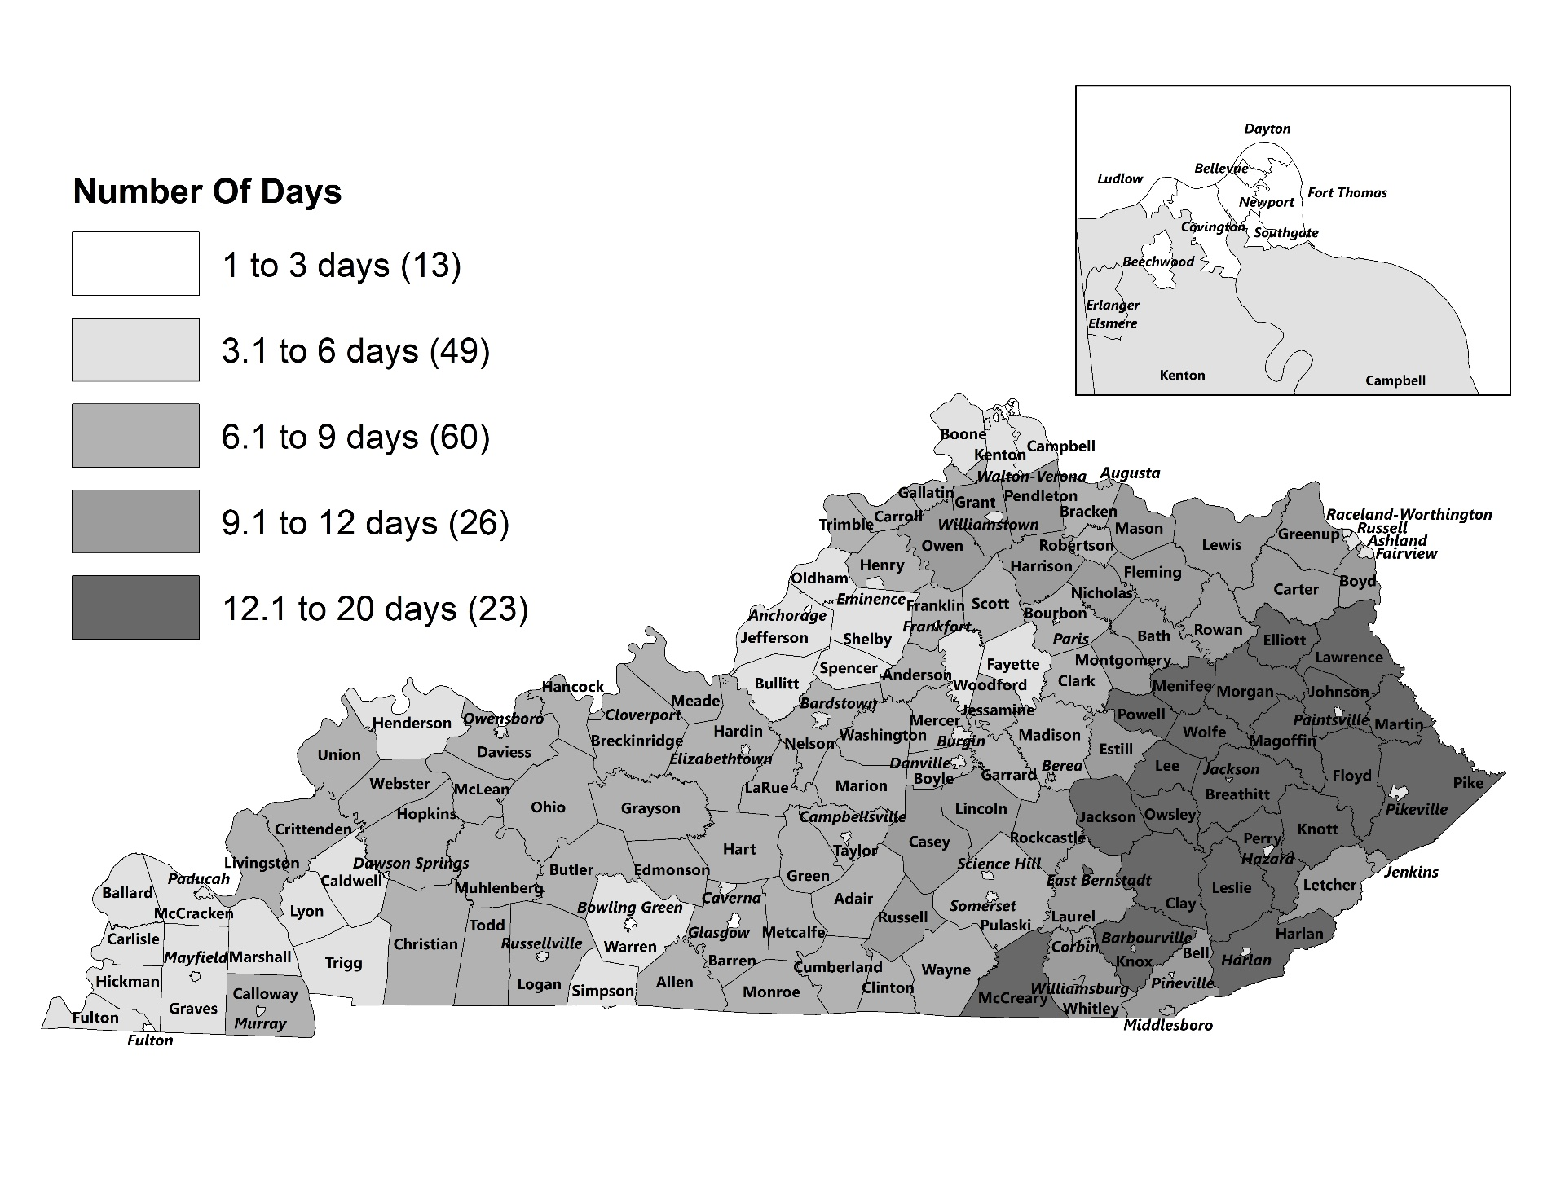
Average Number Of Weather-Related District Closures, 2011-2019
Notes:
This map provides perspective on weather closures by district. The map is shaded according to the average number of weather-related closures for school years 2011 to 2019. The districts shaded in the darkest gray were the 23 districts with the highest average weather closures during that time period. Those eastern Kentucky districts had on average 13 to 20 weather closures per school year.
NTI districts are in all regions of the state, but notice that there were some high-weather districts that had not yet joined the NTI program as of 2019. Likewise, there were some lower weather districts that entered the program.

Slide 19
Annual Average Weather And NTI Days By NTI Status, 2011 To 2019
Notes:
This chart shows the comparison of average annual weather and NTI days for NTI districts relative to non-NTI districts.
Each school year on the chart has comparison bars, with non-NTI districts on the left and NTI districts on the right. Except for the 2011 school year, which preceded the NTI program. Take note that there were only 3 districts in the NTI program for school years 2012 to 2014, and the NTI comparison groups only include the districts in the NTI program for each school year.
The stacked bars for the NTI districts show both weather days and NTI days. The weather days are shown in black, and NTI days in gray.
As you can see, NTI districts used a mixture of weather and NTI days each year to meet annual instructional hour requirements. On average, NTI districts used 5.4 NTI days per year between 2011 and 2019.
Action was taken by the General Assembly to waive instructional hours for districts that were unable to meet the 1,062 instructional hours required per year for school years 2014 through 2016, but it has not been necessary for the General Assembly to do so since then. This can be attributed to factors such as more districts entering the NTI program during the 2017-2019 school years, and the fact that the winter weather closures have not reached the levels seen in 2014 and 2015.
Data on this slide are calculated base on NTI days used by districts when the entire district was closed. The next slide will show remote learning rates of districts in the 2021 school when all districts entered the program. In that year, students could learn remotely on NTI days on which the entire district was closed as well as hybrid days when some students were learning in person and others remotely.

Slide 20
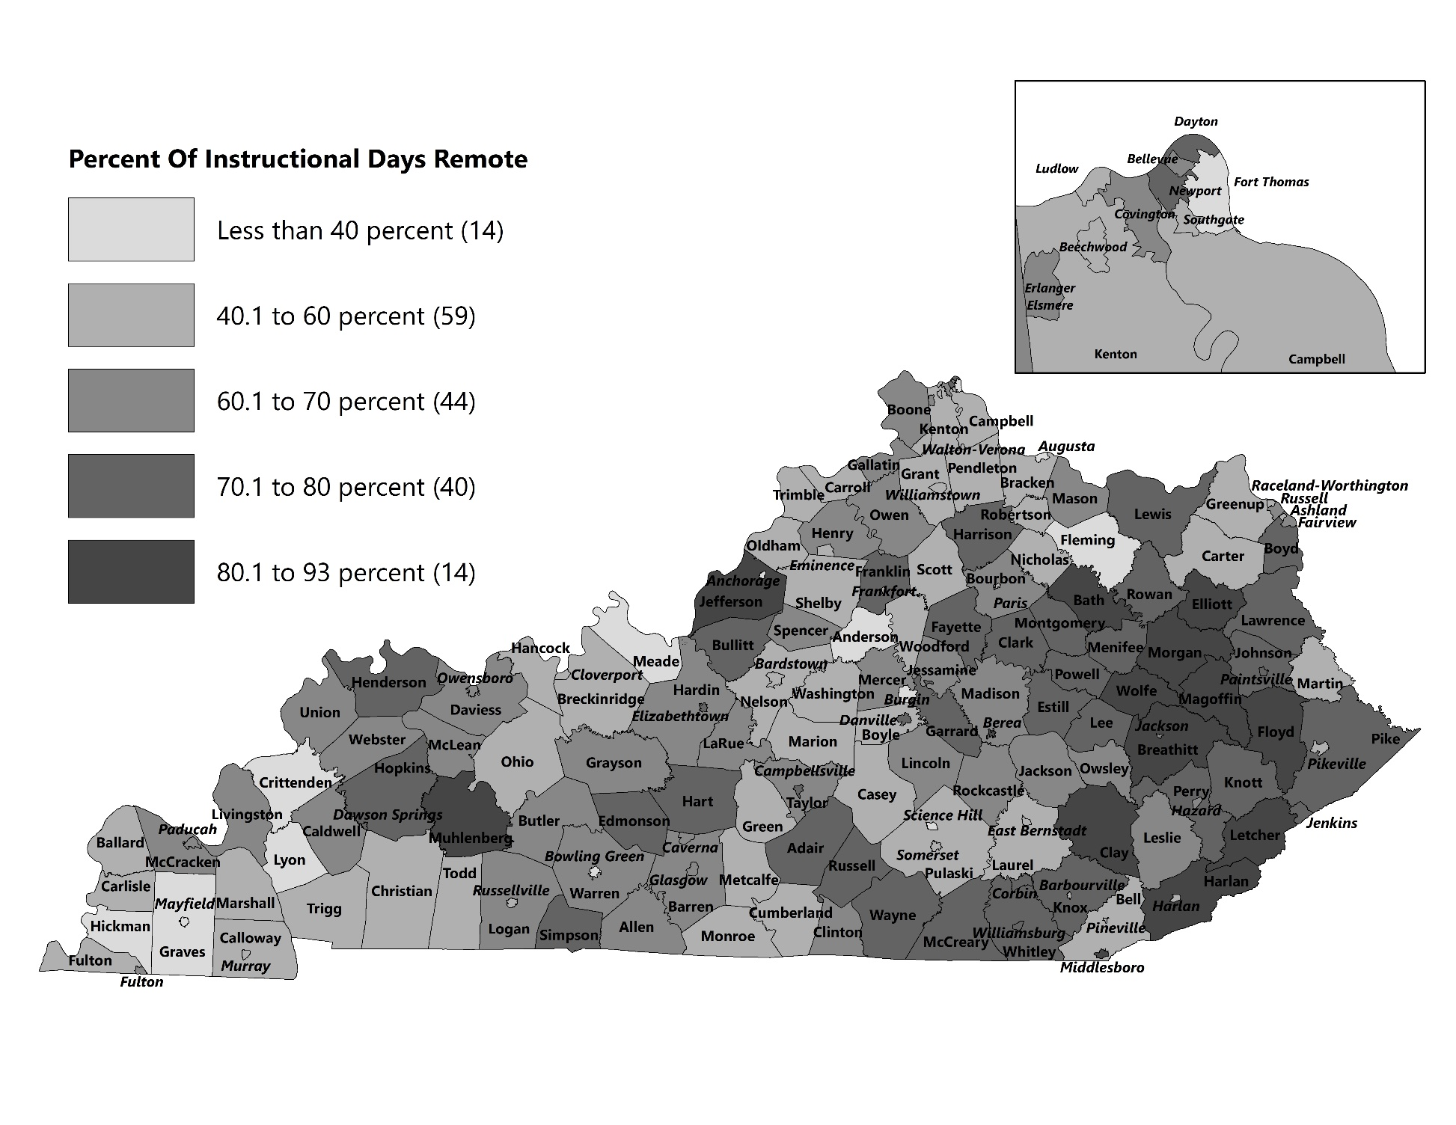
Percentage Of Student Instructional Days In
Remote Learning Mode, 2021
Notes:
This map shows the percentage of instructional days that students learned remotely, by district in 2021.
Individual students within each district may have learned remotely at lower or higher rates.
On average 68 percent of instructional days were remote. Remote instruction rates ranged broadly from a low of 10 percent to a high of 93 percent. Districts with higher remote rates included many rural districts as well as Jefferson County. On average the percent of students living in poverty was greater in higher versus lower remote districts.
Given high rates or remote learning, student home internet access became especially critical in 2021. On the next slide, Deb will review trends in student home access data.

Slide 21
Presentation Outline
NTI Program Background And Requirements
NTI Districts And Days Used
Technology
Advances in the last decade
Student home internet and device access
Synchronous instruction, 2021
Attendance
Academic Outcomes
Conclusions
Notes:
We’ll begin by looking at technological advances since the program was implemented
Click

Slide 22
Evolution From Paper To Digital Modes Of Instruction
NTI initially based primarily on paper-based assignments
By 2020:
Predominantly digital instruction in middle and high schools
95 percent of districts had learning management systems
These web-based systems link teachers, students, assignments, instructional resources
Also capture and store data on student work and engagement
Notes:
Instruction on NTI days was initially based primarily on paper-based assignments
By 2020:
Instruction had become predominantly digital instruction in middle and high schools, though elementary remained primarily paper-based
95 percent of districts had acquired learning management systems, such as google classroom
These web-based systems link teachers, students, assignments, instructional resources
Also capture and store data on student work and engagement

Slide 23
Student Home Internet Access
KDE digital readiness survey data show student home internet access increased from 72 percent in 2011 to 84 percent in 2020
In 2020, students lacking access exceeded 10 percent in most districts
Notes:
While districts were acquiring technology to provide digital instruction, students’ lack of access to instructional devices and to the internet at home remained a challenge
Click
At the state level, student home internet access had increased from the beginning of the NTI program; by 2020 districts reported 84% internet access
click
As you’ll see on the next slide, as of 2020, immediately preceding the pandemic, most districts had a substantially minority of students—at least 10 percent-- that lacked access

Slide 24
Number of Districts By Percentage Of Students With Strong Home Internet Access, 2020
Student access lower in high-poverty districts. An equity concern for NTI and also “homework gap.”
Source: KDE Digital Readiness Survey
Notes:
This slide shows the number of districts reporting various percentages of student home internet access as of the fall of 2020,
On the far right you can see 7 districts reporting 96 percent or more of students had access. On the far left, you can see a total of 12 districts reporting 60 percent or less of students with home internet access.
The overwhelming majority of districts had at least 10 percent of students lacked access.
click
Lack of home internet access is an equity concern not only during NTI but during regular instruction. For example, researcher has shown that internet access is increasingly important for homework and that students lacking access are at a disadvantage throughout the year.

Slide 25
Home Internet And Device Access Gaps Narrowed During COVID-19
Districts used COVID-19 federal funds to
Assist families with internet connection
Purchase mobile devices
KDE data indicate 98 percent of students had access at some location outside school campus in 2021
No KDE data on student home access in 2021
Accurate data on student home access important for local and state purposes
Through 2020, about 40 percent of districts estimated data
KDE requiring systematic data collection as of this school year
Notes:
Click
During the COVID-19 crisis districts were able to use an unprecedented influx of federal dollars to
Assist families with internet connection and purchase mobile devices
click
KDE data indicate 98% of students had access at some location outside school campus in 2021
Click
KDE did not collect data on student home access in 2021
click
Accurate data on student home access important for local and state purposes
click
Through 2020, about 40% of districts estimating
KDE required systematic data collection as of 2022

Slide 26
Recommendation 2.3
The Kentucky Department of Education (KDE) should continue to require districts to collect and record student-level data on student home internet and instructional device access using a standardized instrument recommended by KDE.
Notes:
OEA recommends that KDE require districts to collect data systematically using a standardized instrument.
Related to technology, we’ll note finally that the increase in student home access in the 2021 school year led to expansions in remote instructional options, especially synchronous instruction
click

Slide 27
Opportunities For Synchronous (Face-To-Face) Instruction
Rare In NTI Pre-COVID
Teachers mostly expected to be available by phone or
e-mail
Reported As Regular
By Students In 2021
Elementary: 94 percent
Middle: 88 percent
High: 75 percent
Source: KDE Opportunity to Learn Survey
Opportunities Varied 2021
Every class
Combination of daily “check in,” independent work, tutoring
Little or no synchronous; students instructed almost entirely on software
Best practices not yet known
Notes:
Synchronous instruction was rare in NTI prior to the pandemic. Teachers were expected to be available during school hours and assist students by phone or e-mail if requested. They were not normally required to instruct in real time or otherwise proactively engage with students.
click
Students reported regular synchronous instruction in 2021, especially at the elementary level.
Click
Anecdotal indicate a broad range in access to synchronous instruction, however
Click
Some schools provided synchronous instruction in every class
Click
Others combined daily synchronous check ins with independent work and tutoring for those who needed it
Click
We know that some schools provided little or no synchronous instruction throughout the week. In those schools, students learned almost entirely on software
Click
While best practices for synchronous instruction are not know—especially for short term remote instruction as is normally provided in NTI, it is likely important for some students

Slide 28
Benefits Synchronous Instruction
Parents surveyed by Prichard Committee identified top factors in effective remote learning as:
Personalized guidance (78 percent)
Options for virtual tutoring (64 percent)
Synchronous instruction and engagement may be especially important for some student populations:
Students needing additional assistance, tutoring
Students needing social and emotional support
Students receiving interventions (like Read to Achieve)
Notes:
Parents surveyed by the Prichard committee identified the top factors in effective remote instruction to be synchronous, though not necessarily whole class.
Personalized guidance and options for virtual tutoring were highly valued
click
Synchronous instruction especially may be important for some student populations:
Students needing additional assistance, tutoring
Students needing social and emotional support
Many NTI districts receive read to achieve reading grants that assist struggling students. According to program staff, these interventions can only be provided in person or through synchronous remote instruction
Given its importance to some students and the fact that teachers were not required proactively to instruct or engage with students synchronously prior to COVID-19 it may be important to clarify the minimum amounts of synchronous instruction that should be available to students moving forward.

Slide 29
Recommendation 2. 1
The Kentucky Department of Education should consider establishing, through guidance, minimum requirements for synchronous instruction or engagement that must be offered to students on nontraditional instruction days.
Notes:
OEA recommends that KDE establish minimum expectations for the amount of synchronous instruction that should be at least offered to students on NTI days.

Slide 30
Presentation Outline
NTI Program Background And Requirements
NTI Districts And Days Used
Technology
Attendance
Trends evident only in student-level 2021 data
Questions about quality of participation data
Recommendations
Academic Outcomes
Conclusions
Notes:
The presentation will now shift to the discussion on attendance, including findings pertaining from the student-level data for 2021, and on some of the concerns associated with that data.

Slide 31
District- Versus Student-Level Participation Data
NTI data usually submitted to KDE as district aggregate numbers
In 2021, KDE required that student level participation be entered into student information system (IC)
Notes:
As a remainder, NTI data usually submitted to KDE as district percentage
The report does review those district-level percentages
But it focuses on the student-level data that were collected in 2021. The next few slides are based on that student-level 2021 data.

Slide 32
Aggregate Participation Rates Mask Important Trends
Average NTI participation rates similar to NTI attendance rates
93 percent participation rate in 2021
94 percent attendance rate in 2019
Student-level data reveal substantial differences among students, schools
From 2019 to 2021, chronic absence increased from 19 percent to 22 percent statewide
From 2019 to 2021, chronic absence nearly doubled for black, Hispanic, and limited English proficiency students
Notes:
**Click**
On the surface, a comparison of state-level attendance rates on regular instructional days and student-level participation rates on NTI days were similar.
**Click**For instance, the state-level participation rates for the 2021 school year was 93 percent compared with an attendance rate of 94 percent for the 2019 school year, which was the most recent year in which attendance was calculated.
**Click**But this aggregate data masks substantial differences at the student and school levels.
**Click**For example, the chronic absence rate was 19 percent in 2019, and increased slightly to 22 percent for the 2021 school year. **Click**However, the chronic absence rates nearly doubled from 2019 to 2021 for black, Hispanic, and limited English proficiency students.
The next slide shows that state level chronic absence comparisons mask substantial differences among schools.

Slide 33
Chronic Absence Rates 2019 And 2021
25 or less (n=36)
51-75 (n=648)
76-100 (n=336)
Notes:
This figure shows a school-level comparison of chronic absence rates for the 2019 and 2021 school years for schools grouped by poverty level as measured by the percentage of FRPL-eligible students in those schools. The bars representing chronic absence are divided into 3 groups, the white portion of the bar represents the percentage of students chronically absent 10 to 20 percent, the gray section of the bar the percentage chronically absent 21 to 30 percent, and the black section of the bar represents the percentage chronically absent more than 30 percent of the school year. The collective bar represents the overall chronic absence rate for that year.
You can see that chronic absence rates increased for all schools during the 2021 school year, but the largest increase in chronic absence occurred in schools with the highest concentration of FRPL-eligible students, those schools also had the most students that were absent more than 30 percent of the 2021 school year.
Data shown later in the presentation suggests that highest-poverty schools also experienced disproportionate impacts on student achievement in 2021.
Because student level participation data reveal important patterns not evident in aggregate data, and allow for better monitoring, OEA recommends that:

Slide 34
Recommendation 3.1
The Kentucky Department of Education should consider requiring nontraditional instruction (NTI) districts to enter student-level participation data in the state student information system for each NTI day.
Notes:
KDE should consider requiring NTI districts to enter student-level participation data in the state student information system for each NTI day.
Student level data allow for closer tracking of participation by students. It also allows for greater monitoring by administrators and KDE.

Slide 35
Validity And Reliability Of Participation Data
Analysis of 2021 participation also raise questions about data quality:
In-person participation rates lower than remote
90 percent in person versus 94 percent remote
Chronic absence of high school students double in person versus remote
31 percent in person versus 16 percent remote
Schools with similar attendance rates have very different remote participation rates
Notes:
We will move now to illustrate concerns raised in the report about whether student participation data as currently collected are valid as indicators of continued student learning and whether they are reliable indicators of differences among schools and districts
Analysis of 2021 participation data raise questions about data quality
For instance *Click*
*Click* Participation rates for in-person instruction very different from remote
*click*
For example, at 16 percent remote chronic absence rates for high school grade students were actually lower than either chronic absence rates in 2019. But their in person chronic absence rates were much higher in 2019 and almost double the remote rates.
This could mean that high school students are more likely to be engaged in learning on remote participation days than to attend school on in person days. It may also indicate relatively lower standards that need to be met on in-person days in some schools.
*click*
Some of the data in the report raise questions about how these standards are applied in different schools. For example
*click* Schools with similar 2019 attendance rates had very different remote participation rates in 2021

Slide 36
School-Level 2019 Attendance Compared With 2021 Remote Participation Rates
Notes:
**Click**This slide will illustrate the comparison of school-level attendance rates in 2019 with the 2021 student participation rates.
***Click**First I will show the bars representing 2019 attendance rates. The overwhelming majority of schools that year had attendance rates in the 93 to 96 percent range. There were 31 schools in 2019 with average attendance rates in in the 97-98 percent range.
***Click***2021 school-level student participation rates fell within a much larger range relative to the attendance rates in 2019. There were 115 schools with student participation rates below 85 percent in 2021, compared to 2 schools in 2019, and there were 319 schools, including more than half of middle and high schools with participation rates at 99 percent or more, compared to zero schools in 2019.
School that had similar attendance rates in 2019 had very different remote participation rates in 2021. For example, many of the schools within the 95 percent attendance rate range in 2019 reporting almost perfect participation rates in 2021, whereas as other schools within that range reported much lower participation rates. What can we conclude from this?

Slide 37
Student Participation Data Standards Permit A Broad Range Of Criteria
Pre-COVID NTI
COVID-Era NTI
Criteria determined by districts:
Student work completion
Student software login
KDE specified criteria (once daily) :
Teacher/student video communication or phone calls
(group or one-on-one)
Student work
Student software login
No minimum instructional hour equivalents associated with these criteria
Some other states established time-related guidance
Minimum instructional hour equivalents may be helpful to eliminate extreme variation in standards
Notes:
To answer Chris’s question, we do not know what to make of these data trends.
click
It is possible that some schools are much more effective at others at engaging remote learners and that 100 percent participation indicates learning and engagement by all students in a school. Data may also reflect differences in standards used by different schools to consider a student participating.
As this slide will show, KDE guidance permits a broad range of criteria
Click
Previously, districts were permitted to determine their own criteria for participation. Click
In 2021, KDE identified specific evidence required at least once per day
Click
No minimum instructional hour equivalents have been associated with these criteria. This means that a student could log in briefly to a learning management system and be considered as participating for the entire day
Click
Some other states established time-related guidance
Click
Minimum requirements might be helpful to eliminate extreme variation in participation standards
OEA offers a series of recommendations aimed at focusing greater attention on the quality of student participation data.

Slide 38
Recommendations For KDE To Consider For Participation Data Standards And Monitoring
3.2 Establish guidance for minimum instructional hour equivalents for remote participation criteria
3.3 Require daily verification of participation data by certified person at school
3.4 Conduct annual participation data reviews of select districts
Notes:
OEA recommends first that KDE consider establishing minimum instructional hour equivalents . This recommendation does not suggest that remote participation be measured by precise measures of instructional hour equivalents. Many experts recommend against this practice.. Minimum requirements could, however, rule out a single log in as evidence of participation
OEA also recommends that data be verified daily by a certified person at the school level. Random checks of student work on NTI days were already reported by districts in some NTI plans analyzed for this study.
Finally, OEA recommends that the department conduct annual participation data reviews in select districts. These reviews would serve not only as data checks but as learning opportunities.

Slide 39
Future Consideration For KDE Oversight And District Reporting Requirements
Closer review of participation data might offer greater insights than the current process of reviewing aggregate district data for each NTI day
Quality of data can’t be evaluated in aggregate
Should KDE take steps to address participation data issues, it might reconsider whether district daily NTI-day documentation submission and KDE approval of individual NTI days is necessary
Notes:
The processes recommended above or alternative ways of validating participation data in NTI districts would provide more insight than the current review of daily data in aggregate form. The quality of data can’t be evaluated in aggregate form. KDE has never denied a district NTI days based on the quality of evidence submitted.
click
Should KDE take steps to address participation data issues, it might reconsider whether daily NTI-day documentation submission and KDE review are necessary
OEA has one final recommendation related to participation data; based on uncertainty about the degree of learning that can be measured on NTI day click

Slide 40
Recommendation 3.5
The General Assembly may consider amending KRS 158.070 (9) to establish a standard number of instructional hours that can be granted for each NTI student attendance day.
Notes:
OEA recommends that the
General Assembly consider establishing a standard number of instructional hours to be granted on NTI days.
As noted earlier in the presentation, some districts are receiving up to one instructional hour more than others for each NTI day.

Slide 41
Presentation Outline
NTI Program Background And Requirements
NTI Districts And Days Used
Technology
Attendance
Academic Outcomes
Conclusions
Notes:
We’ll move next to discuss background information and NTI program requirements, including a comparison of requirements for similar programs in other states

Slide 42
Student Outcomes NTI Pre-COVID
Staff analyzed 2018 reading and mathematics scores of students in NTI and Non-NTI districts taking into account:
Prior performance (2014)
Total numbers of weather days and NTI days
Years of NTI participation
Student demographic characteristics
No significant and substantial effects of NTI days on student performance as NTI program is normally implemented (up to 10 days)
Based on state test data alone, no cause for concern overall about continuation of learning on NTI days versus weather makeup days
Notes:
Staff analyzed 2018 reading and mathematics scores of students in NTI and Non-NTI districts taking into account:
Prior performance (2014)
Total numbers of weather days and NTI days
Years of NTI participation
Student demographic characteristics
click
And found no significant and substantial effects of NTI versus weather days on student performance
In other words, state test data alone do not provide cause for concern about the quality of continued learning on NTI days compared with weather make up days. Overall.
As the next series of slides will show, higher remote learning rates were associated with drops in student performance in 2021. The degree to which these drops were associated with remote learning versus other effects of the pandemic are not clear.

Slide 43
Percentage Proficient Or Distinguished Reading And Mathematics On Annual State Tests By School Level, 2019 And 2021
Note: State annual tests were called K-PREP in 2019 and KSA in 2021
Notes:
The percentage of students considered proficient or distinguished on state tests dropped from 2019—the last year in which students were tested, and 2021, with decreases being slightly greater in math than in reading.
(if asked)
Drops:
Math elem: 17
Reading elem: 15
Math middle: 19
Reading middle: 16

Slide 44
Percentage Of 11th Grade Students Meeting CPE College-Readiness Benchmarks In ACT English, Reading, And Mathematics, 2019 And 2021
Notes:
The percentage of students meeting CPE college readiness benchmarks for the ACT also dropped by about 6 percentage points in each subject.
(Note: for consistency with other slide take out the n counts?)

Slide 45
Percentage Of Students Grades 9-12 Earning One Or More F, By Subject 2019 And 2021
Note: increases almost double in highest- versus lower-poverty schools
Notes:
This slide shows increases in the percentage of high school students failing at least one class, by subject and in any class. The percentage of students failing at least one math or English class increased by 7 percentage points and the percentage of students failing at least one of any class increased by 11 percentage points.
Click
As shown in the report, increases were almost double in higher- versus lower poverty schools.

Slide 46
Presentation Outline
NTI Program Background And Requirements
NTI Districts And Days Used
Technology
Attendance
Academic Outcomes
Conclusions
Notes:
In conclusion,

Slide 47
NTI Achieved Key Program Objectives
Allowed districts to continue learning and meet calendar
requirements despite inclement weather
Districts used an average of 5.4 NTI days or about
3 percent of instructional year; rarely used 10 days
NTI districts continued to use weather days
Notes:
Allowed districts to continue learning, meet calendar
requirements despite inclement weather
Districts used an average of 5.4 NTI days or about
3 percent of instructional year; rarely used 10 days
NTI districts continued to use weather days

Slide 48
Technology
Student home access gaps an enduring challenge
Districts used federal funds to increase home access in COVID-era NTI
Important equity concern for NTI and “homework gap”
Accurate student home access data important; systematic data collection should be sustained
Notes:
Student home access gaps enduring challenge
Narrowed during pandemic
Important equity concern NTI and “homework gap”
Accurate student home access data important; systematic data collection should be sustained

Slide 49
Academic Outcomes
NTI Pre-COVID
(average 3 percent remote)
State test data show no substantial effects
Based on state test data, no concern overall about learning on NTI versus weather makeup days
COVID-Era NTI
(average 68 percent remote)
Substantial decreases achievement on state tests
Increase in failing grades, especially highest-poverty schools
Relative effects of remote learning vs. other COVID-associated factors not known
Notes:
As just noted, OEA found no substantial effects of NTI on achievement pre-COVID, but reported substantial drops in student achievement during extended remote learning.
Relative effects of remote learning vs. other COVID-associated factors on these drops are not known

Slide 50
Attendance/Participation Importance Of Student-Level Data
Attendance and participation appear similar on surface
Student-level 2021 data reveal important trends:
Chronic absence almost double for some students
Notes:
Attendance rates and participation rates appear very similar on the surface
Closer analyses, especially those made possible by the student-level data collected in the 2021 school year reveal important trends not evident in aggregate data

Slide 51
Attendance/Participation Reliability And Validity Of Data
Chronic absence rate for high school students during remote instruction about half of in-person chronic absence rate
Unexplained variation among schools
No middle and high schools had attendance rates 99 percent or greater in 2019
More than half had participation rates 99 percent or greater in 2021
Notes:
Student-level also reveal
And unexplained variation between in-person and remote chronic absence rates
click
And between what schools normally report for attendance and what they report for participation

Slide 52
Overall Conclusions
Overall, NTI pre-COVID achieved key program goals with no evidence of negative effects on student achievement
NTI COVID-era may offer important lessons
Closer attention to participation data
Sustaining availability of synchronous instruction

Slide 53
End

Slide 54
Average Number Of Weather-Related District Closures, 2011-2019
And NTI Status As Of 2019
Notes:
This map shows the percentage of instructional days that students learned remotely, by district in 2021.
Individual students within each district may have learned remotely at lower or higher rates.
On average 68 percent of instructional days were remote. Remote instruction rates ranged broadly from a low of 10 percent to a high of 93 percent. Districts with higher remote rates included many rural districts as well as Jefferson County. On average the percent of students living in poverty was greater in higher versus lower remote districts.
Given high rates or remote learning, student home internet access became especially critical in 2021. On the next slide, Deb will review trends in student home access data.

