Slide 1
Kentucky District Data Profiles School Year 2024
Presentation to the
Education Assessment and Accountability Review Subcommittee
by the
Office of Education Accountability
July 14, 2025

Slide 2
Presentation Outline
Background
Overview
Organization
Data Layout
Data Snapshots
Data Notes

Slide 3
Overview: General Contents
Snapshot of key education data for 171 districts and a Kentucky state page
Overview and Trends
Staffing
Finance
Performance
Surrounding states and national comparative data
Data include:
Compilation of Kentucky Department of Education (KDE)-calculated district or state data
OEA original calculations from data submitted by districts to KDE
Professional staff data (PSD)
Classified staff data (CSD)
District annual financial reports (AFRs)
In compiling data, OEA attempts to understand unusual trends or outliers

Slide 4
Data Profiles Organization
Introduction
171 District Profiles
Kentucky Profile
Interstate Comparisons
Appendices On Selected Measures
Technical Appendix (Appendix D)
Data Dictionary
Sources
Data Notes (Appendix E)
Moved
New

Slide 5
DDP Interactive, Online Version
Allows for additional analysis and visualization
Geographic mapping
Sorting metrics by values
10-year trends
Available on LRC website “Interactive Features”
Will be posted by August 2025 for the District Data Profiles 2024 data
10-year trend data based on OEA calculations will be delayed
OEA in the process of coding previous years’ staffing and finance data for export

Slide 6
OEA staff available to assist in use of the interactive profiles.

Slide 7
Presentation Outline
Background
Data Layout
Data Snapshots
AADA 2015-2024
Students eligible for special education, 2015 and 2024
Starting teacher salaries, 2024
Data Notes

Slide 8
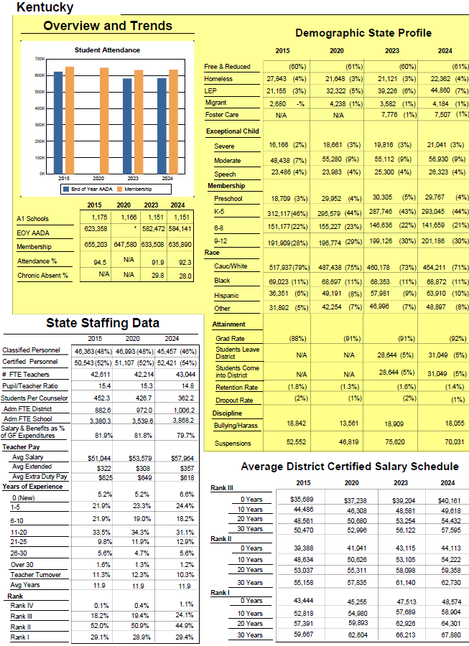
Staffing Data
Classified, certified
Per-pupil ratios-counselors, teachers
Teachers:
Average salary
Years experience
Turnover
Percent by
years/rank
District salary schedule
Overview And Trends
Membership, AADA
Number of Schools
Attendance
Demographic/program
Student movement
Graduation rates
Discipline
OEA Calculated

Slide 9
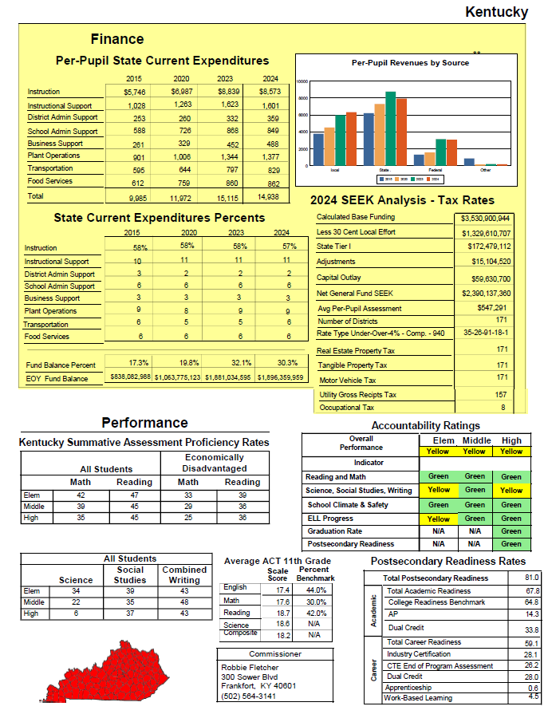
Finance
Expenditures by function
Revenues by source
Distributions from Support Education Excellence in Kentucky (SEEK) funding formula
Tax information
Performance
Kentucky Summative Assessment (KSA)
ACT
Accountability ratings
Postsecondary readiness
OEA Calculated

Slide 10
Examples Of OEA-Calculated Data
Pupil-to-counselor ratios
Total number of district and school administrators
Salaries and benefits as a percent of general fund expenditures
Percent of teachers by rank
Postsecondary readiness rates by indicator

Slide 11
Changes In Adjusted Average Daily Attendance (AADA) 2015-2024
AADA is the foundational number driving calculations of revenue through the SEEK funding formula
AADA calculation reflects both student enrollment and attendance
Statewide, AADA declined by 6.4 percent from 2015 to 2024
District trends varied
105 districts declined by 5 percent or more
20 districts increased by 5 percent or more

Slide 12
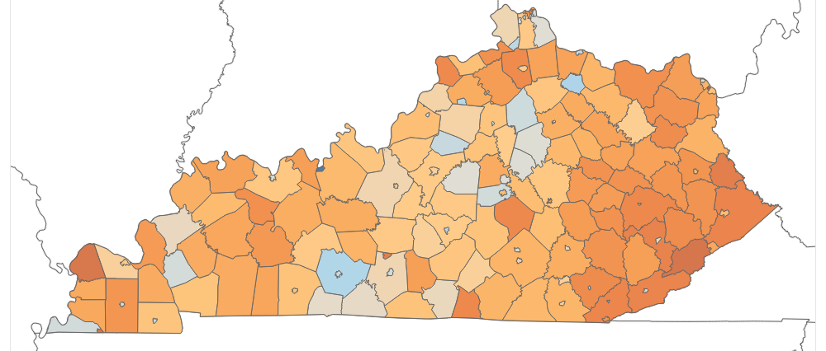
Percentage Change AADA, 2015-2024
Percentage Change AADA
-39
227

Slide 13
Students With Disabilities Eligible For Special Education Services, 2015 And 2024
Note: Percentages are calculated using end-of-year student membership.

Slide 14
Starting Teacher Salary, 2024
Starting Teacher Salary
$35,150
$49,555

Slide 15
Average Starting Teacher Salary Surrounding States And US, 2024
Average Starting Teacher Salary
CWIFT-Adjusted Average Starting Teacher Salary*
Rank | State | Salary
16 | VA | $48,666
-- | US | 46,526
26 | IL | 45,061
27 | IN | 45,007
29 | TN | 44,897
37 | WV | 42,708
47 | OH | 40,055
48 | KY | 40,161
49 | MO | 38,871
Rank | State | Salary
7 | WV | $52,988
17 | IN | 51,028
22 | TN | 49,941
34 | VA | 46,749
35 | KY | 46,699
-- | US | 46,526
40 | OH | 45,184
44 | IL | 44,547
49 | MO | 43,480
* CWIFT= Comparable Wage Index for Teachers

Slide 16
Presentation Outline
Background
Data Layout
Data Snapshots
Data Notes (Appendix E)
State revenue trends and Teachers’ Retirement System (TRS) on-behalf payments

Slide 17
Per-Pupil Revenues By Source
Per-Pupil Revenue ($)
Local
State
Federal
Other

Slide 18
State Per-Pupil Revenue Associated With Additional General Assembly Appropriations For TRS
Increased revenue in 2023 included an additional, one-time appropriation of $479.2 million from the General Assembly to TRS on behalf of school districts
Government accounting standards require districts to record on-behalf payments on annual financial reports as both revenues and expenditures
On-behalf payments were also associated with increased state revenue beginning in 2018
reflected an initial appropriation of $498.6 million to support long-term solvency of the TRS
appropriations have continued in each subsequent year and increased over time
Note: Appendix E contains additional information

Slide 19
END

