Slide 1
Education Professional Standards Board
Education Assessment & Accountability Review Subcommittee

Slide 2
What is the EPSB?
The Education Professional Standards Board (EPSB) has the authority and responsibility to establish standards and requirements for obtaining and maintaining a teaching certificate. [KRS 161.028(1)(a)]
Most members are active educators
9 members are teachers from elementary, middle school, high school, special education and secondary vocational classrooms.
Two members are school administrators one of whom shall be a school principal.
One member is a representative of local boards of education.
Three members are representatives of postsecondary institutions.
Two are ex-officio members (“The secretary of the Education and Labor Cabinet and the president of the Council on Postsecondary Education, or their designees”).
[KRS 161.028(2)(a)]

Slide 3
EPSB Appointed Members
Chair Amber Snell, Middle School Teachers
Vice-Chair CJ Fryer, High School Teachers
Scottie Collier, School Administrators
Elijah Edwards, High School Teachers
Cathy Gunn, Middle School Teachers
Priscilla Keller, Elementary School Teachers
Jacqueline Mayfield, Elementary School Teachers
Lori McKeehan, Elementary School Teachers
Justin Mitchell, Middle School Teachers
Corinne Murphy, Public Postsecondary Institutions
Merideth Pittman, Middle School Teachers
Lisa Rudzinski, School Administrators
Vacant, Local Boards of Education
Vacant, Private Postsecondary Institution
Vacant, Public Postsecondary Institution

Slide 4
EPSB’s Disciplinary Authority
The EPSB may take action against a certificate for any misconduct described in KRS 161.120(1) including violations of the Professional Code of Ethics for Kentucky Certified School Personnel promulgated in 16 KAR 1:020.
This process is independent of the district’s disciplinary, and the tribunal process described in KRS 161.790.
[KRS 161.120(3) and (4)]

Slide 5
EPSB’s Disciplinary Authority cont’d
The EPSB has specifically been given the authority to sanction an educator’s certificate in the following manner:
Revoke, suspend or refuse to issue or renew;
Impose probationary or supervisory conditions upon;
Issue a written reprimand or admonishment; or
Any combination of those actions.
[KRS 161.120(1)]

Slide 6
Purpose of EPSB Disciplinary Process
“In order to support the mission of the EPSB, the EPSB may take action against an educator's certificate in an effort:
To ensure that an educator has an understanding of an educator’s professional duties and responsibilities; and
To protect students, parents of students, school personnel, or school officials.”
[16 KAR 1:030 Section 1]

Slide 7
It Starts with a Completed Complaint
The largest amount of cases are initiated from Superintendent reports which are mandated under KRS 161.120(3)(a).
The EPSB receives complaints from a variety of sources including parents, concerned citizens, and other state agencies like OEA and CHFS.
The EPSB does not accept anonymous complaints.

Slide 8
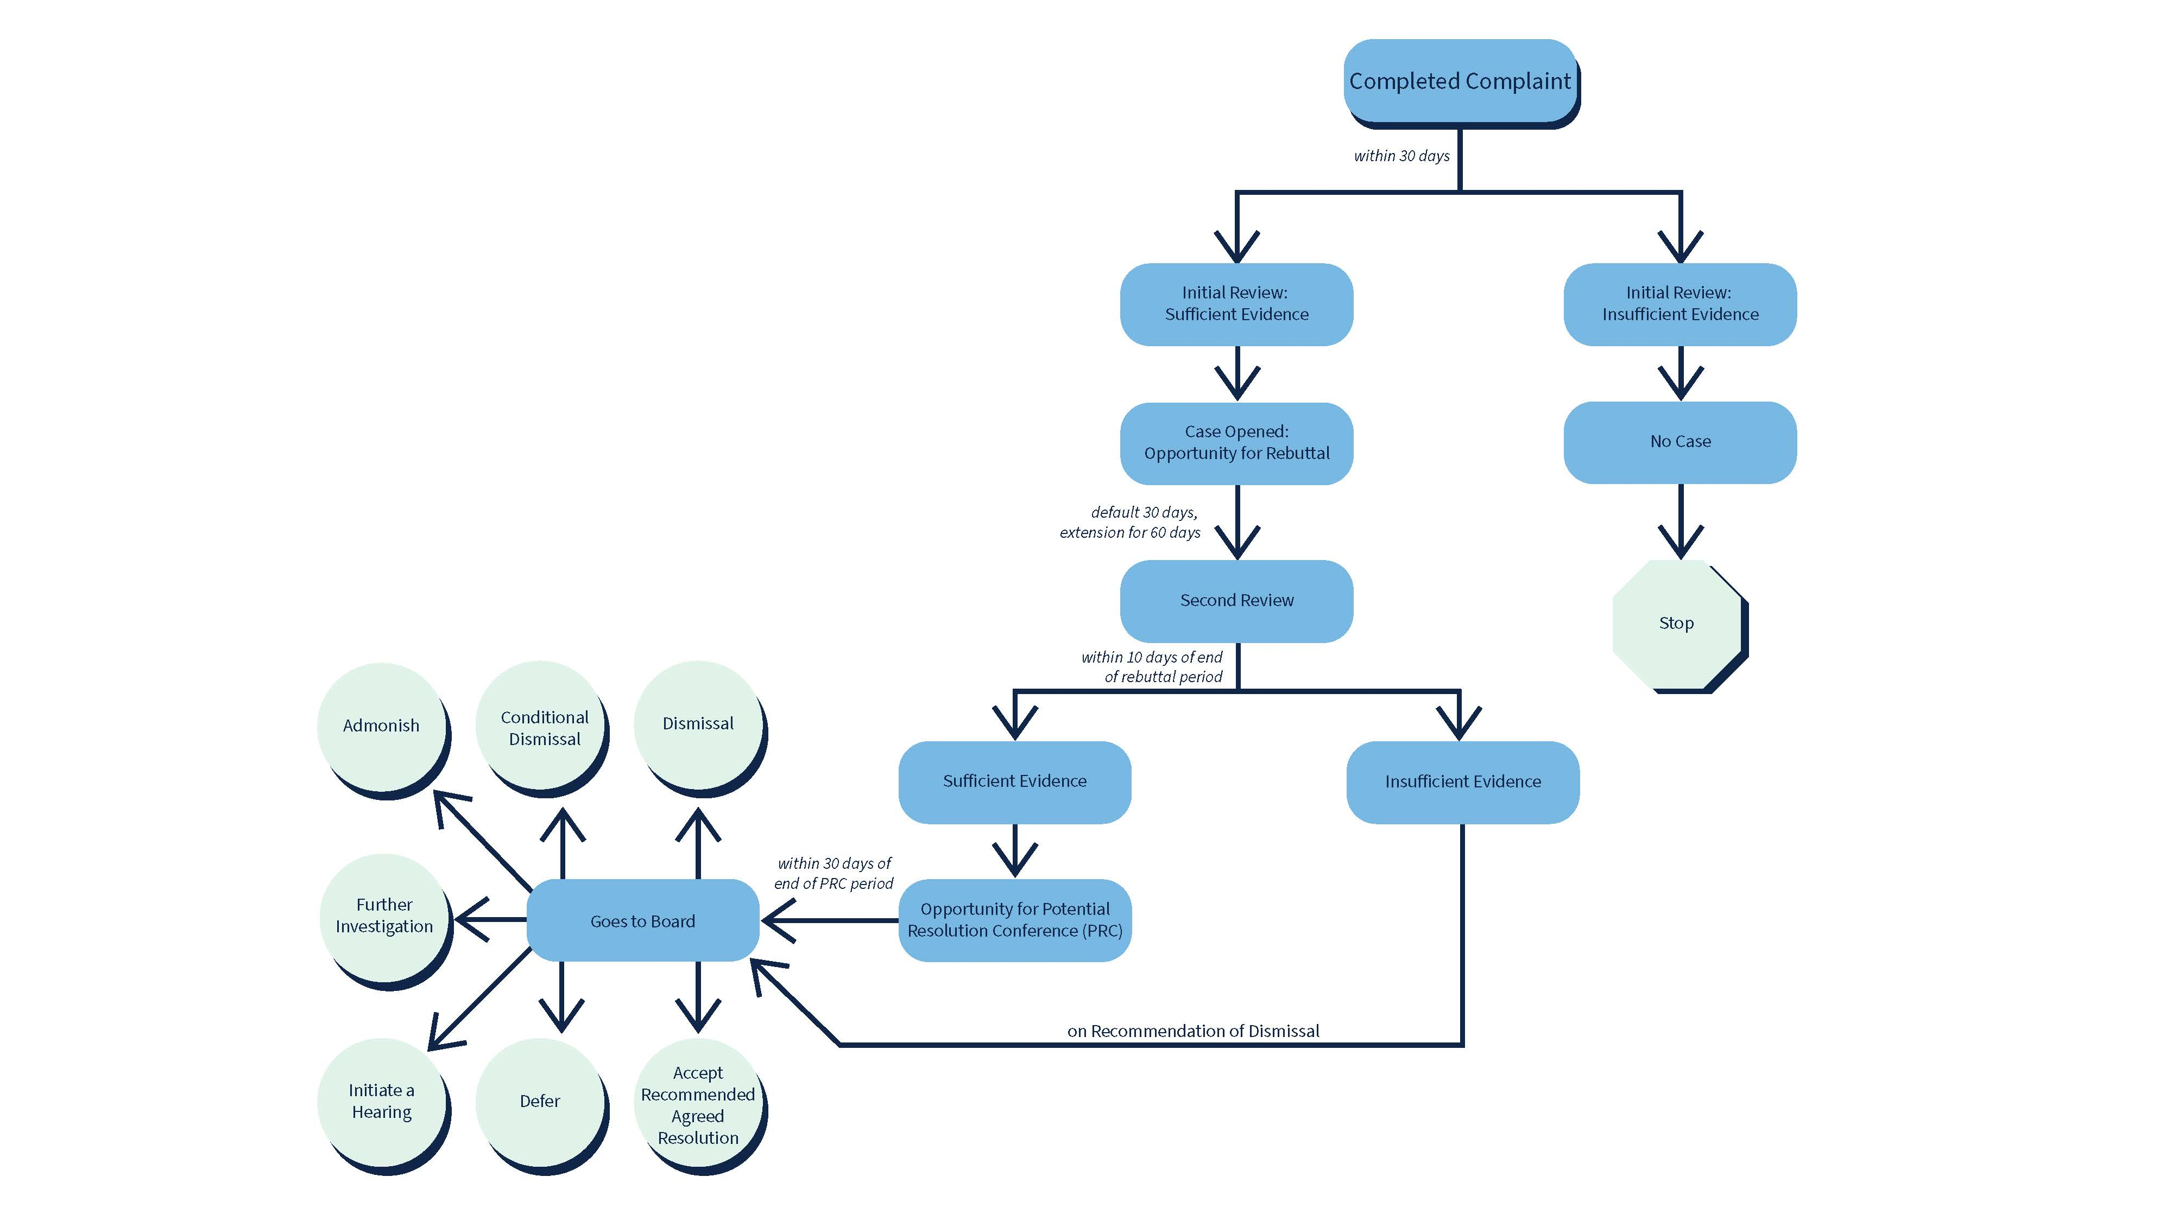

Slide 9
Board Review
The EPSB may make one of the following decisions on a case in closed session:
Dismissal
Conditional Dismissal upon Completion of Training
Admonish
Further Investigation
Initiate a Hearing
Accept Recommended Agreed Resolution
Defer
[KRS 161.120(2)(e)]

Slide 10
Reasonableness of Sanction
Under 16 KAR 1:030 there are 6 factors that the board is required to consider:
The seriousness of the alleged violation;
Whether an attempt to conceal the alleged violation was made;
Whether there were any prior violations;
Whether training is appropriate to prevent further violations;
Whether the sanction is necessary to deter future violations; and
Other relevant circumstances or facts.

Slide 11
Violations of KRS 161.120:
a) Convictions for felonies, certain misdemeanors, and any misdemeanor involving a student;
b) Having sexual contact with a student or a minor;
c) Committing any act that constitutes fraudulent, corrupt, dishonest, or immoral conduct;
d) Demonstrating willful or careless disregard for the health, welfare, or safety of others;
e) Physical or mental incapacity that prevents the educator from performing duties with reasonable skill, competence, or safety;
f) Possessing, using, or being under the influence of alcohol, which impairs the performance of duties;
g) Unlawfully possessing or unlawfully using a drug during the performance of duties;
h) Incompetency or neglect of duty;
i) Falsifying information in an effort to obtain or renew a certificate;
j) Failing to report misconduct;
k) Failing to comply with an order of the EPSB;
l) Violating any state statute relating to schools or the teaching profession;
m) Violating the Professional Code of Ethics;
n) Violating any administrative regulation promulgated by the EPSB or KDE; or
o) Discipline from another licensing or certifying jurisdiction on grounds that constitute a violation in Kentucky

Slide 12
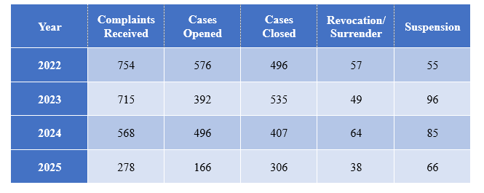
Educator Case Overview
Data was obtained from the Kentucky Educator Credentialing System.
2025 Data is for January 1, 2025 - June 30, 2025.

Slide 13
Questions?
Contact Information:
Office of Legal Services
300 Sower Blvd., 5th Floor
Frankfort, Kentucky 40601
502-564-4606
www.epsb.ky.gov
Staff email addresses:
Todd.Allen@education.ky.gov
Cassie.Trueblood@education.ky.gov
EPSBEducatorEthics@education.ky.gov

