Slide 1

Early Childhood Regional Training Centers (RTCs)
Presentation to the
Education Accountability and Assessment Review Subcommittee by the
Office of Education Accountability
October 14, 2025

Slide 2
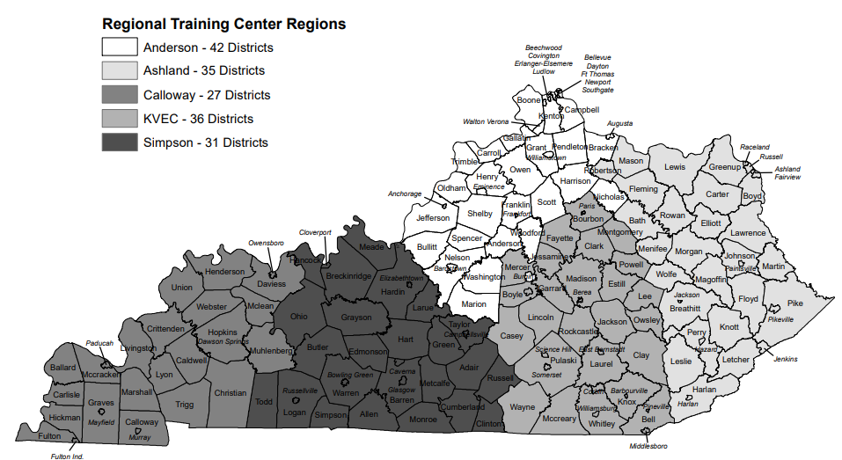
Regional Training Center Regions (RTCs)

Slide 3
Study Request And Findings
Study request
Funding
Student populations
Federal and state program requirements
Major Findings
RTCs provide necessary training and support to preschool personnel
Consistent with program requirements
Greater oversight by KDE needed for fiscal accountability and program impact
RTC model merits evaluation

Slide 4
Data Sources
KDE contracts (MOAs)
Student enrollment and preschool funding
District annual financial reports and quarterly project budget reports
Professional and classified staffing data
LEAD teacher certification data
KDE staff interviews

Slide 5
Presentation Outline
State and Federal Program Requirements
Populations Served
Revenues
Oversight Issues

Slide 6
Federal Policy Requirements
Individuals With Disabilities Act (IDEA) B preschool grant
Permits use of state set-aside funds to support state activities
Funds may be used for a variety of services and models, including technical assistance to support state goals for preschool-aged children with disabilities
Regional service center model not required
Administered and under direction of KDE’s Office of Special Education and Early Learning (OSEEL)

Slide 7
State Policy Requirements
KRS 157.318
Establishes regional centers to support preschool and early childhood personnel operating programs for disabled and at-risk children
Support shall include peer-to-peer training, consultation, technical assistance, and materials
Requires use of available federal funding to support centers

Slide 8
RTC Program Objectives
Student behavior interventions & positive behavior support
Evidence-based inclusive practices
IDEA compliance and Individualized Educational Program (IEP) development
Kindergarten transition and family engagement

Slide 9
Presentation Outline
State and Federal Program Requirements
Populations Served
Revenues
Oversight Issues

Slide 10
Number Of Preschool Students In Each RTC Region, SY 2024
SWD = Students with disabilities

Slide 11
Preschool Teachers In Districts Served By RTCs, SY 2024
Reginal Training Center | Count Of Teachers | Percent Of All Teachers
Anderson | 373 | 30%
Ashland | 148 | 12
Calloway | 182 | 15
KEDC | 274 | 22
Simpson | 251 | 20
Grand Total | 1,228 | 100
The report notes that many preschool personnel were recorded with incorrect job class codes or not included in staffing data.

Slide 12
Presentation Outline
State and Federal Program Requirements
Populations Served
Revenues
Oversight Issues

Slide 13

2024 Federal Funding IDEA-B Preschool Funding
IDEA B Preschool Funding – $11.2 Million
District Grants
$8.37 Million
Retained By KDE
$575,187
State Set-Aside
$2.3 Million
RTCs
$2.26 Million

Slide 14
2024 RTC Appropriataions And Funding Per Child
 |  | Funding Per Child
RTC | Revenue | Disability |  | Disability + At-Risk
Anderson | $471,392 | $117 | $ 68
Ashland | $448,367 | 427 | 259
Calloway | $448,367 | 300 | 154
KVEC | $448,367 | 167 | 99
Simpson | $448,367 | 182 | 108
Total | $2,264,860 | 193 | 112

Slide 15
Recommendation 1
The Kentucky Department of Education should review Regional Training Centers’ district service areas and allocation of grant funding to ensure equitable access to Regional Training Center resources and services by participating districts.

Slide 16
Presentation Outline
State and Federal Program Requirements
Populations Served
Revenues
Oversight Issues
Fiscal
Program Impact

Slide 17
RTC Staffing Model
Personnel By RTC, 2024
RTC | Director | Consultant/ Coach | Administrative Assistant | Total Personnel
Anderson | 1 | 1 | 1 | 3
Ashland | 1 | 2 |  | 3
Calloway | 1 | 2.5 |  | 3.5
KVEC | 1 | 1 | 1 | 3
Simpson | 1 | 1 | 1 | 3

Slide 18
Methodology
MOA/Contract
RTC annual reports
Expenditures
Did not review purchase orders or invoices

Slide 19
Fiscal Issues
Questionable expenditures
Excessive overhead (indirect) costs in one RTC
Use of RTC grants funds to support district expenses in one RTC
In all RTCs, incorrect coding of RTC revenue and expenditures as district funds
Should be coded as state agency funds
Note: Appendix C includes more details on questionable expenditures.

Slide 20
Recommendation 2
The Kentucky Department of Education should ensure that Regional Training Centers apply correct and uniform coding practices for both expenditures and staffing classifications. For example, the Kentucky Department of Education should require that Regional Training Center financial accounts be established as agency funds rather than district funds.

Slide 21
Recommendation 3
The Kentucky Department of Education should review Regional Training Center budgets and expenditures to ensure they are consistent with contractual requirements and state guidelines. These requirements include, but are not limited to, indirect and direct cost rates and exclusive use of Regional Training Centers’ grant funding to support Regional Training Center activities.

Slide 22
Program Impact
Goals lacked sufficient baseline data for performance evaluation
Inadequate evidence to support attainment of quantified goals—such as percentage increases
Lending libraries may be underutilized

Slide 23
RTC Model Merits Evaluation
RTCs in existence for 35 years
Most regional support staff now employed by KDE
Technology has evolved
Training
Distribution of materials
Five separate contracts may be difficult to monitor
Each contract has 3 employees, which includes a director
May place undue administrative burden on KDE and RTC staff

Slide 24
Recommendation 4 – Part 1
The Kentucky Department of Education should conduct an evaluation of the current structure of the Early Childhood Regional Training Centers to assess whether the existing model effectively and efficiently delivers support services to school districts. This evaluation should include a cost comparison between the current regional model and an alternative model in which staff are employed directly by the Kentucky Department of Education.

Slide 25
Recommendation 4 – Part 2
Findings should be shared with the Education Assessment and Accountability Review Subcommittee and the Interim Joint Committee on Education. Based on findings of the report, the General Assembly may wish to consider amending or removing requirements of KRS 157.318 related to early childhood regional training centers.

Slide 26
Conclusions
RTCs provide needed personnel training and supports
More KDE oversight is needed
RTC model merits evaluation
Statutory changes may be necessary to permit alternative use of federal preschool grant funds

Slide 27
End
Questions?

