Slide 1
Department for Medicaid Services
Prepared for the Medicaid Oversight and Advisory Committee
Lisa Lee, Commissioner, DMS
Steve Bechtel, Chief Financial Officer, DMS
June 16, 2021

Slide 2
OVERVIEW OF MEDICAID WORKS PROGRAM

Slide 3
Medicaid Works Background
Individuals with severe medical or physical impairments have high medical costs
Prior to ACA, difficulty finding affordable private health insurance or may be denied health insurance due to pre-existing condition
May not be able to afford employer coverage
Employers may not offer health insurance
To be eligible for disability benefits, individuals must be unable to engage in substantial gainful activity (SGA)
Disability is an eligibility category for Medicaid
Individuals who earn more than the SGA are no longer considered disabled for purposes of SSI or Medicaid

Slide 4
Medicaid Works Background
Ticket to Work and Work Incentives Improvement Act of 1999 option for working individuals with disabilities to buy-in to Medicaid
Individuals who would be eligible for SSI benefits except for their earnings
State establishes income and asset tests as well as methodology for determining
May impose premiums based on a sliding scale
No premiums for those below 100% of FPL

Slide 5
Kentucky Medicaid Works
Implemented November 2007
Eligibility Criteria
Blind or disabled individuals – must meet Social Security definition of disabled
Continues to be eligible for Medicaid except for employment earnings
Lack of eligibility for Medicaid would inhibit ability to continue employment
Between the ages of 16 and 64
Must meet Medicaid resource standards – no more than $4,000 in personal assets
Only income of working disabled is counted
Unearned income limit (SS, Worker’s Comp, Veteran’s benefits, interest) of approximately $773 monthly

Slide 6
Kentucky Medicaid Works Enrollment
15 Unduplicated Members since implementation
5 currently enrolled
All below 100% of FPL – no premium requirement
Move to Medicaid Expansion?
HJR57 – Bridge Plan potential for those who do not qualify for expansion

Slide 7
SFY 2021 Benefits Budget Update

Slide 8
Kentucky Medicaid at a Glance
Approximately 1,664,000 members currently enrolled
605,159 children enrolled in Medicaid and KCHIP (36% of total enrollment)
129,454 of total enrolled are currently in presumptive eligibility (8% of total enrollment)
Over 59,300 enrolled providers
$14.7 billion budget (Administrative and Benefits combined)

Slide 9
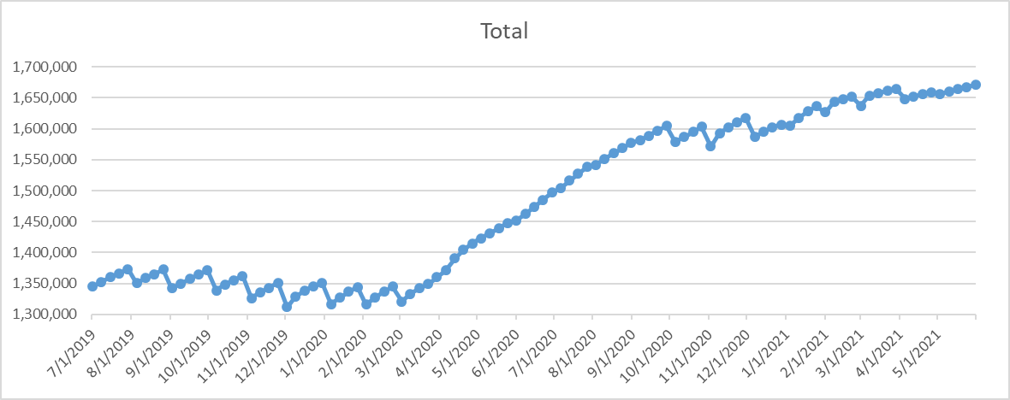
Eligibility Experience
Enrollment for the period of July 2019 through May 2021:
Since March 2020, our Total Enrollment has increased by 350,047 (26.50%).
Presumptive Eligibility currently accounts for 129,454 (37%) of the overall increase in eligible members.

Slide 10
Presumptive Eligibility
Total Number of Individuals Ever Enrolled Since March 2020
227,996
Qualified for Full Medicaid
29,443
Discontinued (moved to Exchange, employer sponsored health insurance, or uninsured)
69,099
Currently Enrolled
129,454

Slide 11
PE Expenditures
Total FFS Spend: $312,433,833
Average of $1,370.35 per enrollee

Slide 12
BENEFITS (INCLUDES KCHIP) Historical Expenditures and Enacted Budget
MEDICAID EXPENDITURES
(actual)
(actual)
(actual)
(actual)
(budgeted)

Slide 13
BENEFITS SFY 2021 Budgeted vs. Actual
MEDICAID EXPENDITURES
(actual)
(actual)
(actual)
(actual)
(budgeted)

Slide 14
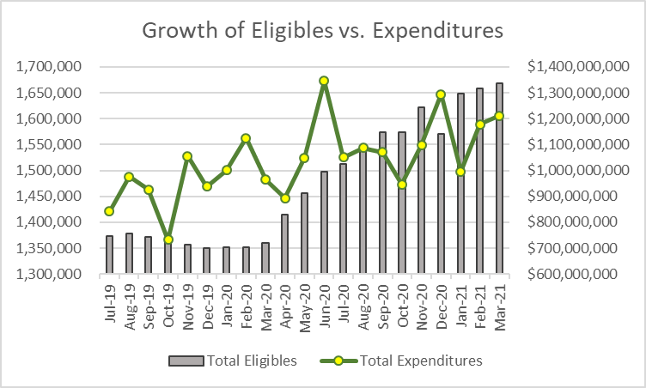
Growth of Medicaid
In comparing June 2019 thru March 2020 data to June 2020 thru March 2021 data, we can see the following:
18.83% increase in the monthly average eligibles
16.05% increase in total expenditures

Slide 15
Per Member Per Month (PMPM)

Slide 16
TEMPORARY INCREASE IN FMAP FOR HCB WAIVER SERVICES AUTHORIZED BY THE AMERICAN RESCUE PLAN

Slide 17
Temporary Increase in FMAP for HCBS
One-year, 10% increase in FMAP for HCBS
Must be used to supplement, not replacing existing state funds
Facilitate activities that enhance, expand, or strengthen HCBS
Cannot impose stricter eligibility requirements
States must submit plan to CMS within 30 days of receipt of guidance – Kentucky requested and was approved a 30 day extension for plan submission
Conducting provider and member surveys
Internal workgroup to eliminate duplication of efforts across the Cabinet
States have until March 31, 2024 to fully expend funds
Must receive appropriations for state match

Slide 18
Temporary Increase in FMAP for HCBS Options
Conducting crosswalk from all agencies providing recommendations
Oversight – quarterly reporting to CMS
Short term vs. Long Term
Bolstering workforce: invest in training and career pathway strategies to grow a diverse LTC workforce
Rate methodology – aligning reimbursement across waiver types and programs serving the population across Cabinet
PACE
Home modifications – structural improvements (Hart-Supported Living)
Technology – computers, tablets to assist with telehealth, remote patient monitoring devices
Compliance with procurement rules

Slide 19
UPDATE ON MCO CONTRACT AND RFP PROCESS

Slide 20
QUESTIONS and/or Comments?

