Slide 1
COVID-19 Testing and Reporting Process Program Review and Investigation Committee August 13, 2020
Kentucky Department for Public Health
Dr. Steven Stack, Commissioner Dr. Doug Thoroughman, State Epidemiologist (acting)
CDC Career Epidemiology Field Officer

Slide 2
COVID-19 – Quick Update

Slide 3
KENTUCKY¹
State of Emergency declared March 6, 2020
34,982
Cases (↑404)
773
Deaths (↑1)
2.2%
Mortality Rate
120 counties
with at least one case
UNITED STATES²
Risk to Americans is widespread
4,974,959
Cases (↑54,590)
161,284
Deaths (↑1,064)
3.3%
Mortality Rate
59 states + territories
with at least one case
WORLD³
WHO declared pandemic on March 11, 2020
19,462,112
Cases (↑273,552)
722,285
Deaths (↑6,207)
3.7%
Mortality Rate
215 countries
with at least one case
¹Kentucky Department for Public Health
²The Centers for Disease Control and Prevention https://www.cdc.gov/coronavirus/2019-ncov/cases-in-us.html
³The World Health Organization https://www.who.int/emergencies/diseases/novel-coronavirus-2019/situation-reports/

Slide 4
Kentucky COVID-19 New Cases by Week (n = 34,982)
Number of Cases
Date Cases Announced
Last Updated August 10, 2020

Slide 5
Public Health Laws in Relation to COVID-19

Slide 6
902 KAR 2:020 Reportable Disease Surveillance
Public health’s primary operating law
Requires CHFS to implement a statewide program for the detection, prevention, and control of communicable diseases, etc. including:
Notification standards
Submission of specimens
Reporting classifications and methods
Which infectious conditions are reportable
Section 10 specifies that “Newly recognized agents” and “Emerging Pathogens” are immediately reportable
Also specifies that any outbreak, epidemic are immediately reportable 10 (2)(b) An outbreak of a disease or condition that resulted in multiple hospitalizations or death 10 (2)(d) An epidemic

Slide 7
902 KAR 2:020 – Notification Standards
Section 2 – Specifies who must report
Health Professionals AND facilities/laboratories must report cases of reportable disease to local and/or state health departments
Section 5 – Specifies time frames for reporting
“Immediate” – Bioterrorism, select agent testing, outbreaks, epidemics, emerging pathogens – COVID-19 Falls in this category on several levels
“Urgent” – Within 24 hours (list of conditions in Section 6)
“Priority” – Within 1 business day (list of conditions in Section 7, 11, 12(3), 17(4), or 18)
“Routine” – Within 5 business days (list of conditions in Section 8, 9, 10, 13(1), 16(1),
17(7), or 20(1))
Section 5 – Also specifies how reporting is done
Electronic or fax submission
EPID 200 Reportable Disease Form
For COVID-19 KDPH also requires a CDC COVID-19 Case Investigation Form

Slide 8
COVID-19 Laboratory Testing and Test Reporting

Slide 9
COVID-19 Laboratory Testing
Types of Tests
Virus detection – Nasopharyngeal (NP), Oropharyngeal (OP), Nasal swabs
PCR – Detects genetic material of the COVID-19 virus
Antigen – Detects proteins specifically associated with the virus
More likely to indicate active infection
Dependent on other characteristics like symptom timeframe, exposure to confirmed cases
Serology – blood tests
Antibody testing – Detects body’s response to pathogen, development of antibodies
Less likely to indicate current infection, but infection at some point in the past
Symptomology could indicate more recent infection

Slide 10
COVID-19 Laboratory Reporting
1st Priority: Report results to the clinician or facility ordering the test
2nd Priority: Report results to Public Health
Preferred Method – Kentucky Health Information Exchange (KHIE)
Facilities must be onboarded to KHIE for this to occur
Many “pop-up” labs offer testing for COVID-19 that have never tested for reportable diseases
Not connected to KHIE
Many not even aware that they need to report to Public Health
New, point-of-care/rapid tests add another layer of complexity
There is no “lab”, just the facility offering testing – pharmacies, doctor’s offices, other groups
Secondary Methods
Report directly to NEDSS (National Electronic Disease Surveillance System)
Fax
Electronic file (spreadsheet) submission

Slide 11
Reporting of Positives vs. ALL Test Results
Reporting of positive results required by law (902 KAR 2:020)
Reporting of negative results not required by law
Need negative results to determine positivity rate of testing
Labs reporting through KHIE submit ALL test results
Labs reporting to NEDSS directly submit ALL test results
But not easy to extract and combine data with KHIE data
Commissioner has mandated all labs to get onboarded to KHIE
In the interim, labs can report full results via spreadsheets submitted to KDPH
Again, not easy to combine data with KHIE or NEDSS (manpower issue)
Many labs don’t submit regular or full data
They know it isn’t required by law!

Slide 12
Laboratories Testing Kentucky Residents
AIT
Appalachian Regional Hospital
Baptist Health Corbin
Baptist Health Lexington
Baptist Health Richmond
Biocerna
BioTapMedical (Baptist Louisville-Norton Healthcare)
Bluewater Diagnostics (Bluewater Toxicology)
Center for Predictive Medicine
Clarity Lab Solutions
Deaconess Hospital
Diatherix
Dominion Diagnostics
eTrueNorth Labs (Walmart Drive Thru) Reditus Laboratories
eTrueNorth Labs (HealthQuest Labs)
Fulgent
Genetworx
GeneTrait Labs (PTC)
Gravity Diagnostics
Integrity
KY State Lab (DLS)
LabCorp
LabTox
Lexar
Louisville Metro Public Health Lab
Mako Genomics
Mayo Clinic
Nulease Medical Solutions
Onsite Health Solutions
Owensboro Health Regional Hospital
PathGroup
Pathology and Cytology Labs
Premier Medical
Pride Diagnostic
Quest
Solaris
X-Gene (Colt Neck Labs/Tec Biosciences)
U of L Research Laboratory
U of L Infectious Disease Laboratory
University of Kentucky
VA Lexington Micro Biology (LEXINGTON VA HEALTH CARE)
VA Medical Center Lexington (Special Reference Laboratory Lexington VAMC)
VA Medical Center Louisville (Robley Rex)
Vault Medical Services
VIKOR Scientific
Viracor Eurofins
Walgreens--- PWN Health

Slide 13
Lab Testing Surveillance
Need to collect data on testing being performed on KY residents
Lab survey initiated April 3, 2020
National Guard contingent assigned to KDPH created survey
Contacted labs to begin reporting
Survey collects data from labs we know are testing residents of Kentucky
Cumulative and daily numbers
Total number of tests performed
Total number of positive tests
Broken down by PCR, Antigen and Antibody
Reporting is irregular by lab, so we use cumulative reporting to look at positivity rates

Slide 14
Specific Testing Questions
All PCR, antigen, and antibody results are reportable to KDPH
Not all are counted and reported as cases
No financial incentive to report positive tests for facilities or clinicians
Not aware of anyone manipulating results for financial gain
We have heard of unscrupulous testing operations, however
Quality Assurance for Labs: The duty of FDA, not KDPH
State Lab has assisted in validating a few laboratories
Laboratories that have “false” results
If we hear about these, KDPH investigates, Commissioner often intervenes
State Lab has been available to validate results from labs in this situation
We don’t have a clear mechanism to exclude results from labs unless it is proven that their results are 100% false

Slide 15
Confusion in Test Results
Timing of testing matters during course of infection
PCR/Antigen will detect presence of virus
If too early, may not detect due to insufficient viral load
Body will shed virus for weeks, so likely positive well after infectiousness
Antibodies for COVID-19 show up late, usually late in 2nd week of infection
Presence of antibodies indicate you have been infected but not when
Sensitivity and specificity of test matter
Most genetic (PCR/antigen) tests are pretty good
Each test differs and there are dozens
Adequacy of specimen
Sometimes get a poor nasopharyngeal specimen
Storage, shipment, and time between collection and testing can diminish specimen viability
Contamination in lab – antigen testing particularly susceptible

Slide 16
COVID-19 Disease Reporting Process

Slide 17
Case Definition
In order to count cases, you must have a case definition
CDC establishes a standard case definition for all reportable diseases
States may adapt or modify for their own purposes
Case definitions change as we learn more about a disease
CDC case definition for COVID-19 changed just last week
Kentucky follows COVID-19 CDC case definition with a few minor modifications:
Adding some specificity to testing criteria
Giving some additional examples beyond CDC definition
Clarifying non-COVID-19 related deaths
“If the cause of death is clearly unrelated to COVID-19, this will not qualify despite laboratory evidence of SARS-CoV-2 infection at time of death”

Slide 18
Criteria for COVID-19 Case Definition
Clinical Criteria
Signs/Symptoms consistent with COVID-19
No alternative likely diagnosis
Laboratory Criteria
Confirmatory – Detection of SARS-CoV-2 RNA
Presumptive – Detection of SARS-CoV-2 Antigen
Supportive – Detection of specific antibodies to SARS-CoV-2
Epidemiologic Criteria
Close contact with a confirmed or probable case
Member of a risk cohort – definite possibility of exposure to other cases
Vital Records Criteria
Listed on Death Certificate as primary or contributing cause of death

Slide 19
Defining a Case of COVID-19
Confirmed
PCR Positive
Probable
Meets Clinical and Epidemiologic criteria with no confirmatory lab evidence
Meets Presumptive lab criteria (antigen test positive)
Meets Supportive lab criteria (antibody positive) AND Clinical or Epidemiologic criteria
Meets Vital Records criteria with no confirmatory lab evidence
Suspect
Meets Supportive lab criteria (antibody positive) with no prior history of being confirmed or probable case
Meets Clinical and Epidemiologic Criteria but has a negative confirmatory test

Slide 20
How are COVID-19 Cases Reported?
Clinician ordering test is required to report positive results to KDPH
EPID 200 Reportable Disease Form
CDC COVID-19 Case Report Form (Person Under Investigation – PUI)
These reports come in via fax only
Case information is added to NEDSS and COVID-19 database
Linked to lab test results
Deduplicated daily
Case investigation data is collected and added by local health departments/regional epidemiologists
For COVID-19, we are compressing about 2 weeks of work into a few hours each day

Slide 21
Reporting Process to Governor
Division of Epidemiology provides daily report each afternoon
Case numbers/mortality
Lab testing numbers
Patient disposition counts
Race/Ethnicity distributions
Stats for new cases and deaths
Key Points document is produced for each day with additional analysis
Distributed internally to public health and cabinet officials
Distributed to LHD directors and staff

Slide 22
Mortality Tracking
COVID-19 deaths are counted according to the case definition
Mortality surveillance process
Led by
Dr. Kelly Giesbrecht State PH Veterinarian
Claudia Valdevieso Vital Statistics Epidemiologist
Identify and track all COVID-19 deaths individually
Identify cases where classification needs review
Death Review Committee
Reviews all deaths where COVID-19 involvement is questionable
Dr. Kelly Giesbrecht (State PH Veterinarian)
Dr. Connie White (Deputy Commissioner)
Dr. David Bensema (Inf. Disease Branch Mgr)
Dr. Tisha Johnson (Medical Epidemiologist – HIV/AIDS Director)
Dr. Doug Thoroughman (Acting State Epidemiologist)
Claudia Valdevieso (Vital Statistics Lead Epidemiologist)
Amah Martin (Vital Statistics Epidemiologist)
Some deaths are ruled non-COVID-19-related, based on medical record and epidemiologic evidence
Not reported in mortality counts

Slide 23
Additional Questions

Slide 24
“Recovered”
Something Public Health doesn’t normally track and is not equipped to do
How do you define “Recovered?”
Complete absence of symptoms
Released from isolation
Released from the hospital
Statistic desired by leadership and the public for COVID-19
Initially National Guard contingent designed a survey for regional epidemiologists to enter follow-up data on number recovered
Became a burden as case numbers increased
Tough to ascertain – have to keep in contact with patients to determine status
Just transitioned to “Symptom Resolution” in NEDSS
Regional epidemiologists enter data
Large underestimate of the true number of patients recovered

Slide 25
Daily Reporting
Daily case reports include all patients determined to be COVID-19 Confirmed or Probable cases on that day
Does not accurately reflect the daily incidence of disease
Spikes can be due to delayed reporting of a given facility or testing effort
De-duplication is an ongoing process so this reduces the numbers
Other measures have problems also
Date of onset of symptoms – missing in about 46.9% of cases
Date of specimen collection – dependent on testing operations
Governor reports daily reported cases and events that might drive up results for that day

Slide 26
Kentucky COVID-19 New Cases Announced by Day (n = 34,578)
Artificially high number of cases reported July 19, 2020, due to one laboratory reporting on a large number of past cases simultaneously, all added in one day.
Testing results at Green River Correctional Complex over several days were announced on May 5, 2020, adding >300 cases in one day.
Number of Cases
Date Cases Announced
Last Updated August 8, 2020

Slide 27
Kentucky COVID-19 Cases by Date of Specimen Collection (n =29,114)
Specimens collected during this
time may not yet be reported
Number of Cases
Date of Specimen Collection

Slide 28
COVID-19 Compared to Flu
Flu counts are dependent on testing
COVID-19 testing is much more rigorous due to current focus
Flu counting is getting better based on availability of PCR-based rapid tests
Actual counts may be comparable
COVID-19 higher currently: ≅ 35,000 cases in 5 months
Flu: ≅ 27,500 cases in about 7 months last season
Mortality higher for COVID
More COVID-19 deaths in KY (772 by 8/8) than past four years of Flu: 767
National Flu estimates are 26,000 – 35,000 deaths annually
COVID-19 has now accounted for over 160,000 U.S. deaths in first 6 months

Slide 29
Influenza Testing
2016-2020 flu season calendar (Oct-May)
Only positive tests are reported
58,587 positive tests reported from October 2016 to May 2020

Slide 30
Why isn’t Mortality Matching Case Increases?
Lag in mortality likely plays some role
People may be ill for quite some time before expiring
Change in case population most likely explanation
Younger people more likely to become cases as businesses open up
More younger people being tested now (see graphs)
Younger people are less likely to have severe illness
Older populations are more protected now
Nursing home measures
Community mitigation measures
Case counts rising but mortality has shown only slight increase
Theoretical possibility – less virulent strains arising through mutation

Slide 31
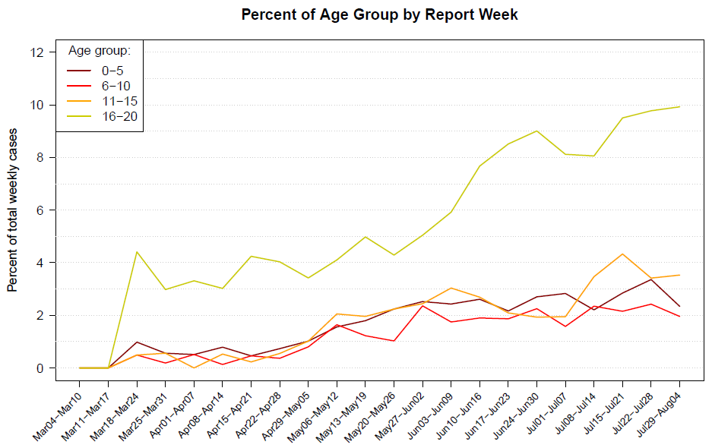

Slide 32
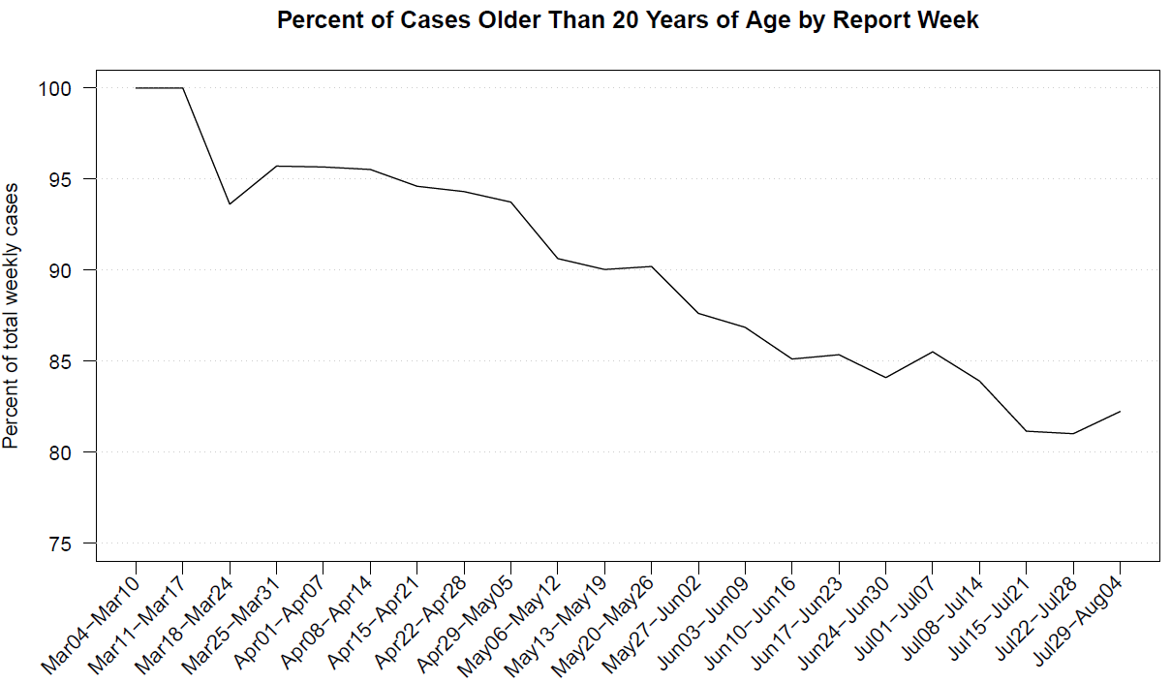

Slide 33
Kentucky COVID-19 Deaths by Reported Date of Death (n=772)
Number of Deaths
Date of Death
Last Updated August 8, 2020

Slide 34
Difficult-to-Answer Questions
Rapid test availability
Test platforms are available
Test supplies (medium, collection kits) may be in short supply
Machines can be expensive
Research on vaccines
Moving ahead rapidly
Only time will tell if we get an effective vaccine
UK testing flaw
No visibility on this – need to ask UK
Governor of OH testing positive then negative shortly after
Any number of possibilities!

Slide 35
Final Words
Testing and reporting are complex and difficult processes
No test is perfect, no reporting mechanism complete
Goal is to collect information to give public health staff the ability to take action to reduce disease transmission
If we don’t test, we can’t determine who is ill, who is at risk
If we do test, we have to accept the huge problems inherent in a rapidly-evolving test environment and a newly-established reporting system
If we don’t do this, we risk becoming a New York City, Florida, Texas, or Arizona, where disease rates climbed so high that hospitals were overwhelmed
Following recommended public health measures works to keep businesses open and the economy moving

Slide 36
Thank you!

Slide 37
COVID-19 Supporting Slides

Slide 38
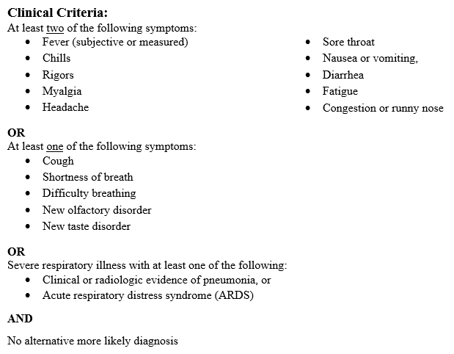
COVID-19 Clinical Criteria

Slide 39
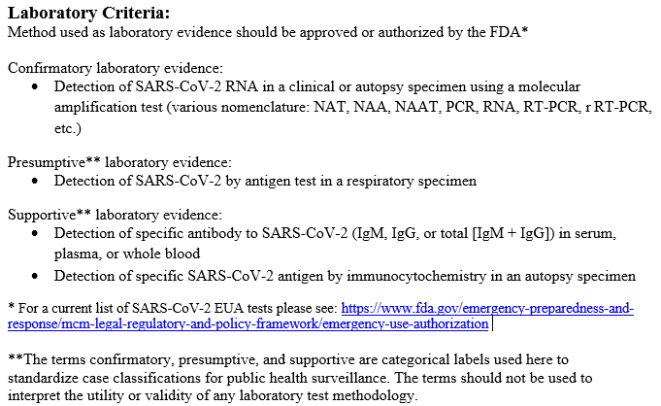
COVID-19 Laboratory Criteria

Slide 40
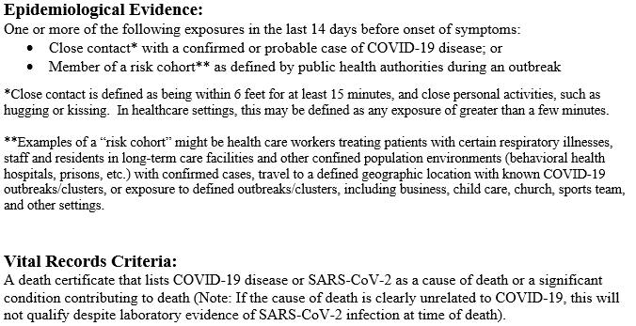
COVID-19 Epidemiologic and Vital Records Criteria

Slide 41
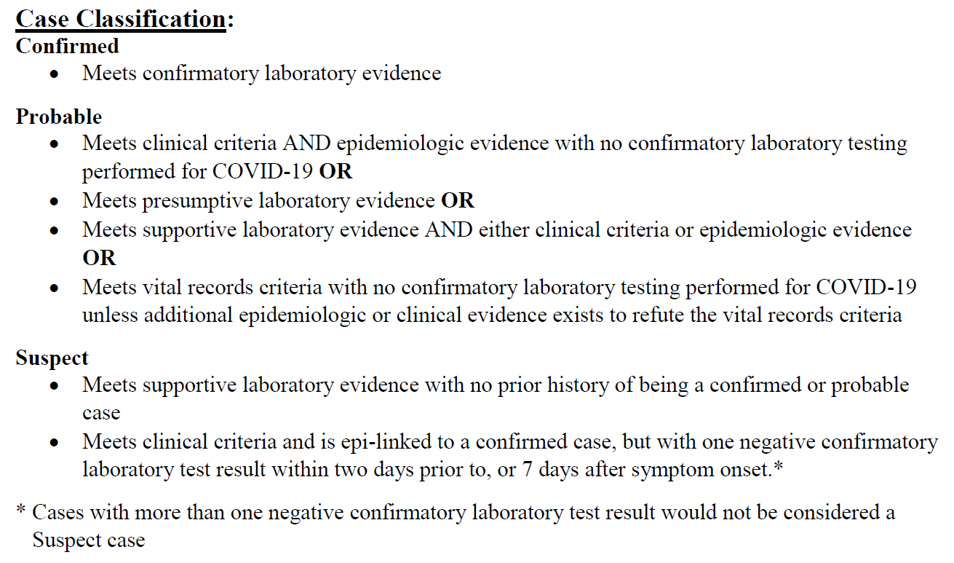
Case Classification

