Slide 1

Fighting Hunger, Delivering Hope:
KY Agricultural Development Board
Funded Projects
Notes:
Thank Chairman Dosset
Introductions – at table
In audience: Cathy? Tina? Joe? Martin- Advisory committee; Bill W

Slide 2

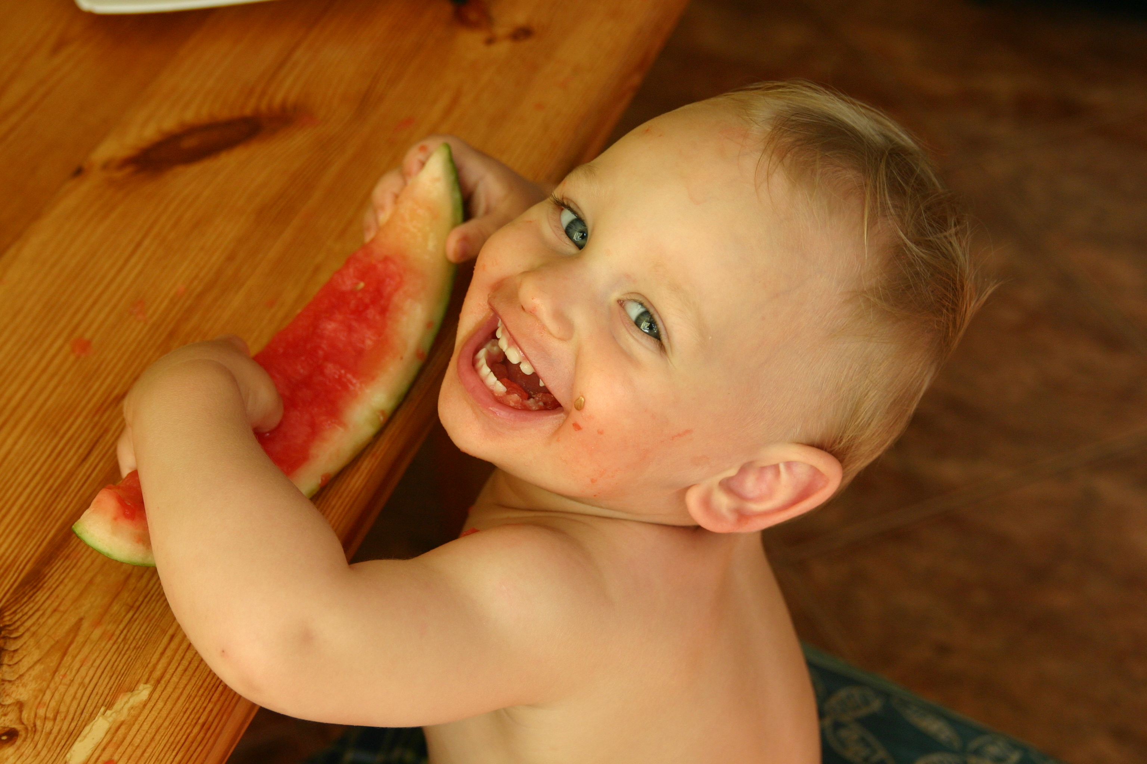
Who is struggling with hunger in Kentucky?
Notes:
The face of hunger may surprise you.
Our goal: to dispel some of the myths about who is accessing food through food banks and why.
Demographics: ethnicity:
77% of clients identified themselves as white
17% as black or African American
2% Hispanic or Latino

Slide 3
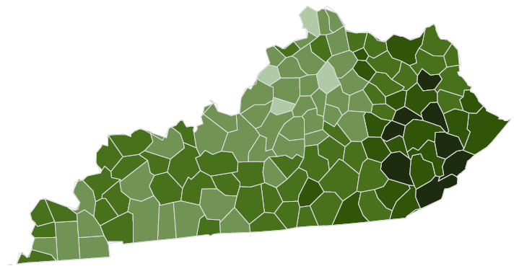
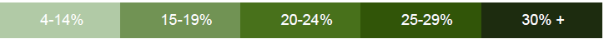
Child Food Insecurity Rates by County
Counties with the highest
child food insecurity rates:
Magoffin
Wolfe
Knott
Clay
Elliot
Source: Map the Meal Gap 2018
Notes:
Child rate= 19.2% or 1 in 5
Overall rate= 15.5% or 1 in 6
Hunger exists in every county in KY

Slide 4
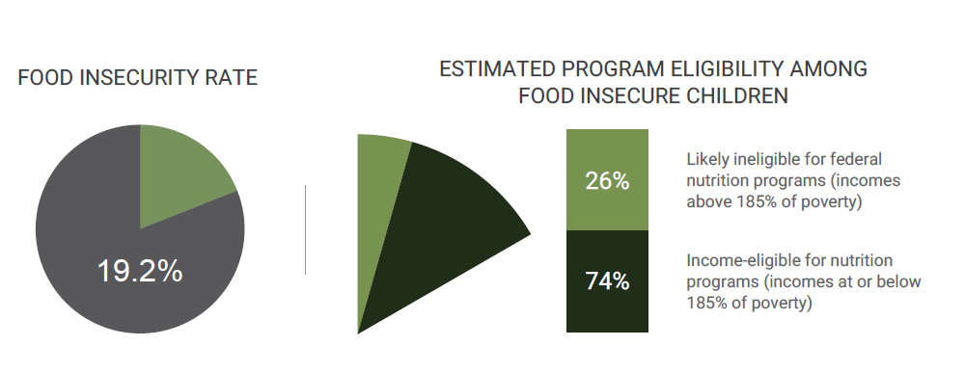
Meal Gap
Source: Map the Meal Gap 2018
Notes:
(kids: 26% do not qualify for federal nutrition programs)
(adults 30% of food insecure Kentuckian do not qualify for federal nutrition programs)
Must rely on charitable food assistance

Slide 5
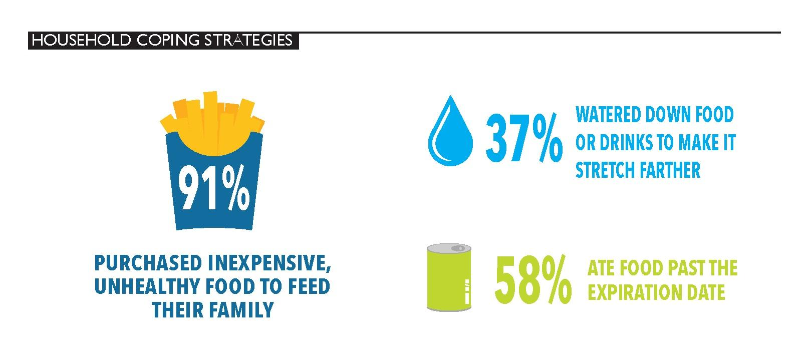
Notes:
Many households incorporate assistance received through food banks into their overall monthly strategy for obtaining food.
Most households are employing multiple coping strategies to try to secure enough food, demonstrating that they are expending great effort to piece together solutions to redue the likelihood of hunger in their households
84% of households in KY reported using multiple strategies for getting enough food in the last 12 months

Slide 6
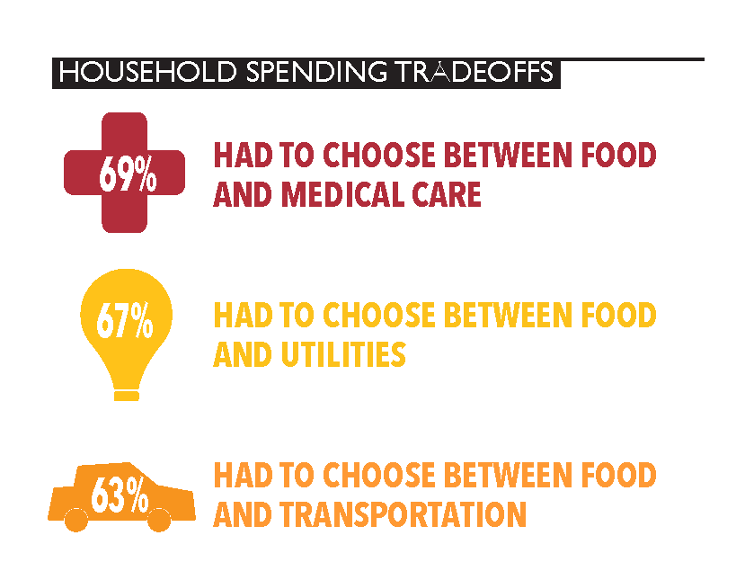
Notes:
These families are facing excruciating choices no one should ever be forced to make.
Nearly 1/3 of families who had to make these tradeoffs faced the choice every single month.

Slide 7
Impacts of Hunger on Children
Deficits in cognitive, social and emotional development.
Special education services, grade repeat.
Chronic health conditions, behavioral problems, psychiatric distress.
Notes:
Too little energy, protein and nutrients during 1st 3 years of life can lead to lasting deficits in cognitive, social and emotional development.
Hungry children are more likely to receive special education services, to have repeated a grade in school and to have received mental health counseling.
They are at increased risk for chronic health conditions, psychiatric distress, behavioral problems.
For the 1 in 5 kids in Kentucky facing hunger, getting the energy they need to learn and grow can be a day-in, day-out challenge. Food insecurity can have a long-term impact on health, education, and Kentucky’s economy.
Families often work to keep their food-insecurity hidden and some parents may feel shame or embarrassment that they are not able to feed their children adequately. Children may also feel stigmatized, isolated, ashamed or embarrassed by their lack of food.

Slide 8
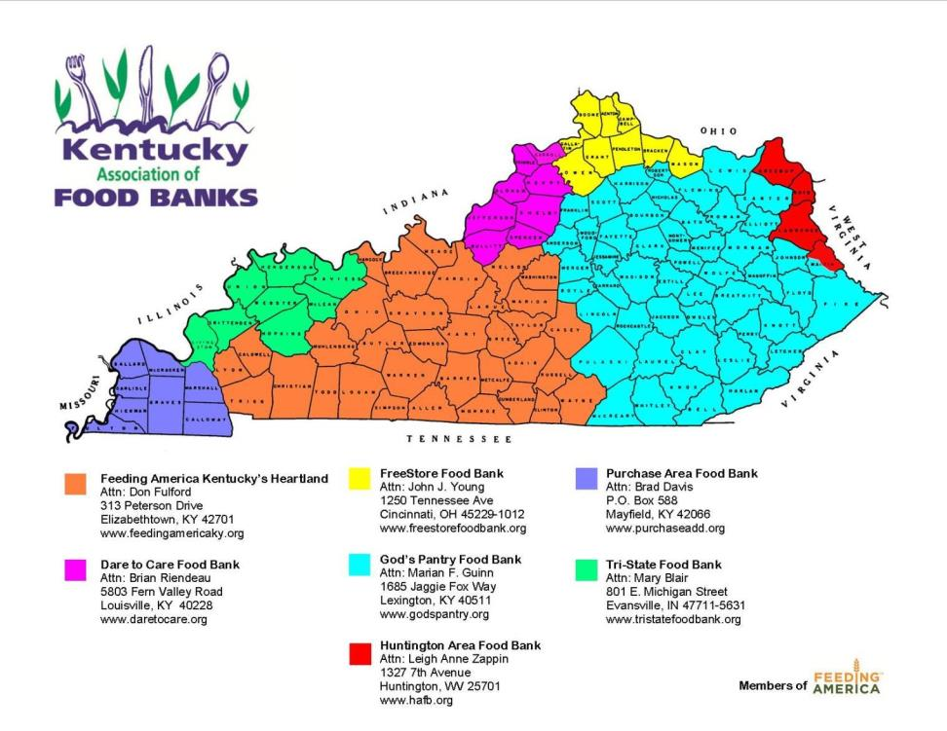
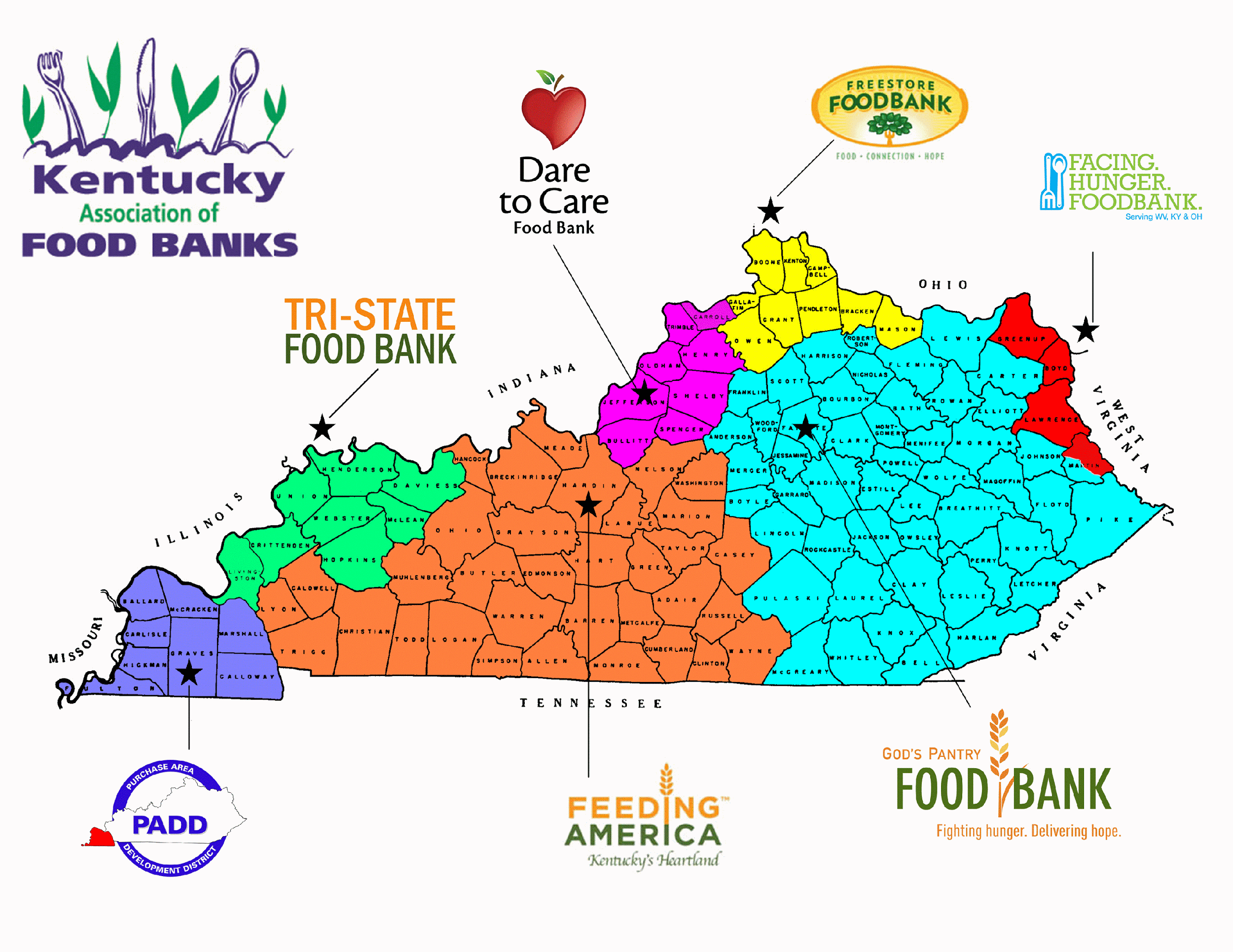

Slide 9
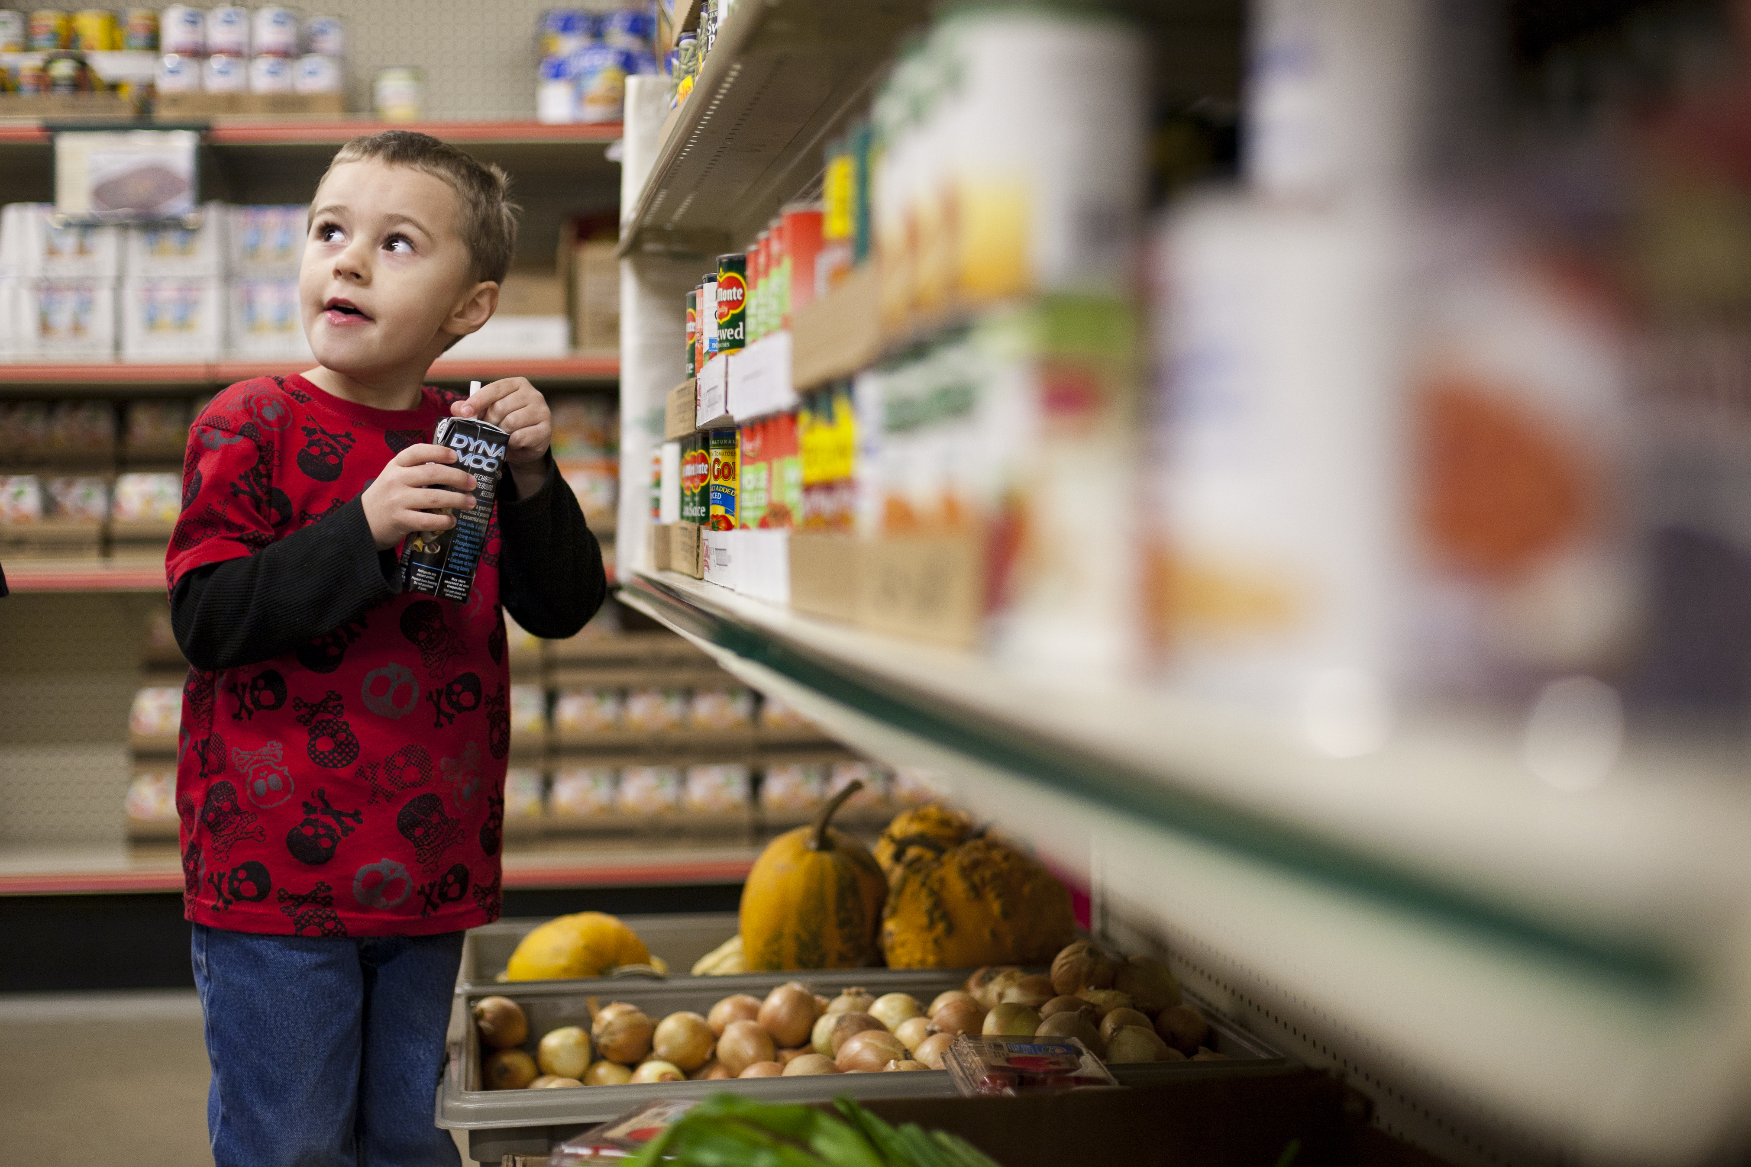
We feed 1 in 7 Kentuckians
Notes:
Over 53,000 each week

Slide 10

63 million meals last year

Slide 11
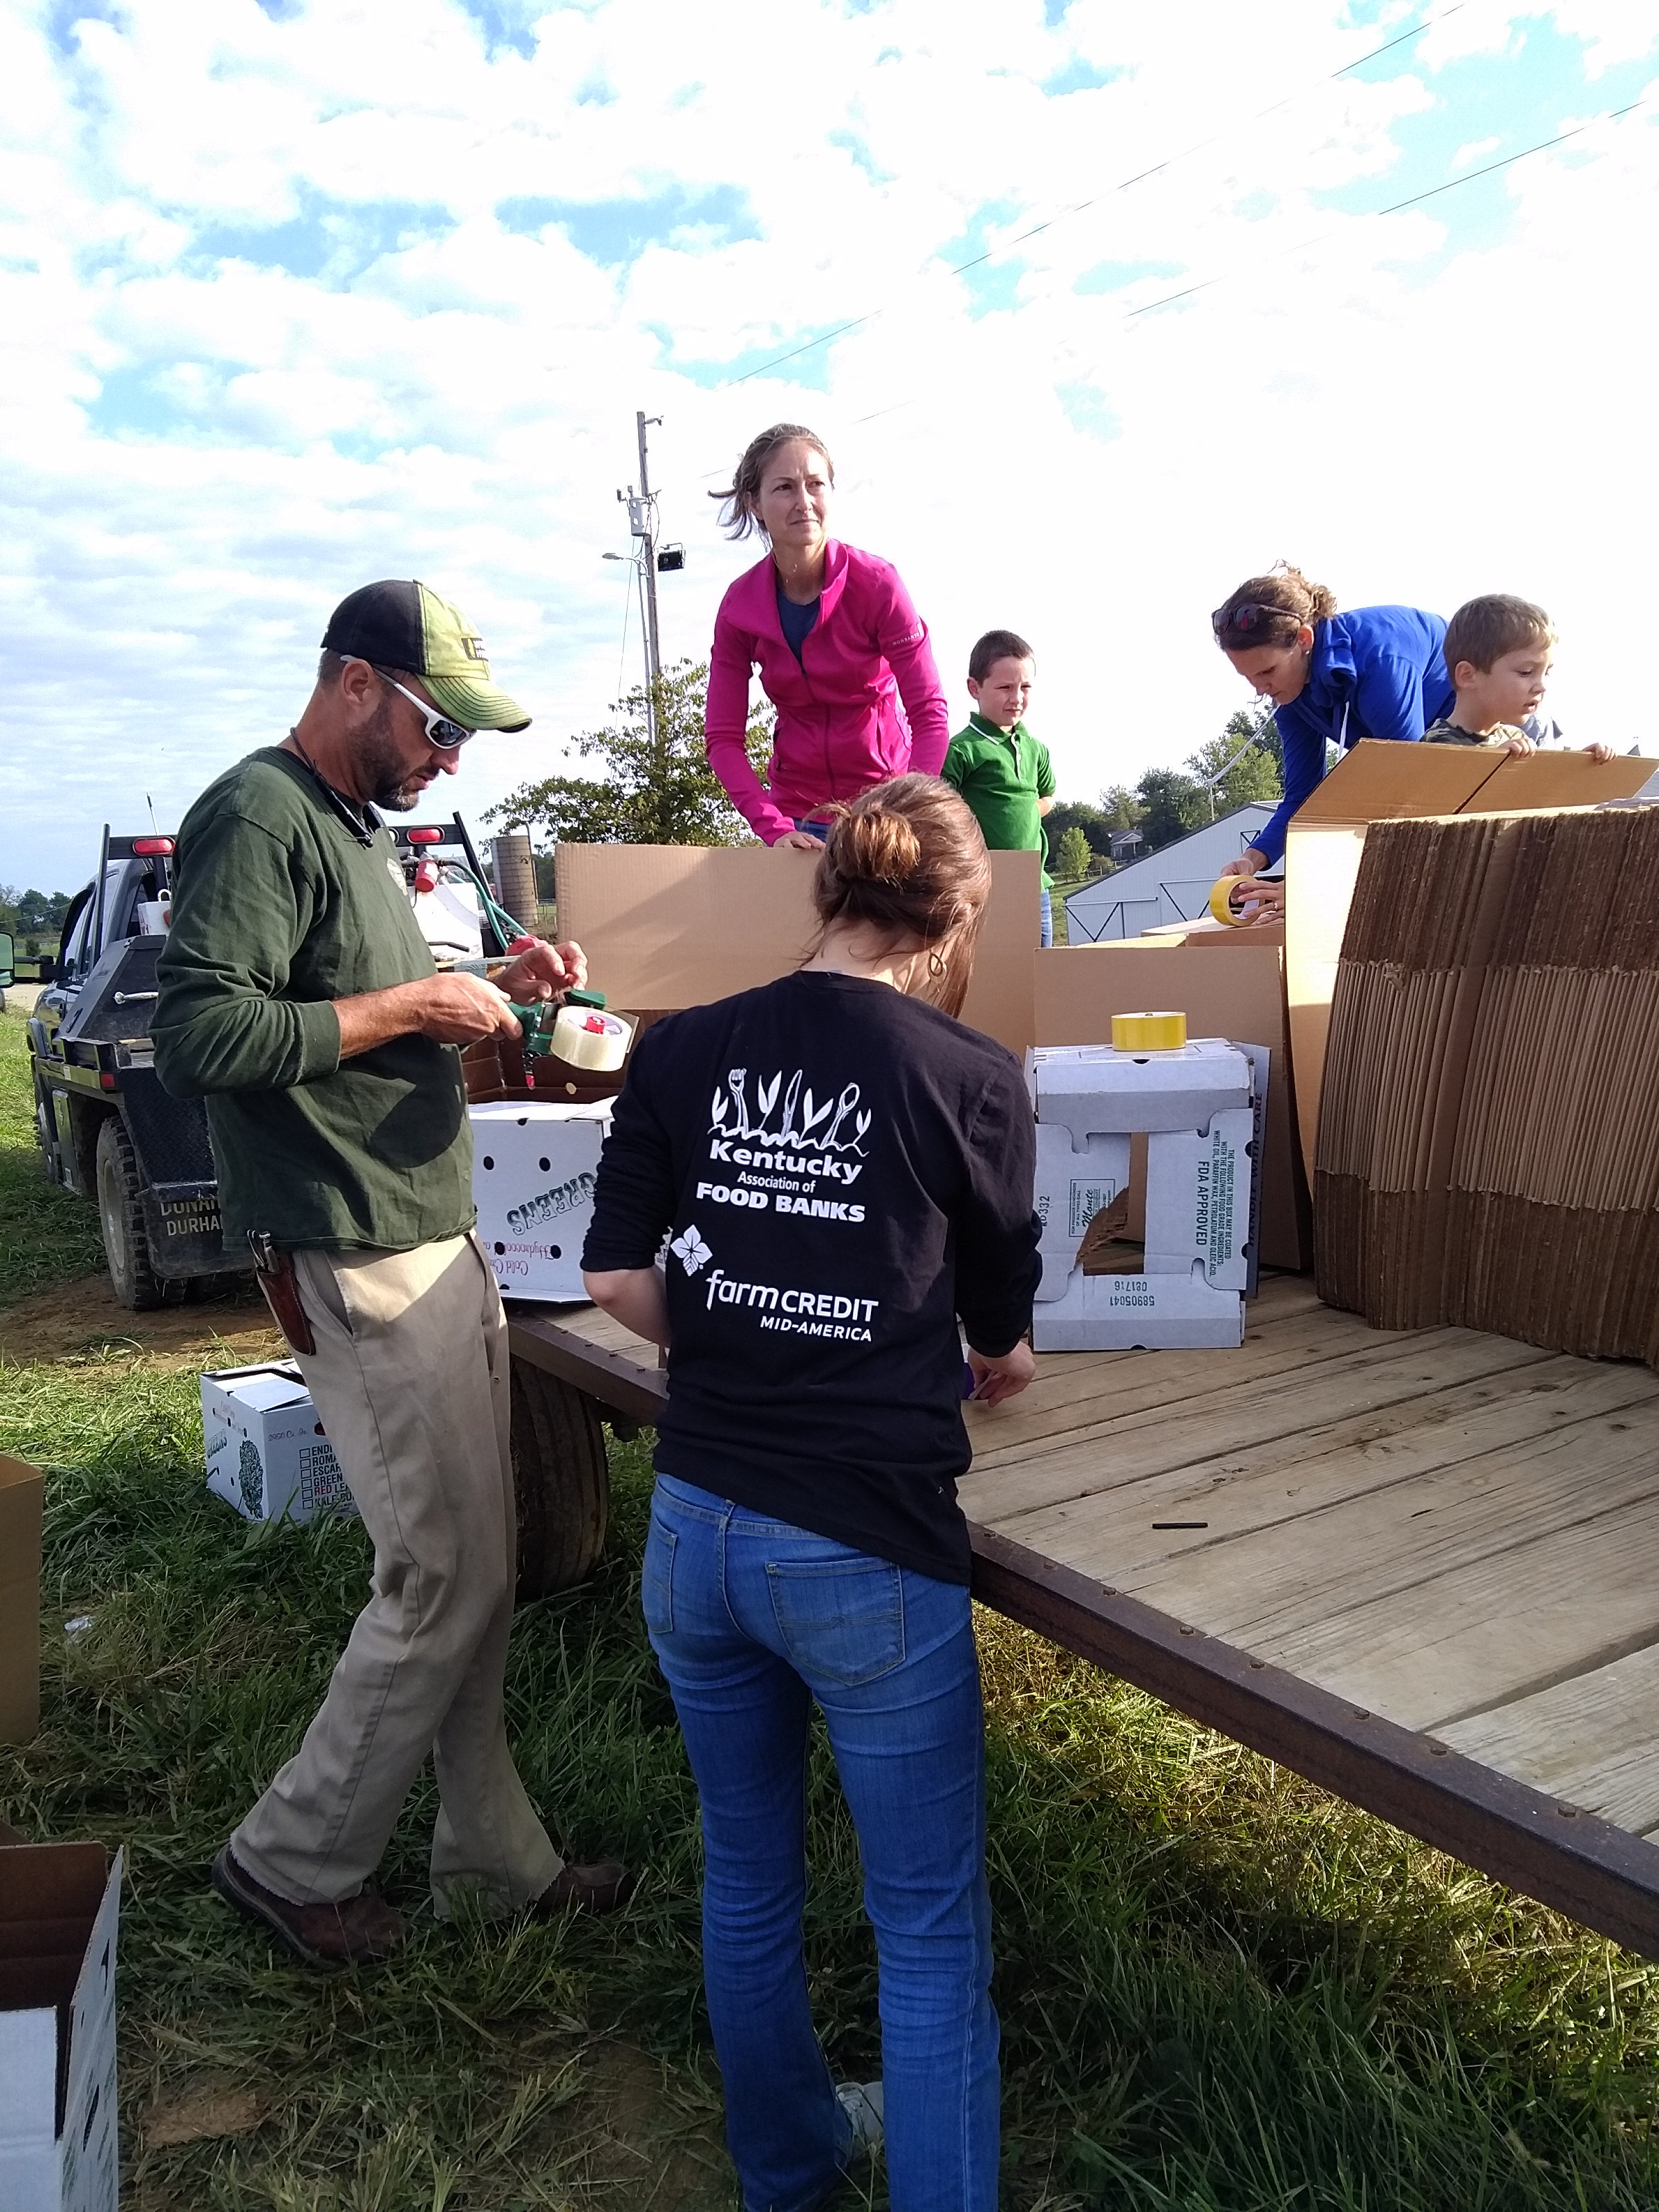
Farms to Food Banks
Fresh produce from farmers needing a market…

Slide 12
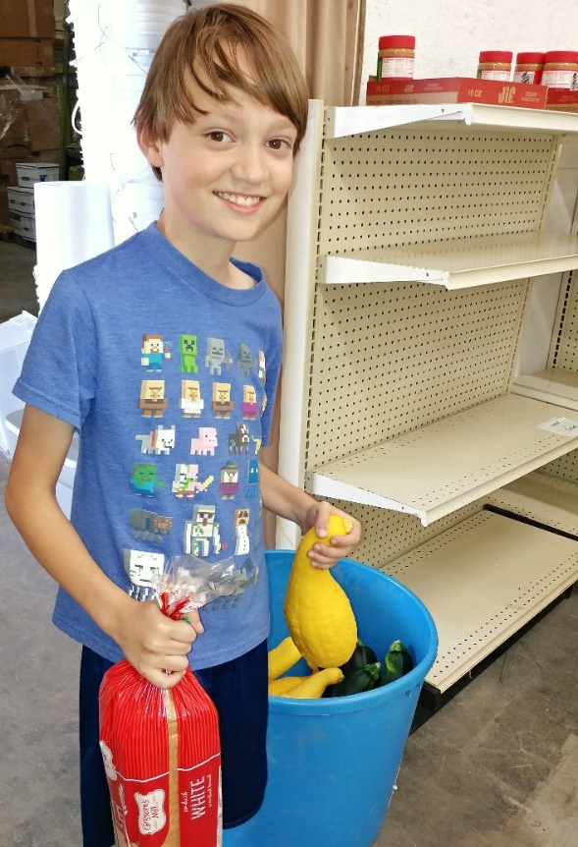
Farms to Food Banks
…to Kentuckians in need.

Slide 13
Goals
Increase access to healthy food among our struggling neighbors.
Pay fair prices that help farmers recoup losses.
Reduce the amount of wasted food.

Slide 14

2011: $163,000
2012:
  $47,500 in county funds (Allen, Casey, Garrard, Jessamine, Shelby)
  $60,084 Phase II - Tobacco Settlement Trust closeout grant
2013 - 2014:
  $69,500 state; $69,500 county (Bath, Bourbon, Breckinridge, Green, Laurel, LaRue, Laurel, Lincoln, Mason, Montgomery, Pulaski, Scott, Todd, Woodford)
Appropriation:
  FY15: $600,000 (actual: 531,902)
  FY16: $600,000 (actual: 562,725)
  FY17: $600,000
  FY18: $600,000
  Pending approval FY19: $500,000
Notes:
In addition to other sources of funds: tax refund donations, private fnd like Lift a Life; corporate like Farm Credit Mid-America
Federal grant: USDA Community Foods Project grant, which Martin will address (400,000 over 4 years– use state appropriation as a match)

Slide 15
Benefits to KY
$3,000,000 invested in farm families.
  850+ farmers in 85 counties.
  $3.3M in additional economic benefit.
15,000,000 pounds of food rescued rather than wasted.
  25M meals; all 120 counties.
Notes:
New market – increased cash flow for farmers. Helps them diversify– acre of tomatoes can be as profitable as an acre of tobacco if they can only find a home for it.
From “The importance of Agriculture for KY” – UK. Output multiplier (additional $ generated as result of interactions between fruit producers, suppliers and household spending) and income multiplier (additional income generated within local economy as result of new income generated for vegetable producers).

Slide 16
Benefits to KY
Competitiveness of Kentucky’s specialty crop market enhanced through increased
  awareness/familiarity.
  consumption.
  intent to purchase in the future.
Notes:
A program evaluation conducted by the University of Kentucky found that cost is the primary barrier to consumption of fresh produce among surveyed patrons. Food pantries are second only to groceries as a source of fresh produce among our patrons. Half of our patrons (51.4%) reported increased awareness of and familiarity with fresh produce over last year. Over half of respondents (59.6 %) reported increased consumption of fresh produce. 87.4% reported “I feel like I’m eating healthier.” These results demonstrate the positive impact Farms to Food Banks had on healthy food consumption among our hungry neighbors.
Food is medicine!

Slide 17

Kentucky Kids Eat
Increasing access among children to federal nutrition programs

Slide 18
KY Kids Eat
A statewide network creating innovative child hunger solutions.
Provides funding, training, and support for schools and nonprofits.
Need: Kentucky ranks 47th highest for summer hunger.
Notes:
A statewide network of nonprofits, school systems, policy makers, business leaders, and community members creating innovative hunger solutions.
Kentucky had the 3rd largest increase in children served summer meals and moved in the national rankings on the indicator from 49th lowest to 47th.
Only 1 in 12 KY kids who need summer meals access them.
When school lets out, millions of low-income children lose access to the school meals and healthy afterschool snacks they receive during the regular school year. The Summer Nutrition Programs help fill this gap by providing free meals and snacks that meet federal nutrition standards to children who might otherwise go hungry.
Summer meals participation is measured in the report not just in absolute numbers, but also by comparing the number of children receiving summer meals to the number of low-income children receiving school lunch during the regular school year. By this measure, only 1 in 12 children in Kentucky who needed summer meals received them in 2016.

Slide 19


K-VIP
Kentucky-grown Fruit and Vegetable Incentive Program.
Creates a financial incentive for sponsors to include Kentucky- grown fruit and vegetables in the summer meals they serve.
Boosts participation in summer feeding programs.
Notes:
Acknowledge partners– Commissioner Quarles’s Hunger Initiative

Slide 20
K-VIP
For every $3 a participating sponsor spends at a Kentucky farm, K-VIP will reimburse them for $1.
$185,000 awarded 2017.
Projection: $550,000 invested in local food economy in 2018

Slide 21
Together, we can solve hunger in Kentucky!
Notes:
We can help families that do not have consistent access to nutrition foods while leveraging dollars to support local farmers.

Slide 22
Kentucky Association of Food Banks www.KyFoodBanks.org
859-986-7422

