Slide 1
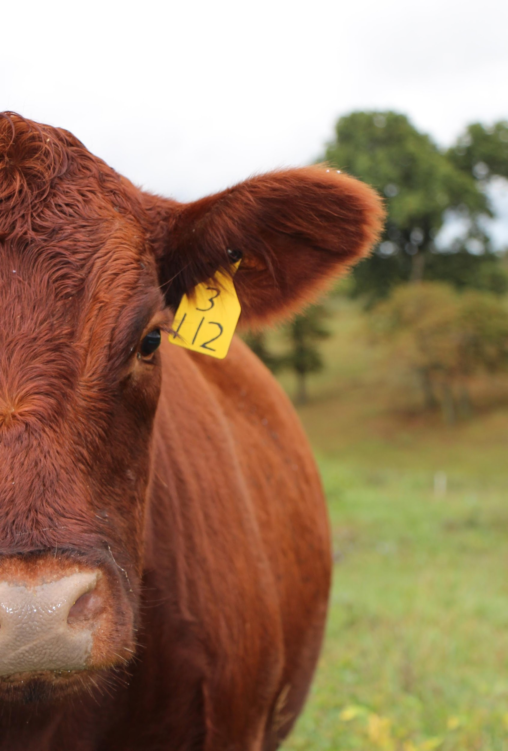
KENTUCKY BEEF NETWORK

Slide 2
Our goal is to efficiently produce a valuable product and capture that value.
Webster’s defines commodity as “a mass-produced unspecialized product”.
We want to move the Kentucky feeder calf or marketed product away from a “commodity” and closer to a recognized valuable product in demand by retailers.
Proven
valued product
with a consistent, predictable market
Verified safe, responsibly produced
Use proven, modern production practices

Slide 3
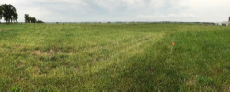
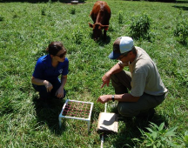
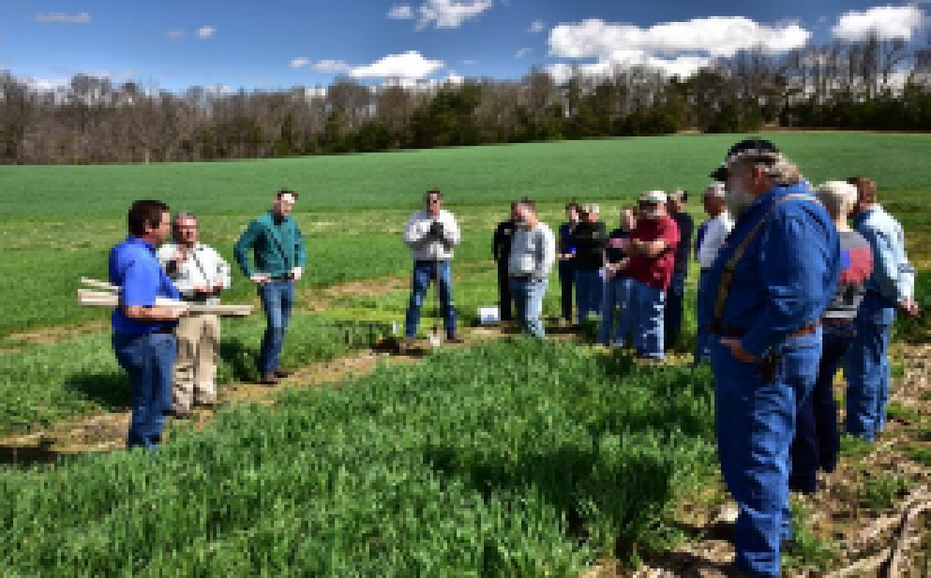
Master Grazer
Wolf County ANR Agent Heather Graham
and Dr. Jeff Lehmkuhler
utilize a grid to determine the density
of Red Clover.
Stockpile demonstration showing area that received N fertilizer on the right and area unfertilized on the left. Note the dark green urine/dung patches in the upper left portion of the field. Photo by Jeff Lehmkuhler.
Putting grazing practice to work:
Increased total pounds of beef produced from 683 lbs to 810 lbs.
Returns increased by $103/acre
Discussion on grazing cover crops at the "Cover Crop Field Day" at the UKREC in Princeton KY

Slide 4
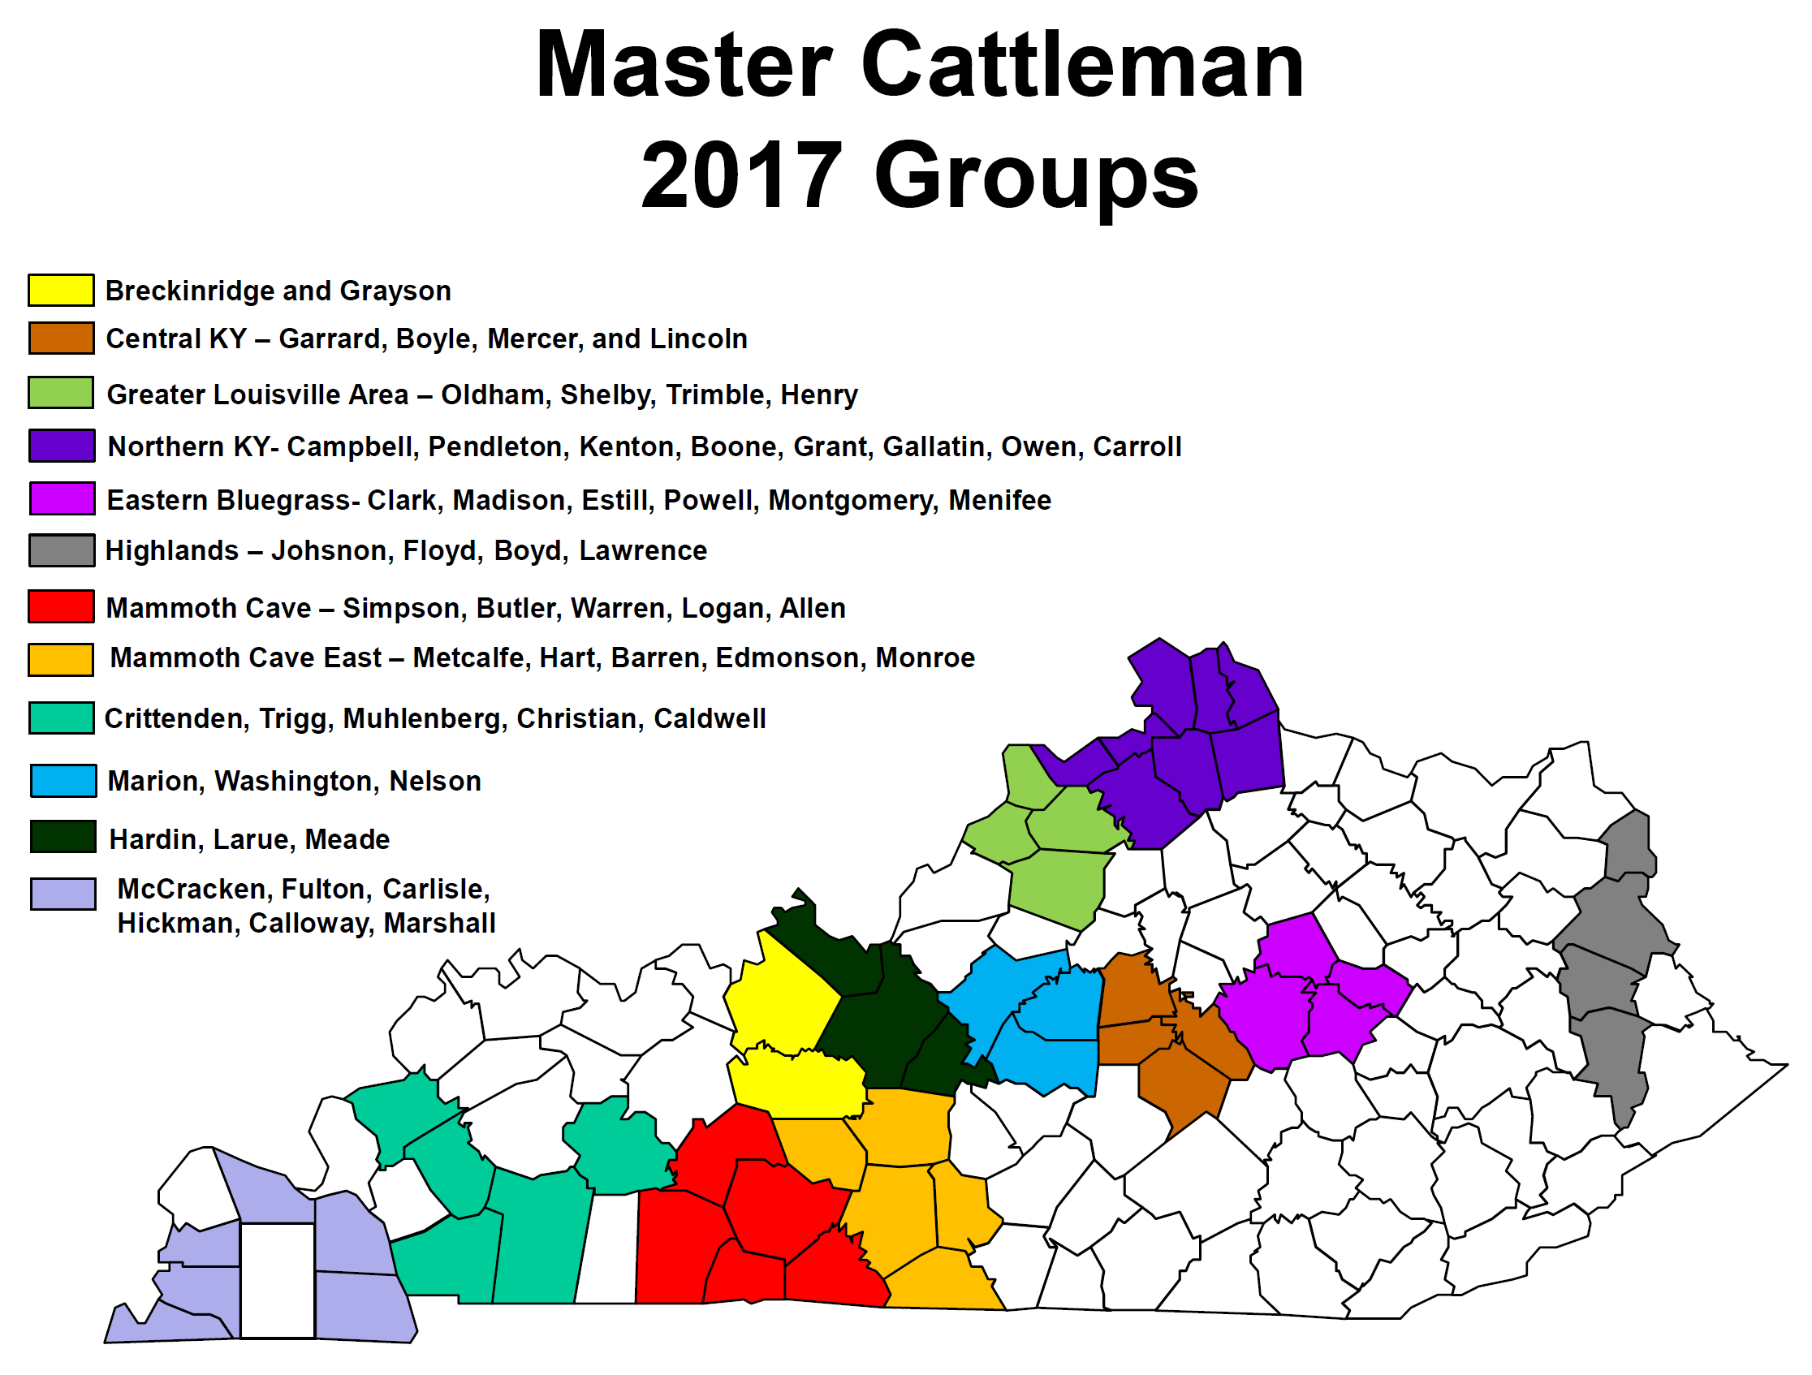
Master Cattlemen
Adoption of management practices = KY farm impact
$13.6 million per year
or
$4,500 per year per producer
12 groups 420 producers

Slide 5
Integrated Reproductive Management
1,234,683 – 1,051,308 = 183,375 pounds
= $269,863.82 ($147.165/cwt)
$3,291.02/producer
24% increase in revenue!

Slide 6
Cattle Handing & Care Kentucky Beef Quality & Care Assurance
Implement to raise awareness of practices that ensure proper cattle handling and welfare to keep producer safe while continuing to prove healthy beef to consumers
Merging with KY-BQA program to make a self sustaining program
Individual Modules
New Content
23,570 people trained in 18 yrs

Slide 7
Tom Field, University of Nebraska

Slide 8
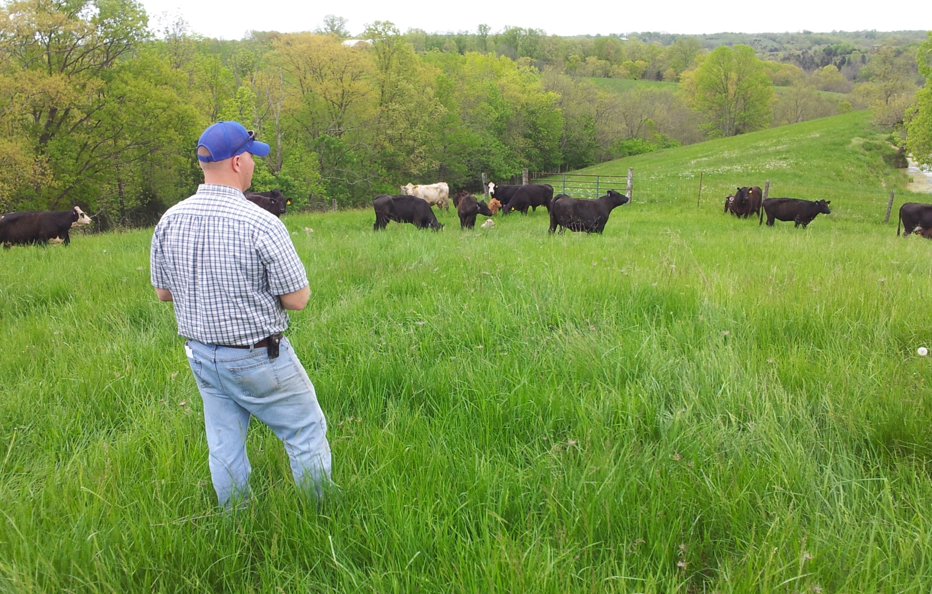

Slide 9
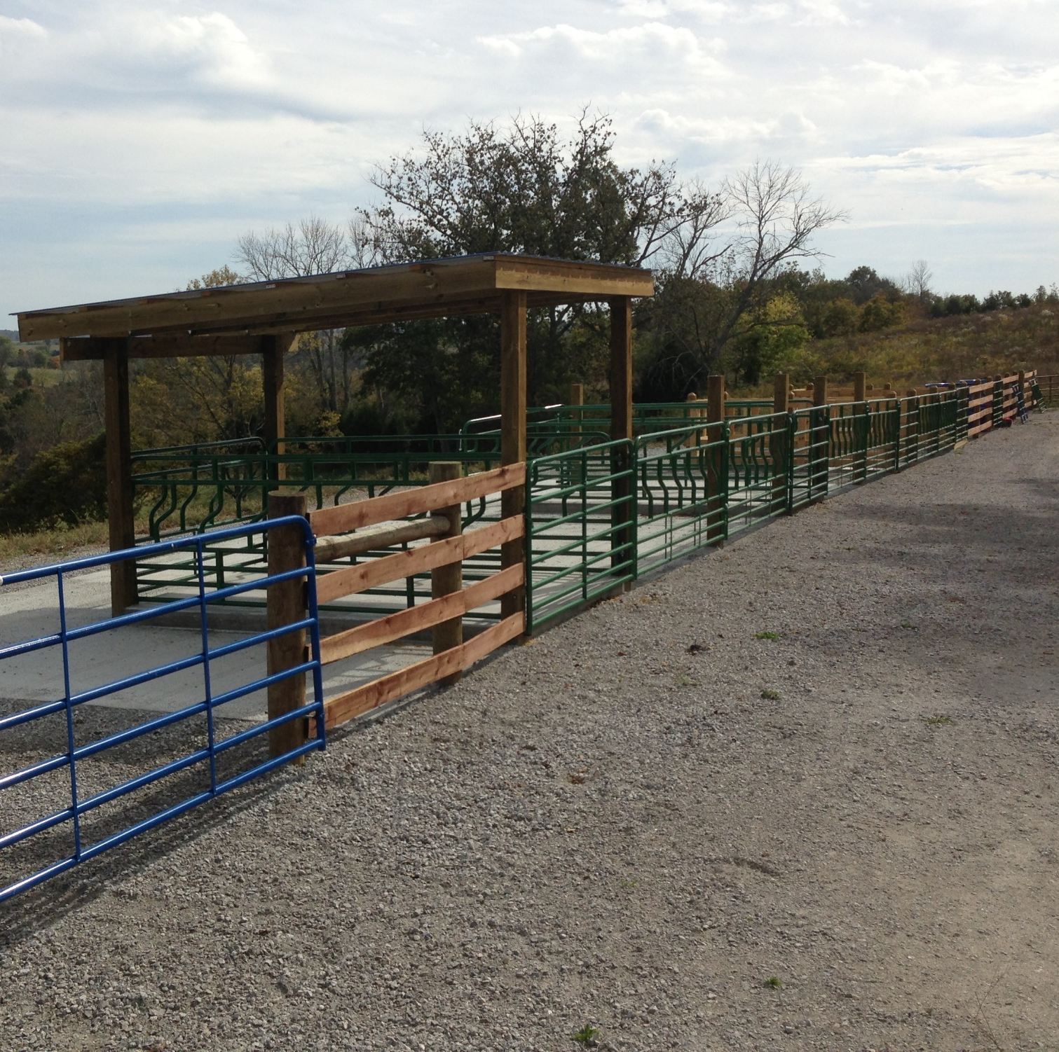
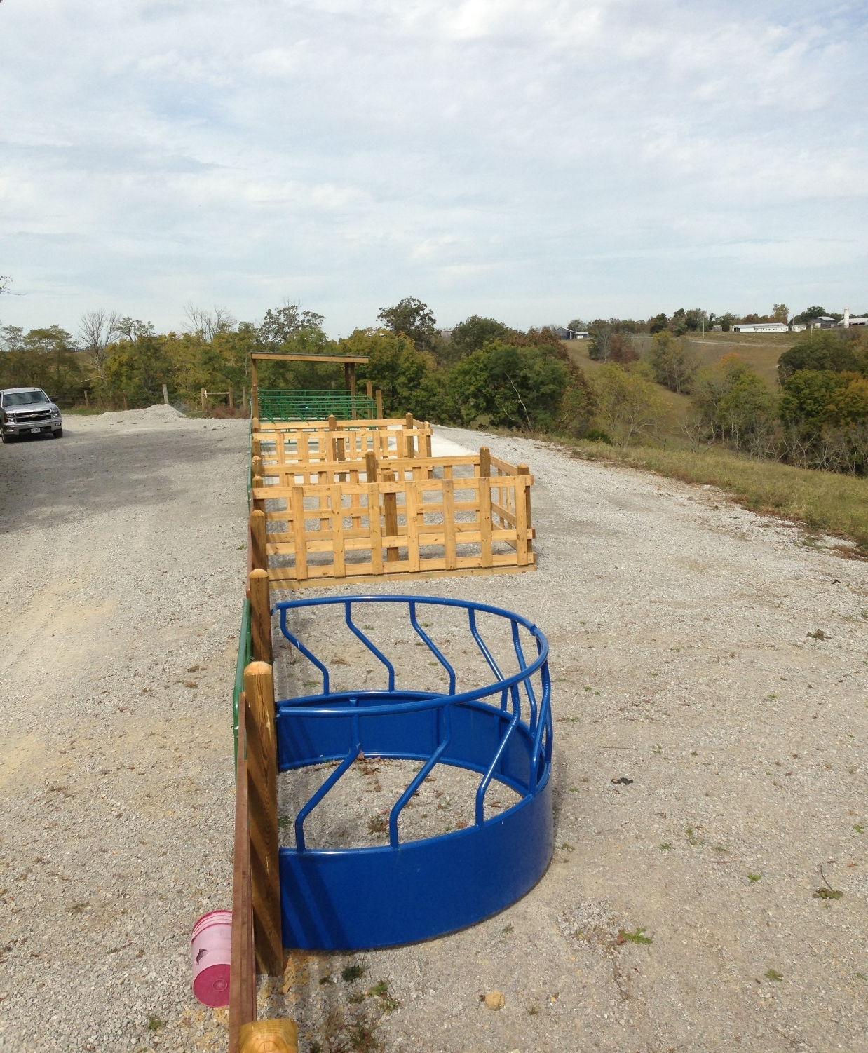
Fenceline Feeding System

Slide 10
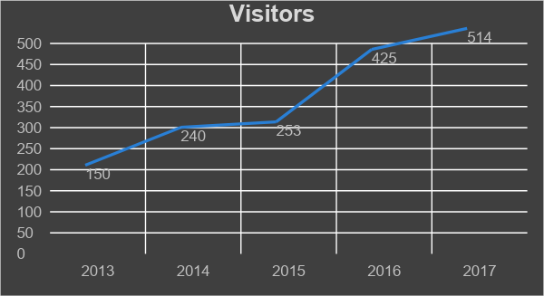
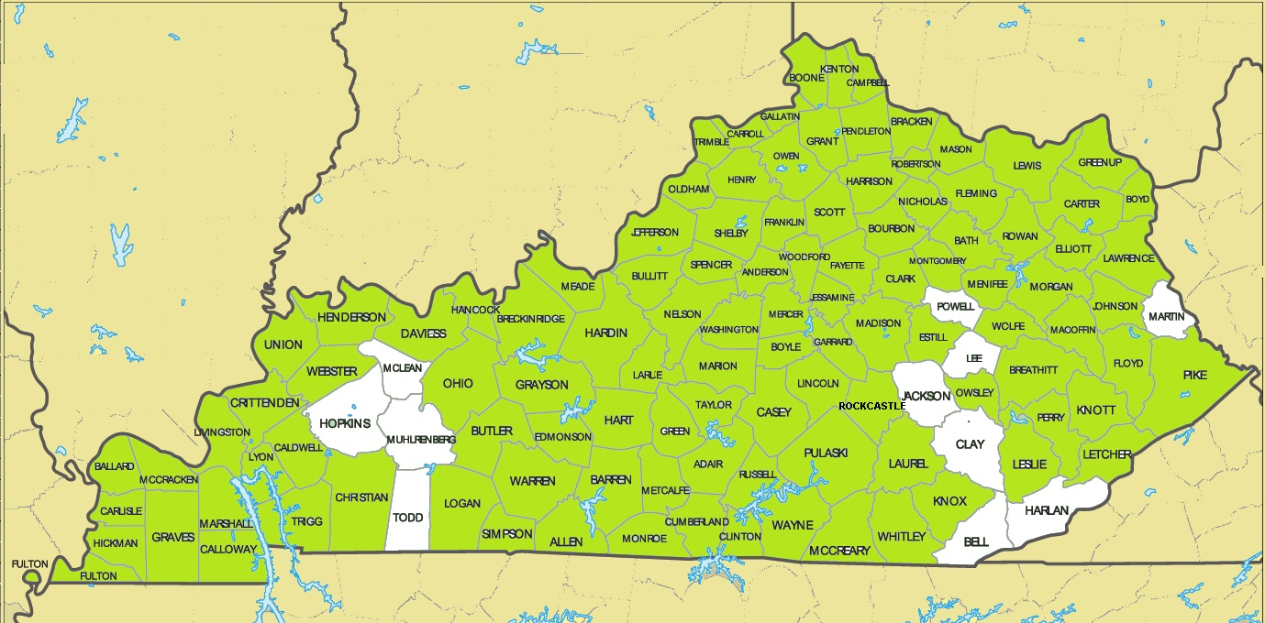
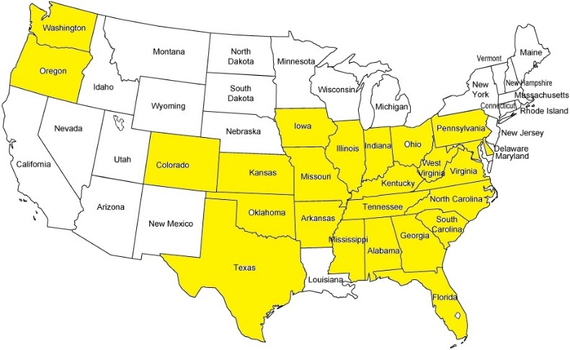
Number of Visitors
2013 | 2014 | 2015 | 2016 | 2017 | Total
150 | 240 | 253 | 425 | 514 | 1,582
109 Counties Visited
25 States Visited

Slide 11
In their words….
“Data and research on new practices. Return on investment estimates for new practices.”
“TIME and how busy I am with work, family & LIFE.”
“Getting everyone together and on the same page.”
“Market Opportunities and new trends in production.”
“The desire for self improvement. Discovering new methods through research and marketing.”
“University of Kentucky literature/studies. Eden Shale farm practice implementation gives me ideas for longer term practice changes I would like to implement.”
“We are always looking for ways to be more profitable and more efficient to produce more pounds of beef per acre with fewer inputs but not at the expense of jeopardizing cow health.”

Slide 12
Looking Forward…..
International Markets
Traceability
Women in Agriculture
Distillery By-Products Use & Infrastructure
Bull Assessment Program
Cattle Management
Cattle Confinement Feeding

Slide 13
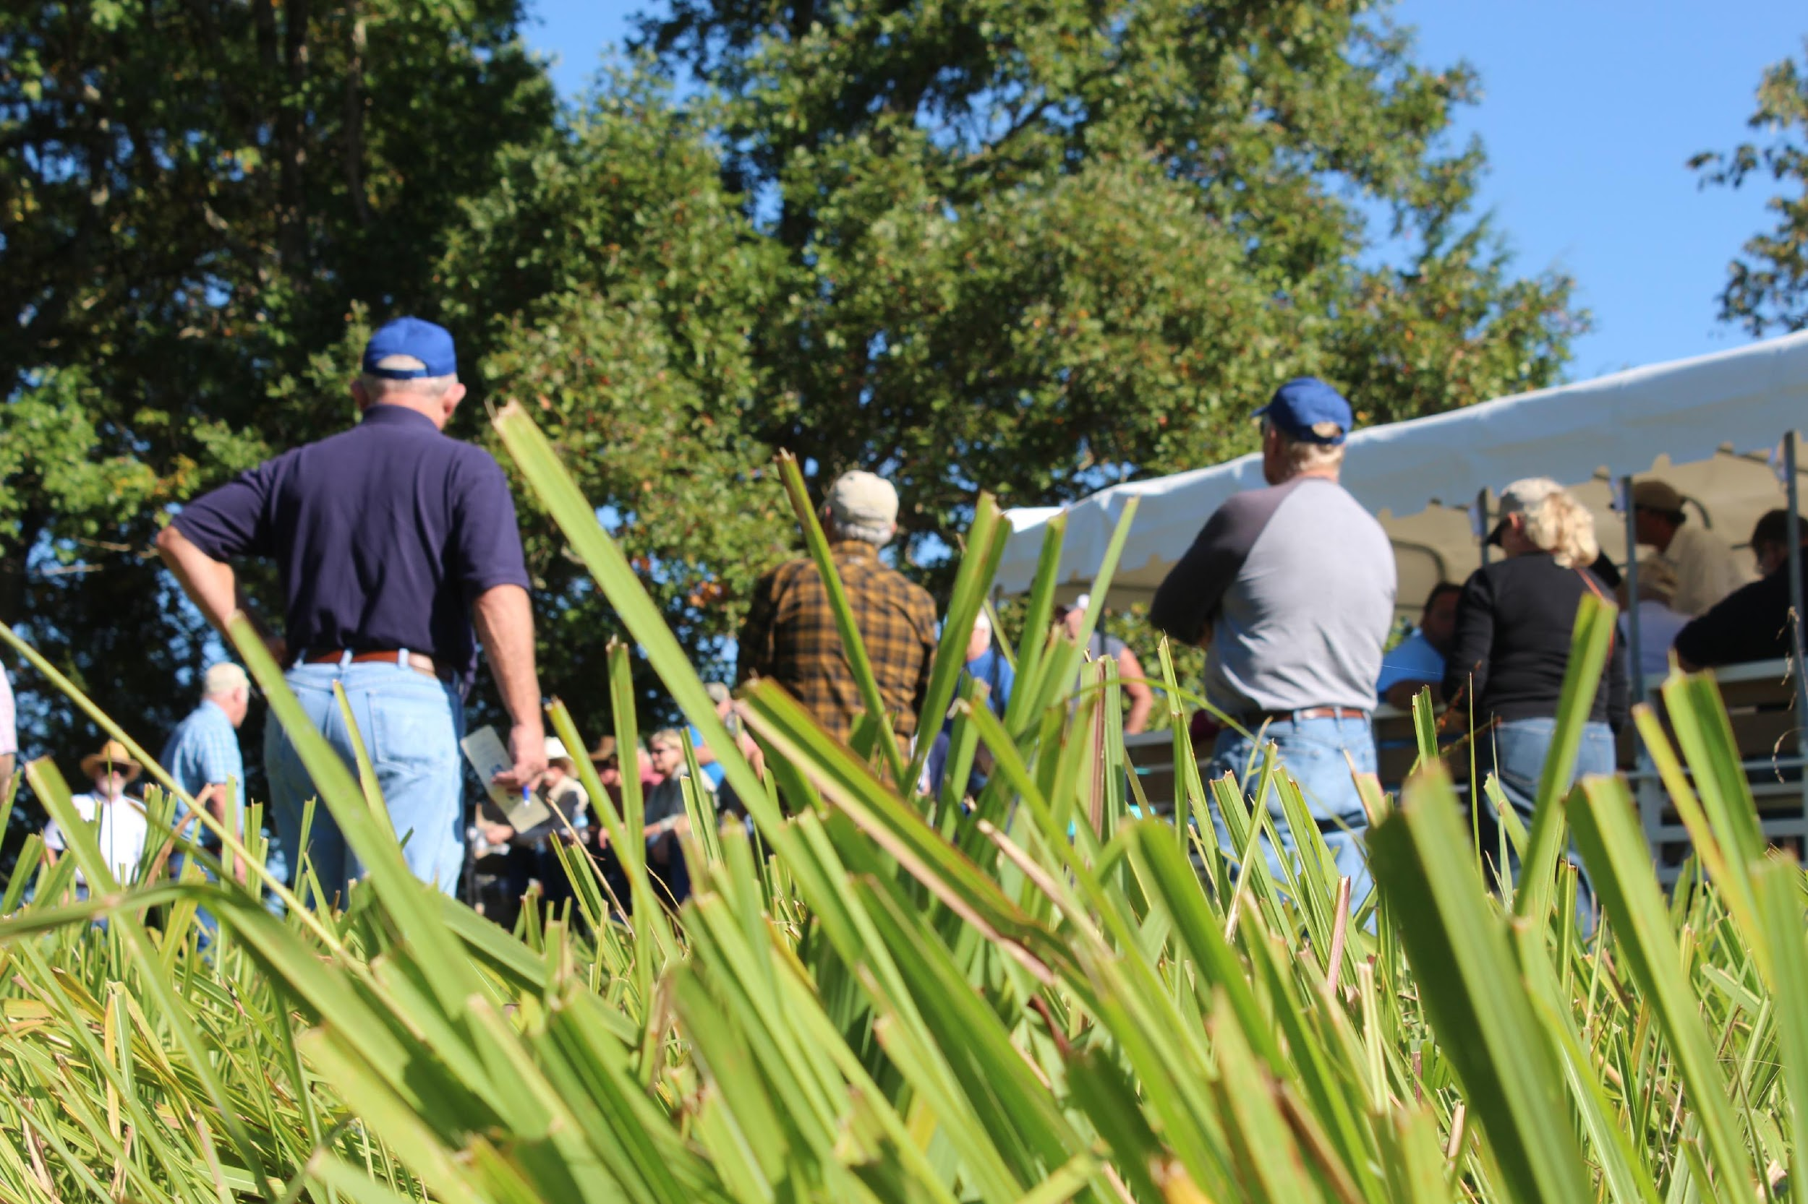
Thank You!

