Slide 2
Thank you
General Assembly
KADB Members
GOAP Staff
UK Extension
Beef Producers

Slide 3
Kentucky Beef Industry
Independent Family Owned Farms
They own the Cows
They make the decisions
38,000 Producers (29 head)
1.1 million cows
2.24 million… all cattle and calves
Forages and Water
Strong Domestic Demand and strong Exports
Marketing structure

Slide 4
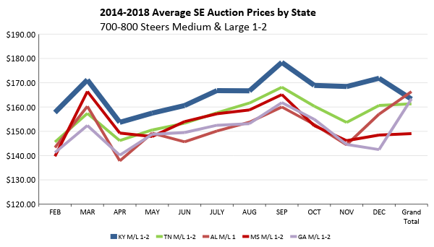

Slide 5
Challenges
We have 38,000 independent cattlemen
Keeping up with changing production practices is often hard.
Our cattle get on a truck and leave Kentucky
Fake Meat, new competition
Tariffs
Exports
Traceability
Complex business that has nice ups but often really hard downs.
Animal rights groups….

Slide 6
Kentucky Cattlemen’s Association
Modern Day Association formed in 1973
10,668 members
99 County Chapters
Members in all 120 Kentucky Counties
Young Cattlemen are stepping up to leadership positions.
Steven Jones – Hart
Stephen Humphries – Trigg

Slide 7
Defense
Offense

Slide 8
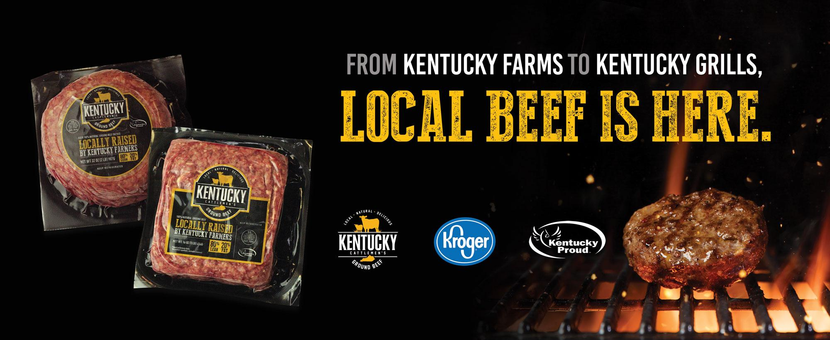

Slide 9
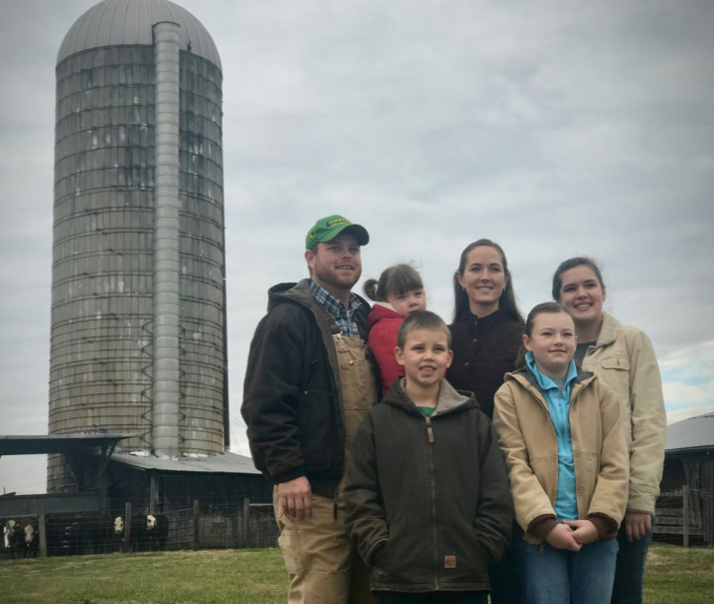
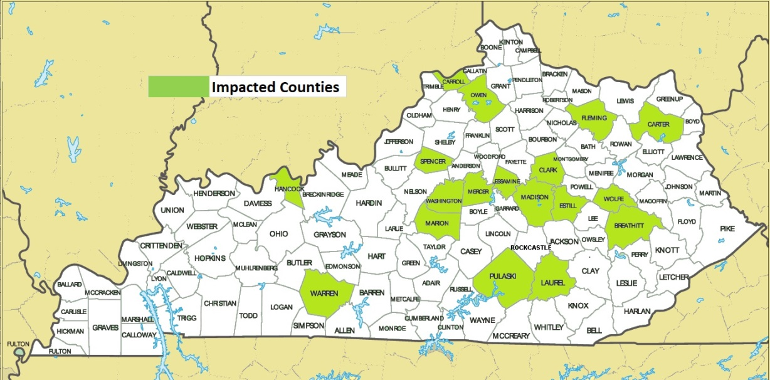
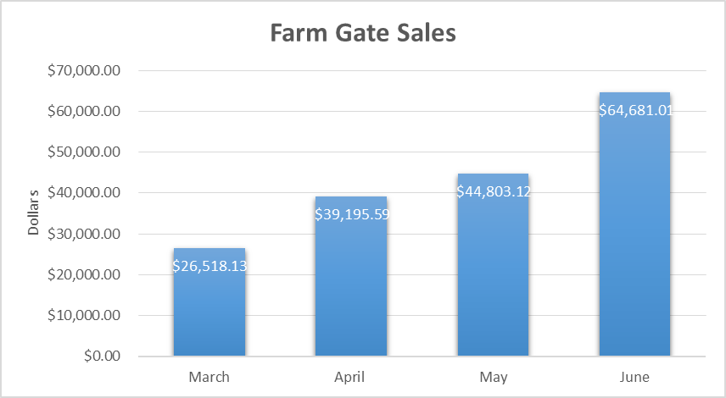
Kentucky Farm Family Impact
Total:
$175,197.85

Slide 10
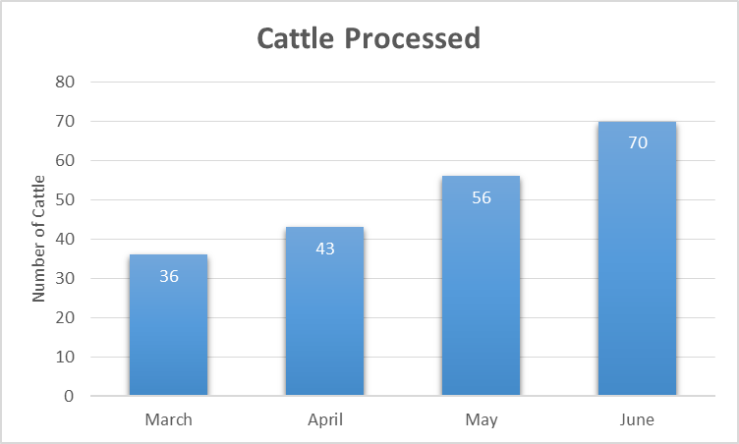
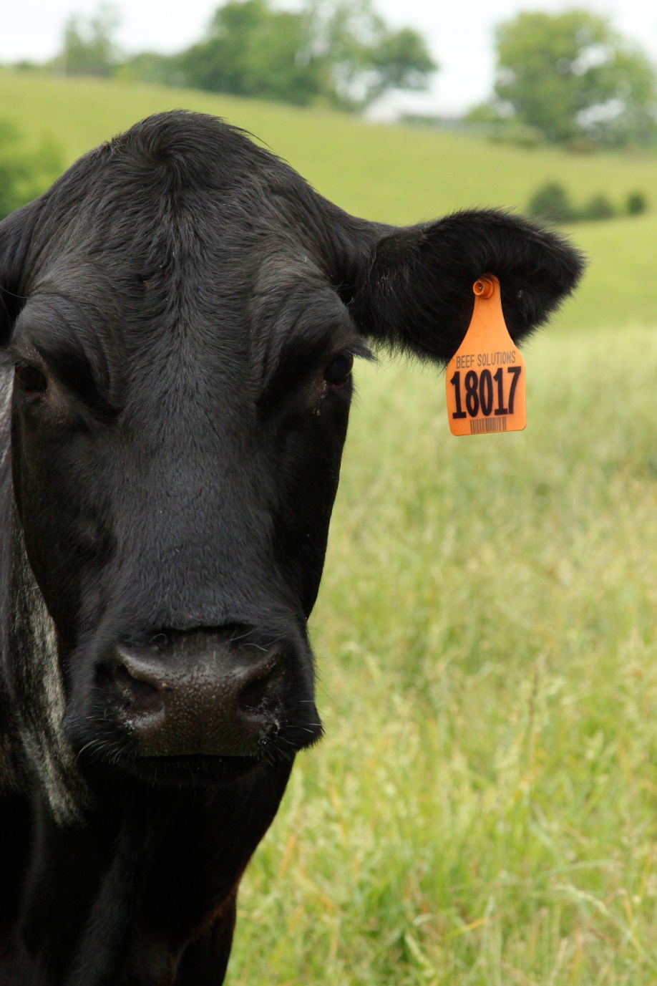
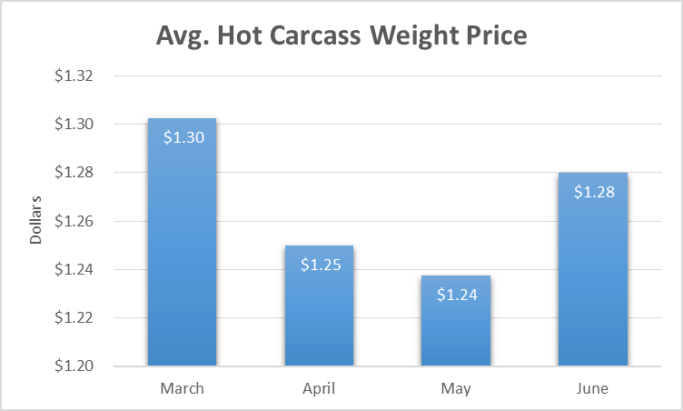
Total:
205 head
Avg: $1.27

Slide 11
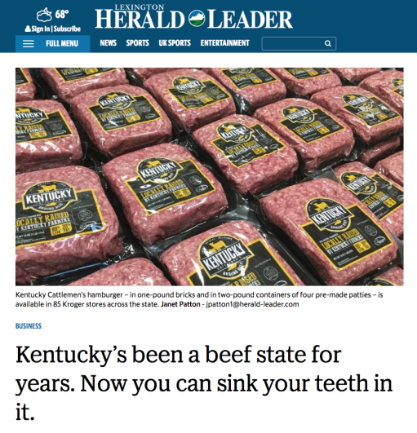
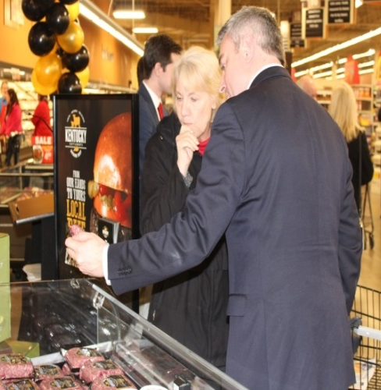
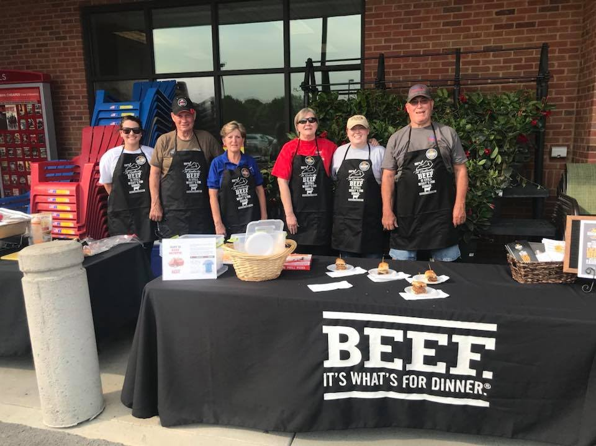
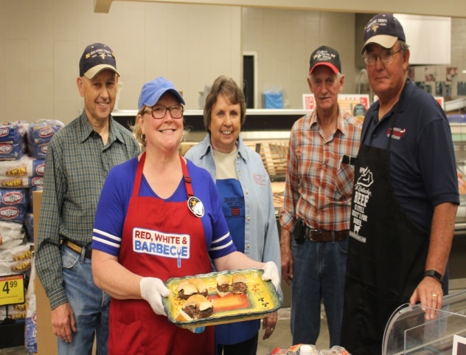
Total Packaged lbs. 89,015

Slide 12
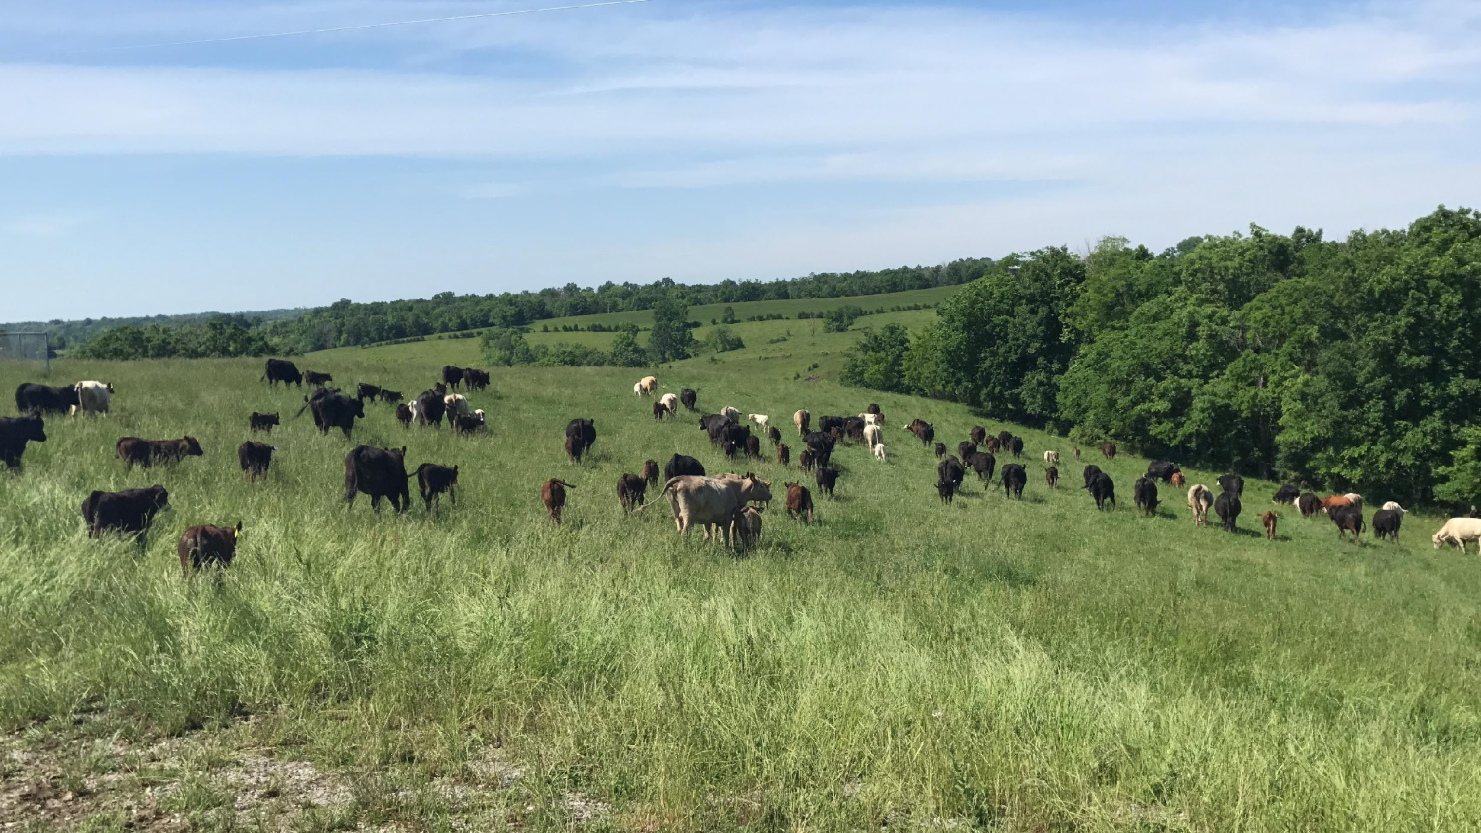
Thank you

Slide 13
Kentucky Beef Council
National Beef Checkoff $1.00
Federal law - guidelines
50/50 national/state
Promotion, research, consumer, foreign
State Beef Checkoff $ 1.00
State law (voluntary)
Kentucky producers follow state guideline and decide how to allocate
Education, Promotion, Market Development, Research, Foreign Marketing

Slide 14
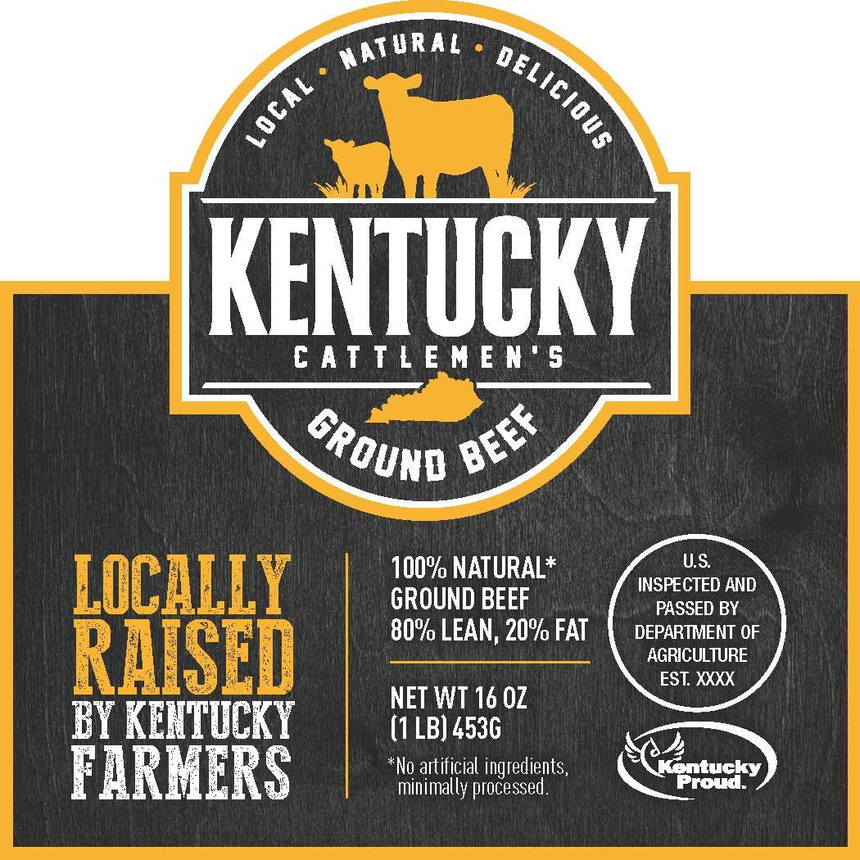
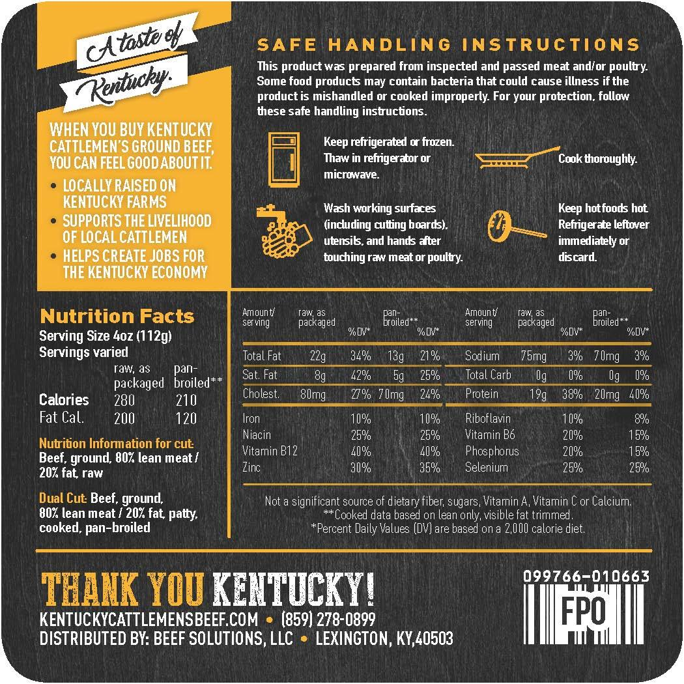
FRONT LABEL
BACK LABEL

Slide 15
