Slide 1

Tobacco Settlement Agreement Fund Oversight Committee
Jason Chesney, MD, PhD,
Director, J. Graham Brown Cancer Center
Associate VP of Health Affairs, University of Louisville

Slide 2
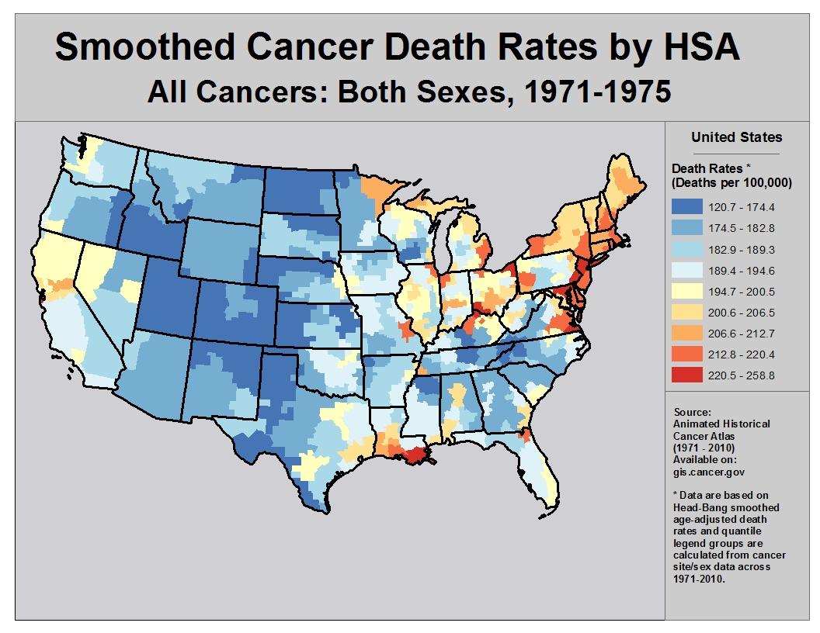
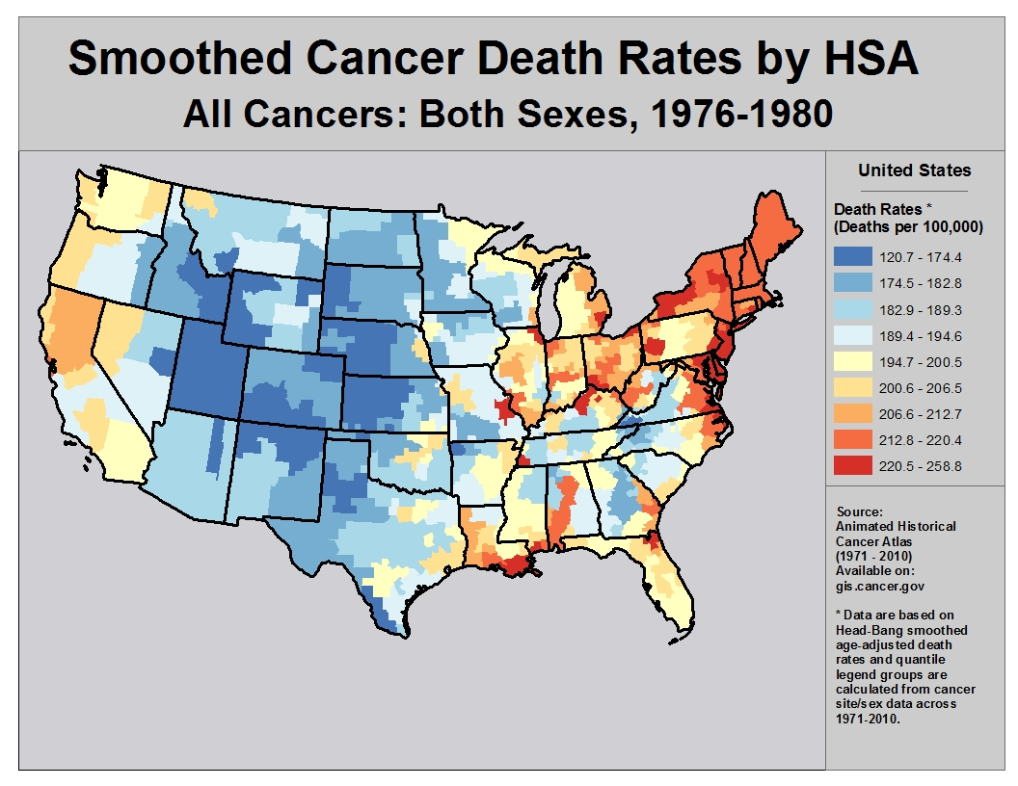
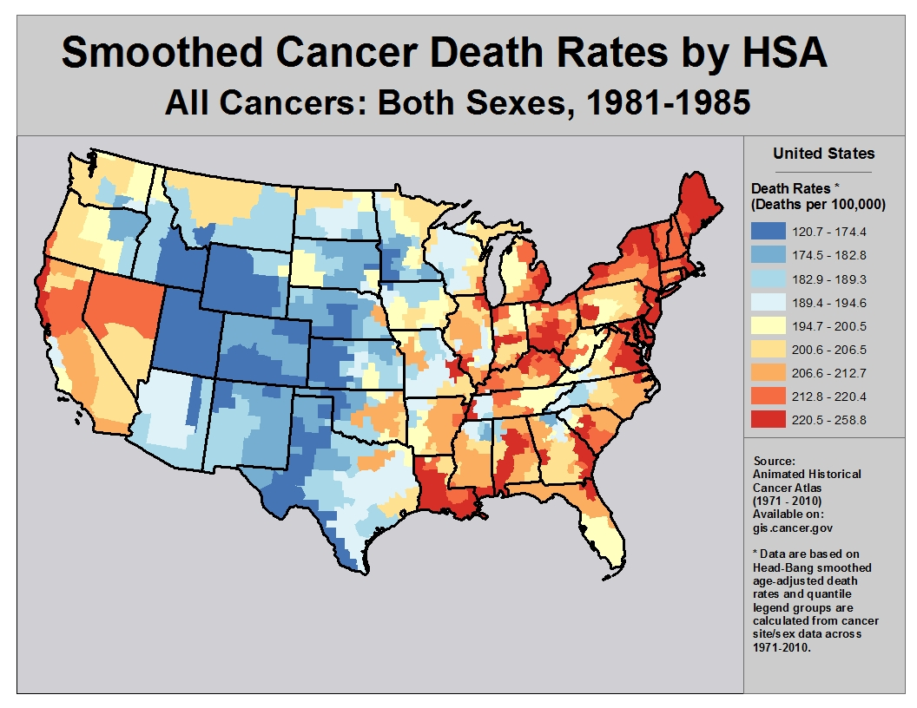
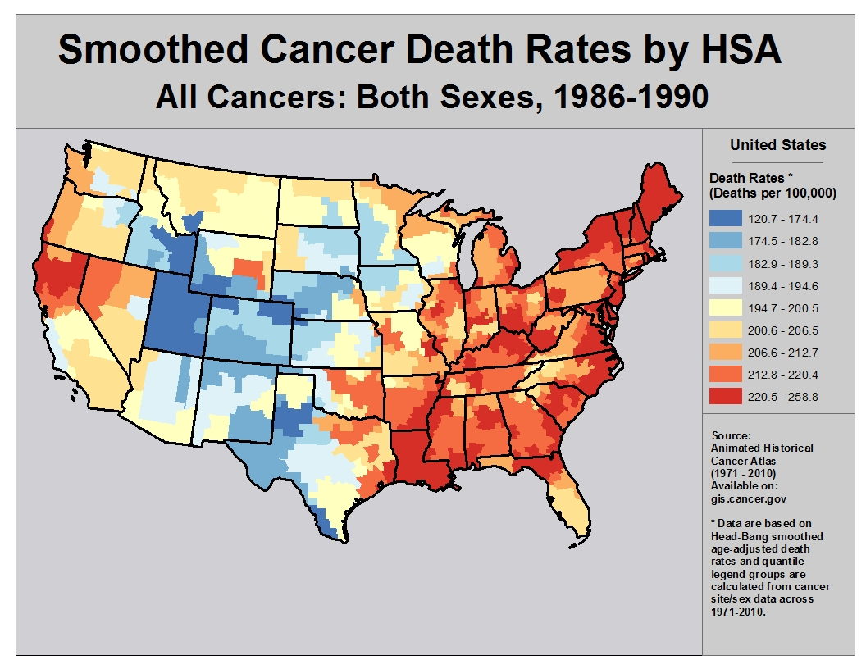
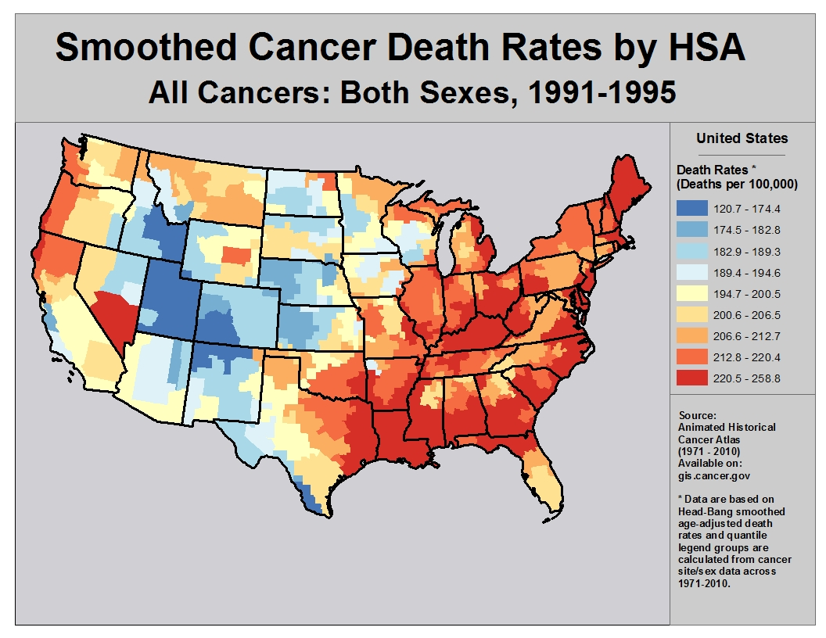
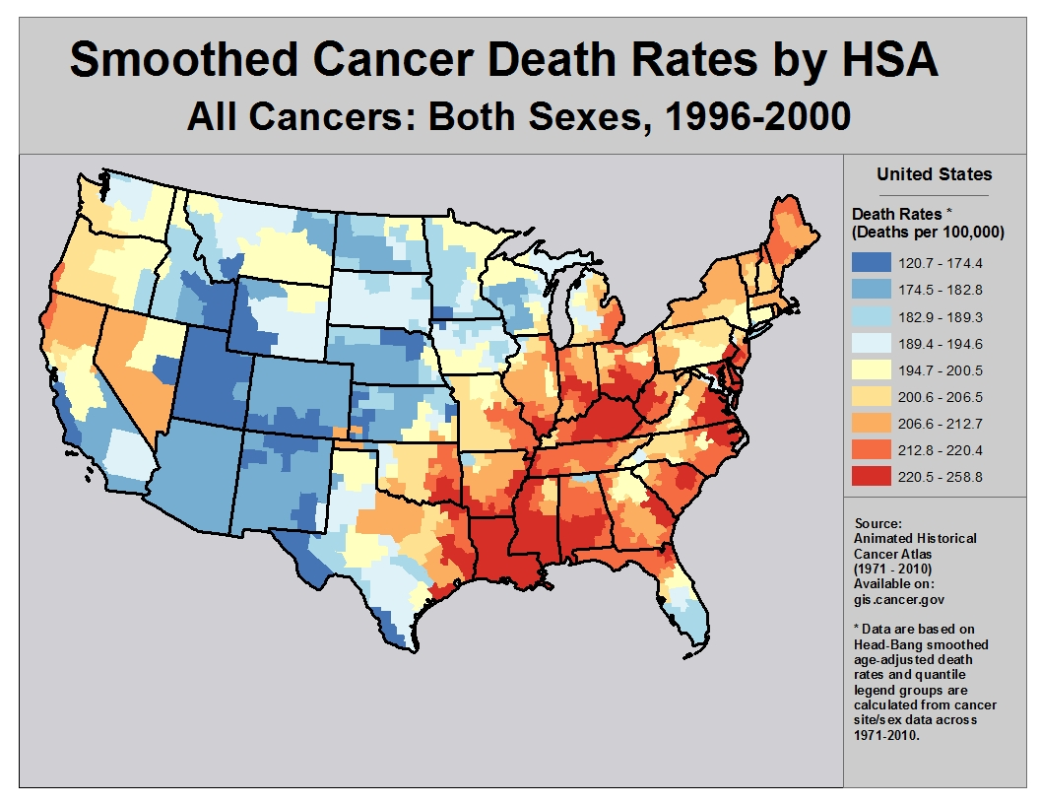
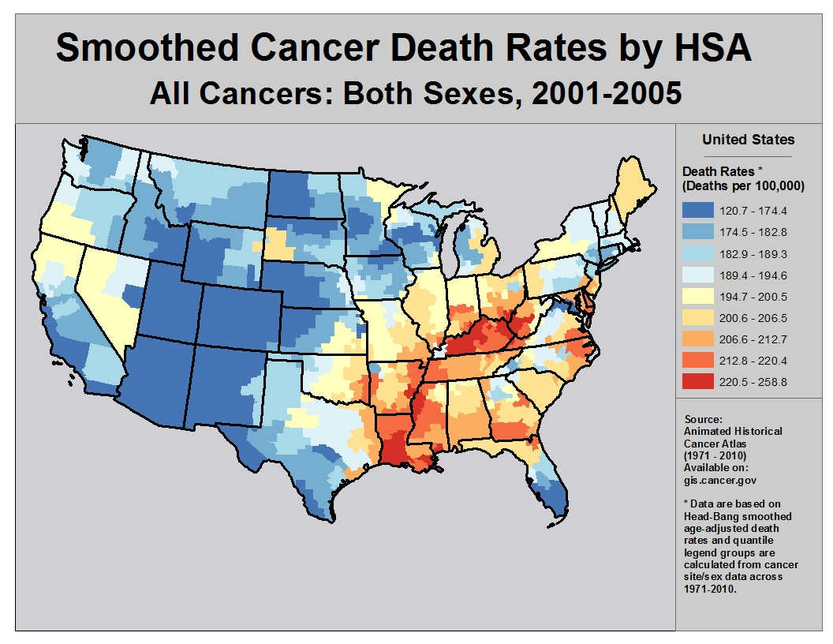
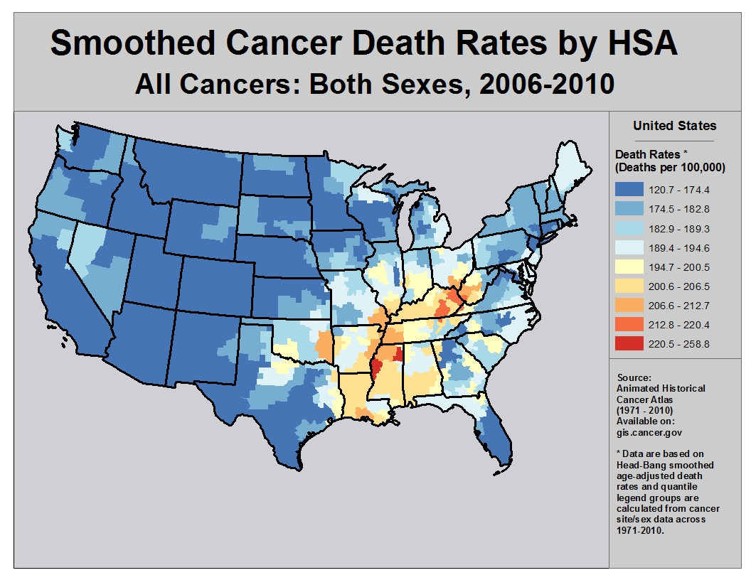

Slide 3
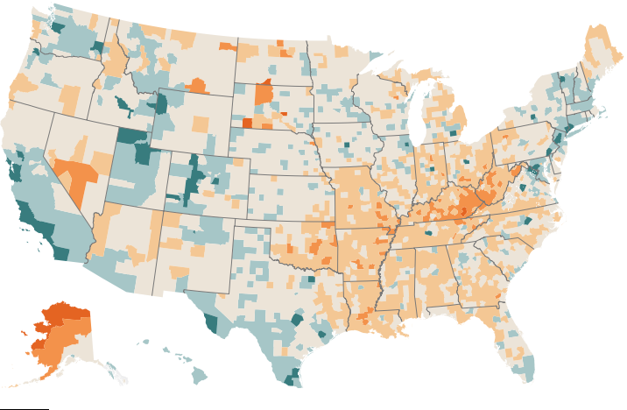
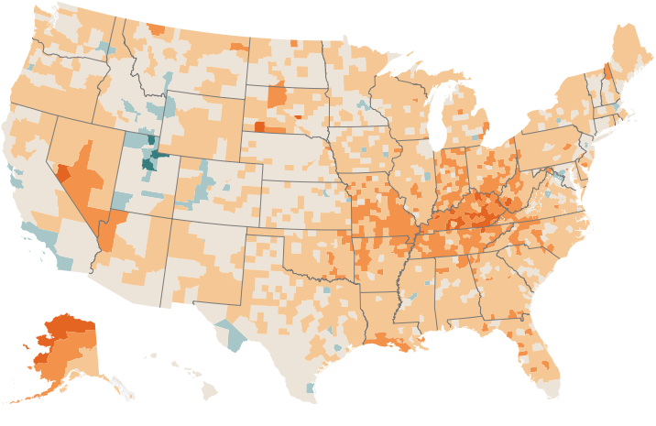
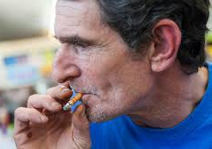
Smoking Rates
1996
2012

Slide 4
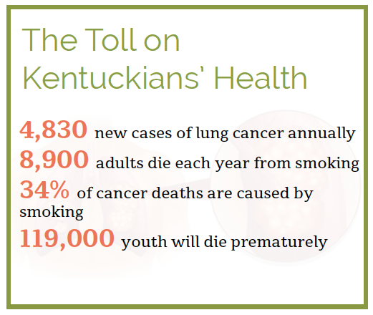
4

Slide 5
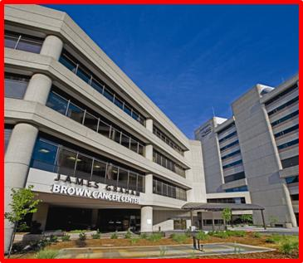
The James Graham Brown Cancer Center
Mission is to reduce cancer-related suffering and deaths both locally and globally
Founded in 1981 by the people of Louisville in response to the growing cancer crisis in Kentucky
Has developed a national reputation for the discovery of novel cancer drugs and testing of novel immunotherapeutics
92 oncologists and scientists; 388 clinical and technical staff
5

Slide 6
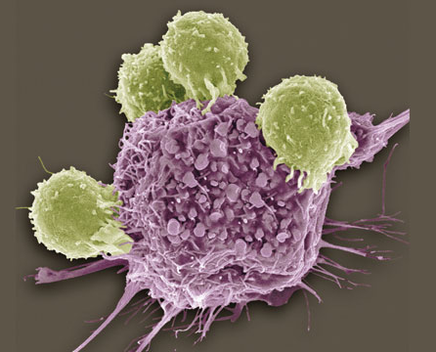
Our Approach to Reducing Lung Cancer Deaths In the Commonwealth of Kentucky
Prevention
Early Detection
Therapeutics – Pre-Clinical
Therapeutics – Clinical

Slide 7
Prevention
The Kentucky Cancer Program helps tobacco users stop smoking by improving access to group classes, resources, information, and Kentucky's tobacco
Treating Tobacco Use and Dependence in Kentucky Hospitals is now available to help hospitals address patients' tobacco use and implement tobacco-free policies. This is offered by our KCP office at (502) 852-6318.
Louisville Jefferson County Partnership in Cancer Control recently expanded its focus to include tobacco control. This coalition is working to increase the ability of individuals, businesses, and community as a whole to become tobacco free through improving the availability of stop smoking classes, and sharing information on smoke-free policies.

Slide 8
Early Detection
“Lung cancer screening rates: Data from the lung cancer screening registry” ASCO Pham et al, Brown Cancer Center, U. of Louisville
Lung cancer is the leading cause of cancer related mortality in the United States. Since 2013, the United States Preventive Services Task Force (USPSTF) recommended annual screening for lung cancer with low-dose computed tomography (LDCT) for those aged 55-80 years for those who have smoked at least 30 pack years who currently smoke or have quit within the past 15 years.
Methods: Using data from the Lung Cancer Screening Registry (LCSR) in 2016, our researchers collected the total number of LDCT from all 1,796 accredited radiographic screening sites. They then used the 2015 National Health Interview Survey to estimate screening eligible smokers per USPSTF criteria and compared them with the 2016 LCSR reported screens.
Results: In 2016, 1.9% of 7.6 million eligible smokers were screened. The majority of eligible smokers were populated in the South and had the most accredited screening sites, but were still amongst the lowest in screening rate.

Slide 9
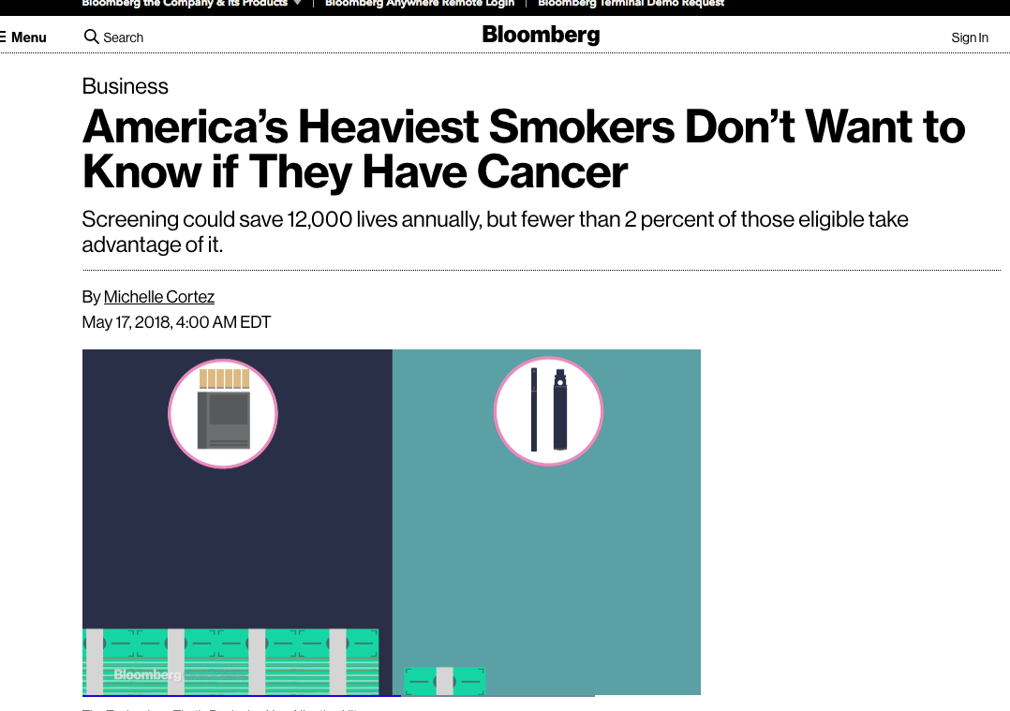
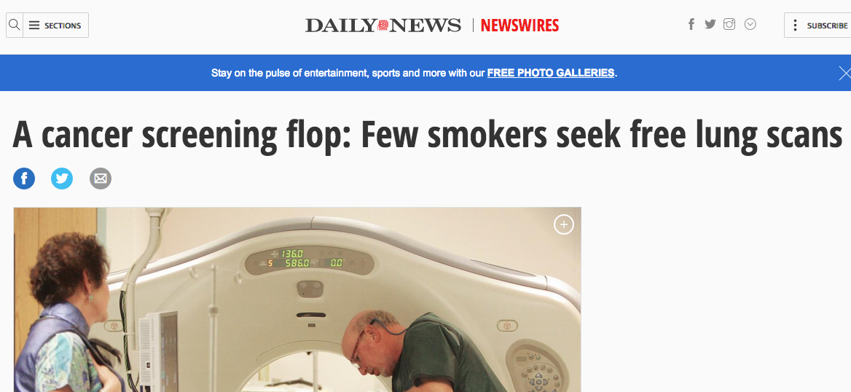
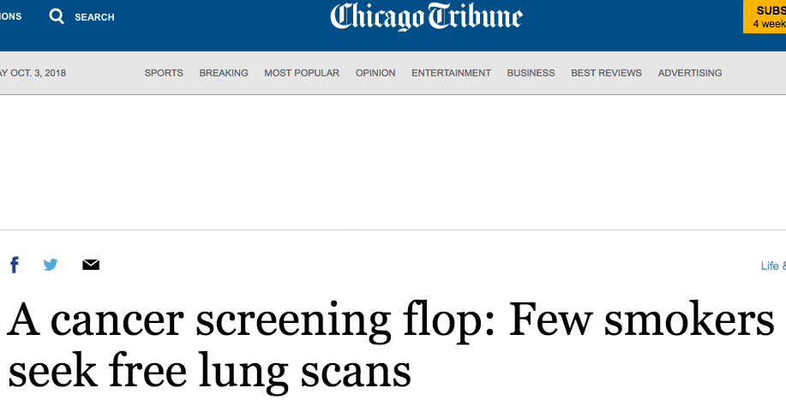
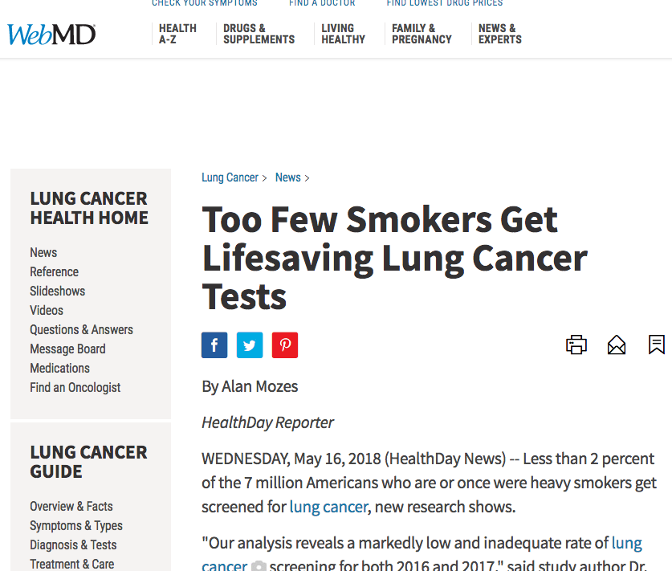
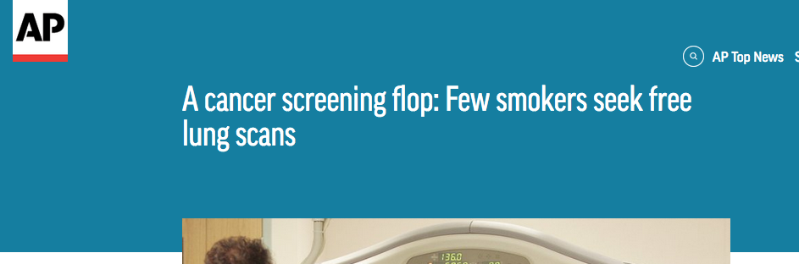
Early Detection
“Lung cancer screening rates: Data from the lung cancer screening registry” ASCO Pham et al, Brown Cancer Center, U. of Louisville

Slide 10
Early Detection
DSC = Differential Scanning Calorimetry
Plasma thermograms = heat profile of the major proteins in blood plasma
Thermogram profile changes with clinical status:
  Healthy
  Multiple Cancers
  Patient monitoring

Slide 11
Early Detection

Slide 12
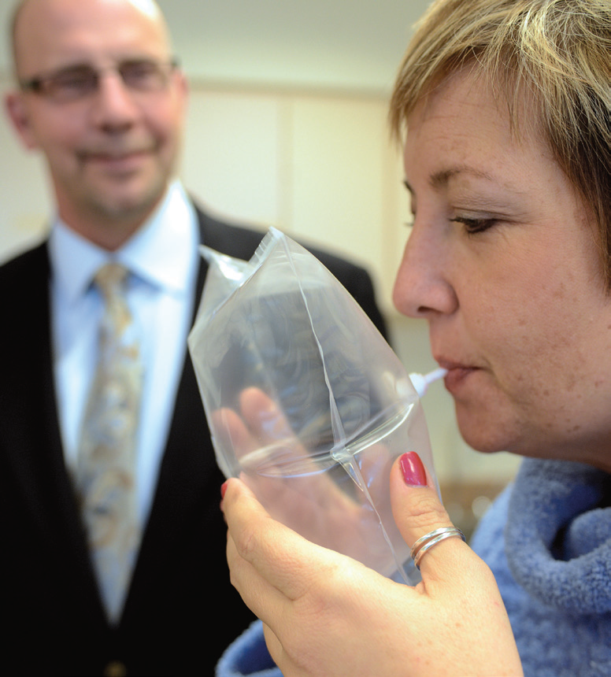
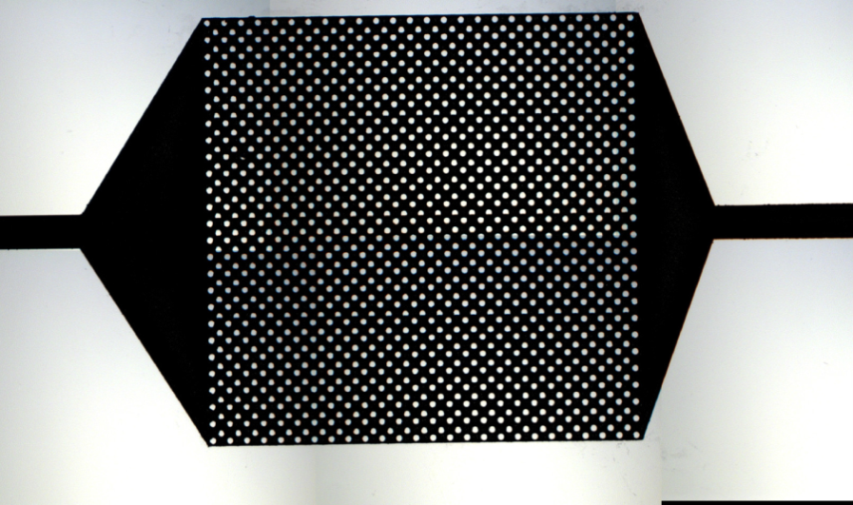
Early Detection
Early Detection of Lung Cancer By Breath Carbonyl Detection
2-butanone
3-hydroxy-2-butanone
2-hydroxyacetaldehyde

Slide 13
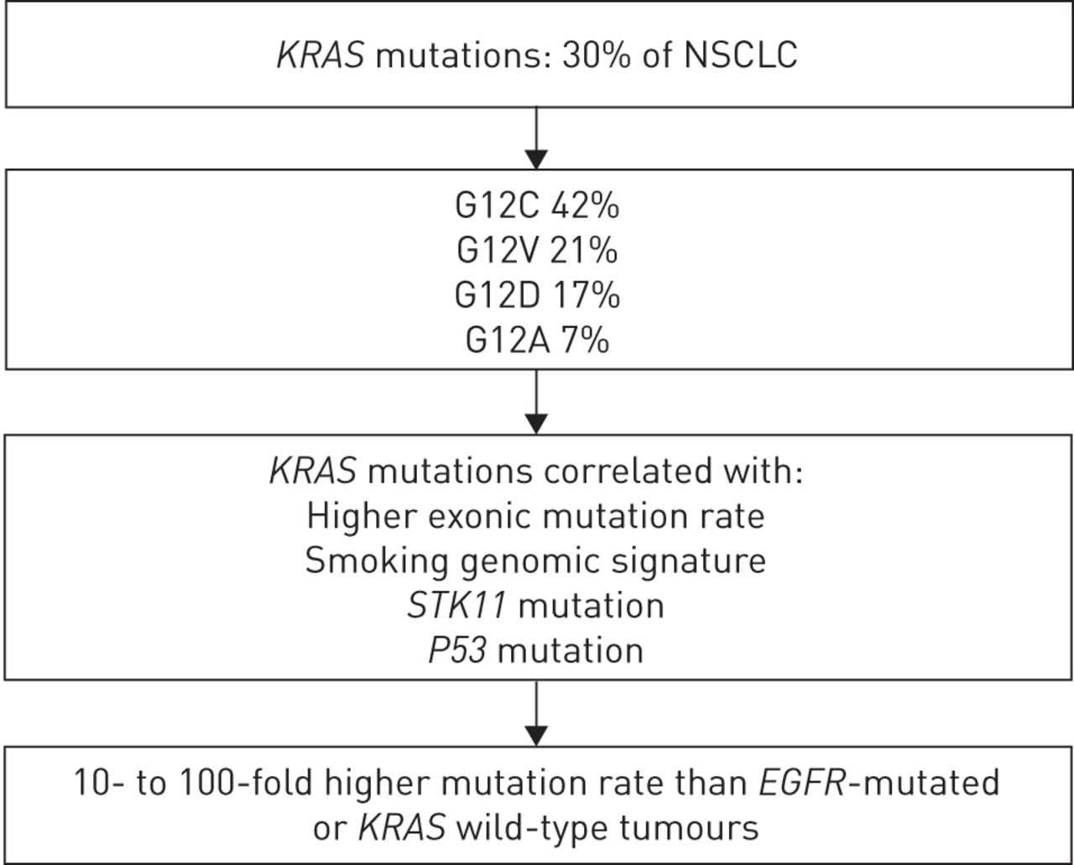
New Therapies – Pre-Clinical

Slide 14
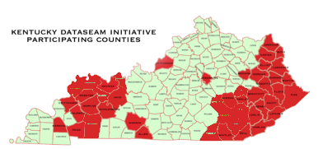
New Therapies – Pre-Clinical
Virtual Screening
Kentucky Dataseam University of Louisville Public-Private Partnership
Grid Computing in 52
K-12 Kentucky School Districts
Dataseam Grid
Virtual screening on over
24,000 processors 24/7

Slide 15
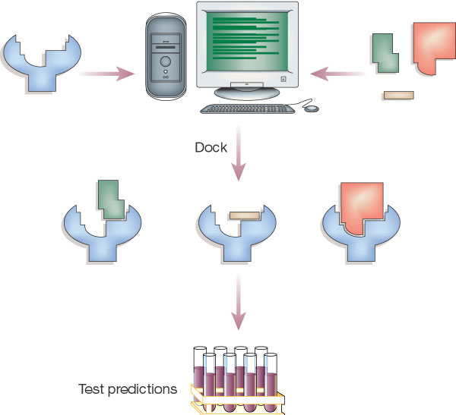
New Therapies – Pre-Clinical
Virtual Screening
Kentucky Dataseam University of Louisville Public-Private Partnership
Use computers to find potential drugs that block cancer target structures.
Speed is linear to number of computers.
Dataseam Grid: 24,000 dedicated virtual screening processor cores
Routine Libraries to screen
2014 ZINC Drug-Like: 24,877,119 compounds
2016 ZINC Drug-Like: 17,244,856 compounds
Virtual ligand
Library
Database of small
molecules

Slide 16
New Therapies – Pre-Clinical
In silico discovery of RAS inhibitors
F3

Slide 17
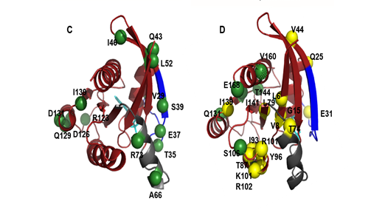
New Therapies – Pre-Clinical
ITC and NMR analysis confirms F3 direct binding,
strong GTP preference and effector loop involvement
GDP GTP
Kd ~ 16 uM

Slide 18
New Therapies – Pre-Clinical

Slide 19
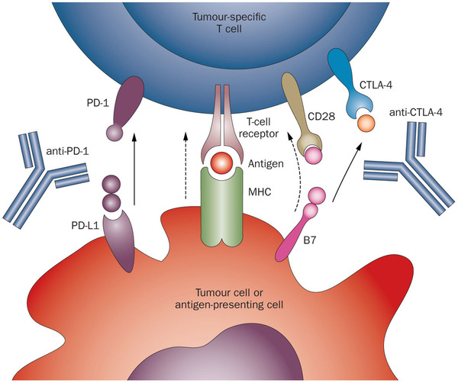
New Therapies – Clinical
Immunotherapies Are A Novel Treatment Strategy for Cancer and the Brown Cancer Center Is a Lead Site for Human Trials

Slide 20
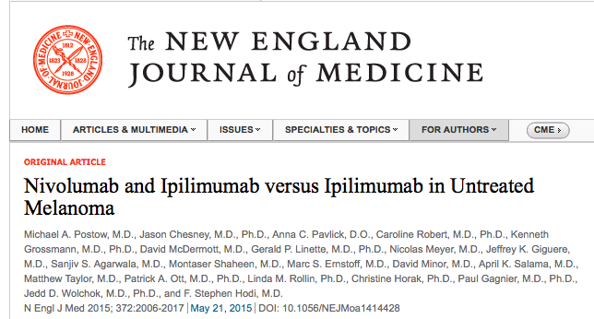
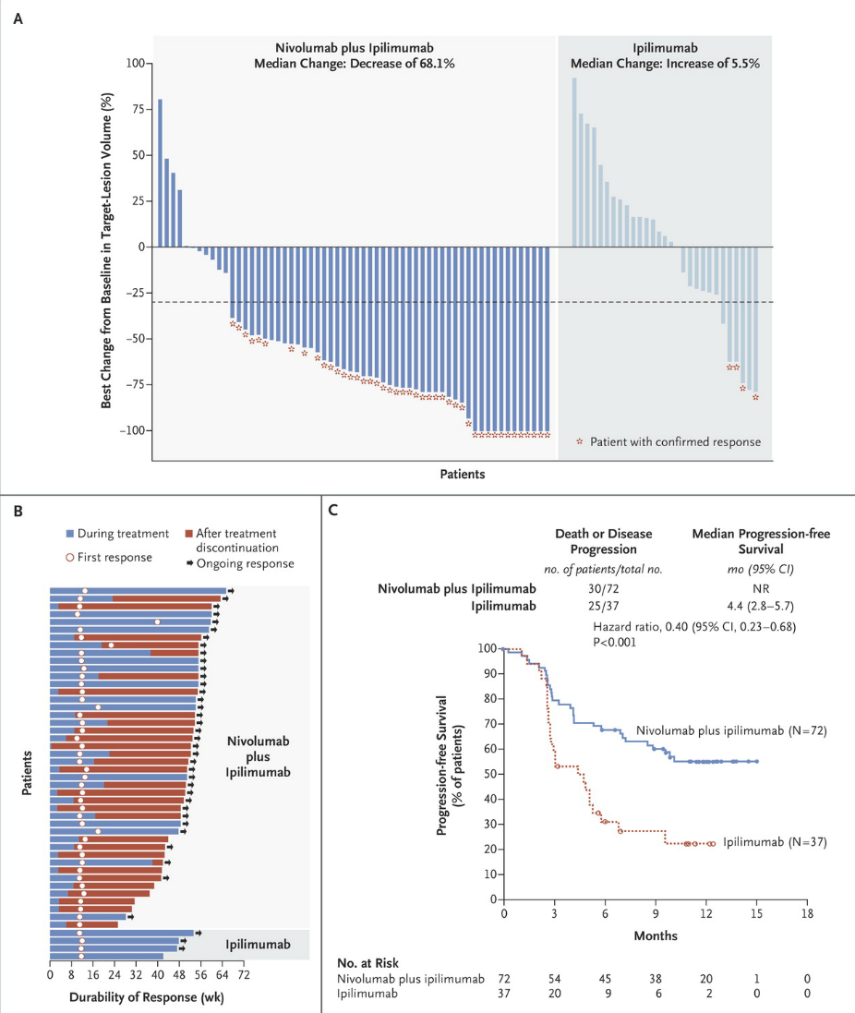
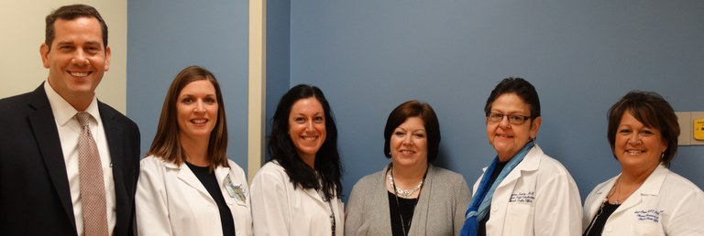
New Therapies – Clinical
372(21): 2006-2017, 2015 PMID:25891304
αCTLA4 + αPD1
Golladay Swartz Baum

Slide 21
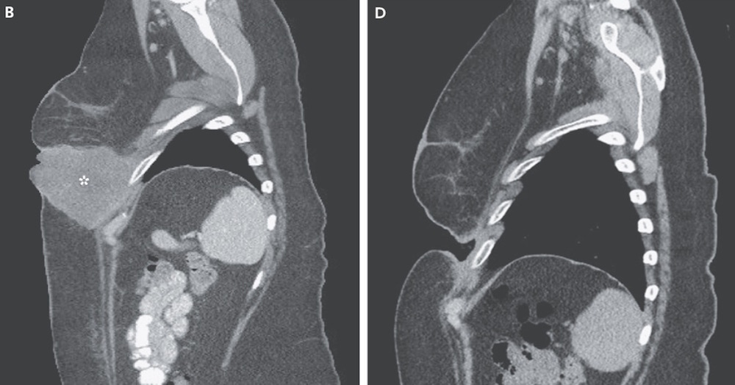
New Therapies – Clinical
372(21): 2006-2017, 2015 PMID:25891304
αCTLA4 + αPD1

Slide 22
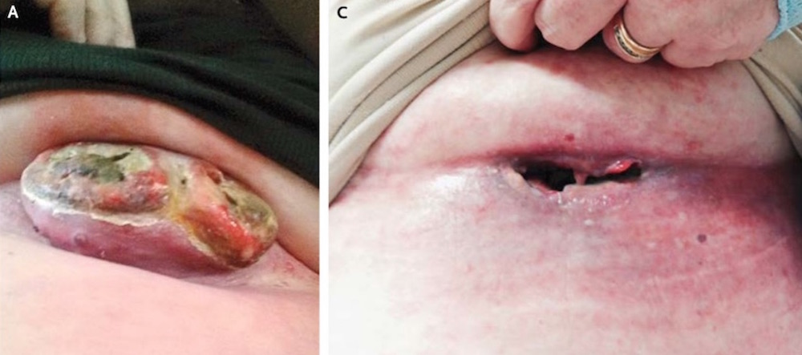
New Therapies – Clinical
372(21): 2006-2017, 2015 PMID:25891304
αCTLA4 + αPD1

Slide 23
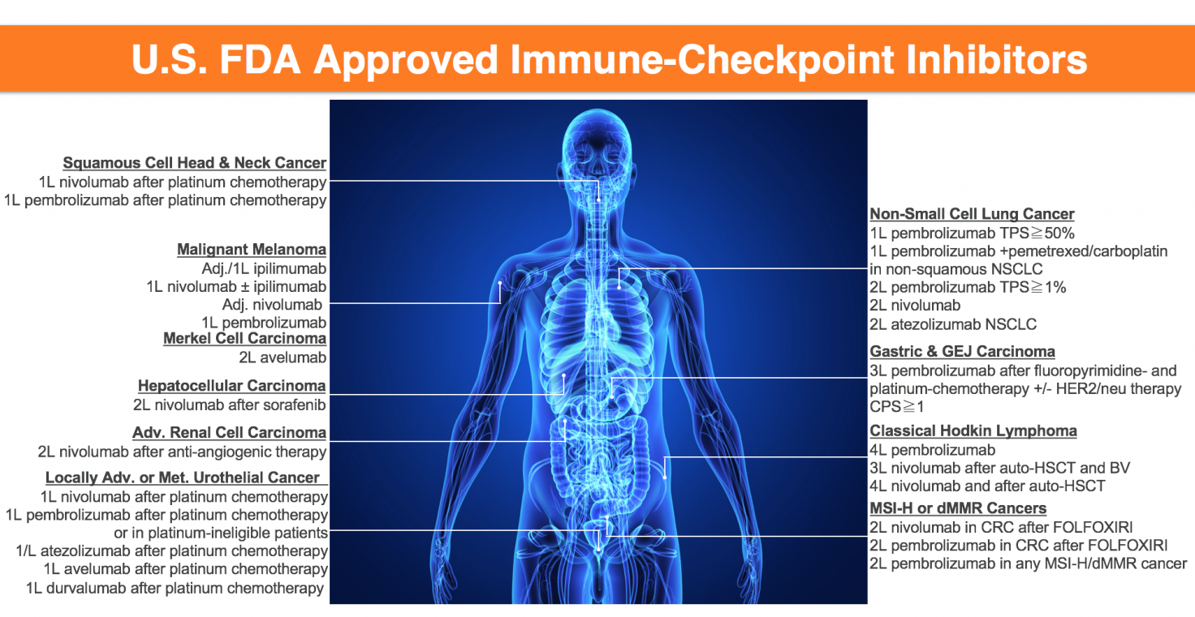
New Therapies – Clinical

Slide 24
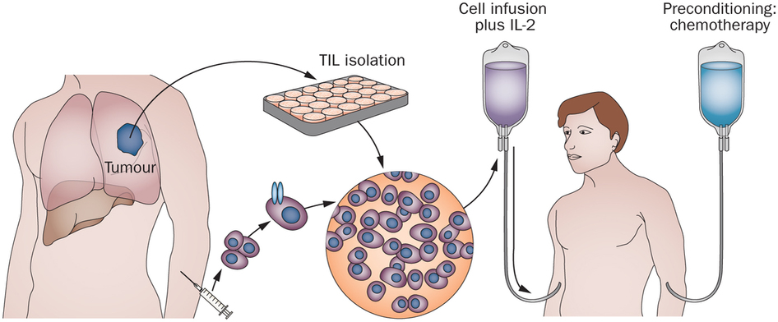
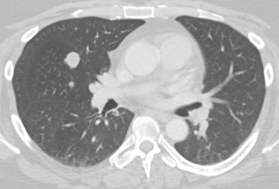
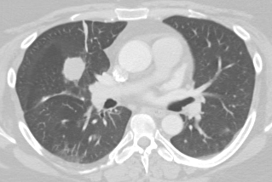
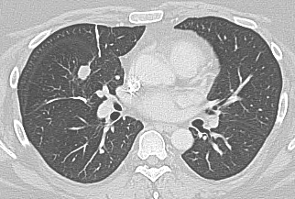
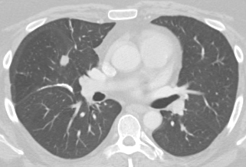
New Therapies – Clinical
Tumor Infiltrating Lymphocytes (TILS)
Melanoma, Lung Cancer, Cervical Cancer, Head/Neck Cancer
April 2017
July 2017
Sept 2017
Oct 2017
TILS

Slide 25
New Therapies – Clinical
Genetically Modified Viruses Can Be Used to Activate Cancer Immunity

Slide 26
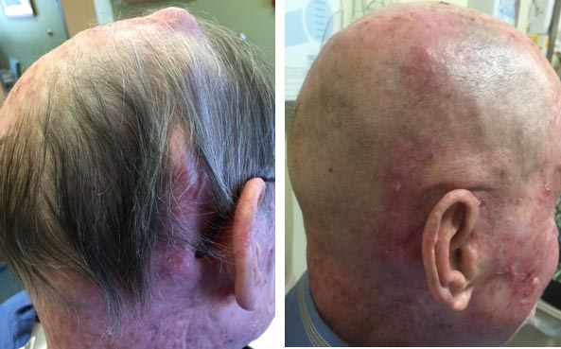
New Therapies – Clinical

Slide 27
New Therapies – Clinical
We used tobacco settlement funds to expand our early phase, innovative immunotherapeutic trial program for patients suffering from lung cancer
An Open-Label, Single Arm Phase 2 Study of Nivolumab in Combination with Ipilimumab as first line-therapy in stage IV Non-Small Cell Lung Cancer (NSCLC)
Study of Autologous Tumor Infiltrating Lymphocytes (LN-145) Alone and In Combo With Durvalumab in Non-Small Cell Lung Cancer
A Phase 1, Multicenter, Open-Label Trial to Evaluate the Safety of Talimogene Laherparepvec Injected Into Liver Tumors in Lung Cancer Patients

Slide 28
Impact of a $2M Investment in Tobacco Settlement Funds
A forensic analysis of past funding from the James Graham Brown Foundation revealed the following impact from $2M in philanthropic investment:
A 7-fold return on investment as a result in $14.5M in newly awarded grant funding for cancer research and the resultant economic impact of $38M to the region
Development of a nationally-recognized clinical trials program to test novel immunotherapeutics
120 peer-reviewed, high impact cancer research articles
Awarding of 5 U.S. patents related to cancer
320 cancer patient accruals to trials of test agents that are now saving the lives of cancer patients

