Slide 1
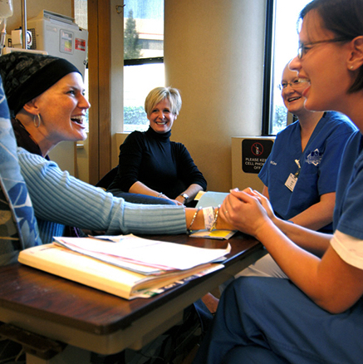
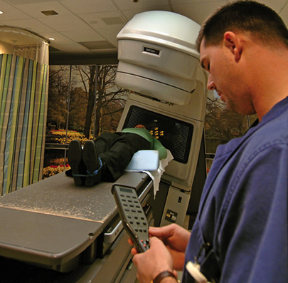
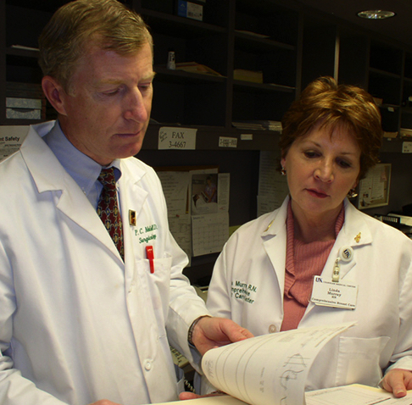
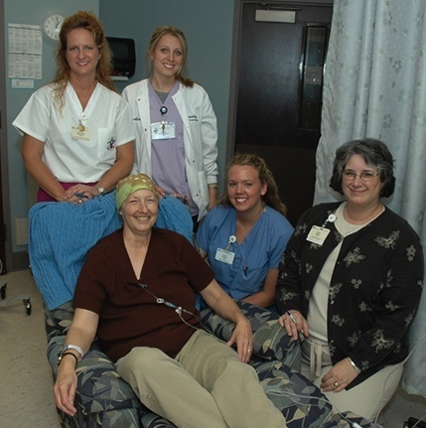

Tobacco Settlement
Agreement Fund Update
B. Mark Evers, MD
October 3, 2018

Slide 2
Lung cancer accounts for 35% of total cancer deaths in Kentucky
Compared to 28% in the U.S.
All genders, all races, 2007-2011

Slide 3
The Toll of Tobacco in Kentucky
More than 24%
of adults smoke (previously 28%)
Each year nearly 8,900
adults die from tobacco-related
illnesses
Annual health care costs
caused by tobacco use
are $1.92B
Productivity losses caused by
smoking are $2.8B
each year
Source: www.tobaccofreekids.org

Slide 4
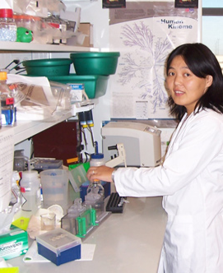
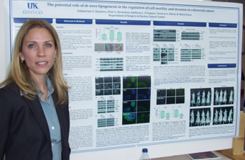
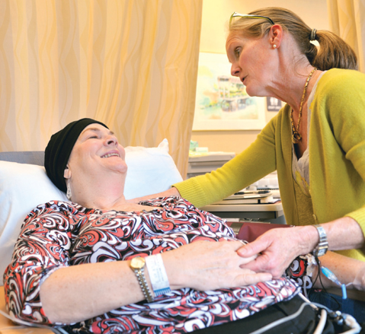
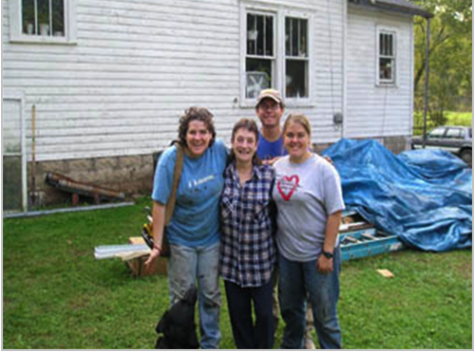

Markey Cancer Center (MCC): Our Mission
To reduce cancer mortality in our state through a comprehensive program of cancer research, treatment, education, and community engagement with a particular focus on the underserved population of Appalachian Kentucky.

Slide 5
Conquering Cancer in the Commonwealth
DROP FROM
STATE
IN CANCER MORTALITY
50% REDUCTION
#1
In cancer mortality in the Commonwealth
(Nearly 11,000 cancer deaths
every year)

Slide 6
Impact of the KLCR Program:
Fostering Research at UK

Slide 7




Kentucky Lung Cancer Research Program (KLCRP) Economic Impact (2001 – July 2015)
Total Economic Impact
The combined return on investment as a result of dedicated funding support
$707.4M
for KLCRP is
$11.34
per dollar invested or leveraged.
5,426
Jobs
created
$24M
In state and local tax revenue

Slide 8
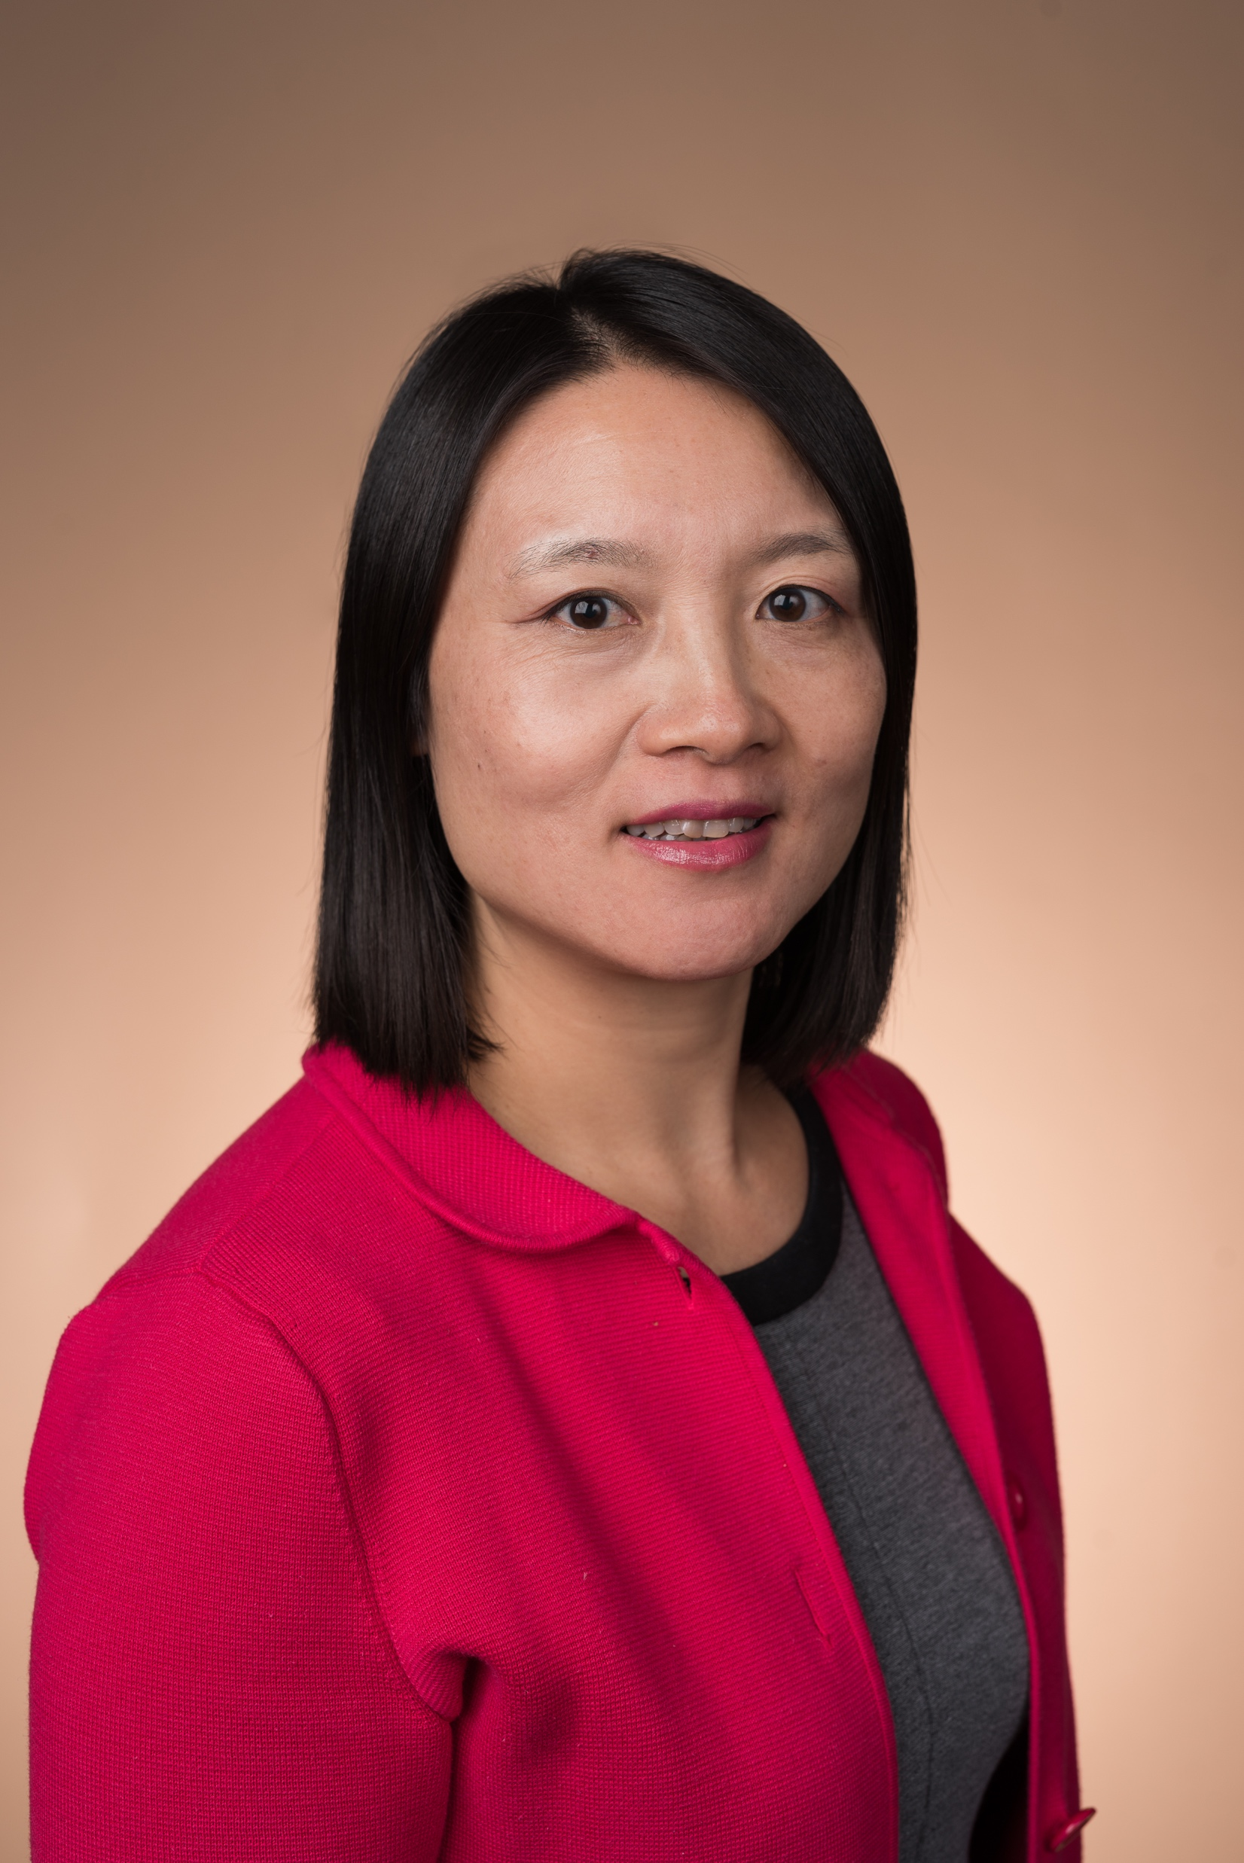
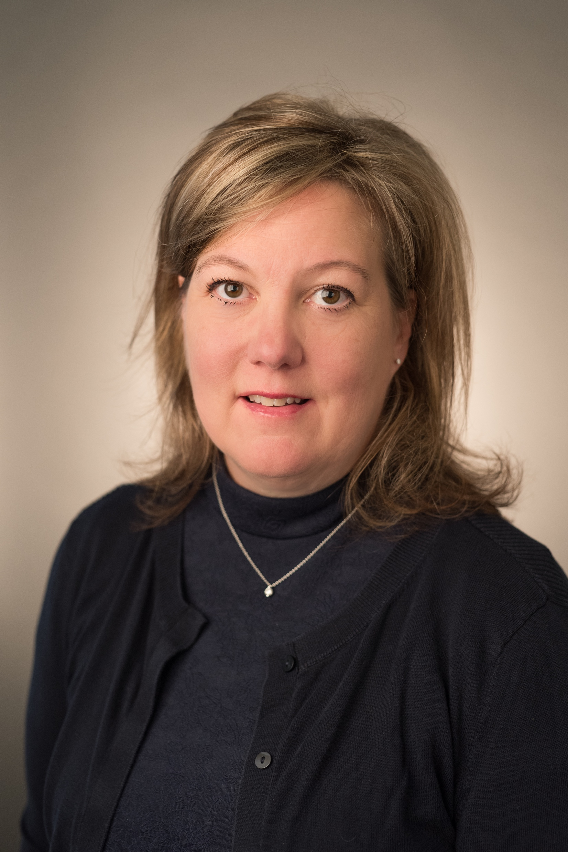

Recruiting with the help of KLCR Funding
Chunyan He, ScD | Jill Kolesar, PharmD | Christine Brainson, PhD
Arrived at UK in 2017 Now a program leader in Cancer Prevention and Control Holds Susan G. Komen and NCI R01 funding Currently recruiting additional molecular epidemiologists to expand our team | Arrived at UK in 2016 Now a program leader in Drug Discovery, Delivery and Translational Therapeutics Leader and founder of MCC’s Molecular Tumor Board and Precision Medicine Clinic Currently holds two active KLCR grants | Arrived at UK in 2016 Will be coming on to our COBRE Center for Cancer and Metabolism as a project leader Currently holds an active KLCR grant Also has NCI K22 funding and an active project from the V Foundation

Slide 9

Kentucky Clinical Trials Network (KCTN)
KCTN was an established platform to increase access to relevant research and serve Kentucky communities.
KCTN enrolled 4,273 participants to trials, residing in 108 of the 120 counties (90%) in Kentucky.
Portfolio included trials outlined in the KLCR Strategic Plan, including therapeutic, early detection and prevention, screening, health services research, survivorship.
Scioto, OH
Athens, OH
Ironton, OH
Dearborn, IN

Slide 10
Impact of the KLCR Program:
Achieving NCI Designation and National Recognition

Slide 11

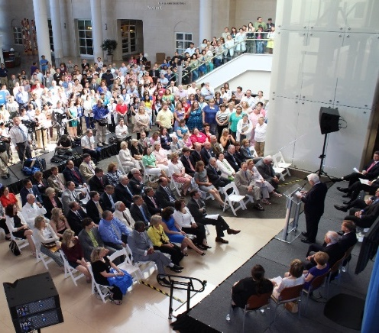
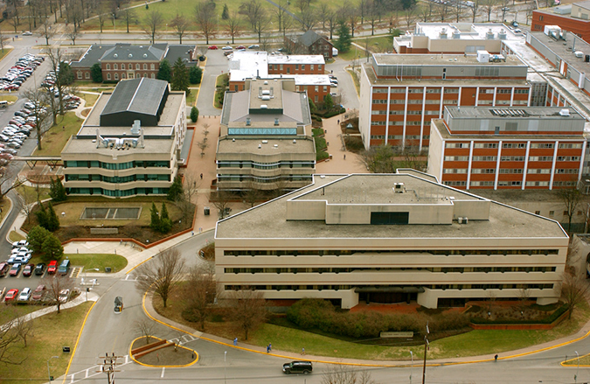
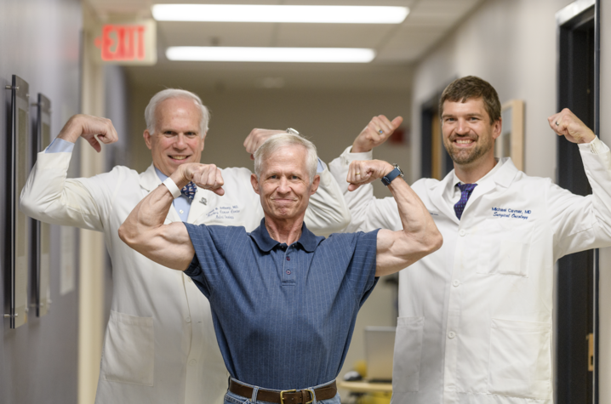
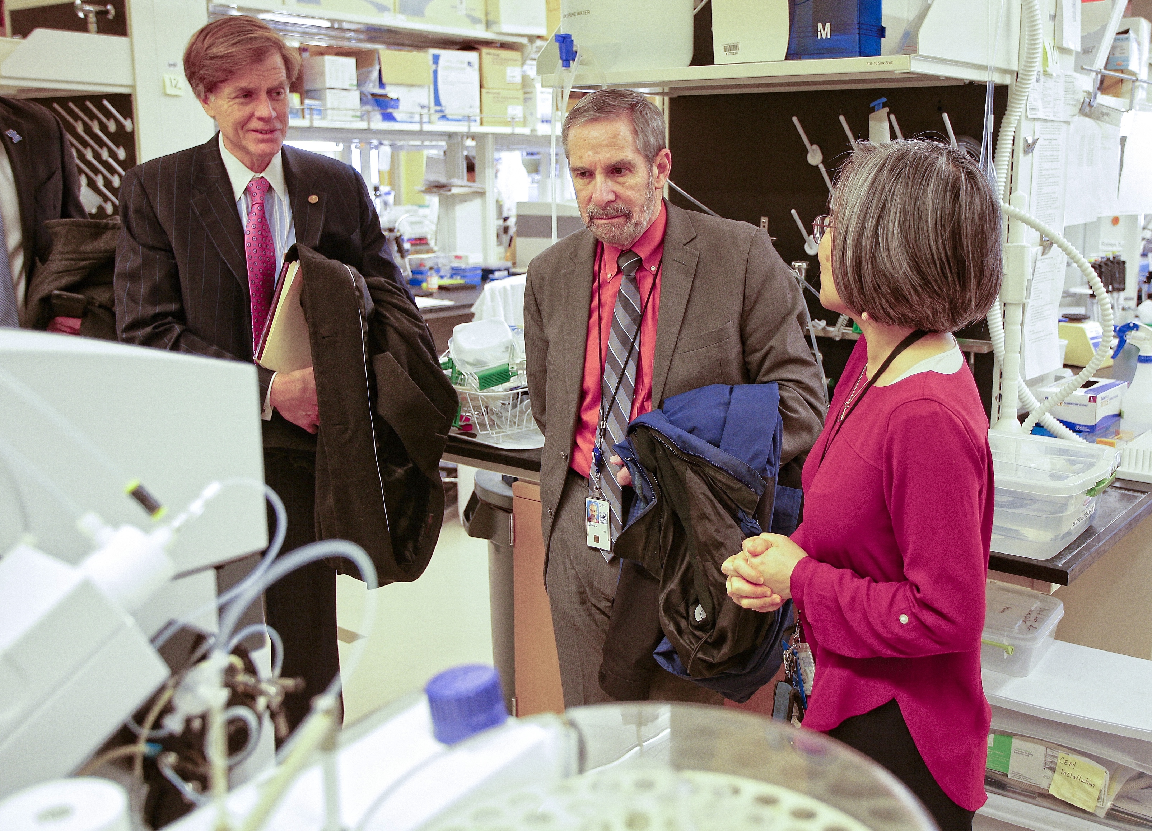
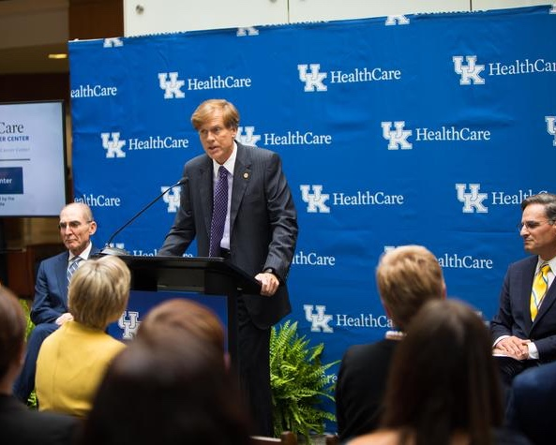
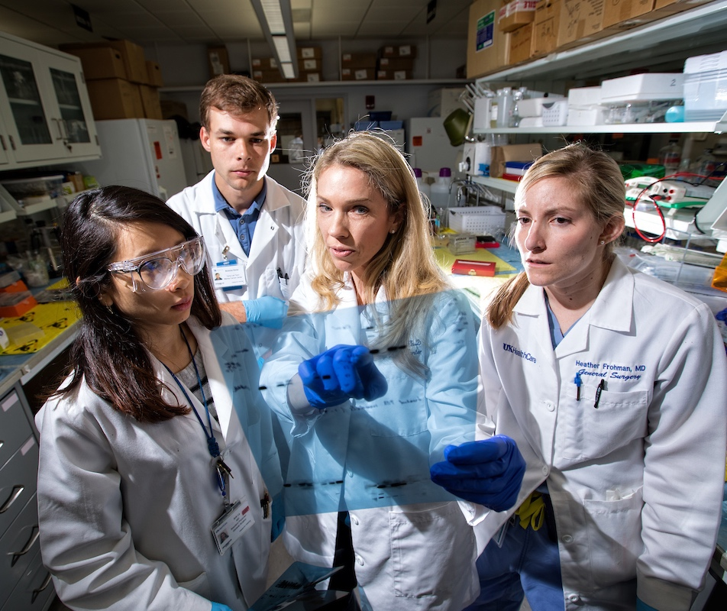
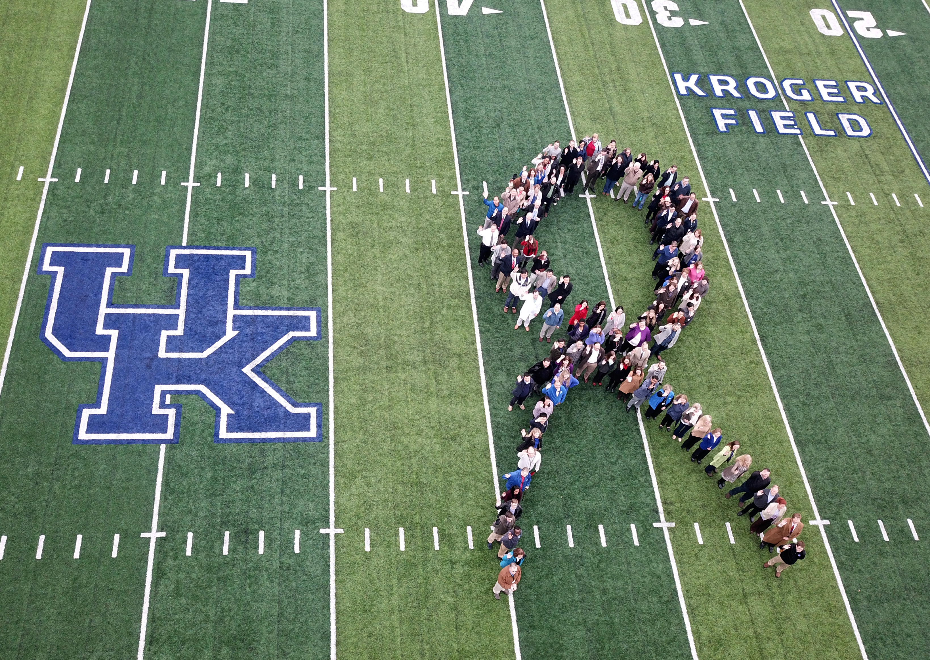
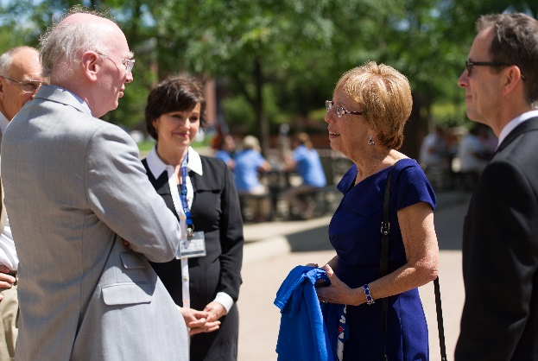
MCC’s NCI Designation Path
Awarded initial designation – July 2013
Five-year renewal submitted – September 2017
Site visit by NCI reviewers – February 2018
Next five-year funding period began – July 2018

Slide 12
U.S. News and World Reports
Top 50 Cancer Centers
2017
2018
#50
#38

Slide 13
Increased Cancer Research Funding
2012 – Present
40%
$39.7 M
$28.4 M
NCI Designation July 2013

Slide 14
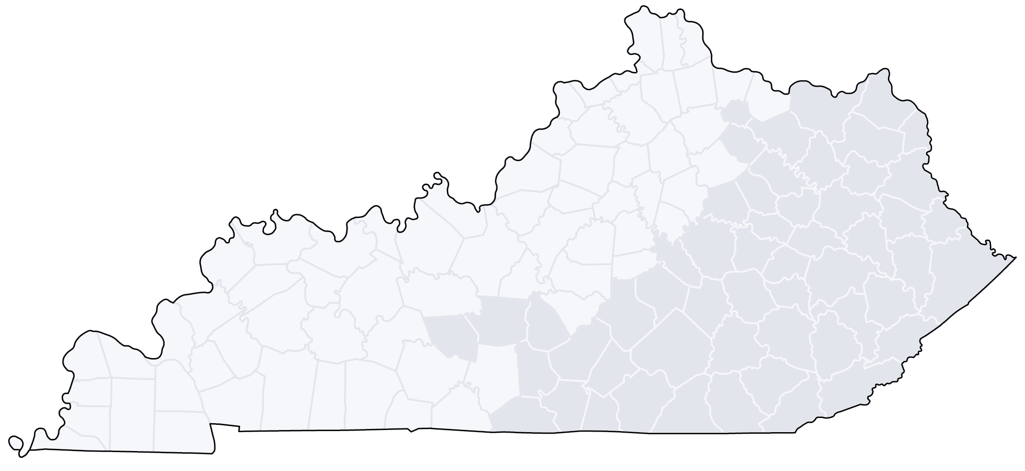

MCC Affiliate and Research Networks
MCC Affiliate Network (20 sites)
Recruiting Affiliate Network (7 sites)
MCC Research Network (6 sites)
Edgewood
Portsmouth, OH
Recruiting Research Network (3 sites)
Huntington
Cynthiana
Ashland
Georgetown
Frankfort
Charleston,
WV
Morehead
Louisville
Winchester
South
Williamson
Beckley
Lexington
Henderson
Owensboro
Elizabethtown
Prestonsburg
Mt. Vernon
Hazard
Bowling
Green
Paducah
Glasgow
Somerset
Harlan
Murray
Bristol, TN
59% of all new cancer cases in Kentucky are
directly or indirectly cared for by MCC
59%

Slide 15

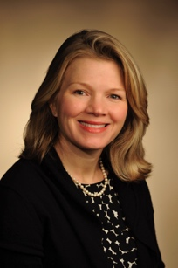
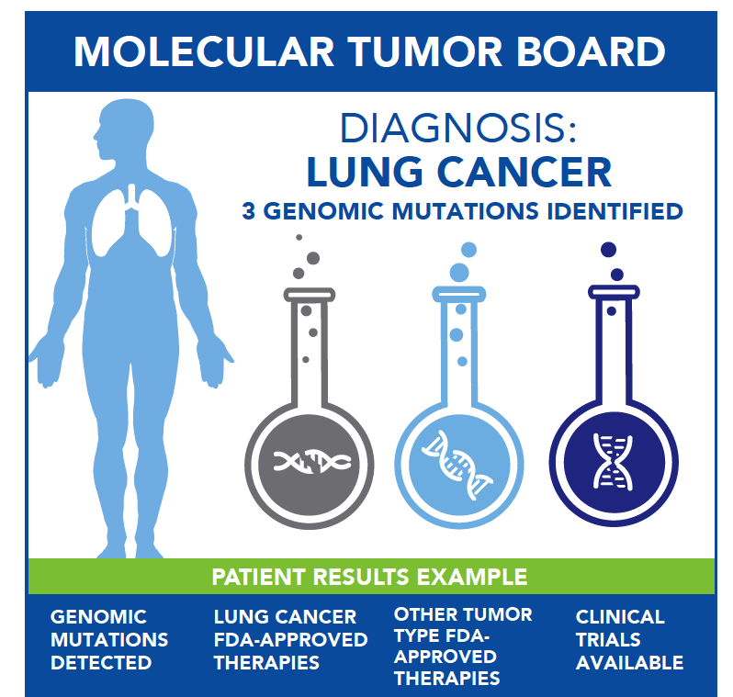
Molecular Tumor Board (MTB)
Launched October 2016 and now statewide through teleconferencing options
Using a multidisciplinary team, the MTB analyzes the molecular characteristics of cancers on a case-by-case basis and provides individualized recommendations for treatment.
274 observational patients on study
37 therapeutic patients on study
907 patients on ORIEN Total Cancer Care
Jill Kolesar, PharmD
Professor
College of Pharmacy
Rachel Miller, MD
Associate Professor,
College of Medicine

Slide 16
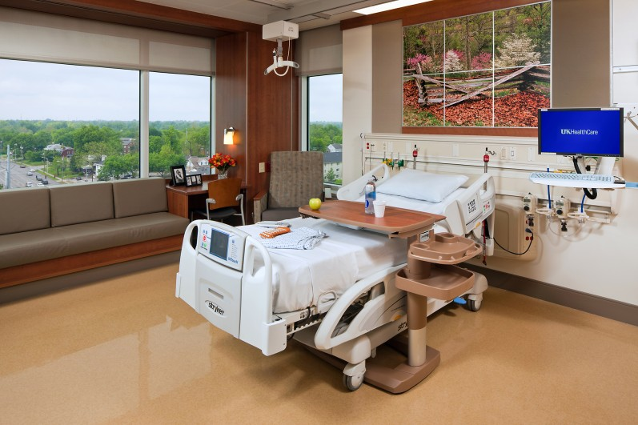
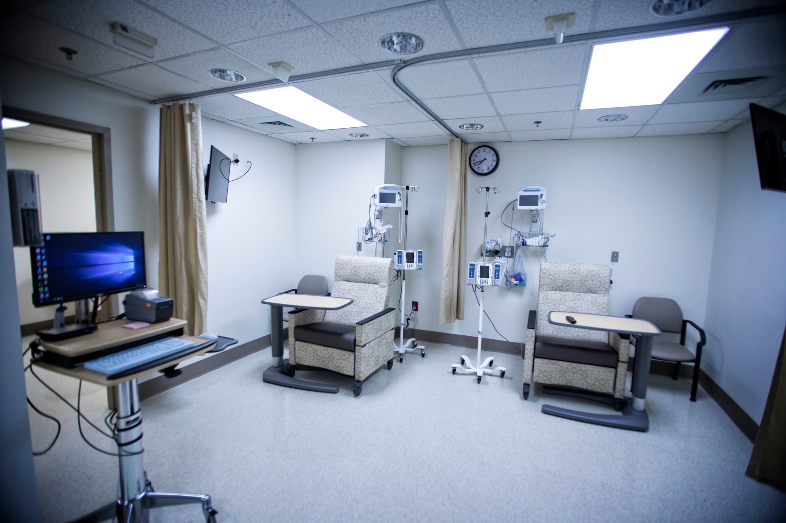
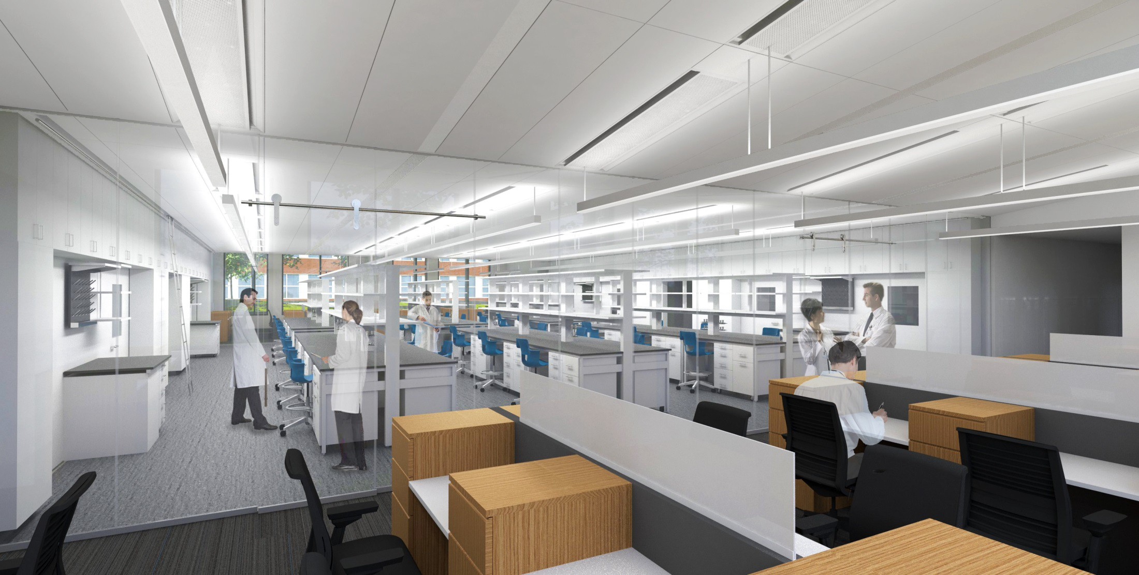
MCC Space Expansion 2017 - 2018
Chandler Hospital new 11th floor (63 inpatient beds) opened in December 2017
Early Phase Clinical Trials Center opened in November 2017
  Offers early-phase treatments for cancer patients
Research Building 2 opening in October 2018
  Supported by Kentucky legislature

Slide 17
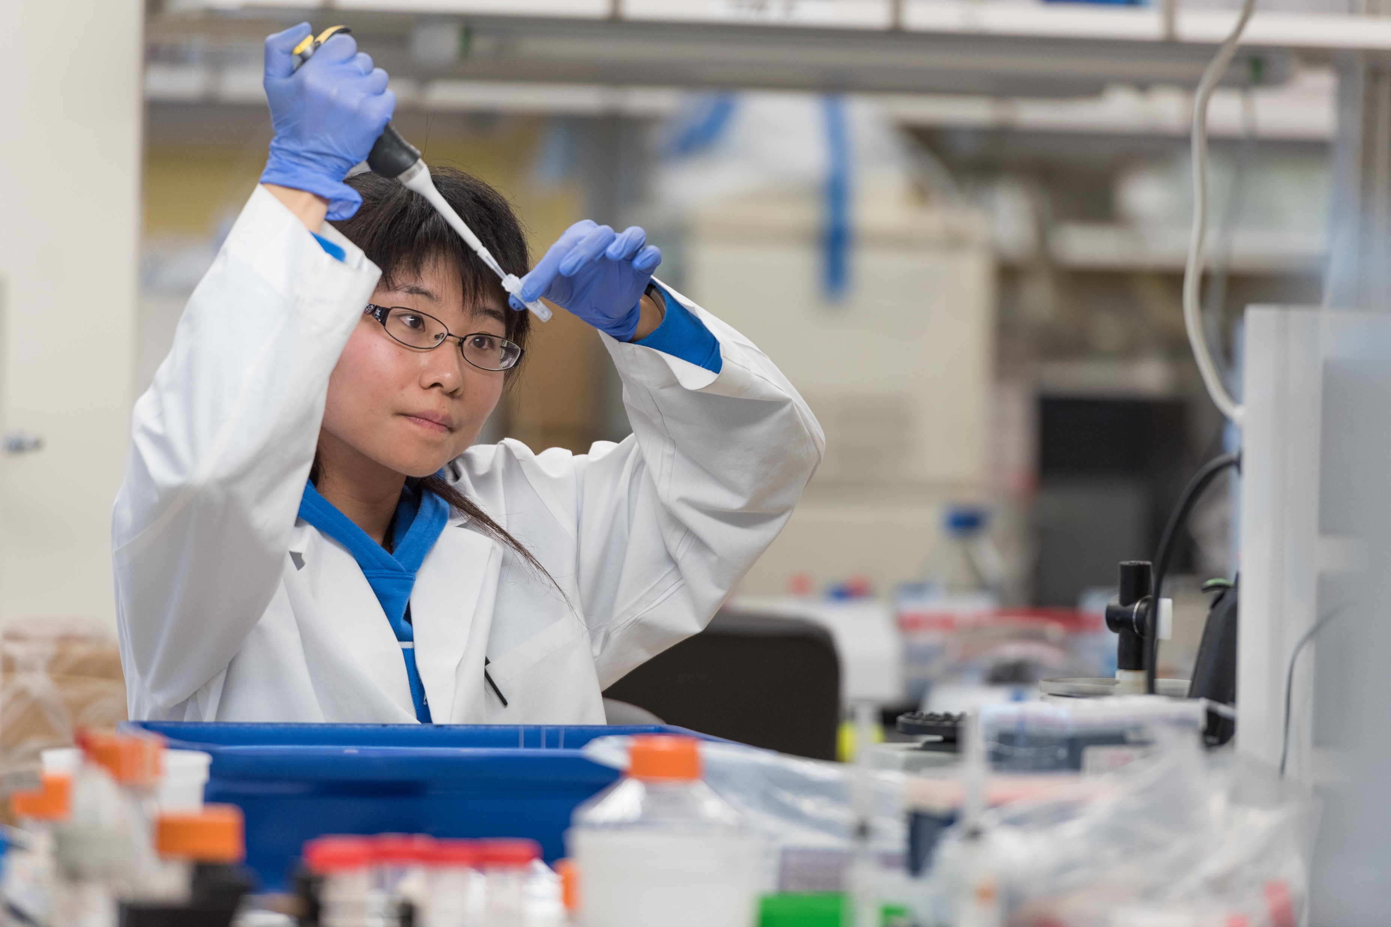

Other Impacts of NCI Designation
28 new faculty recruits over our initial funding period
983 manuscripts since we were funded – most of which include collaborations with researchers outside UK
Increase in collaborative funded research – multi-PI and team proposals
Accrual of more than 10,000 subjects to interventional trials; 44% from Appalachia
Establishment of our Community Advisory Board
Training more than 5,700 health care professionals across the state

Slide 18
MCC Research Updates
2017-2018

Slide 19
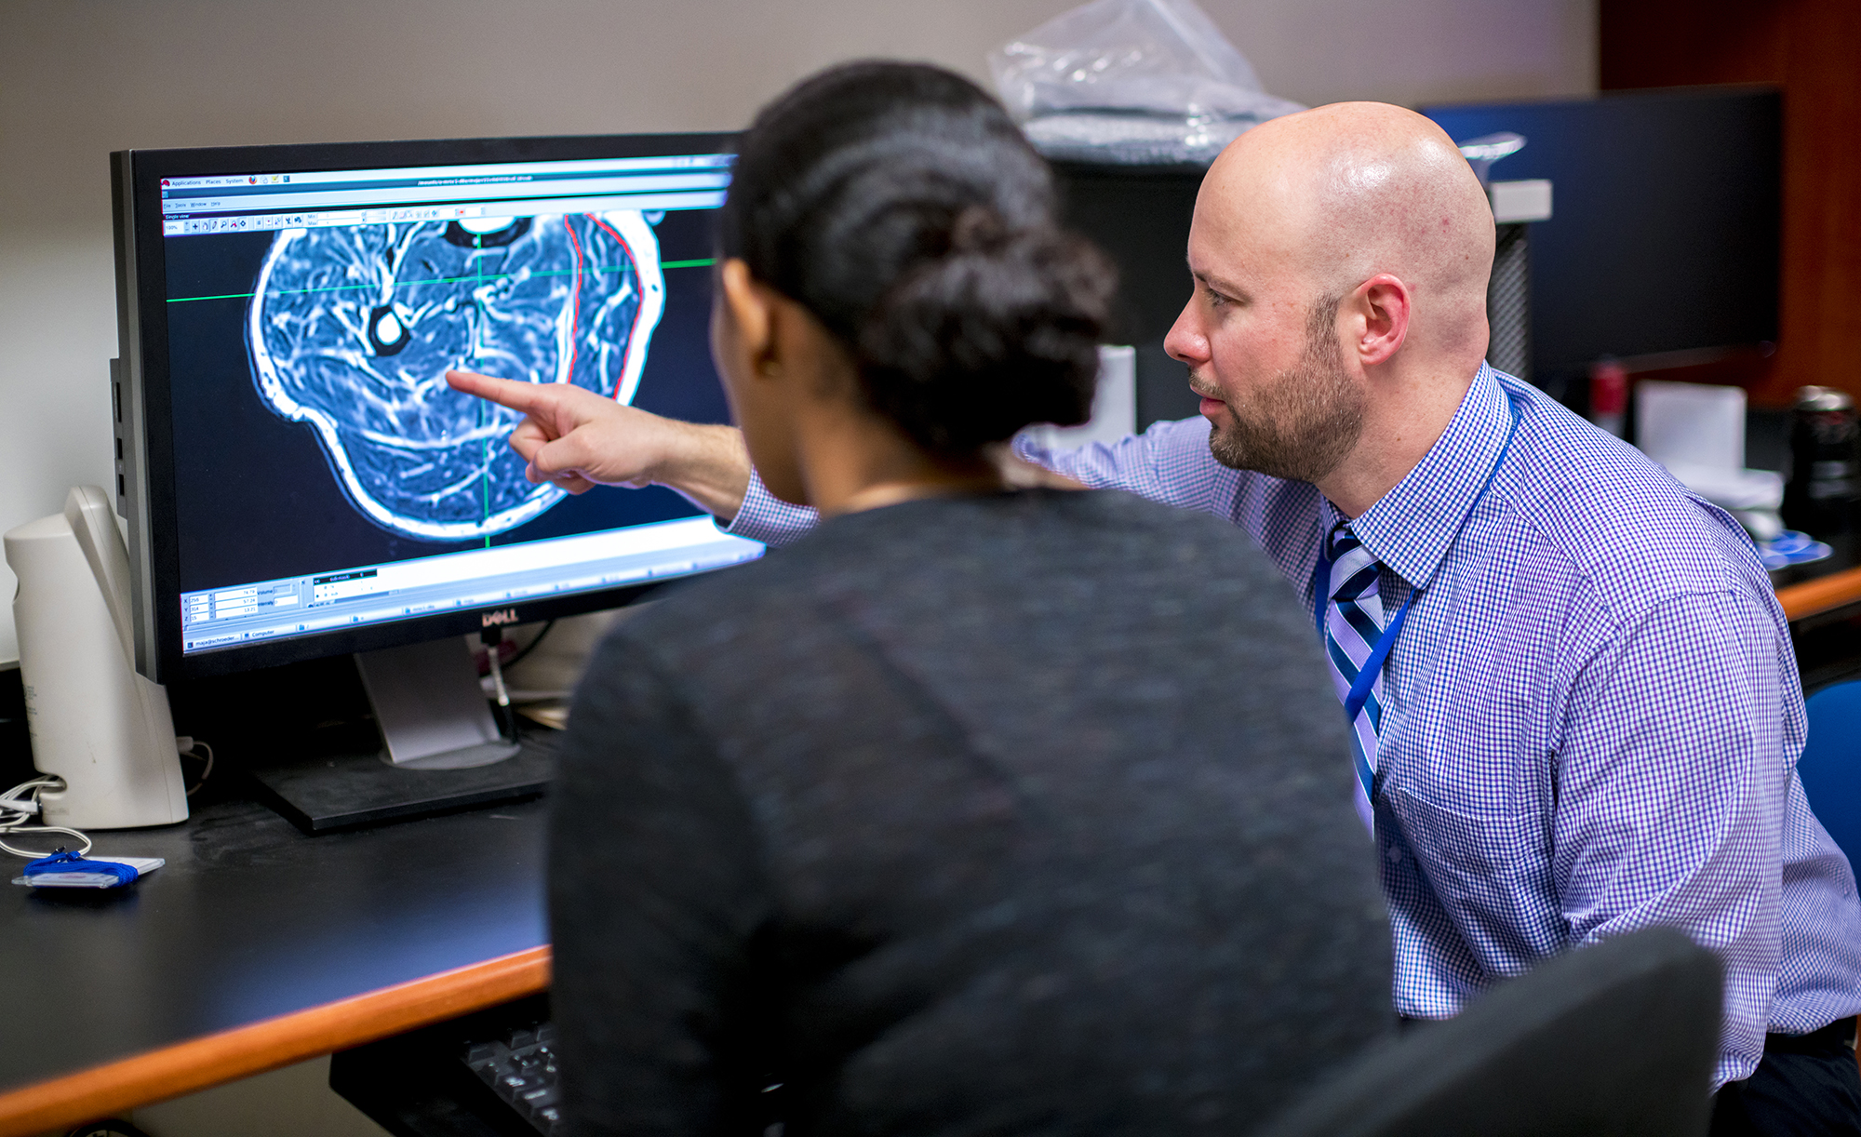
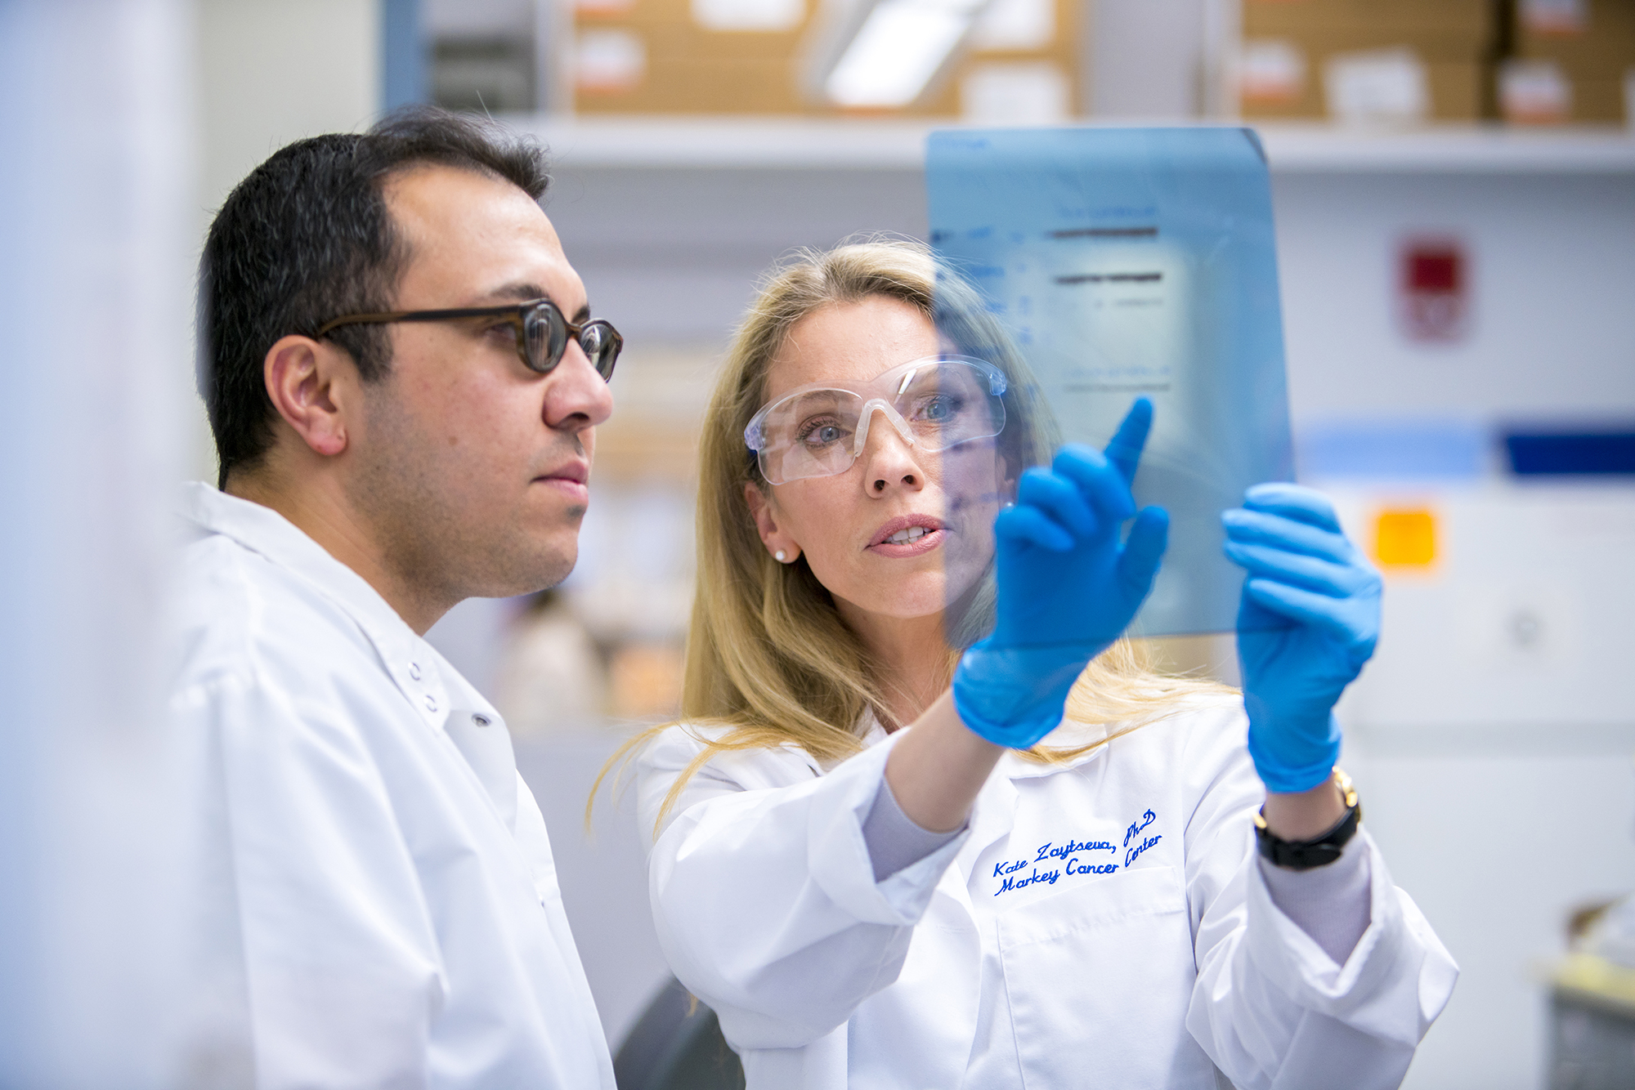
Ongoing Lung Cancer Research
Center for Cancer and Metabolism
  $11.2M Phase I award began in March 2017
  Four current projects led by junior faculty members and four pilot projects funded per year; each explores the relationship between cancer and metabolism
UK-CARES (Center for Appalachian Research in Environmental Sciences)
  $7.5M award from NIEHS
  Provides infrastructure support for research on environmental health impacts and interventions in Appalachian Kentucky
  Includes partners in the Big Sandy, Kentucky River and Cumberland Valley districts in southeastern Kentucky

Slide 20
Ongoing Lung Cancer Research
Kentucky LEADS Collaborative (Lung Cancer Education. Awareness. Detection. Survivorship)
  Collaborative effort between MCC, Brown Cancer Center and the Lung Cancer Alliance
  $7.1M in funding through the Bristol-Myers-Squibb Foundation
  Reaches Kentucky-based clinicians, lung cancer survivorship care specialists, survivors and caregivers, and provides tools to screening programs around the state of Kentucky
CCSG Supplement: Develop Tobacco Cessation Treatment Capacity and Infrastructure for Cancer Patients
  $253,858 total costs awarded
  Creates the Markey CARES (Cancer-specific, Assessment, Referral, Engagement and Support) Tobacco Program
    Examines tobacco cessation after cancer diagnosis
    Ensures access to high-quality tobacco treatment for all outpatients at Markey

Slide 21


New Research Coming on Board
Christine Brainson (new recruit / junior investigator)
  V Foundation Award, Using Epigenetic Therapy to Boost
  Immunotherapy in Squamous Lung Cancers ($200K over 2 years)
Eric Durbin
  NCI renewal of our SEER contract ($31M over 10 years)
Ramakanth Kavuluru (junior investigator)
  NCI R21, Toward Fine-Grained E-Cigarette Surveillance on Social Media:
  Evolving Themes, Popularity Predictors, and Demographic
  Variations ($366K over 2 years)
Jennifer Redmond Knight
  Patient Advocate Foundation, Lung Cancer Prevention,
  Control, and Survivorship with Business and Community
  Engagement ($127K over 3 years)
Lovoria Williams (new recruit)
  Augusta University, Increasing Community Awareness of Lung Cancer Screening in Minority and Underserved Communities, a cancer-Community Awareness Access Research & Education (c-CARE) initiative ($55K over 2 years)

Slide 22


New Research Coming on Board
Jamie Studts
  LUNGevity Foundation, Project ACTS (Adherence to CT Screening): Development and Usability of Patient Engagement Tools to Support Lung Cancer Screening Adherence ($322K over 2 years)
Brady Reynolds
  R21, Using Mindfulness Training to Reduce Delay
  Discounting in Rural Adult Smokers ($408K over
  2 years)
Amanda Fallin-Bennett (junior investigator)
  R37 MERIT Award, Adoption of Smoke-free Laws
  and Voluntary Policies in Rural Communities in
  Southern States ($2M over 5 years)
Kristin Ashford and Amanda Fallin-Bennett (junior investigators)
  R34, Behavioral and Enhanced Perinatal intervention for Cessation (B-EPIC): Reducing Tobacco use among Opioid Addicted Women ($688K over 3 years)

Slide 23
Research shows highly effective efforts to improve the health of Kentuckians
Enact a 100% smoke-free policy in KY
  Currently, 34% of KY population is covered by state-wide smoke-free acts
Cigarette Excise Tax (CET)
  Current CET rose 50 cents this year and is currently $1.10/pack
  Still below national average of $1.72/pack
  KY has the second-highest percentage of adult cigarette use and the 16th lowest Excise Tax in the U.S.
  Indirect relationship between Excise Tax and smoking rates
Smoking Prevalence vs. Tax Rate
$3.00
45%
$2.50
40%
35%
$2.00
30%
$1.50
25%
20%
$1.00
15%
$0.50
10%
5%
$0.00
0%
Average Tax
(Federal + State) ($)
Smoking Prevalence (%)

Slide 24
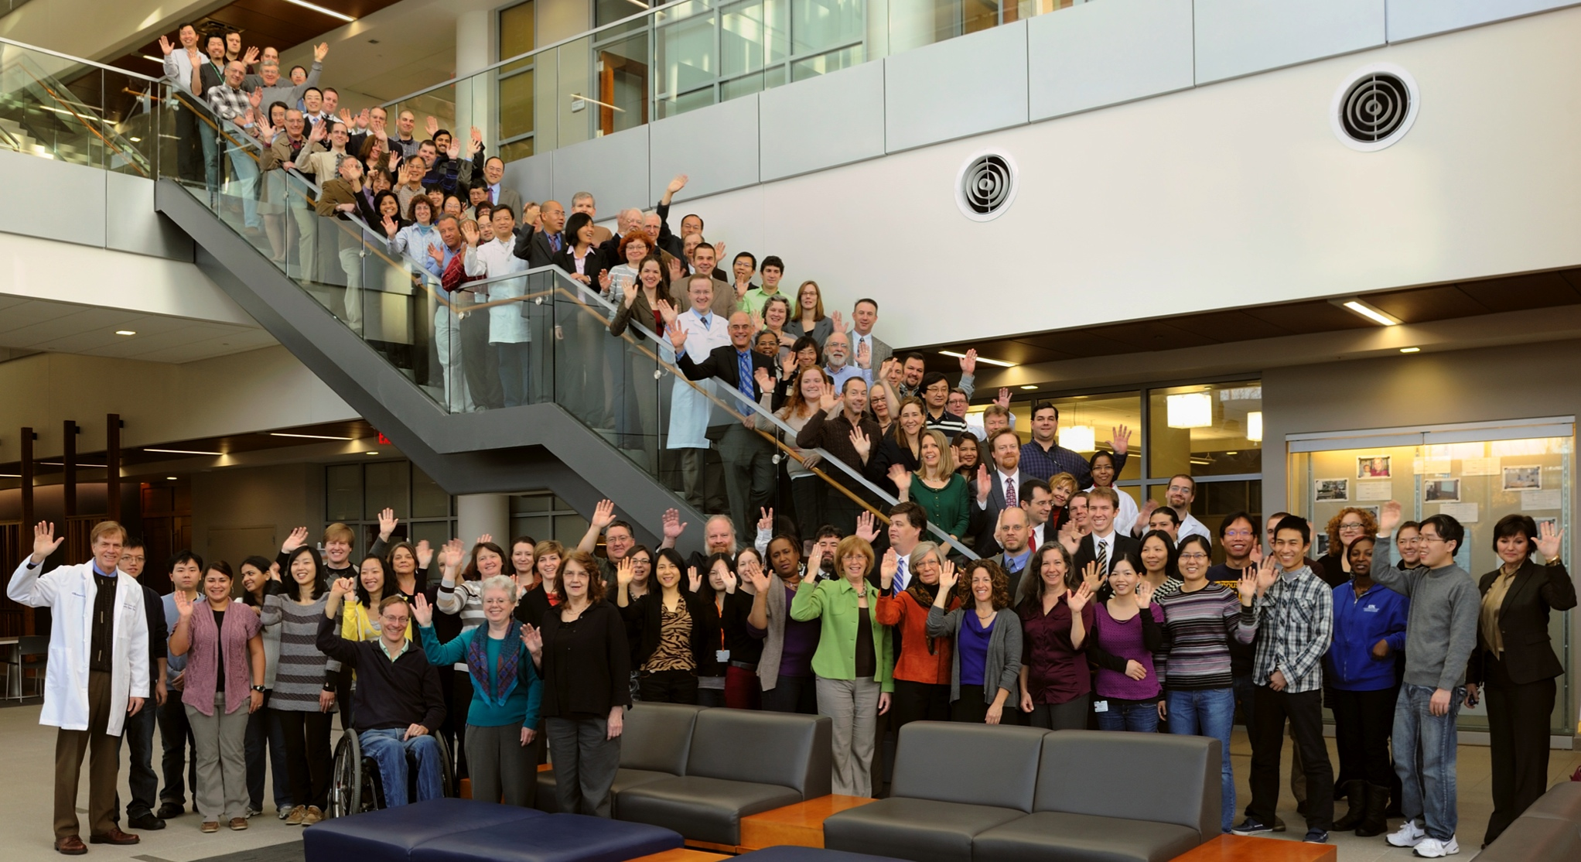
Thank you!

