Slide 1
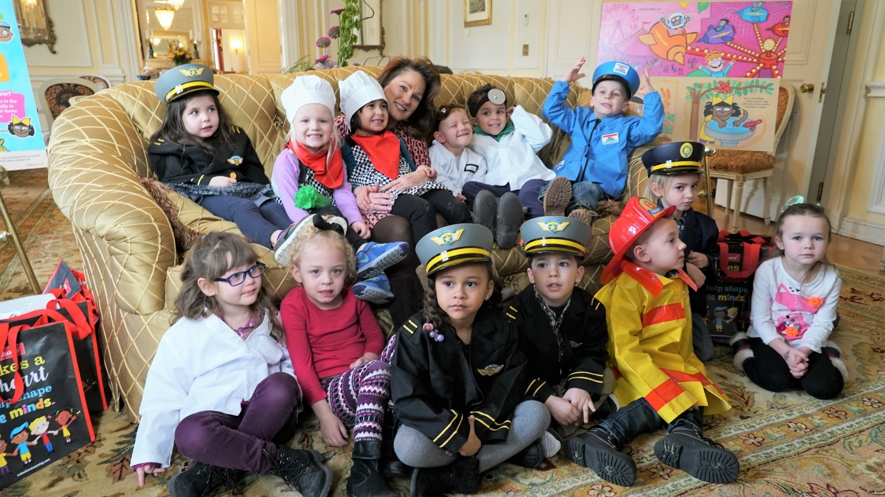

Kentucky Governor’s
Office of Early Childhood
Tobacco Settlement Agreement Fund
Oversight Committee
Friday, November 16, 2018

Slide 2

Benefits of Early Care & Education
Quality early care and education programs improve outcomes for a lifetime
Home visiting strengthens families and improves outcomes for children
Increased metabolic screening leads to identification of early childhood health risks
Increased participation in Kentucky Quality Rating and Improving System (QRIS), Kentucky All STARS, leads to more children in high quality care
Increased focus on the science of brain development
Community involvement in Community Early Childhood Councils (CECCs) improves school readiness at the community level

Slide 3
Early Childhood Distribution of
Master Tobacco Settlement Funds for FY18
Division of Early Childhood Development (GOEC) $2,050,000
Early Childhood Oral Health $500,000
Child Care Program $8,714,700
HANDS
Program
$9,000,000
Folic Acid Program
$80,000
Total FY18 Tobacco Funds $24,516,100
Early Childhood Scholarship Program $1,100,000
Family & Community Based Services
$180,000
Healthy Start Program
$1,000,000
Early Childhood Mental Health $1,000,000
Substance Abuse Treatment Program $891,400

Slide 4

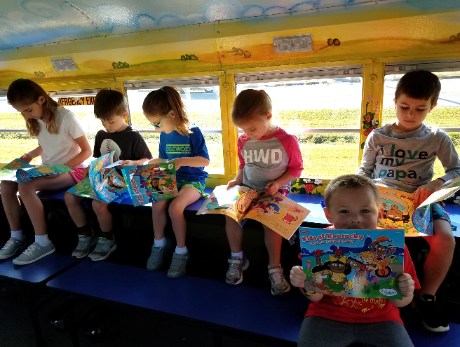
What Do You Want To Be? Book Launch
The KY Governor’s Office of Early Childhood, First Lady Glenna Bevin, KY Dept. of Agriculture, KY Association of Food Banks and Lakeshore Learning partnered to develop the book Kids of Kentucky, What Do You Want to Be? to support Kentucky proud products, the No Kid Hungry campaign, and to promote quality efforts that advance the most critical years of young children’s lives.
  On January 24, 2018, First Lady Glenna Bevin hosted The KY Governor’s Office of Early Childhood and Lakeshore Learning for a book reading at the Governor’s Mansion, with a local early childhood program.
  5000 books were distributed to summer meal sponsors with an interest in incorporating an educational component in their program.

Slide 5

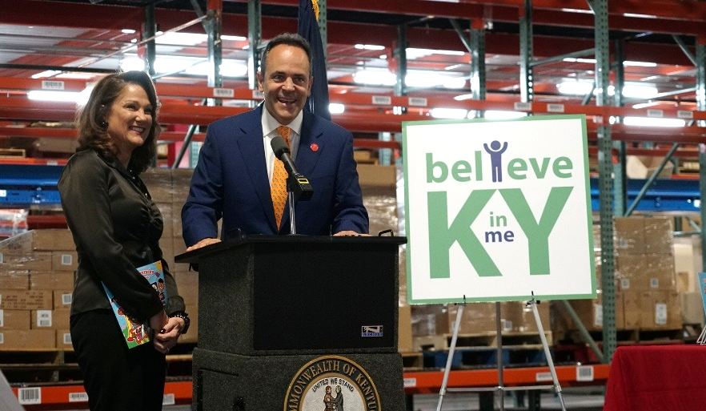
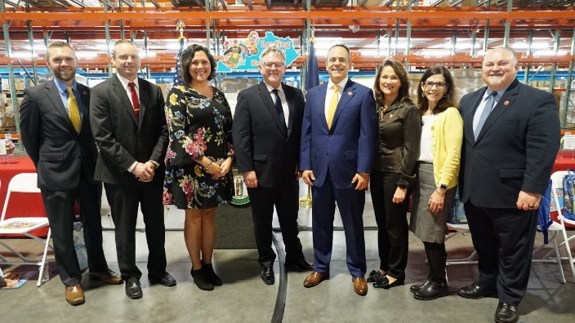
Who Is In Your Family? Book Launch
The KY Governor’s Office of Early Childhood, First Lady Glenna Bevin, and Lakeshore Learning partnered to develop the book Kids of Kentucky, Who Is In Your Family? to raise awareness around foster care/adoption and the diversity of families in Kentucky.
A copy of the book and learning kits have been distributed to foster/adoptive families, Family Court Judges, and the 9 Department for Community Based Services Regions.

Slide 6

The Early Childhood Institute (ECI) was held June 13-15, 2017 with 1,500 in attendance.
This year’s theme was: “Leading the Way for Kids of Kentucky”
146 Professional Development Sessions
Child Care Training Hours
  25,236 Hours
Effective Instructional Leadership Act (EILA)
  1,764 Professional Development Hours Issued Through the Kentucky Department of Education

Slide 7



Community Early Childhood Councils (CECCs)
CECCs are an integral part of Kentucky’s early childhood system. CECCs have the crucial role of mobilizing local community members to build innovative, collaborative partnerships to help Kentucky improve Kindergarten readiness.
  Funding was designed to assist communities in responding to their unique needs related to improving Kindergarten readiness within their council service area.
  A total of $1,238,573.64 was awarded to 72 councils during the 2018-2019 grant cycle.

Slide 8
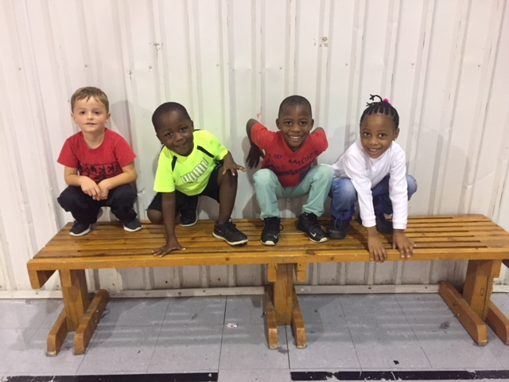

Warren County Community Early Childhood Council
The Foundry
Bowling Green, KY

Slide 9
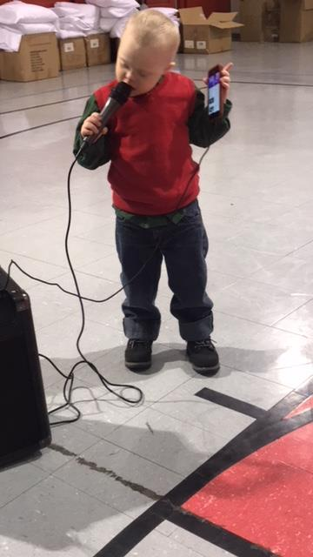

The Foundry is a Christian Community Center focused on providing the children of Bowling Green opportunities to succeed.
Collaborative Partners:
  Warren County Community Early Childhood Council
  Bowling Green Independent
  Warren County
  United Way
  US Bank
  Bowling Green Women’s Fund
  Harlem Children Zone

Slide 10

Kentucky Early Childhood Programs Make a Difference:
30,931 children receive child care assistance
2,101 centers participate in the All STARS program
49% of participating centers are rated as high quality (levels 3-5)
5,540 families received Health Access Nurturing Development Services (HANDS) home visits supported by $9 million in Tobacco funds
586 students are attending college with early childhood scholarships

Slide 11

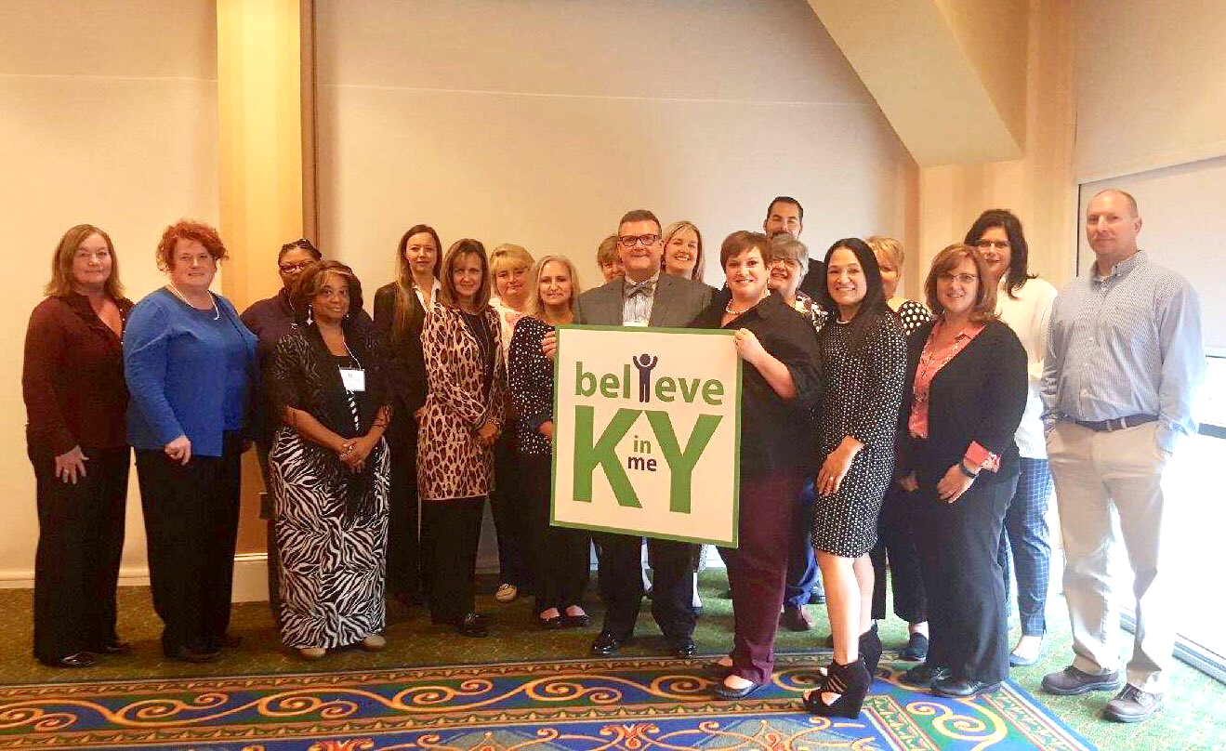

A Day of Action: November 16, 2018
9am-3pm
Who:
Governor and First Lady Bevin
The Kentucky Governor’s Office of Early Childhood
State Dignitaries
Early Childhood Programs
Lakeshore Learning
What:
A day to promote the importance of early literacy and to raise awareness around foster care/adoption in Kentucky.
The Governor, First Lady and State Dignitaries will take turns reading Kids of Kentucky, Who In Is Your Family? to early childhood programs visiting the Capitol.
Where:
Capitol Mezzanine
700 Capitol Ave
Frankfort, KY 40601
Use #BelieveinmeKY when posting your pictures on social media to show us your participation!

Slide 12


Kentucky All STARS
Validation and Sustainability Studies
Kentucky All STARS is Kentucky’s expanded five-star quality rating and improvement system serving all early care and education programs – including childcare centers, Head Start and public preschool – that receive public funding. The unified system is based on Kentucky’s Early Childhood Standards and research-based indicators of quality.
Compass Evaluation and Research

Slide 13
Validating the Model
Early childhood professionals, parents, and system stakeholders were invited to provide feedback
  Over 300 sites received on-site visits and observations
  Over 650 professionals across the state provided feedback
Examined:
  Face validity,
  Content validity, and
  Procedural validity
Also examined infrastructure supports and challenges
Kentucky All STARS
Validation and Sustainability Studies
Notes:
Face Validity:
General agreement that All STARS criteria reflect what is necessary to provide quality at sites.
Most of the existing standards received widespread support
Some populations may not yet be connecting concepts about quality with All STARS
In particular, there is a need for education and outreach among parents
Stakeholders agree on the importance of “every day quality.”
Implications for system guidance, professional learning supports and monitoring.
Content Validity:
All STARS standards were chosen through a careful process of review and pilot testing
General research and literature support for constructs
Emerging interests:
Quality for children with special or developmental needs
Quality for highly vulnerable children (and families)
Deeper dives into classroom interactions and socio-emotional supports
Every day quality in every age group
Procedural Validity:
Three operational models with different Rating, Monitoring, Staffing, TA/Coaching, PD, and Financing/Incentives
Advancement also reflects:
Desire to advance in rating,
Ability to implement structural and administrative improvements in quality,
Ability to recruit and retain qualified teaching staff, and
Costs of achieving or maintaining high quality.
Direct and indirect expenses related to quality are important for decisions to advance in rating
Time and access to professional supports also may be important
Observations (Environment Rating Scales) conducted at sites:
Confirm there is general advancement in quality from 1 to 5 stars
1- to 3-stars may have their quality underestimated
Results from the Family Provider Teacher Relationship Quality Scale:
Many sites score “average” as regards their supports and practices for family engagement
May have some room for development in the area of “Attitudes”
Openness and commitment to engagement between teachers and parents

Slide 14
Model Fidelity and Best Practices
Professional supports are critical infrastructure
  Technical assistance, coaching, or training
    Many professionals cited the importance of “Knowing who to contact for help, coaching, or technical assistance”
    Professionals also interested in:
      Ongoing discussions and trading ideas in Professional Learning Communities (PLCs) or Communities of Practice,
      Observing others in high quality sites or classrooms (having things modeled for me),
      On site coaching with external consultants/coaches, and
      Offsite professional development trainings or classes.
  Incentives and financial supports
    Scholarships
    Monetary and non-monetary supports for quality
Kentucky All STARS
Validation and Sustainability Studies

Slide 15
Sustaining Quality
Cost is a barrier to achieving and sustaining quality
2017 Cost of Quality study found that reimbursement rates were significantly lower than the actual cost of care for the Kentucky Preschool Program and Child Care Assistance Programs.
Top cost factors that impact quality:
  Costs of paying teachers and staff more, and
  Costs of finding and retaining high qualified teachers or staff
Critical system elements for sustaining quality include:
  Teacher scholarships,
  Teacher compensation to sustain a highly qualified workforce,
  Professional development that is ongoing and intensive,
  Subsidy reimbursement rates that reflect the full cost of care, and
  Specialized supports and services for children with high needs.
Kentucky All STARS
Validation and Sustainability Studies

Slide 16
Local Collaboration and Supports
Community Early Childhood Councils (CECC) and School Readiness Summits provide key supports for local communities
  Further collaborations with the school system and foster school readiness,
  Further outreach and education with families,
  Utilize and disseminate data, and
  Identify and meet emerging needs.
Blended pre-kindergarten models allow leveraging of resources and sharing expertise
  There are operational challenges
    Need ways to support high performing blended models.
Kentucky All STARS
Validation and Sustainability Studies

Slide 17
Supporting the Most Vulnerable
Who are the most vulnerable?
  Families with mental health or substance abuse issues
  Children who have had traumatic experiences in their home or community
  Children involved with child welfare or foster care
  Homeless children and families
  Children with special needs
Kentucky All STARS
Validation and Sustainability Studies
Notes:
Many professionals reported working with a highly vulnerable population
More than half of respondents reported no formal training or professional development on ACES
Most common techniques for working with vulnerable children and families were referrals to outside resources
Do more to support or emphasize classroom-based strategies

Slide 18
Department for Community Based Services
Division of Child Care

Slide 19
Child Care Program Tobacco Settlement Fund Expenditures SFY17/18
 | SFY 2018 | % of Fund | SFY 2017 | % of Fund
Budget Allotment | $ 8,718,144.42 |  | $ 8,536,555.58
SFKN Quality Recognition (Subsidy Enrollment) | $ 1,038,841.00 | 11.92% | $ 1,563,618.00 | 18.32%
SFKN Achievement Award (Initial Award) | $ 182,704.00 | 2.10% | $ 388,021.00 | 4.55%
SFKN Stars Program (Annual Award) | $ 428,169.91 | 4.91% | $ 451,524.41 | 5.29%
KY All Stars Initial Award | $ 196,894.00 | 2.26% | $ -
KY All Stars Annual Award | $ 131,534.00 | 1.51% | $ -
KY All Stars Quality Award (Subsidy Enrollment) | $ 476,866.00 | 5.47% | $ -
Training Credentials (Non-College Scholarships) | $ 1,382,671.62 | 15.86% | $ 595,477.04 | 6.98%
CCDF Daycare Training (Quality Rating Staff) | $ 780,086.89 | 8.95% | $ 265,278.34 | 3.11%
Subsidy Benefits | $ 4,100,377.00 | 47.03% | $ 5,272,636.79 | 61.77%

Slide 20
Impact of All STARS Incentives on
CCAP Reimbursement Rates
A Type I Licensed Facility in Hopkins County providing full day care for 6 infants and toddlers and 12 preschool children plus half day care for 6 school-age children:
*Rates calculated using state maximum reimbursement rates and 20 attendance days per child per month. All STARS monetary incentive rates includes Subsidy Enrollment Award and Annual Quality Award.
Current CCAP Reimbursement | CCAP + All STARS Level 3 | CCAP + All STARS Level 4 | CCAP + All STARS Level 5
$8,160 | $8,799 | $9,114 | $9,454

Slide 21
Department for Public Health
Early Childhood Program Highlights:
HANDS & ECMH

Slide 22
Early Childhood Mental Health (ECMH)
(Amount of Tobacco Funding: $1,000,000 per year)
Purpose: to build capacity to meet the mental health needs of young children and their families by partnering with the Departments for Public Health and Behavioral Health, Developmental and Intellectual Disabilities.
Structure: funds support Early Childhood Mental Health Specialists in the regional Comprehensive Community Mental Health Centers (14 total)
ECMH services include working with community child-serving agencies to:
  Consult on social-emotional issues
  Train on social-emotional issues
  Evaluate/assess children ages birth through 5
  Provide therapeutic services to children ages birth through 5 and their families

Slide 23
ECMH Accomplishments
Served 4,756 children and families in FY18
Provided 2,838 consultations to child-serving agencies
Provided training to over 1,000 early care and education staff in Head Start, childcare, and state-funded preschool
Increased capacity to implement services based on evidence-based practices/programs such as:
  Parent-Child Interaction Therapy
  Moving beyond Depression
  Nurturing Parent
  Trauma-focused Cognitive Behavioral Therapy
  Child-Parent Psychotherapy

Slide 24


Slide 25
Health Access Nurturing Development Services (HANDS)
In FY 18, 5504 families served through support of Tobacco Funds
Voluntary weekly home visiting program administered by local health departments
Designed to:
  Assist overburdened parents/caregivers during the prenatal period until the child’s third birthday
  Improve health outcomes for both mother and child
  Improve social outcomes for child and family

Slide 26
Goals
Healthy pregnancies and births
Optimal child growth and development
Children live in healthy and safe homes
Family self-sufficiency
Increase ECMH and HANDS skills and gain more knowledge of early childhood professionals
Invest in capacity putting KY in the position to address current issues without delay

Slide 27

Connect the Dots training and visuals were created by Department for Community Based Services (DCBS), Division of Child Care (DCC) in collaboration with Early Childhood Comprehensive Systems Grant and the Early Childhood Mental Health Program (ECMH), August 2016
Notes:
About Connect the Dots:
A joint collaboration between multiple early education and mental health professionals as well as families across Kentucky. The collaboration was built to address a common need: The need for a concise yet high impact skills-based training for providers and parents teaching the basics of social and emotional best practices.
ECHM Specialists deeply involved in development and delivery of the training.

Slide 28

What is Connect the Dots?
Connect the Dots (CTD) summarizes social and emotional best practices into
4 easy-to-remember steps.
It provides a common language and a common approach to addressing challenging behaviors in a way that builds strong social and emotional skills in children ages 2-5 years.
11

Slide 29
Trainings
Staff worked closely with the KY Strengthening Families Training Workgroup, Early Childhood Mental Health, Child Care Health Consultation, HANDS Home Visiting Program, First Steps Part C program and others to develop this training program and supporting materials.
195
500+
Total trainings
Trainers
People trained
in ECE
People not in the childcare training system (*estimated)
3,477
3,300
12
Notes:
From fall of 2016 to present
Also continuing to develop new modules—intended audiences include children with autism spectrum disorders,, children in grief, children reuniting with parents (after rehab, incarceration, etc), children with Down Syndrome

Slide 30

A Small Group Experience with Wrap-Around Services for
Mothers and Babies in Recovery.
In partnership with the Floyd County Health Department
13
Notes:
The first HEART pilot is through the Floyd County Health Department. The Big Sandy Region has the highest rate of NAS births at a rate of 70/1000- births
We are fully staffed, trained and actively recruiting mothers now. Our goal is to have a full group of 10 mothers and babies by the end of October

Slide 31
Key Points
Who we serve:
  Pregnant and parenting women with Opioid Use Disorder (OUD) and babies with Neonatal Abstinence Syndrome (NAS)
What we do:
  Support group experience
  Building protective factors to buffer stress and Adverse Childhood Experiences (ACEs)
  Parent-driven and strength-based program
  Resources for physical and mental healing
  Education and skill building for nurturing parenting
  Supports for success in long-term recovery

Slide 32
HEART Staff
Regional Project Coordinator
Substance User Disorder-Peer Support Specialist/ “Peer Recovery Coach”
Early Childhood Mental Health Specialist
Parent Education Leaders (HANDS)
Child Care Staff
Floyd County Wrap-Around-Services
Substance Abuse Clinician (as needed)
State Technical Assistance
15

Slide 33

Kentucky Governor’s Office of Early Childhood
125 Holmes Street
Frankfort, KY 40601
502-782-0200 https://kidsnow.ky.gov
Linda Hampton
Executive Director, Kentucky Governor’s Office of Early Childhood
Linda.Hampton@ky.gov
Melissa Banks
Assistant Director Child Care, CHFS DCBS DCC
Melissa.Banks@ky.gov
Paula Goff
CHFS PH
Paula.Goff@ky.gov

