Slide 1
Tobacco Settlement Oversight
Paulette Akers, Director
Kentucky Division of Conservation
December 2018

Slide 2
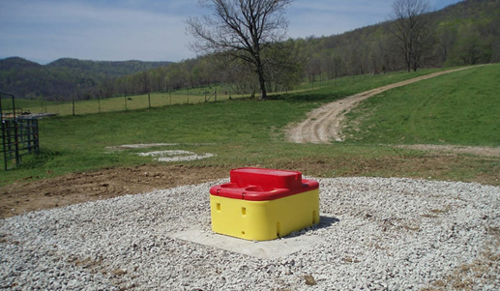
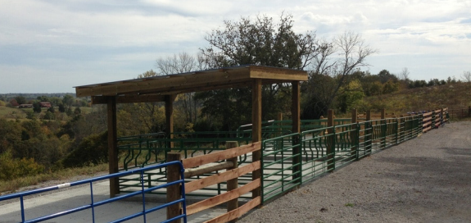
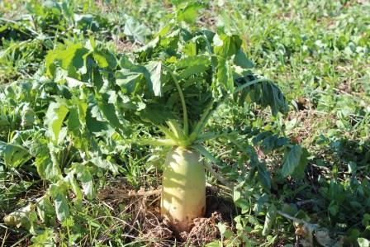
State Cost Share Summary
Originally established in 1994 and funded from General Funds and pesticide Product Registration Fees
Starting in 2000, the program was funded through Tobacco Master Settlement Agreement Funds
Provides financial assistance to farmers at a 75% reimbursement rate for those implementing best management practices on their farms with the assistance of local conservation districts
Notes:
First few slides are going to be based on a summary of all the years and then we will get into this year specifically

Slide 4
Notes:
More than $155 million dollars have been approved for use by Kentucky farmers in the past 24 years. It is larger than the total appropriations over that time because it is hard to give out money.

Slide 5
Why is it hard to give out money?
FY14 cost share data
28% canceled
14% overestimated
$6,057,137 approved and only $3,522,336 paid out
FY15 cost share data
16 % canceled
11% overestimated
$4,885,627 approved and only $3,526,410 paid out

Slide 6
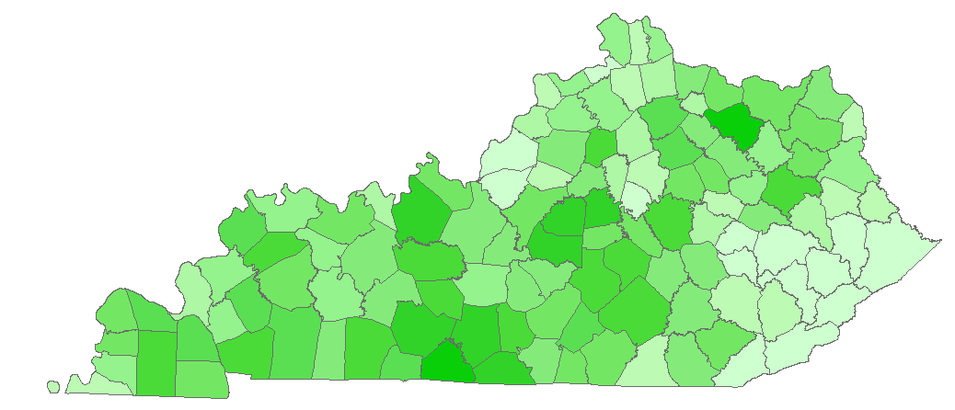
24-year Total Applications Approved

Slide 7
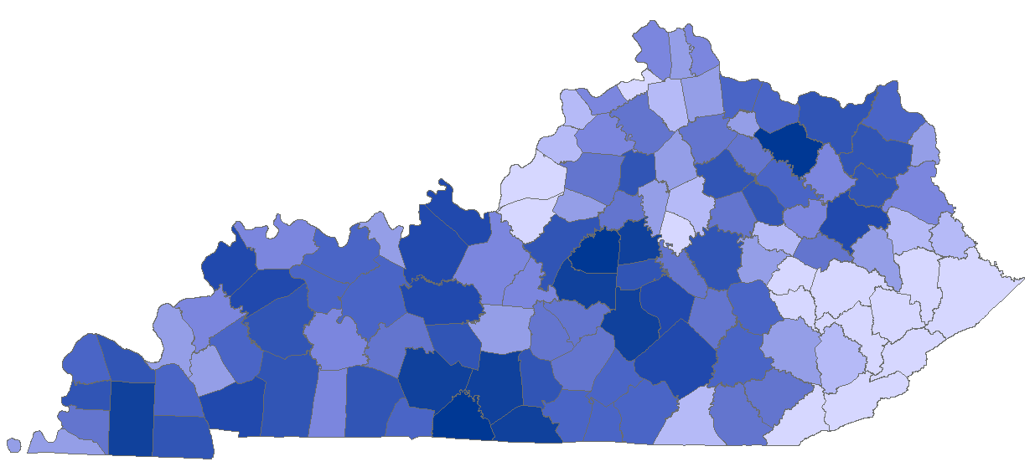
24-year Total Dollars Approved
Notes:
Slightly different since animal waste structures are funded at a higher rate than other practices, so areas of animal ag may receive more money with an equal number of projects.

Slide 8
National Agriculture Statistics Survey 2012
Notes:
77,064 farms and 13,049,347 acres. Median farm size is 75

Slide 9
FY 17 Approved in September 2018
Requests 1242 individuals and $8,961,250.78
Approved 942 individuals and $6,011,372.44
Delay in approval because of web tool
Notes:
Web tool provides greater transparency and less clerical error

Slide 10
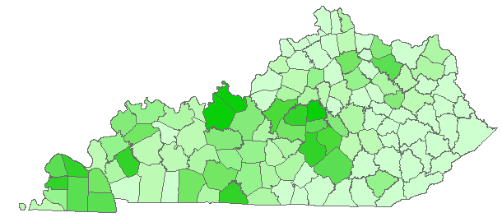
State Cost Share Approved Projects FY 17 Funds

Slide 11
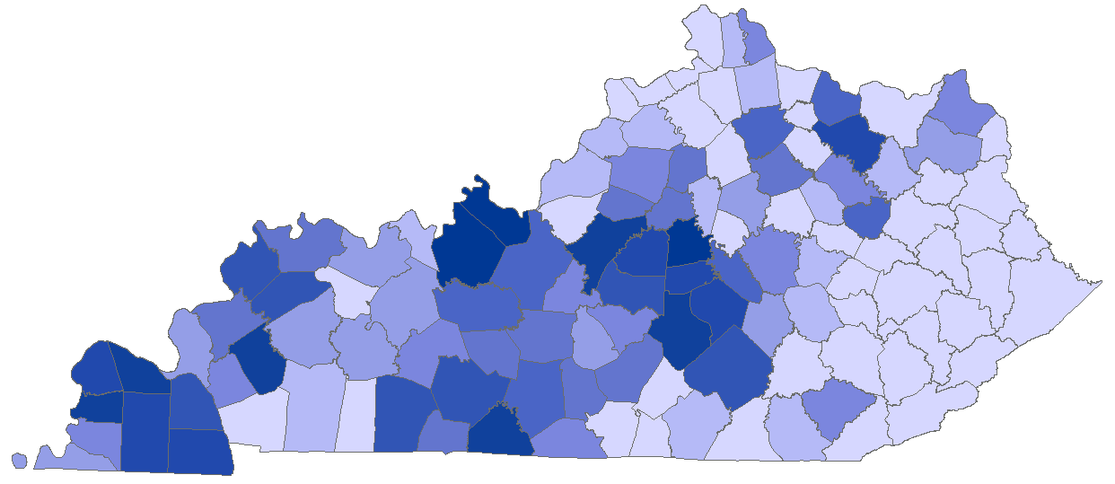
State Cost Share Projects Money FY 17 Funds

Slide 12
Future
Addressing backlog of funds with a goal of having all backlog distributed in this 2 year budget cycle
December 31st cutoff for another round of funding
Evaluate funding cap of $7500 ($20,000 for animal waste storage)
Partnerships
Division of Water to determine priority areas
Regional Conservation Planning Project Managing Poo – Kentucky Beef Network and Kentucky Dairy Development Council
Natural Resources Conservation Service – technical assistance

Slide 13
Contact Information
Paulette.Akers@ky.gov
502-782-6300
Kentucky Division of Conservation
300 Sower Blvd, 2nd floor

Slide 14
Does Cost Share Improve Water Quality?
Implemented practices make a difference on the scale of that farm
Only 1-2% of farmers receive state cost share in a year
Legacy sediments in the stream channel
Notes:
Small amount of money over a large area where there have been decades of land use.

Slide 15
Success Story
Fleming Creek
$1,408,288 in state cost share funds between 1991 and 2007

Slide 16
Notes:
Townsend Creek had conservation district staff providing assistance

