Slide 1
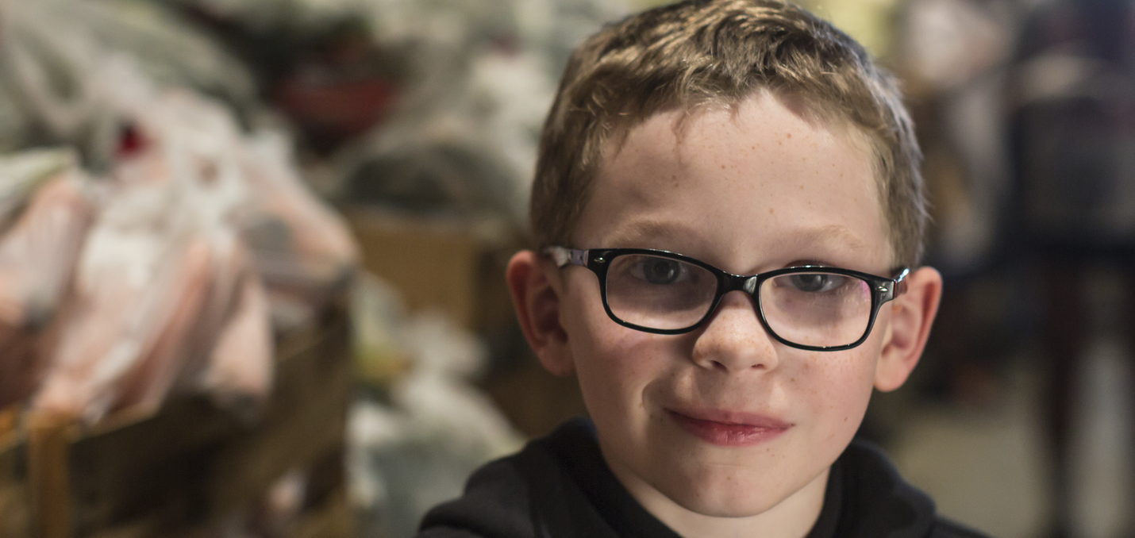


Partnering in the Fight Against Hunger
Report to the Tobacco Settlement Oversight Committee
June 12th, 2019

Slide 2
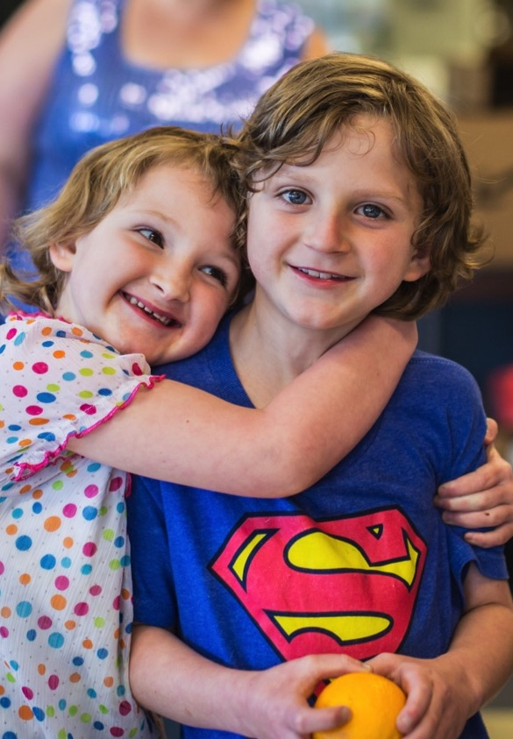
Contents
Hunger in Kentucky
Our response
Farms to Food Banks
Kentucky Kids Eat

Slide 3
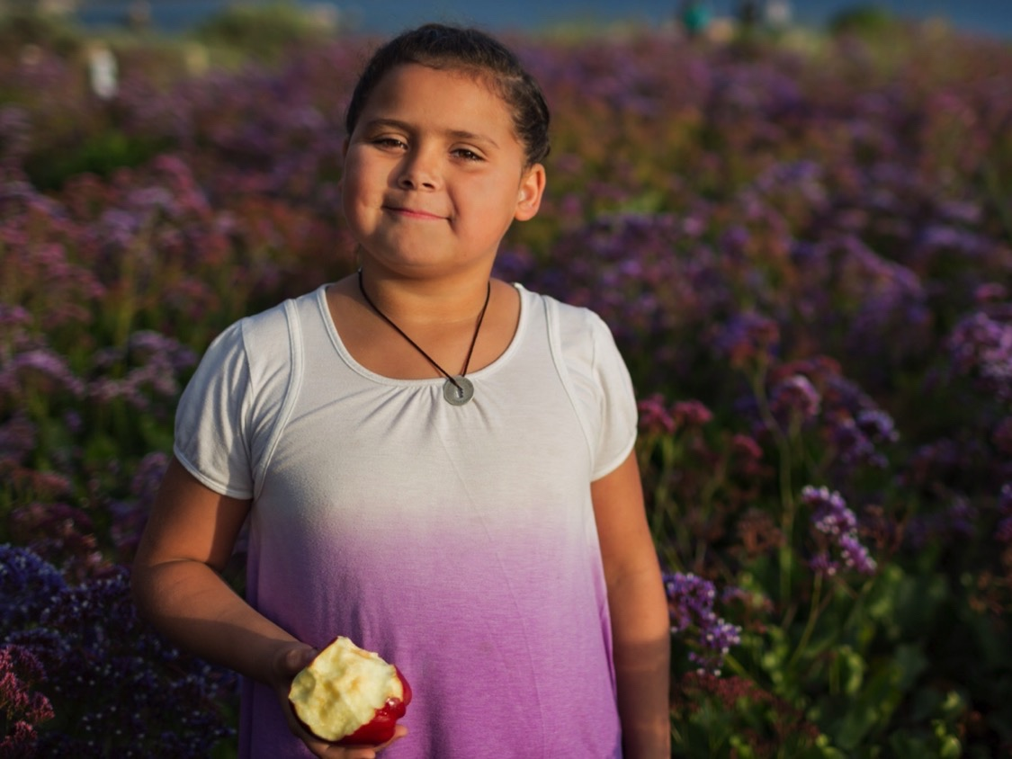
1
Hunger in Kentucky

Slide 4
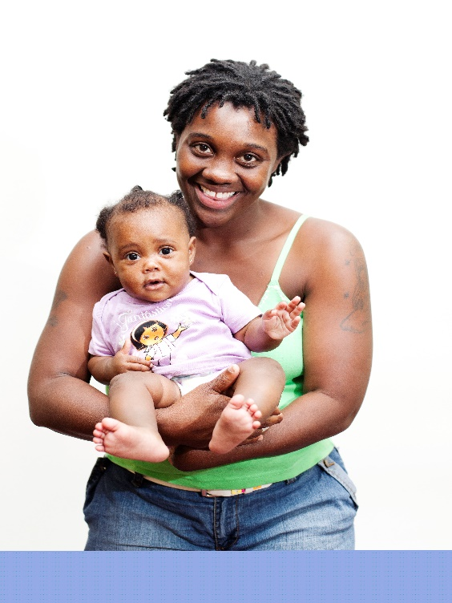
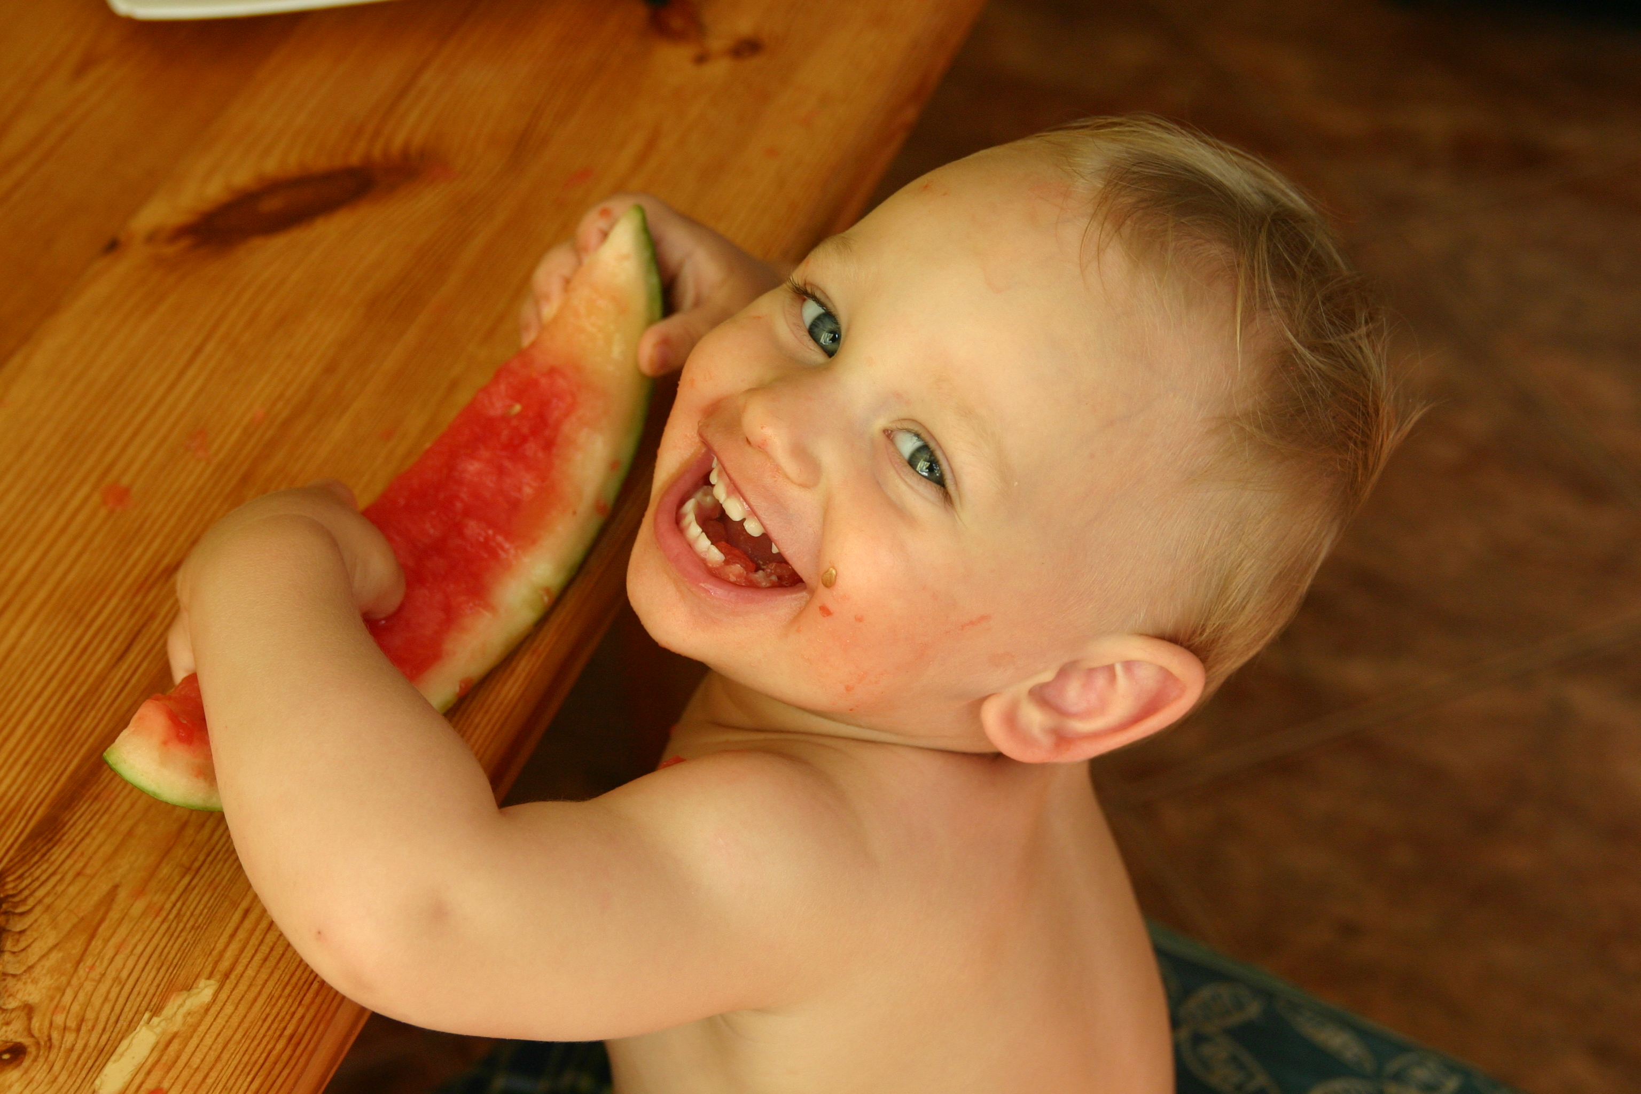
Who is struggling with hunger in Kentucky?
The face of hunger may surprise you.

Slide 5

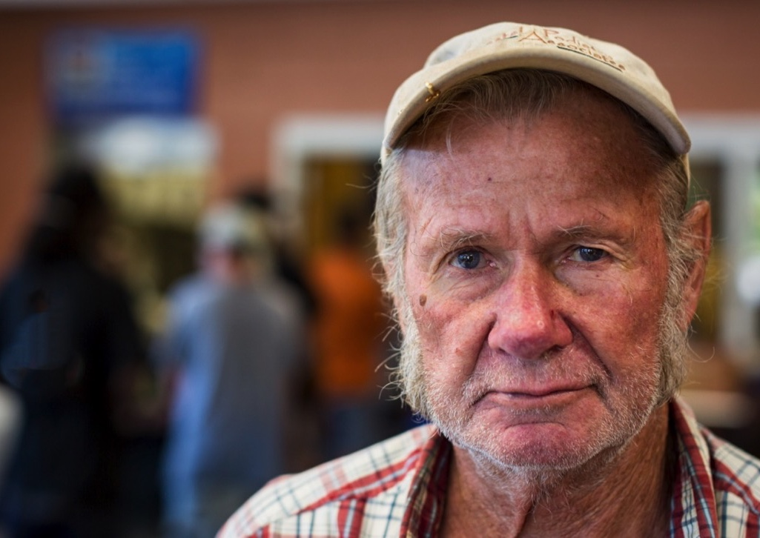

186,660
KY CHILDREN ARE
FOOD INSECURE

Slide 6
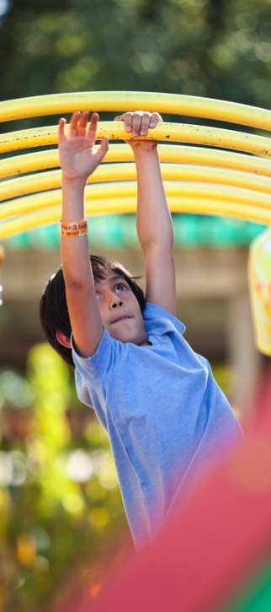
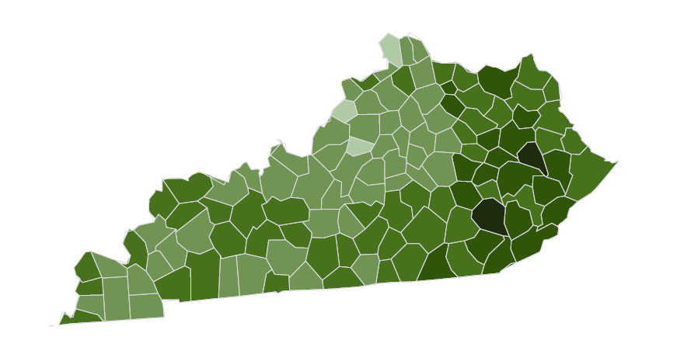
Counties with the highest child food insecurity rates:
Magoffin
Clay
Elliot
Robertson
Breathitt

Slide 7

1 in 5
KY OLDER ADULTS
FOOD INSECURE
*Highest in the nation

Slide 8
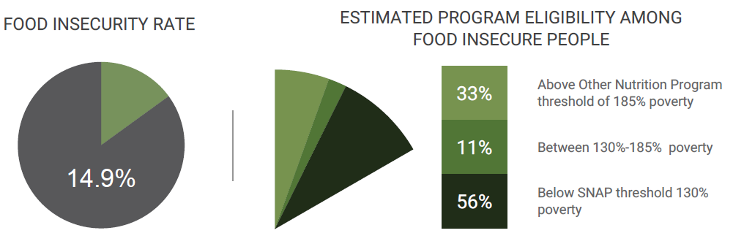
Meal Gap
Source: Map the Meal Gap 2019

Slide 9
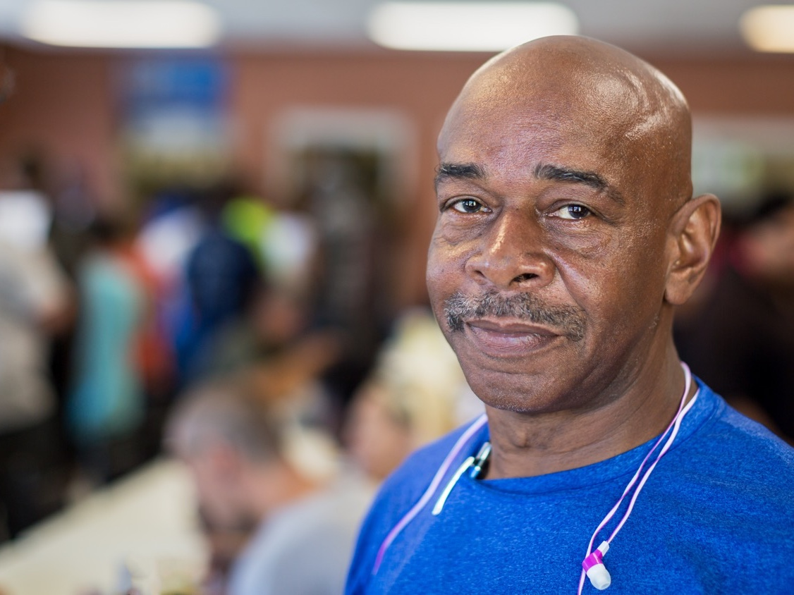
2
Our Response

Slide 11
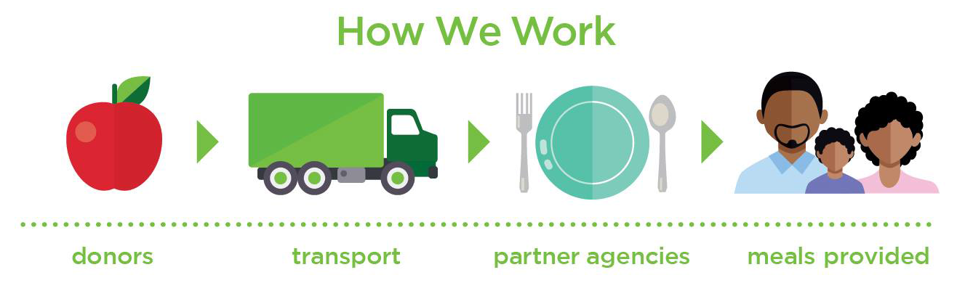
How we work

Slide 12
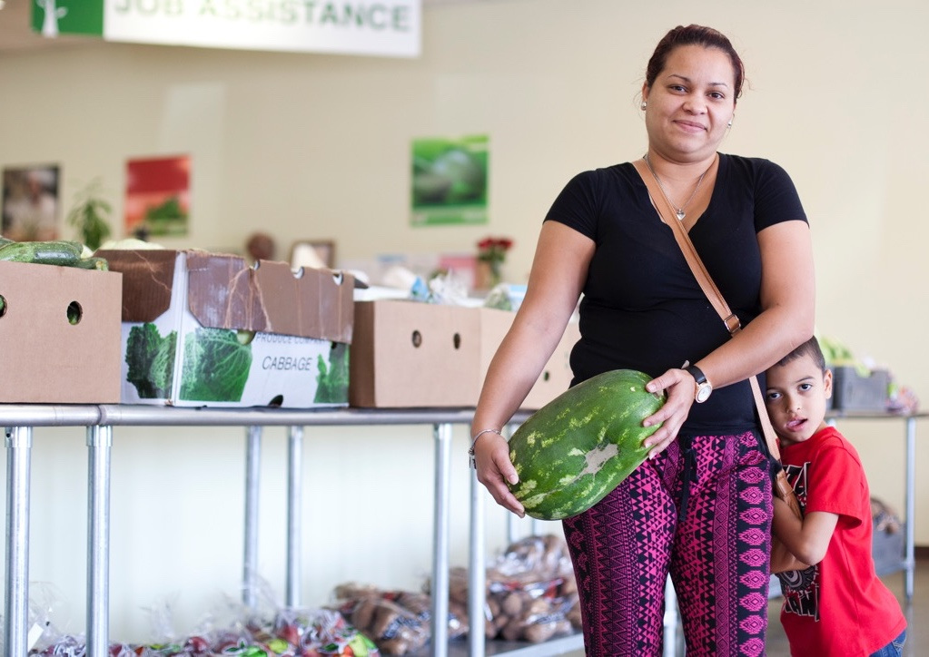

50,000
KENTUCKIANS
SERVED EACH WEEK

Slide 13
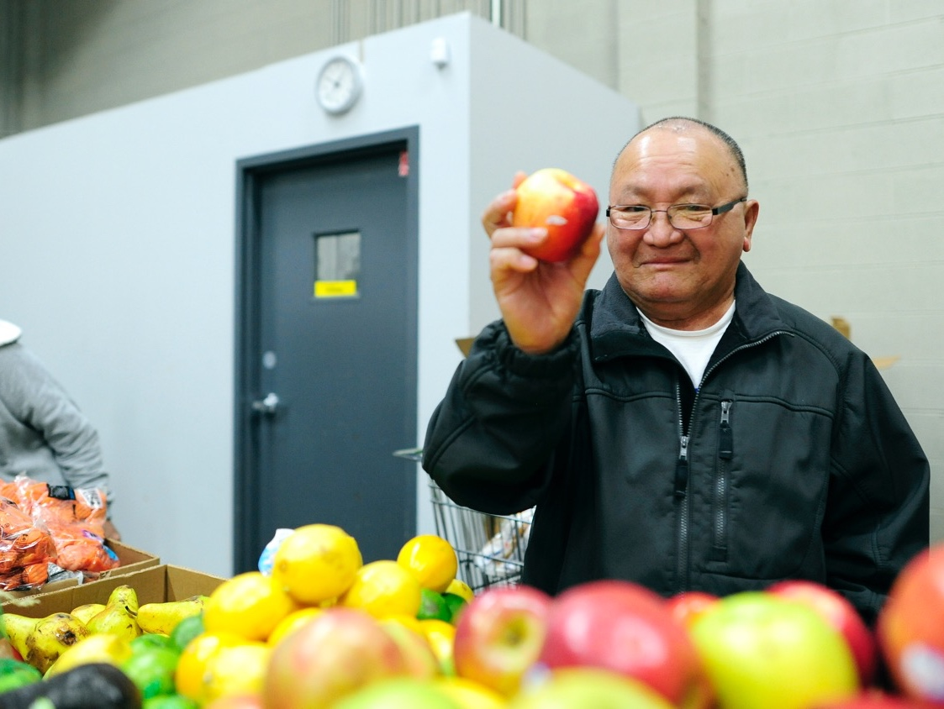
3
Farms to Food Banks

Slide 14
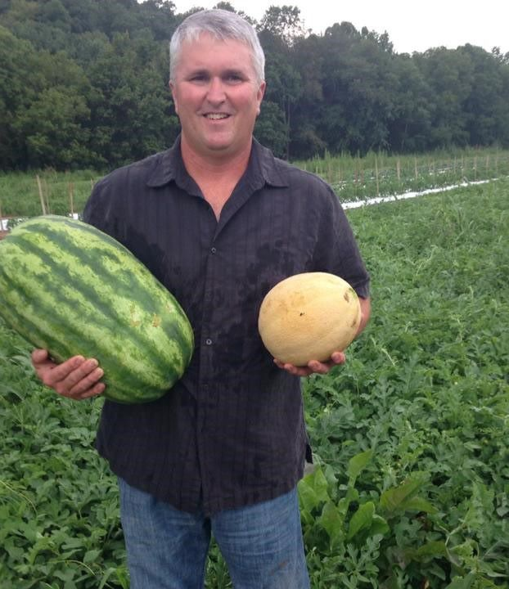
Farms to Food Banks
Fresh produce from farmers needing a market

Slide 15
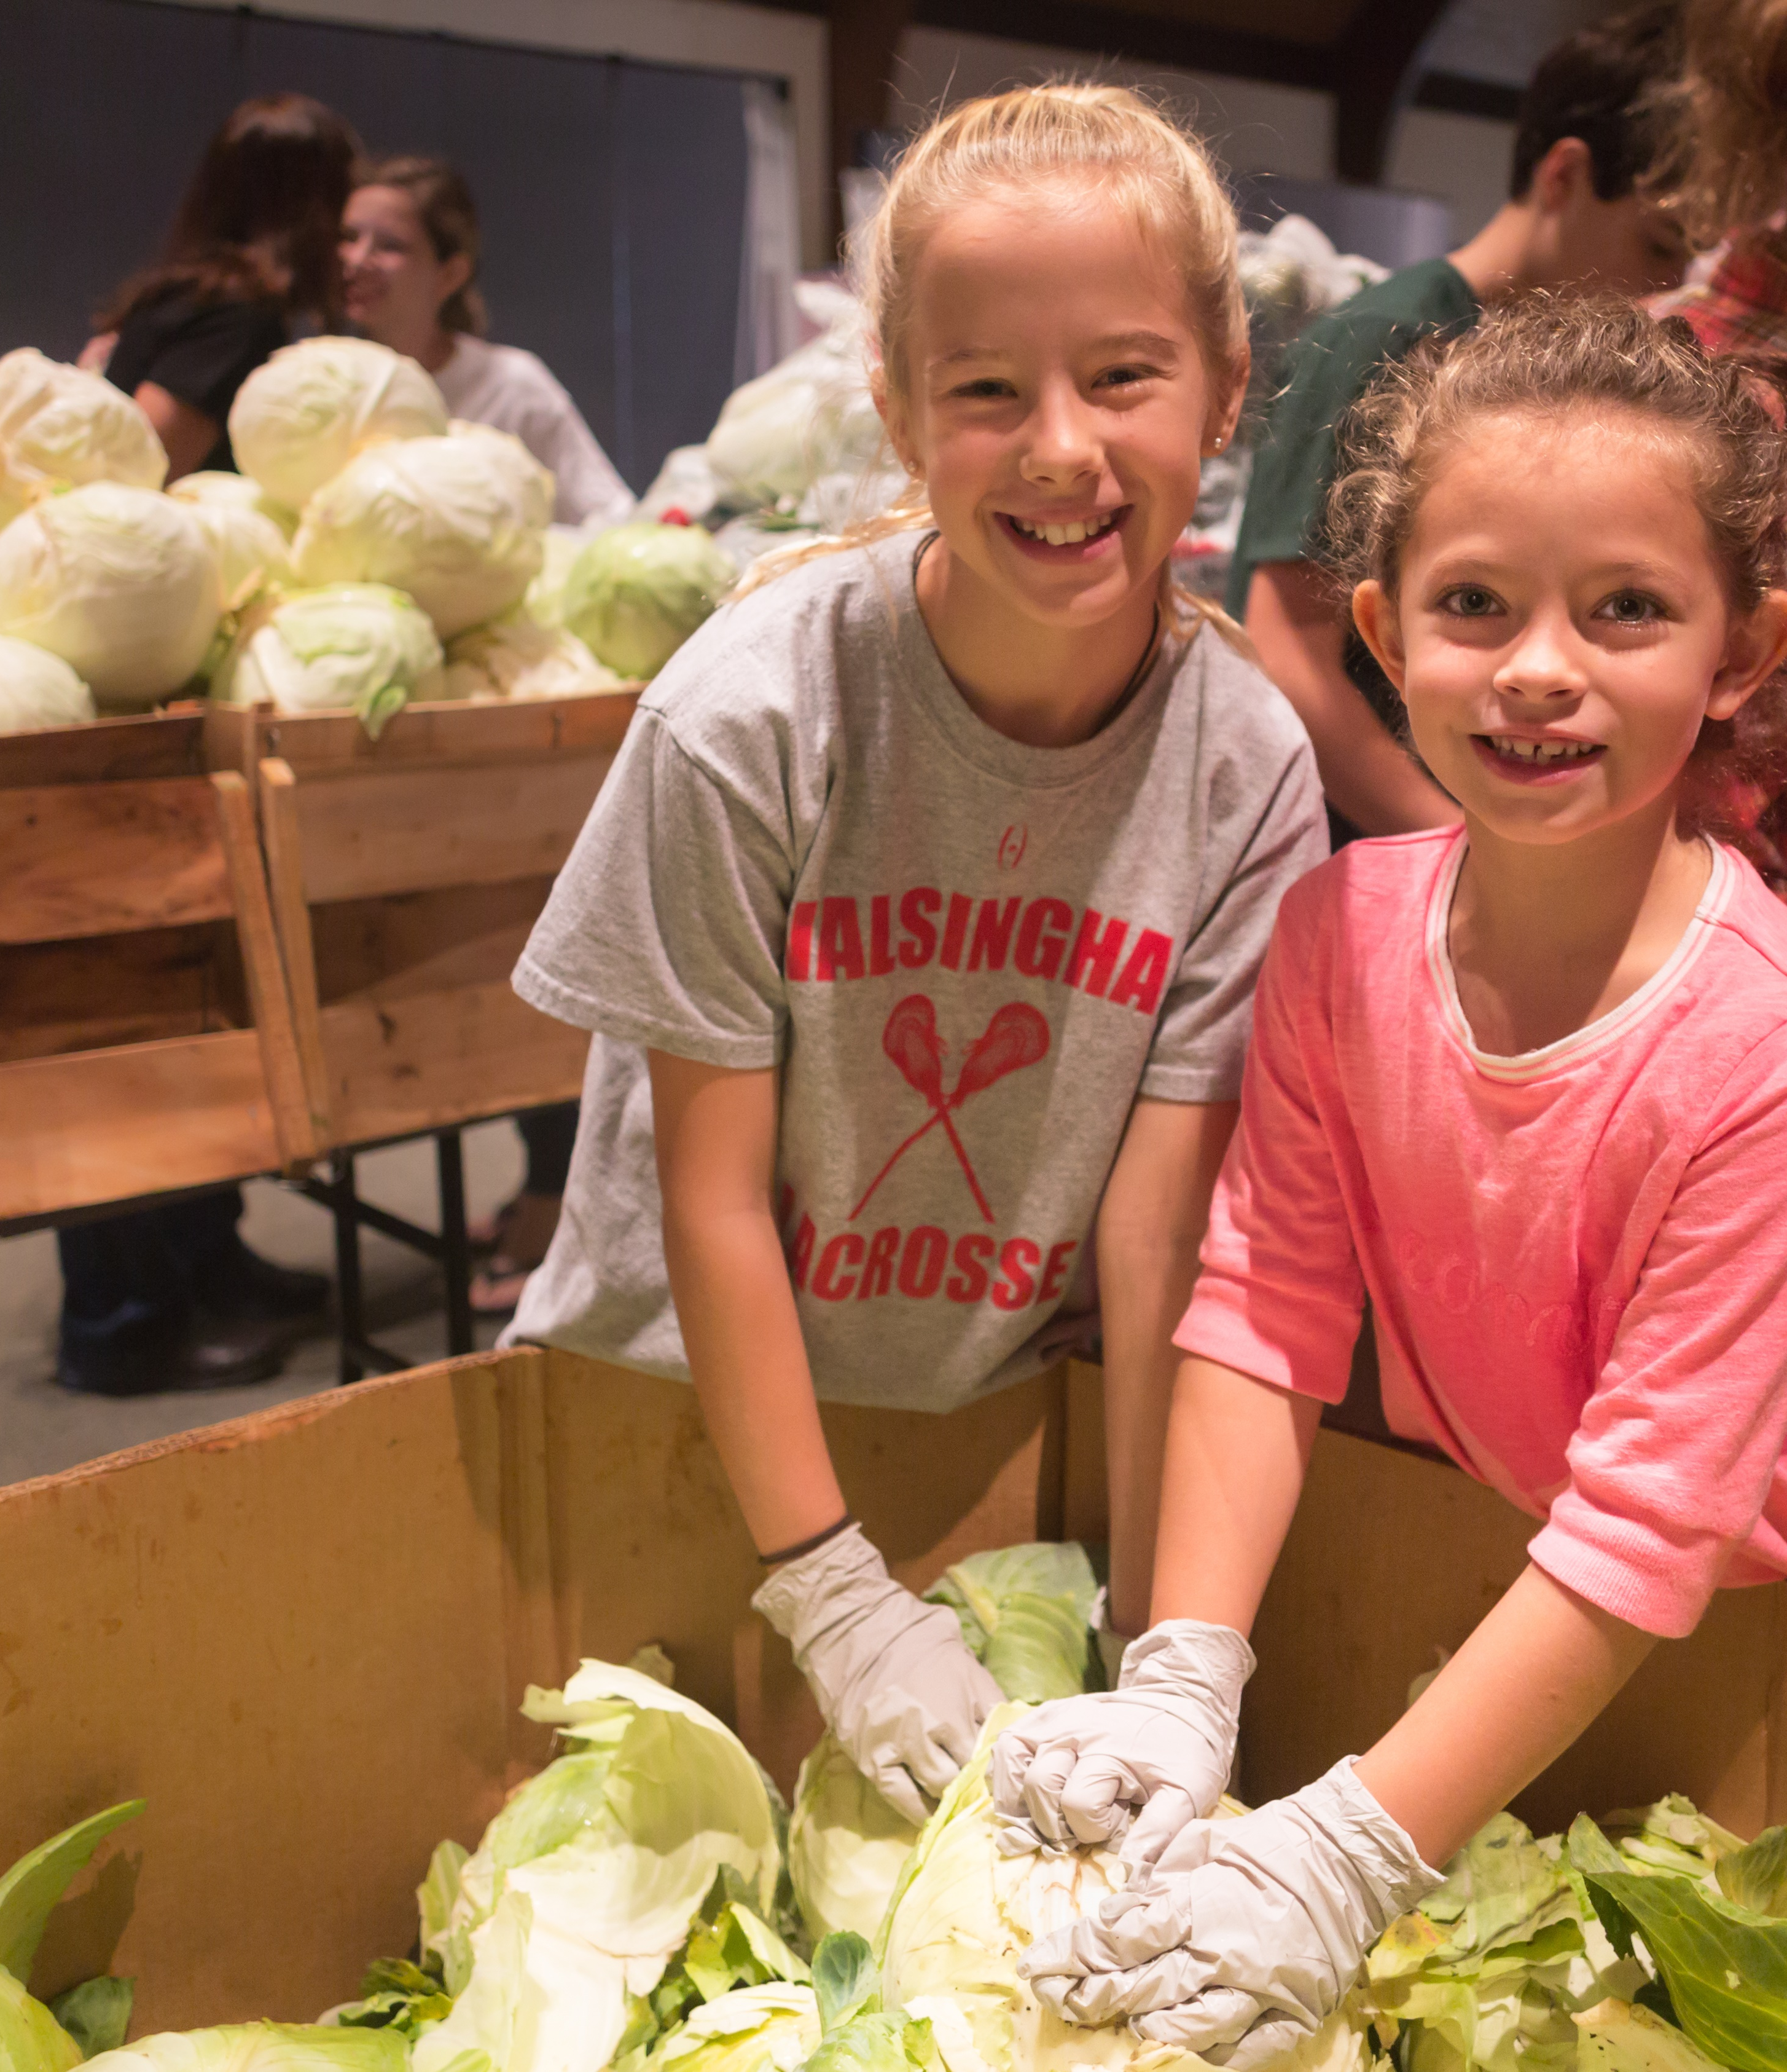
Farms to Food Banks
…to Kentuckians in need.

Slide 16
Goals
Increase Access
Support Farmers
Reduce Waste

Slide 17
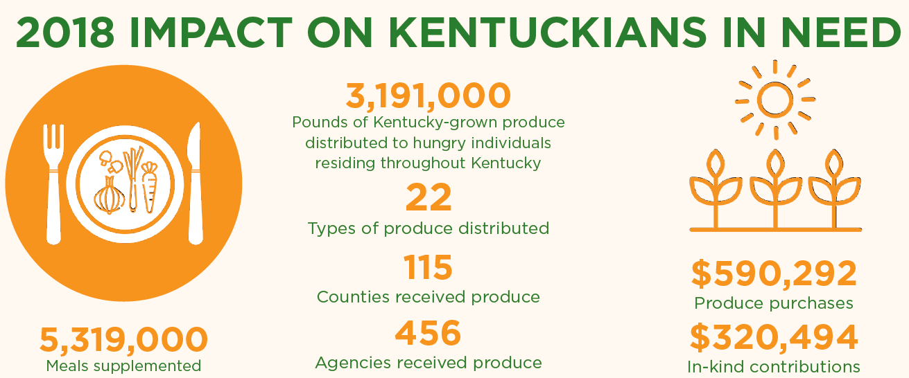

Slide 18
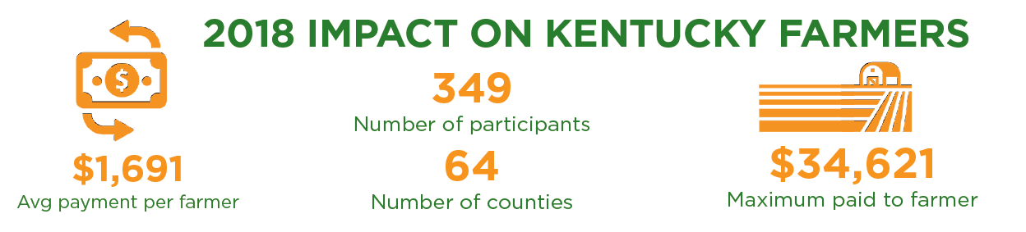

Slide 19
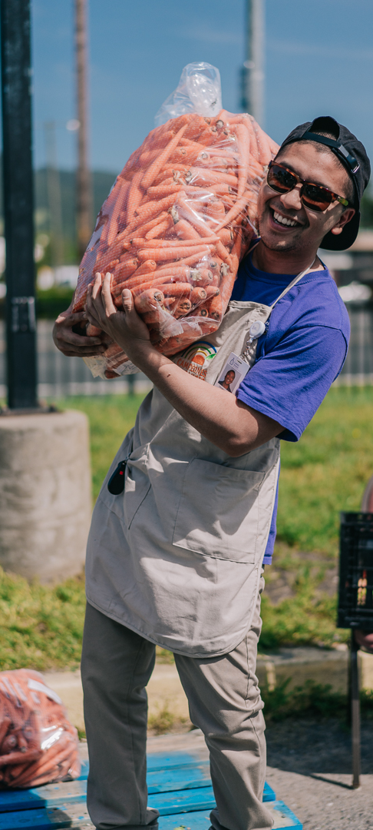
Impact since 2011
18.5M pounds rescued
30.9 million meals
1,000 KY farmers
$3.6M paid to farmers

Slide 20
Good for the Economy
$3,950,000 total additional annual economic benefit for the Commonwealth.
$7,540,000 return on investment.

Slide 21




Supporters

Slide 22
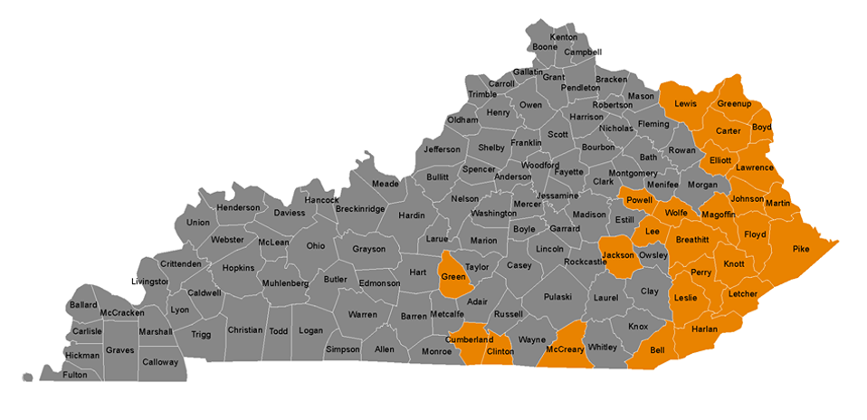
Appalachian Expansion Project
Target Counties:
Bell, Boyd, Breathitt, Carter, Clinton, Cumberland, Elliot, Floyd, Green, Greenup, Harlan, Jackson, Johnson, Knott, Lawrence, Lee, Leslie, Letcher, Lewis, McCreary, Magoffin, Martin, Metcalfe, Perry, Pike, Powell, and Wolfe.

Slide 23
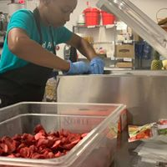

Processing Pilot

Slide 24
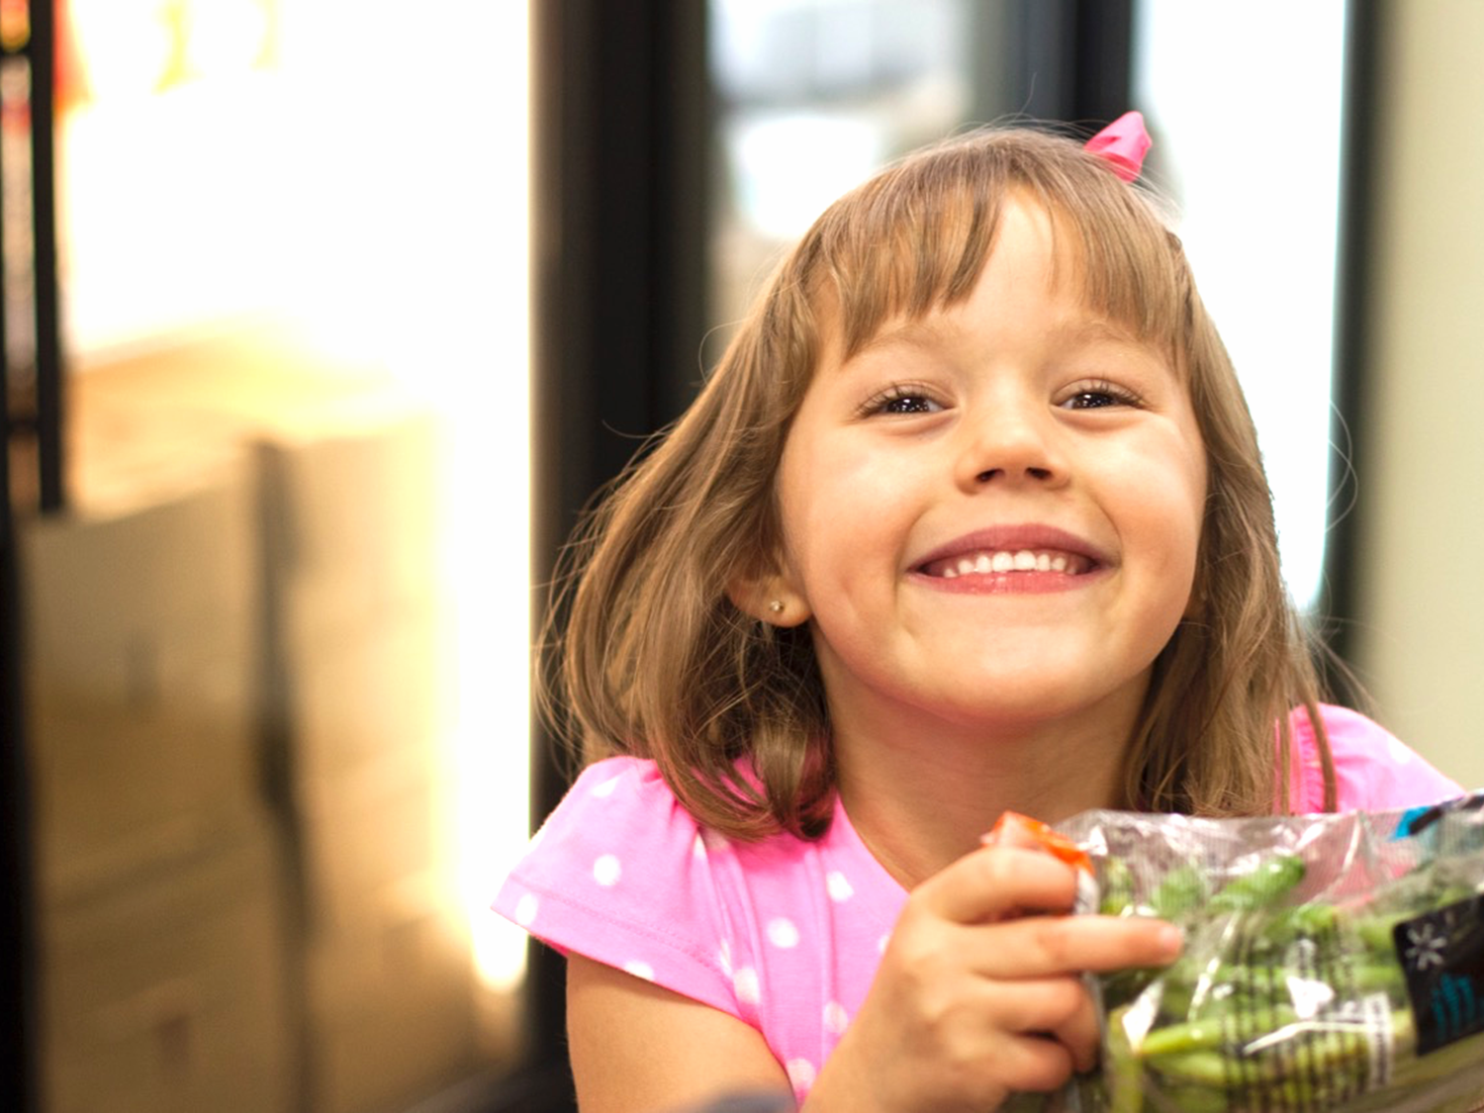
4
Kentucky Kids Eat

Slide 25

Kentucky Kids Eat
End childhood hunger in Kentucky by connecting kids to healthy food 365 days a year.
Summertime need: Kentucky ranks 46th for summer food service program participation.
Support programs that work– school breakfast, afterschool meals, and summer meals.
Provides funding, training, and support for schools and nonprofits.
Awarded 102 schools and nonprofits with 55 grants in summer 2019.

Slide 26



K-VIP
Kentucky-grown Fruit and Vegetable Incentive Program.
Creates a financial incentive for sponsors to include Kentucky-grown fruits and vegetables in the summer meals they serve.
Boosts program capacity for school and nonprofits that feed hungry kids.
Increases access to healthy, fresh foods.

Slide 27
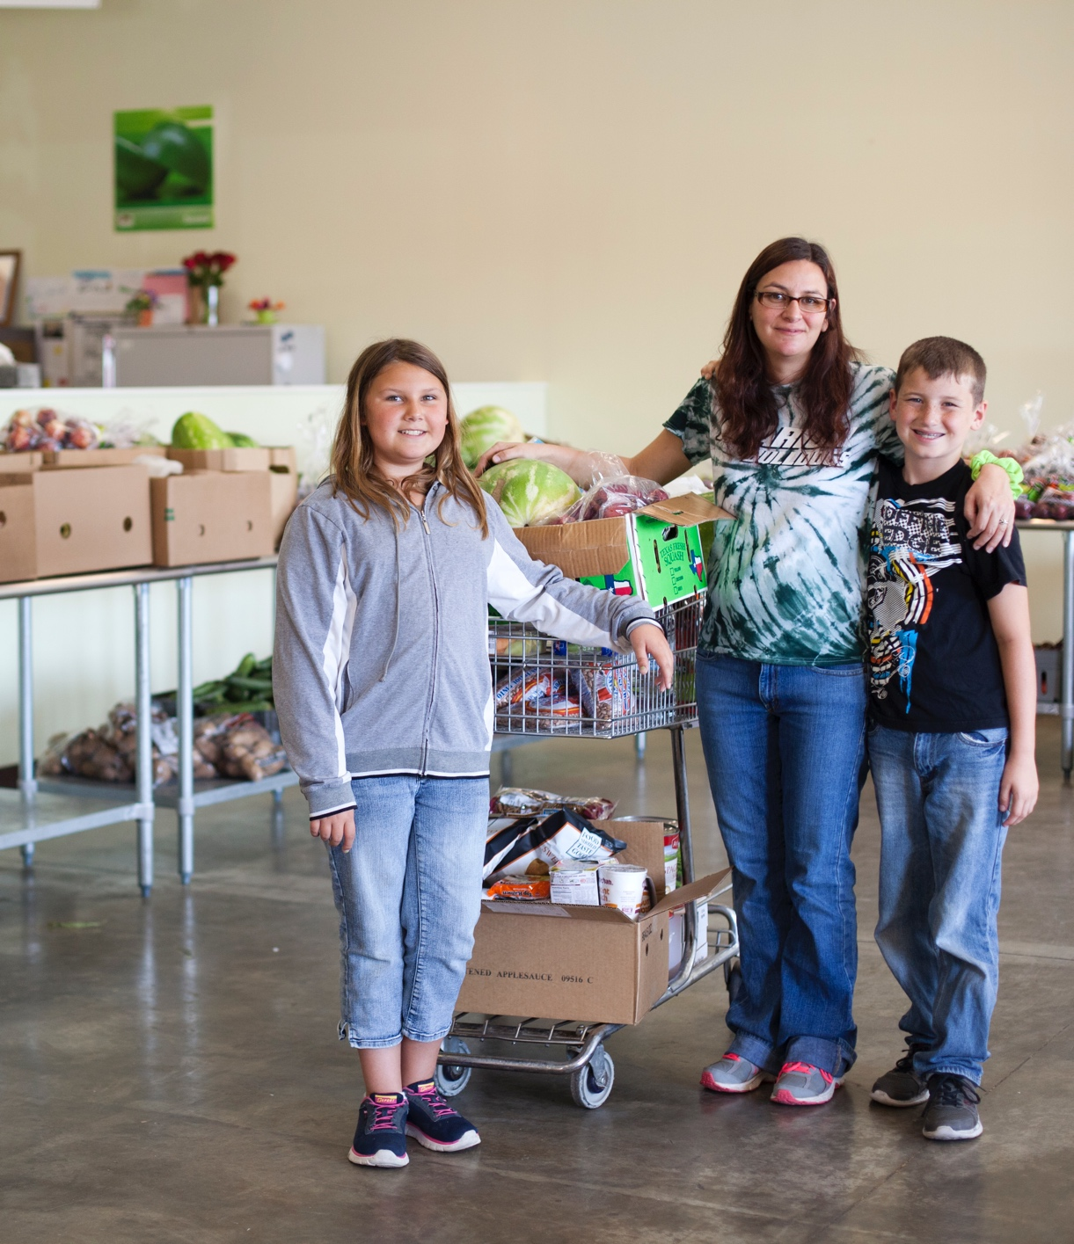
K-VIP
For every $2 a participating sponsor spends at a Kentucky farm, K-VIP will reimburse them for $1.
$185,000 awarded 2017.
$73,169.16 spent on Kentucky-grown produce in summer 2018.
2019 Economic Impact: $321,220 directly to Kentucky farmers.

Slide 28
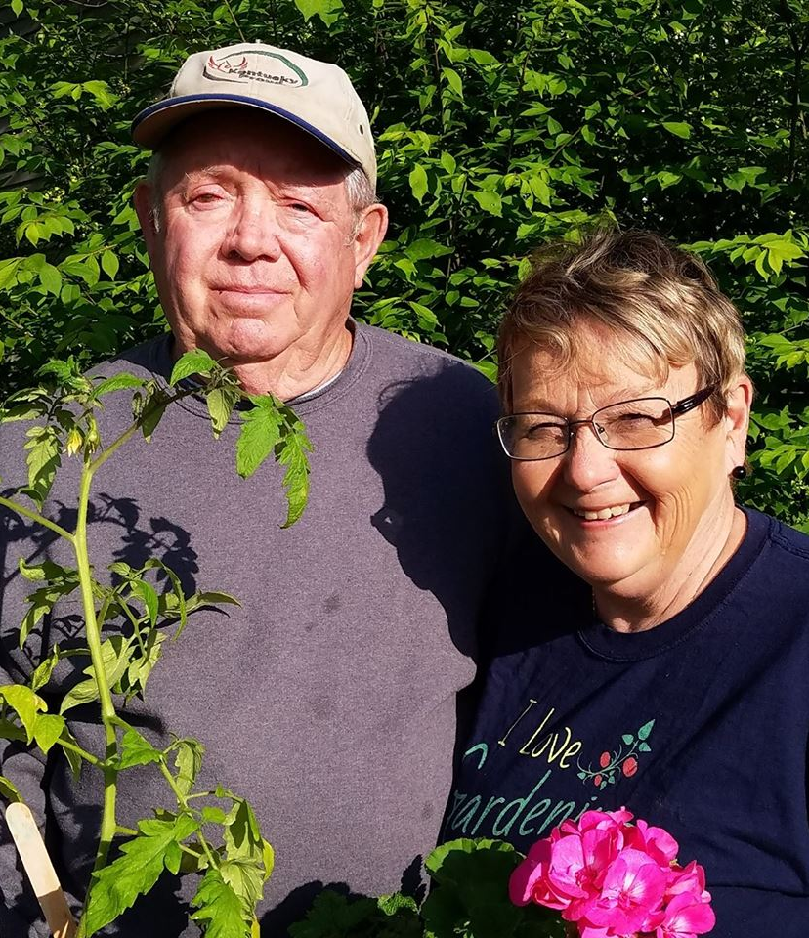
Overman’s Bluegrass Fruits and Vegetables
Lancaster, KY
Kirby Overman
Babette Overman

Slide 29
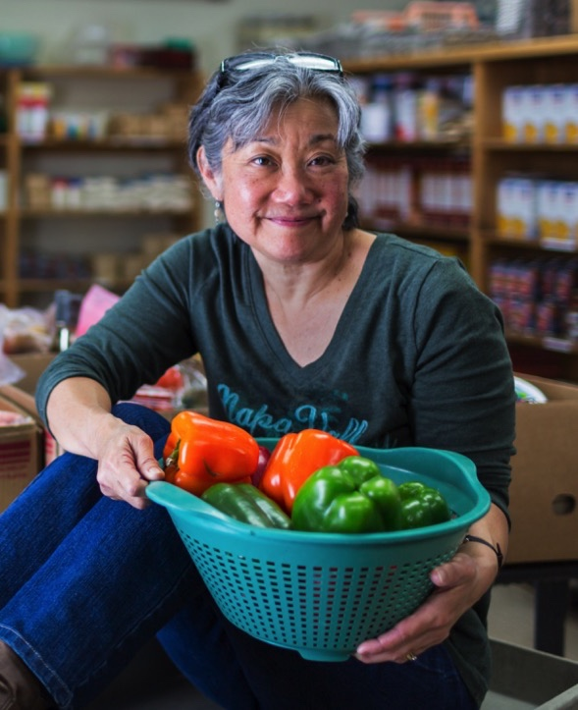
CONTACT
Tamara Sandberg
Executive Director
tamara@feedingky.org
Sarah Vaughn
Programs Coordinator
sarah@feedingky.org
Kate McDonald
KY Kids Eat Coordinator
kate@feedingky.org

Slide 30
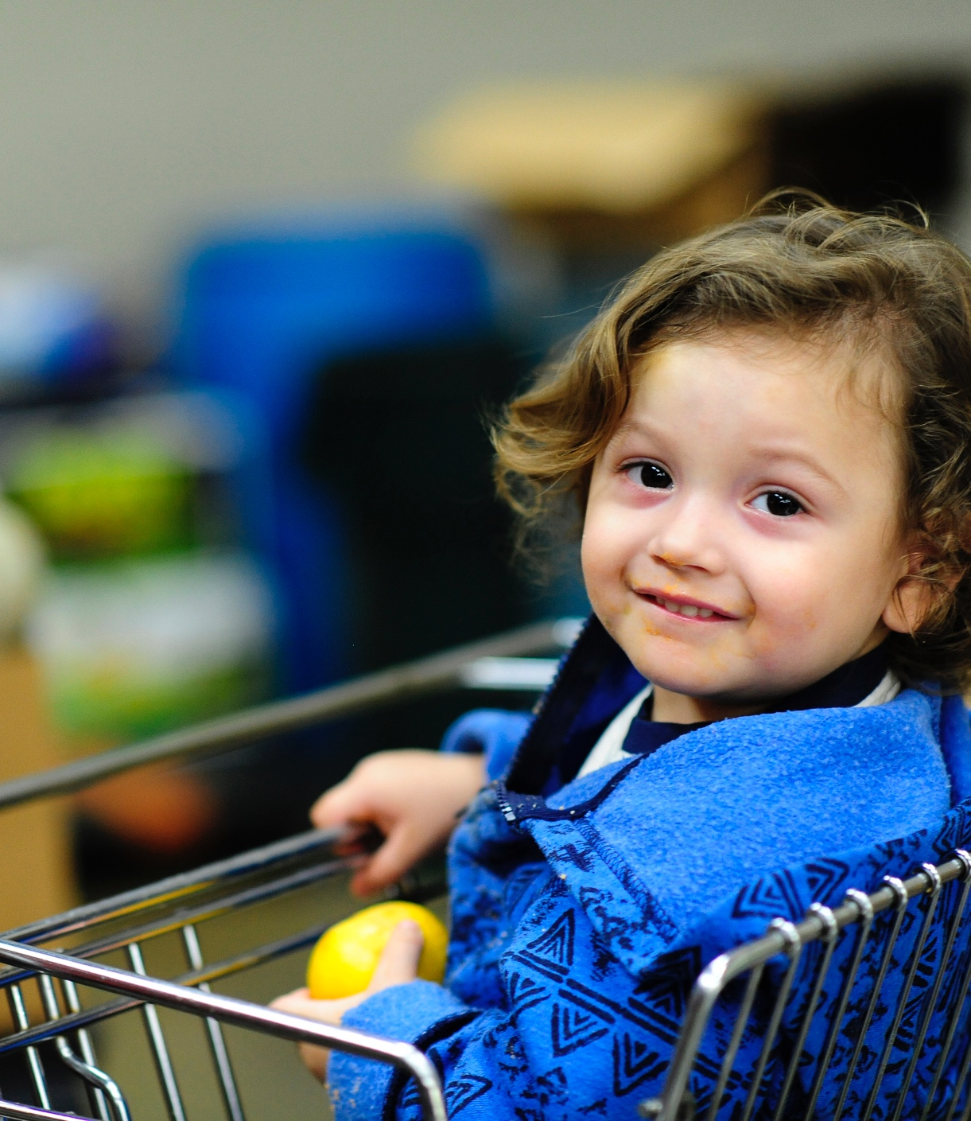
THANK YOU

