Slide 1
KADF Investment Maps

Slide 2
KADF Investment Maps
County Funds: Programs
County Agricultural Investment Program (CAIP)
Deceased Farm Animal Removal Program
Next Generation Farmer Program (NextGen)
Shared-Use Equipment Program
Youth Ag. Incentives Program (Youth/YAIP)

Slide 3
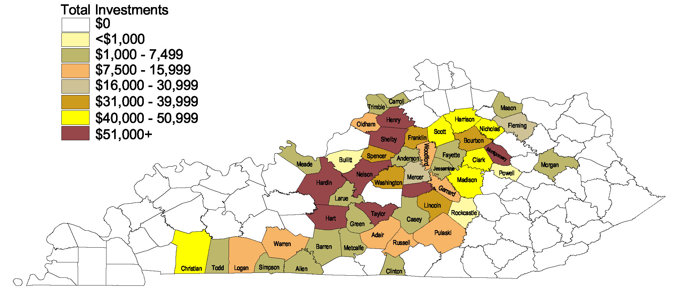
Deceased Farm Animal Removal (DAR)
Funds committed: $1,151,082
County participation: 51
Since 2009
Complete guidelines and program application are available at http://agpolicy.ky.gov/funds/Pages/programs.aspx.
Totals through 11/14/2018.
Notes:
No new counties participating since last year.

Slide 4
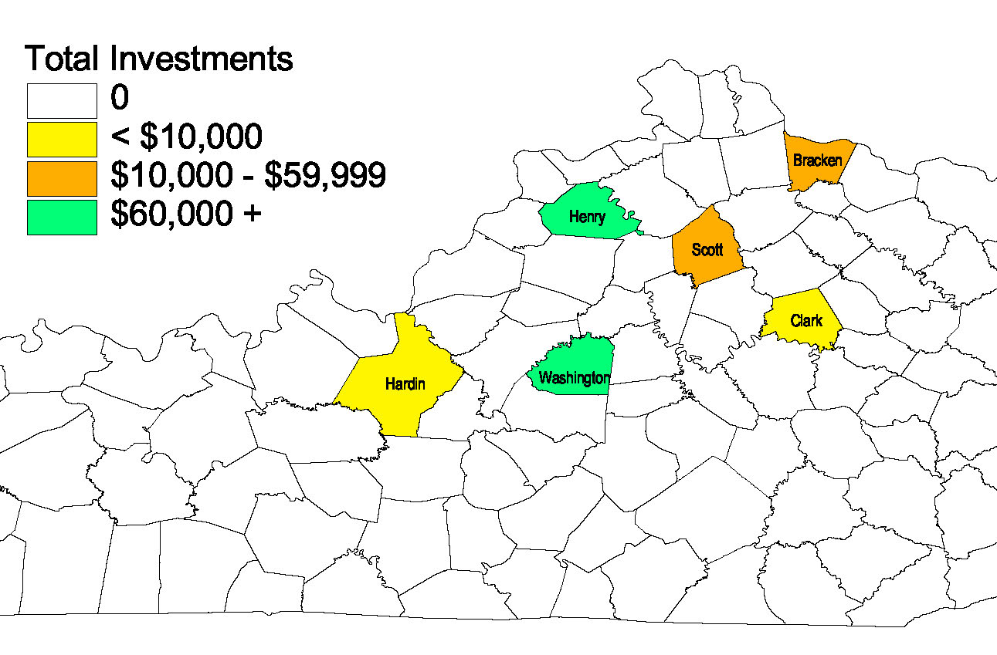
Next Generation Farmer (NextGen)
Funds committed: $252,660
County participation: 6
Since 2017
Complete guidelines and program application are available at https://agpolicy.ky.gov/funds/Pages/program-portal.aspx.
Totals through 11/14/2018.
Notes:
One new county participating in shared-use

Slide 5
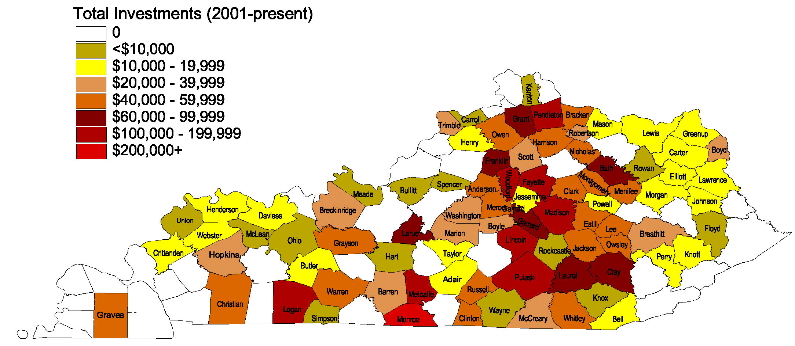
Shared-Use Equipment Program
Funds committed: $3,124,836
County participation: 80
Since 2001
Complete guidelines and program application are available at https://agpolicy.ky.gov/funds/Pages/program-portal.aspx.
Totals through 11/14/2018.
Notes:
One new county participating in shared-use

Slide 6
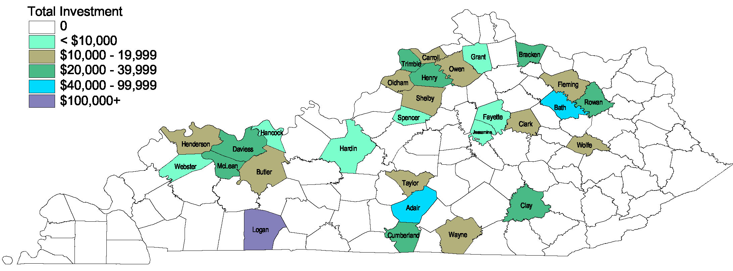
Youth Agricultural Incentives (Youth)
Funds committed: $588,154
County participation: 29
Since 2017
Complete guidelines and program application are available at https://agpolicy.ky.gov/funds/Pages/program-portal.aspx.
Totals through 11/14/2018.
Notes:
One new county participating in shared-use

Slide 7
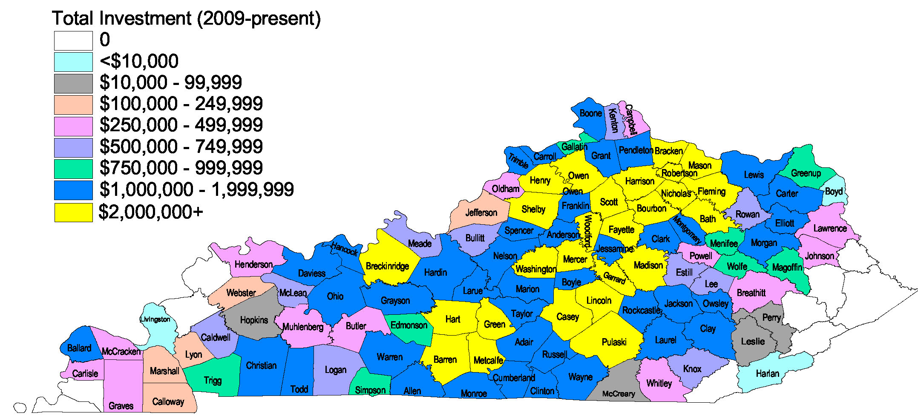
County Agricultural Investment Program (CAIP)
Funds committed: $146,802,791
County participation: 110
Since 2009
Complete guidelines and program application are available at https://agpolicy.ky.gov/funds/Pages/program-portal.aspx.
Totals through 11/14/2018.

Slide 8
KADF Investment Maps
State & County Funds
On-Farm Energy Efficiency Incentives
KADF Projects

Slide 9
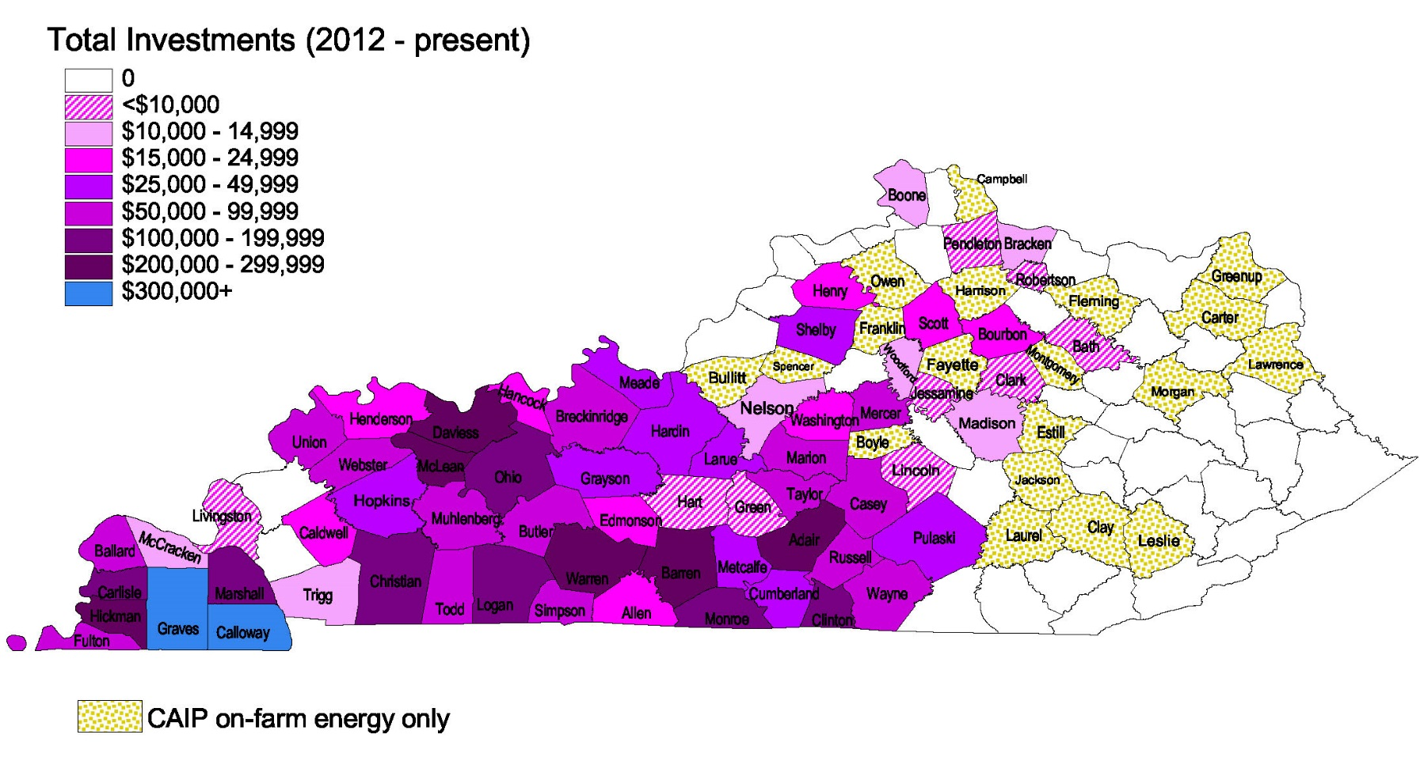
On-Farm Energy Efficiency
Energizing Kentucky agriculture.
Funds committed: $4,760,572
Approved applications: 494
County participation: 64
Since 2012
Total CAIP investment: $356,893 Number Producers: 152 Number Counties: 61
Complete guidelines and program application are available at http://agpolicy.ky.gov/funds/Pages/programs.aspx.
Totals through 11/14/2018.

Slide 10
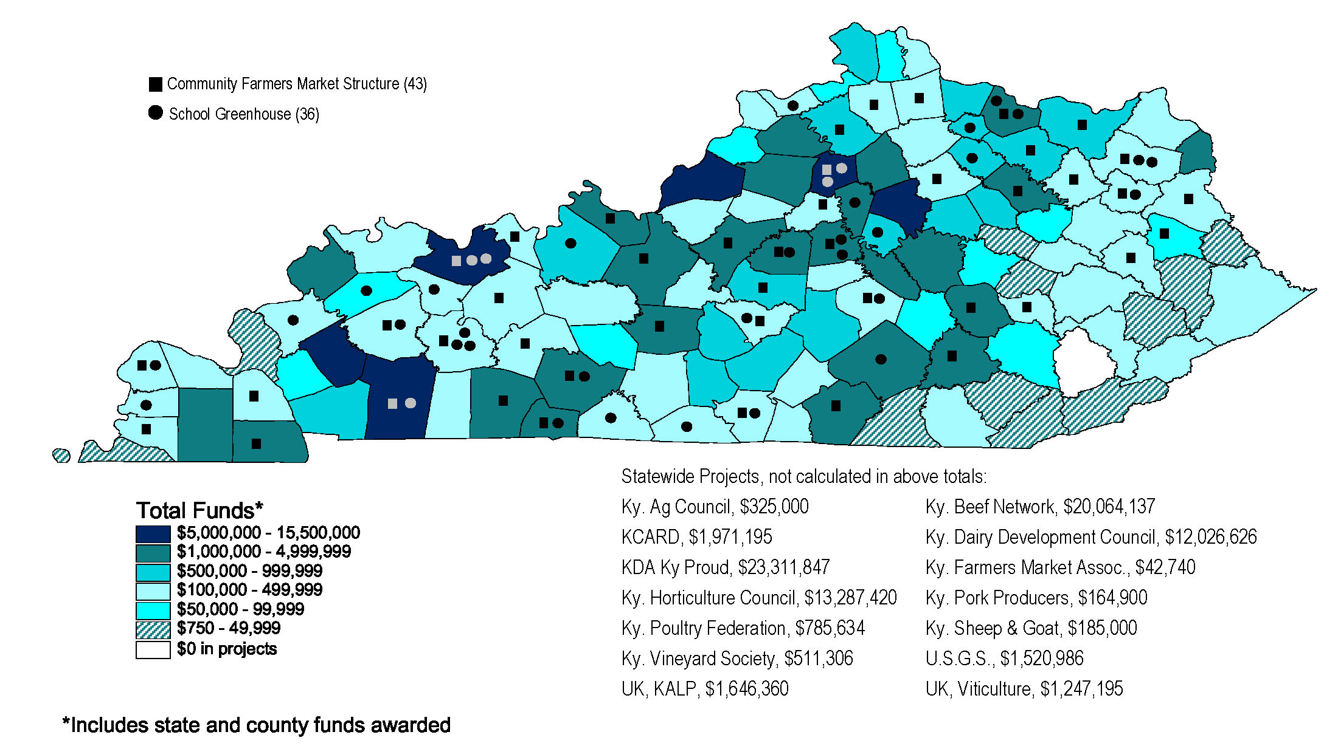
KADF Projects
Total KADF Invested by Project Location County

Slide 11
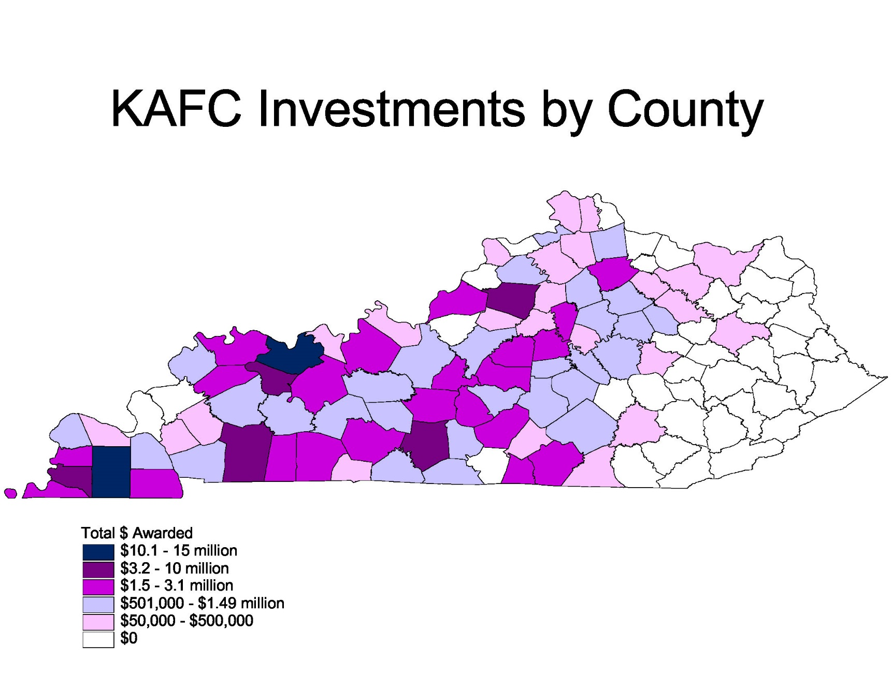
Over 1,000 loans approved for $136 million in total.
Presently, 600 loans with $84 million obligated.

Slide 12
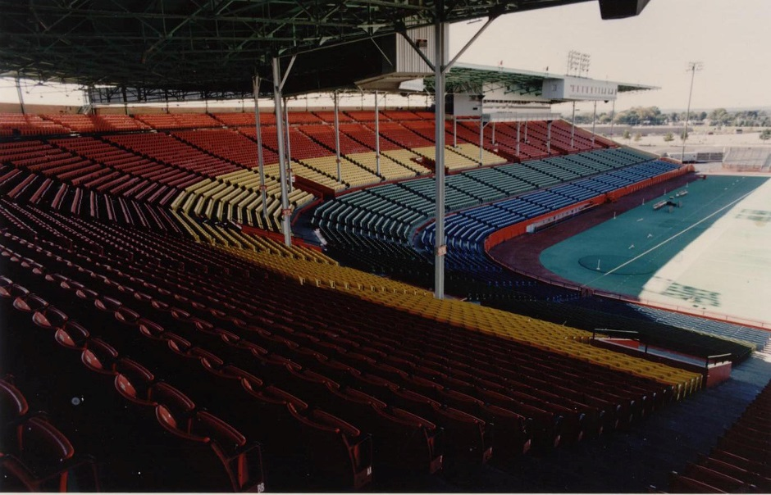
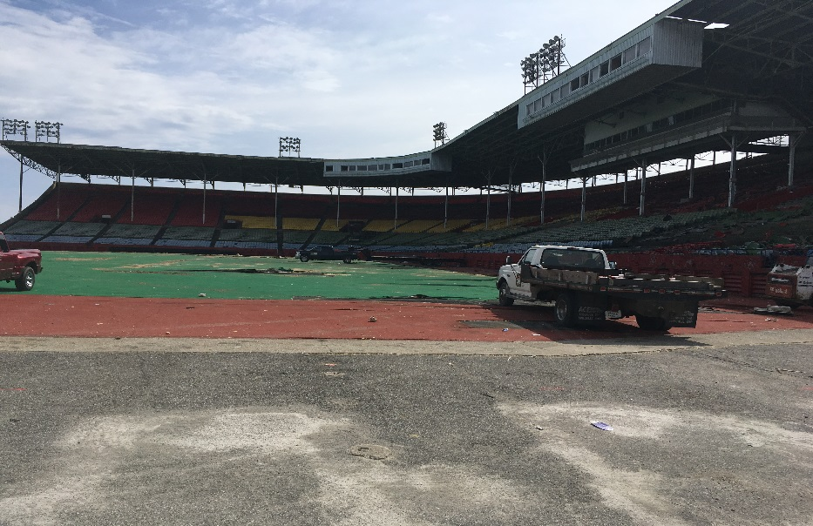
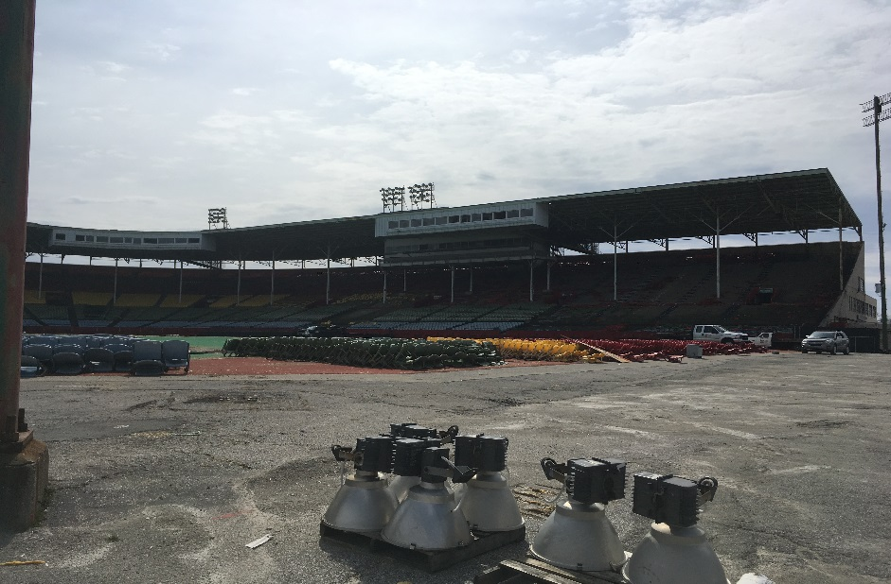
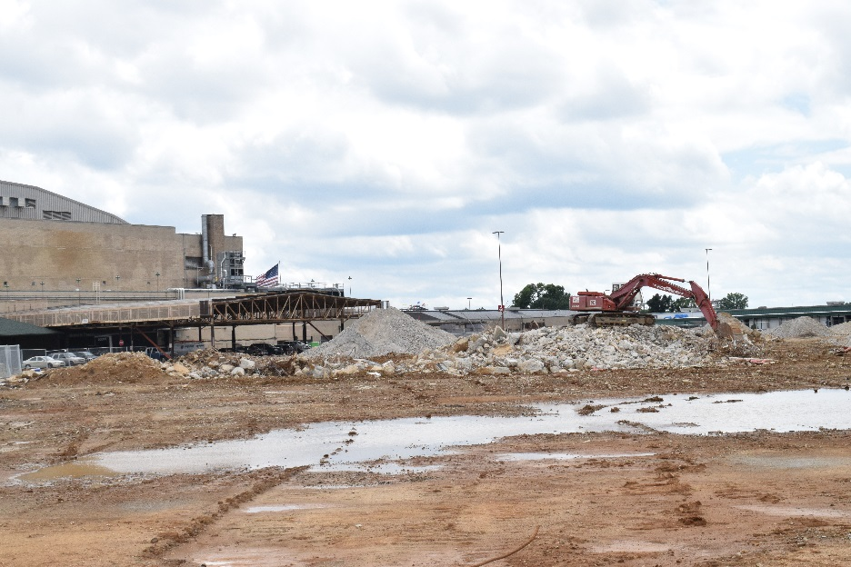
Cardinal Stadium Demolition

Slide 13
