Slide 1
Department for Community Based Services
Tobacco Settlement Funds Report
FY19 Child Care Allotment: $10,448,648
Sept. 4, 2019

Slide 2
Tobacco Settlement Funds in Community Based Services
Child Care - $10.4M
Family & Community Based
Services - $180,000
Early Childhood Adoption & Foster Care Supports - $2.5M
FY19 Child Care Expenditures
$9,680,154
FY19 Tobacco Settlement Funds Projected Child Care Budget
Notes:
Family & Community Based Services - $180,000 – Goes directly to Child Advocacy Centers which are nonprofit organizations dedicated to reducing the trauma experienced by children impacted by abuse.
Early Childhood Adoption & Foster Care Supports - $2,500,000 – This is used to pay subsidy for children in foster care placements after they have been removed from their home due to abuse or neglect.

Slide 3
The Child Care and Development Fund (CCDF) SFY19 allocation (all funds): $133,776,748
This federal grant is designed to promote success for children, employment for parents, and economic security for parents by ensuring stable, high quality child care.
CCDF funds support the following initiatives in Kentucky:
Child care subsidies for 26,428 families and 47,675 children in SFY19
Monitoring and supports for approximately 2,200 child care centers and family child care homes at any given time
Professional development supports and background checks for 40,631 child care workers since February 2018
Special initiatives for infant and toddler care, disaster preparedness training and response, and consumer education
Tobacco dollars serve as the entirety of the required matching funds for CCDF

Slide 4
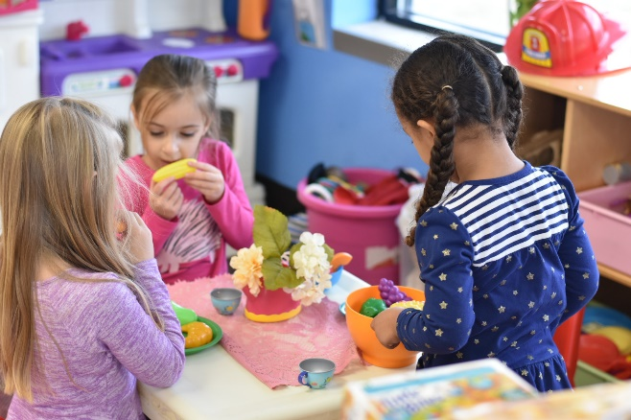
What is Kentucky All STARS?
Kentucky All STARS is Kentucky's five-star quality rating and improvement system for early childhood education programs.
Child care programs participating in Kentucky All STARS demonstrate a commitment to quality by focusing on the following indicators:
Family and Community Engagement
Classroom and Instructional Quality
Staff Qualifications and Professional Development
Administrative and Leadership Practices

Slide 5
Kentucky All STARS Levels by Provider Type
 | Level 1 | Level 2 | Level 3 | Level 4 | Level 5
CERTIFIED | 148 | 34 | 25 | 25 | 7
LICENSED TYPE I | 751 | 155 | 349 | 319 | 216
LICENSED TYPE II | 28 | 7 | 5 | 8 | 5
Total | 927 | 196 | 379 | 352 | 228
Child Care Assistance Program (CCAP) children currently enrolled in high quality (levels 3-5) centers: 13,457

Slide 6
What Does High Quality Look Like?
Notes:
Introduce Brenda Bruner:
Executive Director of 14 Southside Christian Daycare locations in KY
7 – 3 star centers
5 – 4 star centers
Has received tobacco settlement funds in the form of All STARS quality incentives for all programs rated Level 3 or higher. Brenda will talk about her experience with the system and how quality incentives have supported her centers and the ability to serve low-income families.

Slide 7
Professional Development Initiatives
In FFY18 Tobacco Funds helped to support the following:
345 scholarships for Career Development Associates (CDA)
350 scholarships for Commonwealth Child Care Credential
225 mini grants for Career Development Associates
448 Milestone Achievement Awards
308 education reimbursement grants

Slide 8
How Does Kentucky Stand Out?
Comprehensive professional registry
Integrated systems to support quality
Monetary incentives for high quality
Balanced approach to Child Care and Development Fund (CCDF) mandated activities

Slide 9
Questions?
Division of Child Care
Department for Community Based Services
Dr. Sarah Vanover, Director
(502)564-2524
https://chfs.ky.gov/agencies/dcbs/dcc

