Slide 1
Tobacco Oversight Committee
United States Geological Survey (USGS)
Meat Processing Plants
Shared-Use Equipment Program
Highlight on Pulaski County Shared-Use

Slide 2
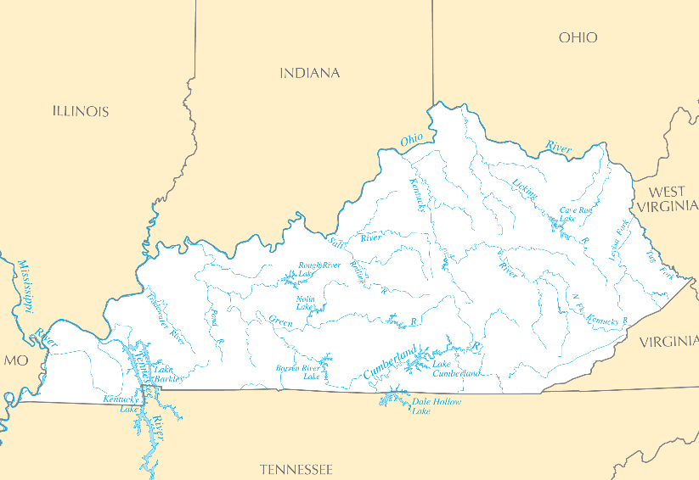
Fixed-station Super Gages (average continuous nitrate concentrations)
0.81 mg/L nitrate
USGS and GOAP site
National USGS site
Licking R. 0.71 mg/L
Ohio R. 0.81 mg/L
Kentucky R. 0.71 mg/L
Wabash R. 2.24 mg/L
Green R. 1.29 mg/L
Ashville
Louisville
Ohio R. 1.30 mg/L
Paducah
Preliminary Information-Subject to Revision. Not for Citation or Distribution

Slide 3
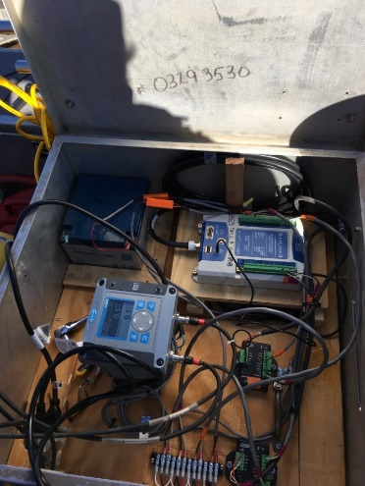
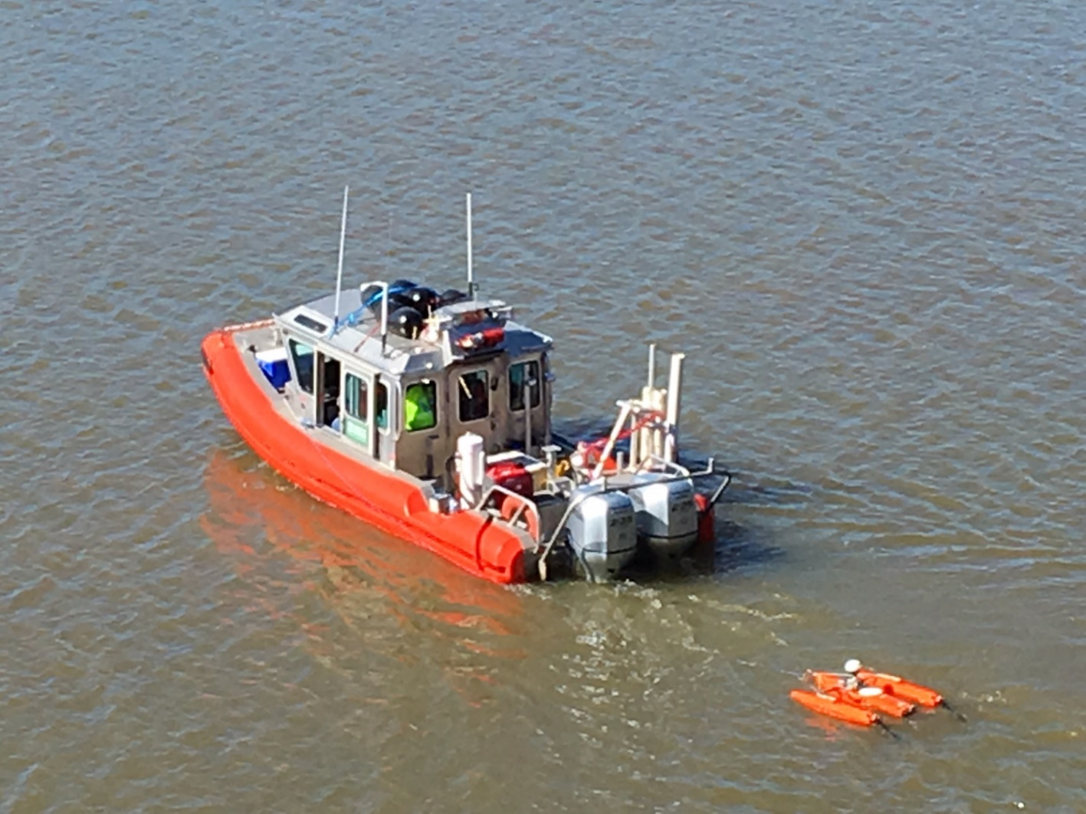
USGS Mobile Super Gage
Turbidity
Water temperature
pH
Specific conductance
Dissolved oxygen
Nitrate + nitrite
Sondes
(In Water)
Chamber
(Pumped)
Preliminary Information-Subject to Revision. Not for Citation or Distribution
Notes:
USGS super gages serve a wide variety of purposes across our region; some may document nutrient loads from large geographic areas (multiple states) or river basins (such as the Ohio River) while others may monitor the runoff from small agricultural fields draining only a few acres. In all cases, USGS super gages are located at critical sites where high-quality physical data is required to document important issues, develop mitigation strategies, and(or) manage the Nation’s resources. In Kentucky, for example, USGS fixed-station super gages play a key role in developing the Commonwealth’s nutrient reduction strategy and documenting the nutrient loads entering and leaving the Commonwealth’s major river basins.
Mobile Super Gage
Fixed stations good for estimating nutrient loads, etc. and bracket contributing sources. They help to know what happens in between the stations.
Making a super gage “mobile” tells more about “where” and “how” – response to question “if not coming from here, then where is it coming from?”

Slide 4
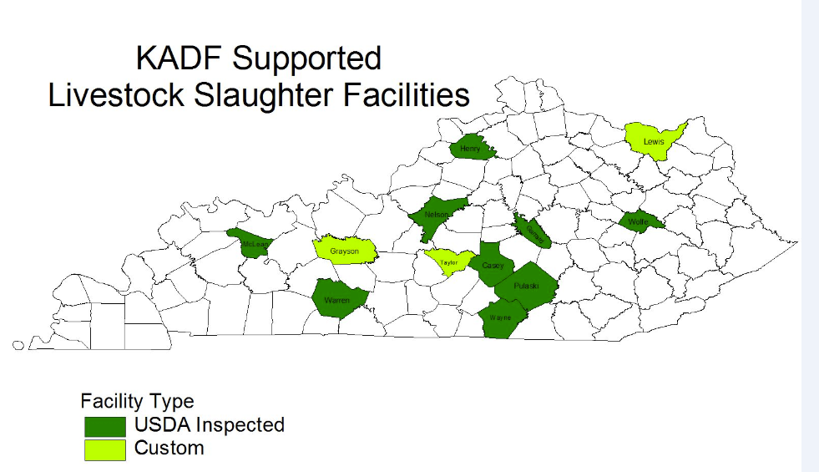
Meat Processing Plants
9 USDA funded projects totaling $2,460,987
Purnell and JBS Swift
USDA Plants
Further Processing Plants
Independent Poultry Processing Plants

Slide 5
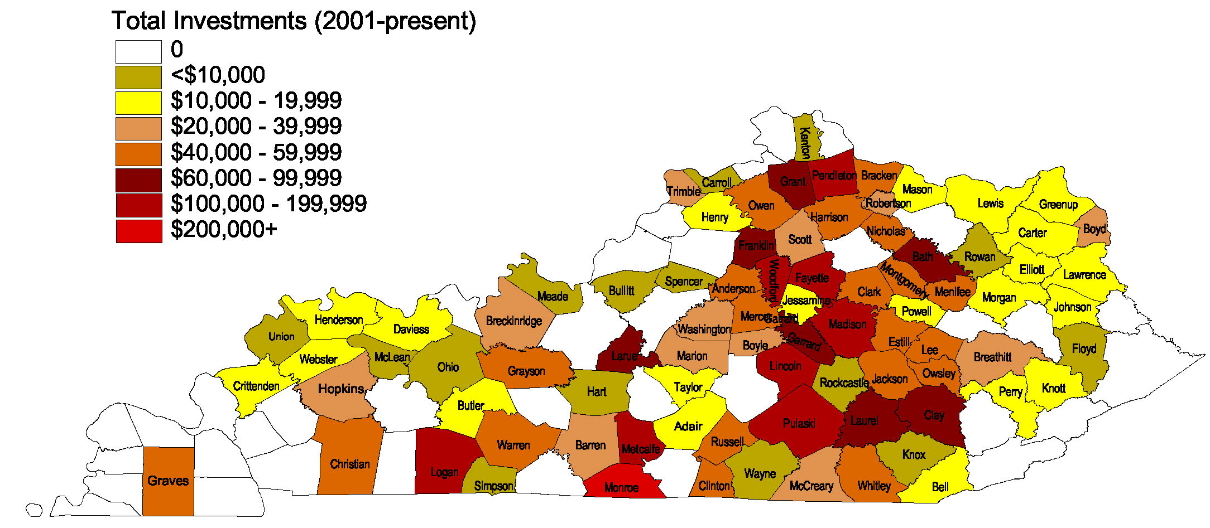
Shared-Use Equipment Program
Funds committed: $3,124,836
County participation: 80
Since 2001
Types of equipment/count (2018-2019):
Bale Wrapper | 2
In-Line Bale Wrapper | 1
Lime Spreader | 1
Manure Spreader | 1
No-Till Drill | 11
Sprayer | 5
Trailer | 1
Plastic Mulch Layer | 1
Totals through 11/14/2018.

Slide 6
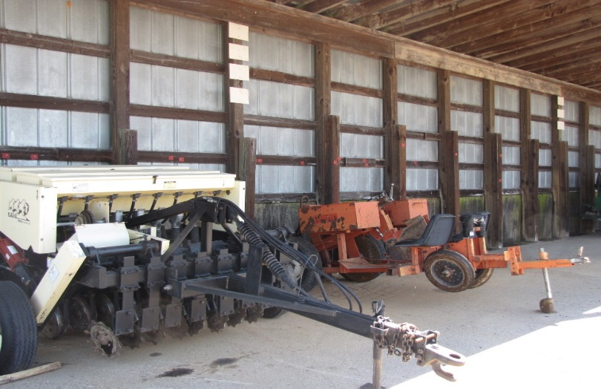
Highlight on Pulaski County Shared-Use
Awarded $11,998 to begin program in 2009
Pulaski County Conservation District has obtained 14 pieces of active equipment and constructed a storage building with help from the KADF
Equipment includes no-till drills, post drivers, and bale wrappers
Utilizes rental dollars to maintain equipment and purchase new equipment

