Slide 1
Tobacco Settlement Agreement Fund
Oversight Committee
September 4, 2019

Slide 2
Early Childhood Distribution of Master Tobacco Settlement Funds for FY19
Division of Early Childhood Development (GOEC) $2,050,000
Early Childhood Oral Health $1,050,000
Child Care Program $10,711,100
HANDS
Program
$9,000,000
Folic Acid Program
$80,000
Total FY19 Tobacco Funds $29,071,100
Early Childhood & Foster Care Supports $2,500,000
Family & Community Based Services
$180,000
Healthy Start Program
$1,000,000
Early Childhood Mental Health $1,000,000
Substance Abuse Treatment Program $1,500,000

Slide 3
Early Childhood Advisory Council (ECAC)
Goals:
Advance comprehensive early care and education through strategic messaging.
Grow and strengthen the early care and education workforce by providing a career pathway for advancement and professional learning opportunities.
Increase coordination, program quality, and service delivery by fostering effective collaboration between agencies and stakeholders.
Promote a comprehensive framework to effectively partner with families.
Inform funding and resource allocations, policy recommendations, and programming by consistently applying data driven systems and processes.
Secure new, diverse funding and utilize existing resources more effectively.
Vision Statement:
All children in Kentucky will have the foundation that enables school and personal success and are supported by strong families and communities.
Mission Statement:
The ECAC provides leadership and direction for the Commonwealth of Kentucky by providing a comprehensive and sustainable prenatal to age five early childhood system that will ensure a strong foundation for all children.

Slide 4
Community Early Childhood Councils (CECCs)
CECCs have the crucial role of mobilizing local community members to build innovative, collaborative partnerships to help Kentucky improve Kindergarten readiness.
Funding was designed to assist communities in responding to their unique needs related to improving Kindergarten readiness within their council service area.
A total of $1,069,345.00 was awarded to 72 Councils in the 2019-2020 grant funding cycle.

Slide 5
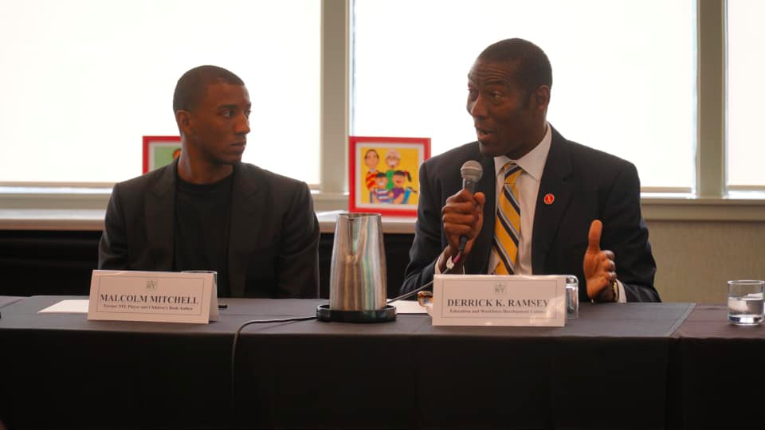
2019 Early Childhood Institute (ECI)
Held June 19-21, 2019 in Louisville, KY, with the theme of the 2019 institute focused on the motto: "Believe in Me KY."
The approximately 1,000 participants chose from 167 total Effective Instructional Leadership Act credit hours to fulfill their 18 credit hours for early childhood educator requirements.
For the first time, the 2019 ECI issued awards which included, the Governor's Office of Early Childhood Award, Teacher of the Year Award, Director of the Year Award, and Early Care Center Award.

Slide 6
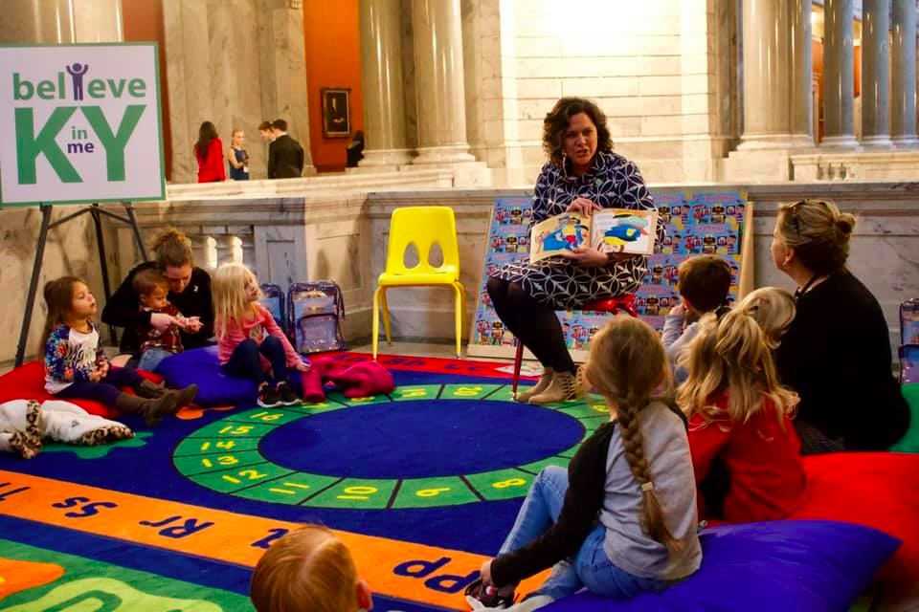
#BelieveinmeKY Day of Action
On Nov. 16, 2018, the GOEC promoted the importance of early literacy by creating a day of action called #BelieveinmeKY. Participates used this hashtag on social media to share their day of action.
Governor Bevin, First Lady Bevin and State Dignitaries read to local early childhood programs at the Capitol Rotunda, which we transformed into classrooms.
We distributed approximately 10,000 copies of the book to early childhood programs, Family Court Judges, Career Centers, Public Libraries, Adult Learning Centers and Departments for Community Based Services throughout the Commonwealth.

Slide 7
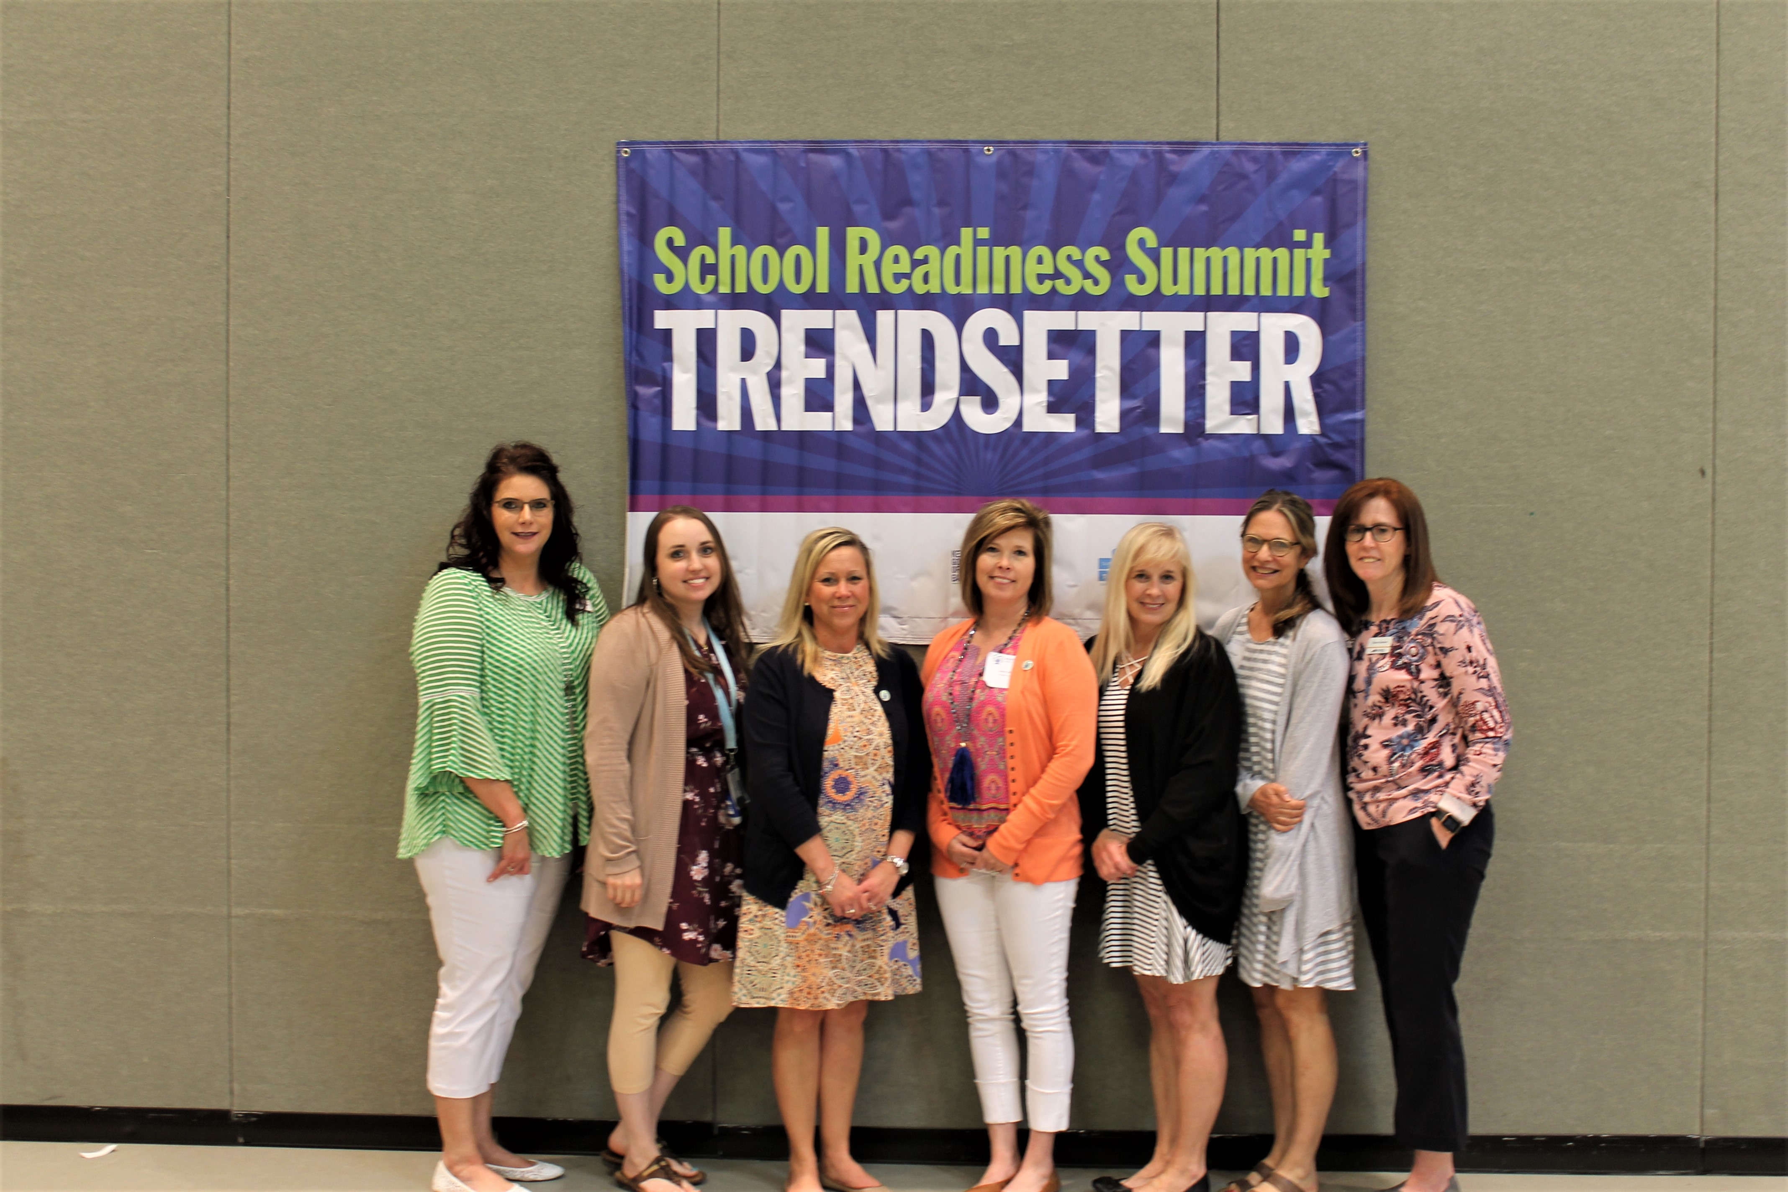
School Readiness Summits
Kentucky created the School Readiness Summit to engage Superintendents and the community by providing an opportunity for collaboration and action planning. Summit team members could include: District representatives, Child Care representatives, Head Start representatives, Community Early Childhood Council representatives and community partners.
30 School Readiness teams, for the year of 2019
Through the Preschool Development Grant, each team will be rewarded a mini grant in the amount up $45, 000.

Slide 8
Kentucky Governor’s Office of Early Childhood 125 Holmes Street Frankfort, KY 40601 502-782-0200 https://kidsnow.ky.gov
Linda Hampton
Executive Director, Kentucky Governor’s Office of Early Childhood
Linda.Hampton@ky.gov

